Slide 1
Nap: A Black-Box Approach to NUMA-Aware
Persistent Memory Indexes
OSDI 21
Qing Wang, Youyou Lu, Junru Li, Jiwu Shu
Tsinghua University
Shared by Yiduo Wang, Xinyang Shao at USTC Reading Group
Notes:
大家好，我叫王一多，今天我和邵新洋师兄为大家带来清华大学Storage Research Group在OSDI21的文章：Nap的分享。这篇文章介绍了一种能使非易失性内存索引感知NUMA架构的方法，并且是一种黑盒方法，接下来我们会具体介绍。

Slide 2
Background: Persistent Memory
 | Memory(DRAM) | Block Device
Bandwidth | High(>100GB/s) | Low (~500MB/s)
Latency | Low(~100ns) | High (~50us)
Persistency | No | Yes
Byte-addressable | Yes | No
Capacity | Low | High
Notes:
首先简单介绍一下PM。我们都知道传统计算机中有两大类存储设备，高带宽低延迟但不具有持久性的DRAM内存，以及低带宽高延迟，但在断电后依然能够完好保存数据的块设备。

Slide 3
Background: Persistent Memory
 | Memory(DRAM) | Block Device | Persistent Memory
Bandwidth | High(>100GB/s) | Low (~500MB/s) | ~6GB/s
Latency | Low(~100ns) | High (~50us) | ~300ns
Persistency | No | Yes | Yes
Byte-addressable | Yes | No | Yes
Capacity | Low | High | Medium
Notes:
而非易失性内存，也就是PM，则是结合了两者长处的一种新型设备。
它的访问延迟在300ns左右，虽然差于DRAM，但是已经是同一个量级了，同时它还具有介于块设备与DRAM之间的带宽与容量，并且

Slide 4
Background: Persistent Memory
 | Memory(DRAM) | Block Device | Persistent Memory
Bandwidth | High(>100GB/s) | Low (~500MB/s) | ~6GB/s
Latency | Low(~100ns) | High (~50us) | ~300ns
Persistency | No | Yes | Yes
Byte-addressable | Yes | No | Yes
Capacity | Low | High | Medium
Persistency, Byte-addressability
High capacity, Low latency
Notes:
PM具有块设备的可持久化的特点，因此，PM的出现为构建大容量、低延迟、崩溃可恢复的新型计算机系统带来了无数机遇与挑战。

Slide 5
Background: PM Index
PM index: Index with Crash-Consistency
Challenge: High overhead of cache line flush & memory fence
NV-Tree
FAST’15
FPTree
SIGMOD’16
CCEH
FAST’19
PM-DRAM
Hybrid
Optane
2019
wB+-Tree
VLDB15
clfB-tree
TOS’18
FAST_FAIR
FAST’18
PM-only
Notes:
而PM索引便是其中一个重要的机遇。传统的内存索引不具有crash-consistency，而PM则带来了这种可能，但又来带了cache line flush和memory 的高开销。为此已经有许多的研究人员，在2019年第一款商用PM诞生前，
NV-Tree [FAST15]基于B+Tree,由于崩溃后内部节点可通过叶子结点重建，所以只对叶子节点保证强一致性，减少对PM的flush
FPTree [SIGMOD16] 叶子节点与内部节点分层存储，内部节点保存在内存，叶子节点保存在PM
clfB-tree[TOS18] 尽量保证每个节点的大小与cacheline(64B)的大小相近，减少对PM的flush次数
FAST_FAIR[FAST18] 基于B+Tree,允许cacheline(64B)内部存在不一致状态和重复数据，并通过利用PM8字节操作的原子性来保证故障恢复，从而减少flush次数
CCEH[FAST’19] 实现了面向PM的可扩展哈希表，对过设计对cache line友好的层级结构加速索引查找速度，并实现了lazy deletion和原子更新

Slide 6
Background: PM Index
PM index: Index with Crash-Consistency
Challenge: High overhead of cache line flush & memory fence
NV-Tree
FAST’15
FPTree
SIGMOD’16
CCEH
FAST’19
uTree
VLDB’20
PM-DRAM
Hybrid
Optane
2019
wB+-Tree
VLDB15
clfB-tree
TOS’18
FAST_FAIR
FAST’18
DPTree
VLDB’19
Clevel
ATC’20
PM-only
Notes:
以及它诞生后，有许多的工作在DRAM-PM混合或者PM-only的场景下进行了内存索引的研究。同时，
DPTree[VLDB19] 内存和PM混合存储，内存存储只读的Buffer tree和base tree的内部节点，通过NVM log保证一致性（还引入了 bloom filter等技术来优化读）
Clevel[ATC20] 通过多层哈希和无锁的rehash设计实现在PM上的哈希
uTree[VLDB20] 专注解决PM Index中由Sort, split, merge等（SROs）操作带来的的长尾问题,将B+tree中的索引节点和需要做SRO操作的leaf node都放在DRAM里面

Slide 7
Background: PM Index
PM index: Index with Crash-Consistency
Challenge: High overhead of cache line flush & memory fence
NV-Tree
FAST’15
FPTree
SIGMOD’16
CCEH
FAST’19
Recipe
SOSP’19
uTree
VLDB’20
TIPS
ATC’21
Optane
2019
wB+-Tree
VLDB15
clfB-tree
TOS’18
FAST_FAIR
FAST’18
DPTree
VLDB’19
Clevel
ATC’20
Pronto
ASPLOS’20
Notes:
也有一些研究讲传统的内存索引转化为PM索引，来获得较好的索引性能与crash-consistency。但是
Recipe[SOSP19] 提出了将原有的memory index转换为PM-Index的准则，可以以尽量少的代码修改，将现有的成熟的index转换为具有crash-consistency的PM Index，并完成了数个转换实例
TIPS[ATC21]
Pronto[ASPLOS20]

Slide 8
Background: PM Index
PM index: Index with Crash-Consistency
Challenge: High overhead of cache line flush & memory fence
NV-Tree
FAST’15
FPTree
SIGMOD’16
CCEH
FAST’19
Recipe
SOSP’19
uTree
VLDB’20
TIPS
ATC’21
NUMA impacts on PM Indexes are under-explored！
Optane
2019
wB+-Tree
VLDB15
clfB-tree
TOS’18
FAST_FAIR
FAST’18
DPTree
VLDB’19
Clevel
ATC’20
Pronto
ASPLOS’20
Notes:
虽然有这么多先前的工作，但是本文作者提出：NUMA架构对PM index的影响还没有被完全搞清楚，而这项工作便是第一个针对numa架构下PM index深入探讨的工作

Slide 9
Background: NUMA (Non-Uniform Memory Access)
DRAM
CPU 0
PM
DRAM
CPU 1
PM
Notes:
这里简单介绍一下NUMA架构。NUMA, Non-Uniform Memory Access，这是一种多CPU架构，每个CPU有自己管理的本地内存，而如果要访问其他CPU管理的内存，

Slide 10
Background: NUMA
DRAM
CPU 0
PM
UPI
DRAM
CPU 1
PM
Notes:
则要通过CPU间的专门通道如UPI来进行。这种设计虽然使得一个计算机能够有多个CPU，但是并非没有代价，

Slide 11
Background: NUMA
100ns
DRAM
CPU 0
300ns
PM
100ns
UPI
100ns
DRAM
CPU 1
300ns
PM
Notes:
UPI本身是有100ns左右的延迟的，这使得访问远端内存或者PM的延迟都会较高。而NUMA架构对PM的带宽有什么影响呢？

Slide 12
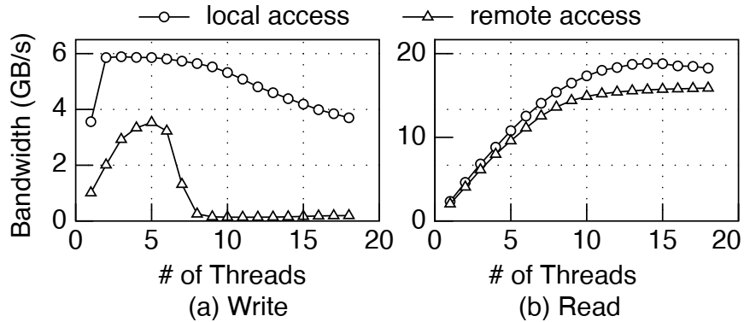
Motivation: NUMA impact on PM
3*128G Optane DIMMs
Read/Write test, varying threads
Notes:
这里为具体探究，我们进行一组实验，使用3个Optane PM进行读写测试，圆圈代表本地访问三角形则是远程访问，横坐标是线程数纵坐标是带宽。
可以看到随着线程数的增长，读写带宽也随之提升。虽然写带宽很快带到了上限，但目前看起来一切都还正常
然而，当我们继续增加线程数，可以看到一个明显的现象：写带宽明显下降，尤其是远程写带宽在线程数达到8后跌入谷底，不到0.25GB/s。

Slide 13
Motivation: NUMA impact on PM
3*128G Optane DIMMs
Read/Write test, varying threads
PM system should avoid accessing remote PM, especially for writes.
Notes:
那么PM的这个特性给我们带来的一个启示就是：一个PM系统应当尽量避免远程的PM访问，特别是写。

Slide 14
Motivation: NUMA impact on PM Index
Take CCEH^{[1]} as an example
Setup: 18 cores * 4 NUMA nodes, 50%write, Zipfian 0.99, 8-bytes value
[1] Write-optimized dynamic hashing for persistent memory. FAST19
Notes:
那么目前的PM索引有做到这一点吗？这里以CCEH，一个知名的PM 索引为例进行分析。
实验在具有4个Numa node的机器上进行，每个CPU有18个核。使用读写混合的工作负载，用zipfian0.99作为参数读写8字节长度的KV
接下来我们来分析实验结果，

Slide 15
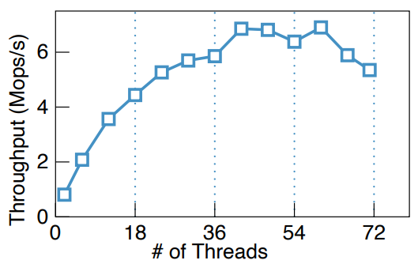
Motivation: NUMA impact on PM Index
Take CCEH as an example
Setup: 18 cores * 4 NUMA nodes, 50%write, Zipfian 0.99, 8-bytes value
1 node: scales well
Notes:
横坐标是线程数，从1到72，纵坐标则是吞吐量，越高越好。
可以看到在线程数从1增加到18时，CCEH的吞吐量几乎线性扩展。这时只使用了一个CPU

Slide 16
Motivation: NUMA impact on PM Index
Take CCEH as an example
Setup: 18 cores * 4 NUMA nodes, 50%write, Zipfian 0.99, 8-bytes value
2 nodes: slow down
Notes:
而当线程数超过18，也就是逐渐引入远程PM访问后，吞吐量的上升逐渐缓慢了

Slide 17
Motivation: NUMA impact on PM Index
Take CCEH as an example
Setup: 18 cores * 4 NUMA nodes, 50%write, Zipfian 0.99, 8-bytes value
Multiple nodes: fluctuates
Notes:
当nume node的数量增加到3到4个时，可以发现性能无法再提升了。这是由于CCEH没有针对NUMA架构设计，没有考虑到远程PM访问的影响。我们简单介绍一下CCEH的访问流程

Slide 18
Motivation: NUMA impact on PM Index
Take CCEH as an example
Directory
①read directory
remote read
access thread
node 1
node 0
Segment
Notes:
CCEH是一种可扩展哈希的改进版，传统的可扩展哈希有Directory 层核Bucket层，CCEH则在其中额外加了一个Segment层，这里我们只需要知道大体架构。
当一个线程想要增加进行一个CCEH insert操作时，它首先会读取CCEH的Directory层查找对应的Segment，这地方可能会引入一个远程PM读

Slide 19
Motivation: NUMA impact on PM Index
Take CCEH as an example
Directory
①read directory
remote read
②get segment, lock
remote write
access thread
node 1
node 0
Segment
Notes:
然后对其上锁，这里可能是一个远程PM写

Slide 20
Motivation: NUMA impact on PM Index
Take CCEH as an example
Directory
①read directory
remote read
②get segment, lock
remote write
access thread
③search segment
remote read
node 1
node 0
Segment
Notes:
接着读segment查找对应的bucket

Slide 21
Motivation: NUMA impact on PM Index
Take CCEH as an example
Directory
①read directory
remote read
②get segment, lock
remote write
access thread
③search segment
remote read
④write kv
local write
kv
node 1
node 0
Segment
Notes:
插入新的kv项

Slide 22
Motivation: NUMA impact on PM Index
Take CCEH as an example
Directory
①read directory
remote read
②get segment, lock
remote write
access thread
③search segment
remote read
④write kv
local write
kv
⑤update pointer
remote write
node 1
node 0
Segment
Notes:
更新原本segment的指针

Slide 23
Motivation: NUMA impact on PM Index
Take CCEH as an example
Directory
①read directory
remote read
②get segment, lock
remote write
access thread
⑥unlock
remote write
③search segment
remote read
④write kv
local write
kv
⑤update pointer
remote write
node 1
node 0
Segment
2 remote PM read, 3 remote PM write
Notes:
Unlock，完成
这个流程最多可能会有3次远程PM写入，也是为什么在NUMA架构下性能表现较差的原因。

Slide 24
Motivation: NUMA impact on PM Index
Take CCEH as an example
Directory
①read directory
remote read
②get segment, lock
remote write
access thread
⑥unlock
remote write
③search segment
remote read
④write kv
local write
kv
⑤update pointer
remote write
node 1
node 0
Segment
A fast PM index should be NUMA-aware, especially for writes
Notes:
所以这里作者进一步提出：一个高性能的PM索引应当是NUMA感知的，特别是对于写操作。
那么到现在我们知道了目前的PM 索引不适合NUMA场景，但是

Slide 25
Motivation: NUMA impact on PM Index
Migrate NUMA-aware DRAM indexes solution to PM?
State-of-the-art: Node Replication(NR^{[2]})
Each NUMA nodes maintains a replica
Node 0
Node 1
[2] Black-box Concurrent Data Structures for NUMA Architectures
Notes:
目前其实以及有了NUMA感知的内存索引技术，能否把他们直接套用到PM上呢？这里以state-of-the-art的内存技术NR为例，它的核心思想有两点，一个是每个NUMA节点都有索引节点的replica

Slide 26
Motivation: NUMA-aware DRAM Index
Migrate NUMA-aware DRAM indexes solution to PM?
State-of-the-art: Node Replication(NR^{[2]})
Each NUMA nodes maintains a replica
Synchronize by replaying log
Node 0
Node 1
Shared op log
[2] Black-box Concurrent Data Structures for NUMA Architectures
Notes:
二是使用一个共享的日志来在不同节点间进行同步。但是这种方法放到PM场景下并不适用

Slide 27
Motivation: NUMA-aware DRAM Index
Migrate NUMA-aware DRAM indexes solution to PM?
State-of-the-art: Node Replication(NR^{[2]})
Each NUMA nodes maintains a replica
Synchronize by replaying log
No crash-consistency
Space consumption
Node 0
Node 1
Shared op log
[2] Black-box Concurrent Data Structures for NUMA Architectures
Notes:
作者提出了几点原因，首先是不支持crash-consistency,以及空间开销大。其实空间开销大这点我个人觉得是不太站得住脚的，因为DRAM比PM还贵，DRAM耗得起PM理应也耗得起。但是下一点原因是很强的：

Slide 28
Motivation: NUMA-aware DRAM Index
Migrate NUMA-aware DRAM indexes solution to PM?
State-of-the-art: Node Replication(NR^{[2]})
Each NUMA nodes maintains a replica
Synchronize by replaying log
No crash-consistency
Space consumption
Amplifying local accesses
PM: lower bandwidth
Node 0
Node 1
Shared op log
[2] Black-box Concurrent Data Structures for NUMA Architectures
Notes:
这种方法会有很大的访问放大，虽然是本地访问，但是我们前面提到：PM的带宽相对于DRAM轻松上百G的带宽要低得多，再加上访问放大，对于本不富裕的PM带宽可谓是雪上加霜。
基于现有的观察，作者提出了Nap，接下来的部分将由邵新洋师兄来进行介绍

Slide 29
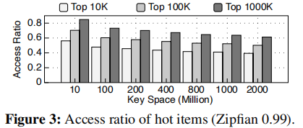
Key Idea (1) - Making Hot Accesses NUMA-Aware
Modern workloads always feature skewed access patterns
YCSB (SOCC’10), Twitter cache workloads (OSDI’20) ….
Top 100K hottest items receive > 50% accesses (typical Zipfian 0.99, 2 billion items)

Slide 30
Key Idea (1) - Making Hot Accesses NUMA-Aware
Hot Accesses
Node 0
Node 1
Cold Accesses

Slide 31
Key Idea (1) - Making Hot Accesses NUMA-Aware
Hot Accesses
Node 0
Node 1
NUMA-Aware Layer
Cold Accesses

Slide 32
Key Idea (2) - Minimizing PM State Synchronization
Hot Accesses
Node 0
Node 1
Cold Accesses
Partial View
Partial View
Raw PM Index
(e.g. CCEH, FAST_FAIR)

Slide 33
Key Idea (3) – Fast reaction to handle hotspot shift
Hotspots change over time.
NAP maintains the current hot items, and replaces the existing NAL when a new set of hot items detected.

Slide 34
Challenges for Practical Design
NAL should guarantee the following aspects:
Coherency: Updates must be visible in sequence to all NUMA nodes.
Low Sync Cost: Avoid access to remote PM, i.e. PM updates must be local.
Agility: Recognize and shift hotspots over time.

Slide 35
Design: NAL Arch Overview
Hot Accesses
Node 0
Node 1
Cold Accesses
DRAM
Global & Volatile View
PM
Partial View
Partial View
Raw PM Index
(e.g. CCEH, FAST_FAIR)

Slide 36
Design: NAL Arch Overview
Hot Accesses
Node 0
Node 1
lookup
insert/update/delete
Cold Accesses
DRAM
Global & Volatile View
1
2
PM
Partial View
Partial View
Raw PM Index
(e.g. CCEH, FAST_FAIR)
Notes:
快速读靠DRAM，快速写和断电consistency靠PM。

Slide 37
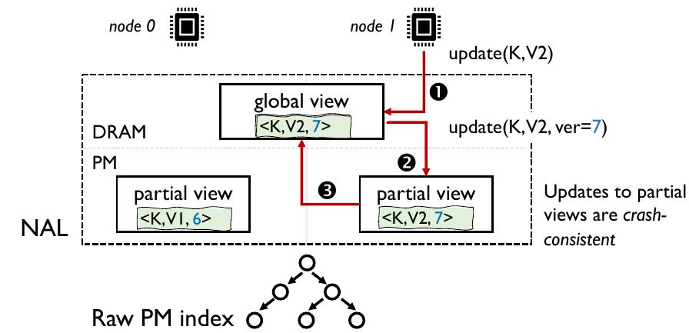
Coherency: Concurrent Control with Data Versions
Notes:
为了保证新KV对数值的一致性，在写到PC-View之前需要读一次DRAM，获取版本号和写锁。PC-View写完之后，还需要在DRAM中更新对应的值。

Slide 38
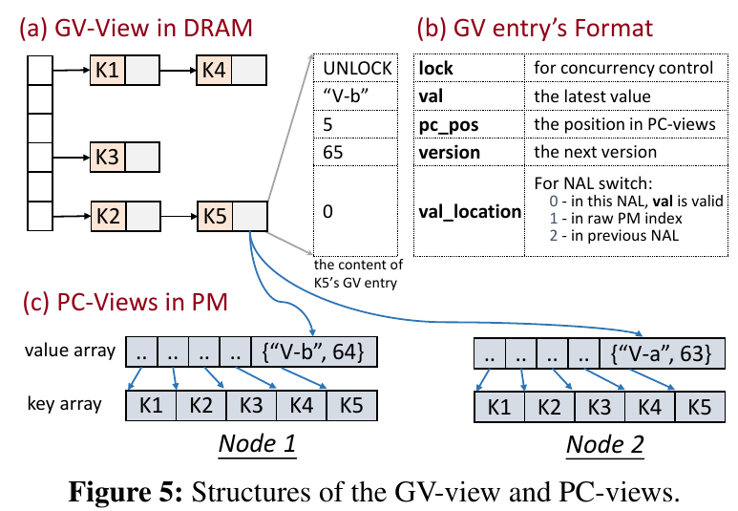
Design: Structure of the GV-View and PC-Views

Slide 39
Design: Global & Volatile View
Philosophy of the GV-View:
Use fixed set of hot items for each .
Always be the latest value.
Use strict locking (readers-writer) to control concurrency.
Cache position in PC-View.
Cache version of value.
GV-View entries are organized with hash tables, but when the raw PM index supports range query, a tree-based structure is used.

Slide 40
Design: Partial & Crash-consistent View (PC-View)
Philosophy of the PC-View:
Use value array to store local view of all hot items.
Use a read-only key array to store all keys, pointed by value array items. (for recovery).
Value items are pointed to by “pc_pos” field in GV entry.

Slide 41
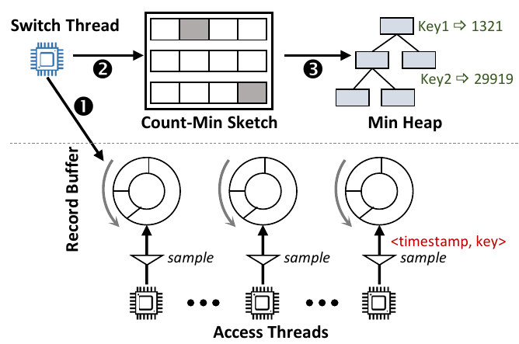
Hot Set Identification
Access threads publish their access patterns using sampling
A dedicated switch thread produces current hot set
a count-min sketch estimates frequency of keys
a min heap records the current hot set

Slide 42
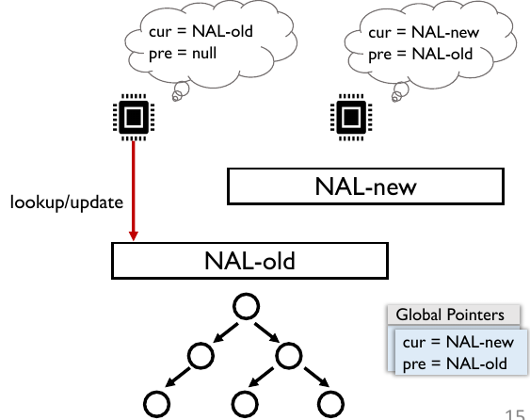
NAL Switch – Three Phase Switch
Phase 1: Initialize and install a new NAL
change global pointers, making NAL-new visible
some threads see concurrent switch, others don’t
if seeing switch, updates to NAL-old are blocked

Slide 43
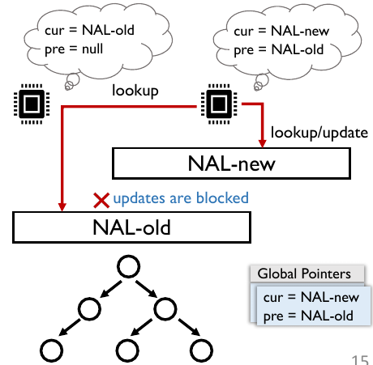
NAL Switch – Three Phase Switch
Phase 1: Initialize and install a new NAL
change global pointers, making NAL-new visible
some threads see concurrent switch, others don’t
if seeing switch, updates to NAL-old are blocked

Slide 44
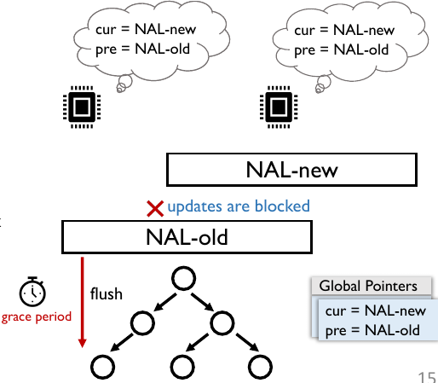
NAL Switch – Three Phase Switch
Phase 1: Initialize and install a new NAL
change global pointers, making NAL-new visible
some threads see concurrent switch, others don’t
if seeing switch, updates to NAL-old are blocked
Phase 2: Flush NAL-old
wait for a grace period, to ensure no updates on NAL-old
flush items from global view of NAL-old into raw PM index

Slide 45
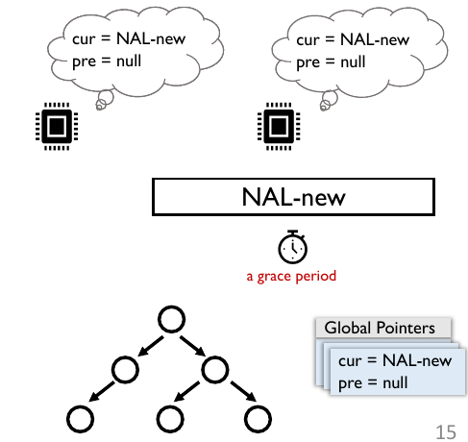
NAL Switch – Three Phase Switch
Phase 1: Initialize and install a new NAL
change global pointers, making NAL-new visible
some threads see concurrent switch, others don’t
if seeing switch, updates to NAL-old are blocked
Phase 2: Flush NAL-old
wait for a grace period, to ensure no updates on NAL-old
flush items from global view of NAL-old into raw PM index
Phase 3: Recycle NAL-old
set global pointer pre to null
wait for a grace period, to ensure no lookups on NAL-old
release PM/DRAM space of NAL-old

Slide 46
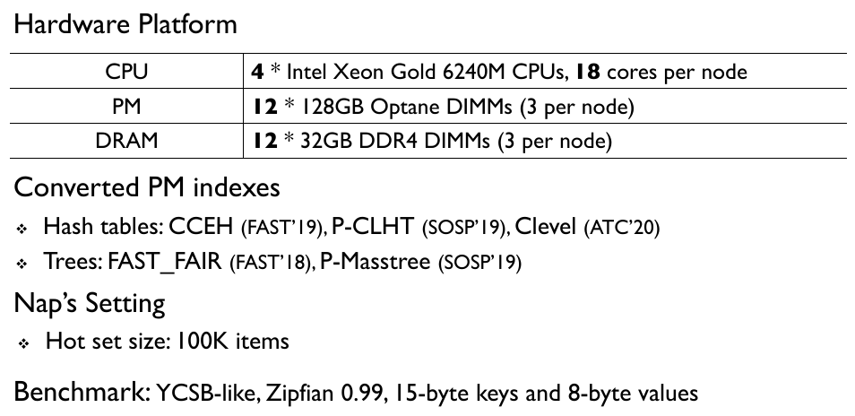
Evaluations - Setup

Slide 47
Evaluations - Perspectives
How does Nap-converted PM indexes compare with original PM indexes?
How does Nap perform when value size is variable?
How does Nap react to dynamic workloads?
How do the characteristics of workloads and NUMA configurations affect the performance of Nap?
How does Nap compare with Node Replication?
What are the overheads incurred when using Nap?
What is the benefit of Nap to real applications?

Slide 48
Global Performance

Slide 49
Dynamic Workload Adaption

Slide 50
Dynamic Workload Adaption

Slide 51
Thanks for listening!
Nap: A Black-Box Approach to NUMA-Aware
Persistent Memory Indexes
OSDI 21
Qing Wang, Youyou Lu, Junru Li, Jiwu Shu
Tsinghua University
Shared by Yiduo Wang, Xinyang Shao at USTC Reading Group

Slide 52
Backup slides

Slide 53
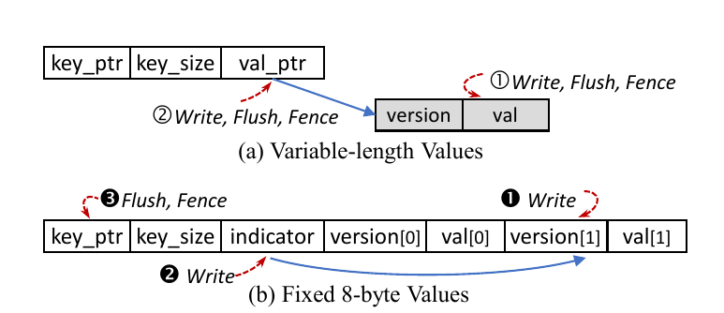
Design: Partial & Crash-consistent View (PC-View)

