Slide 1
USTC-SYS Reading Group
Kick-off Meeting
Spring 2021

Slide 2
Agenda
Introduction to Reading Group
Awards
Advices for reading a paper
Advices for giving a talk

Slide 3
Mission
Discuss “latest research in systems research”
Learn “how to do high-quality systems research”
Polish soft skills
Understanding
Presentation
Critical thinking
Communication
…

Slide 4
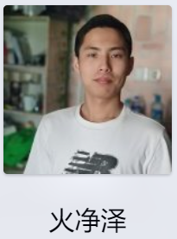
Arrangement
Runs every semester (8th round now)
Time: 19:00 – 20:00, Wednesday evening
Location: Virtual meeting (Tecent meeting)
Assistant: Jingze Huo
Internal webpage:
http://210.45.114.146/wiki/doku.php?id=public:rg:readinggroup

Slide 5
What do we read?
The most recent works in systems research
Published at top conferences such as
OSDI/SOSP/EuroSys/USENIX ATC – operating systems
FAST – storage systems
SIGCOMM/NSDI – networking systems
SIGMOD/VLDB/ICDE/PODS – database systems
ASPLOS – architectures, systems, languages
ACM SoCC – cloud computing
...

Slide 6
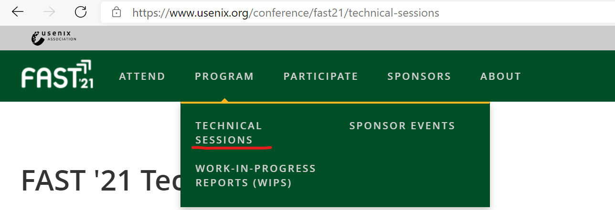
How to search?
Read best papers!!!

Slide 7
Important dates

Slide 8
More to check
A comprehensive list of systems-related conferences:
http://www.cs.technion.ac.il/~dan/index_sysvenues_deadline.html

Slide 9
Focus of this semester
FAST 2021
https://www.usenix.org/conference/fast21/technical-sessions
NSDI 2021
https://www.usenix.org/conference/nsdi21/technical-sessions
EuroSys 2021
https://2021.eurosys.org/program.html#program
OSDI 2021
https://www.usenix.org/conference/osdi21
USENIX ATC 2021
https://www.usenix.org/conference/atc21
ACM SoCC 2020
http://acmsocc.org/2020/schedule.html
Notes:
SOSP2021到下半年了

Slide 10
Discussion format
Primary focus: understanding the paper
What is the problem?
What are the challenges?
What are the key insights/techniques?
Lessons learned from experiments?
Whole discussion: 1 hour, presentation: around 35 minutes
Notes:
讨论的目标是深度理解一篇paper

Slide 11
Presentation tips
Two students present a single paper
Please make around 35 slides!
Too much text ☹
Copy paste figures ☹
Animations ☺
Transitions between slides ☺
One slide: 1 - 2 minutes
Please do rehearsals offline
Notes:
动画
提前排练

Slide 12
Higher requirements
Relate one work to the series of works
E.g., Saurabh Kadekodi, et al., "Pacemaker: avoiding HeART attacks in storage clusters with disk-adaptive redundancy", OSDI'20
Saurabh Kadekodi, et al., "Cluster storage systems gotta have HeART: improving storage efficiency by exploiting disk-reliability heterogeneity", FAST'19
Francisco Maturana, et al., "Access-optimal Linear MDS Convertible Codes for All Parameters", ISIT'20
Francisco Maturana, et al., "Convertible Codes: New Class of Codes for Efficient Conversion of Coded Data in Distributed Storage", ITCS'20
Francisco Maturana, et al., "Bandwidth Cost of Code Conversions in Distributed Storage: Fundamental Limits and Optimal Constructions", arXiv

Slide 13
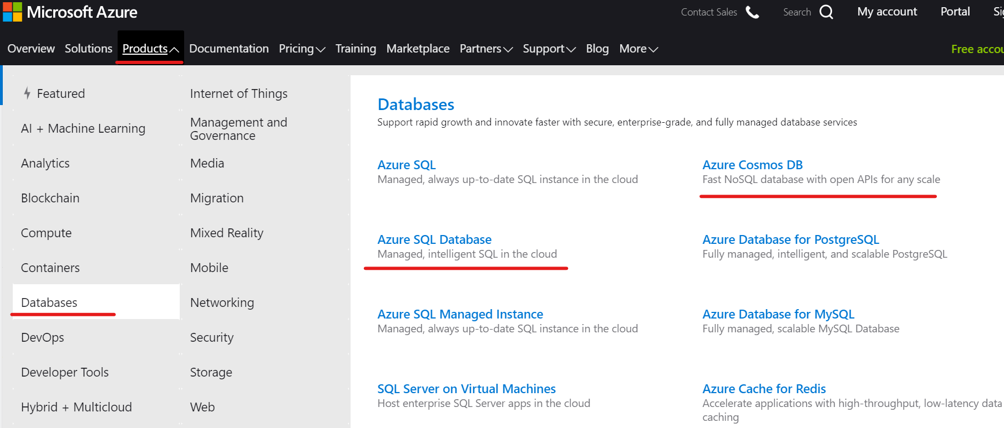
Enterprise developments
Notes:
Azure SQL sharding/scaling out/scaling up怎么做：https://docs.microsoft.com/en-us/azure/azure-sql/database/elastic-scale-introduction

Slide 14
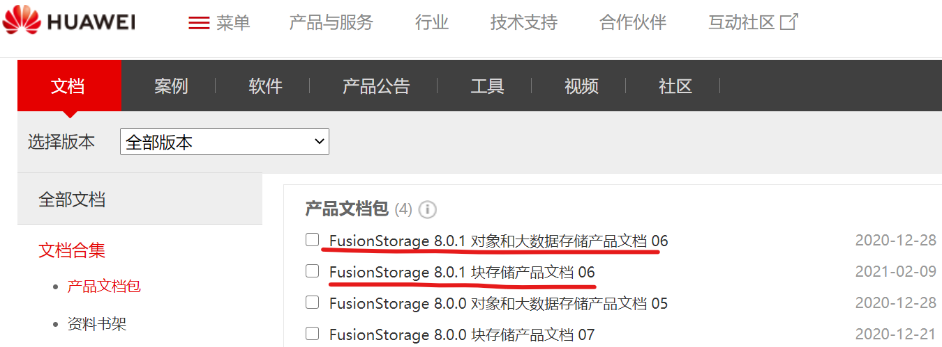
Enterprise developments
To know 'storage pool', 'object store', 'file store', 'block store', 'distributed hash', 'disaster tolerance', ...

Slide 15
Agenda
Introduction to Reading Group
Awards
Advices for reading a paper
Advices for giving a talk

Slide 16
Best Presentation Award
Long Deng, Yuan Zeng
Nov.25,2020,''From Wisckey to Bourbon: A Learned Index for Log-Structured Merge Trees'', OSDI'20

Slide 17
Best Presentation Award
Ziyue Qiu, Zevin King
Nov.18,2020,''Understanding, Detecting and Localizing Partial Failures in Large System Software'', NSDI'20

Slide 18
Best Presentation Award
Chuqing Gao, Zhanghan Wang
Dec.16,2020,''Byzantine Ordered Consensus without Byzantine Oligarchy'', OSDI'20

Slide 19
Best Service Award
Yiming Zhu

Slide 20
Agenda
Introduction to Reading Group
Awards
Advices for reading a paper
Advices for giving a talk

Slide 21
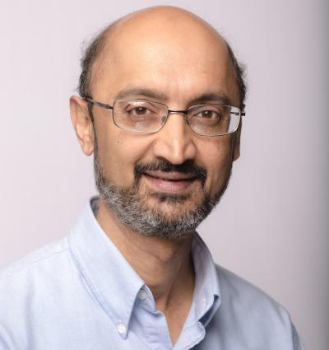
How to Read a Paper!
From Srinivasan Keshav
The Robert Sansom Professor of Computer Science at the University of Cambridge
ACM/IEEE Fellow
Three passes
1st: get a bird's-eye view
2nd: grasp the content
3rd: rethink, recreate the work
http://ccr.sigcomm.org/online/files/p83-keshavA.pdf
Notes:
剑桥大学 克沙夫。三遍循序渐进，第一遍，掌握大概（题目、摘要、简介、整体架构等）；第二遍，掌握内容（整个paper解决的问题、使用的technique、做的实验搞清楚了）；第三遍，理解细节，从你自己的角度去思考、复述整个paper

Slide 22
Agenda
Introduction to Reading Group
Awards
Advices for reading a paper
Advices for giving a talk

Slide 23
Advices
https://people.eecs.berkeley.edu/~jrs/speaking.html
Preparing a talk
Giving the talk
http://pages.cs.wisc.edu/~markhill/conference-talk.html
Oral presentation advice
How to give a bad talk

Slide 24
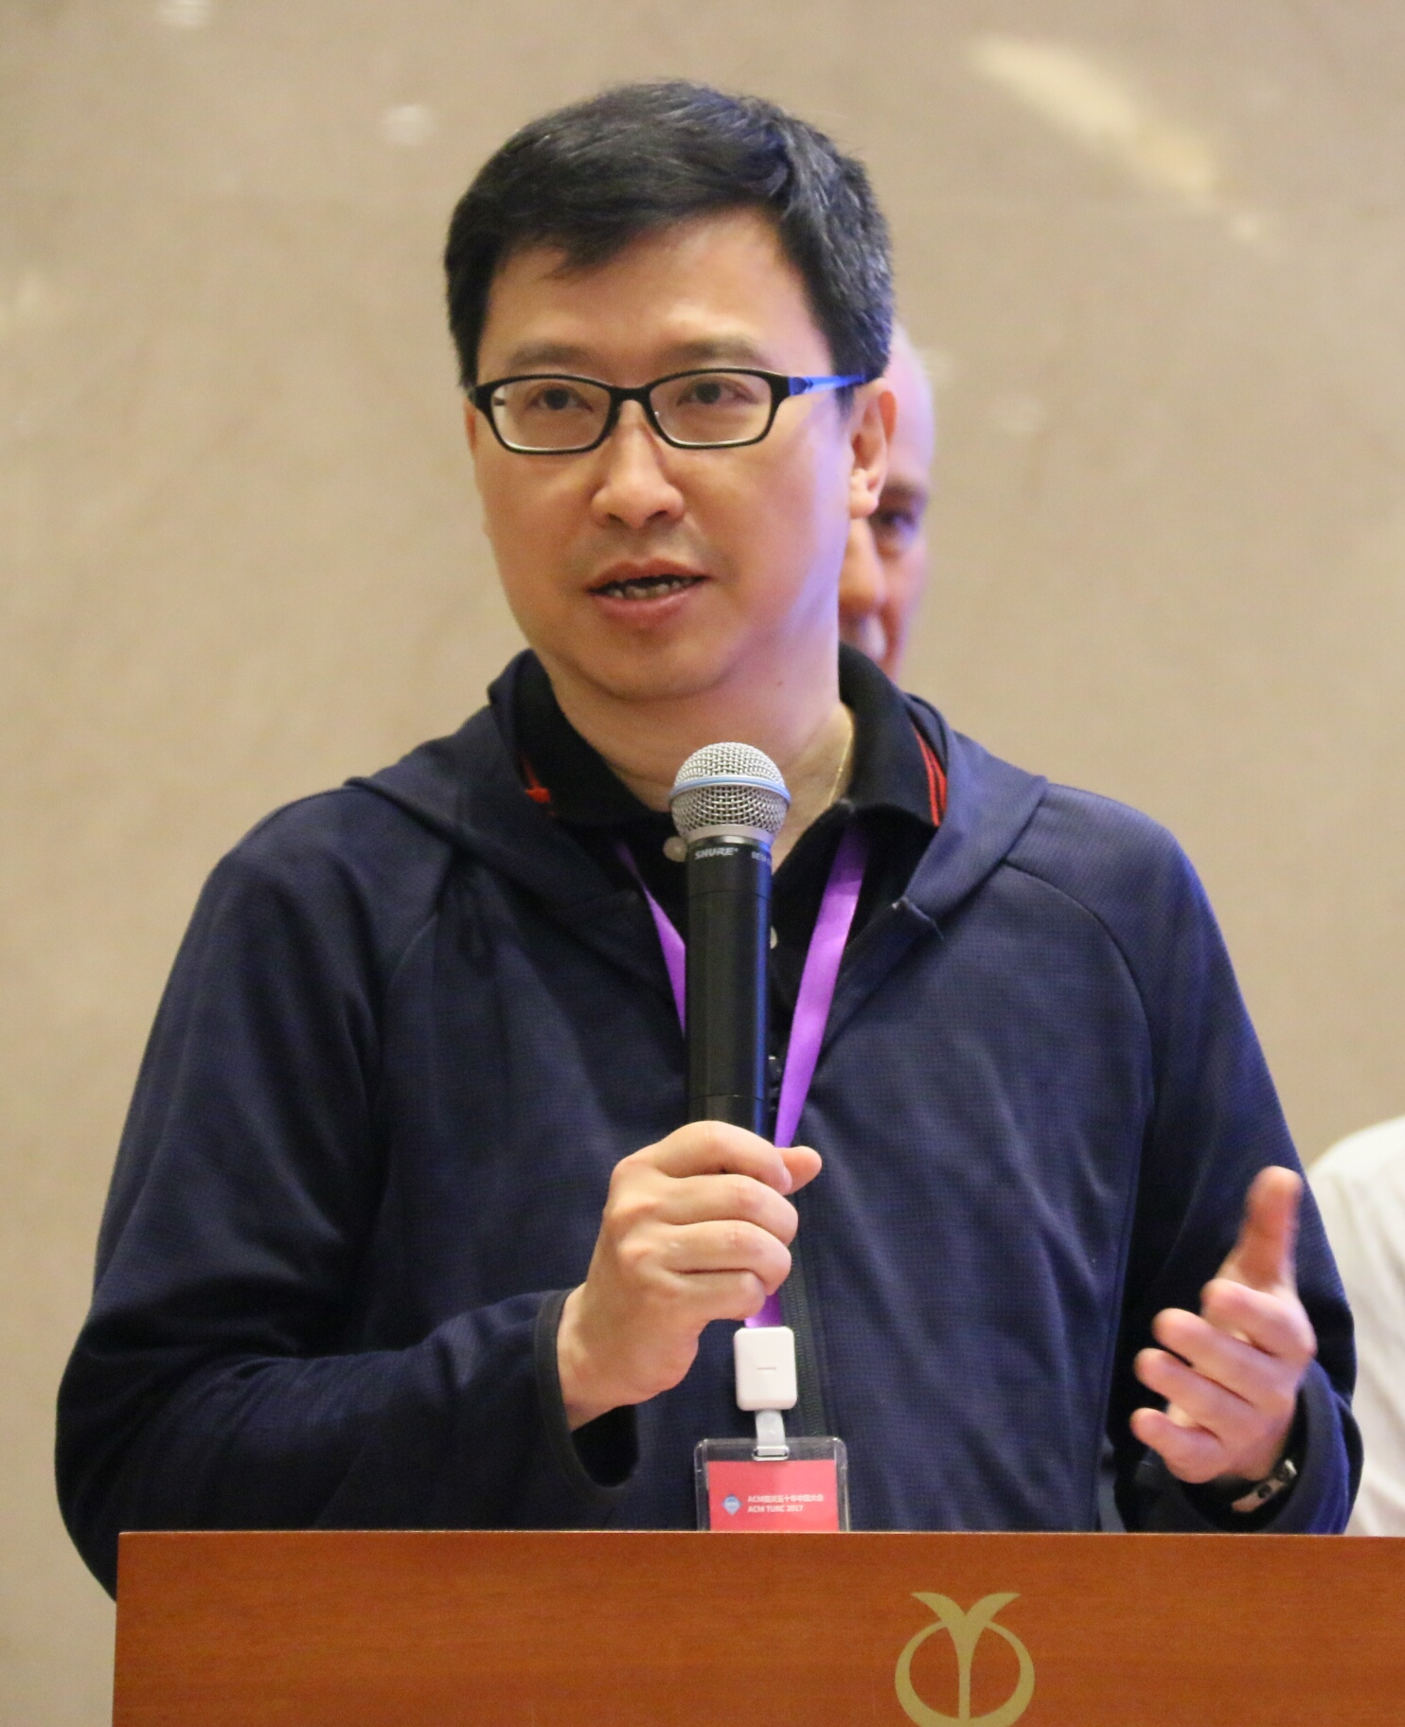
More advices
From John C.S. Lui
Choh-Ming Li Chair Professor of Computer Science and Engineering in The Chinese University of Hong Kong
ACM/IEEE Fellow
Computer science research, writing and speaking advice
Writing and publishing
Research skills
Speaking
Career development
...
http://www.cs.cmu.edu/afs/cs.cmu.edu/user/mleone/web/how-to.html

Slide 25
Signup please
Please contact Jingze as soon as possible
In particular, for those who have never presented

Slide 26
USTC-SYS Reading Group
Kick-off Meeting
Q& A

