Slide 1
INFINI CACHE
Exploiting Ephemeral Serverless Functions
to Build a Cost-Effective Memory Cache

Slide 2
INFINI CACHE
Background and Motivation
InfiniCache Design

Slide 3
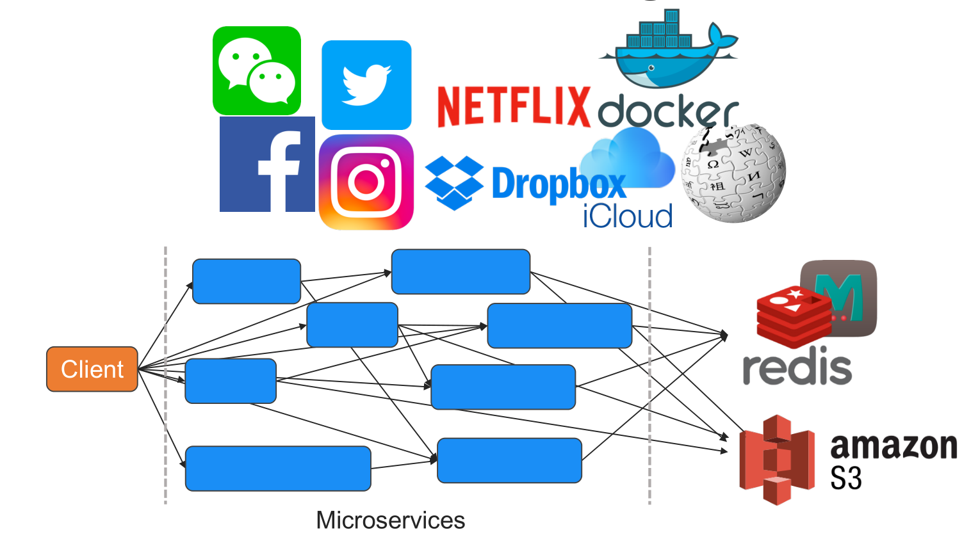
Background and Motivation
Notes:
Large-scale web applications have increasingly complex stor-
age workload characteristics. Many modern web applications
utilize a microservice architecture, whichconsistsofhundreds
tothousandsofmicroservicemodules[ 33 ]. Differentmodules
exhibit different object size distributions and request patterns.
For example, a Docker image registry service uses Redis to
store small-sized container metadata (i.e., manifests), and an
object store to store large-sized container images [ 17 , 40 ].
While in-memory caching has been extensively studied in
the context of large-scale web applications focusing on small
objects, cloud cache management for large objects remains
poorly explored and poses further challenges.

Slide 4
Background and Motivation
Case study: IBM Docker registry workloads
• Object size distribution
• Large object reuse patterns
• Storage footprint

Slide 5
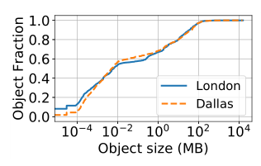
Background and Motivation
Case study: IBM Docker registry workloads
• Object size distribution
• Large object reuse patterns
• Storage footprint
Extreme variability in object sizes:
• Object sizes span over 9 orders of magnitude
• 20% of objects > 10MB

Slide 6
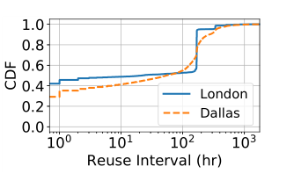
Background and Motivation
Case study: IBM Docker registry workloads
• Object size distribution
• Large object reuse patterns
• Storage footprint
Caching large objects is beneficial:
• > 30% large object (>10MB) access 10+ times
• Around 45% of them got reused within 1 hour

Slide 7
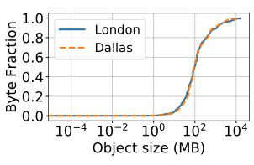
Background and Motivation
Case study: IBM Docker registry workloads
• Object size distribution
• Large object reuse patterns
• Storage footprint
Extreme tension between small and large objects:
• Large objects (>10MB) occupy 95% storage
footprint

Slide 8
Background and Motivation
Case study: IBM Docker registry workloads
Caching Large Object can provide significant benefit
Caching both small and large objects is challenging
Existing solutions are expensive

Slide 9
Background and Motivation
Serverless Computing is desirable
• Insight #1: Serverless functions’ <CPU, Mem> resources are pay-per-use Cost-effectiveness
• Insight #2: Serverless providers offer “free” function caching for tenants High-performance
Goal: Exploit the serverless computing model to build
a cost-effective, high-performance in-memory cache
Notes:
Large-scale web applications have increasingly complex stor-
age workload characteristics. Many modern web applications
utilize a microservice architecture, whichconsistsofhundreds
tothousandsofmicroservicemodules[ 33 ]. Differentmodules
exhibit different object size distributions and request patterns.
For example, a Docker image registry service uses Redis to
store small-sized container metadata (i.e., manifests), and an
object store to store large-sized container images [ 17 , 40 ].
While in-memory caching has been extensively studied in
the context of large-scale web applications focusing on small
objects, cloud cache management for large objects remains
poorly explored and poses further challenges.

Slide 10
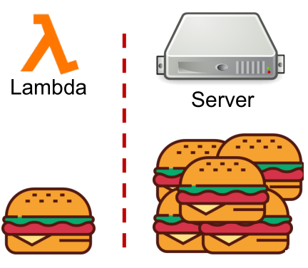
Challenges
• Limited CPU and memory capacity
• Lambda functions are not Addressable
• No data availability guarantee
Notes:
Large-scale web applications have increasingly complex stor-
age workload characteristics. Many modern web applications
utilize a microservice architecture, whichconsistsofhundreds
tothousandsofmicroservicemodules[ 33 ]. Differentmodules
exhibit different object size distributions and request patterns.
For example, a Docker image registry service uses Redis to
store small-sized container metadata (i.e., manifests), and an
object store to store large-sized container images [ 17 , 40 ].
While in-memory caching has been extensively studied in
the context of large-scale web applications focusing on small
objects, cloud cache management for large objects remains
poorly explored and poses further challenges.

Slide 11
InfiniCache Design
proxy servers
client library
proxy servers

Slide 12
InfiniCache Design
Notes:
Object is split and encoded into k+r chunks
Object chunks are sent to the proxy in parallel
Proxy invoke Lambda cache nodes

Slide 13
InfiniCache Design
GET
Notes:
Object is split and encoded into k+r chunks
Object chunks are sent to the proxy in parallel
Proxy invoke Lambda cache nodes

Slide 14
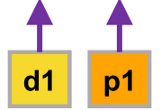
InfiniCache Design
Notes:
Object is split and encoded into k+r chunks
Object chunks are sent to the proxy in parallel
Proxy invoke Lambda cache nodes

Slide 15
InfiniCache Design
Maximizing data availability
• Periodic warm up
• Periodic delta sync backup
Notes:
Object is split and encoded into k+r chunks
Object chunks are sent to the proxy in parallel
Proxy invoke Lambda cache nodes

Slide 16
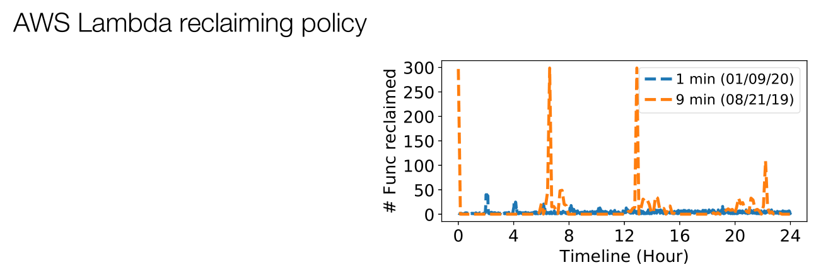
InfiniCache Design
Notes:
Object is split and encoded into k+r chunks
Object chunks are sent to the proxy in parallel
Proxy invoke Lambda cache nodes

Slide 17
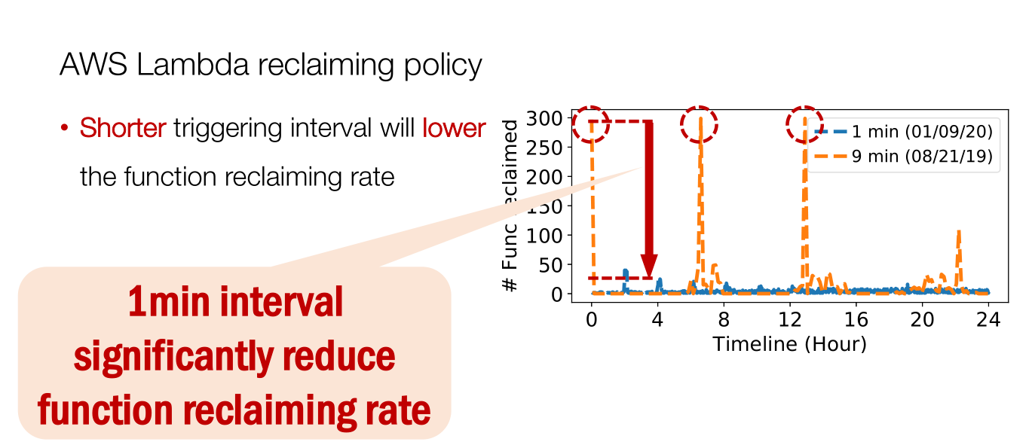
InfiniCache Design
Notes:
Object is split and encoded into k+r chunks
Object chunks are sent to the proxy in parallel
Proxy invoke Lambda cache nodes

Slide 18
InfiniCache Design
Notes:
Object is split and encoded into k+r chunks
Object chunks are sent to the proxy in parallel
Proxy invoke Lambda cache nodes

Slide 19
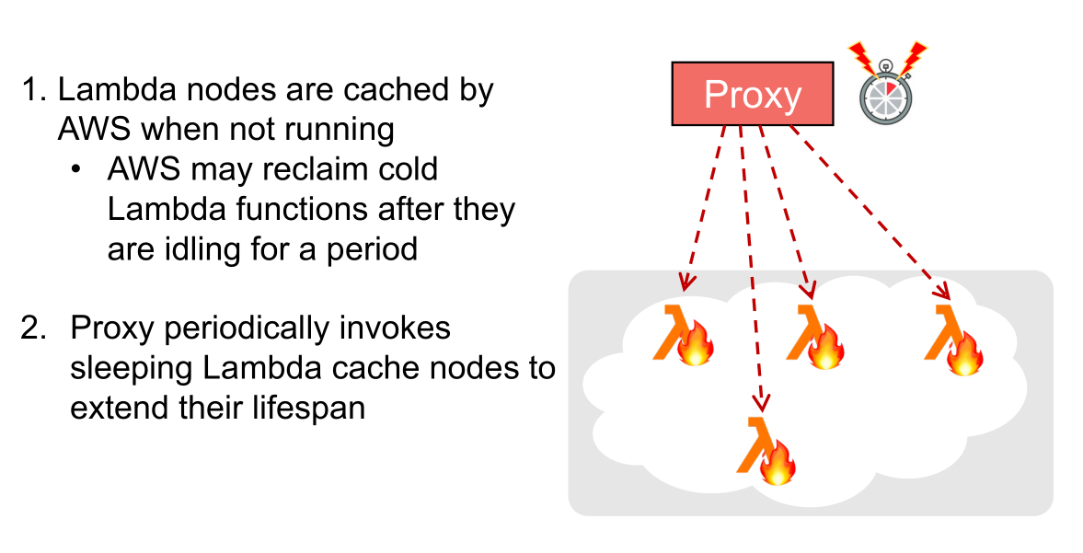
InfiniCache Design
Notes:
Object is split and encoded into k+r chunks
Object chunks are sent to the proxy in parallel
Proxy invoke Lambda cache nodes

Slide 20
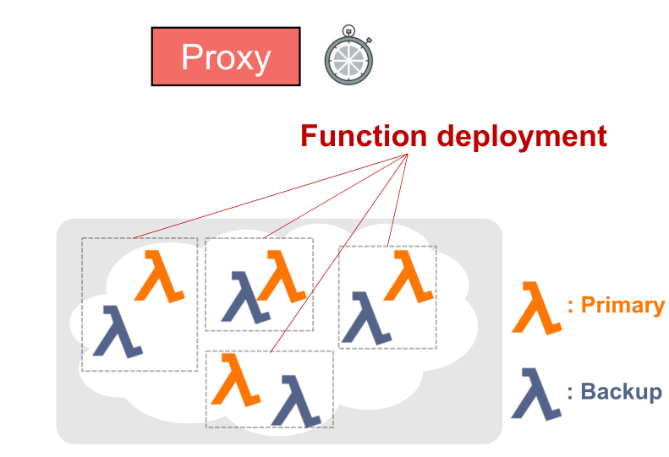
InfiniCache Design
Notes:
Object is split and encoded into k+r chunks
Object chunks are sent to the proxy in parallel
Proxy invoke Lambda cache nodes

Slide 21
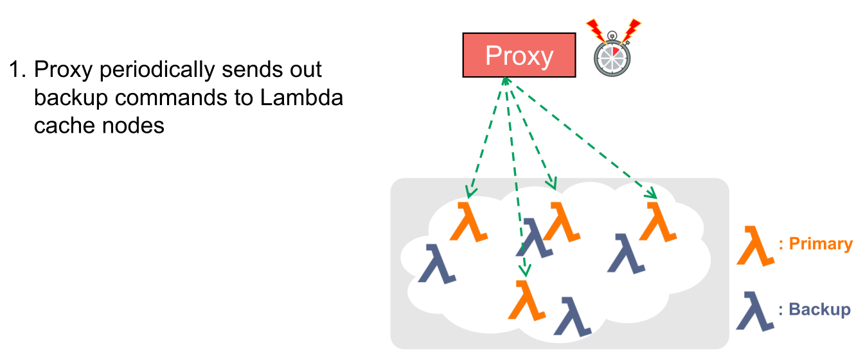
InfiniCache Design
Notes:
Object is split and encoded into k+r chunks
Object chunks are sent to the proxy in parallel
Proxy invoke Lambda cache nodes

Slide 22
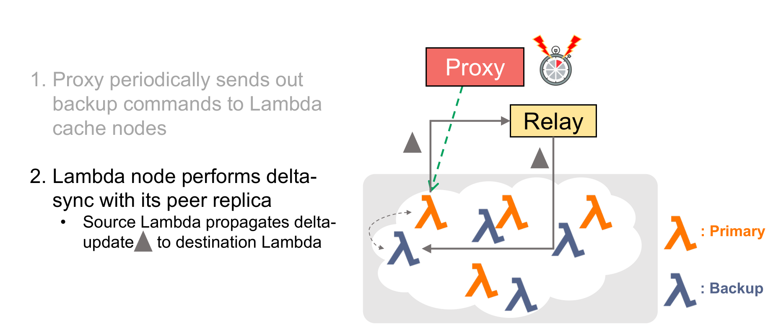

Slide 23
