Slide 1
Distributed Systems
Lecture 3 – Event, Order & Clock
Cheng Li

Slide 2
Why do we need to order events?
$$p_{0}$$
$$p_{1}$$
$$p_{2}$$
Note: everybody should know how to draw this time-space diagram!

Slide 3
Why do we need to order events?
$$m_{0}^{0}$$
$$p_{0}$$
$$p_{1}$$
$$p_{2}$$

Slide 4
Why do we need to order events?
$$m_{0}^{0}$$
$$p_{0}$$
$$m_{0}^{0}$$
$$p_{1}$$
$$m_{0}^{0}$$
$$p_{2}$$

Slide 5
Why do we need to order events?
$$m_{0}^{0}$$
$$m_{1}^{0}$$
$$p_{0}$$
$$m_{0}^{0}$$
$$m_{1}^{0}$$
$$p_{1}$$
$$m_{0}^{0}$$
$$m_{1}^{0}$$
$$p_{2}$$

Slide 6
Why do we need to order events?
$$m_{0}^{0}$$
$$m_{1}^{0}$$
$$p_{0}$$
$$m_{0}^{0}$$
$$m_{1}^{0}$$
$$p_{1}$$
$$m_{1}^{0}$$
$$m_{0}^{0}$$
$$p_{2}$$
Messages can be delayed and disordered.

Slide 7
Order matters - Facebook example
Remove boss as friend
Post “My boss is the worst, I need a new job!”
Don’t want to get these in the wrong order!

Slide 8
Why do we need to order events?
$$m_{0}^{0}$$
$$t^{}$$
$$m_{1}^{0}$$
$$p_{0}$$
$$m_{0}^{0}$$
$$m_{1}^{0}$$
$$t^{′}$$
$$p_{1}$$
$$m_{1}^{0}$$
$$t^{′}$$
$$m_{0}^{0}$$
$$t^{}$$
$$p_{2}$$
Physical clocks $t< t^{′}$not always holds
due to clock drift

Slide 9
Physical clocks
accuracy is proportional to cost

Slide 10
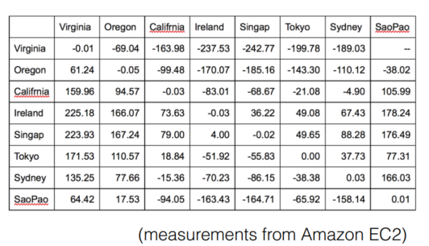
How well are clocks synchronized in practice?

Slide 11
How well are clocks synchronized in practice?
Within a datacenter: ~20-50 microsecond
Across datacenters: ~50-250 milliseconds
For comparison: can process a RPC in ~3us
200ms is a user-perceptible difference

Slide 12
Two main approaches
Synchronize physical clocks
Logical clocks

Slide 13
Synchronize physical clocks
NTP uses an interrogation-based approach, plus:
taking multiple samples to eliminate ones not close to min RTT
averaging among multiple masters
taking into account clock rate skew
PTP adds hardware timestamping support to track latency introduced in network
TrueTimer in Spanner
Note: please read the materials by yourselves!
http://www.ntp.org/
https://www.cs.rutgers.edu/~pxk/417/notes/ptp.html
https://dl.acm.org/doi/10.1145/3035918.3056103

Slide 14
Alternative: logical clocks
Landmark 1978 paper by Leslie Lamport
another way to keep track of time
based on the idea of causal relationships between events
doesn’t require any physical clocks
It covers a wide range of proposals including Lamport clock and vector clock.

Slide 15
Model of a Distributed System
Process: Set of events, a priori total ordering (sequence)
Event: Sending/receiving message
Distributed System: Collection of processes, spatially separated, communicate via messages

Slide 16
Happens-before relationship
Lamport’s “happened-before” notation
a → b: event a happened before event b
e.g.,: a: message being sent, b: message receipt
means: b saw side effects of a if a is a write
means: b could have been influenced by a
Transitive:
if a → b and b → c then a → c
It will establish a global partial order.
If two events a, b are not ordered by →, then we say they are concurrent; write as a || b.

Slide 17
Abstract logical clocks
Goal: if a → b, then C(a) < C(b)
Clock conditions:
if a and b are on the same process i, Ci(a) < Ci(b)
if a = process i sends M, and b = process j receives M, then Ci(a) < Cj(b)

Slide 18
Algorithm of Lamport clock
Each process i increments counter Ci between two local events.
It is a monotonically increasing software counter. It need not relate to a physical clock.
When i sends a message m, it includes a timestamp Tm = (Ci at the time message was sent)
On receiving m, process j updates its clock: Cj = max(Cj, Tm + 1) + 1
source: https://amturing.acm.org/p558-lamport.pdf
Notes:
question, why Tm+1, instead of Tm?

Slide 19
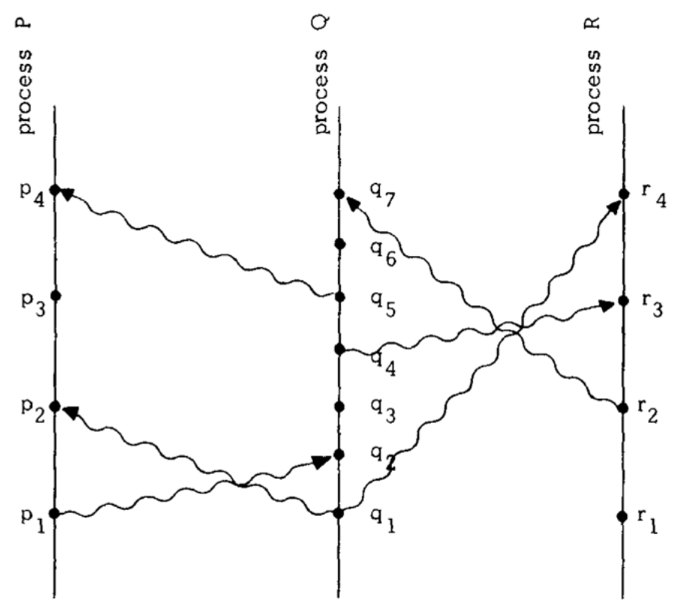
Time space diagram

Slide 20
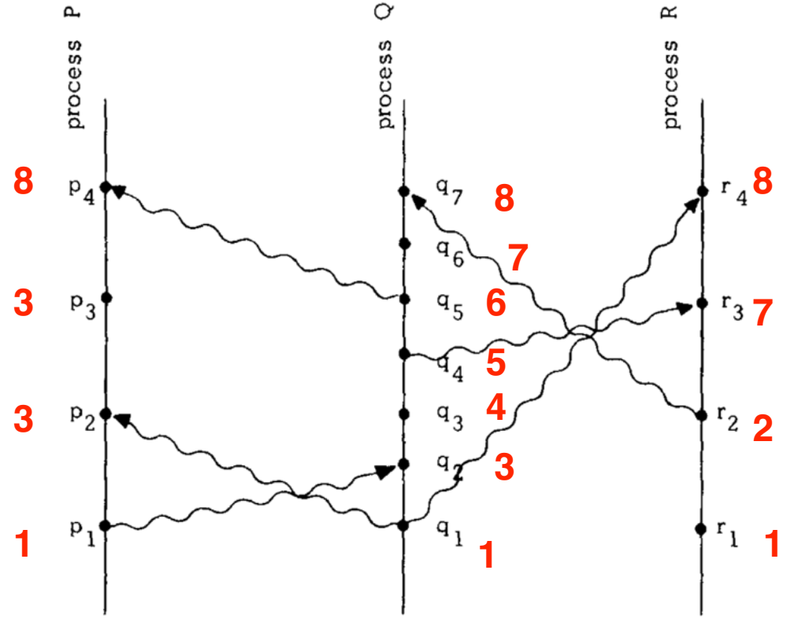
Time space diagram

Slide 21
What are the implications?
If a → b, then C(a) < C(b)
But, is the converse true: if C(a) < C(b) then a → b?

Slide 22
What are the implications?
If a → b, then C(a) < C(b)
But, is the converse true: if C(a) < C(b) then a → b?
no, they could also be concurrent
if we were to use the Lamport clock as a global order, we would induce some unnecessary ordering constraints
It is important to use clocks to detect causality violations in practice.

Slide 23
Could we build a better logical clock?
Strawman: keep a dependency list, i.e. a list of all previous events
Reading: Don’t Settle for Eventual: Scalable Causal Consistency for Wide-Area Storage with COPS
https://www.cs.cmu.edu/~dga/papers/cops-sosp2011.pdf
Reading: Dependency graph developed in machine learning frameworks such as Tensorflow, MxNet, Pytorch
Please talk to Youhui Bai

Slide 24
Could we build a better logical clock?
Strawman: keep a dependency list, i.e. a list of all previous events
Reading: Don’t Settle for Eventual: Scalable Causal Consistency for Wide-Area Storage with COPS
https://www.cs.cmu.edu/~dga/papers/cops-sosp2011.pdf
Reading: Dependency graph developed in machine learning frameworks such as Tensorflow, MxNet, Pytorch
Please talk to Youhui Bai
But the list can be large, and transferring overhead is high.
Better answer: vector clocks

Slide 25
Vector clocks
Proposed by Mattern [1989] and Fidge [1991]
Vector clocks can be used to detect causality violations after-the fact.
Each process not only increments its own counter, but also keeps track of the values of other peers’ counters.
source: https://www.vs.inf.ethz.ch/publ/papers/VirtTimeGlobStates.pdf
http://zoo.cs.yale.edu/classes/cs426/2012/lab/bib/fidge88timestamps.pdf

Slide 26
Vector clocks
Vector clock: an array of N integers for a system with N processes. Each process Pi has its own local vector clock Vi.
Rules for updating clocks:
VC1: initially for each pi, Vi[j] = 0 for i, j = 1, 2, …N
VC2: pi timestamps an event it sets Vi[i] := Vi[i] +1
VC3: pi piggybacks t = Vi on every message it sends
VC4: when pi receives (m,t) it sets Vi[j] := max(Vi[j] , t[j]) j = 1, 2, …N (then adds I to its own element using VC2)
Merge operation

Slide 27
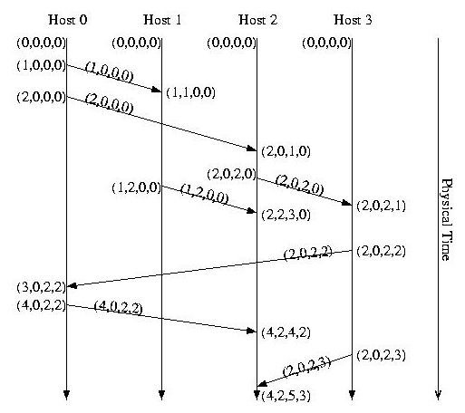
Vector clocks

Slide 28
Comparing vector clocks
When comparing vector timestamps, we compare them by comparing each element in one timestamp to the corresponding element in the other timestamp.
Rule1: If corresponding elements in two timestamps are identical, the two events are the same event -- timestamps of different events should never be identical.
Rule2: If Event_{A} → Event_{B} then each element of Event_{A}'s timestamp is less than or equal to the corresponding element in Event_{B}'s timestamp, and at least one element is less than the corresponding element in Event_{B}'s timestamp.

Slide 29
Comparing vector clocks
Rule3: If Event_{B} → Event_{A} then each element of Event_{A}'s timestamp is greater than or equal to the corresponding element in Event_{B}'s timestamp, and at least one element is greater than the corresponding element in Event_{B}'s timestamp.
Rule4: If two events are concurrent, they will have "mixed" timestamps such that at least one pair of corresponding elements is "greater than" and at least one corresponding pair of elements is "less than."

Slide 30
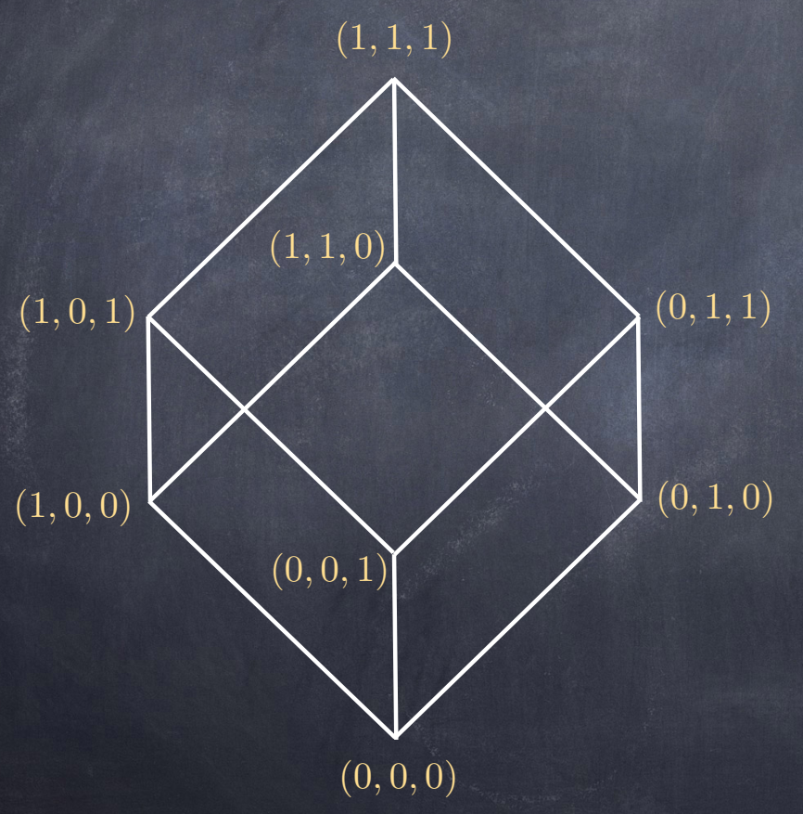
What can be obtained by VC?
A strict partial order (Lattices)
Reading: J. Halpern and Y. Moses Knowledge and Common Knowledge in a Distributed Environment
E.W. Dijkstra Prize 2009.

Slide 31
Usecase of Vector clock and Causality
The importance of global states
Sometimes, we need to detect violations of predicts over the state of a distributed application.
i.e., the success of bank transfer
Often used by checkpoint/snapshot
for distributed debugging, fault tolerance
Hard to obtain a global state of distributed system
consists of states of multiple processes and channel states
concurrency, independent failure, no global clock
only by message passing, the state of each process (data and variables), is private information.

Slide 32
More applications

Slide 33
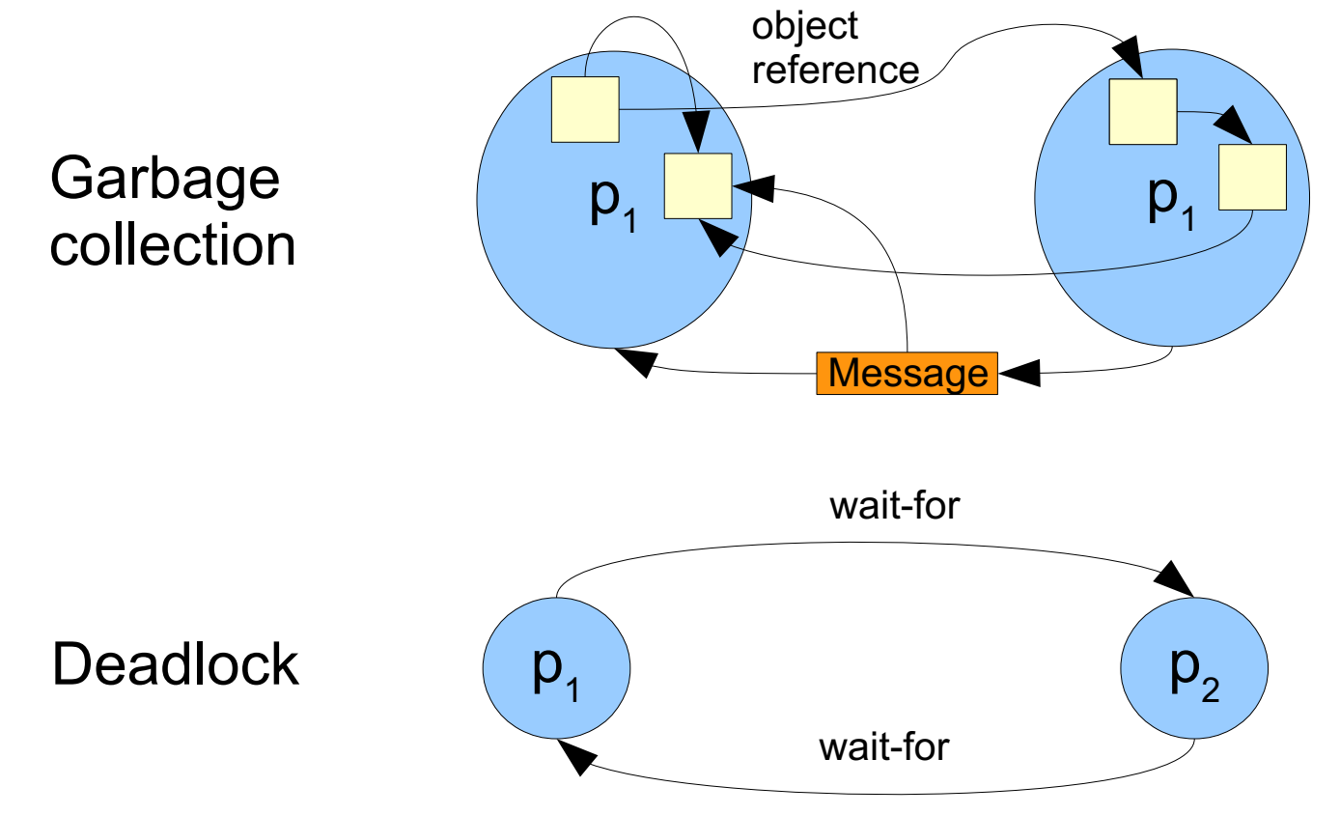
More examples

Slide 34
Global state vs global consistent state
If all processes do agree on the time, the state recorded at processes is a global state of the system.
But, no perfect clock synchronization
How to obtain a meaningful/consistent global state from local states recorded at different real times?
i.e., no causality violations
Consistency => no violations in domain-specific ordering constraints

Slide 35
More definitions

Slide 36
Cuts

Slide 37
Global states and cuts

Slide 38
Consistent cuts and global states

Slide 39
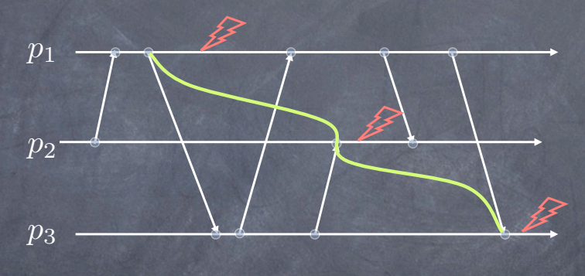
Question?
If this cut a consistent one?

Slide 40
Question?
If this cut a consistent one?
Not a consistent global state: the cut contains the event corresponding to the receipt of the last message by but not the corresponding send event.

Slide 41
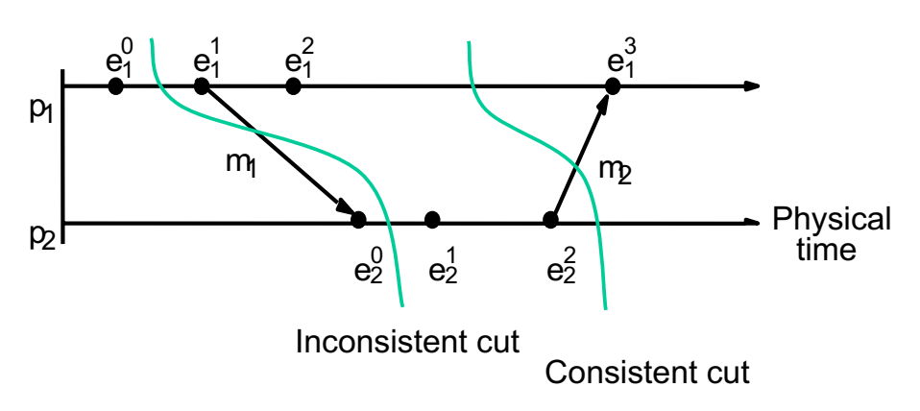
More examples

Slide 42
Next task
Develop a protocol by which a processor can build a consistent global state
‘Snapshot’ algorithm, [Chandy & Lamport 1985]: to determine global states of distributed systems.
It’s a distributed algorithm to collect local states.
Reading: Distributed Snapshots: Determining Global States of Distributed Systems
https://lamport.azurewebsites.net/pubs/chandy.pdf

Slide 43
Algorithm: first glance

Slide 44
More readings
A Survey of Rollback-Recovery Protocols in Message-Passing Systems
http://www.cs.cornell.edu/courses/cs514/2001fa/alvisi.pdf

Slide 45
Distributed Systems
Lecture 3 – Event, Order & Clock
Q & A!

