Slide 1
Reading Group
Nightcore: Efficient and Scalable Serverless Computing for Latency-Sensitive, Interactive Microservices
ASPLOS21’
Authors: Zhipeng Jia， Emmett Witchel
2021/09/15
Presenter: Zhiwei Bai， Xiyuan Liang
Notes:
ASPLOS21

Slide 2
Outline
1
Background
2
Motivation
3
Design
4
Evaluation
3
5
Conclusion
Notes:
下面我们将按照如下顺序来介绍本篇文章

Slide 3
Outline
1
Background
2
Motivation
3
Design
4
Evaluation
3
5
Conclusion
Notes:
首先我来讲一下本篇文章的背景

Slide 4
Background
Microservice
Serverless computing

Slide 5
Background
Microservice
In short, the microservice architectural style is an approach to developing a single application as a suite of small services, each running in its own process and communicating with lightweight mechanisms, often an HTTP resource API. ------Martin Fowler
Notes:
在这个领域比较有名的Public speaker:简而言之，微服务体系结构风格是一种将单个应用程序开发成一组小型服务的方法，每个服务都在自己的进程中运行，并与轻量级机制(通常是HTTP资源API)进行通信。

Slide 6
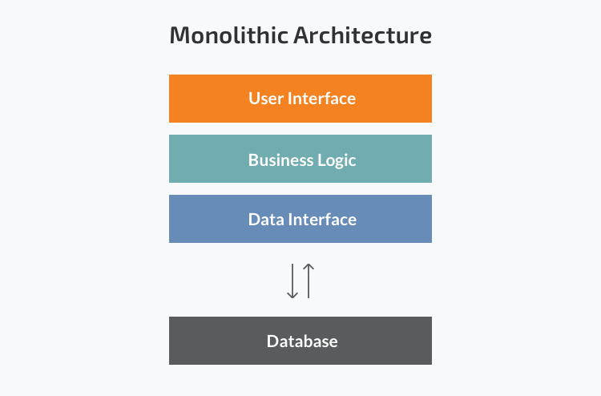
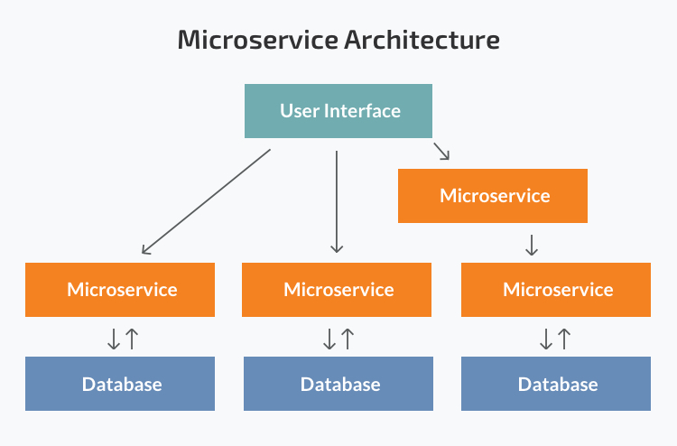
Background
Notes:
这张图可以看出microservice和传统的一体化设计有什么区别
左图三层，从上到下分别UI,功能实现，数据接口（连接数据库）
右图分为多个microservice，可以看到相互调用，并且它们大多数都有自己的数据库，易于扩展，易于容错
无状态不需要维护状态数据，使得它配置简单，扩展性强，用户不需要为了之前的状态访问特定服务器
容器是为无状态的，因为这适合他们的便携式，灵活的性质。

Slide 7
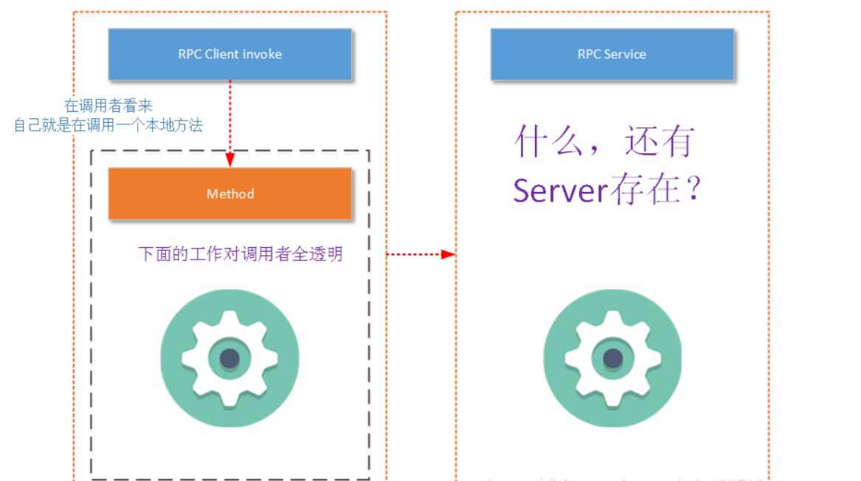
Background
RPC（Remote procedure call）
Notes:
通信方式有很多，它们之间的取舍并不是本文的重点，我们就介绍本文涉及的RPC（Remote procedure call）
the programmer writes essentially the same code whether the subroutine is local to the executing program, or remote.
就是无论你调用的方法是本地的，还是远程的，程序员编写的代码都是相同的，不用考虑物理地址不同
现在的microservice大多编写成一个RPC server端

Slide 8
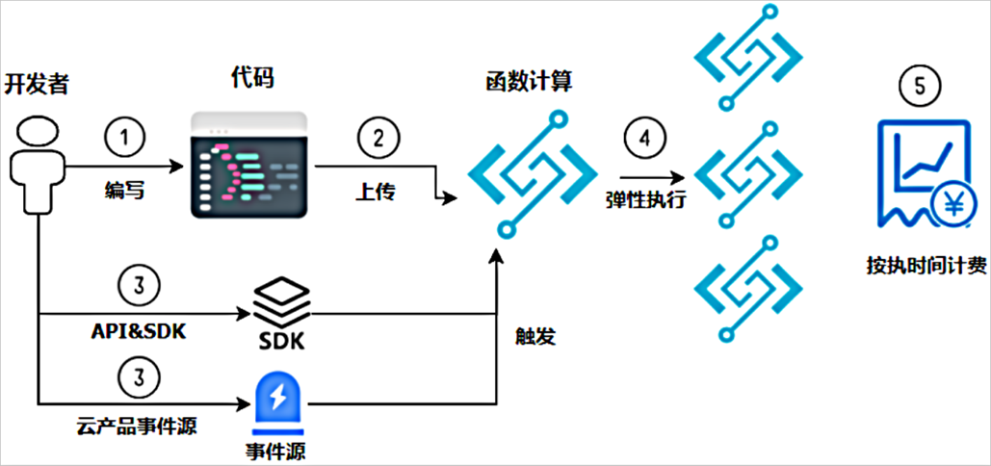
Background
Serverless computing
Notes:
Serverless conputing 简称serverless
Serverless is a model in which application code is executed on-demand in response to triggers that application developers configure ahead of time.
Serverless一种开发模型，在该模型中，应用程序代码 按需执行 ，以响应应用程序开发人员提前配置的触发器

Slide 9
Background
example
a web function that will be used to monitor a data stream.
traditional development
AWS Lambda development
function
Create trigger
resources
维护
function
server
Notes:
用于监视数据流的web函数
traditional development:
编写函数 提供和配置资源 设置网络服务器 需要持续的消耗成本来 维护 该功能(即使该功能没有使用)。
编程 创建触发器 触发器是用来响应触发事件、外部请求的，用来调用你的函数 假设现在没有事件发生，你的应用休眠，当出现数据流（你设置的触发事件），应用开始工作，应用获得服务器等资源，否则应用休眠，不分配资源
在这个过程中你只负责告诉lambda，你的触发事件是什么，用来调用（唤醒）你的应用，至于服务器等资源都由它帮你管理

Slide 10
Background
Serverless’s Advantages
Allocate resources when you need
Pay as much as you used
Simplify development
Notes:
当应用程序没有使用时，就没有分配给应用程序的计算资源。
定价是基于应用程序消耗的资源的实际数量。
无服务器方法使开发人员能够更多地专注于创建函数，从而获得更简化的开发和部署体验。

Slide 11
Background
Serverless Microservices ? ? ?
Notes:
由之前的介绍很自然能够想到将二者结合起来，用serverless模型编写一组microservice
节约资源，开发好像也更加方便
那这其中可能会出现一些问题，比如性能

Slide 12
Outline
1
Background
2
Motivation
3
Design
4
Evaluation
3
5
Conclusion
Notes:
下面由火净泽师兄给大家介绍本文的 motivation 与 design & Implementation 部分

Slide 13
Motivation
Performance goals
Our performance goals
Notes:
首先明确我的们的目标
在原来的fass平台上由于工作负载是 video processing, distributed compilation, data analytics 单个fuction运行时间长，所以 调用率低，所以延迟可以在毫秒级
但是对于微服务来说，每个fuction执行时间短，要求延迟短，调用率高
我们的目标就是减低函数调用延迟，提高调用率
可能这样还是比较抽象 我们讲一个具体的例子来说明

Slide 14
New Tweet
NGINX frontend
compose-post
UploadText
(1710μs)
text
UploadText
(3640μs)
End to end response time :5.10 ms
user-timeline
WriteUserTimeline
(650μs)
unique-id
user-mention
UploadUserMention
(690μs)
media
UploadMedia
(320μs)
user UploadUserWithUserId (300μs) | UploadUniqueId (330μs)
 | compose-post UploadUniqueId (140μs)
compose-post
UploadUserMention
(130μs)
post-storage
StorePost
(260μs)
compose-post
UploadMedia
(140μs)
compose-post
UploadCreator
(130μs)
write-home-timeline FanoutHomeTimelines (640μs)
url-shorten
UploadUrls
(590μs)
Stateful service
Stateless service (running on FaaS)
compose-post
UploadUrls
(140μs)
social-graph
GetFollows
(230μs)
RPC trace from SocialNetwork microservices
Notes:
我们先来看一个例子
图中展示了在社交网络中发布一篇新的推文function之间的调用和以及每个function运行时间
这里的end to end response time 指代的是每个fuction之间调用延迟

Slide 15
New Tweet
NGINX frontend
compose-post
UploadText
(1710μs)
text
UploadText
(3640μs)
user-timeline
WriteUserTimeline
(650μs)
unique-id
user-mention
UploadUserMention
(690μs)
media
UploadMedia
(320μs)
user UploadUserWithUserId (300μs) | UploadUniqueId (330μs)
 | compose-post UploadUniqueId (140μs)
compose-post
UploadUserMention
(130μs)
post-storage
StorePost
(260μs)
compose-post
UploadMedia
(140μs)
compose-post
UploadCreator
(130μs)
write-home-timeline FanoutHomeTimelines (640μs)
url-shorten
UploadUrls
(590μs)
Stateful service
Stateless service (running on FaaS)
Observation 1: μs-scale execution time
compose-post
UploadUrls
(140μs)
social-graph
GetFollows
(230μs)
RPC trace from SocialNetwork microservices
Notes:
我们首先可以观察到的是
每个微服务基本是微秒级的执行时间

Slide 16
New Tweet
1 request
NGINX frontend
compose-post
UploadText
(1710μs)
text
UploadText
(3640μs)
= 15 fn invocations
user-timeline
WriteUserTimeline
(650μs)
unique-id
user-mention
UploadUserMention
(690μs)
media
UploadMedia
(320μs)
user UploadUserWithUserId (300μs) | UploadUniqueId (330μs)
 | compose-post UploadUniqueId (140μs)
compose-post
UploadUserMention
(130μs)
post-storage
StorePost
(260μs)
compose-post
UploadMedia
(140μs)
compose-post
UploadCreator
(130μs)
write-home-timeline FanoutHomeTimelines (640μs)
url-shorten
UploadUrls
(590μs)
Stateful service
Stateless service (running on FaaS)
Observation 2: High invocation rate
compose-post
UploadUrls
(140μs)
social-graph
GetFollows
(230μs)
RPC trace from SocialNetwork microservices
Notes:
其次，一次请求产生了多次的函数调用，而且在一次请求中产生链式的内部函数调用
可以看出 微秒级的运行时间和高调用率的情况下 5.1ms的调用延迟是十分不合理的
为什么会导致这种情况？瓶颈在哪里？
后面将分析现有fass平台对于现有微服务应用的不足

Slide 17
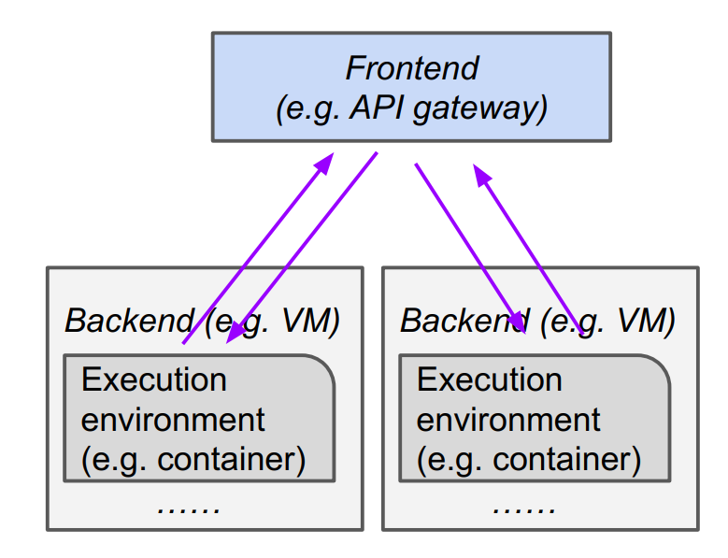
Motivation
Gateway
function requests are received by the gateway
round-trip times range from 101μs to 237μs
Notes:
首先从架构上来说
现有的Fass平台函数之间的调用都要通过网关
无论是外部请求还是内部调用都会经过网关
而一次RTT的开销就到达了101-237微秒
对于大部分执行时间只需要几百微秒的微服务来说显然是不合理的

Slide 18
Motivation
Inter-process communications (IPC) must be efficient
feature-rich RPC libraries like gRPC
over Unix sockets
take 13μs for sending 1KB RPC payloads
Notes:
刚刚介绍了现有fass平台在架构上对于微服务应用的不足之处
现在介绍现在广泛使用的RPC对于微服务应用的不足之处
现在fass上有丰富的RPC库，例如gRPC
以gRPC为例，它是建立在Unix 套接字上的，传输1kb 的rpc信息需要13微秒
这在大量的调用中会成为减少时延的瓶颈

Slide 19
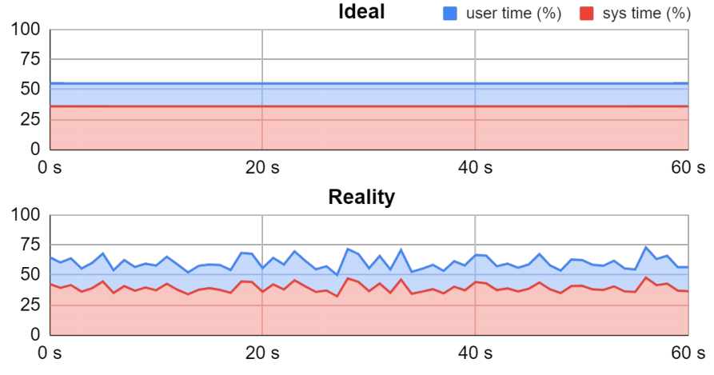
Motivation
Managed Concurrency
Stage-based nature of microservices
Complex internal load dynamics
Overusing concurrency for bursty load
Worse overall performance
Timeline of CPU utilization Running SocialNetwork microservices at a fixed request rate
Notes:
除了对于调用延迟的优化，通过合理的并行度设置也可以提高调用率
现在的Fass平台并不提供并行度管理
首先微服务由多个阶段组成，之间具有复杂的内部的负载变化
下图中，即使在外部固定的请求速率下，内部的函数之间的调用因为延迟的关系并不能保持恒定的调用速率，CPU的利用率也不是像想象中的那样保持不变，会有波动
在实际的情况中外部输入请求也会不断变化，情况会更为复杂
第二，如果设置过高的并行读应对突发负载会也导致性能下降
所以我们需要合理的并行度的管理

Slide 20
Motivation
Reduce the number of times through the gateway
Inter-process communications (IPC) must be efficient
Managed Concurrency
Notes:
总结一下
最后的要改进点有三个
1 减少通过网关的次数
2 保证线程之间通信的高效
3 合理的并行度管理

Slide 21
Outline
1
Background
2
Motivation
3
Design
4
Evaluation
3
5
Conclusion

Slide 22
Design
Nightcore’s design
Nightcore’s Engine
Low-latency message channels
Event-driven concurrency
Managing concurrency
Notes:
Nightcore 有四个主要的设计，我们会在接下来逐个进行分析。

Slide 23
Design
Nightcore’s Engine
Fast internal function calls without going through the gateway
An individual worker server is capable of running most function containers from a single microservice-based application
High internal function call rate
Notes:
首先是nightcore engine
这个组件的作用是让内部函数调用绕开网关
这是因为在调研中发现
一个服务器上可以运行一个微服务上的绝大部分function容器
微服务具有内部函数高调用率
下面详细介绍nightcore engine是如何工作的

Slide 24
Design
Nightcore’s Engine
Gateway
1、 Fn_{y} invoked via Nightcore’s runtime API
Invoke Fn_{y}
②
Nightcore‘s runtime library
①
⑧
Dispatching queues
⑦
Worker of Fn_{x}
Fn_{x}
..
..
..
x
Nightcore’s runtime library
Fn_{y}
..
..
..
y
③
④
⑤
Nightcore’s Engine
⑥
Worker of Fn_{y}
Worker server
Notes:
如图中所示 Fnx和Fny是一个微服务的两个function ，每个function由一个容器承载，里面运行 Nightcore’s runtime library，通过Api能和Nightcore engine建立快速调用通道
第一步Fnx通过 Nightcore‘s runtime library和Night engine组件之间的api进行对于Fny的快速调用

Slide 25
Design
Nightcore’s Engine
Gateway
1、 Fn_{y} invoked via Nightcore’s runtime API
2、Req_{y} sent to Nightcore’s engine
Invoke Fn_{y}
②
Nightcore‘s runtime library
①
⑧
Dispatching queues
⑦
Worker of Fn_{x}
Fn_{x}
..
..
..
x
Nightcore’s runtime library
Fn_{y}
..
..
..
y
③
④
⑤
Nightcore’s Engine
⑥
Worker of Fn_{y}
Worker server
Notes:
第二步 Nightcore‘s runtime library 组件将请求发送给 Nightcore’s Engine组件

Slide 26
Design
Nightcore’s Engine
Gateway
1、 Fn_{y} invoked via Nightcore’s runtime API
2、Req_{y} sent to Nightcore’s engine
3、Place req_{y} in the dispatching queue
Invoke Fn_{y}
②
Nightcore‘s runtime library
①
⑧
Dispatching queues
⑦
Worker of Fn_{x}
Fn_{x}
..
..
..
x
Nightcore’s runtime library
Fn_{y}
..
..
..
y
③
④
⑤
Nightcore’s Engine
⑥
Worker of Fn_{y}
Worker server
Notes:
第三步 Nightcore’s Engine将req放入到Fny的调度队列当中

Slide 27
Design
Nightcore’s Engine
Gateway
1、 Fn_{y} invoked via Nightcore’s runtime API
2、Req_{y} sent to Nightcore’s engine
3、Place req_{y} in the dispatching queue
4、Dispatch req_{y} to worker of Fn_{y}
Invoke Fn_{y}
②
Nightcore‘s runtime library
①
⑧
Dispatching queues
⑦
Worker of Fn_{x}
Fn_{x}
..
..
..
x
Nightcore’s runtime library
Fn_{y}
..
..
..
y
③
④
⑤
Nightcore’s Engine
⑥
Worker of Fn_{y}
Worker server
Notes:
第四步 将请求调度到某个具体的执行线程中去执行

Slide 28
Design
Nightcore’s Engine
Gateway
1、 Fn_{y} invoked via Nightcore’s runtime API
2、Req_{y} sent to Nightcore’s engine
3、Place req_{y} in the dispatching queue
4、Dispatch req_{y} to worker of Fn_{y}
5、Worker thread executes code of Fn_{y}
Invoke Fn_{y}
②
Nightcore‘s runtime library
①
⑧
Dispatching queues
⑦
Worker of Fn_{x}
Fn_{x}
..
..
..
x
Nightcore’s runtime library
Fn_{y}
..
..
..
y
③
④
⑤
Nightcore’s Engine
⑥
Worker of Fn_{y}
Worker server
Notes:
第五步 执行线程执行代码

Slide 29
Design
Nightcore’s Engine
Gateway
1、 Fn_{y} invoked via Nightcore’s runtime API
2、Req_{y} sent to Nightcore’s engine
3、Place req_{y} in the dispatching queue
4、Dispatch req_{y} to worker of Fn_{y}
5、Worker thread executes code of Fn_{y}
6、Execution of req_{y} completed
Invoke Fn_{y}
②
Nightcore‘s runtime library
①
⑧
Dispatching queues
⑦
Worker of Fn_{x}
Fn_{x}
..
..
..
x
Nightcore’s runtime library
Fn_{y}
..
..
..
y
③
④
⑤
Nightcore’s Engine
⑥
Worker of Fn_{y}
Worker server
Notes:
第六步 请求执行完成 将结果返回给Nightcore’s Engine

Slide 30
Design
Nightcore’s Engine
Gateway
1、 Fn_{y} invoked via Nightcore’s runtime API
2、Req_{y} sent to Nightcore’s engine
3、Place req_{y} in the dispatching queue
4、Dispatch req_{y} to worker of Fn_{y}
5、Worker thread executes code of Fn_{y}
6、Execution of req_{y} completed
7、Send output back to worker of Fn_{x}
Invoke Fn_{y}
②
Nightcore‘s runtime library
①
⑧
Dispatching queues
⑦
Worker of Fn_{x}
Fn_{x}
..
..
..
x
Nightcore’s runtime library
Fn_{y}
..
..
..
y
③
④
⑤
Nightcore’s Engine
⑥
Worker of Fn_{y}
Worker server
Notes:
第七步 Nightcore’s Engine 将结果返回给Fnx

Slide 31
Design
Nightcore’s Engine
Gateway
1、 Fn_{y} invoked via Nightcore’s runtime API
2、Req_{y} sent to Nightcore’s engine
3、Place req_{y} in the dispatching queue
4、Dispatch req_{y} to worker of Fn_{y}
5、Worker thread executes code of Fn_{y}
6、Execution of req_{y} completed
7、Send output back to worker of Fn_{x}
8、Execution flow returns back to code of Fn_{x}
Invoke Fn_{y}
②
Nightcore‘s runtime library
①
⑧
Dispatching queues
⑦
Worker of Fn_{x}
Fn_{x}
..
..
..
x
Nightcore’s runtime library
Fn_{y}
..
..
..
y
③
④
⑤
Nightcore’s Engine
⑥
Worker of Fn_{y}
Worker server
Notes:
第八步 从Fnx中断处继续执行代码
可以看出通过 Nightcore’s Engine 和Nightcore’s runtime library 两个组件之间建立快速通道进行内部函数之间的调用
减少经过网关的次数 从而减少延迟

Slide 32
Design
Low-latency message channels
Built on top of OS pipes
Transmit fixed-size 1KB messages
Deliver messages in 3.4μs
Notes:
虽然本地fuction调用通过nightcore’s engine已经减少了一部分
但是之前提到过已有的rpc库并不能满足要求
所以本文建立了专属的线程之间的信息通道
建立在OS通道之上
传输固定大小为1kb的信息
传输信息只需要3.4微秒

Slide 33
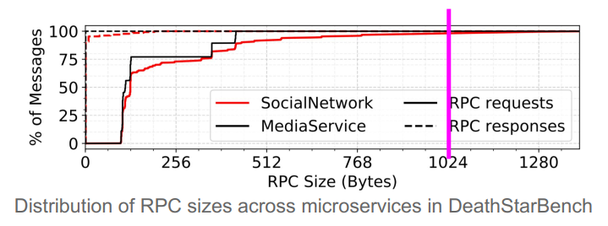
Design
Low-latency message channels
Why choosing 1KB as the message size?
Notes:
为什么选择1kb为信息的大小
在测试实验中发现1kb大小的信息已经可以几乎满足百分之百的需求

Slide 34
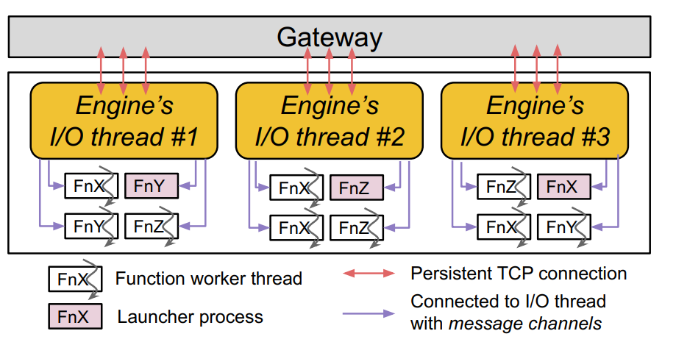
Design
Event-driven concurrency
Notes:
已经介绍完了本文对于延迟方面的改进
现在开始介绍关于并行度方面的改进
为了防止nightcore’s engine成为瓶颈，无法满足十万每秒的请求速率
通过多个 I/O线程满足调用需求，
外部调用的时候 网关和I/O线程通信，I/O在通过轮询的方式和fuction建立请求
内部调用的时候 也是通过I/O线程通信
在实验中发现4个线程就可以满足100K/s的调用率

Slide 35
Design
Managed Concurrency
Per-function concurrency target
Limiting concurrent execution
Prevent overuse of concurrency
Dynamically computed with input load
Notes:
介绍完了engine的并行度改进
现在介绍如何设置每个function的并行度
对于目标并行度要满足两个需求
1 防止并行度设置过高 导致 性能表现差
2 对于动态负载能够动态的调整

Slide 36
Design
Managed Concurrency
Ensures the maximum concurrency
Little’s law $concurrency target=\left(invocation rate\right)∗(function execution time)$
adapt to load variation
allow more than concurrent threads to exist in the pool
less than 2*concurrent threads
Notes:
计算公式为 调用率和平均执行时间

Slide 37
Design
Managed Concurrency
Ensures the maximum concurrency
Little’s law $concurrency target=\left(invocation rate\right)∗(function execution time)$
adapt to load variation
allow more than $concurrency target$to exist in the pool
less than 2* $concurrency target$
Notes:
为了适应动态的负载变化
防止频繁的线程创建和销毁带来的巨大开销
在线程池当中可以允许超过并行度目标数的线程存在
上限是两倍
这样可以有效的减少线程创建和销毁带来的开销

Slide 38
Outline
1
Background
2
Motivation
3
Design & Implementation
4
Evaluation
3
5
Conclusion
Notes:
下面继续由我来为大家介绍本文的evaluation部分

Slide 39
Evaluation
Environment
Amazon EC2 C5
Ubuntu 20.04
Linux kernel 5.4.41
Notes:
c5.2xlarge EC2 VM, which has 8 vCPUs and 16GiB of memory.
c5.xlarge EC2 instances for worker VMs, which have 4 vCPUs and 8GiB of memory

Slide 40
Evaluation
Systems for Comparison
RPC servers
OpenFaaS
Notes:
RPC servers ― non-serverless deployment of microservices
OpenFaaS ― a popular open source FaaS system

Slide 41
Evaluation
 | Ported services | RPC framework
Social Network | 11 | Apache Thrift
Movie Reviewing | 12 | Apache Thrift
Hotel Reservation | 11 | gRPC
HipsterShop | 13 | gRPC
Notes:
四个最真实、公开可用、交互式的微服务代码库
DeathStarBench [ASPLOS ‘19]一篇论文
SocialNetwork
MovieReviewing
HotelReservation
HipsterShop is a microservice demo from Google Cloud Platform

Slide 42
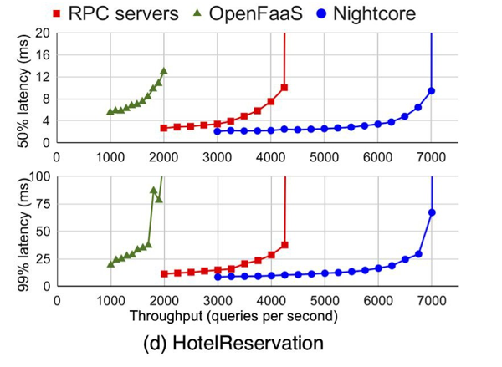
Evaluation

Slide 43
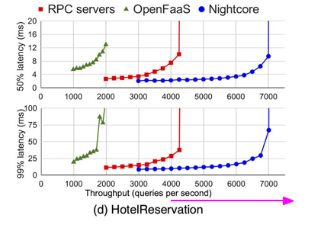
Evaluation

Slide 44
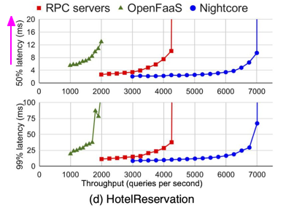
Evaluation

Slide 45
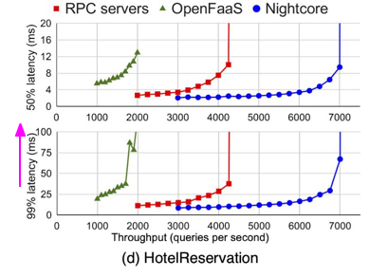
Evaluation

Slide 46
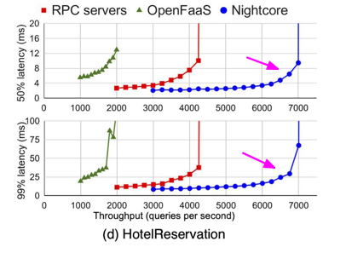
Evaluation

Slide 47
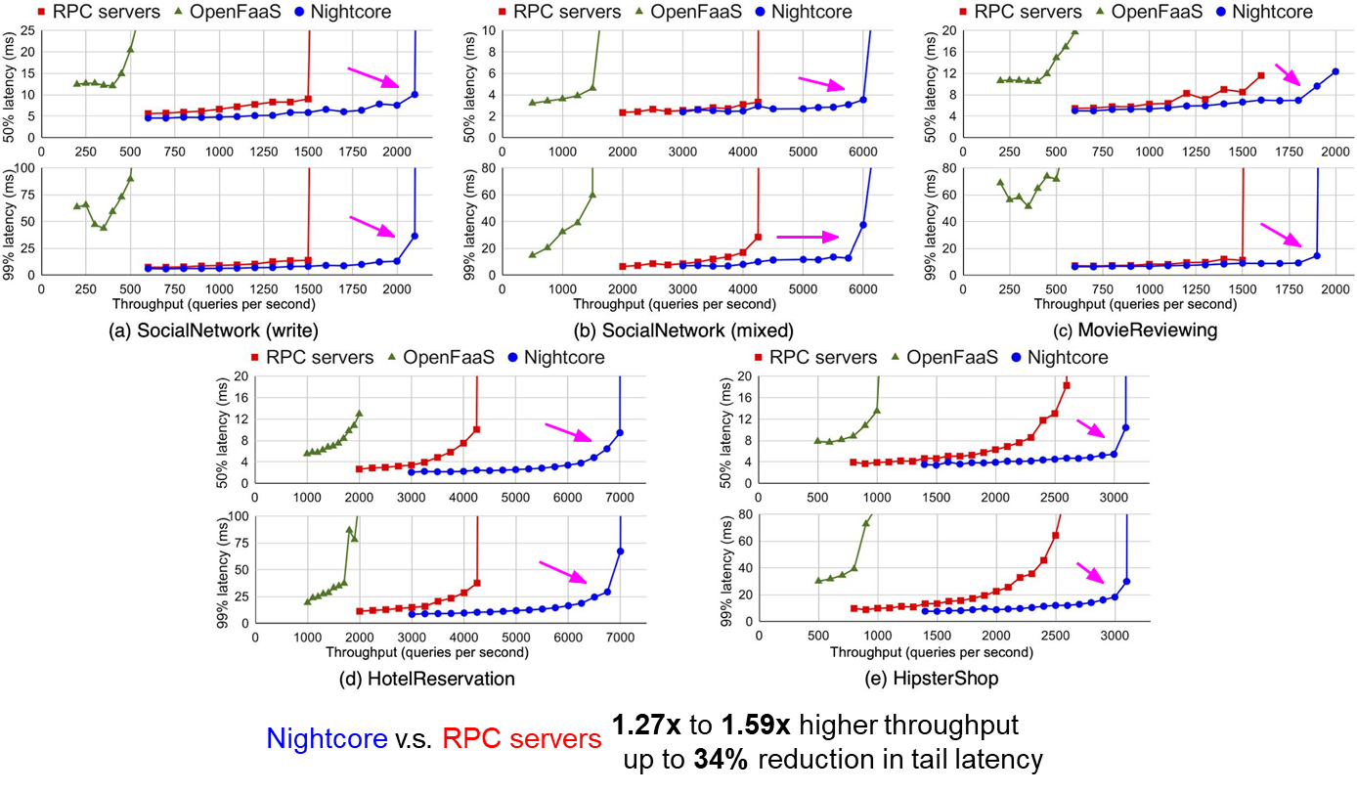
Evaluation

Slide 48
Evaluation

Slide 49
Evaluation

Slide 50
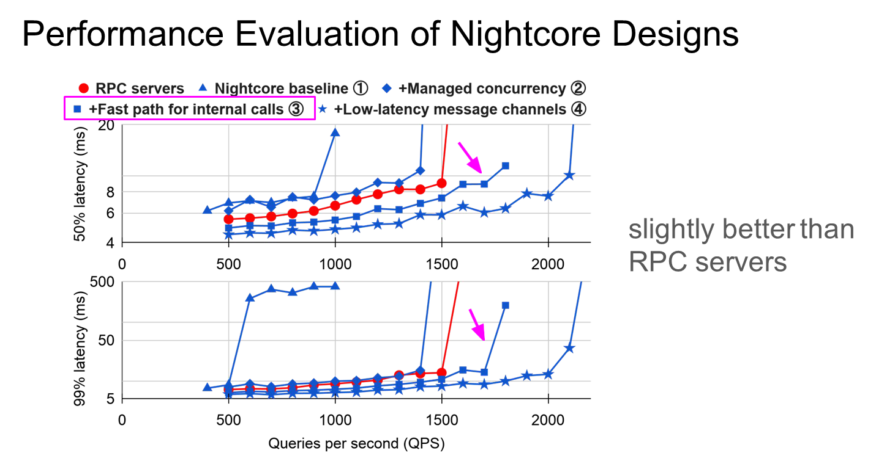
Evaluation

Slide 51
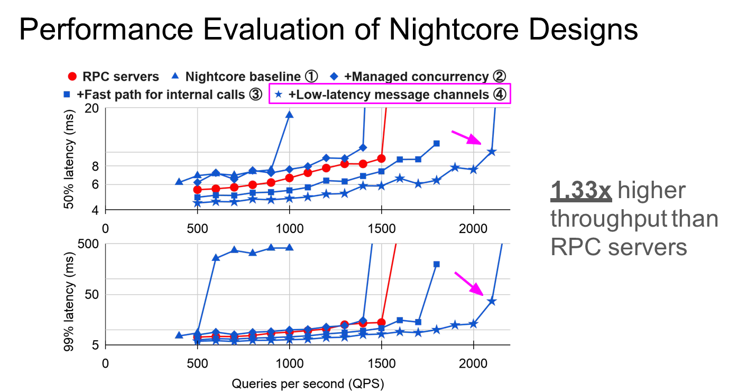
Evaluation

Slide 52
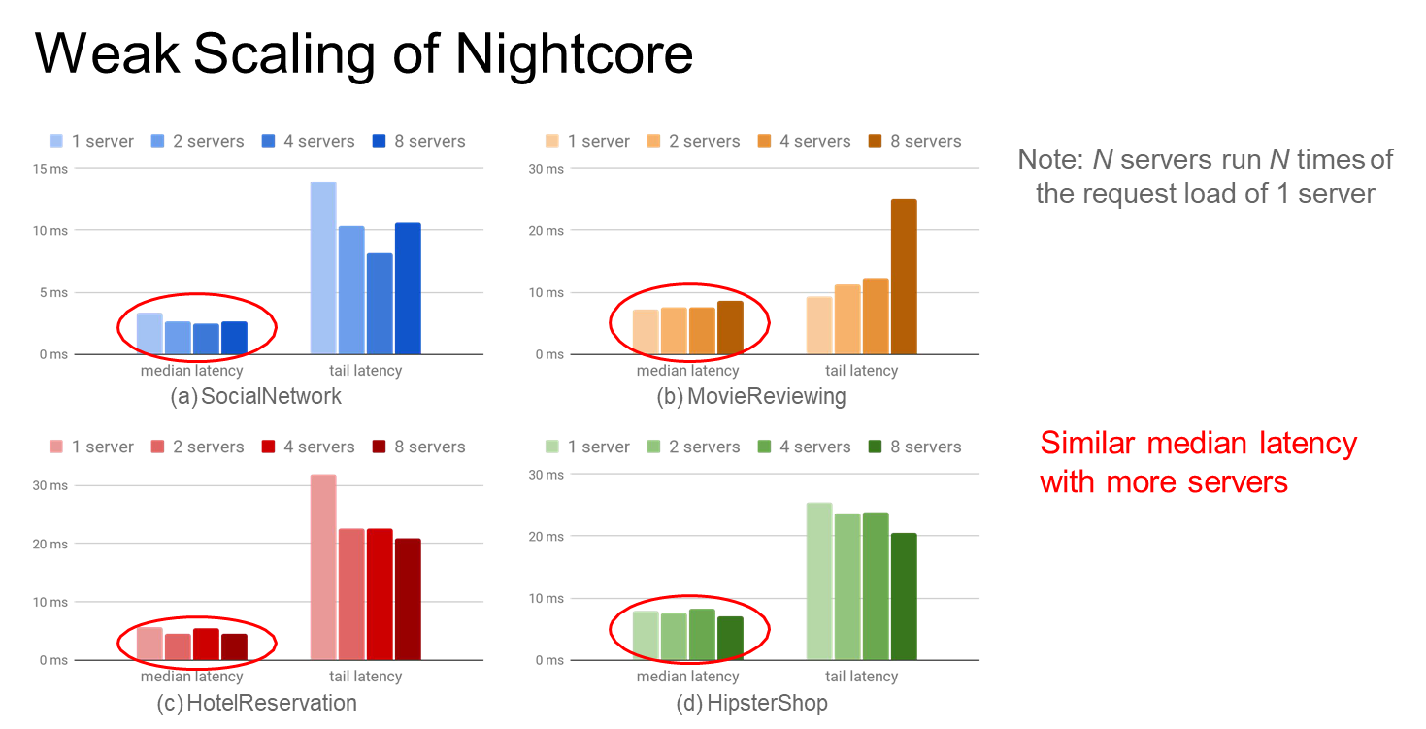
Evaluation

Slide 53
Evaluation

Slide 54
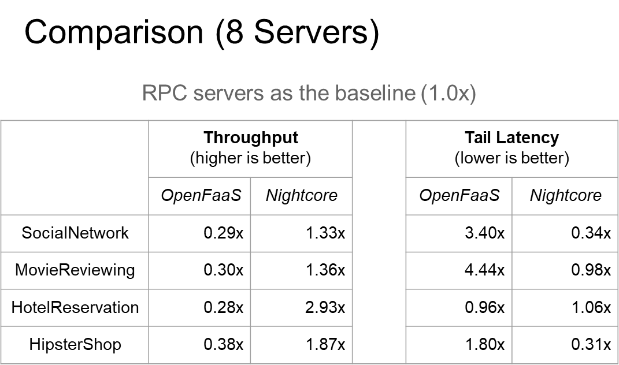
Evaluation

Slide 55
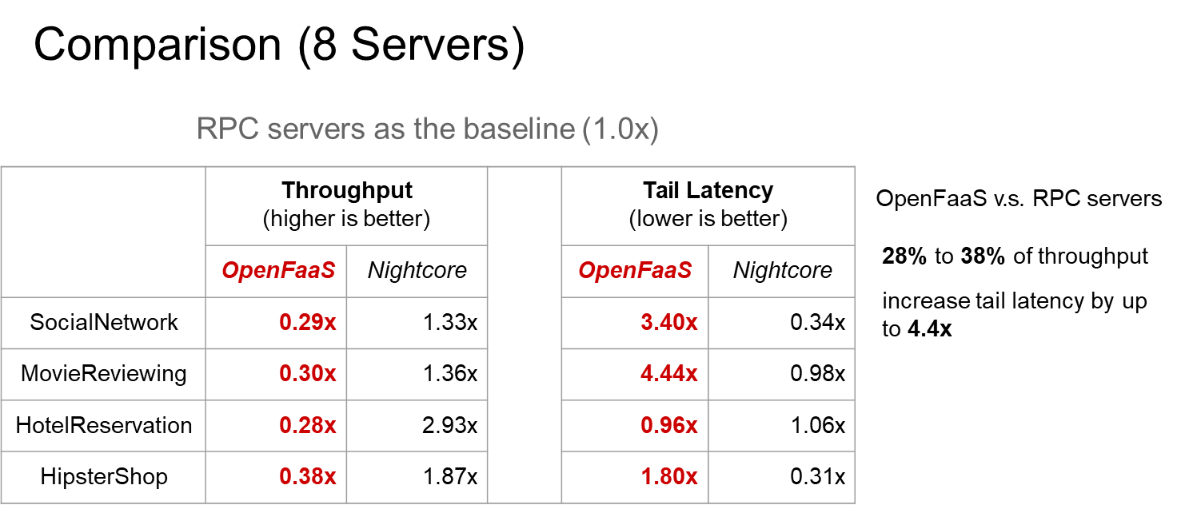
Evaluation

Slide 56
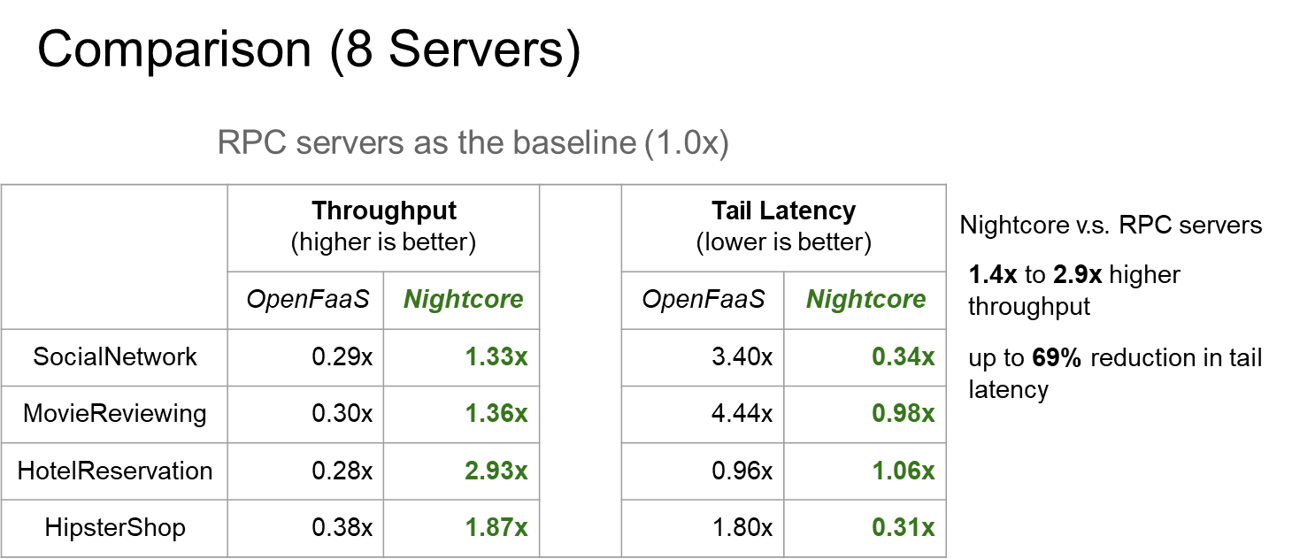
Evaluation

Slide 57
Outline
1
Background
2
Motivation
3
Design
4
Evaluation
3
5
Conclusion

Slide 58
Conclution
Nightcore is a FaaS runtime for μs-scale microservices
Nightcore includes diverse techniques to eliminate μs-scale overheads
Nightcore achieves 1.4x–2.9x higher throughput than containerized RPC servers, and up to 69% reduction in tail latency

Slide 59
THANK YOU

