Slide 1
Coupling Decentralized Key-Value Stores with Erasure Coding
SoCC 2019
Liangfeng Cheng, Yuchong Hu, and Patrick P. C. Lee.
the Chinese University of Hong Kong.
Shared by LingJiang Xie,QingPeng Du
Fall 2020

Slide 2
Talk about
Introduction
Propose chanllenges for scaling
FragEC as solutions
Experiment and Conclusion
Summary

Slide 3
Context
Decentralized KV-Store [Dynamo Memcached]
Data distributed via Consistent Hashing
Apply Cross-Coding approach
Unavoidable and Costly Scaling

Slide 4
Hashing-Scalability
271
272
273
300
Why use a hash ring ？
N1
N2
N3
3 201,273,300
200,272
1,91,202,271
201,273
200
201
202
203
1
2
3
2,92,200,203,272
202
N4
3,203,271
1
2
3
91
92

Slide 5
Consistent Hashing-Load Balance
Why use virtual nodes ？

Slide 6
Consistent Hashing-Load Balance
Why use virtual nodes ？

Slide 7
Erasure Coding versus Replica
Organize whole data into chunks and encode chunks as a stripe
Same fault-tolerancy but more efficient storage overhead
A
A
data chunk
B
B
A
chunk
C
C
Data
divide
encode
D
D
200%
B
stripe
C
A+C
A+C
parity chunk
B+D
B+D
D
A+D
A+D
B+C+D
B+C+D
Data
Data
replicate
Data
Data
Data
300%

Slide 8
Erasure Coding - RS(n,k)
Flexible trade off between fault-tolerance and storage efficiency by changing parameters (n,k)
Maximum Distance Separable(abbr . MDS) property
Encode
Decode
1
0
d1
1
0
d1
-1
Encode Matrix
0
1
d1
d2
1
0
d1
stripe
x
y
d2
p1
x
y
x
y
p1
p1
z
w
data
p2
d1
d2

Slide 9
Erasure Coding - Degraded Read
When transient failure happens , quite often
Include a whole stripe read and decode
GET : A
A
A
B
B
C
C
Decode
A
B
D
D
A+C
A+C
C
B+D
B+D
D
A+D
A+D
B+C+D
B+C+D

Slide 10
Erasure Coding - Coding Scheme
Self-Coding [eg HDFS ]
objects are split
Cross-Coding
objects are not split
for small objects [KV-Store Workloads Analysis , Facebook 2012]
Object
A
divide
B
encode
C
D
Object
Object
divide
encode
Object
Object

Slide 11
Scaling
Add/Remove a Node
Data-Node Remapping
Data Migration
a
b
c
d
f
g
h
i
parity

Slide 12
Scaling as Challenge
Parity Updating Cost
a
b
c
f
g
h
d
i
parity

Slide 13
Scaling as Challenge
Data Unavailability
a
b
c
?
GET : d
f
g
h
d
i
parity

Slide 14
Scaling as Challenge
Degraded Read Fail
a
b
c
GET : d
f
g
h
d
i
a
a
f
b
g
c
h
parity
d
d

Slide 15
Approach:FragEC
Decoupling the chunk-node mapping
Multiple hash rings and isolated chunks within a stripe.
Hierarchical Index structure for fast object/chunk/stripe locating.

Slide 16
Architecture
client
client
client
client
Proxy
buffer
buffer
buffer

Slide 17
Fragmented Chunk
Allow fragmented sub-chunks that logically belonging to the same chunk.
No Parity Update Cost!
a
b
c
a
f
b
g
parity
c
h
f
g
h
d
i
d
i
parity

Slide 18
Multiple Hash Rings
multiple hash rings to deal with degraded read during scaling
GET : b GET : f GET : c
Proxy
a
b
c
d
f
g
h
i

Slide 19
Multiple Hash Rings
GET : i
4
Proxy
3
1
d
i
2
2
a
b
c
d
f
g
h
i
i

Slide 20
Hierarchical Index
Hierarchical Index for fast locating
length
offset
stripe id
chunkindex
stripe
index
object 1
object 4
object 3
object index
object 5
chunk1ID
chunk2ID
chunk3ID
object 2
......
object index reference list

Slide 21
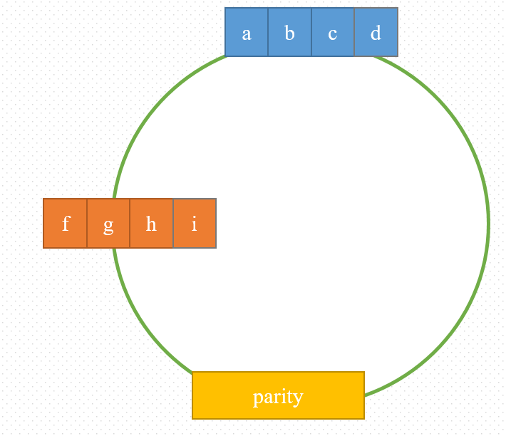
ECHash Design
Node Failure?
N2
N1
d
i
p
N3

Slide 22
ECHash Design
Node Failure?
N2
a
b
c
N1
N4
d
i
p
f
g
h
d
i
parity
N3

Slide 23
ECHash Design
Design Goals:
No parity updates during scaling
Efficient degraded reads
Eifficient node repair

Slide 24
Architecture
client
client
client
client
server
server
server
server
server
server
server
server
server
hash ring

Slide 25
Architecture
a
b
c
d
object size
multiple hash ring

Slide 26
Architecture
All the nodes are dispersed
1 hash ring contains at least 1 node
Scaling occurs no more than (n-k) rings

Slide 27
Basic Requests
Object selects a hash ring via hash(key) mod n
Proxy appends the value of each object to the buffer
Write
Read
Update
Delete

Slide 28
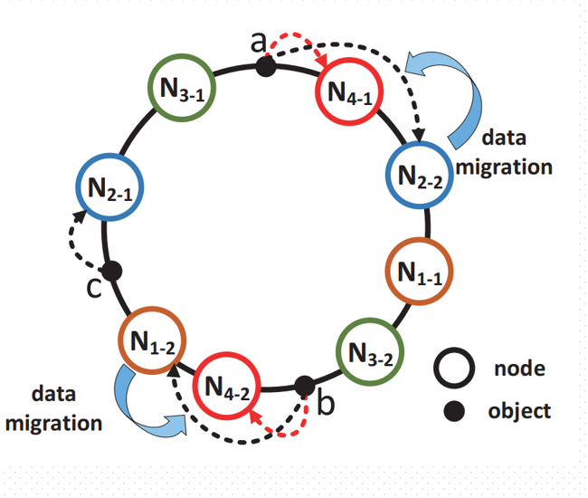
Scaling
N1
N9
N1
N3
N1
N3
N3
N7
N7
N7
N9
N9

Slide 29
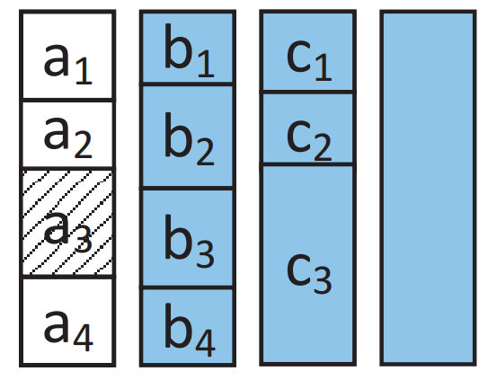
Node Repair
Notes:
刚才说到ECHash实现的一个目标是更高效的节点修复，在传统的EC里面，条带修复需要动用至少k个chunk，我们以这张图的3数据块1校验块的EC为例，如果只是失去了a3，就需要读取整个b1b2b3b4,c1c2c3和整个校验块来进行修复，一个块的大小可能是kb级的，但一个对象可能只有几个字节，这样修复导致的额外开销是非常大的。右下图是之前我们提到的FragEC的索引，利用它我们可以直接取出a3的所在chunk，长度和偏移量，通过长度和偏移量我们可以直接确定真正参与a3解码只需取出哪些对应的部分数据就可以了，在这个例子中，bc数据块只有b2b3和c3需要取出。对于校验块，当前的ECHash实现的方式是整个parity全部取出，不过作者也提到了想要在之后实现只取对应部分的校验数据，像这样，可以把修复开销压得更低。

Slide 30
Degraded Reads
Data2
Parity
d e f
Data1
Chunk index
N2
N1
N9
N5
N7
N3
N6
N8
N4
Stripe metadata
Stripe index
Object index
Object index
Object index
Notes:
最后我们来借助一个流程图理解一下在ECHash模型中降级读的执行方式。如上，abc组成的数据块1，def组成的数据块2以及他们编码生成的校验块被分散在3个哈希环上。同一个环内的数据因为缩放的影响不一定在同一个节点上。这时如果a因为各种原因无法读取，代理会在a对应的环的对象索引中找到它的条带数据，然后对于对应解码的数据块，比如这个例子中的def，可以查到它的块索引，下一步，需要取出的数据块从块索引读取出来，而校验快不需要chunk index，从条带索引即可取出；最后，使用a的长度和偏移量在存储中恢复对应数据，就完成了。到这里，Echash的三个功能就都实现了，

Slide 31
Evaluation
Implementation:
Extend libMemcached with about 3,600 SLoC in C++ on Linux – ECHash
Extend Memcached and implement the cross-coding scheme used in existing erasure-coded Memcached systems – ccMemcached
Vanilla Memcached without erasure coding
Notes:
然后我们来简单的看一看实验部分。作者通过3600行代码来扩展libmamcache实现了echash，并且为普通的memcache实现了现有的crosscoding策略，命名为ccmemcached，来比较他提出的方案的提升效果；此外，Vanilla作为非EC的baseline比较一下使用EC之后部分性能下降的是否明显。

Slide 32
Evaluation
Local Setting:
7 physical machines(1 proxy, 1 backup proxy, 5 servers)
8-core Intel(R) Xeon(R) CPU E5- 2630 v3 @ 2.40 GHz
100 GiB of RAM, interconnected via a 10 Gb/s network.
An additional MySQL-5.1.71 database
45 Memcached instances among the five servers

Slide 33
Evaluation
compare Vanilla, ccMemcached, and ECHash in terms of throughput

Slide 34
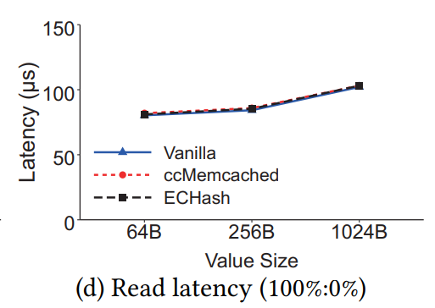
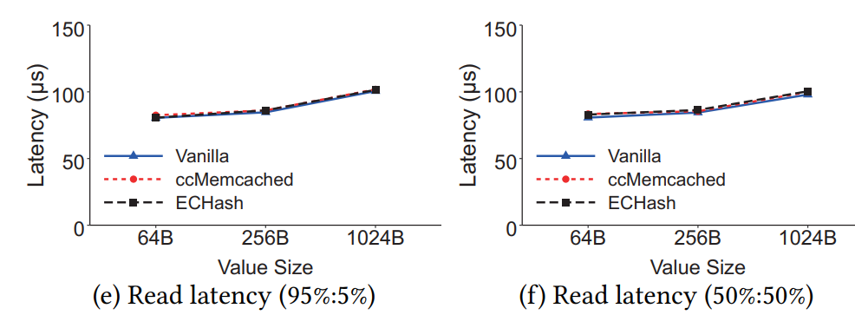
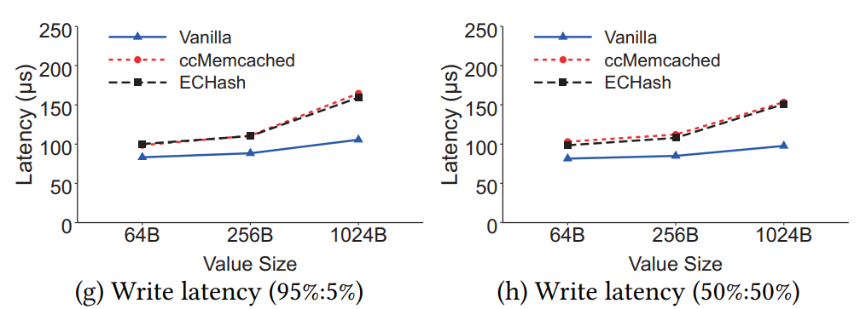
Evaluation

Slide 35
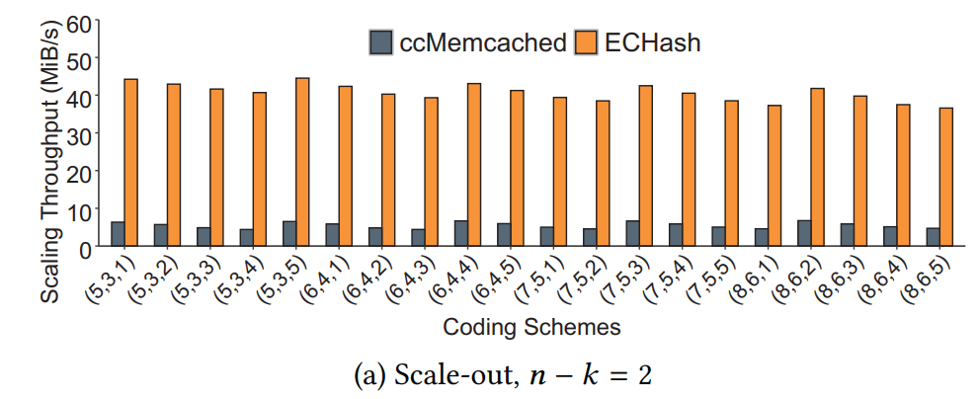
Evaluation
scaling throughput

Slide 36
Evaluation

Slide 37
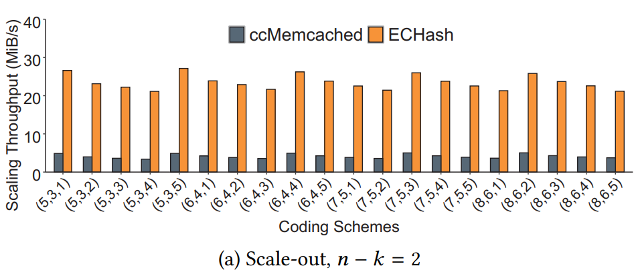
Evaluation
Cloud Setting:
On Amazon Cloud (EC2 and Elasticache)
45 cache.r4.large Memcached instances of Elasticache
3 m5d.2xlarge instances has less improvement in the scaling performance in the cloud setting.
ECHash has less improvement in the scaling performance in the cloud setting.

Slide 38
Coupling Decentralized Key-Value Stores with Erasure Coding
Thanks

