Slide 1
FusionRAID: Achieving Consistent Low Latency for Commodity SSD Arrays
FAST 2021
Tianyang Jiang, Guangyan Zhang, and Zican Huang, Tsinghua University; Xiaosong Ma, Qatar Computing Research Institute, HBKU; Junyu Wei, Zhiyue Li, and Weimin Zheng, Tsinghua University
shared by Lingjiang Xie , Yuan Zeng , USTC
September 22nd, 2021
2020/4/17

Slide 2
Outline
Background
Motivation
Design
Evaluation
Conclusion
2020/4/17

Slide 3
Outline
Background
Motivation
Design
Evaluation
Conclusion
2020/4/17

Slide 4
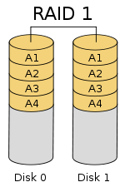
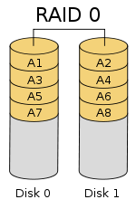
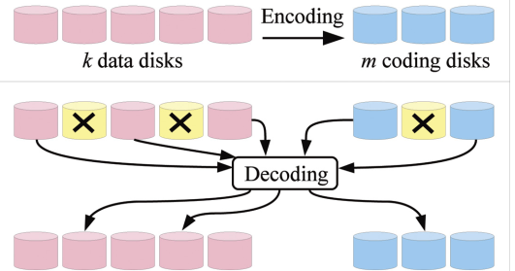
Brief intro to RAID
RAID: Redundant Array of Independent Disks
Basic idea is to connect multiple disks together to provide:
- Large storage capacity
- Faster access to reading data
- Redundant data
3 Key Concept
Mirroring - Data Stripping - Data parity
Notes:
https://www.purestorage.com/knowledge/what-is-an-all-flash-array.html

Slide 5
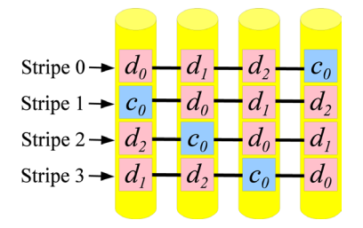
RAID-5
• Balance the tradeoff between reliability and storage cost - Redundancy with parities • Parity generation:
- Each parity block is the XOR value of the corresponding data disks • Data striping - Data and parity blocks are distributed across disks
• RAID 5 is an ideal combination of :
good performance
good fault tolerance
high capacity
storage efficiency

Slide 6
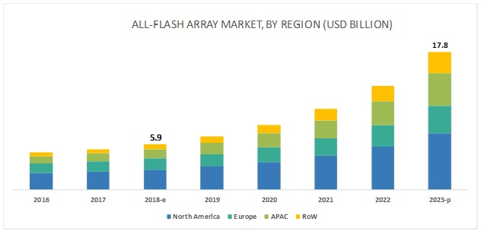
All Flash Arrays on Rise
What is AFAs
- An all-flash array (AFA) is a storage infrastructure that contains only flash memory drives instead of spinning-disk drives.
A rapidly growing of AFAs Market
- The overall AFA market was valued at USD 5.9 billion in 2018 and is expected to reach USD 17.8 billion by 2023, at a CAGR of 24.53% during this period
- Major growth drivers are increasingly being used in data centers.
Data source : https://www.marketsandmarkets.com/Market-Reports/all-flash-array-market-41080938.html
Notes:
https://www.marketsandmarkets.com/Market-Reports/all-flash-array-market-41080938.html

Slide 7
Outline
Background
Motivation
Design
Evaluation
Conclusion
2020/4/17

Slide 8
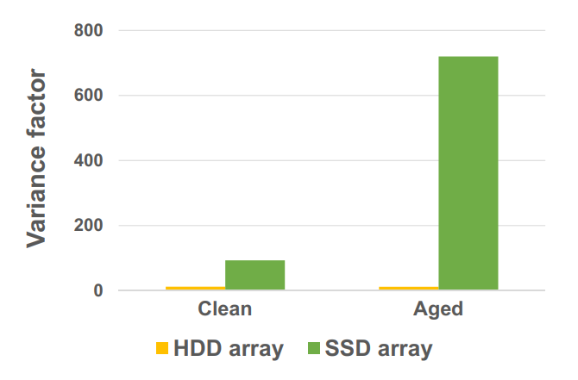
SSD Arrays Performance Problem
Higher latency variability compared to HDD RAID
Higher tail-to-median latency ratio than HDD
Furter agitated by disk aging
Testing to illustrate above problem
2 software RAID-5 arrays Built on Seagate HDDs and Intel commodity consumer SSDs
Running Write-intensive Exchange trace from Microsoft Production Server Traces
- Smaller median latency , higher Variance factor
Deteriorates significantly when aged
Not specific to software RAID

Slide 9
SDD RAID Latency Source Study
Workload I/O Characteristics
Workload usually irregular , with interleaving bursts
Guide : All-for-all model is better than physically partitioning
Write Overhead in SSD RAID
SSD RAID writes suffer significant software overhead
Guide : shorter write path is desirable
Pathological Latency Spikes of SSDs
SSD performance anomaly common , and latency spikes tall and lasting enough
Guide : spikes can be and should be detected at runtime to redirect incoming requests.

Slide 10
Outline
Background
Motivation
Design
Evaluation
Conclusion
2020/4/17

Slide 11
Overview of FusionRAID
Design Rationale
- Guide : All-for-all model is better than physically partitioning
- Spreading requests to all SSDs in a shared , large storage pool .
Guide : shorter write path is desirable
Performing temporary , replicate writes .
Guide : spikes can be and should be detected at runtime .
Using lightweight SSD latency spike detection and request redirection .

Slide 12
Shared Storage Pool
Fusion logical address space
Notes:
大家好，现在我来接着为大家讲解一下本文中的ECHash的Design部分。承接之前的部分，我们知道了：设计并使用FragEC模型能够解决现在一致性哈希环境下的缩放会使EC的校验数据大量更新的问题，但是这却带来了另一些问题，那就是由于逻辑上参与编码运算的数据块在实际物理存储中可能位于同一节点上，这会导致EC失去原本的容错性能。比如现在右边这张图，通过EC编码，abcd fghi这些数据在N1N2N3上组成了一个条带并且生成了对应的parity，通过聚集任意两个chunk便可还原剩余的数据，例如d和i不论损失哪一个块都可以通过另一个块和parity的计算得到恢复。

Slide 13
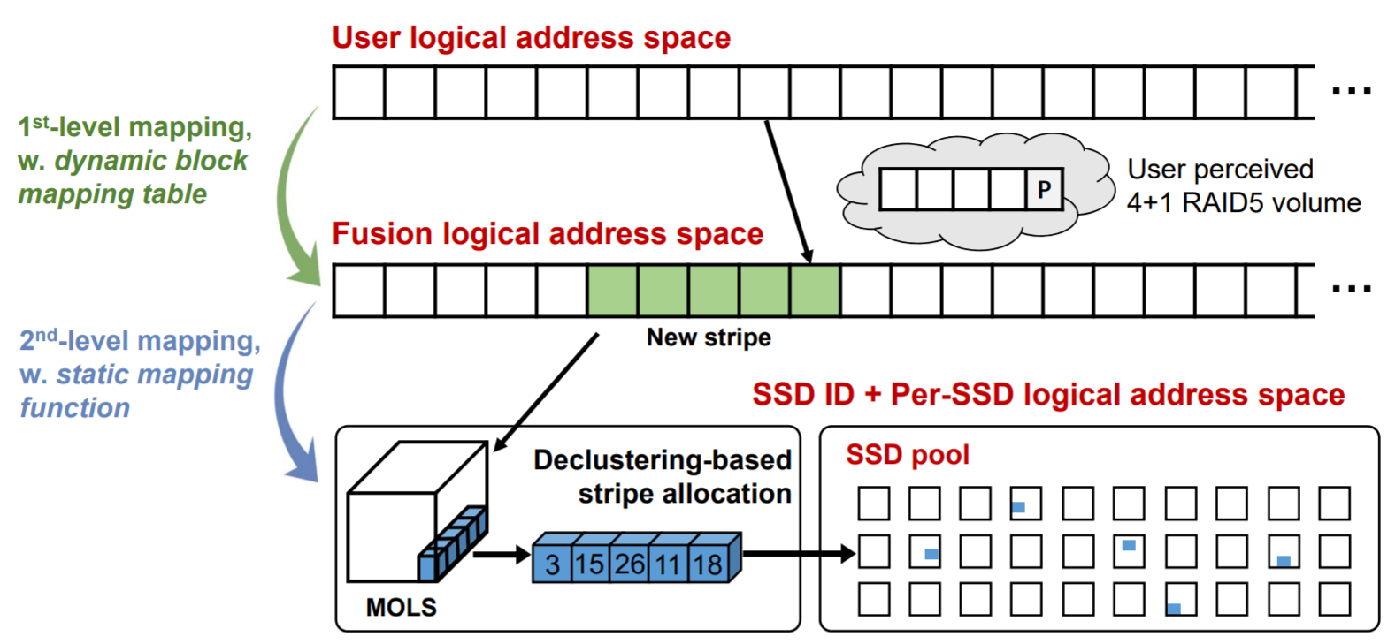
Shared Storage Pool
Fusion logical address space
RAID+,[FAST18]
Notes:
大家好，现在我来接着为大家讲解一下本文中的ECHash的Design部分。承接之前的部分，我们知道了：设计并使用FragEC模型能够解决现在一致性哈希环境下的缩放会使EC的校验数据大量更新的问题，但是这却带来了另一些问题，那就是由于逻辑上参与编码运算的数据块在实际物理存储中可能位于同一节点上，这会导致EC失去原本的容错性能。比如现在右边这张图，通过EC编码，abcd fghi这些数据在N1N2N3上组成了一个条带并且生成了对应的parity，通过聚集任意两个chunk便可还原剩余的数据，例如d和i不论损失哪一个块都可以通过另一个块和parity的计算得到恢复。

Slide 14
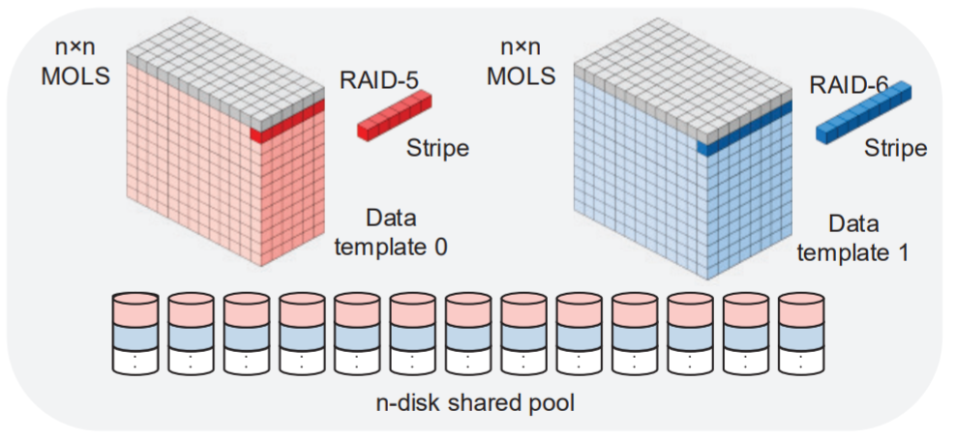
Storage Organization
RAID+：spreading both normal I/O and reconstruction workloads to a larger disk pool in a balanced manner.
Mapping table: 0.0084% of storage capacity
Notes:
Raid+是作者组的前一工作，由于篇幅有限，这里我们只简述它的作用；
它通过设计的正交拉丁阵将条带内的各个块映射到不同的硬盘，保证条带数据的容错，同时使宏观上的数据尽量均匀的散布，使得工作负载均匀，如图上所示，它也支持同时处理不同的raid策略。
通过这一部分的优化，fusionRAID首先实现了数据在ssd池中的均匀化存储。

Slide 15
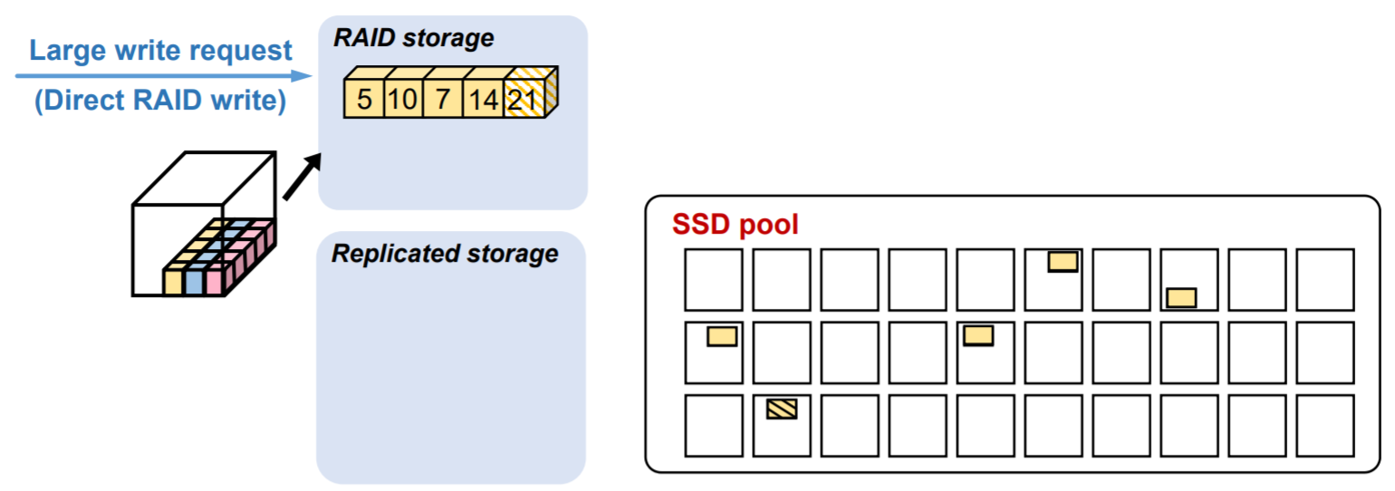
Two-phase Write Operations
avoids the dependency brought by the read-compute-write process
21
5

Slide 16
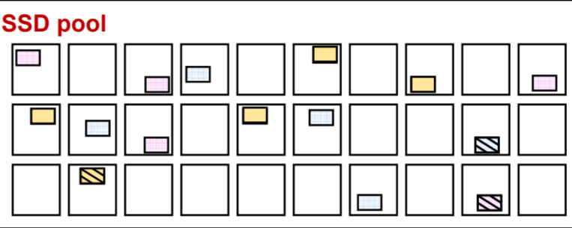
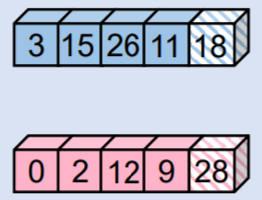
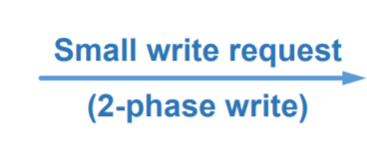
Two-phase Write Operations
FusionRAID performs its two-phase writes selectively.

Slide 17
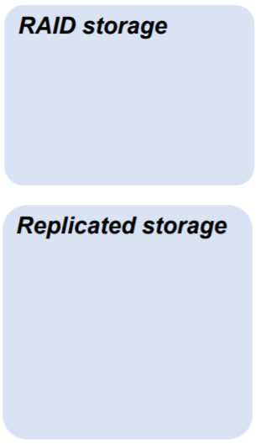
Two-phase Write Operations
RAID stripes: more space efficient

Slide 18
Two-phase Write Operations
The replicated blocks already form two valid stripes according to FusionRAID’s MOLS-based template.
Notes:
这样也可以继续沿用前一个设计中的分布策略，不用重新考虑如何让数据均匀分布的问题

Slide 19
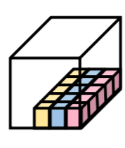
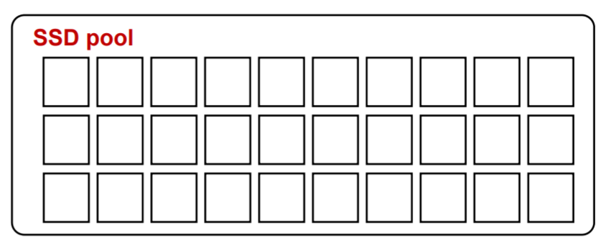
Two-phase Write Operations
Blocks in the same stripe need to sit on two different SSDs.
The replicated blocks need to sit on two different SSDs.
A
B
C
D
P
?
A
B
C
D
P
Notes:
这样也可以继续沿用前一个设计中的分布策略，不用重新考虑如何让数据均匀分布的问题

Slide 20
Two-phase Write Operations
Solution: selecting a pair of stripes with the fewest common disk IDs.
3,5,7,8,9
A
B
C
2,3,5,7,9
1,2,3,7,8
A
B
C
1,4,5,6,9
cycles through the common disk IDs list
Notes:
这样也可以继续沿用前一个设计中的分布策略，不用重新考虑如何让数据均匀分布的问题

Slide 21
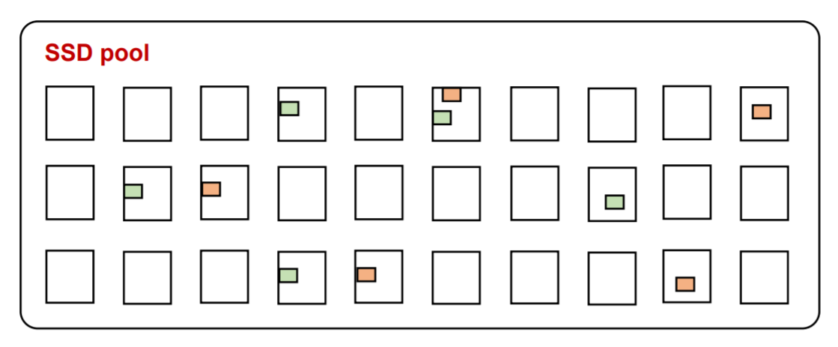
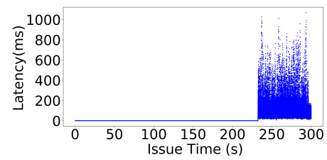
Spike Detection & Request Redirection
Applications suffer sudden surges in request latency when the underlying SSD devices undergo activities such as GC.
Notes:
这样也可以继续沿用前一个设计中的分布策略，不用重新考虑如何让数据均匀分布的问题

Slide 22
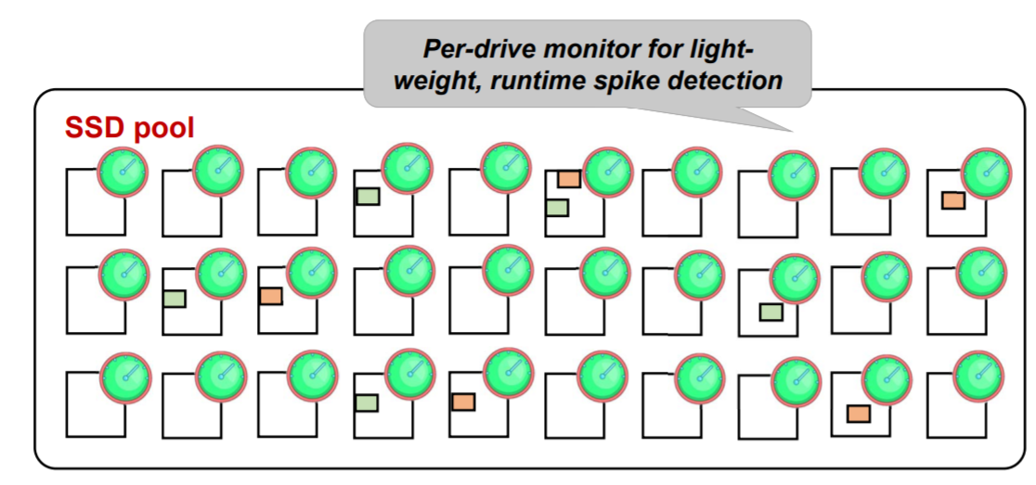
Spike Detection & Request Redirection
when latency spikes are detected: Performs constant SSD responsiveness monitoring and request diversion.
counter
timeslot
Notes:
这样也可以继续沿用前一个设计中的分布策略，不用重新考虑如何让数据均匀分布的问题

Slide 23
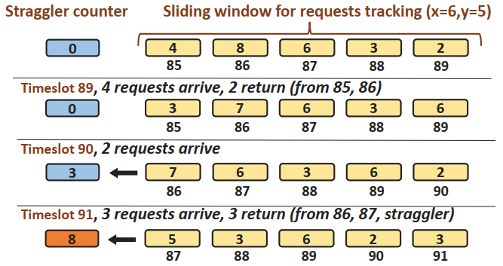
Spike Detection & Request Redirection
-1
-1
+4
-1
-1
-1
New request
New request
Notes:
这样也可以继续沿用前一个设计中的分布策略，不用重新考虑如何让数据均匀分布的问题

Slide 24
Request diversion
Write: searches along the spare block pair or stripe list till it finds one not involving any unresponsive SSD.
Read:
RAID area – reconstruct data from all the remaining blocks in the stripe
replicated area –
reads from the faster of the blocks.
slow
fast
slow
fast
slow
Data reconstruction
fast
fast
fast

Slide 25
Outline
Background
Motivation
Design
Evaluation
Conclusion

Slide 26
Experiment Setup
· Testbed
· RAID System
- Commercial RAID : 4-RAID5 , RAID50
- Latest RAID in paper : ToleRAID(FAST’16) , LogRAID (SYSTOR’14 , ATC’19)

Slide 27
Overall Performance

Slide 28
Impact of individual techniques
4-RAIDM : 4-RAID5 + Replicate Write
Fusion-ND ：Fusion – spike detection

Slide 29
Clean vs Aged

Slide 30
Outline
Background
Motivation
Design
Evaluation
Conclusion

Slide 31
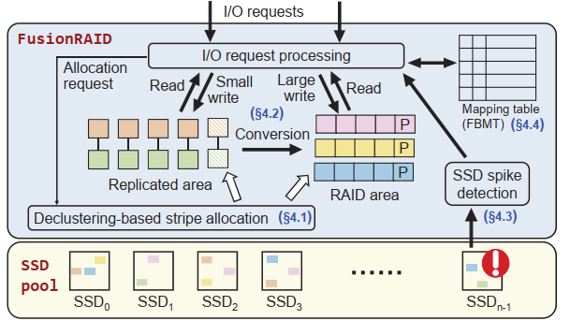
Conclusion
Summary
- Spreading requests to all SSDs in a shared , large storage pool .
- Performing temporary , replicate writes .
Using lightweight SSD latency spike detection and request redirection .

Slide 32
FusionRAID: Achieving Consistent Low Latency for Commodity SSD Arrays
Thanks

Slide 33
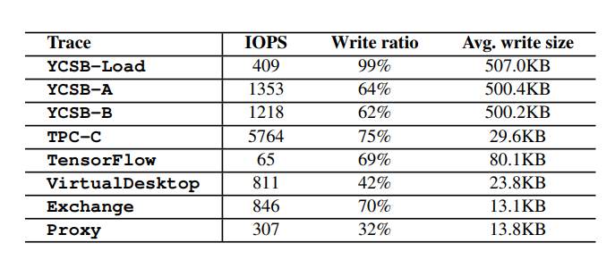
Workload I/O Characteristics
Workload Parameters
Some Definition
Mixed workload partition: giant set & dwarf set
Majority ratio ($R_{maj}$): Instantaneous bandwidths of giant set / entire
Instantaneous complementarity: $R_{maj}$ > 0.75 in a timeslot (1ms)
Notes:
后三者来自Microsoft and SPC trace collections

Slide 34
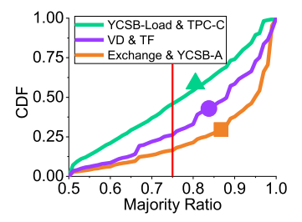
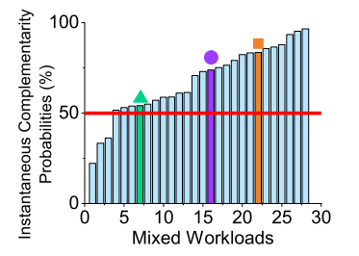
Workload I/O Characteristics
3 types of 2-Workload Mixes
light-light (VD +TF) workload mixes
heavy-heavy mix (YCSB-Load +TPC-C)
light-heavy (Exchange +YCSB-A)
54.1%
73.9%
83.6%
Instantaneous complementarity appears in all types!
All 2-Workload Mixes
25 out of the 28 have instantaneous complementarity in over half of the timeslots .
An average ratio across all 28 mixes sitting at 67.8% .
Across all 4-workload mixes, this average ratio rises to 91.4% .
Instantaneous complementarity appears frequently!
Notes:
后三者来自Microsoft and SPC trace collections

Slide 35
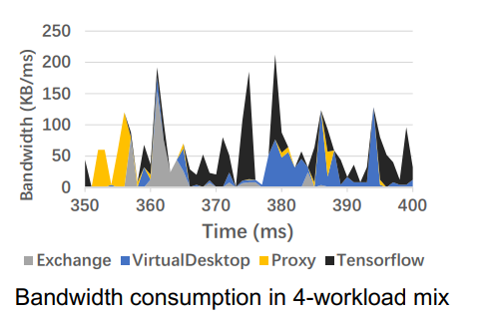
Workload I/O Characteristics
4-Workload Mixes Breakdown
2-Workload Mixes
Workload usually irregular , with interleaving bursts
Guide : All-for-all model is better than physically partitioning
Notes:
后三者来自Microsoft and SPC trace collections

Slide 36
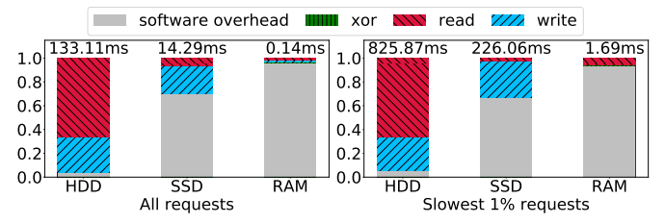
Write Overhead in SSD RAID
Configuration
- (4 + 1) RAID-5 arrays
- Intel 545s SATA SSDs
- Seagate 7200RPM SATA HDDs
- RAM disks
- Workload: Microsoft Enterprise Exchange
Much higher relative overhead than HDD and Much higher absolute overhead than RAM .
SSD’s software overhead mainly caused by synchronization .
Guide : A shorter write path , with fewer dependencies , is desirable .
Notes:
Numbers at the top of the bars give the average latency values for each group.

Slide 37
Pathological Latency spikes of SSDs
SSDs Parameters

Slide 38
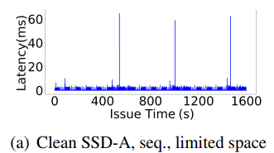
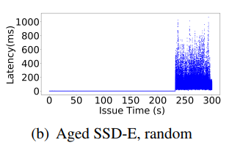
Pathological Latency spikes of SSDs
Consumer SSDs
DRAM buffer flush
GC
GC spikes both higher (21×) and long-lasting (18×) .
There are obvious intervals between spikes .
Further, aged SSDs see more severe and frequent spikes .
DC SSDs
GC
Periodic latency spikes are not seen under sequential write workload.
Once GC is triggered , the latency goes far beyond 100ms.
Spikes cannot be divided strictly.

