Slide 1
An Empirical Guide to the Behavior and Use of
Scalable Persistent Memory
Jian Yang, Juno Kim, and Morteza Hoseinzadeh, UC San Diego;
Joseph Izraelevitz, University of Colorado, Boulder; Steve Swanson, UC San Diego
Presenters: Jingbo Su, Luofan Chen

Slide 2
Today’s agenda
Motivation
Performance Characterization
Comparison to Emulation
Best Practices for Optane DIMM
Case Study
Conclusion

Slide 3
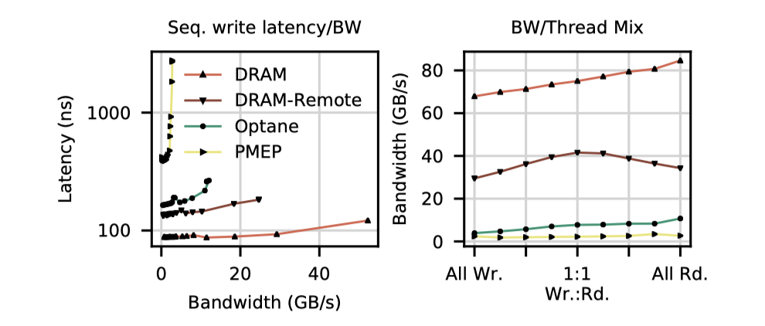
Background
Previous papers made design decisions based on
NVDIMM has lower bandwidth and higher latency
Many assumptions are incorrect……

Slide 4
Optane Overview
Sits on memory bus, conntected to iMC
NVDIMM
Higher density and persistence
128, 256, 512GB
Memory address-based interface

Slide 5
Optane platform
Casecade Lake
Each die: 2 iMCs
Each iMC: 3 channels
Far Mem
Near Mem
AppDirect Mode
Optane DIMM
DRAM
Interleaved
Core
Core
Optane DIMM
L1 & L2
L1 & L2
Optane DIMM
Optane DIMM
DRAM
Optane DIMM
2 Operation Modes
Memory Mode
AppDirect Mode
LLC Cache
DRAM
Optane DIMM
DRAM
Mesh Interconnect
DRAM
iMC
iMC
Direct-Mapped Cache
(4KB Block)
DRAM
Memory Mode

Slide 6
Operation modes
Memory Mode
Expand Main Memory
Volatile
DRAM as cache
Far Mem
Near Mem
AppDirect Mode
Optane DIMM
DRAM
Interleaved
Core
Core
Optane DIMM
L1 & L2
L1 & L2
Optane DIMM
Optane DIMM
DRAM
Optane DIMM
LLC Cache
DRAM
Optane DIMM
DRAM
Mesh Interconnect
DRAM
iMC
iMC
Direct-Mapped Cache
(4KB Block)
DRAM
Memory Mode

Slide 7
Operation modes
Memory Mode
Expand Main Memory
Volatile
DRAM as cache
Far Mem
Near Mem
AppDirect Mode
Optane DIMM
DRAM
Interleaved
Core
Core
Optane DIMM
L1 & L2
L1 & L2
Optane DIMM
Optane DIMM
DRAM
Optane DIMM
App Direct Mode
Separate, persistent
Does not use DRAM cache
Needs file-system
LLC Cache
DRAM
Optane DIMM
DRAM
Mesh Interconnect
DRAM
iMC
iMC
Direct-Mapped Cache
(4KB Block)
DRAM
Memory Mode
In both modes, Optane DIMMs can be interleaved.

Slide 8
Interleaving
CPU
Optane DIMM #0
Core
Core
Optane DIMM #3
Optane DIMM #1
Optane DIMM #4
LLC Cache
Optane DIMM #2
Optane DIMM #5
iMC
iMC
PhyAddr Offset: 0
24KB
Stripe size
……..
#DIMM:
#2
0
#3
0
#1
0
#5
0
#0
0
#4
0
#2
4K
#3
4K
DIMM Addr:
4KB
Interleaving size

Slide 9
Architecture
ADR Domain
Ensure data persistency
i.e. flush data to NVDIMM within 100us
iMC maintains read and write queue
Flush to NVM on power failure
Connect to Optane using DDR-T interface
iMC
From CPU
Queues
WPQ:
ADR Domain
DDR-T
Cacheline: 64B
Optane DIMM
Controller
DRAM
Buffer:
AIT Cache
XPLine: 256B
3D-Xpoint Media
AIT

Slide 10
ISA Support
clflush, clflushopt
instructions to flush cache lines back to memory
clflushopt having weaker ordering constraints,
clwb can write back (but not evict) cache lines.
software can use non-temporal stores (e.g., ntstore) to bypass the cache hierarchy and write directly to memory.
sfence ensure that a previous cache ﬂush, cache write back, or non-temporal store is complete and persistent.

Slide 11
Experimental Configuration
24core Cascade Lake engineering sample
similar spec as Xeon Platinum 8160.
384 GB (2 socket × 6 channel × 32 GB/DIMM) of DRAM
3 TB (2 socket × 6 channel × 256 GB/DIMM) of NVMM.
Fedora 27
Linux kernel version 4.13.0 built from source.

Slide 12
Today’s agenda
Motivation
Performance Characterization
Comparison to Emulation
Best Practices for Optane DIMM
Case Study
Conclusion

Slide 13
Goal and Challenge
Goal: measure Optane’s performance along multiple axes to provide the intuition and data that programmers and system designers will need to effectively utilize Optane
Challenge:
underlying technology --> major differences from DRAM
publicly-available documentation --> scarce
existing tools --> locality and access size
Optane --> memory interleaving and concurrency
Tool: LATTester (https://github.com/NVSL/OptaneStudy)

Slide 14
LATTester Configuration and Parameters
Config: run as a dummy file system in the kernel and accesses pre-populated (i.e., no page-faults) kernel virtual addresses of Optane DIMMs
Config: pins the kernel threads to fixed CPU cores and disables IRQ and cache prefetcher
Config: collects a large set of hardware counters at both the CPU and NVDIMM
Parameters including
access patterns (random vs. sequential)
operations (loads, stores, fences, etc.)
access size
stride size
power budget
NUMA configuration
address space interleaving

Slide 15
Typical Latency
Read and write latencies are key memory technology parameters
Measurements reflect the load and store latency as seen by software rather than those of these underlying memory devices
Figure 2: Best-case latency. An experiment showing random and sequential read latency, as well as write latency using cached write with clwb and ntstore instructions. Error bars show one standard deviation.

Slide 16
Typical Latency
Config: Timing the average latency for individual 8-byte load instructions to sequential and random memory addresses
T_{load} = T_{on-chip interconnect} + T_{iMC} + T_{XPController} + T_{3D-XPoint media}
empty the CPU pipeline and issue a memory fence between measurements
Figure 2: Best-case latency. An experiment showing random and sequential read latency, as well as write latency using cached write with clwb and ntstore instructions. Error bars show one standard deviation.

Slide 17
Typical Latency
Config: Load the cache line into the cache and then measure the latency of one of two instruction sequences:
Write(clwb): a 64-bit store, a clwb, and an mfence;
Write(ntstore): a non-temporal store followed by an mfence.
Figure 2: Best-case latency. An experiment showing random and sequential read latency, as well as write latency using cached write with clwb and ntstore instructions. Error bars show one standard deviation.

Slide 18
Typical Latency
Most of this difference is due to Optane’s longer media latency
2×–3×
Figure 2: Best-case latency. An experiment showing random and sequential read latency, as well as write latency using cached write with clwb and ntstore instructions. Error bars show one standard deviation.

Slide 19
Typical Latency
Optane memory is also more pattern-dependent than DRAM. This gap is a consequence of the XPBuffer
80%
20%
Figure 2: Best-case latency. An experiment showing random and sequential read latency, as well as write latency using cached write with clwb and ntstore instructions. Error bars show one standard deviation.

Slide 20
Typical Latency
For stores, the memory store and fence instructions commit once the data reaches the ADR at the iMC
Non-temporal stores are more expensive than writes with cache flushes (clwb)
similar latency
Figure 2: Best-case latency. An experiment showing random and sequential read latency, as well as write latency using cached write with clwb and ntstore instructions. Error bars show one standard deviation.

Slide 21
Typical Latency
The first cache line access loads the entire XPLine into XPBuffer, and the following three accesses read data in the buffer
higher variances
Figure 2: Best-case latency. An experiment showing random and sequential read latency, as well as write latency using cached write with clwb and ntstore instructions. Error bars show one standard deviation.

Slide 22
Tail Latency
Memory and storage system tail latency critically affects response times and worst-case behavior in many systems
Observed a very consistent latency for loads and stores except a few “outliers”, which increase in number for stores when accesses are concentrated in a “hot spot”
Figure 3: Tail latency. An experiment showing the tail latency of writing to a small area of memory (hotspot) sequentially. Optane memory has rare “outliers” where a small number of writes take up to 50 μs to complete (an increase of 100× over the usual latency).

Slide 23
Tail Latency
How the relationship between tail latency and access locality?
Config: Allocate a circular buffer with each hot spot size, and use a single thread to issue 20 million 64-byte writes.
2 orders of magnitude higher
than a common case
remapping for wear-leveling
or thermal concerns ???
Figure 3: Tail latency. An experiment showing the tail latency of writing to a small area of memory (hotspot) sequentially. Optane memory has rare “outliers” where a small number of writes take up to 50 μs to complete (an increase of 100× over the usual latency).

Slide 24
Bandwidth
Detailed bandwidth measurements are useful to application designers as they provide insight into how a memory technology will impact overall system throughput

Slide 25
Bandwidth
How performance varies with thread count?
Config: at different thread counts for sequential accesses with 256 B access granularity.; loads and stores (Write(ntstore)); cached writes with flushes (Write(clwb)); use AVX-512 instructions
Figure 4: Bandwidth vs. thread count. An experiment showing the maximal bandwidth as thread count increases (from left to right) on local DRAM, non-interleaved and interleaved Optane memory. All threads use a 256 B access size. (Note the difference in vertical scales).

Slide 26
Bandwidth
How performance varies with access size?
Config: random accesses of a given size; loads and stores (Write(ntstore)); cached writes with flushes (Write(clwb)); use AVX-512 instructions; use the best-performing thread count for each curve
Figure 5: Bandwidth over access size. An experiment showing maximal bandwidth over different access sizes on (from left to right) local DRAM, interleaved and non-interleaved Optane memory. Graph titles include the number of threads used in each experiment (Read/Write(ntstore)/Write(clwb)).

Slide 27
Bandwidth
DRAM bandwidth is both higher than Optane and scales predictably (and monotonically) with thread count until it saturates the DRAM’s bandwidth, which is mostly independent of access size.

Slide 28
Bandwidth
For a single DIMM, the maximal read bandwidth is 2.9× of the maximal write bandwidth, where DRAM has a smaller gap (1.3×) between read and write bandwidth.
1.3×
2.9×

Slide 29
Bandwidth
With the exception of interleaved reads, Optane performance is non-monotonic with increasing thread count.

Slide 30
Bandwidth
Optane bandwidth for random accesses under 256 B is poor. This knee corresponds to XPLine size

Slide 31
Bandwidth
DRAM bandwidth does not exhibit a similar knee at 8 kB (the typical DRAM page size), because the cost of opening a page of DRAM is much lower than accessing a new page of Optane

Slide 32
Bandwidth
These speedups match the number of DIMMs in the system and highlight the per-DIMM bandwidth limitations of Optane
5.8×
5.6×
5.8×
5.6×

Slide 33
Bandwidth
This dip is an emergent effect caused by contention at the iMC, and it is maximized when threads perform random accesses close to the interleaving size

Slide 34
Today’s agenda
Motivation
Performance Characterization
Comparison to Emulation
Best Practices for Optane DIMM
Case Study
Conclusion

Slide 35
Comparison to Emulation
How Optane DIMM is different from DRAM and other emulation techniques?
Config: Our PMEP configuration adds a 300 ns latency on load instructions and throttles write bandwidth at 1/8 of DRAM bandwidth as this configuration is the standard used in previous works
None of the emulation mechanisms captures the details of Optane’s behavior — all methods deviate drastically from real Optane memory
Figure 6: Microbenchmarks under emulation. The emulation mechanisms used to evaluate many projects do not accurately capture the complexities of Optane performance.

Slide 36
Today’s agenda
Motivation
Performance Characterization
Comparison to Emulation
Best Practices for Optane DIMM
Case Study
Conclusion

Slide 37
Best Practices for Optane DIMMs
Avoid random accesses smaller than 256 B.
Use non-temporal stores when possible for large transfers, and control cache evictions.
Limit the number of concurrent threads accessing an Optane DIMM.
Avoid NUMA accesses ( especially read-modify-write sequences).

Slide 38
Avoid small random accesses
Internally, Optane DIMMs update Optane contents at a 256 B granularity
This granularity means that smaller updates are inefficient since they require the DIMM to perform an internal read-modify-write operation causing write amplification
How to quantify the inefficiency of small stores ?
Figure 7: Relationship between EWR and throughput on a single DIMM. Each dot represents an experiment with dif- ferent access size, thread count and power budget configurations. Note the correlation between the metrics.

Slide 39
Effective Write Ratio(EWR)
The ratio of bytes issued by the iMC divided by the number of bytes actually written to the 3D-XPoint media
EWR values below one indicate the Optane DIMM is operating inefficiently since it is writing more data internally than the application requested. In general, small stores exhibit EWR’s less than one
The EWR can also be greater than one, due to write-combining at the XP-Buffer
maximize EWR --> maximize bandwidth
Figure 7: Relationship between EWR and throughput on a single DIMM. Each dot represents an experiment with dif- ferent access size, thread count and power budget configurations. Note the correlation between the metrics.

Slide 40
Avoid small random accesses
256-byte updates are efficient, even though the iMC only issues 64 B to accesses the DIMM — the XPBuffer is responsible for buffering and combining 64 B accesses into 256 B internal writes
Optane DIMMs can efficiently handle small stores, if they exhibit sufficient locality
How much locality is sufficient?
Figure 9: Inferring XPBuffer capacity. The data shows that the Optane DIMM can use the XPBuffer to coalesce writes spread across up to 64 XPLines.

Slide 41
Avoid small random accesses
Config: Allocate a contiguous region of N XPLines. During each “round” of the experiment, first update the first half (128 B) of each XPLine in turn. Then, update the second half of each XPLine. Measured the EWR for each round.
Avoid small stores, but if that is not possible, limit the working set to 16 kB per Optane DIMM.
hitting
XPBuffer ~ 16 kB
Figure 9: Inferring XPBuffer capacity. The data shows that the Optane DIMM can use the XPBuffer to coalesce writes spread across up to 64 XPLines.

Slide 42
Best Practices for Optane DIMMs
Avoid random accesses smaller than 256 B.
Use non-temporal stores when possible for large transfers, and control cache evictions.
Limit the number of concurrent threads accessing an Optane DIMM.
Avoid NUMA accesses ( especially read-modify-write sequences).

Slide 43
Use non-temporal stores for large writes
After a regular store, programmers can either evict (clflush, clflushopt) or write back (clwb) the cache line to move the data into the ADR and eventually the Optane DIMM. Alternatively, the ntstore instruction writes directly to persistent memory, bypassing the cache hierarchy
Figure 12: Performance achievable with persistence instructions. Flush instructions have lower latency for small accesses, but ntstore has better latency for larger accesses. Using ntstore also avoids an additional read of the cache line from Optane memory, resulting in higher bandwidth.

Slide 44
Use non-temporal stores for large writes
For all these instructions, a subsequent sfence ensures that the effects of prior evictions, write backs, and non-temporal stores are persistent
How performance achievable with persistence instructions?
Config: sequential accesses using AVX-512 stores with three different in struction sequences followed by a sfence; bandwidth test used six threads
Figure 12: Performance achievable with persistence instructions. Flush instructions have lower latency for small accesses, but ntstore has better latency for larger accesses. Using ntstore also avoids an additional read of the cache line from Optane memory, resulting in higher bandwidth.

Slide 45
Use non-temporal stores for large writes
Letting the cache naturally evict cache lines adds nondeterminism to the access stream that reaches the Optane DIMM. Proactively cleaning the cache ensures that accesses remain sequential
Figure 12: Performance achievable with persistence instructions. Flush instructions have lower latency for small accesses, but ntstore has better latency for larger accesses. Using ntstore also avoids an additional read of the cache line from Optane memory, resulting in higher bandwidth.

Slide 46
Use non-temporal stores for large writes
A store + clwb must load the cache line into the CPU’s local cache before executing store, thereby using up some of the Optane DIMMs bandwidth
As ntstores bypass the cache, they will avoid this extraneous read and can achieve higher bandwidth.
Figure 12: Performance achievable with persistence instructions. Flush instructions have lower latency for small accesses, but ntstore has better latency for larger accesses. Using ntstore also avoids an additional read of the cache line from Optane memory, resulting in higher bandwidth.

Slide 47
Use non-temporal stores for large writes
How sfences affect performance?
Config: a single thread to issue sequential writes of different sizes on Optane-NI; issued clwb during the write of each cache line (every 64B), or after the entire write (write size). At the end of the write issued a single sfence to ensure the entire write is persistent
Figure 13: Bandwidth over sfence intervals. The bandwidth of Optane memory decreases when sfence interval increases, causing implicit cache evictions.

Slide 48
Use non-temporal stores for large writes
This peak is a consequence of the semantics of clflushopt which is tuned for moderately sized writes
Figure 13: Bandwidth over sfence intervals. The bandwidth of Optane memory decreases when sfence interval increases, causing implicit cache evictions.

Slide 49
Use non-temporal stores for large writes
Flushing during or after a medium sized write (beyond 1 kB) does not affect the bandwidth, but when the write size is over 8 MB, flushing after the write causes performance degradation as we incurred cache capacity invalidations and a higher EWR.
Figure 13: Bandwidth over sfence intervals. The bandwidth of Optane memory decreases when sfence interval increases, causing implicit cache evictions.

Slide 50
Best Practices for Optane DIMMs
Avoid random accesses smaller than 256 B.
Use non-temporal stores when possible for large transfers, and control cache evictions.
Limit the number of concurrent threads accessing an Optane DIMM.
Avoid NUMA accesses ( especially read-modify-write sequences).

Slide 51
Limit the number of concurrent threads accessing a Optane DIMM
An Optane DIMM’s limited store performance and limited buffering at the iMC and on the DIMMs combine to limit its ability to handle accesses from multiple threads simultaneously.
Contention for space in the XPBuffer will lead to increased evictions and write backs to 3D-XPoint media, which will drive down EWR.
Figure 15: Plotting iMC contention. With a fixed number of 6 threads, as the number of DIMMs accessed by each thread grows, the bandwidth drops. For maximal bandwidth, threads should be pinned to DIMMs.

Slide 52
Limit the number of concurrent threads accessing a Optane DIMM
How limited queue capacity in the iMC also hurts performance when multiple cores target a single DIMM?
Config: Use a fixed number of threads (24 for read and 6 for ntstore) to read/write data to 6 interleaved Optane DIMMs. Let each thread access N DIMMs (with even distribution across threads) randomly; the WPQ buffer queues up to 256 B data issued from a single thread
Figure 15: Plotting iMC contention. With a fixed number of 6 threads, as the number of DIMMs accessed by each thread grows, the bandwidth drops. For maximal bandwidth, threads should be pinned to DIMMs.

Slide 53
Limit the number of concurrent threads accessing a Optane DIMM
As N rises, the number of writers targeting each DIMM grows, but the per-DIMM bandwidth drops. A possible culprit is the limited capacity of the XP-Buffer, but EWR remains very close to 1, so the performance problem must be in the iMC
Figure 15: Plotting iMC contention. With a fixed number of 6 threads, as the number of DIMMs accessed by each thread grows, the bandwidth drops. For maximal bandwidth, threads should be pinned to DIMMs.

Slide 54
Limit the number of concurrent threads accessing a Optane DIMM
Since Optane DIMMs are slow, they drain the WPQ slowly, which leads to head-of-line blocking effects. Increasing N increases contention for the DIMMs and the likelihood that any given processor will block waiting for stores ahead of it to complete
Figure 15: Plotting iMC contention. With a fixed number of 6 threads, as the number of DIMMs accessed by each thread grows, the bandwidth drops. For maximal bandwidth, threads should be pinned to DIMMs.

Slide 55
Limit the number of concurrent threads accessing a Optane DIMM
The workload in spreads accesses across these interleaved DIMMs, and will lead to spikes in contention for particular DIMMs. For accesses larger than the interleaving size, each core starts spreading their accesses across multiple DIMMs, evening out the load
Figure 15: Plotting iMC contention. With a fixed number of 6 threads, as the number of DIMMs accessed by each thread grows, the bandwidth drops. For maximal bandwidth, threads should be pinned to DIMMs.

Slide 56
Best Practices for Optane DIMMs
Avoid random accesses smaller than 256 B.
Use non-temporal stores when possible for large transfers, and control cache evictions.
Limit the number of concurrent threads accessing an Optane DIMM.
Avoid NUMA accesses ( especially read-modify-write sequences).

Slide 57
Avoid mixed or multi-threaded accesses to remote NUMA nodes
NUMA effects for Optane are much larger than they are for DRAM, so designers should work even harder to avoid cross-socket memory traffic.
How the bandwidth changes for Optane on both local and remote CPUs by adjusting the read and write ratio?
Figure 15: Memory bandwidth on Optane and Optane-Remote. This chart shows bandwidth as we varied the mix of accesses for one and four threads. Pure reads or pure writes perform better on NUMA than mixed workloads, and in- creased thread count generally hurts NUMA performance.

Slide 58
Avoid mixed or multi-threaded accesses to remote NUMA nodes
For multi-threaded accesses, remote performance drops off more quickly as store intensity rises, leading to lower performance relative to the local case.
Figure 15: Memory bandwidth on Optane and Optane-Remote. This chart shows bandwidth as we varied the mix of accesses for one and four threads. Pure reads or pure writes perform better on NUMA than mixed workloads, and in- creased thread count generally hurts NUMA performance.

Slide 59
Today’s agenda
Motivation
Performance Characterization
Comparison to Emulation
Best Practices for Optane DIMM
Case Study
Conclusion

Slide 60
The NOVA ﬁlesystem
Long structured, NVMM file system
Not optimized for Optane
Use small log size – 40-60B
Use copy-on-write to 4KB pages
Does not limit number of writers

Slide 61
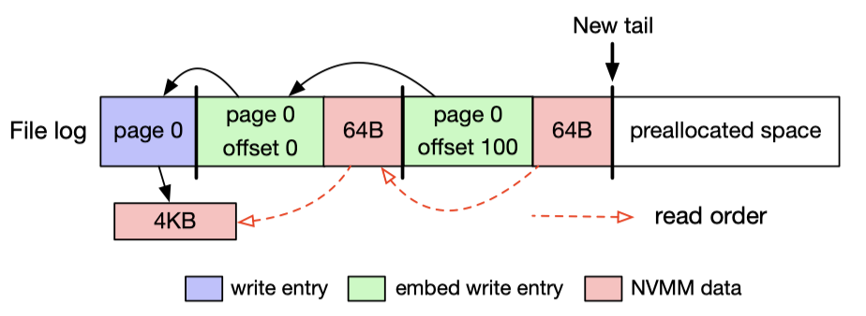
The NOVA ﬁlesystem
Optimize NOVA by ……
Increasing size of log entries
Avoiding copy-on-write operations

Slide 62
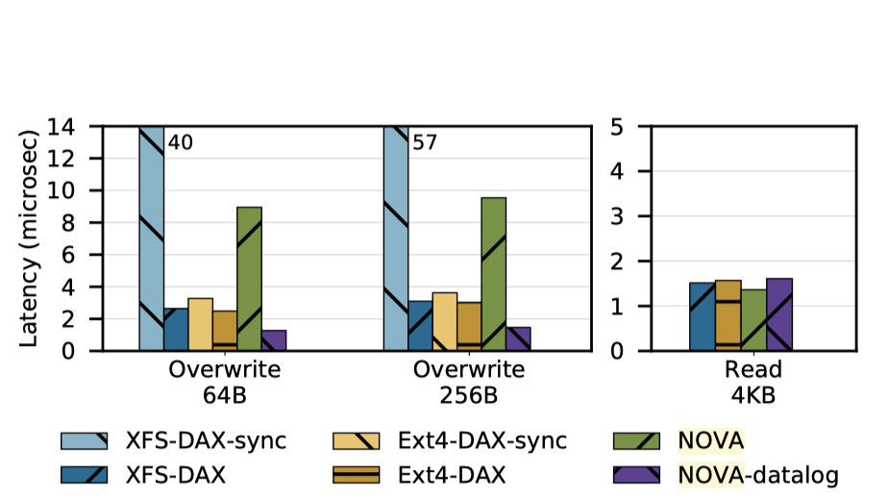
The NOVA ﬁlesystem
Optimize NOVA by ……
Increasing size of log entries
Avoiding copy-on-write operations

Slide 63
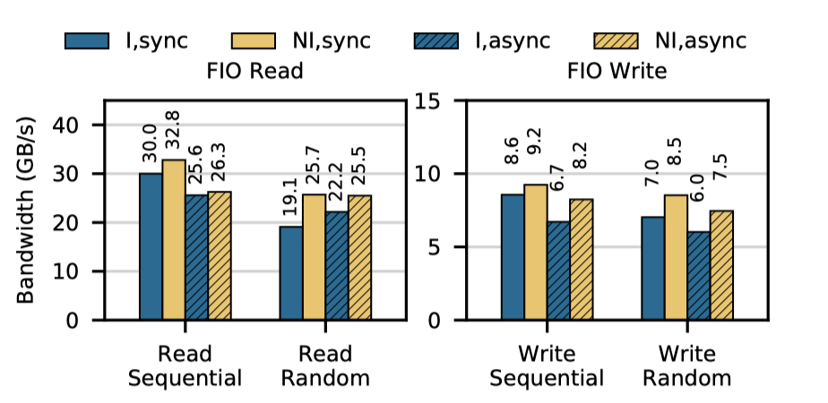
The NOVA ﬁlesystem
Optimize NOVA by ……
Increasing size of log entries
Avoiding copy-on-write operations
pin writer threads to noninterleaved Optane

Slide 64
Today’s agenda
Motivation
Performance Characterization
Comparison to Emulation
Best Practices for Optane DIMM
Case Study
Conclusion

Slide 65
Conclusion
This Paper:
has described the performance of Intel’s new Optane DIMMs across micro- and macro-level benchmarks
extracted actionable guidelines for programmers to fully utilize these devices’ strengths

Slide 66
An Empirical Guide to the Behavior and Use of
Scalable Persistent Memory
Q& A

