Slide 1
PinK: High-speed In-storage Key-value Store with Bounded Tails
ATC 2020
Junsu Im, Jinwook Bae, Chanwoo Chung*, Arvind*, and Sungjin Lee
Daegu Gyeongbuk Institute of Science & Technology (DGIST) *
Massachusetts Institute of Technology (MIT)
Presented by Qingyuan Chen and Yuming Xu, USTC, ADSL
November 11st, 2020
2020/4/17

Slide 2
Outline
Motivation & Background
Design
Evaluation
Conclusion
2020/4/17
Notes:
接下来讲一下我们的研究内容

Slide 3
Outline
Motivation & Background
Design
Evaluation
Conclusion
2020/4/17
Notes:
接下来讲一下我们的研究内容

Slide 4
Key-Value System
Key
Value
20%
80%
Blooming unstructured data
Key-Value System
Notes:
SSD结构

Slide 5
Key-Value Storage Device
KV system
Key-Value Interface
CPU
SSD access
Bottle neck
Fewer Host Resources
Low Latency
High Throughput
Host Key-Value Engine
Bottleneck move to cpu overhead KVell(sosp 19)
Key-Value Interface
Kvell(sosp 19)
Block-SSD
KV-SSD

Slide 6
KV-SSD
Provides the key-value interface
Key and value are both of variable sizes
Support a rich set of operations like iterations, range queries
Challenge :
Limited DRAM & CPU capability
Redesign of the FTL ( flash translation layer )
Implementation
Academia
KAML (HPCA’17), NVMKV(ATC’15), Bluecache (VLDB’16)，LightStore (ASPLOS’19)，iLSM-SSD (MASCOTS’19)
Industry
Samsung’s KV-SSD
SSD : 4TB, DRAM : 4GB ( 0.1% )
What’s their Problem ?

Slide 7
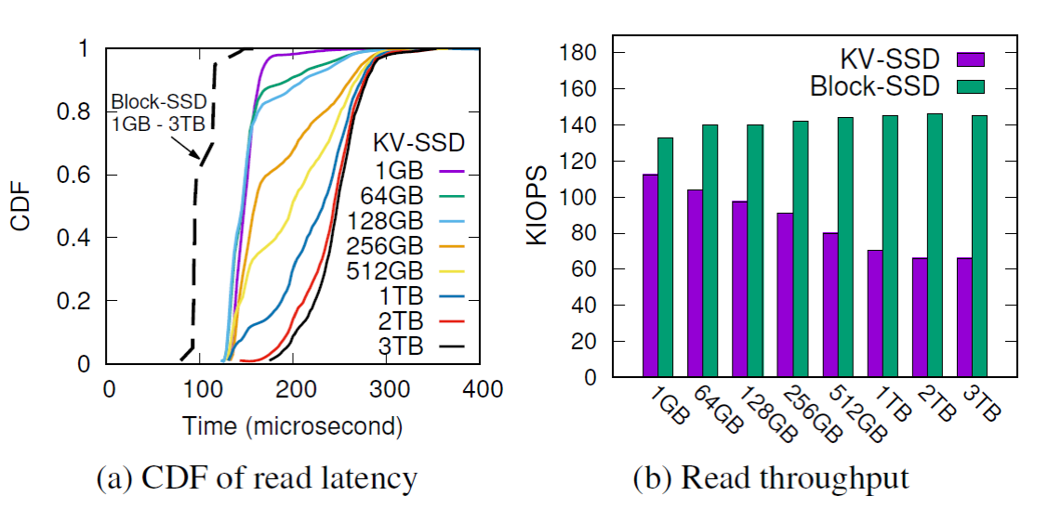
Hash-based SSD Experiments
Samsung’s KV-SSD prototype
Hash-based SSD
Benchmark
Key and Value sizes : Average 32B and 1KB
Conclude
long tail latency
inconsistent read latency
What’s the reason?
Notes:
random GET() requests on these KV pools for 10 minutes
KV pools ranging in size from1GB to 3TB

Slide 8
Problem of Hash-based KV-SSD
Huge Hash Table
All hash table on DRAM : 144GB DRAM needed
Using signature : blooming conflict
Using signature
inconsistent read latency
Store more, conflicts more, flash access more
long tail latency
Signature conflict result unpredictable flash access
Cannot efficiently support iterations and range operations
SSD : 4TB, DRAM : 4GB
Key : 32B, Value : 1KB

Slide 9
LSM-tree
2-properties
Each level, KV objects are unique and kept sorted
Due to overwrites, there are overlaps between levels
L2 index
L3 index
LSM-tree Structure
L0
4
15
33
51
High
DRAM
Flash
L1
2
7
52
60
Low
39
L2
1
3
7
10
33
51
60

Slide 10
LSM-tree
2-properties
Each level, KV objects are unique and kept sorted
Due to overwrites, there are overlaps between levels
L2 index
L3 index
Once GET() come
L0
GET(39)
4
15
33
51
High
DRAM
Bloom filter
Flash
L1
2
7
52
60
Low
39
L2
1
3
7
10
33
51
60

Slide 11
LSM-tree
2-properties
Each level, KV objects are unique and kept sorted
Due to overwrites, there are overlaps between levels
L2 index
L3 index
Once GET() come
L0
GET(39)
4
15
33
51
High
DRAM
Bloom filter
Flash
L1
2
7
52
60
Low
39
L2
1
3
7
10
33
51
60

Slide 12
LSM-tree
Flush & Compaction
Once L0 Full
L0
4
15
33
51
High
DRAM
flush
Flash
L1
2
7
52
60
Low
39
L2
1
3
7
10
33
51
60

Slide 13
LSM-tree
Low DRAM requirement
Support range and scan operations
worst-case latency of LSM-tree is bounded
Good enough?
After Flush & Compaction
High
L0
DRAM
L1
Flash
L2
51
10
39
52
60
Low
1
2
3
4
7
15
33

Slide 14
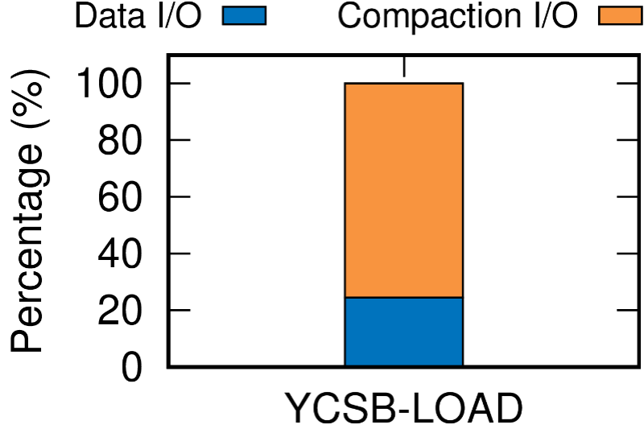
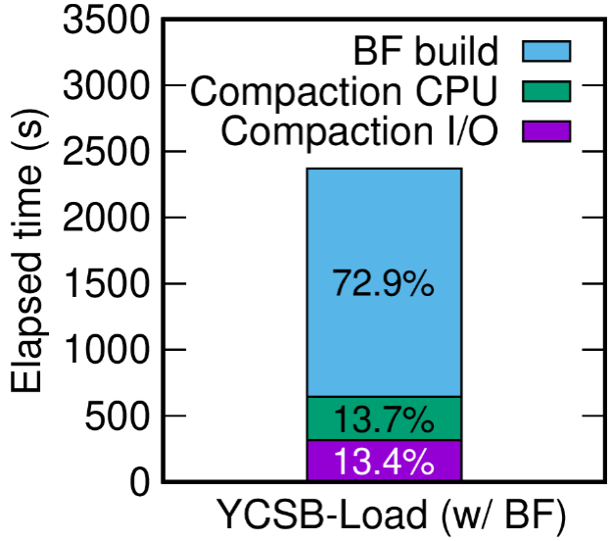
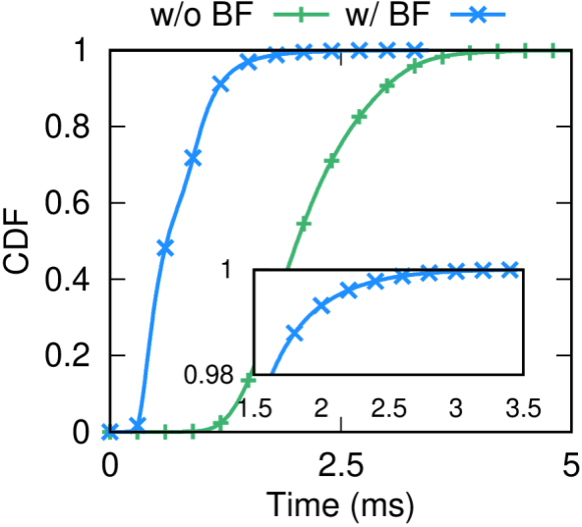
LSM-based SSD Experiments
Lightstore: LSM-tree-based KV-SSD
Improve Bloom filter
Benchmark
Lightstore: YCSB-LOAD(100%write) and YCSB-C (100%Read), 32B key and 1KB value

Slide 15
Problem of LSM-based KV-SSD
Long tail latency
probabilistic nature of Bloom filter
CPU overhead
Rebuild Bloom filer
Merge sort at compaction
I/O overhead
I/O at compaction

Slide 16
Outline
Motivation & Background
Design
Evaluation
Conclusion
2020/4/17
Notes:
接下来讲一下我们的研究内容

Slide 17
Design of PinK
Overview
Level Pinning
Optimizing Search Path
Compaction Speed Up
Optimizing GC
Durability and Scalability Issues
2020/4/17
Notes:
接下来讲一下我们的研究内容

Slide 18
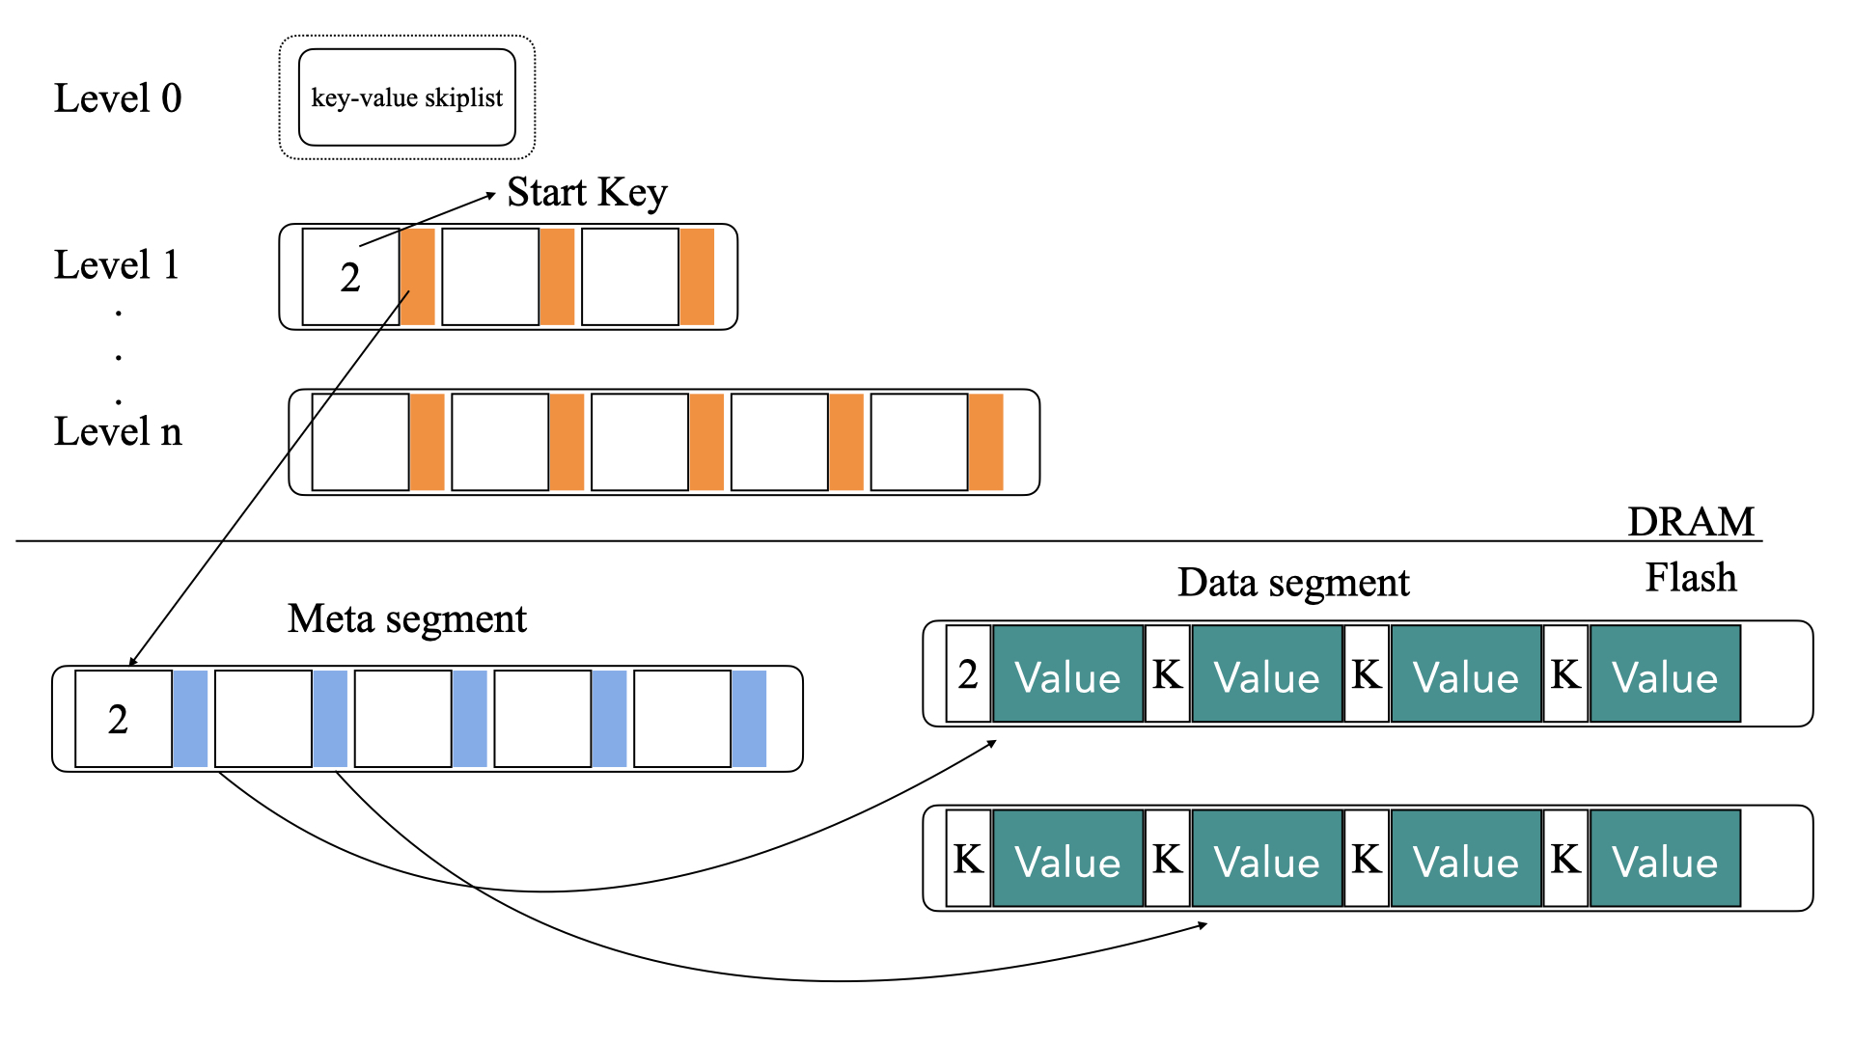
Overview
PinK is based on key-value separated LSM-tree
Key-Value Separated LSM-tree

Slide 19
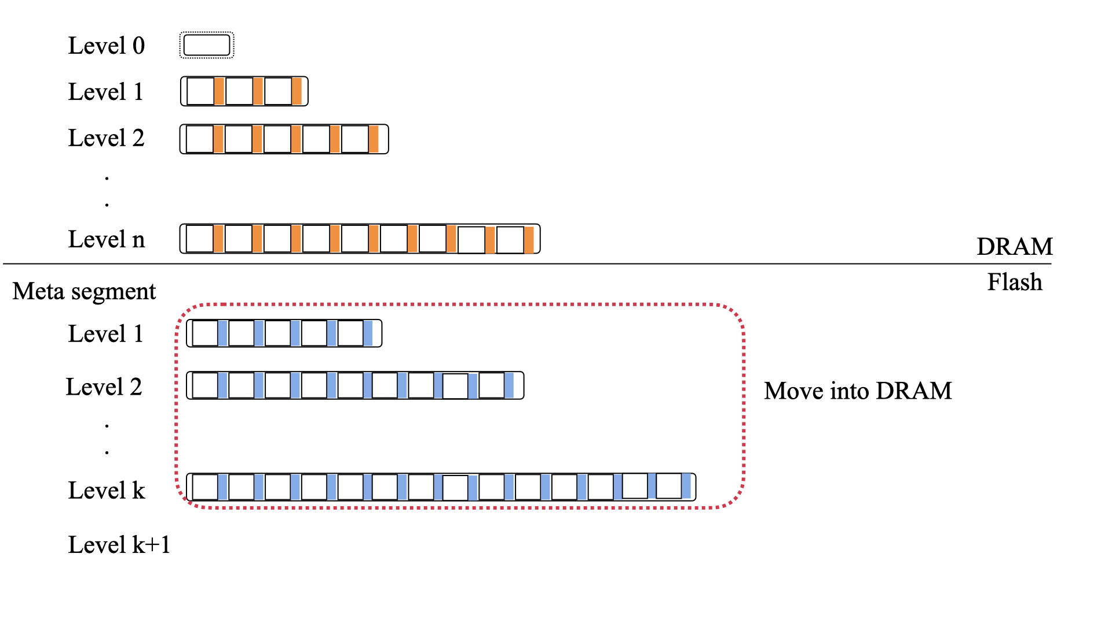
Level Pinning
PinK keeps meta segments of K levels in DRAM
Read worst case:Only need O(h-1-k) Flash access to get value
Move K levels’ meta segment into DRAM

Slide 20
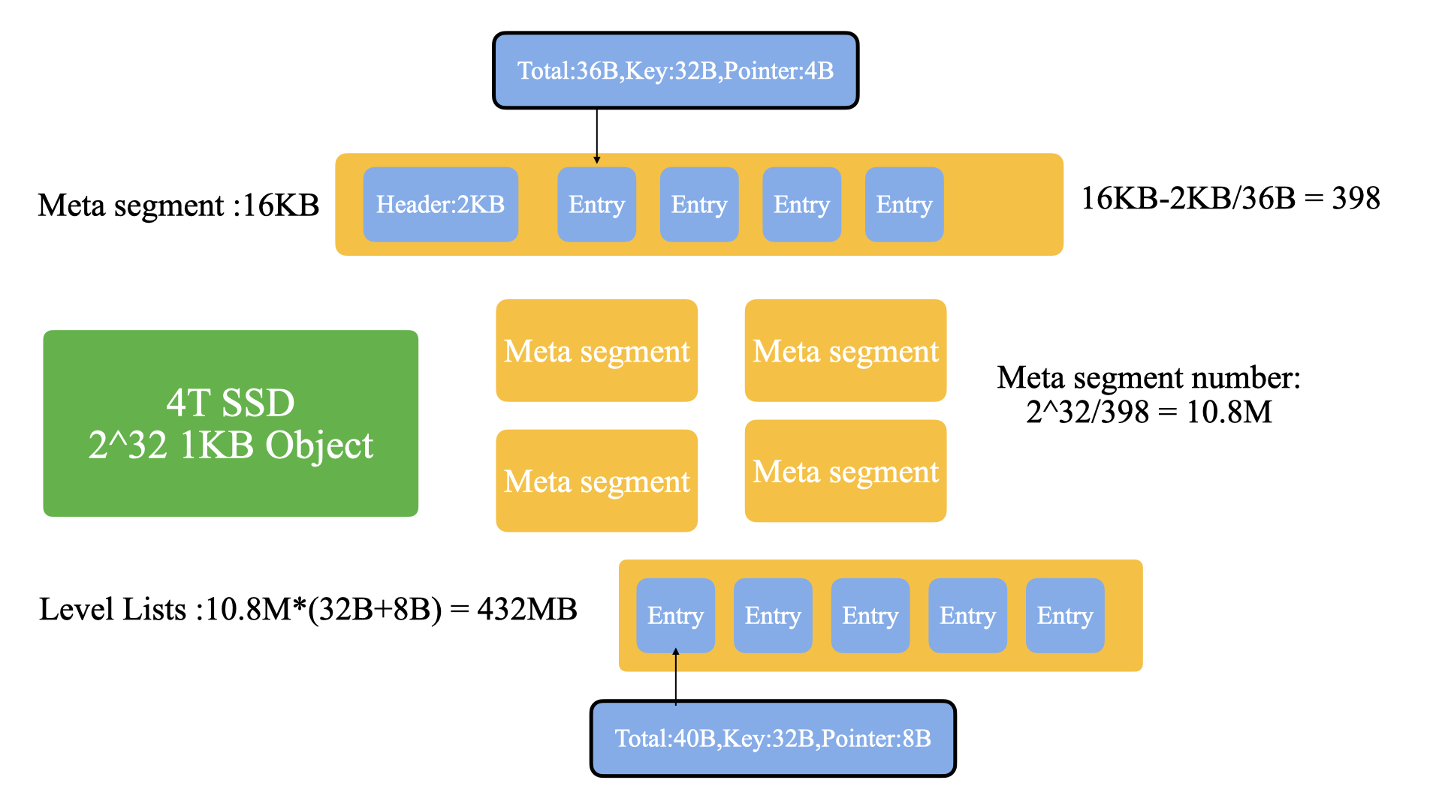
Level Pinning
PinK keeps meta segments of K levels in DRAM
Memory Requirement？
Assume that an SSD capacity is 4TB and each meta segment is 16KB
And average sizes of keys and values are 32B and 1KB
Meta segment size for L1,L2,L3,L4:
0.91MB,50.86MB,2.83GB,161.63GB
4GB DRAM(0.1% of SSD capacity) can hold L1-L3

Slide 21
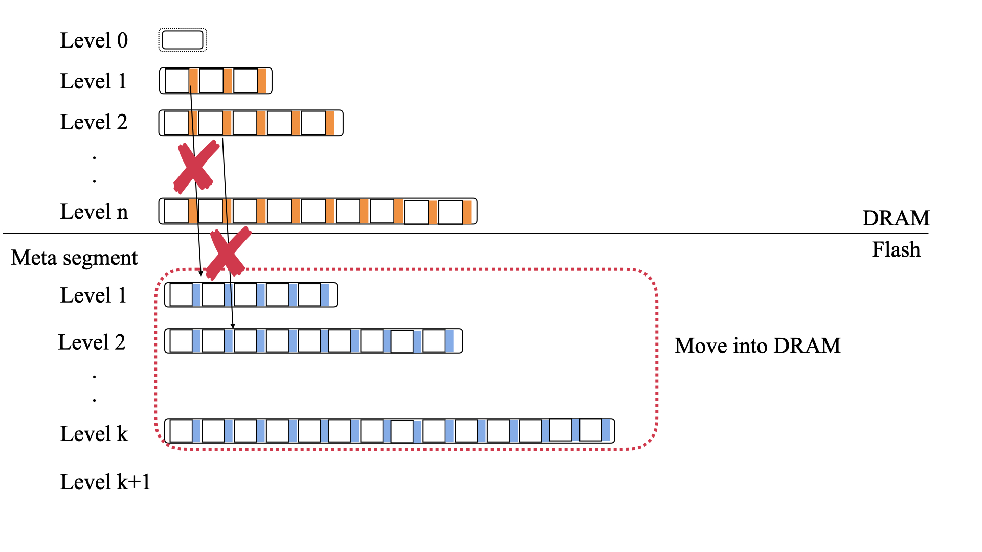
Level Pinning
PinK keeps meta segments of K levels in DRAM
Reduce Compaction I/O
meta segments are in DRAM, don’t have to access flash，just update it directly
Dirty segments don’t have to write back to flash due to extra capacitors

Slide 22
Optimizing Search Path
Stop using Bloom Filter
Use prefix of a key to reduce string comparison
Set a range pointer in each entry

Slide 23
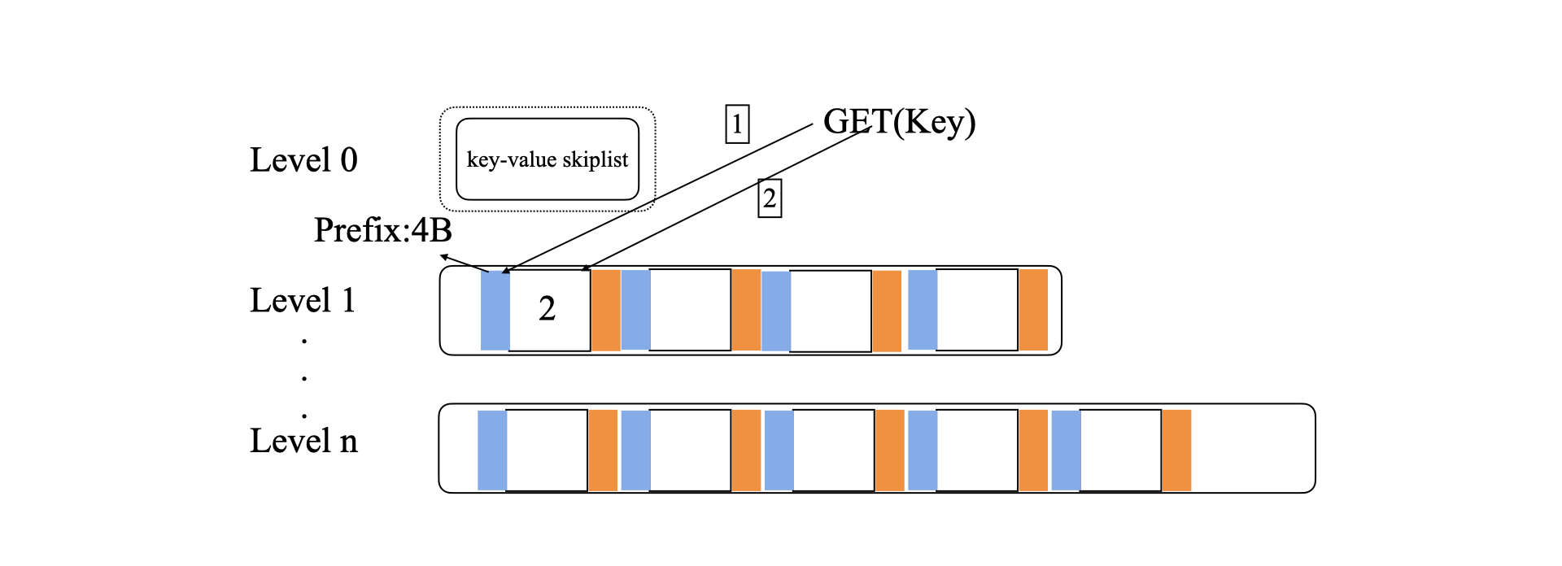
Optimizing Search Path
Stop using Bloom Filter
Reduce CPU overhead
Use prefix of a key to reduce string comparison
Add extra a prefix of a key(4B) in level list

Slide 24
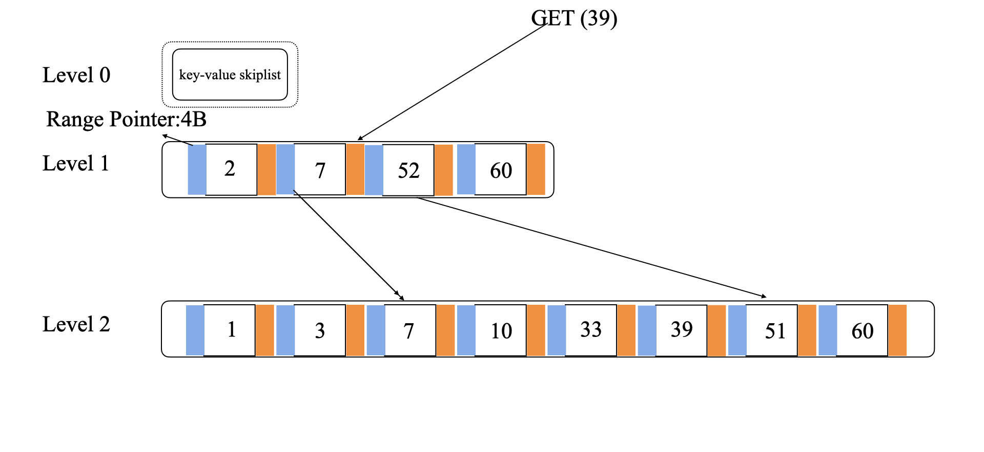
Optimizing Search Path
Set a range pointer in each entry
reduce search ranges of the level lists by borrowing fractional cascading technique
Level h-1 doesn’t maintain range pointer
说明

Slide 25
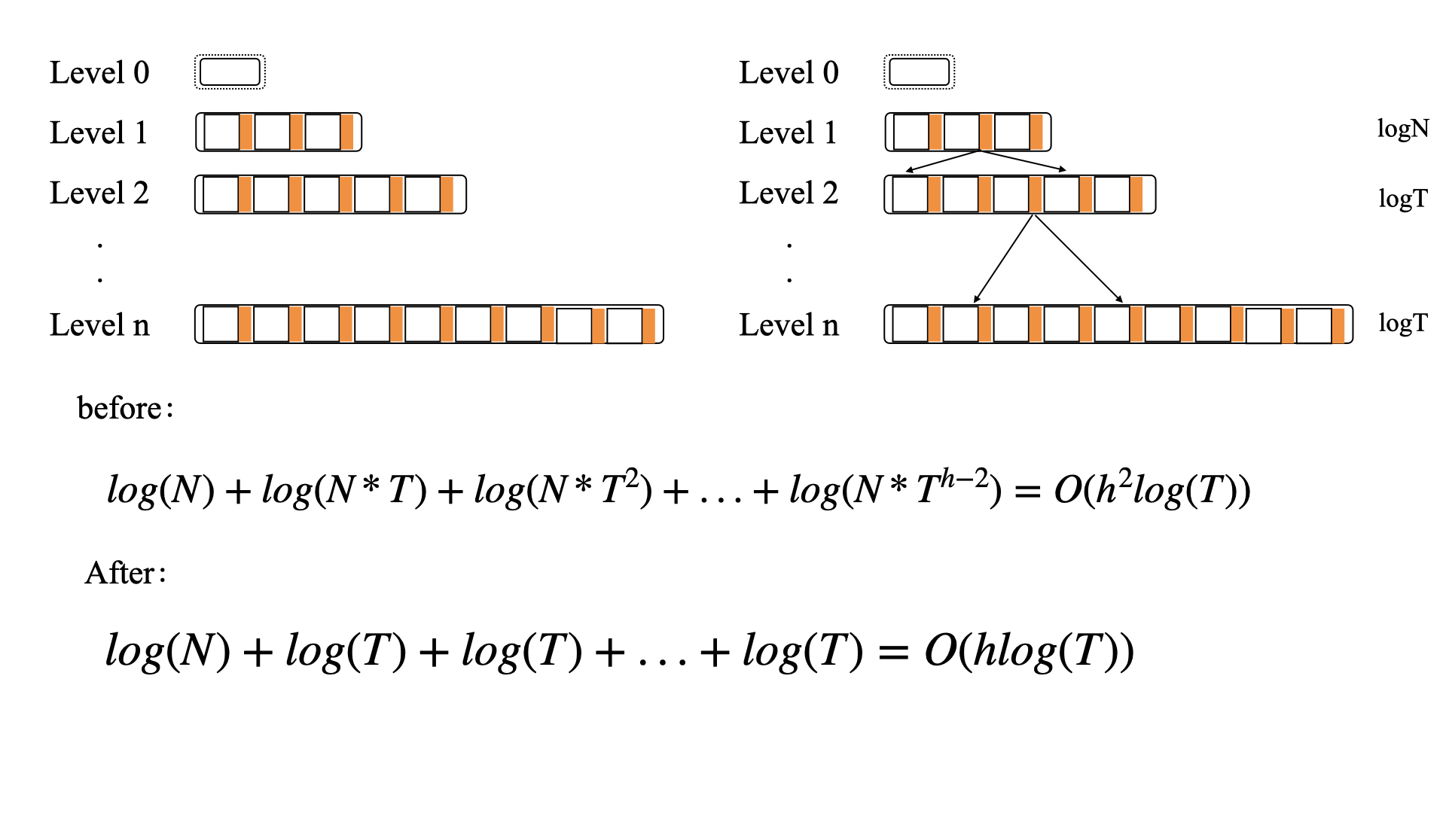
Optimizing Search Path
Set a range pointer in each entry
Memory Requirement: extra 43.9MB(10%)
说明

Slide 26
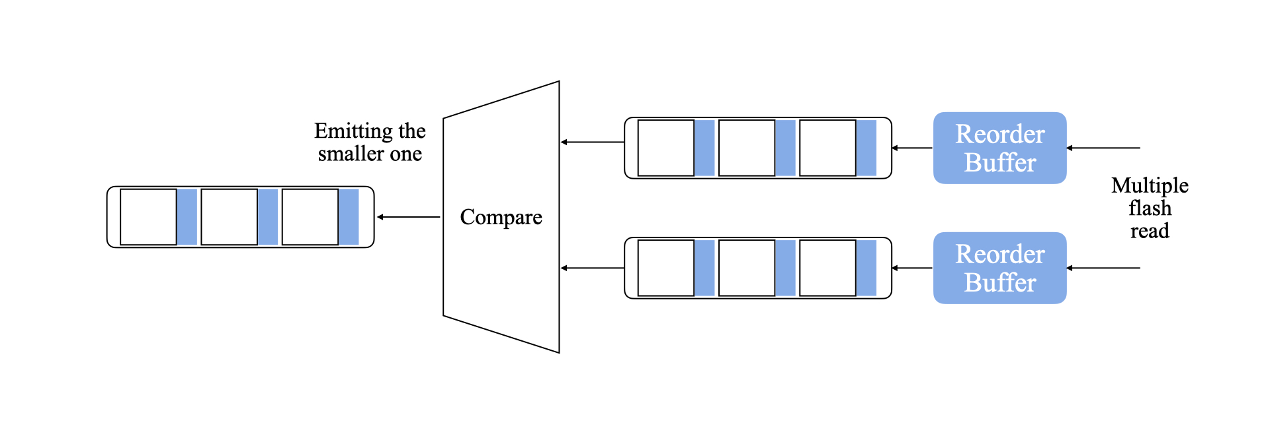
Compaction Speed Up
Move Compaction From CPU to HW accelerator in SSD controller

Slide 27
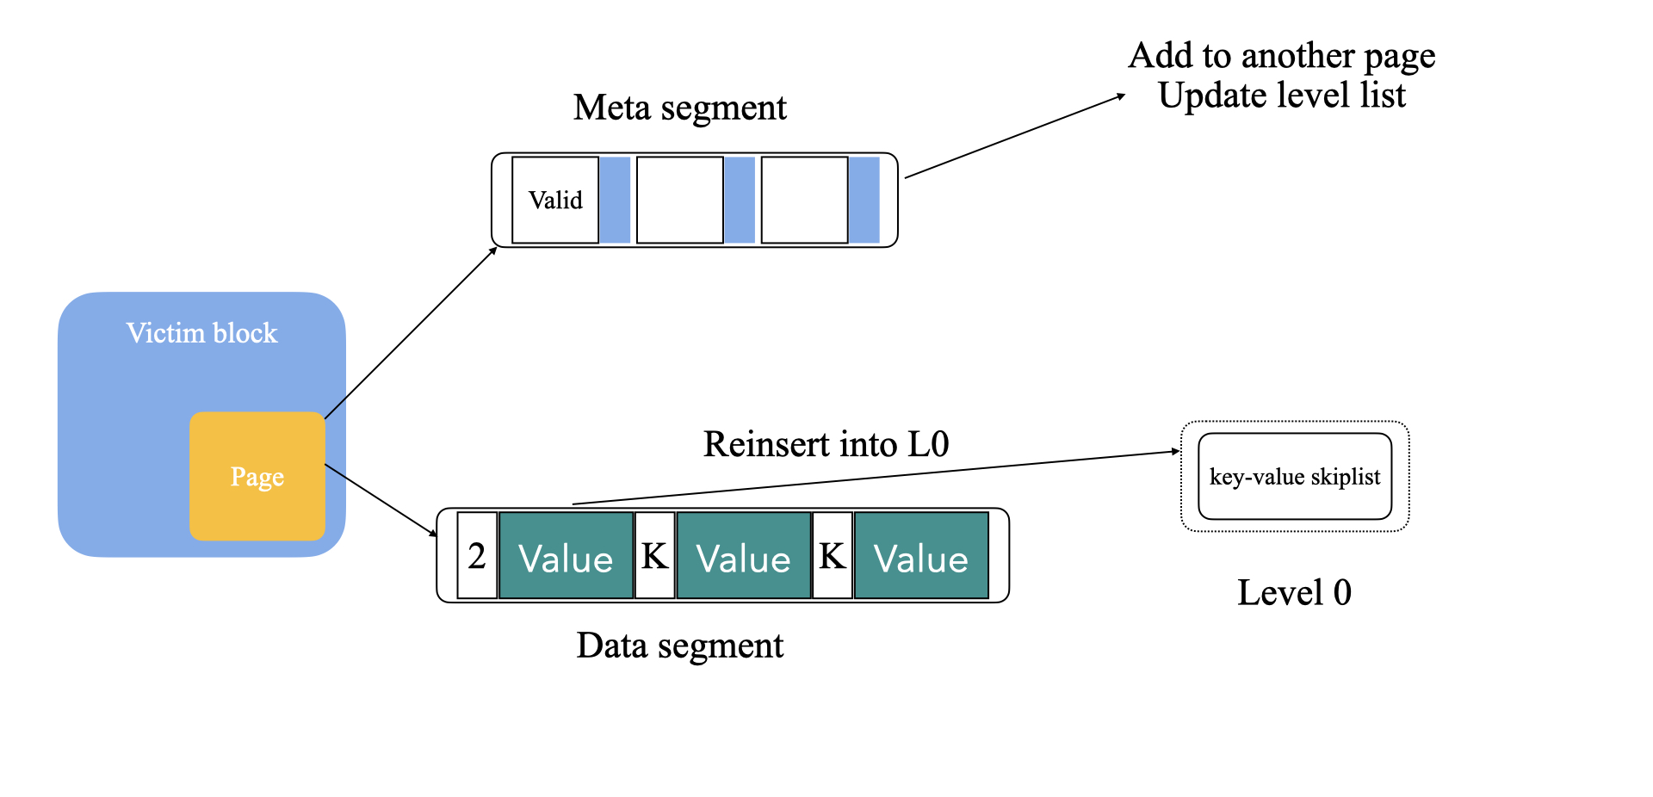
Optimizing GC
Optimizing GC by reinserting valid data to LSM-tree

Slide 28
Durability and Scalability Issues
Capacitor Limitation
PinK can address this issue by regularly writing data structures that reside in DRAM into flash
DRAM Scalability
One option is reduce the levels which are kept in DRAM
Another is reduce the height of the tree

Slide 29
Design conclusion
Long tail latency
Level-pinning
CPU overhead
Remove Bloom filter
Optimize binary search
Adopt HW accelerator
I/O overhead
Reduce compaction I/O
Optimize GC

Slide 30
Outline
Motivation & Background
Design
Evaluation
Conclusion
2020/4/17
Notes:
接下来讲一下我们的研究内容

Slide 31
Setup
All algorithms for KV-SSD were implemented on ZCU102 board
For fast experiments: 64GB SSD, 64 MB DRAM (0.1% of NAND capacity)
Benchmark
YCSB, key: 32B, value: 1KB, first using load to create 44GB KV pool
 | Load | A | B | C | D | E | F
R/W | 0:100 | 50:50 | 95:5 | 100:0 | 95:5 | 95:5 | 50:50
Query Type | Point |  |  |  |  | Range | Point
Request Distribution | Uniform | Zipfan |  |  | Latest | Zipfian

Slide 32
Testing Algorithms
Hash: 8-bit signature: total 320MB buckets
LSM-tree: based on Lightstore, total 5 levels (1~4 in flash)
Pink: Total 5 levels (only 4 in flash, rest pinned in DRAM)
Pink+HW: using HW accelerator
 | Hash | LSM-tree | Pink, Pink+HW
64MB DRAM | LRU bucket caching (64MB) | Level list (9MB) Bloom filter (55MB) | Level list + prefix range (10MB) Level-pinning (54MB)

Slide 33
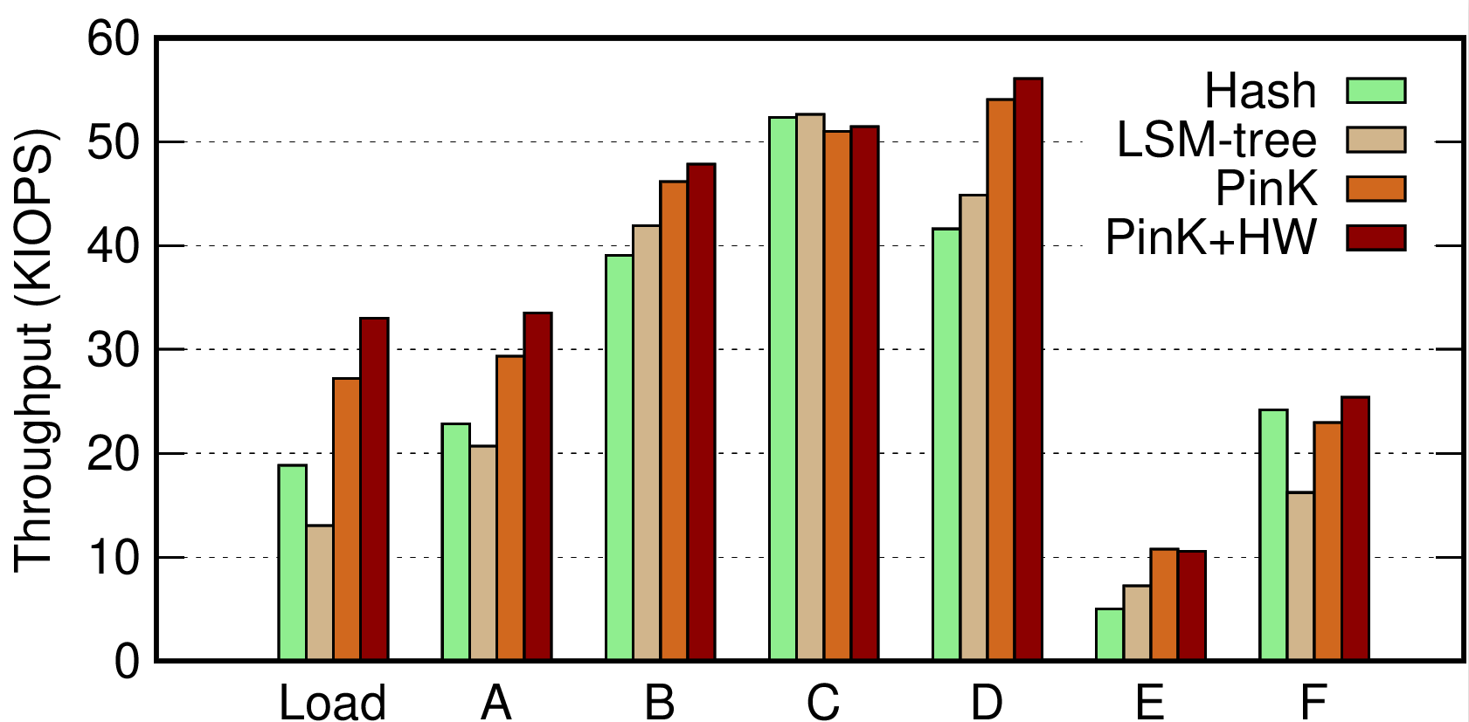
YCSB Throughput

Slide 34
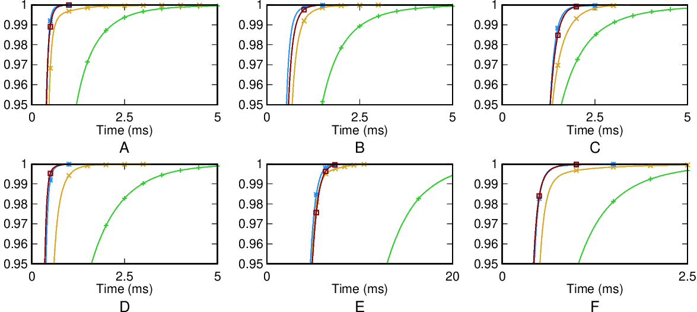
YCSB Read latency

Slide 35
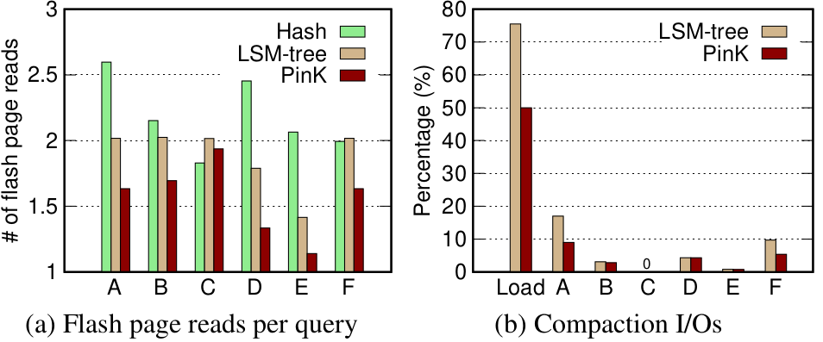
Level Pinning

Slide 36
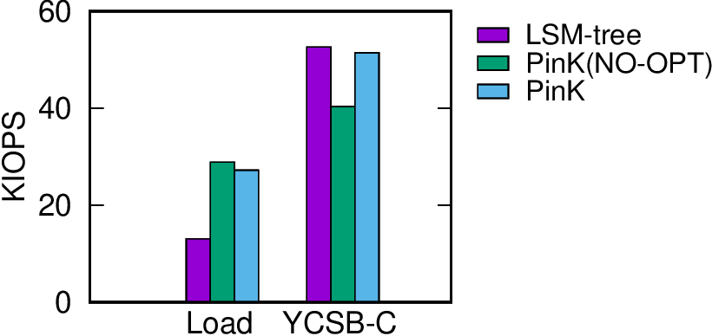
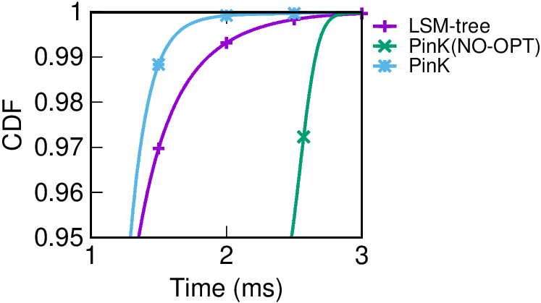
Search Path Optimization
PinK(NO-OPT): PinK without prefix and range pointer

Slide 37
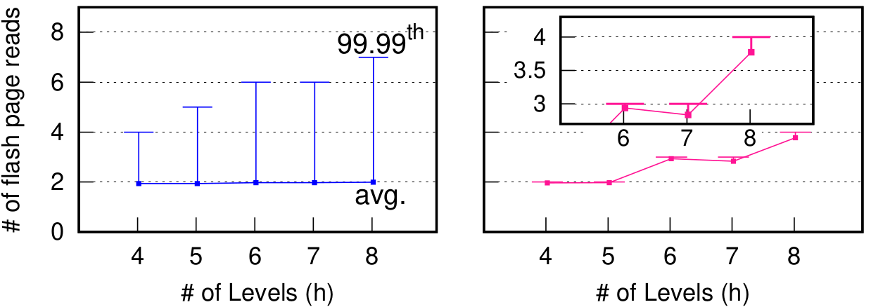
Level-pinning on Higher LSM-tree
Keep DRAM in 64MB but change the height of LSM-tree
Benchmark:YCSB-C (all read query)
LSM-tree(Monkey)
Pink

Slide 38
Outline
Motivation & Background
Design
Evaluation
Conclusion
2020/4/17
Notes:
接下来讲一下我们的研究内容

Slide 39
Conclusion
Goal: improve the performance of LSM-tree based KV-SSD
Long tail latency
CPU overhead
I/O overhead

Slide 40
Conclusion
Approach
Another way
Level Pinning instead of using Bloom Filter
Space-Time Trade
Search Optimizing
Offload CPU
Move merge from CPU to HW accelerator
Optimize GC
In stead of updating meta segment which will cause a lot of flash read, reinsert KV pair

Slide 41
PinK:
High-speed In-storage Key-value Store with Bounded Tails
Thanks & QA!
November 11st, 2020
2020/4/17

