Slide 1
Memory Resource Management in VMware ESX Server
Junming Liu

Slide 2
Background
Reclamation
Sharing
Allocation policies
Conclusions

Slide 3
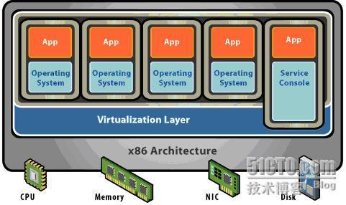
Virtualization Architecture
Hosted Architecture
Bare Metal Architecture

Slide 4
ESX Server
Commercially-available product
Thin kernel designed to run VMs
Multiplex hardware resources
High-performance I/O

Slide 5
Motivation
Server consolidation
Many physical servers underutilized
Consolidate multiple workloads per machine
Virtual machines
Illusion of dedicated physical machine
Encapsulate workload (OS + apps)
Resource management
Fairness, performance isolation
Efficient utilization

Slide 6
Memory Virtualization
Traditional VMM approach:
extra level of indirection
virtual → “physical”
guest maps VPN to PPN
“physical”→ machine
pmap maps PPN to MPN
Ordinary memory refs:
hardware maps VPN to MPN
VPN
PPN
MPN
guest
Hardware
page table
Hardware
TLB
pmap
Bhargava R, Serebrin B, Spadini F, et al. Accelerating two-dimensional page walks for virtualized systems[C]//ACM SIGARCH Computer Architecture News. ACM, 2008, 36(1): 26-35.

Slide 7
Background
Reclamation
Sharing
Allocation policies
Conclusions

Slide 8
Paging
Paging guest memory
reclaim guest memory
without coordinating with guest OS
Paging guest hot-memory
guest may have free memory
may not reclaim guest free memory, but reclaim guest hot-memoy

Slide 9
Ballooning

Slide 10
Background
Reclamation
Sharing
Allocation policies
Conclusions

Slide 11
Sharing Memory
Motivation
multiple VMs running same OS, apps
collapse redundant copies of code, data, zeros
Content-based sharing
general-purpose, no guest OS changes
background activity saves memory over time

Slide 12
Page Sharing: Scan Candidate PPN

Slide 13
Page Sharing: Successful Match

Slide 14
Background
Reclamation
Sharing
Allocation policies
Conclusions

Slide 15
Allocation Parameters
Min size
guaranteed
enforced by admission control
Max size
amount of “physical” memory seen by guest OS
allocation when memory is sufficient
Shares
Specify relative importance
Proportional-share fairness

Slide 16
Shares-Based Allocation
VM1 Shares:1 VM2 Shares:2
System memory: 6 page
VM1
VM2

Slide 17
Shares-per-page
VM1 Shares:1 VM2 Shares:2
Reclaim memory -> chose which VM?
VM1
VM2
1/2
2/3

Slide 18
Reclaiming Idle Memory
Tax on idle memory
charge more for idle page than active page
idle-adjusted shares-per-page ratio
Tax rate
explicit administrative parameter
High default rate(75%)
reclaim most idle memory
some buffer against rapid working-set increases

Slide 19
Idle-adjusted shares-per-page ratio
VM1 Shares:1 VM2 Shares:2
Tax rate: 75%
Reclaim memory -> chose which VM?
VM1
VM2
1/5
2/13

Slide 20
Background
Reclamation
Sharing
Allocation policies
Conclusions

Slide 21
Conclusions
Memory Shortage
reclaim which VM’s memory?
proportional-sharing with idle memory tax
how reclaim VM’s memory?
ballooning or paging depend on reclaimation state
Content-based sharing
deduplication

