Slide 1
Distributed Systems
Lecture 4 – Transaction & Atomic Commit
Cheng Li

Slide 2
Outline
Transactions (Single machine, local transactions)
Distributed transactions
Atomic commit protocols
Two phase commit

Slide 3
Single machine, local transactions
Transactions groups a set of read/write operations together
begin_tx
v <-- read(checking)
v' <-- read(saving)
write(checking, v-10)
write(saving,v'+10)
commit_tx

Slide 4
Transaction properties: ACID
Atomicity: Either all changes performed by transaction
occur or none occurs
Consistency: A transaction as a whole does not violate
integrity constraints
Isolation: Transactions appear to execute one after the
other in sequence
Durability: If a transaction commits, its changes will
survive failures
Goal: maintain these four properties in spite of failures and concurrency

Slide 5
Transaction significance
Major component of database systems
Critical for most applications
Banking, Stock, etc
Turing awards to database researchers:
Charles Bachman 1973 for inventing DBMS
Edgar Codd 1981 for inventing relational DBs
Jim Gray 1998 for inventing transactions

Slide 6
Two goals:
handle failure (A, D): today’s focus
A machine crash and later re-starts.
handle concurrency (C, I)
Leave this out for next lecture in which we talk about mutual exclusion & concurrency control

Slide 7
First goal first.
----- Failure handling ---------------
begin_tx
//buffer writes
end_tx
commit_tx starts the commit protocol:
write(checking, 90) to disk
write(saving, 110) to disk
what happens when crash happens after first write, before second write.
---> after recovery, partial writes, money is lost

Slide 8
First goal first.
----- Failure handling ---------------
begin_tx
//buffer writes
end_tx
commit_tx starts the commit protocol:
write(checking, 90) to disk
write(saving, 110) to disk
what happens when crash happens after first write, before second write.
---> after recovery, partial writes, money is lost

Slide 9
all-or-nothing atomicity
How to implement all-or-nothing atomicity:
Write-ahead Logging
One type of logging: redo logging
append_log_entry(checking=90,saving=110)
write(checking, 90) <------ does not have to immediately flush to disk
write(saving, 110) <-------does not have to immediately flush to disk

Slide 10
Caveats
How to ensure each log entry can be written atomically?
(each log entry is checksummed)
How to recover from logs?
replay from the beginning of time
recovery takes too log
Periodic checkpoint
how to checkpoint?
naive way: stop all transactions, flush all storage state to disk, write a checkpoint entry to log

Slide 11
Outline
Transactions (Single machine, local transactions)
Distributed transactions
Atomic commit protocols
Two phase commit

Slide 12
Distributed database management system
Important: many forms and definitions
Our definition: shared nothing infrastructure
Multiple machines connected with a network
DBMS
Network
DBMS
Stored
data
Stored
data
DBMS
DBMS
Stored
data
Stored
data

Slide 13
Relationship with Replication
Replication is about doing the same thing multiple places to provide fault tolerance
Sharding is about doing different things multiple places for scalability

Slide 14
Relationship with Replication
Replication Dimension
A-F
A-F
A-F
Sharding Dimension
G-L
G-L
G-L
M-R
M-R
M-R
S-Z
S-Z
S-Z

Slide 15
Focus on Sharding for Today
Replication Dimension
A-F
A-F
A-F
Sharding Dimension
G-L
G-L
G-L
M-R
M-R
M-R
S-Z
S-Z
S-Z

Slide 16
Distributed transactions
In a distributed DBMS, transactions may span multiple sites
A transaction may need to update data items located at different sites
All operations must be performed as a unit (with ACID properties)
Important goal: ensure atomic commit of all distributed transactions

Slide 17
Outline
Transactions (Single machine, local transactions)
Distributed transactions
Atomic commit protocols
Two phase commit

Slide 18
Atomic Commit
Atomic: All or nothing
Either all participants do something (commit) or no participant does anything (abort)
Common use: commit a transaction that updates data on different shards

Slide 19
Model
For each distributed transaction T:
one coordinator
a set of participants
Coordinator knows participants; participants don’t necessarily know each other
Each process has access to a Distributed Transaction Log (DT Log) on stable storage

Slide 20
The setup
Each process $p_{i}$ has an input value ${vote}_{i}$:
${vote}_{i}∈\{Yes, No\}$
Each process $p_{i}$ has an output value ${decision}_{i}$:
${decision}_{i}∈\{commit, abort\}$

Slide 21
Atomic Commit (AC) Specification
AC-1: All processes that reach a decision reach the same one.
AC-2: A process cannot reverse its decision after it has reached one.
AC-3: The Commit decision can only be reached if all processes vote Yes.
AC-4: If there are no failures and all processes vote Yes, then the decision will be Commit.
AC-5: If all failures are repaired and there are no more failures, then all processes will eventually decide.

Slide 22
Reasoning about fault tolerance
This is hard! – How do we design fault-tolerant systems? – How do we know if we’re successful?
Often use “properties” that hold true for every possible execution
We focus on safety and liveness properties

Slide 23
Safety
“Bad things” don’t happen – No stopped or deadlocked states – No error states
Examples – Mutual exclusion: two processes can’t be in a critical section at the same time

Slide 24
Liveness
“Good things” happen – …eventually
Examples – Starvation freedom: process 1 can eventually enter a critical section as long as process 2 terminates – Eventual consistency: if a value in an application doesn’t change, two servers will eventually agree on its value

Slide 25
Often a tradeoff
“Good” and “bad” are application-specific
Safety is very important in banking transactions
May take some time to confirm a transaction
Liveness is very important in social networking sites
See updates right away

Slide 26
Liveness & Uncertainty
A process is uncertain if it has voted Yes but does not have sufficient information to commit
While uncertain, a process cannot decide unilaterally
Uncertainty + communication failures = blocking!

Slide 27
2-Phase Commit
Coordinator $c$
Participant $p_{i}$
I. Sends VOTE-REQ to all participants

Slide 28
2-Phase Commit
Coordinator $c$
Participant $p_{i}$
I. Sends VOTE-REQ to all participants
II. Sends ${vote}_{i}$ to Coordinator
if ${vote}_{i}$ = NO then
${decision}_{i}$ := ABORT
halt

Slide 29
2-Phase Commit
Coordinator $c$
Participant $p_{i}$
I. Sends VOTE-REQ to all participants
II. Sends ${vote}_{i}$ to Coordinator
if ${vote}_{i}$ = NO then
${decision}_{i}$ := ABORT
halt
III. if (all votes YES) then
${decision}_{c}$ := COMMIT
send COMMIT to all
else
${decision}_{c}$ := ABORT
send ABORT to all who voted YES
halt

Slide 30
2-Phase Commit
Coordinator $c$
Participant $p_{i}$
I. Sends VOTE-REQ to all participants
II. Sends ${vote}_{i}$ to Coordinator
if ${vote}_{i}$ = NO then
${decision}_{i}$ := ABORT
halt
III. if (all votes YES) then
${decision}_{c}$ := COMMIT
send COMMIT to all
else
${decision}_{c}$ := ABORT
send ABORT to all who voted YES
halt
IV. if received COMMIT then
${decision}_{i}$ := COMMIT
else
${decision}_{i}$ := ABORT
halt

Slide 31
Failure cases to consider
Three possible worries
Some participant might fail at some step of the protocol
The coordinator might fail at some step of the protocol
Communication failures

Slide 32
Notes on 2PC
Satisfies AC-1 to AC-4
But not AC-5 (at least “as is”)
A process may be waiting for a message that may never arrive
Use Timeout Actions
No guarantee that a recovered process will reach a decision consistent with that of other processes
Processes save protocol state in DT-Log

Slide 33
Timeout actions

Slide 34
Timeout actions

Slide 35
Timeout actions

Slide 36
Timeout actions

Slide 37
Termination protocols
Wait for coordinator to recover
It always works, since the coordinator is never uncertain
may block recovering process unnecessarily
Ask other participants

Slide 38
Cooperative termination

Slide 39
Logging actions

Slide 40
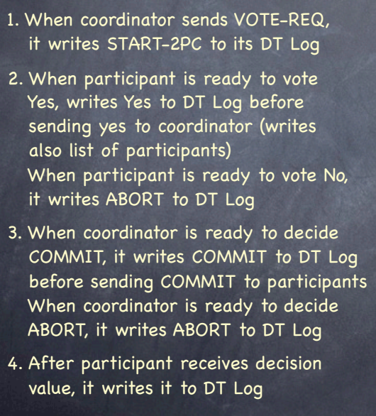
p recovers

Slide 41
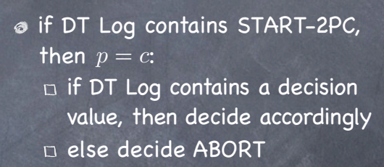
p recovers

Slide 42
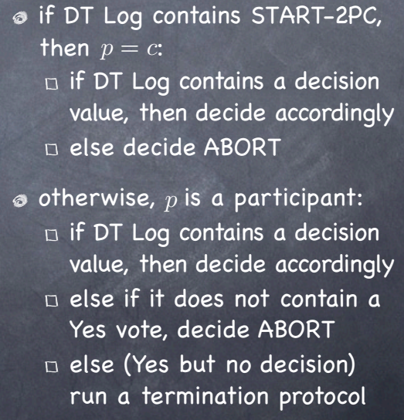
p recovers

Slide 43
2PC and blocking
Blocking occurs whenever the progress of a process depends on the repairing of failures
No AC protocol is non blocking in the presence of communication or total failures
But 2PC can block even with non-total failures and no communication failures among operating processes!

Slide 44
Summary
Distributed transactions are useful.
Atomicity of executing transactions is a great virtue.
Atomic protocol is the key to avoid inconsistencies when failures and concurrency are present.
Please read more about atomic protocol if interested
2 Phase-Commit: C. Mohan, B. Lindsay, and R. Obermarck. 1986. Transaction management in the R* distributed database management system. ACM Trans. Database Syst. 11, 4 (December 1986), 378-396
https://pdos.csail.mit.edu/6.824/papers/rstar.pdf
3 Phase-Commit: D. Skeen and M. Stonebraker. 1983. A Formal Model of Crash Recovery in a Distributed System. IEEE Trans. Softw. Eng. 9, 3 (May 1983), 219-228.

Slide 45
More readings
Efficient commit protocols for the tree of processes model of distributed transactions
https://dl.acm.org/doi/10.1145/850770.850772
It’s Time to Move on from Two Phase Commit
http://dbmsmusings.blogspot.com/2019/01/its-time-to-move-on-from-two-phase.html
Scalable Atomic Visibility with RAMP Transactions
http://www.bailis.org/papers/ramp-sigmod2014.pdf
Non-blocking Transactional Atomicity
http://www.bailis.org/blog/non-blocking-transactional-atomicity/

Slide 46
Distributed Systems
Lecture 4 – Transaction & Atomic Commit
Q & A!

