Slide 1
Erasure Coding & PARIX
Daniel Shao
2018/4/19

Slide 2
Table of contents
Basic Introduction to Erasure Coding
PARIX: Speculative Partial Writes in Erasure-Coded Systems
EC in Ceph RADOS

Slide 3
Introduction to EC
How to REMEMBER things?

Slide 4
Introduction to EC
How to remember 3 numbers, $a, b$ and $c$ ?
Trusting friends: Alice, Bob, Carol, Dave …
Alice
Bob
Carol
Dave

Slide 5
Introduction to EC
Solution 1: Alice helps to remember all.
Drawback: Availablity
$$a,b,c$$
Do not rely too much on me.
Sometimes I ’ll forget things too.

Slide 6
Introduction to EC
Solution 2: Alice, Bob, Carol, Dave … everyone remembers all.
Drawback: unnecessary workload (12 numbers remembered in total, efficiency: $\frac{3}{12}=$25%)
$$a,b,c$$
$$a,b,c$$
$$a,b,c$$
$$a,b,c$$

Slide 7
Introduction to EC
Solution 3: Alice: a, Bob: b, Carol: c, Dave: a+b+c
$$a$$
$$c$$
$$a+b+c$$
$$b$$

Slide 8
Introduction to EC
Now I know $a$.
Now I know $b$.
Now I know $c$.
Now I know $a+b+c$.

Slide 9
Introduction to EC
Question: How do I
know $a$ now?
Disconnected.
Now I know $b$.
Now I know $c$.
Now I know $a+b+c$.

Slide 10
Introduction to EC
Parity
Block
Parity: a redundant block of data
11001010
10010101
01101100
00110011
11001010⊕10010101⊕01101100=00110011

Slide 11
Introduction to EC
What if any of the data blocks are down/disconnected?
?
10010101
01101100
00110011
?⊕10010101⊕01101100=00110011

Slide 12
Introduction to EC
?⊕10010101⊕01101100=00110011
Here, the inversing operation of ⊕ is itself.
$A op B=C$, inverse operation? $A=C op^{′}B$
$∀A∈Binary, A⊕A≡0$
$A⊕B=C → A⊕B⊕B=C⊕B → A=C⊕B$

Slide 13
Introduction to EC
What if any of the data blocks are down/disconnected?
11001010
?
10010101
01101100
00110011
?⊕10010101⊕01101100=00110011
$$↓$$
?=00110011 ⊕10010101 ⊕01101100=11001010

Slide 14
Parity Logging
What if data block changes?
Problem: $P^{′}=A⊕B′⊕C$?
Read A and C? What if many more blocks?
B’
A
B
C
P

Slide 15
Parity Logging
$P=A⊕B⊕C$
$P^{′}=A⊕B′⊕C$
And $P$ is not unreachable.
$P^{′}=A⊕B^{′}⊕C=A⊕B^{′}⊕\left(B⊕B\right)⊕C=P⊕(B⊕B^{′})$

Slide 16
Parity Logging
FlowChart:
$$⊕$$
B’
$$⊕$$
$$=$$
P’
A
B
P
B
C
P

Slide 17
Parity Logging
Parity Logging(PL): Lazy update for parity block
B’’
$$⊕$$
B’’’
$$⊕$$
P’’
$$=$$
P’’’
B’
$$⊕$$
B’’
$$⊕$$
P’
$$=$$
P’’
B
$$⊕$$
B’
$$⊕$$
P
$$=$$
P’
A
B
C
P

Slide 18
Parity Logging
Parity Logging(PL): Lazy update for parity block
B’’
$$⊕$$
B’’’
$$⊕$$
P’’
$$=$$
P’’’
B’
$$⊕$$
B’’
$$⊕$$
P’
$$=$$
P’’
B
$$⊕$$
B’
$$⊕$$
P
$$=$$
P’
A
B
C
P

Slide 19
Parity Logging
Parity Logging(PL): Lazy update for parity block
B’’’
B’’
$$⊕$$
B’’’
B’’
B’
$$⊕$$
B’’
B’
B
$$⊕$$
B’
A
B
C
P

Slide 20
Parity Logging
Parity Logging(PL): Lazy update for parity block
B’’
$$⊕$$
B’’’
$$⊕$$
P’’
$$=$$
P’’’
B’
$$⊕$$
B’’
$$⊕$$
P’
$$=$$
P’’
B
$$⊕$$
B’
$$⊕$$
P
$$=$$
P’
A
B
C
P

Slide 21
ParaX
Remember: $∀A, A⊕A$=0
$P^{(n)}=\sum{(B^{\left(i\right)}⊕B^{\left(i+1\right)})}=B+B^{(n)}$
Avoid WAR
B’’
$$⊕$$
B’’’
B’
$$⊕$$
B’’
B
$$⊕$$
B’
A
B
C
P

Slide 22
ParaX
Remember: $∀A, A⊕A$=0
$P^{(n)}=\sum{(B^{\left(i\right)}⊕B^{\left(i+1\right)})}=B+B^{(n)}$
Avoid WAR
B’’’
B’’
B
B’
A
B
C
P

Slide 23
PBS and Evaluation
PBS: Parity Block Store
Configuration:
Dual 10-core Xeon E5-2630v4 2.20GHz CPU, 128GB RAM, one 10GbE NIC port, and 10 7200RPM HDDs.
The machines connect to a non-blocking 10GbE network.

Slide 24
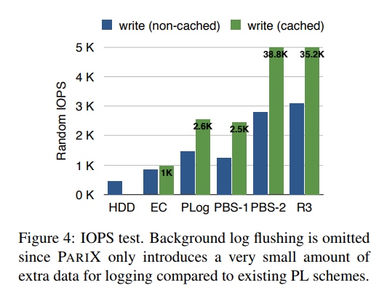
PBS
PBS: Parity Block Store

Slide 25
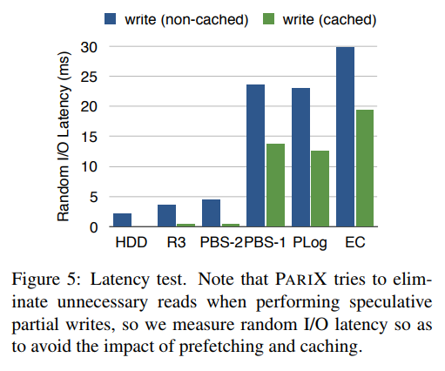
PBS
PBS: Parity Block Store

Slide 26
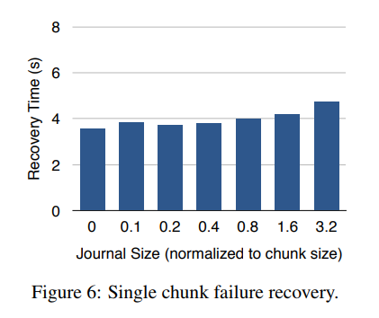
PBS
PBS: Parity Block Store

Slide 27
EC in Ceph RADOS
No support for partial overwriting.
Only support fully overwriting and appending.

Slide 28
Ceph I/O flow
Write object
Send write op to primary OSD
Primary OSD slice and compute with EC
Send sub-op to slave OSDs
Support append and overwrite
Read object
Send read op to primary OSD
Primary OSD send sub-op to slave OSDs which just store data chunks
object
Primary OSD
Slave OSDs
object
Primary OSD
Slave OSDs

Slide 29
Problem
Partial-stripe update
Extra read op
Write amplification
Goal: optimize pertial-stripe update based on parity logging, parity caching or elastic striping
A
B’
C
P₁’
P₂’
A
A
C
B
C
P₁
P₂

