Slide 1
GNNAdvisor: An Efficient Runtime System for GNN Acceleration on GPUs
Ping Gong, Youhui Bai
2021/04/28

Slide 2
Outline
1
Background
2
Motivation
3
System design and implementation
4
Evaluation and results
5
Conclusion
Notes:
Partial-Order Restrictions (or short, PoR) Consistency

Slide 3
Outline
1
Background
2
Motivation
3
System design and implementation
4
Evaluation and results
5
Conclusion
Notes:
Partial-Order Restrictions (or short, PoR) Consistency

Slide 4
Graph computing
Notes:
由于图能十分自然地表达各种复杂类型的数据，提供丰富的语义，并且可以为常见的机器学习模型提供抽象。因此近年来图数据和计算技术一直是学术界和工业界的热点。
可以预见，图计算将在下一代人工智能的各种应用中发挥重要作用，包括反欺诈，智能物流，城市大脑，生物信息学，公共安全，公共卫生，城市规划，反洗钱，基础设施，推荐系统，金融技术和供应链等领域。

Slide 5
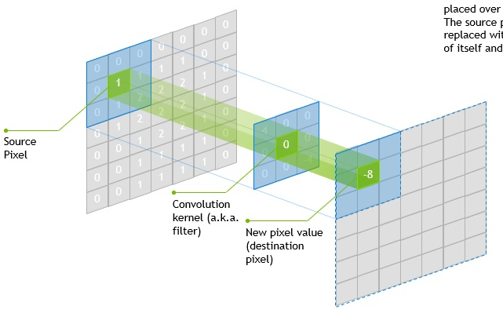
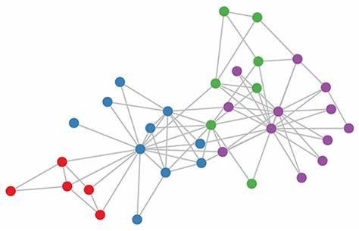
Graph Neural Network
Challenges
Euclidean Structure for CNN
Non-Euclidean Structure for GNN
CNN: Neural networks applied for Euclidean structure data, e.g., images, texts
GNN: Neural networks applied for non-Euclidean structure data, e.g., graphs
Notes:
近年来提出的GNN，作为图计算领域的典型代表，将图中的结构和属性信息与深度学习中的特征相结合，已被证明在许多与图相关的任务上具有令人信服的表现。在结果的可解释性、深层次推理因果等方面将起到越来越重要的作用。
图数据的组织方式给神经网络的应用带来了困难。

Slide 6
How GNN works
Basics
$$F_{6}$$
6
Node
$$F_{2}$$
$$F_{3}$$
Edge
2
3
${Edge/Node}_{n}$ Feature
ϵ $R^{k}$
$$F_{n}$$
1
$$F_{4}$$
$$F_{5}$$
Leverage neighbor features to learn node embeddings (hidden states)
4
5
8
$$F_{7}$$
$$F_{8}$$
7
9
$$F_{9}$$

Slide 7
How GNN works
Three training phases: [Aggregation – Update] - Predict
$$F_{2}$$
$$F_{2}$$
$$F_{3}$$
$$F_{2}^{new}$$
$$F_{3}^{new}$$
2
3
2
2
3
3
$$F_{2}$$
$$F_{3}$$
$$F_{1}^{new}$$
$$F_{4}$$
1
$$F_{3}$$
1
1
$${Out}_{1}=f_{o}(F_{1}^{new})$$
$$F_{4}$$
$$F_{5}$$
4
5
4
4
5
5
$$F_{5}$$
$$F_{4}$$
$$F_{4}^{new}$$
$$F_{5}^{new}$$
$$F_{5}$$
Aggregation
Update
Predict [task specific]
${Agg}_{1}=f($[$F_{2},F_{3},F_{4},F_{5}$]$)$
Sum, Mean, …
$$F_{1}^{new}(Embed)=g({F_{1},Agg}_{1})$$
Linear transformation, activation
Predict based on node features

Slide 8
How GNN works
Multi-layers for aggregating multi-hops node information
Aggregation - Update
$$F_{n}^{Layer1}$$
$$F_{6}$$
6
$$F_{2}$$
$$F_{3}$$
Aggregation - Update
$$F_{n}^{Layer2}$$
2
3
Aggregation - Update
$$F_{n}^{Layer3}$$
1
$F_{1}^{new}$($F_{5}\left(F_{8},F_{9}\right), …)$
$$F_{4}$$
$F_{5}$($F_{8}$, $F_{9})$
4
5
Predict
$${Out}_{n}$$
8
$$F_{7}$$
7
$$F_{8}$$
Backward
Loss = $f_{loss}({Out}_{n}, {Label}_{n})$
9
$$F_{9}$$

Slide 9
State-of-the-art solutions and limitations
Characteristics of GNN
 | Aggregation | Update
Computation | Sparse | Dense
Memory access | Irregular | Regular
Two broad types solutions
Graph-based Systems: borrow optimization principles from graph processing algorithms while ignore the unique context of GNN
Deep Learning Frameworks: not efficient to handle the diversity of GNN architectures, input graph structures and embedding dimensionalities

Slide 10
Outline
1
Background
2
Motivation
3
System design and implementation
4
Evaluation and results
5
Conclusion
Notes:
Partial-Order Restrictions (or short, PoR) Consistency

Slide 11
Motivation
Graph-structure information plays an important role in aggregation. Existing GNN frameworks ignore or do not take full advantage of these information.
Node Degree
Node Embedding
Graph Community

Slide 12
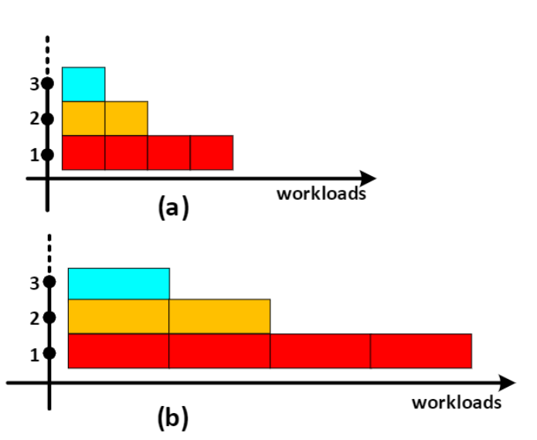
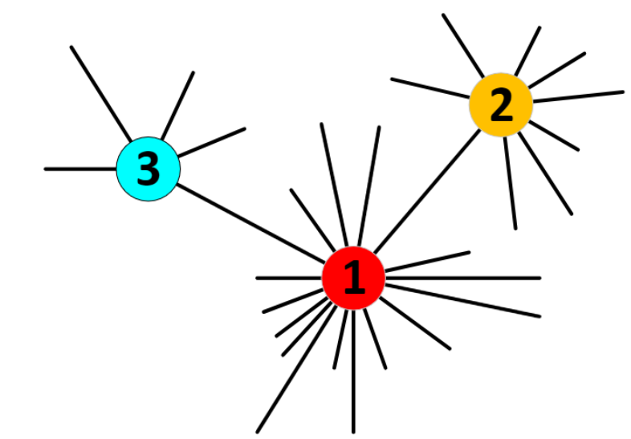
Motivation
Node Degree Impacts on Workload
(a) is Graph Processing Algorithms (e.g., PageRank) (b) is GNNs

Slide 13
Motivation
Node Embedding Invalidates the Original Graph Processing Optimization Strategy
Graph Processing System:
Embedding/Attribute : [2,]
GNN:
Embedding/Attribute : [1, 2, 3, ……, 255, 256]

Slide 14
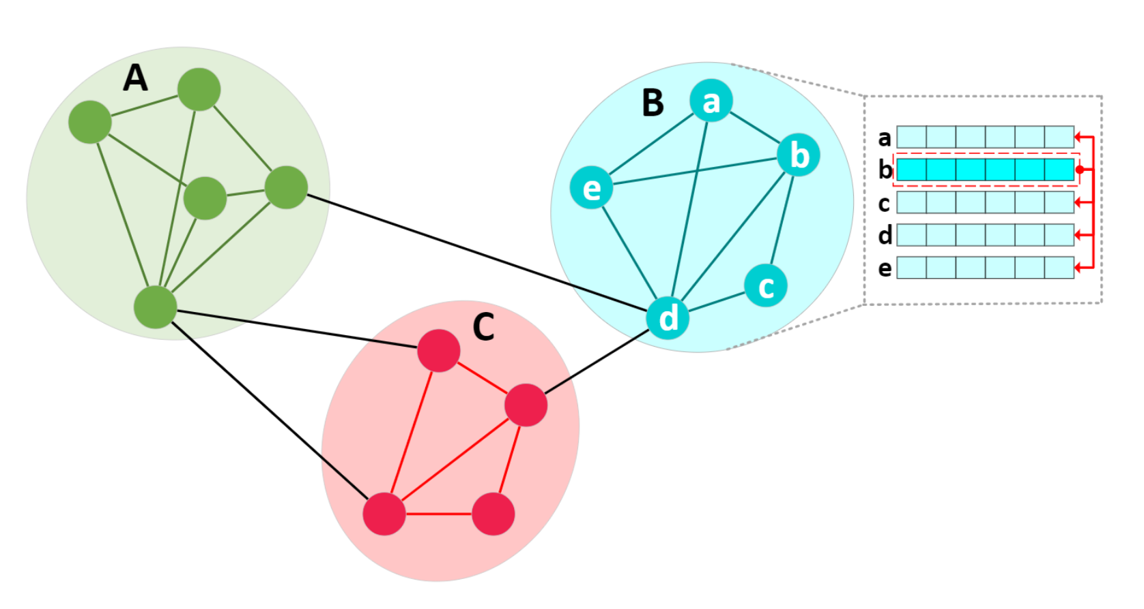
Motivation
Graph Community Impacts on Locality.

Slide 15
Outline
1
Background
2
Motivation
3
System design and implementation
4
Evaluation and results
5
Conclusion
Notes:
Partial-Order Restrictions (or short, PoR) Consistency

Slide 16
Design & Implement
Node Degree
Hyper-param : Group Size
A
A
A
Node-centric
Edge-centric
Group-based

Slide 17
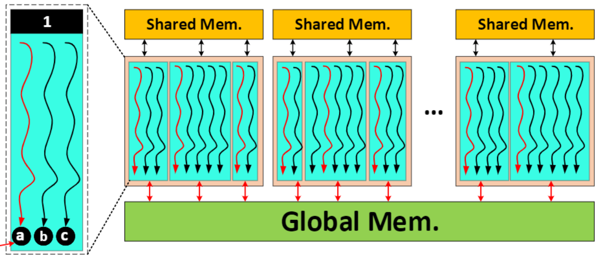
Design & Implement
Node Degree
1
Leader Node
Leader Thread (Write Node 1 to Global Mem)

Slide 18
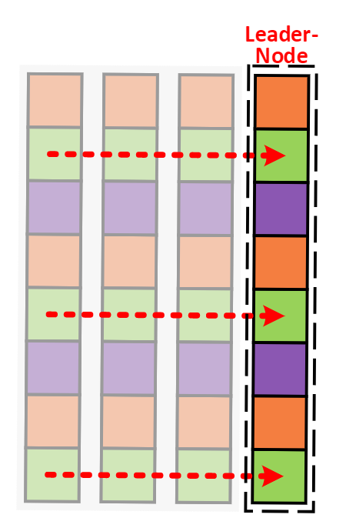
Design & Implement
Node Embedding
Hyper-param : Dimension Worker
A

Slide 19
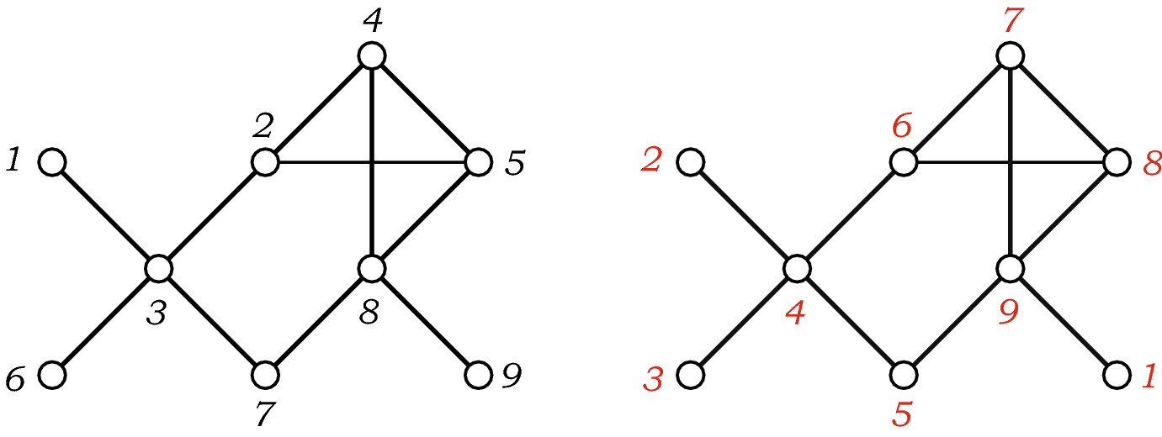
Design & Implement
Graph Community
Block-aware mapping:
Try to allocate neigh-nodes in the same block

Slide 20
Design & Implement
Modeling:
Hyper-parameters:
Group Size (gs)
Dimension Worker (dw)
Thread-per-block (tpb)

Slide 21
Design & Implement
gs : group size, tpb : thread per block, dw : dimension worker
N : num of node, E : num of edge, D : node embedding dimension, $α$ :${ stddev}_{degress}$
max_tpb : the maximum number thread a block can hold
computation_capability
share_memory_capacity
$Latency= \frac{E × D}{gs ×\left| dw −\frac{D}{3} \right| ×\left| tpb − \sqrt{max_tpd} \right|} ×\left(1+\right|gs −α\frac{N}{E}|)$
$$0<gs ×\frac{D}{dw}<computation_capability$$
$$0< \frac{1}{avg_degree}×\frac{tpd ×gs}{dw}D ×byte_{tpye}<share_memory_capacity$$

Slide 22
Design & Implement
Estimating
$Latency= \frac{E × D}{gs ×\left| dw −\frac{D}{3} \right| ×\left| tpb − \sqrt{max_tpd} \right|} ×\left(1+\right|gs −α\frac{N}{E}|)$
$$0<gs ×\frac{D}{dw}<computation_capability$$
$$0< \frac{1}{avg_degree}×\frac{tpd ×gs}{dw}D ×byte_{tpye}<share_memory_capacity$$
randomly generated settings based on the prior;
approximate their performance based on the modeling;
do crossover on these good settings to generate a new set of settings for the next iteration beginning from step2.

Slide 23
Design & Implement

Slide 24
Outline
1
Background
2
Motivation
3
System design and implementation
4
Evaluation
5
Conclusion
Notes:
Partial-Order Restrictions (or short, PoR) Consistency

Slide 25
Evalution
Model
Graph Convolutional Network(GCN) & Graph Isomorphism Network(GIN)
Dataset
Type I Graphs
small in the number of nodes and edges, rich in node embedding information with high dimensionality
Type II Graphs
consists of a set of small graphs, which only have intra-graph edge connections without inter-graph edge connection
Type III Graphs
large graphs in terms of the number of nodes and edges
Baseline
DGL, PyG, GunRock

Slide 26
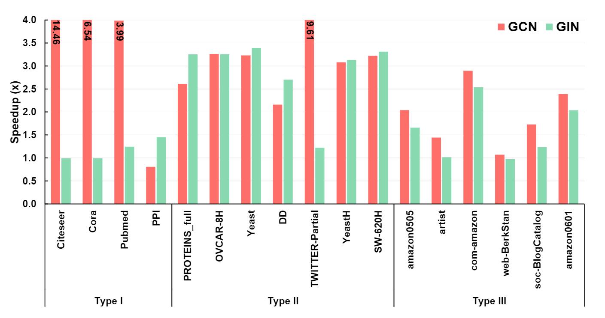
Evalution -- Compared with DGL

Slide 27
Evalution -- Compared with DGL

Slide 28
Evalution
Renumber

Slide 29
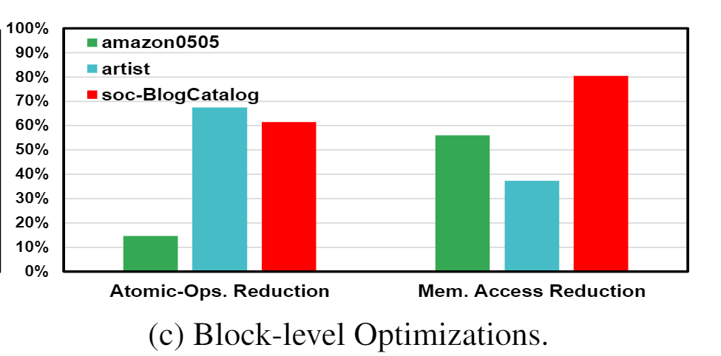
Evalution
Block-aware mapping:

Slide 30
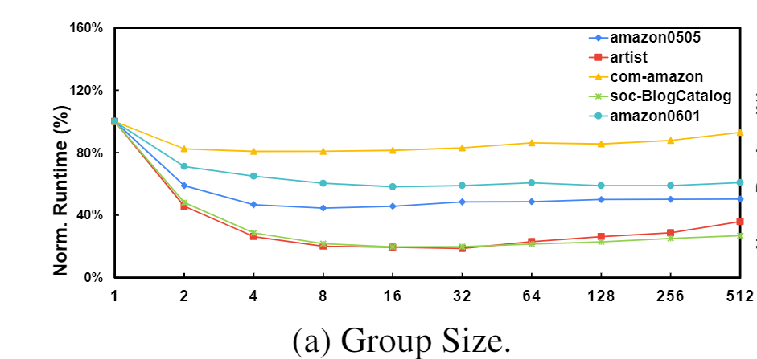
Evalution
Hyper-parameter

Slide 31
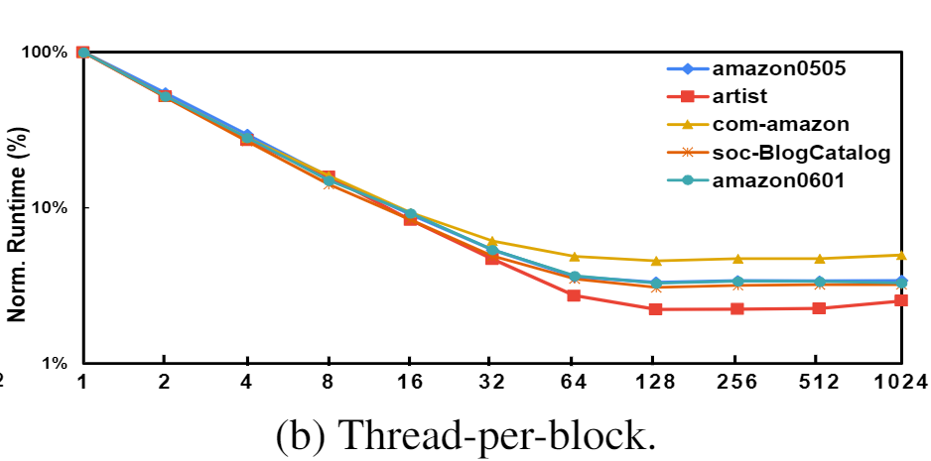
Evalution
Hyper-parameter

Slide 32
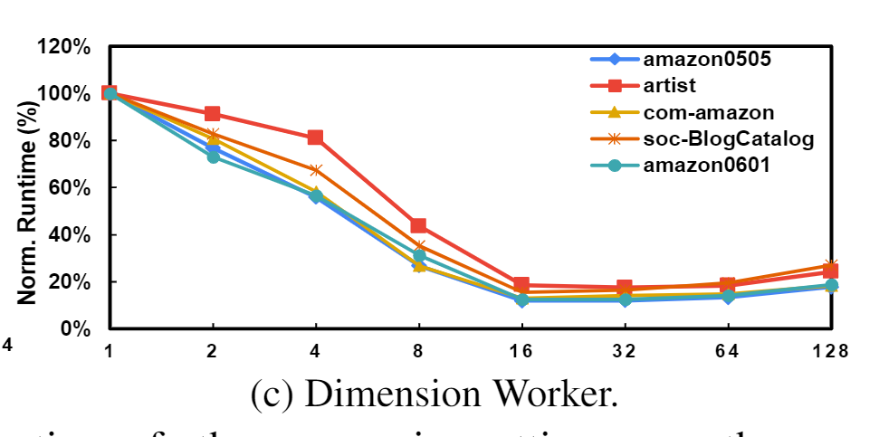
Evalution
Hyper-parameter

Slide 33
Outline
1
Background
2
Motivation
3
System design and implementation
4
Evaluation and results
5
Conclusion
Notes:
Partial-Order Restrictions (or short, PoR) Consistency

Slide 34
Conclusion
GNNAdvisior:
Efficient √
Core : group-base workload
Deep understanding -> Problem -> Simple but efficient solution

Slide 35
Thanks

