Slide 1
Zanzibar: Google’s Consistent,
Global Authorization System
Ruoming Pang,¹ Ramon C aceres, ¹ Mike Burrows,¹ Zhifeng Chen,¹
Pratik Dave,¹ Nathan Germer,¹ Alexander Golynski,¹ Kevin Graney,¹
Nina Kang,¹ Lea Kissner,^{2∗} Jeffrey L. Korn,¹ Abhishek Parmar,^{3∗}
Christopher D. Richards,¹ Mengzhi Wang¹
Reporter: Jingze Huo
1 2 3

Slide 2
Outline
Introduction
Model and Language
Architecture and Implementation
Experience
Conclusion

Slide 3
Outline
Introduction
Model and Language
Architecture and Implementation
Experience
Conclusion

Slide 4
Consistent, Global Authorization System
Consistent？
A
B
Op₀
withdraw(50)
Money=100
Money=50
Money=30
S₀
S₁
S₃
t
Money=100
Not
Consistent!
Consistent!
S₀
S₂
S₃
t
Money=80
Money=30
withdraw(20)
Op₁

Slide 5
Consistent, Global Authorization System
Global
Tens of geographically distributed data centers
Distributes load across thousands of servers around the world

Slide 6
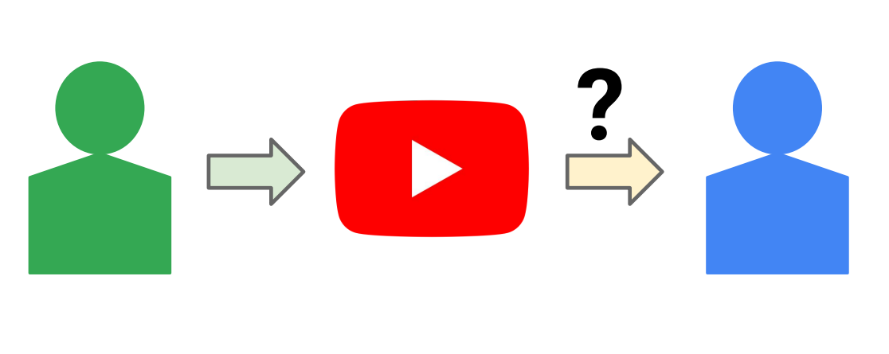
Consistent, Global Authorization System
Authorization System
Public or Private?
Robust authorization checks are central to preserving online privacy

Slide 7
Features of Zanzibar
Correctness
Respects causal ordering of updates to ACLs and objects
Flexibility
Supports a rich variety of access control policies
Low latency
Less than 10ms @ 95%, less than 100ms @ 99.9%
High availability
99.999% over the past 3 years
Large scale
Trillions of ACL entries, millions of checks/second

Slide 8
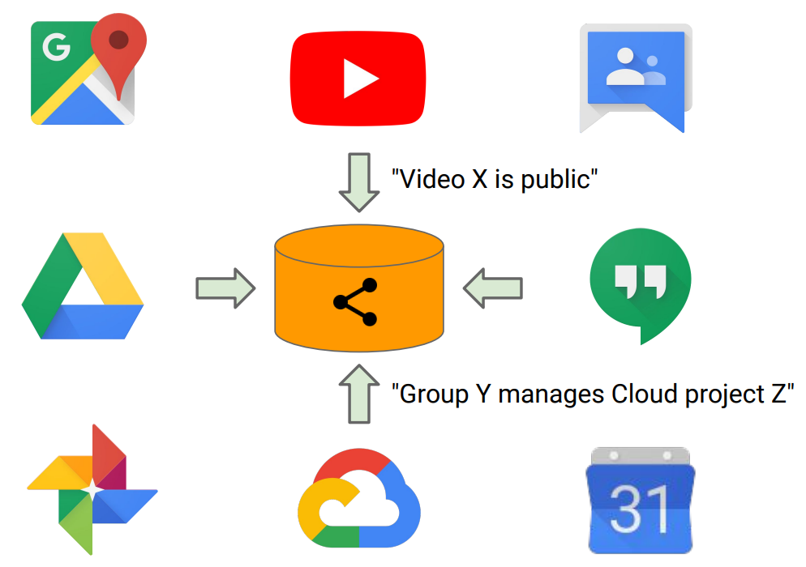
Access Control Lists (ACLs)
Zanzibar stores access control lists

Slide 9
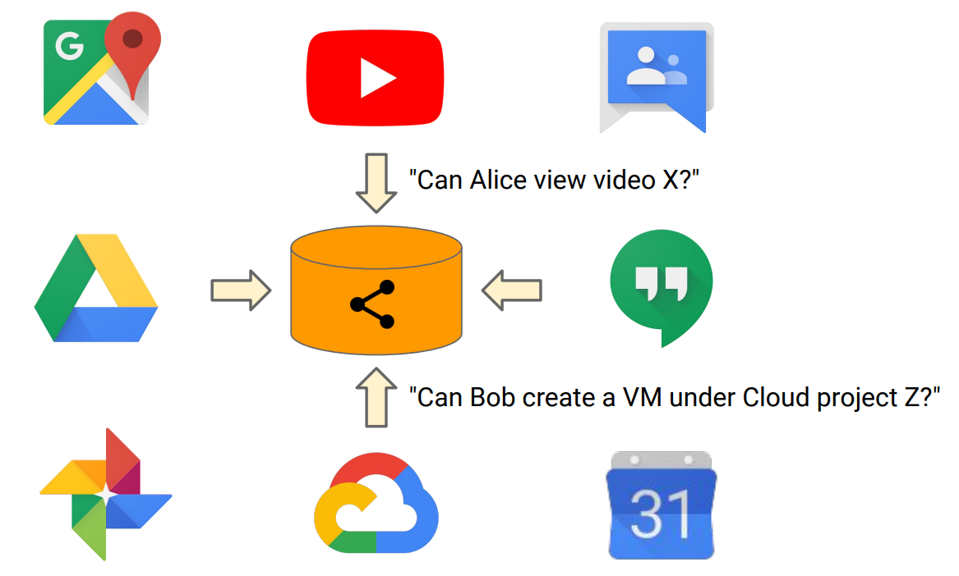
Access Control Lists (ACLs)
…and performs authorization checks based on stored ACLs

Slide 10
Outline
Introduction
Model and Language
Architecture and Implementation
Experience
Conclusion

Slide 11
Relation Tuples in ACL
In Zanzibar, ACLs are collections of object-user or object-object relations represented as relation tuples.
<tuple> ::= <object>‘#’ <relation> ‘@’ <user>
<object> ::= <namespace> ‘:’ <object id>
<user> ::= <user id> | <userset>
<userset> ::= <object> ‘#’ <relation>

Slide 12
Relation Tuples in ACL
In Zanzibar, ACLs are collections of object-user or object-object relations represented as relation tuples.
<tuple> ::= <object>‘#’ <relation> ‘@’ <user>
<object> ::= <namespace> ‘:’ <object id>
<user> ::= <user id> | <userset>
<userset> ::= <object> ‘#’ <relation>

Slide 13
Relation Tuples in ACL
In Zanzibar, ACLs are collections of object-user or object-object relations represented as relation tuples.
<tuple> ::= <object>‘#’ <relation> ‘@’ <user>
Example Tuple in Text Notation
doc:readme#owner@10
group:eng#member@11
doc:readme#viewer@group:eng#member
doc:readme#parent@folder:A#...

Slide 14
Namespaces, relations, usersets, and tuples
Namespace : videos
Check results:
video X, viewer, user A? Yes
video X, viewer, user B? No
video Y, viewer, user A? Yes
video Y, viewer, user B? Yes
Object | Relation | Userset
video X | viewer | user A
video Y | viewer | All Users
AMD, Yes!

Slide 15
Namespaces, relations, usersets, and tuples
Userset indirection can create deep/wide hierarchies
Namespace : videos Namespace : groups
Object | Relation | Userset
video X | viewer | user A
video Y | viewer | (group 1, member)
Object | Relation | Userset
group 1 | member | user B
group 1 | member | user C
Check results:
video Y, viewer, user B? Yes
video Y, viewer, user D? No

Slide 16
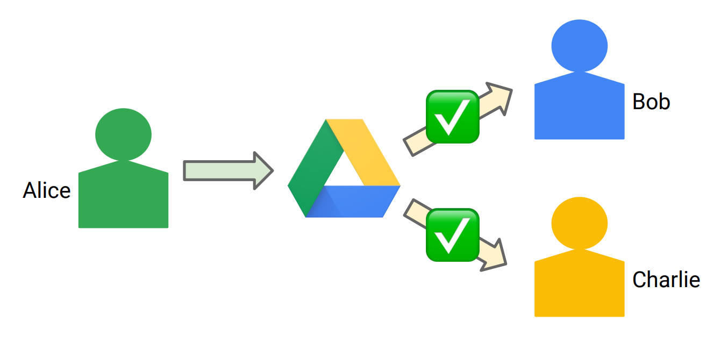
Consistency Model
“New enemy” Problem

Slide 17
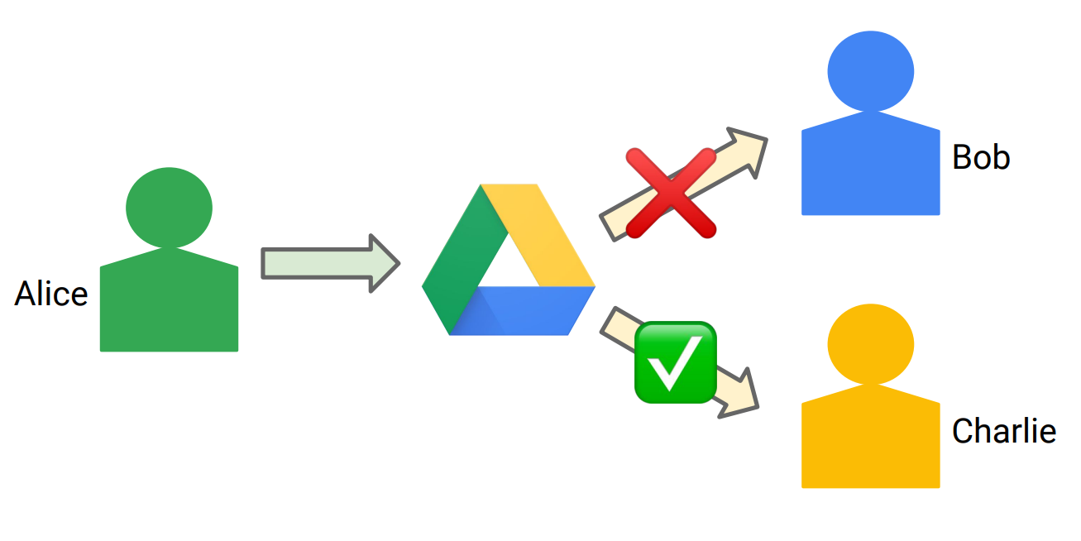
Consistency Model
“New enemy” Problem

Slide 18
Causal Consistency Based on Spanner
Causal Consistency
A
B
wakeup()
brushTeeth()
Sleep
Awake
Happy
S₀
S₁
S₂
t
S₀
S₃
S₄
t
Sleep
？
Sad
Confusing

Slide 19
Causal Consistency Based on Spanner
Causal Consistency
brushTeeth() must happened after wakeup()
A
B
wakeup()
brushTeeth()
Sleep
Awake
Happy
S₀
S₁
S₂
t
S₀
S₁
S₂
t
Wait!
Sleep
Awake
Happy
That’s good!

Slide 20
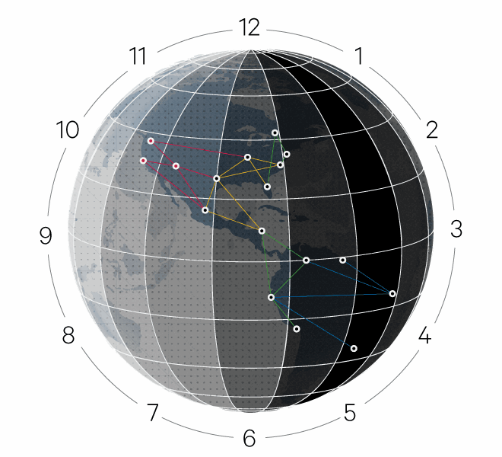
Causal Consistency Based on Spanner
Spanner’s TrueTime ensures every data center has the same time^{[1]}.
We can associate updates with timestamp to create the order.
[1]:Leverages Spanner’s TrueTime mechanism [Corbett et al. 2012]

Slide 21
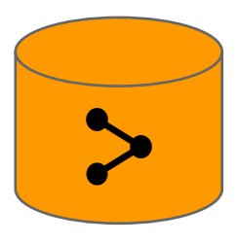
Causal Consistency Based on Spanner
Each ACL or content update will be assigned a timestamp by Zanzibar.
Example: if two causally related updates x ≺ y , then
will be assigned timestamps that reflect the causal order
Tx < Ty
Read at time T
Observers all updates with timestamp ≤ T

Slide 22
Causal Consistency Based on Spanner
Zookie: an opaque byte sequence encoding
a timestamp,
a client content version,
or a read snapshot.
Write at time T
Requests a zookie that has a timestamp T

Slide 23
An Example:

Slide 24
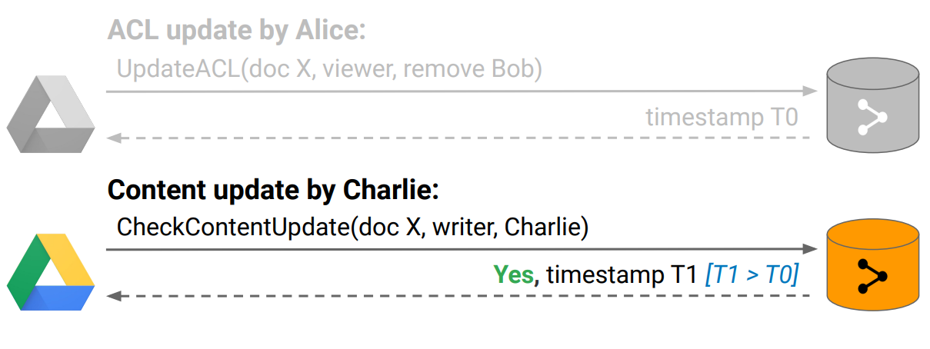
An Example:

Slide 25
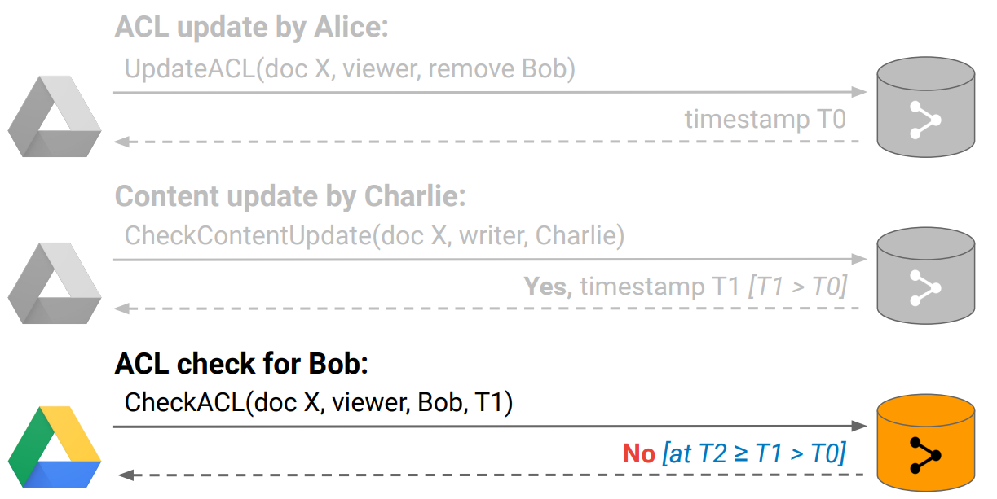
An Example:

Slide 26
Outline
Introduction
Model and Language
Architecture and Implementation
Experience
Conclusion

Slide 27
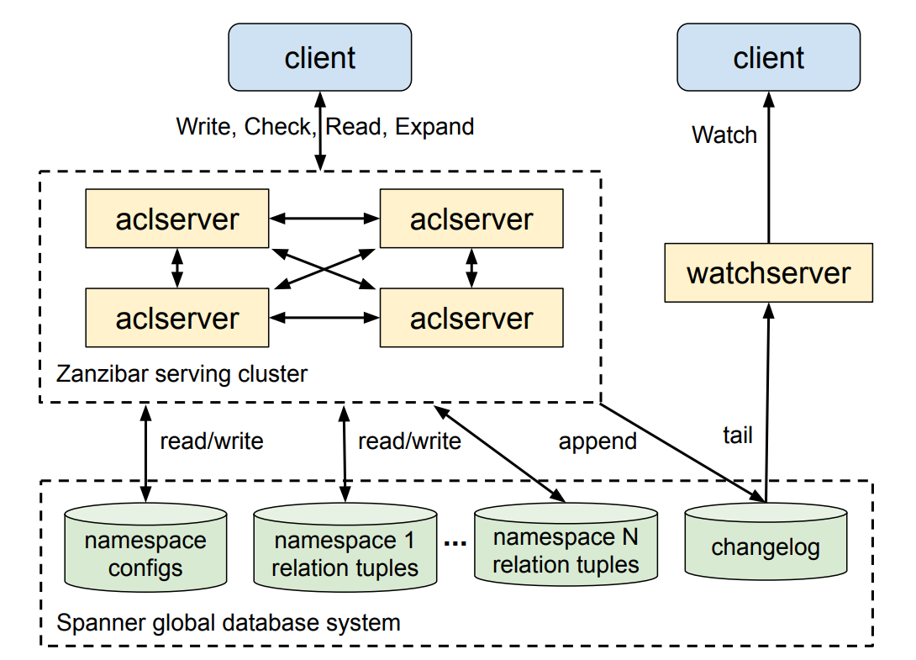
Architecture

Slide 28
Client
Freewheeling. → they will do what they want
High concurrency. → millions of checks/second
Picky. → want the best user experience

Slide 29
ACLServer Cluster
Main server type.
Response to requests.
Fan out works to others.
Gather the final result and return.

Slide 30
Watchserver
Specialized server type.
Response to Watch requests.
Tail the changelog.
Serve a stream of namespace changes to clients.

Slide 31
Spanner Database Cluster
Stores ACLs and their metadata.
One to store relation tuples for each client namespace.
One to hold all namespace configurations.
One to store changelog shared across all namespaces.

Slide 32
Implementation techniques
Timestamps chosen to reduce latency.
Hot-spot mitigation to increase availability
Request hedging to reduce tail latency
Isolation to protect against misbehaving clients

Slide 33
Outline
Introduction
Model and Language
Architecture and Implementation
Experience
Conclusion

Slide 34
Deployment
Zanzibar has been in production use for > 5 years
> 1,500 namespaces defined by hundreds of clients
> 2 trillion relation tuples replicated in several dozen locations worldwide
> 10 million client queries per second, mostly read-only
> 10,000 servers in several dozen clusters worldwide

Slide 35
Latency
 |  | Latency in milliseconds, µ (σ)
 | API | 50%ile | 95%ile | 99%ile
Safe | Check | 3.0 (0.091) | 9.46 (0.3) | 15.0 (1.19)
 | Read | 2.18 (0.031) | 3.71 (0.094) | 8.03 (3.28)
 | Expand | 4.27 (0.313) | 8.84 (0.586) | 34.1 (4.35)
Recent | Check | 2.86 (0.087) | 60.0 (2.1) | 76.3 (2.59)
 | Read | 2.21 (0.054) | 40.1 (2.03) | 86.2 (3.84)
 | Expand | 5.79 (0.224) | 45.6 (3.44) | 121.0 (2.38)
 | Write | 127.0 (3.65) | 233.0 (23.0) | 401.0 (133.0)

Slide 36
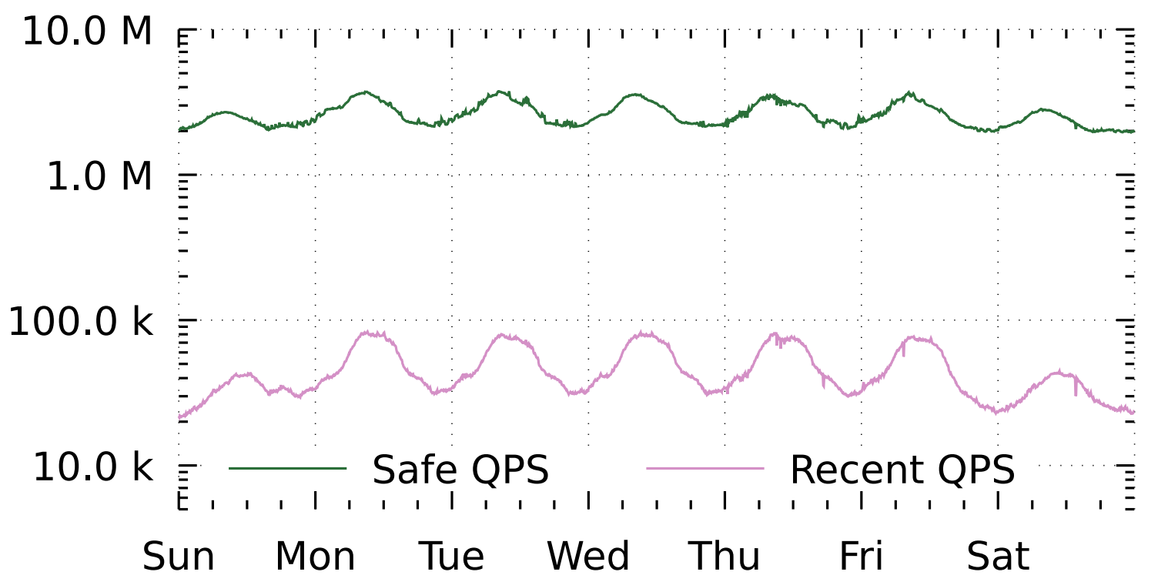
Check Queries per second
Checks peak at 4.2M QPS, Reads at 8.2M, Expands at 760K, Writes at 25K

Slide 37
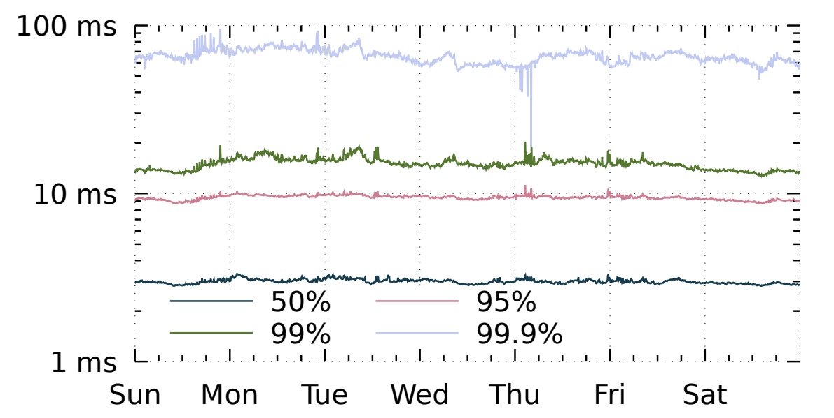
Check Safe Latency
95th-percentile latency is below 10 ms, 99.9th-percentile below 100 ms

Slide 38
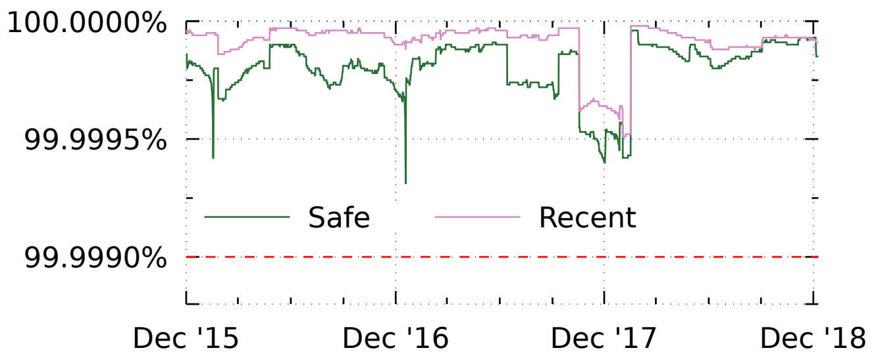
Availability
Availability over the last 3 years has remained above 99.999%

Slide 39
Lessons Learned
Access control patterns vary widely
Freshness requirements are often but not always loose
Request hedging is key to reducing tail latency
Hot-spot mitigation is critical for high availability
Performance isolation is indispensable to protect against misbehaving clients

Slide 40
Outline
Introduction
Model and Language
Architecture and Implementation
Experience
Conclusion

Slide 41
Conclusion
Robust authorization checks are central to preserving privacy
Zanzibar is a unified authorization system for Google services
Respects causal ordering of user actions
Supports a rich variety of access control policies
Offers low latency and high availability
Scales to trillions of ACL entries and millions of checks per second
Supports hundreds of services used by billions of people

Slide 42
Zanzibar: Google’s Consistent,
Global Authorization System
That’s all, Thank you!
Reporter: Jingze Huo

Slide 43
附录1：原子钟
说到原子钟，它最初本是由物理学家创造出来用于探索宇宙本质的;他们从来没有想过这项技术有朝一日竟能应用于全球的导航系统上。
根据量子物理学的基本原理，原子是按照不同电子排列顺序的能量差，也就是围绕在原子核周围不同电子层的能量差，来吸收或释放电磁能量的。这里电磁能量是不连续的。当原子从一个“能量态”跃迁至低的“能量态”时，它便会释放电磁波。这种电磁波特征频率是不连续的，这也就是人们所说的共振频率。同一种原子的共振频率是一定的—例如铯133的共振频率为每秒9192631770周。因此铯原子便用作一种节拍器来保持高度精确的时间。
1967年，由于原子钟的研究取得了丰富的成果，人们重新给秒下了定义，即按照铯原子的振荡频率来制定。今天的原子钟的精度可以达到每十万年误差不超过一秒。

Slide 44
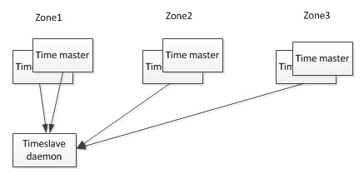
附录2：TrueTime实现
TrueTime是通过以下架构实现的:
每个datacenter具有若干个time master, 另外每台设备上运行有timeslave进程. 前者是Spanner的时钟来源, 大部分是配备GPS接收器,剩下一小部分配备原子钟(防止GPS的天线故障或者频率干扰, 所以也叫"末日时钟").

Slide 45
附录2： TrueTime实现
timeslave以30s的间隔从time master同步时间. 当timeslave需要校准local clock时, 从就近的datacenter和较远的datacenter的time master拉取时间信息, 并通过Marzullo算法[4]识别并丢弃异常的时间来源, 并将多个时间信息归并到一个统一的时间.
TrueTime API的直接数据来源是设备上的local clock. 所以TrueTime的误差来源有: 1. 从time master同步时的网络延迟, 导致的误差大概是1ms. 1. local clock的漂移, 这个误差是时间的锯齿函数, 校准后的一瞬间是0, 校准前的一瞬间是最大值, 范围在0~6ms.
所以TrueTime总的误差是1~7ms, OSID12论文表示平均是4ms左右.

Slide 46
附录3： 一些内容介绍
一致性哈希：
http://www.zsythink.net/archives/1199
https://blog.csdn.net/kefengwang/article/details/81628977
分布式系统一致性介绍：
https://blog.51cto.com/13580976/2161507
https://www.cnblogs.com/hzmark/p/consistency_model.html

