Slide 1
Fine-tuning giant neural networks on commodity hardware with automatic pipeline model parallelism
Saar Eliad, Ido Hakimi, Alon De Jager, Mark Silberstein, Assaf Schuster
Technion - Israel Institute of Technology
Presenter: Guodong Liu
Institute of Computing Technology, Chinese Academy of Sciences

Slide 2
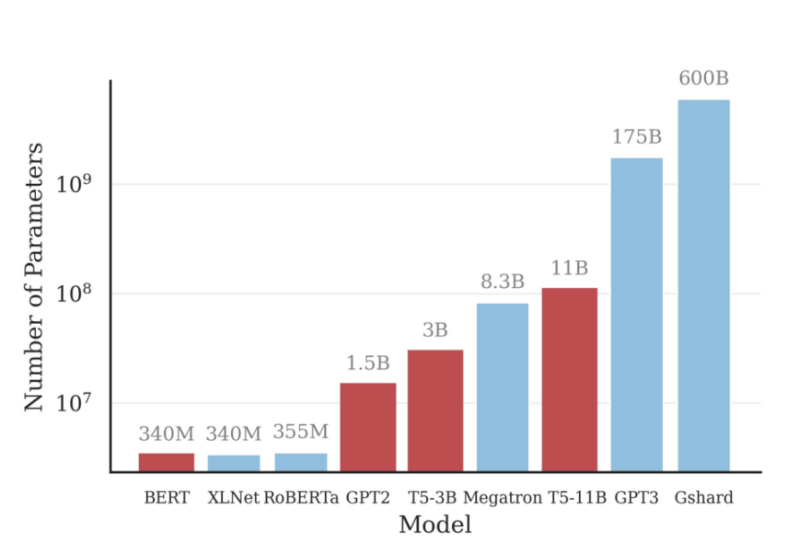
Background and Motivation The trend of giant neural networks
DNNs are getting larger
State-of-the-art NLP models (BERT-340M, GPT2-1.5B, and T5-3B) require e from 12GB to 59GB of GPU memory to fine-tune.
Figure 1. Model size trend.

Slide 3
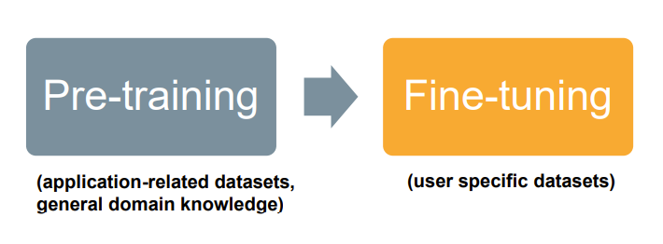
Background and Motivation Importance of fine-tuning
Pre-training is time-consuming and impossible without supercomputer-scale resources.
Fine-tuning operates on relatively small data sets and requires much less computing power to complete.
But fine-tuning still require the whole model to be resident in GPU memory.

Slide 4
Background and Motivation Memory reduction methods have high overheads
Swapping/Sharding: ineffective under slow PCIe communications.
Even worse in fine-tuning scenario:
Intra-layer model parallelism: also require communication (e.g. All-reduce), which is ineffective over PCIe.
Mini-batch size
Example from T5
comp
overhead
 | Pre-training | Fine-tuning
Minibatch size | 2048 | 8(most tasks), 128
comp
overhead
comp
overhead
comp
overhead
comp
overhead
comp
overhead

Slide 5
Background and Motivation Why pipeline model parallelism?
Figure 2. DNN parallelism schemes.[1]
Splits models layer by layer across GPUs
Enables communication-computation overlap
Low communication volume for giant models
Example of communication size of T5-3B (mini-batch size 4):
Data-parallel: 12GB per worker.
Pipeline-parallel: 458MB total.
[1] Ben-Nun, T., & Hoefler, T. (2019). Demystifying parallel and distributed deep learning: An in-depth concurrency analysis. ACM Computing Surveys (CSUR), 52(4), 1-43.

Slide 6
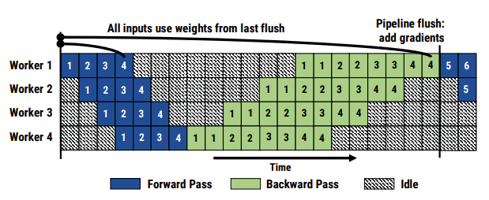
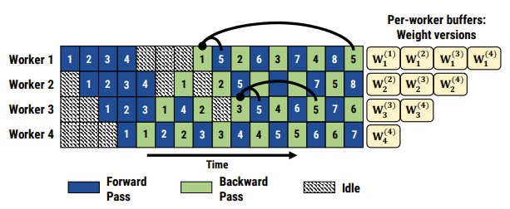
Background and Motivation State-of-the-art pipeline frameworks
Gpipe[1]: synchronous
Pipeline bubbles -> low hardware utilization
PipeDream[2]: asynchronous
Stores multiple version of weights
-> limits the size of models that can be trained.
Figure 3. Illustration of GPipe.[2]
Figure 4. Illustration of PipeDream.[2]
[1] Huang, Y., Cheng, Y., Bapna, A., Firat, O., … & Wu, Y. (2019). Gpipe: Efficient training of giant neural networks using pipeline parallelism. In Advances in Neural Information Processing Systems (pp. 103-112).
[2] Narayanan, D., Harlap, A., … & Zaharia, M. (2019). PipeDream: generalized pipeline parallelism for DNN training. In Proceedings of the 27th ACM Symposium on Operating Systems Principles (pp. 1-15).

Slide 7
Key Observation Topological constraints in pipeline partition causes load imbalance
Example: NLP model partitioning across 3 GPUs. If each GPU may run only consequent layers, there is no balanced partition
Figure 5. Partitioning unbalanced Encoder-Decoder models.
Figure 6. Visualization of imbalanced pipeline partition.

Slide 8
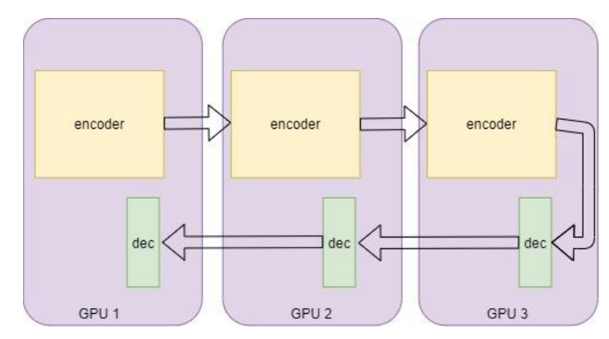
Insights Mixed-Pipe: balanced solution
Mixed-Pipe: A general partitioning scheme that significantly improves memory and compute load balancing while hiding communication overheads.
Figure 7. Balanced partition for Encoder-Decoder models.
Figure 8. Visualization of balanced pipeline partition.
Keeping the computations balanced is sometimes more important than reducing inter-GPU communications.

Slide 9
Background and Motivation Staleness
Figure 4. Illustration of PipeDream.
An asynchronous pipeline as in PipeDream begins the forward pass of the next mini-batch without waiting for the previous one to finish.
Staleness was shown to introduce significant disturbances to the training process[1][2].
[1] Wei Dai, Yi Zhou, Nanqing Dong, Hao Zhang, and Eric Xing. Toward understanding the impact of staleness in distributed machine learning. In International Conference on Learning Representations, 2019.
[2] Shuxin Zheng, Qi Meng, Taifeng Wang, Wei Chen, Nenghai Yu, Zhi-Ming Ma, and Tie-Yan Liu. Asynchronous stochastic gradient descent with delay compensation. In International Conference on Machine
Learning, pages 4120–4129. PMLR, 2017.

Slide 10
Key Observation Fine-tuning large models is less sensitive to staleness
Staleness is higher in the initial phase of the training (pre-training)[1].
Fine-tuning usually uses lower learning rates[2].
Momentum exacerbates staleness, but many fine-tuning tasks do not use momentum[3].
[1] Zhouyuan Huo, Bin Gu, and Heng Huang. Training neural networks using features replay. In Advances in Neural Information Processing Systems, pages 6659– 6668, 2018.
[2] Saar Barkai, Ido Hakimi, and Assaf Schuster. Gap-aware mitigation of gradient staleness. In International Conference on Learning Representations, 2020.
[3] Ilya Sutskever, James Martens, George Dahl, and Geoffrey Hinton. On the importance of initialization and momentum in deep learning. In International conference on machine learning, 2013

Slide 11
FTPipe: system overview
Input: model, dataset, hardware configuration and training configs.
Workflow:
Tracing execution
→ DAG composed of basic blocks.
Profiling
→ Memory and execution time of each basic block.
Model partitioning
& GPU assignment
→ Using Mixed-pipe / exhaustive Seq-pipe search / greedy Seq-pipe search
Work scheduling
→ Using 1F1B-like scheduling, sync / async

Slide 12
Model partitioning: Objective
The objective is to minimize the maximal stage period $T_{max}$among all the pipeline stages.
$$T_{i}=C+\max\left(0,T_{{comm}_{fwd}}−C\right)+max⁡(0,T_{{comm}_{bwd}}−C)$$
$$C=T_{{compute}_{fwd}}+T_{{compute}_{bwd}}$$

Slide 13
Mixed-pipe: High level algorithm
Input: a graph with compute time and memory consumption of each operator.
Step 1 : Coarsening, create L pipeline stages
Step 2 : Load balancing
Step 3 : Uncoarsening, refinement

Slide 14
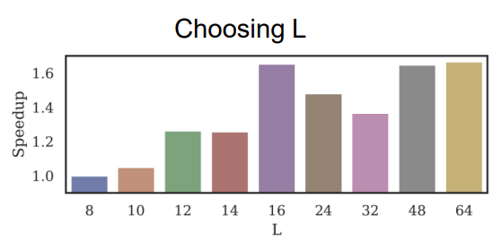
Mixed-pipe: Step 1: Coarsening
Create 𝑳 > 𝑃 pipeline stages from 𝑁 nodes. (typically – thousands of nodes to small 𝐿, e.g., 𝐿 = 2𝑃, 3𝑃)
Heuristics for coarsening:
Starting from smallest node, merge until CCO.
CCO (Communication-Computation-Overlap) block: A block is CCO block when the ratio between computation and communication is sufficiently high:
$T_{{comm}_{fwd}}^{i}−C_{i}≤0, T_{{comm}_{bwd}}^{i}−C_{i}≤0$
Coarsening by type.
Coarsening around centers.
Figure 9. Mixed-pipe performance for different values of L.

Slide 15
Mixed-pipe: Step 2: Load balancing
With the CCO property, the problem becomes classical multiprocessor scheduling problem.
Longest-Processing-Time-First heuristic is used.
Mixed-pipe: Step 3: Refinement
Uncoarsening the 𝑳 stages into basic blocks.
Greedily find blocks which, if moved to adjacent stages can improve the throughput.

Slide 16
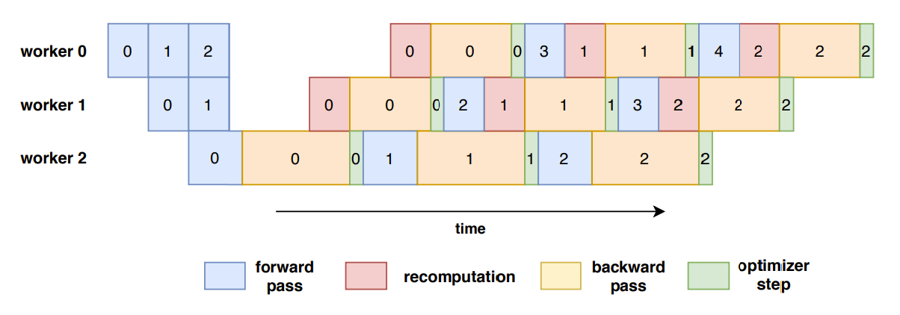
FTPipe: asynchronous pipeline + recomputation
Figure 10. Illustration of FTPipe.
Recomputation is used to save memory but it also mitigates staleness.

Slide 17
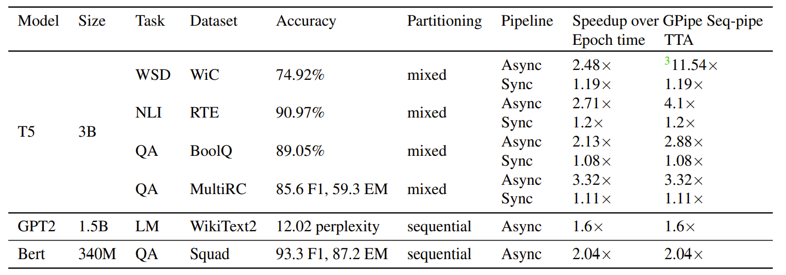
Evaluation: End-to-end
Table 1: Summary of the comparison of FTPipe with
original GPipe Seq-pipe (synchronous pipeline, one stage per GPU) over 8 GPUs
FTPipe achieved faster training without accuracy loss compared to GPipe

Slide 18
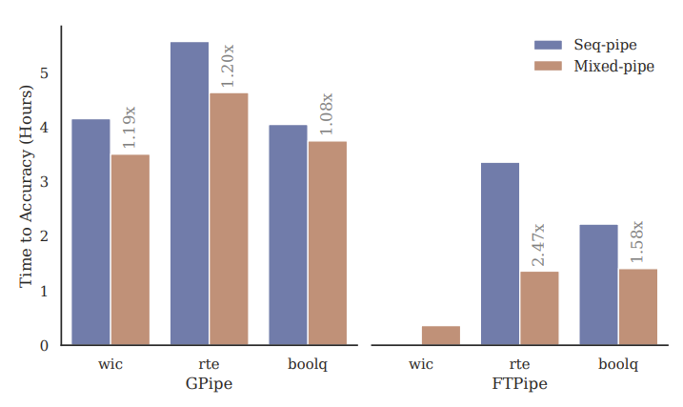
Evaluation: Mixed-pipe vs Seq-pipe
Figure 11. Mixed-pipe speedup over Seq-pipe for reaching top accuracy with T5-3B on three datasets and two pipelines: GPipe (synchronous) and FTPipe (asynchronous).
Mixed-Pipe is useful for both sync and async pipelines

Slide 19
Evaluation: asynchronous training
Figure 12. FTPipe acceleration over GPipe for fine-tuning T5-3B with Glue RTE dataset.
Asynchronous training and mixed-pipe does not hurt accuracy

Slide 20
Summary
FTPipe is a system for fine-tuning giant DNNs with limited resources.
Mixed-Pipe overcomes topology constraints.
Better load balance – no accuracy loss!
Asynchronous fine-tuning: staleness is not a problem when fine-tuning.
Up to 3x faster fine-tuning of giant Transformers with billions of parameters.

