Slide 1
Semi-Dynamic Load Balancing: Efficient Distributed Learning in Non-Dedicated Environments
Shared By Shiyi Wang, Mingxiang Lu
Dec 23th, 2020

Slide 2
Outline
Background
Related work
Design
Experiments and Evaluation
Conclusion

Slide 3
Distributed Machine Learning
Distribute the model training process to multiple workers:
Bulk Synchronous Parallel(BSP):
Barrier
Parameter Server
Worker1
ω
gn
g1
ω
g2
ω
Worker2
Worker1
Worker2
……
Workern
Worker3
B1
B2
……
Bn
Worker4
Sample Input Stream
Iteration k
Iteration k+1
Iteration k+2
Notes:
a most popular worker coordination scheme

Slide 4
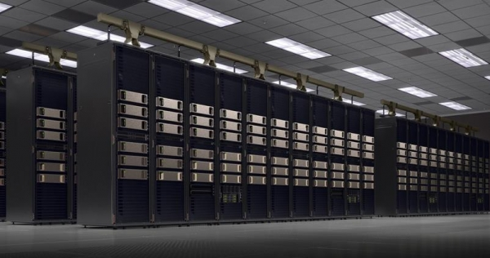
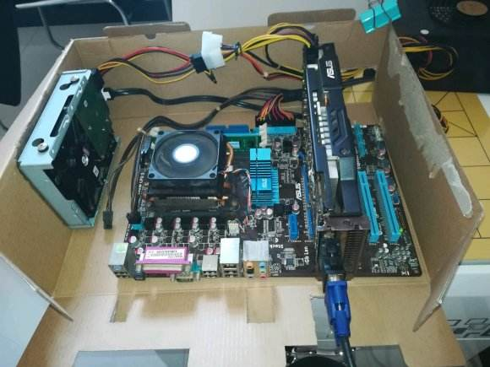
Cluster Environments for Distributed Learning
Dedicated Clusters
Non-Dedicated Clusters
Homogeneous Hardware
No Sharing
Expensive and Scarce
Heterogeneous Hardware
Dynamic Resource in Shared Cluster
Cheap and Abundant
Notes:
Local inventory or Spot market

Slide 5
Stragglers in Distributed Model Training
Non-deterministic Stragglers
Deterministic Stragglers
Worker1
Worker1
Worker2
Worker2
Worker3
Worker3
Worker4
Worker4
Iteration k
Iteration k+1
Iteration k+2
Iteration k
Iteration k+1
Iteration k+2
 | Non-deterministic Stragglers | Deterministic Stragglers
Causes | OS jitter, Garbage Collection | Inconsistent Resource Quality/Quantity
Existence | Dedicated & Non-dedicated Clusters | Only in Non-dedicated Clusters
Characteristics | Transient & Slight | Long-lasting & Salient
Significance | Low | High

Slide 6
Outline
Background
Related work
Design
Experiments and Evaluation
Conclusion

Slide 7
Bypassing Stragglers
With Relaxed Synchronization
Asynchronous Parallel (ASP)
Stale Synchronous Parallel (SSP)
Workers iterate independently
More iterations required to converge
Bound the max iteration gap among workers
Iteration Gap quota easily used up
Worker1
Worker1
Worker2
Worker2
Worker3

Slide 8
Mitigate Stragglers
By Redundant Execution
Training models with backup workers and
synchronize a subset finishing the earliest
Worker1
Worker2
Worker3
Worker4
Iteration k
Iteration k+1
Iteration k+2

Slide 9
Eliminate Stragglers
By Load Balancing
Static Load Balancing
Dynamic Load Balancing
Given scheme(e.g. Round-Robin)
Low overhead
Cannot react to resource variations
Work-stealing(e.g.FlexRR）
Responding to dynamic changes
Much higher overhead
All-or-nothing processing

Slide 10
Design Objectives
Worker Coordination Schemes | Practical (ML Framework Compatibility) | Effective (Fast training Convergence) | Efficient (Low Overhead)
ASP | √ | × | √
SSP | √ | × | √
Redundant Execution(+BSP) | √ | × | ×
Static Load Balancing(+BSP) | √ | × | √
Dynamic Load Balancing(+BSP) | × | √ | ×
? | √ | √ | √

Slide 11
Semi-dynamic Load Balancing
Static Load within each iteration
[Pros]Light-weight
[Pros]Compatible with the tensor-based batch processing style
Dynamic Load across different iteration
Load balance at iteration boundaries of BSP
[Pros]Effective for resource variations

Slide 12
Outline
Background
Related work
Design
Experiments and Evaluation
Conclusion

Slide 13
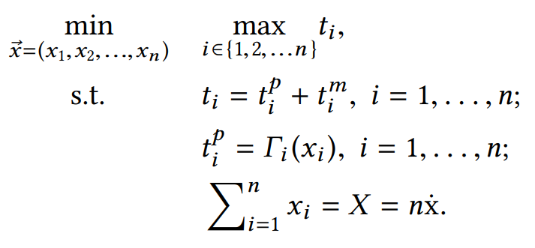
Problem Formulation
Worker1
Worker2
Worker3
Worker4
Iteration k
Iteration k+1
Iteration k+2
$\vec{x}$ = ($x_{1}$, $x_{2}$, ...,$x_{n}$) :
worker batch size
$t^{p}$: Computation time
$t^{m}$: Communication time

Slide 14
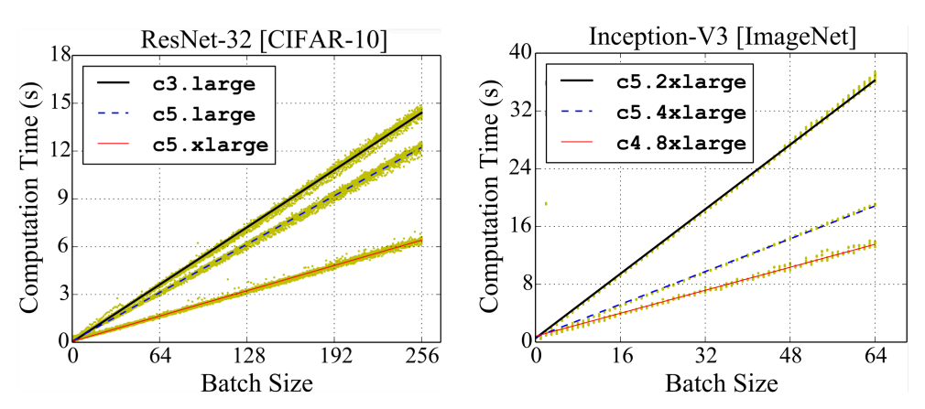
LB-BSP in CPU Clusters
Characteristics:
Negligible Communication Time
Linear Relationship
Notes:
Use cases:
Training non-neural-network model
Demand less computing resource(e.g. SVM, LR)
Training not-so-urgent model
To improve cluster utilization

Slide 15
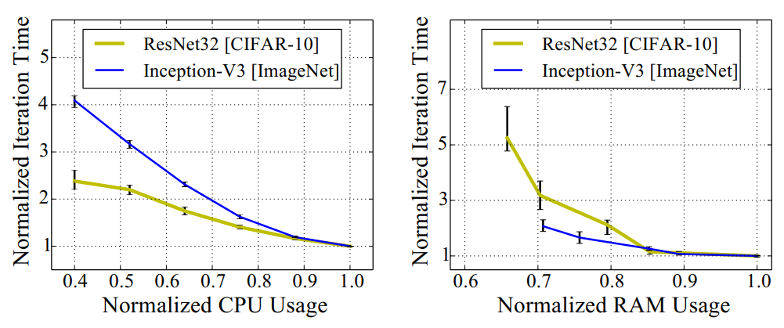
LB-BSP in CPU Clusters
Other factors:
CPU Usage
RAM Usage

Slide 16
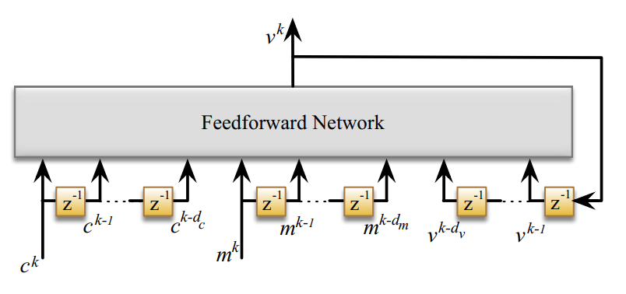
Predicting Sample Processing Speed
Potential Approaches
Memoryless
Exponential Moving Average(EMA)
Autoregressive Integrated Moving Average (ARIMA)
Plain RNN & LSTM
Nonlinear AutoRegressive eXogenous (NARX)
-extended RNN
Notes:
A NARX model for each worker for high prediction accuracy
Look-back window sizes set to 2
to avoid over-fitting and converge fast

Slide 17
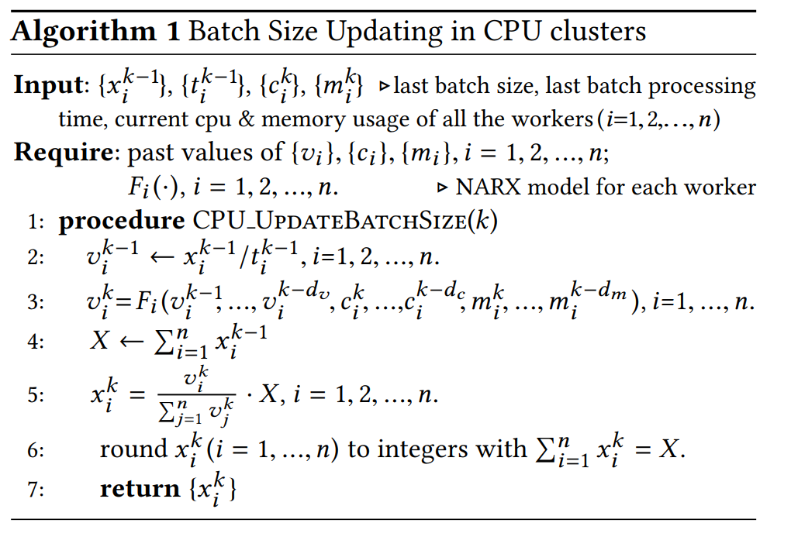
Analytical Method

Slide 18
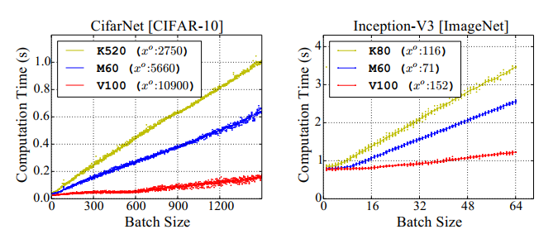
LB-BSP in GPU Clusters
Characteristics:
Non-negligible Communication Time
Non-negligible GPU Launching Overhead
GPU Saturation Effect: $Γ\left(x\right)=c，∀x<x^{s}$
GPU Memory Limitation: $x<x^{o}$

Slide 19
Challenges & Opportunities
Challenges:
analytical method is in appropriate
Opportunities:
Batch processing time increases monotonically with batch size.
Worker performance is stable in most consecutive iterations
Numerical approximation method
Notes:
Profiling non-linear relationship incurs extra programming and time overhead.

Slide 20
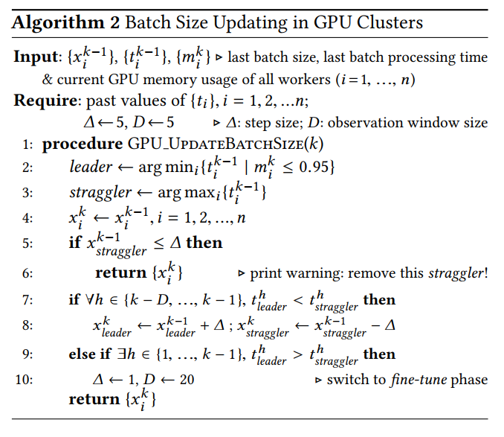
Numeral Method
Two roles:
Leader
Straggler
Two phases:
Fast-approach
Fine-tune

Slide 21
Weighted Gradient Aggregation
Naïve Aggregation:
Weighted Gradient Aggregation:

Slide 22
Outline
Background
Related work
Design
Experiments and Evaluation
Conclusion

Slide 23
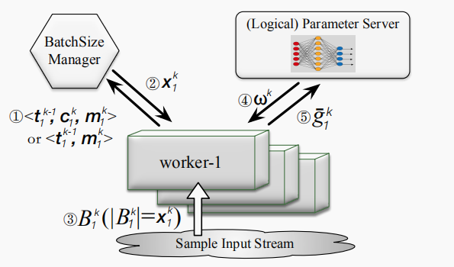
LB-BSP implementation
BatchSizeManager
A Python module pluggable for modern ML frameworks

Slide 24
Experimental Setup
16-node GPU cluster
32-node CPU cluster
Instance Type | GPU Type | Number
p3.2xlarge | Tesla V100 GPU | 4
g3.4xlarge | Tesla M60 GPU | 4
p2.xlarge | Tesla K80 GPU | 4
g2.2xlarge | GRID K520 GPU | 4
Instance Type | CPU (core) | RAM (GB) | Number
m4.2xlarge | 8 | 32 | 17
c5.2xlarge | 8 | 16 | 10
r4.2xlarge | 8 | 61 | 2
m4.4xlarge | 16 | 64 | 2
m4.xlarge | 4 | 16 | 1

Slide 25
Experimental Setup
Model && Datasets
Model | Dataset | Size
CifarNet | CIFAR-10 dataset | 60000 training images in 10 classes[1]
ResNet-32 | CIFAR-10 dataset | 16
Inecption-V3 | ImageNet dataset | 1.28 million training images in 1000 classes
SVM | Malicious URL | 2 million URLs
Notes:[1] http://www.cs.toronto.edu/~kriz/cifar.html

Slide 26
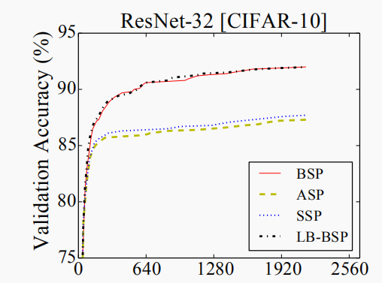
Evaluation in GPU Cluster
LB-BSP speeds up model convergence by over 54%
Much shorter iteration time Fewer iteration An overall improvement of 54%
Iteration Number

Slide 27
Reward in different Clusters
LB-BSP: a bigger reward in a larger worker cluster.
Instance Type | GPU Type | Number
p3.2xlarge | Tesla V100 GPU | 4
g3.4xlarge | Tesla M60 GPU | 4
p2.xlarge | Tesla K80 GPU | 4
g2.2xlarge | GRID K520 GPU | 4

Slide 28
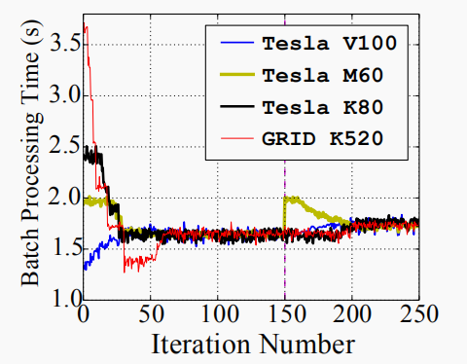
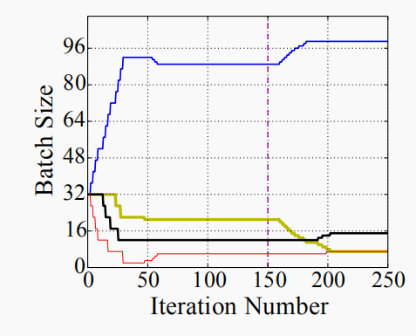
Micro-Benchmark in GPU Cluster
Cluster Setup:
4 different GPU work instances
Downgrade a worker’s bandwidth
at iteration 150
Bandwidth degradation is counteracted by
LB-BSP
Batch processing time gap can be minimized with batch size adjusted.
fast-approach phase to fine-tune phase

Slide 29
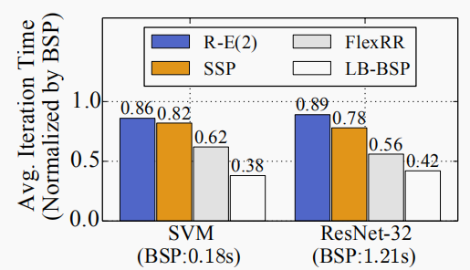
Evaluation in CPU Cluster
LB-BSP outperforms the second best (FlexRR) by 38.7%.

Slide 30
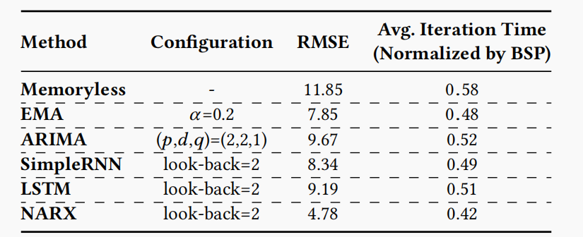
NARX Performance Deep Dive
Comparison with Other Approaches

Slide 31
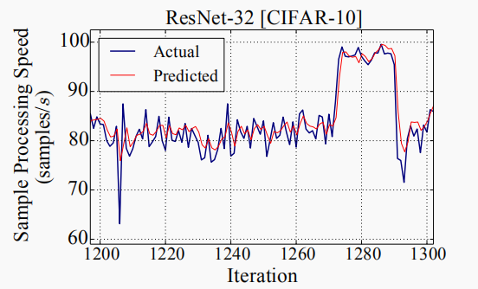
NARX Performance Deep Dive
A NARX prediction snapshot:
Robust to non-deterministic straggler
Sensitive to deterministic straggler
Promptly reply
Robustness

Slide 32
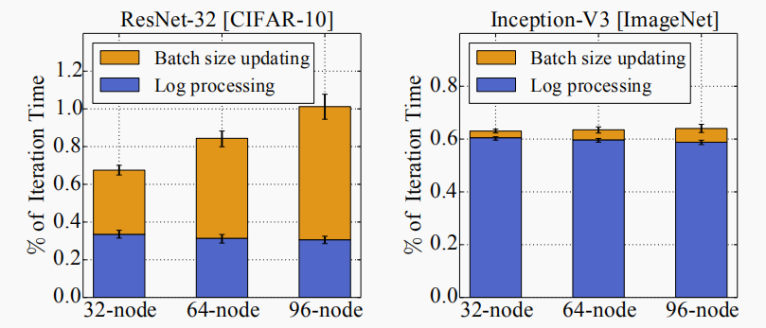
Overhead and Scalability
Total overheads are less than 1.1% of the iteration time

Slide 33
Outline
Background
Related work
LB-BSP
Experiments and Evaluation
Conclusion

Slide 34
Conclusion
Stragglers for distributed model training in non-dedicated clusters shall be load-balanced in a semi-dynamic manner
Batch size shall be adjusted in an analytical manner in CPU
clusters (with NARX prediction model) and in a numerical manner in GPU clusters, with weighted gradient aggregation enabled.
LB-BSP can speed up model convergence by up to 54%.

Slide 35
End
THANKS FOR WATCHING!

