Slide 1
ZeRO-Infinity: Breaking the GPU Memory Wall for Extreme Scale Deep Learning
May 4, 2022
Quan Zhou

Slide 2
Outlines
Background
ZeRO-Series
Techniques
Evaluation
Conclusions

Slide 3
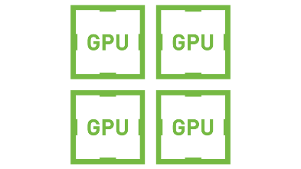
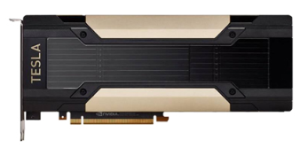
Model Size v.s. GPU Memory
Size comparison
175B parameters
≥19TB to store states
A100/V100
80GB/32GB
DGX-2 (16 V100 inside)
512GB
$400K per node

Slide 4
Model Size v.s. GPU Memory
Comparison of size
175B parameters
≥19TB to store states
A100/V100
80GB/32GB
DGX-2 (16 V100 inside)
512GB
$400K per node
Need 40 DGX-2 to train GPT-3, about $16M（1亿元）

Slide 5
Model Size v.s. GPU Memory
Comparison of growth trends
For last 3 years
Model size 1000x: 100B parameters (ELMo) → 100T parameters (GPT-3)
GPU memory 5x: 16GB → 80GB
即使独角兽级别的公司，
未来也难以承受训练更大模型的成本

Slide 6
Rising Problems
(致未来) 如何训练未来提出的更大的模型？(千万亿参数规模 v.s. 400GB单卡显存)
(看当下) 如何用有限的资源训练超大模型？
(便利性) 如何更简单的训练大模型？

Slide 7
Outlines
Background
Model Size v.s. limited GPU size
Rising problems
ZeRO-Series
Data Parallel
ZeRO
ZeRO-Offload
ZeRO-Infinity
Techniques
Evaluation
Conclusions

Slide 8
Outlines
Background
ZeRO-Series
Techniques
Evaluation
Conclusions

Slide 9
Single GPU training flow
Layer 1
Params: 40GB
Optimizer States: 80GB
Activations: 0
Layer 2
Params: 40GB
Optimizer States: 80GB
Activations: 0
1MB
Forward

Slide 10
Single GPU training flow
Layer 1
Params: 40GB
Optimizer States: 80GB
Activations: 0→20MB
Layer 2
Params: 40GB
Optimizer States: 80GB
Activations: 0
1MB
Forward

Slide 11
Single GPU training flow
Layer 1
Params: 40GB
Optimizer States: 80GB
Activations: 20MB
Layer 2
Params: 40GB
Optimizer States: 80GB
Activations: 0→20MB
1MB
Forward

Slide 12
Single GPU training flow
Layer 1
Params: 40GB
Optimizer States: 80GB
Activations: 20MB
Layer 2
Params: 40GB
Optimizer States: 80GB
Activations: 20MB
……
1MB
Forward

Slide 13
Single GPU training flow
Layer 1
Params: 40GB
Optimizer States: 80GB
Activations: 20MB
Layer 2
Params: 40GB
Optimizer States: 80GB
Activations: 20MB→0
Gradients: 40GB
……
1MB
Backward

Slide 14
Single GPU training flow
Layer 1
Params: 40GB
Optimizer States: 80GB
Activations: 20MB→0 Gradients: 0→40GB
Layer 2
Params: 40GB
Optimizer States: 80GB
Activations: 0
Gradients: 40GB
……
1MB
Backward

Slide 15
Single GPU training flow
Layer 1
Params: 40GB
Optimizer States: 80GB
Activations: 0
Gradients: 40GB→0
Layer 2
Params: 40GB
Optimizer States: 80GB
Activations: 0
Gradients: 40GB→0
……
Step
params, optimizer_states = step(params, optimizer_states, gradients)

Slide 16
Data Parallel
Layer 1
Params: 40GB
Optimizer States: 80GB
Activations: 20MB
Layer 2
Params: 40GB
Optimizer States: 80GB
Activations: 20MB
……
1MB
1MB
1MB
GPU 0

Slide 17
Data Parallel
Layer 1
Params: 40GB
Optimizer States: 80GB
Activations: 10MB
Layer 2
Params: 40GB
Optimizer States: 80GB
Activations: 10MB
……
0.5MB
0.5MB
0.5MB
GPU 0
Layer 1
Params: 40GB
Optimizer States: 80GB
Activations: 10MB
Layer 2
Params: 40GB
Optimizer States: 80GB
Activations: 10MB
……
0.5MB
0.5MB
0.5MB
GPU 1

Slide 18
Recomputation
Layer 1
Params: 40GB
Optimizer States: 80GB
Activations: 0MB
Layer 2
Params: 40GB
Optimizer States: 80GB
Activations: 0MB
……
0.5MB
0.5MB
0.5MB
GPU 0
Layer 1
Params: 40GB
Optimizer States: 80GB
Activations: 0MB
Layer 2
Params: 40GB
Optimizer States: 80GB
Activations: 0MB
……
0.5MB
0.5MB
0.5MB
GPU 1

Slide 19
ZeRO
Layer 1
Params: 20GB
Optimizer States: 40GB
Layer 2
Params: 20GB
Optimizer States: 40GB
……
0.5MB
0.5MB
0.5MB
GPU 0
Layer 1
Params: 20GB
Optimizer States: 40GB
Layer 2
Params: 20GB
Optimizer States: 40GB
……
0.5MB
0.5MB
0.5MB
GPU 1

Slide 20
ZeRO-Offload
Layer 1
Layer 2
……
0.5MB
0.5MB
0.5MB
GPU 0
Layer 1
Layer 2
……
0.5MB
0.5MB
0.5MB
GPU 1
Params: 40GB x N
Optimizer States: 80GB x N
CPU

Slide 21
ZeRO-Infinity
Layer 1
Layer 2
……
0MB
0MB
0MB
GPU 0
Layer 1
Layer 2
……
0MB
0MB
0MB
GPU 1
Activation checkpoints: 0.5 MB x N
CPU
Params: 40GB x N
Optimizer States: 80GB x N
NVMe

Slide 22
Outlines
Background
ZeRO-Series
Techniques
Evaluation
Conclusions

Slide 23
Techs for training unprecedented model scale
Question: How to train GPT-3 scale model with single DGX-2?
Params | Model States | Model states (single op) | Activations (single op)
1T | 18.31TB | 9.77GB | 3.56GB
Infos about model with 1T parameters
#Nodes | #GPUs | Total GPU mem | Total CPU mem | Total NVMe mem
1 | 16 | 0.5 TB | 1.5 TB | 28TB
Info about DGX-2
Notes:
固定一个例子，单个DGX-2中训练GPT-3级别的模型

Slide 24
Techs for training unprecedented model scale
Question: How to train GPT-3 scale model with single DGX-2?
Params | Model States | Model states (single op) | Activations (single op)
1T | 18.31TB | 9.77GB | 3.56GB
Infos about model with 1T parameters
#Nodes | #GPUs | Total GPU mem | Total CPU mem | Total NVMe mem
1 | 16 | 0.5 TB | 1.5 TB | 28TB
Info about DGX-2
Infinity offload engine: Offload model states to NVMe
Notes:
固定一个例子，单个DGX-2中训练GPT-3级别的模型

Slide 25
Techs for training unprecedented model scale
Question: How to train GPT-3 scale model with single DGX-2?
Params | Model States | Model states (single op) | Activations (single op)
1T | 18.31TB | 9.77GB | 3.56GB
Infos about model with 1T parameters
#Nodes | #GPUs | Total GPU mem | Total CPU mem | Total NVMe mem
1 | 16 | 0.5 TB | 1.5 TB | 28TB
Info about DGX-2
Memory-centric tiling: split single op
Notes:
固定一个例子，单个DGX-2中训练GPT-3级别的模型

Slide 26
Techs for training efficiency
Layer 1
Params: 40GB
Optimizer States: 80GB
Activations: 0MB
Layer 2
Params: 40GB
Optimizer States: 80GB
Activations: 0MB
……
0.5MB
0.5MB
0.5MB
Focused on training Transformer-like model with Adam optimizer, enabling mixed precision
Memory types | Required offload bandwidth
Parameters & gradients | ≥ 70GB/s
Optimizer states | ≥1.5TB/s
Activation checkpoints | 1-4GB/s
Notes:
固定一个例子，单个DGX-2中训练GPT-3级别的模型

Slide 27
w.r.t. Parameter & gradients
策略： partition & offload
offload带宽分析：
single node
Aggregated CPU→GPU: 48GB/s
GPUs → GPU: 150-300GB/s
multi nodes (N nodes)
Aggregated CPU→GPU: 48GB/s x N
GPUs → GPU: 60-100GB/s
Memory types | Required offload bandwidth
Parameters & gradients | ≥ 70GB/s
Optimizer states | ≥1.5TB/s
Activation checkpoints | 1-4GB/s

Slide 28
w.r.t. Optimizer States
策略：总量太大，必须offload到NVMe上
优化：optimizer更新部分留在CPU上做
offload带宽分析：
Aggregated bandwidth: 硬盘读取速度 x N(nodes)
Memory types | Required offload bandwidth
Parameters & gradients | ≥ 70GB/s
Optimizer states | ≥1.5TB/s
Activation checkpoints | 1-4GB/s

Slide 29
w.r.t. Activations
offload到CPU上
带宽分析：
CPU→GPU: 3GB/s
Memory types | Required offload bandwidth
Parameters & gradients | ≥ 70GB/s
Optimizer states | ≥1.5TB/s
Activation checkpoints | 1-4GB/s

Slide 30
Evaluation
Hardware:
32 DGX-2 (512 V100x32G)
800Gbps 节点间传输带宽
Models:
single DGX-2
model size: 10B→1T
32 x DGX-2
model size: 0.5T → 20T

Slide 31
Outlines
Background
ZeRO-Series
Techniques
Evaluation
Conclusions

Slide 32
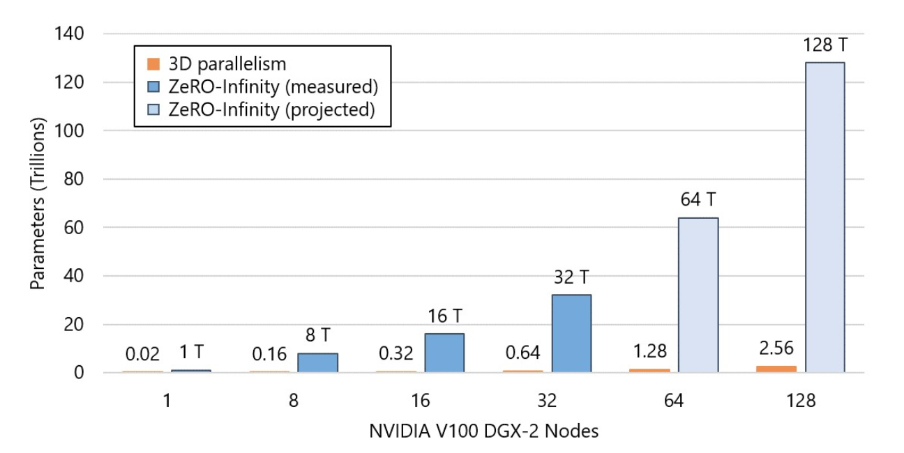
Model Size
50x larger trainable model size

Slide 33
Model Size
Analysis: The maximum trainable model size using 3D parallelism is limited by aggregated GPU memory
50x larger trainable model size

Slide 34
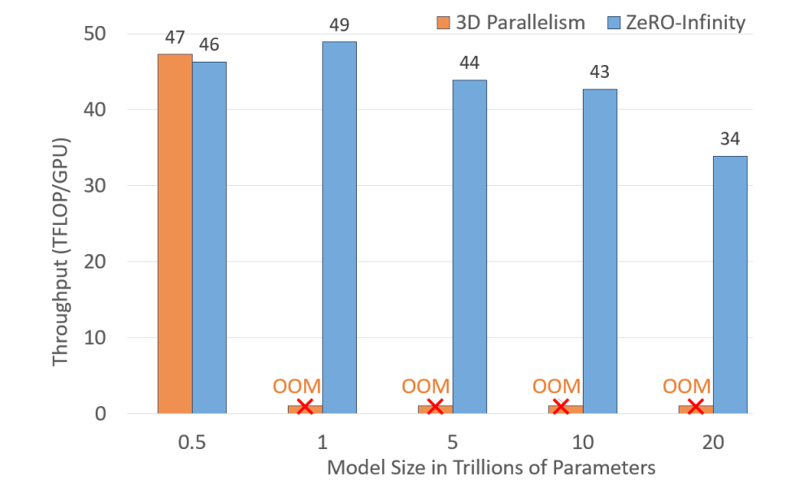
Model Speed

Slide 35
Model Speed
Comparable throughput with SOTA solution

Slide 36
Model Speed
Measured peak TFlops/GPU
Comparable throughput with SOTA solution
≥ 60% peak throughput
Notes:
512 GPUs

Slide 37
Model Speed
Comparable throughput with SOTA solution
≥ 60% peak throughput
CPU memory is not sufficient to hold activation checkpoints
Notes:
512 GPUs

Slide 38
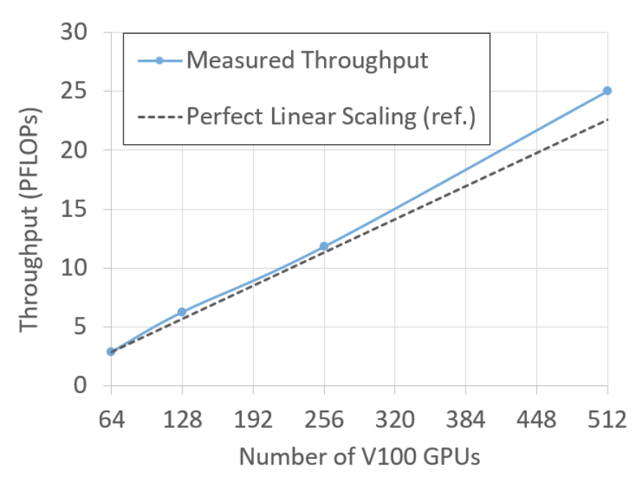
Scalability
Superlinear scalability

Slide 39
Scalability
When adding extra GPUs, the total amounts of parameters+gradients remains constant, but:
Aggregated CPU-GPU bandwidth increases, making offloading params/grads faster
Aggregated CPU computing power increases, making updating optimizer faster
Superlinear scalability

Slide 40
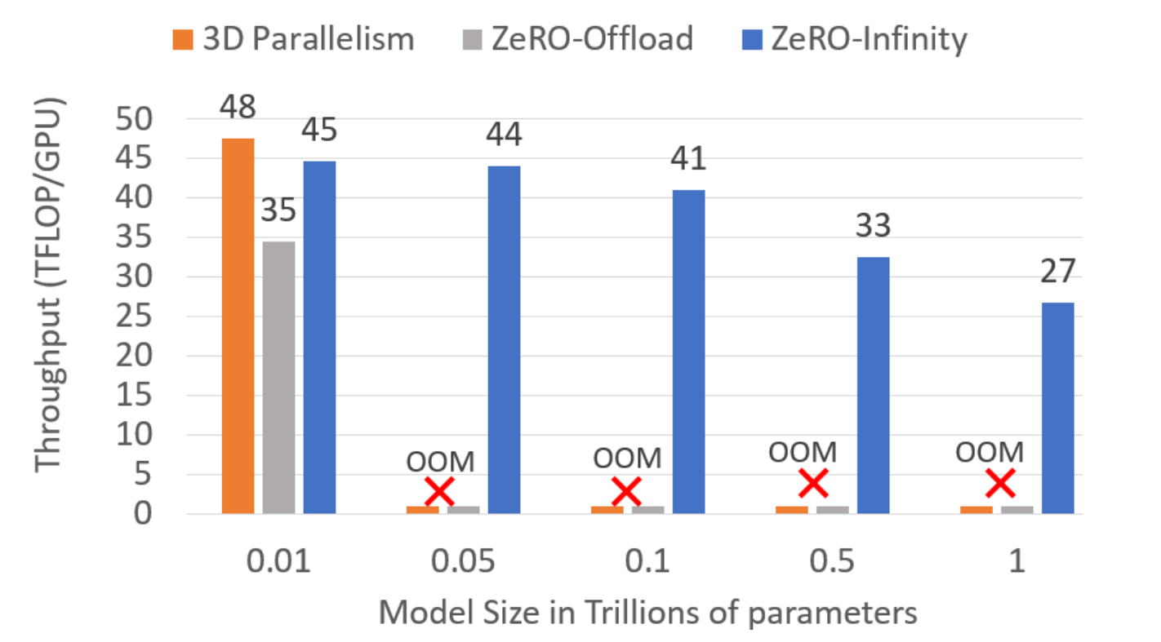
Democratizing Large Model Training
User can train model with up to 1T params using single DGX-2
Throughput is acceptable
Ease of use due to automated methods

Slide 41
Outlines
Background
ZeRO-Series
Techniques
Evaluation
Conclusions

Slide 42
Conclusions
It takes a huge leap of trainable model size
larger model size
less node (for fine-tuning)
ease of use
It points out the direction for the future hardware development
device compute power
device-device bandwidth

