Slide 1
High Velocity Kernel File Systems with Bento
Speaker: Jiahao Li, Yuming Xu
Authors: Samantha Miller, Kaiyuan Zhang, Mengqi Chen, and Ryan Jennings, Ang Chen, Danyang Zhuo, Thomas Anderson

Slide 2
Outline
1
Background
2
Bento Design
3
Implementation & Evaluation
4
Conclusion

Slide 3
Kernel FS Development is Slow
Linux kernel development and deployment are slow and bug-prone.
High development and deployment velocity are critical to modern cloud systems
File systems are particularly affected due to advances in storage hardware and new demands by cloud systems

Slide 4
Existing Techniques aren’t Sufficient
VFS:
Advantage(s):
Can reuse existing kernel utilities (e.g., file system cache)
High performance
Disadvantage(s):
Bug-prone and can cause oops or panic.
Hard to debug

Slide 5
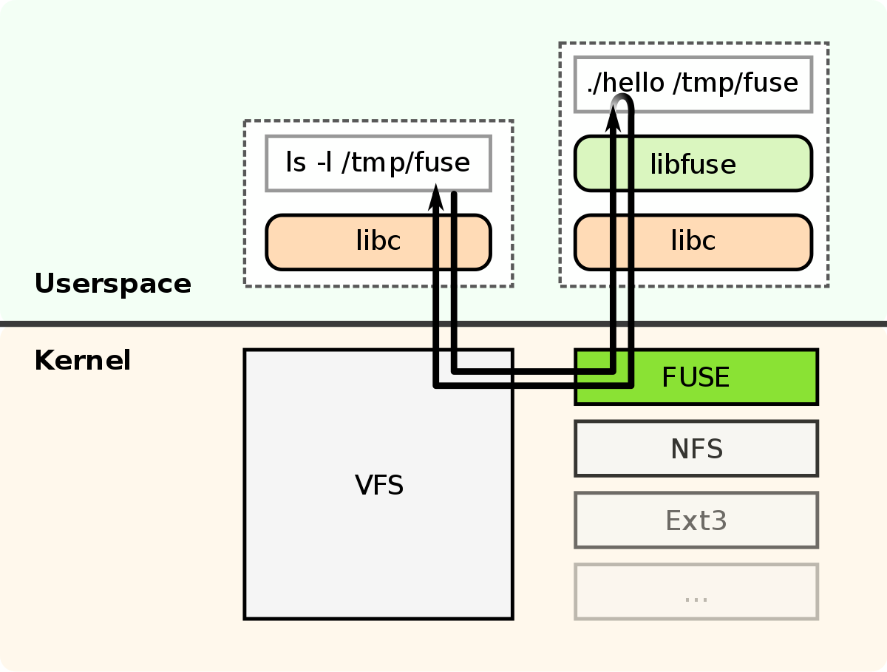
Existing Techniques aren’t Sufficient
FUSE:
Advantage(s):
Implement in user space (easy to develop and debug)
Disadvantage(s):
Slow due to communication overhead.

Slide 6
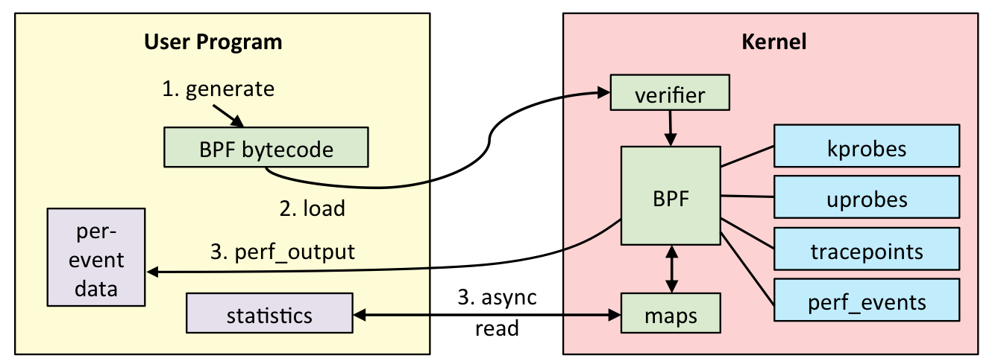
Existing Techniques aren’t Sufficient
eBPF:

Slide 7
Existing Techniques aren’t Sufficient
eBPF:
Advantage(s):
High performance
Do not crash the system
Disadvantage(s):
Limited to a subset of kernel functionalities.
Hard to implement a whole file system.

Slide 8
Bento Goals
High Performance: Has low performance overhead
Safety: Prevention of bugs in the file system
General Programmability: Supports a wide variety of potential file systems
Compatibility: Works with Linux and existing Linux binaries
Live Upgrade: Can redeploy file systems without service downtime
User-level Debugging: File system can be debugged easily with a variety of tools

Slide 9
Rust is Good
Type Safe: Well typed programs cannot go wrong.
Memory Safe: No pointer, no malloc/free, no overflow.
Thread Safe: All threads manipulate shared data structures properly without unintended interaction
Zero-cost Abstraction: What you do use, you couldn't hand code any better
Productivity: Great documentation, a friendly compiler with useful error messages, and top-notch tooling

Slide 10
Challenges
How can we integrate a safe Rust file system in the kernel?
How can we dynamically replace the file system?
How can we support user-level execution?

Slide 11
Outline
1
Background
2
Bento Design
3
Implementation & Evaluation
4
Conclusion

Slide 12
Bento Overview
System architecture
BentoFS
Rust libraries
BentoFS
libBentoFS
File Systems
Kernel Service
FSList
dispatch
read
VFS
fs1
write
fs2
libBentoKS
Update_prepare
Upgrade
BlockDevice
Update_transfer
block_device

Slide 13
Bento Overview
BentoFS
Written in C
Inserted as a separate kernel module
Controller for File systems
BentoFS
libBentoFS
File Systems
Kernel Service
FSList
dispatch
read
VFS
fs1
write
fs2
libBentoKS
Update_prepare
Upgrade
BlockDevice
Update_transfer
block_device

Slide 14
Bento Overview
Rust libararies
libBentoFS
libBentoKS
File Systems
Rust libraries
BentoFS
libBentoFS
File Systems
Kernel Service
FSList
dispatch
read
VFS
fs1
write
fs2
libBentoKS
Update_prepare
Upgrade
BlockDevice
Update_transfer
block_device

Slide 15
Bento Overview
libBentoFS
Translates unsafe calls from BentoFS into safe operations API
BentoFS
libBentoFS
File Systems
Kernel Service
FSList
dispatch
read
VFS
fs1
write
fs2
libBentoKS
Update_prepare
Upgrade
BlockDevice
Update_transfer
block_device

Slide 16
Bento Overview
libBentoKS
Provide a safe API to access kernel service
BentoFS
libBentoFS
File Systems
Kernel Service
FSList
dispatch
read
VFS
fs1
write
fs2
libBentoKS
Update_prepare
Upgrade
BlockDevice
Update_transfer
block_device

Slide 17
Bento Overview
File Systems
Complied as a Rust static library
BentoFS
libBentoFS
File Systems
Kernel Service
FSList
dispatch
read
VFS
fs1
write
fs2
libBentoKS
Update_prepare
Upgrade
BlockDevice
Update_transfer
block_device

Slide 18
Interacting with VFS
Define a new interface for safe kernel file systems
Previous(C):
ssize_t (*read) (struct file *, char __user *, size_t, loff_t *)
Bento(Rust):
bento_read(&self, req, ino, fh, offset, size, reply)
Message-passing based API:
req includes the user application’s uid, gid, and pid;
reply includes data or error values

Slide 19
Interacting with VFS
BentoFS Recevies all calls from VFS
Determine target file system
Handles any necessary operations
Send to libBentoFS
BentoFS
libBentoFS
File Systems
Kernel Service
FSList
dispatch
read
VFS
fs1
write
fs2
libBentoKS
Update_prepare
Upgrade
BlockDevice
Update_transfer
block_device

Slide 20
Interacting with VFS
BentoFS Recevies all calls from VFS
Determine target file system
Handles any necessary operations
Send to libBentoFS
BentoFS
libBentoFS
File Systems
Kernel Service
FSList
dispatch
read
VFS
fs1
write
fs2
libBentoKS
Update_prepare
Upgrade
BlockDevice
Update_transfer
block_device

Slide 21
Interacting with VFS
BentoFS Recevies all calls from VFS
Determine target file system
Handles any necessary operations
Send to libBentoFS
BentoFS
libBentoFS
File Systems
Kernel Service
FSList
dispatch
read
VFS
fs1
write
fs2
libBentoKS
Update_prepare
Upgrade
BlockDevice
Update_transfer
block_device

Slide 22
Interacting with VFS
BentoFS Recevies all calls from VFS
Determine target file system
Handles any necessary operations
Send to libBentoFS(dispatch)
BentoFS
libBentoFS
File Systems
Kernel Service
FSList
dispatch
read
VFS
fs1
write
fs2
libBentoKS
Update_prepare
Upgrade
BlockDevice
Update_transfer
block_device

Slide 23
Interacting with VFS
libBentoFS
Translates unsafe calls into safe operations API
Calls the correct function in the file system
BentoFS
libBentoFS
File Systems
Kernel Service
FSList
dispatch
read
VFS
fs1
write
fs2
libBentoKS
Update_prepare
Upgrade
BlockDevice
Update_transfer
block_device

Slide 24
Interacting with VFS
libBentoFS
Translates unsafe calls into safe operations API
Calls the correct function in the file system
BentoFS
libBentoFS
File Systems
Kernel Service
FSList
dispatch
read
VFS
fs1
write
fs2
libBentoKS
Update_prepare
Upgrade
BlockDevice
Update_transfer
block_device

Slide 25
Interacting with Kernel Services
libBentoKS
Provide wrapping abstractions
Exposing Kernel services safely
May add a small amount of performance overhead
BentoFS
libBentoFS
File Systems
Kernel Service
FSList
dispatch
read
VFS
fs1
write
fs2
libBentoKS
Update_prepare
Upgrade
BlockDevice
Update_transfer
block_device

Slide 26
Live Upgrade
Live upgrade component in BentoFS
When a upgrade module is inserted:
It calls into BentoFS to register itself and indicate it is an upgrade
Kernel Service
BentoFS
libBentoFS
Old Module
FSList
dispatch
VFS
fs1
Update_prepare
fs2
New Module
Upgrade
block_device
Update_transfer
Module Manager

Slide 27
Live Upgrade
Live upgrade component in BentoFS
When a upgrade module is inserted:
BentoFS identifies the target file system, pauses new calls, and waits for current operations to complete
Kernel Service
BentoFS
libBentoFS
Old Module
FSList
dispatch
VFS
fs1
Update_prepare
fs2
New Module
Upgrade
block_device
Update_transfer
Module Manager

Slide 28
Live Upgrade
Live upgrade component in BentoFS
When a upgrade module is inserted:
BentoFS sends bento_update_prepare to the old file system through libBentoFS
Kernel Service
BentoFS
libBentoFS
Old Module
FSList
dispatch
VFS
fs1
Update_prepare
fs2
New Module
Upgrade
block_device
Update_transfer
Module Manager

Slide 29
Live Upgrade
Live upgrade component in BentoFS
When a upgrade module is inserted:
Old file system handles bento_update_prepare, performing cleanup, and creating and returning state transfer struct to BentoFS through libBentoFS
Kernel Service
BentoFS
libBentoFS
Old Module
FSList
dispatch
VFS
fs1
Update_prepare
fs2
New Module
Upgrade
block_device
Update_transfer
Module Manager

Slide 30
Live Upgrade
Live upgrade component in BentoFS
When a upgrade module is inserted:
BentoFS send bento_update_transfer request to new module, passing state transfer struct to the new file system
Kernel Service
BentoFS
libBentoFS
Old Module
FSList
dispatch
VFS
fs1
Update_prepare
fs2
New Module
Upgrade
block_device
Update_transfer
Module Manager

Slide 31
Live Upgrade
Live upgrade component in BentoFS
When a upgrade module is inserted:
New file system initializes itself using the struct and returns
Kernel Service
BentoFS
libBentoFS
Old Module
FSList
dispatch
VFS
fs1
Update_prepare
fs2
New Module
Upgrade
block_device
Update_transfer
Module Manager

Slide 32
Live Upgrade
Live upgrade component in BentoFS
When a upgrade module is inserted:
BentoFS replaces the reference from old module to the new one, then allows calls to proceed to the new module
Kernel Service
BentoFS
libBentoFS
Old Module
FSList
dispatch
VFS
fs1
Update_prepare
fs2
New Module
Upgrade
block_device
Update_transfer
Module Manager

Slide 33
Userspace Debugging Support
This enables developers to leverage gdb and other familiar utilities for higher velocity development
Exposing identical interfaces to both the kernel version and the userspace version of a developed file system

Slide 34
Userspace Debugging Support
Leverages Linux kernel FUSE support to forward file operations to userspace
Design kernel interfaces to mirror existing userspace interface when possible
Otherwise, implement userspace libraries to expose additional abstractions

Slide 35
Userspace Debugging Support
Design kernel interfaces to mirror existing userspace interface when possible
Example:
Userspace: std::sync::RwLock<T>(Rust)
Kernel: kernel read-write semaphores

Slide 36
Userspace Debugging Support
Otherwise, implement userspace libraries to expose additional abstractions
Problem: no standard userspace abstraction that closely mirrors the kernel buffer cache
Kernel file systems directly interface with the kernel buffer cache to access the storage device

Slide 37
Userspace Debugging Support
Otherwise, implement userspace libraries to expose additional abstractions
To address this, Bento provide two additional libraries for userspace version
libBentoFS : translates calls from FUSE into the File Operations API
libBentoKS : implements a basic buffer cache that uses file I/O, providing necessary abstractions to Bento file systems
Using a file I/O will add extra copies and prevent certain optimizations
So performance test should done in kernel mode

Slide 38
Outline
1
Background
2
Bento Design
3
Implementation & Evaluation
4
Conclusion

Slide 39
Evaluation
Use Bento to build a file system: Bento-fs
Bento-fs is like xv6 but includes optimizations to be competitive with ext4
3038 lines of safe Rust code
Passes all seq-2 CrashMonkey crash consistency tests
Also implemented Bento-prov, a version of Bento-fs with file provenance tracking (145 LOC in two weeks of development)

Slide 40
Evaluation
Can Bento support competitive performance?
How does live upgrade impact availability?
Machine setup
Intel Xeon Gold 6138 CPU using 40 hyperthreads
96 GB DDR4 RAM
Intel Optane 900P Series NVMe SSD with 2.5 GB/s read speed and 2 GB/s write speed
Baselines
Ext4 with data journaling (data=journal)
Ext4 with default metadata journaling (data=ordered)

Slide 41
Evaluation
ext4-o: data written to main file system prior to its metadata being committed to the journal
ext4-j: All data are committed into the journal prior to being written into the main file system
Bento-fs
Bento-fs in user space

Slide 42
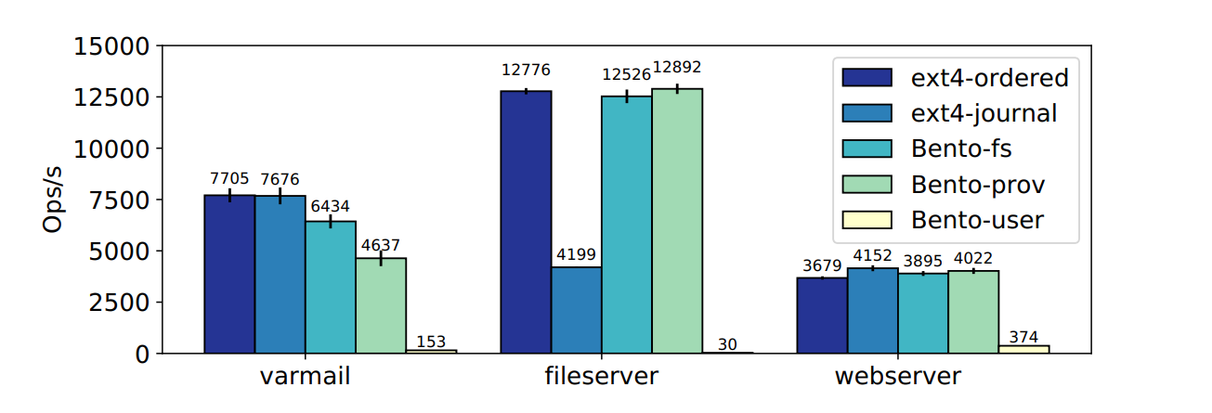
Fileserver

Slide 43
File Operations

Slide 44
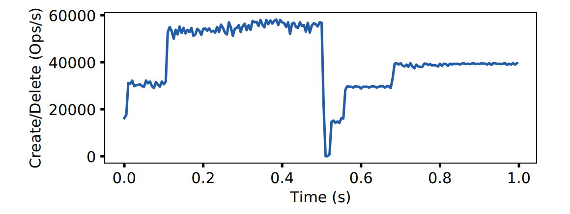
Live Upgrade
Bento-fs
Bento-prov
15ms

Slide 45
Outline
1
Background
2
Bento Design
3
Implementation & Evaluation
4
Conclusion

Slide 46
Conclusion
Built Bento, a framework for high-velocity Linux kernel file systems
A Bento file system performs competitively with ext4 and can be upgraded with only 15ms of downtime

Slide 47
Thanks for your attention!

