Slide 1
Presented by Haiquan Wang
2021-12-1
Notes:
大家晚上好，我今天分享的文章，是由清华、电子科大和华为共同合作完成一个项目，叫做HEALER，发表在SOSP21上，
HEALER翻译过来就是治愈者的意思，在游戏里面也被称为奶妈
这篇工作研究如何用relation learning去kernel fuzzing技术寻找linux kernel当中的bug
另外这个项目还受到了国家自然科学基金的支持

Slide 2
Background
Introduction
Motivation
Observation
Related Work
Design
Evaluation
Outline
Notes:
今天大致会按照以下的outline来分享这篇文章

Slide 3
Background
Linux kernel is developing rapidly for supporting more features

Slide 4
Background
Linux kernel is hard to be free of bugs
Notes:
因此现在的linux操作系统内核非常庞大和复杂，就难以避免各种bug

Slide 5
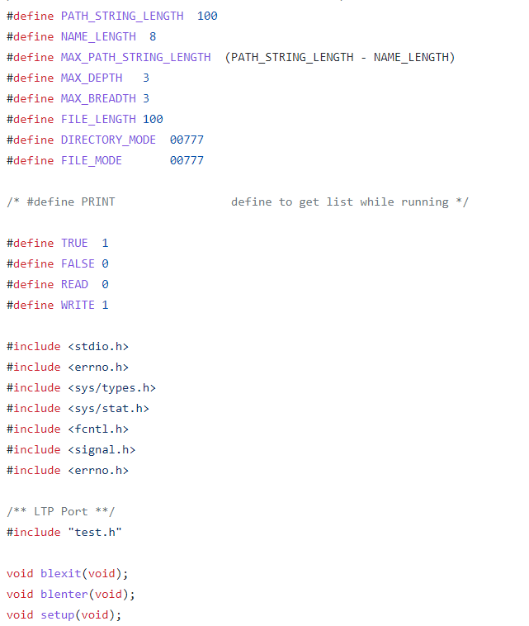
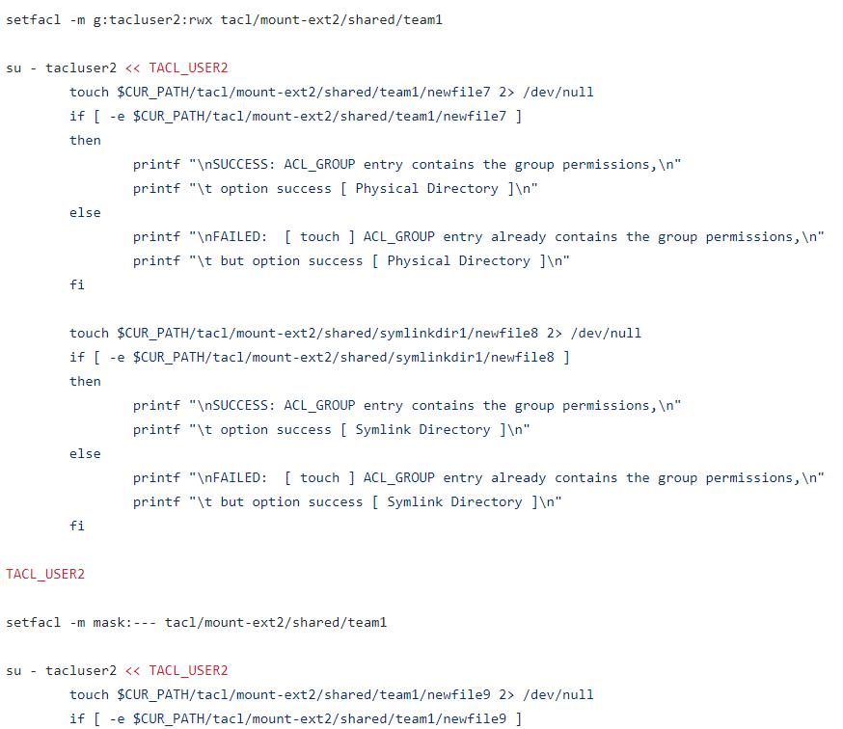
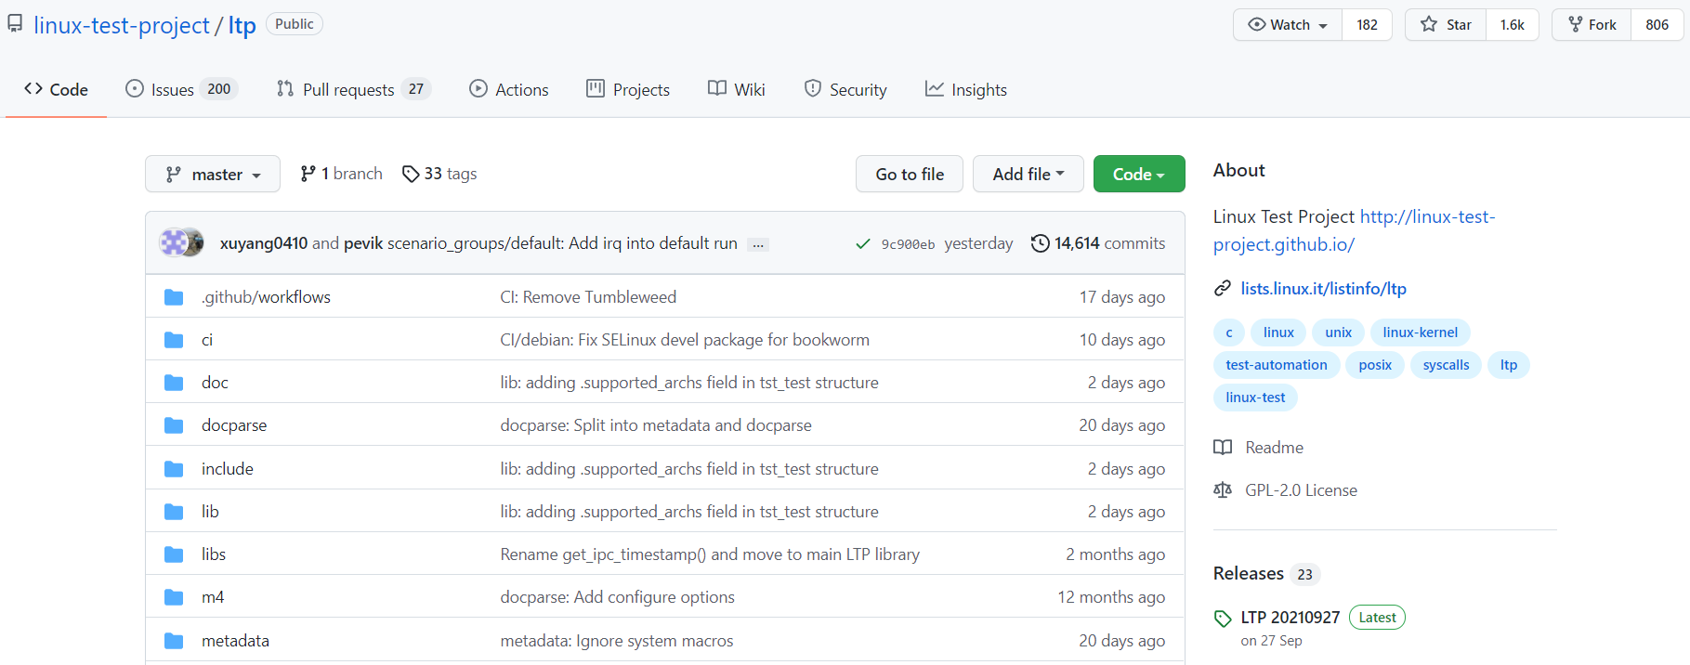
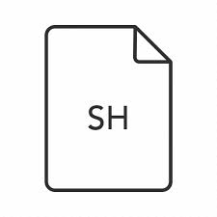
Background
Handwrite
Feed into
It’s difficult for handwritten test suites to keep up with rapid increase of the kernel’s size and complexity
Notes:
在以往，内核的开发人员通常会写很多的测试程序来测试linux kernel
比如像linux test project，（click），就有很多用来测试linux的程序 （click），（click）
但是随着kernel的规模逐渐庞大，通过手写程序的方式来debug越来越困难

Slide 6
Background
Is there any way to test Linux kernel automatically?
Fuzzing!
Notes:
那么我们有没有别的方式能够自动的去检测linux kernel呢？
诶那当然是有的，就是fuzzing技术(click) (click)

Slide 7
Introduction – Fuzzing
Fuzzing – feeding in random inputs until the program crashes
Notes:
从文字上面来定义，fuzzing技术就是随机生成各种输入注入到程序当中，直到程序崩溃
(click)

Slide 8
Introduction – Fuzzing
No
Generate Input
Execute program
Crash?
Yes
Report!
Notes:
基本的fuzzing技术可以用图中简单的流程图来描述

Slide 9
Introduction – Coverage Guided Fuzzing
Corpus
①Select
Mutation
Input Description
④Interesting Path
②Random Input
Saver
Program
③Coverage Feedback
Notes:
而当前主流的fuzzing技术则是在刚刚基本的fuzzing技术基础上增加了一个特点，
就是将程序执行样例的code coverage作为反馈，来指导fuzzing的样例生成
这里讲一下code coverage就是用来描述程序当中被测试过的比例和程度，因为代码中常常有各种分支
如果能够提升代码分支覆盖率，那么这个代码就被检测的越充分，在kernel fuzzing当中这个样例就会被当作好的样例
本文用到fuzzing就是这种coverage guided fuzzing
(click)

Slide 10
Introduction – Kernel Fuzzing
Fuzzing – feeding in random inputs until the kernel crashes
How do we generate inputs
How do we execute the kernel
How do we inject inputs
How do we detect crashes
How do we automate the process
Notes:
刚刚简单介绍了一般的fuzzing技术
而kernel fuzzing其实就是把kernel当作是一个特殊的program进行测试的技术
Fuzzing整个完整的技术需要考虑很多的方面：
如何生成inputs
如何去执行kernel
如何去注入inputs
如何检测崩溃
以及将上面的整个过程自动化
(Click)

Slide 11
Introduction – Kernel Fuzzing
Fuzzing – feeding in random inputs until the kernel crashes
How do we generate inputs
How do we execute the kernel
How do we inject inputs
How do we detect crashes
How do we automate the process
What the paper focus on
Notes:
但是本文的关注点在于用relation learning去解决其中如何生成inputs的这个问题上（click）

Slide 12
Introduction – Kernel Fuzzing
What is kernel’s inputs
Notes:
那么kernel的input是什么呢

Slide 13
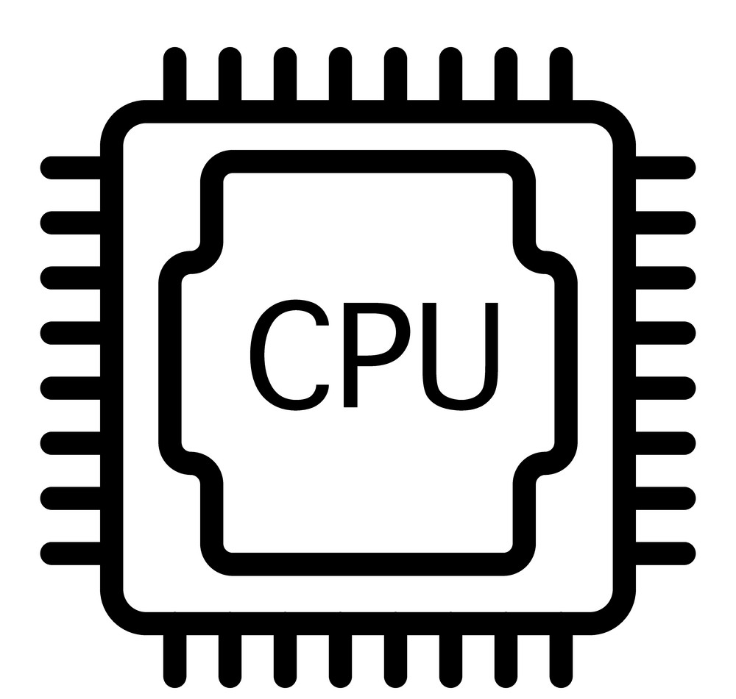
Introduction – Kernel Fuzzing
Kernel inputs: syscalls
Userspace
The system call interface
Kernel
fork()
wait()
exit()
socket()
…
对上层提供各种硬件的抽象，
Hardware
Notes:
Linux kernel是linux操作系统当中最核心的部分
它是位于应用和硬件之间的一个软件层
Linux Kernel 对下管理着硬件的使用，对上层提供各种硬件的抽象
对于linux kernel来说，输入就是从user space传来的系统调用序列；当然从硬件设备传来的中断也可以被kernel接收处理，也能算是kernel的输入，但文章只讨论了系统调用序列，所以后续就只讨论系统调用

Slide 14
Introduction – Coverage Guided Fuzzing
Corpus
①Select
Mutation
Input Description
④Interesting Path
②Random Input
Saver
Program
③Coverage Feedback
Notes:
回顾一下coverage guided fuzzing过程中还有一步就是，input description，它是初始由用户提供，用来描述input的结构，作用就是为后续的变换限定搜索空间

Slide 15
Introduction – Syscall Description Language
Modeling dependencies between syscalls
Resource fd[int32]: 0xffffffffffffffff, AT_FDCWD, 1000000
Resource sock[fd]
Resource sock_in[sock]
Socket$inet(domain const[AF_INET], type flags[socket_type], proto int32) sock_in
Accept$inet(fd sock_in, peer ptr[out, sockaddr_in], peerlen ptr[inout, len[peer, int32]]) sock_in
Bind$inet(fd sock_in, addr ptr[in, sockaddr_in], addrlen len[addr])
Listen(fd sock, backlog int32)
inheritance
Identifier name
type
Optional Arguments
System Call name
Generates and mutates testcases based on Syzlang
Define the search space
Notes:
我们具体来看一下kernel fuzzing当中的input description的例子：
这是一个用来专门描述系统调用接口的语言叫做syzlang
它能够让用户定义
系统调用的函数名；（click）
参数的名字；（click）
参数类型；（click）
定义可选的类型；（click）
它还能够通过定义resource类型来定义两个系统调用的依赖，同时还支持子类型继承，这一点会在后续谈到 （click）
通过以上的描述就可以为mutation定义搜索的空间（click）

Slide 16
Problem – Countless Call combinations
Around 400 syscalls in Linux
4000+ specialized syscalls in Syzlang description
Length of generated call sequence is 8~32
Possible number of combinations is $Σ_{k=8}^{32}\left(\begin{matrix}4000 \\ k\end{matrix}\right)={10}^{80}$
Most call sequences are invalid and equivalent
We need better strategy to choose call combination, rather than random
Notes:
使用fuzzing技术最大的一个问题是，系统调用的组合是非常庞大的，我们可以做一个简单的计算
Linux当中有将近400个系统调用
Syzlang能够描述4000多个特定的系统调用（这里4000应该是指把每一个系统调用的flag都给考虑进去了）
假定生成的序列长度是8~32
就考虑所有可能的组合的情况，有将近10^80个，如果计算机每秒能够处理1000条系统调用序列，那也要处理10^60年
而且大部分的序列其实是无效和重复的
所以我们需要更好的策略去寻找系统调用的组合，而非简单的随机生成

Slide 17
Related Work – Syzkaller’s Choice Table
Each item records the probability that a system call should be invoked before another system call
Choose next call based on the probability
Example: for system call C_{i} C_{j}, the P_{ij} is calculated by
$P_{ij}=\frac{{P0}_{ij}∗{P1}_{ij}}{1000}$ note: ${P0}_{ij}$ and ${P1}_{ij}$ are both normalized to 10 ~ 1000
${P0}_{ij}$ is calculated by static algorithm: specific common types between two system calls
${P1}_{ij}$ is calculated by dynamic algorithm: the more adjacent calls corresponding to (C_{i} , C_{j})
For instance, [C_{i}, C_{j}, C_{k}] is the system call sequence in corpus, but C_{i} may not have impact on the execution path of C_{j}
Too
Empirical

Slide 18
Observation – Influence Relation
sock_fd = socket(AF_INET, SOCK_STREAM, 0)
Former calls setup related kernel states
The latter calls can be influenced by those states
Execution path of the latter call changed due to the internal kernel state modified by the former call
Insert more system calls that have influence relations before the target system call so that we can trigger different kernel states and allow each system call to enter deep execution paths
Create socket inside the kernel
bind(sock_fd, &addr, sizeof(addr))
Bind address to the socket
listen(sock_fd, …)
Mark socket
accept(sock_fd, &peer_addr, &size)
The number of invalid test cases and the size of the search space can be reduced significantly by taking relations between system calls into consideration
Notes:
我们发现之前的工作都没有考虑过系统调用之间的关联性
比如可以看这样一个网络数据传输的例子：
首先是通过系统调用在kernel当中创建一个socket，然后将地址绑定到这个socket，通过监听该socket标记这个socket是可链接的，最后通过该socket接受数据
在这个例子里面，如果没有建立socket就直接绑定的话，bind函数就会return一个error
也就是说前一个系统调用建立了某种状态，（click）
而后续的系统调用会被这种状态所影响（click）
也就是说后续的系统调用的执行路径是会被前面执行的系统调用所影响到（click）
所以我们想到，如果我们能够尽可能多地插入这种有相互关联的系统调用（click），我们就可以极大地减少生成无效的测试样例和搜索的空间（click）

Slide 19
Our Idea – Guide Kernel Fuzzing with Relation Learning
Learn the influence relations dynamically, iteratively
Guide generation and mutation with learned relations
Increase the quality of inputs, speedup the fuzzing process
Notes:
所以我们需要能够动态地学习到kernel之间的关系，然后用来指导生成input，提高input的生成质量，进而加速fuzzing的进程

Slide 20
Design – definition
Relation:
A system call Ci has an influence on another system call Cj if the execution of Ci can influence the execution path of Cj by modifying the kernel’s internal state.
Relation is about influence of execution path
The reason behind relation is kernel state
R_{ij} = 1, if C_{i} has relation with C_{j}
Notes:
这里我们详细给出文章当中relation的定义：
当一个系统调用改变了kernel内部状态，并且能够影响到另一个系统调用的执行路径的时候，我们就称两个系统调用之间是有关联的
然后用一个relation table来保存两个系统调用的关联性，比如Rij=1就代表Ci对Cj有影响

Slide 21
Design – Relation Learning
Static Learning
Dynamic Learning
Step 1: Minimization
Step 2: Update Relation Table
Guided Generation and Mutation
Notes:
然后作者就提出Relation learning算法
整个算法分成三个部分
静态学习和动态学习，并且用学到的relation去指导新的系统调用序列的生成
接下来会一一进行讲解

Slide 22
Design – Static Learning
Purpose: Learn the relations expressible by Syzlang description
Idea: The producer syscall of one resource can influence the consumer syscall of that resource
Steps: two simple rules:
The return type of C_{i} is a resource type r0 with an outward data flow direction
At least one of C_{j}’s parameter is a resource type r0 or resource type r₁ that is compatible with r₀ with an in ward data flow direction
Resource sock_in[sock]
Socket$inet(domain const[AF_INET], type flags[socket_type], proto int32) sock_in
Listen(fd sock, backlog int32)
Notes:
首先是静态学习
其目的在于，从用户事先给出的对系统调用的Syzlang描述当中去学习系统调用间的关联性
（click）（click）
用户在syzlang当中通过souce可以描述两个系统调用间的生产者-消费者关系，比如下面这个例子
通过分析这段描述可以知道socket系统调用的输出可以是listen的输入，两者存在依赖关系
这里补充一下例子里面sock_in是继承自sock 两者是兼容的，这个属于syzlang当中的语言细节

Slide 23
Design – Dynamic Learning
Step 1: Minimization
Purpose: Only analyze calls that contribute to new coverage.
Idea: Remove one call as long as the coverage keeps the same
Steps: For sequence P and code coverage of each call in P:
Extract the subsequence p’ for call Ci that has not yet been included in the other minimal sequences
Remove each call C’ before C_{i} in p’
If coverage keeps same, commit the change
Example
For [call₀, call₁, call₂, call₃], with [cov₀, cov₁, cov₂, cov₃]
remove call₁, execute other calls
cov₃ has no change
Commit ”remove call₁”
Notes:
然后是动态学习，首先第一步，minimization
目的在于将对于多余的system call剔除，简化序列，用于后续的分析
（click）（click）
做法就是，尝试去除一个call，如果目标call的coverage没有发生变化，那么就说明这个call对于分析目标call的relation是多余的，可以去除
（click）
举一个例子
比如对于下面的例子，我想要研究call012是否对call3有影响，我就挨个去除call012，然后看看cov3是否产生变化
比如remove call1，然后执行call023然后cov3没有变化，那么call1就可以被移除了
（click）

Slide 24
Design – Dynamic Learning
Step 2: Update Relation Table
Purpose: Learn the relations not expressible by Syzlang description
Idea: The relation is all about execution path, observe the coverage change
Steps: For each adjacent call pair (C_{i}, C_{j}) of the minimized sequence P:
Remove C_{i}, observe the coverage change of C_{j}
If the coverage of C_{j} changed, C_{i} must have influence relation with C_{j}, since they’re adjacent
Learn relations iteratively
Notes:
然后是第二步
目的就是要学到之前syzlang没有办法描述出来的系统调用之间的联系
做法就是对于刚刚简化过的序列分析里面两两相邻的系统调用是否存在relation，
检测操作与刚刚一样，尝试去掉前面的系统调用，然后看看后面的系统调用的coverage是否发生改变，如果改变了就更新relation table将相应的项置为1

Slide 25
Design – Guided Generation and Mutation
Purpose: Generate high quality inputs
Idea: Use learned relations to select call that matters
Steps: For call sequence [C_{i}, C_{j}, C_{k}] choose C_{x} as next call:
Prefer to randomly choosing next call at the beginning
Find candidate calls that can be influenced by C_{i}, C_{j}, C_{k}, count number of calls that influence the candidate as weight(R_{ix}+R_{jx}+R_{kx})
Make a random selection based on the weights: a higher weight corresponds to a higher probability of being selected
Example:
For sequence [socket, bind]
The candidates are [listen: 2, accept: 1]
`listen` has higher priority to be chosen
Notes:
有了relation table之后我们就可以用它来指导生成新的系统调用序列
Click
具体做法是：
比如对于一个序列[C_{i}, C_{j}, C_{k}] 想选择Cx作为下一个call:
Click
刚开始会倾向于随机地选择下一个系统调用（因为开始的时候relation table比较稀疏基本都是0，用了容易直接收敛）
Click
后续则会在table中选取会被C_{i}, C_{j}, C_{k}影响到的call作为候选，将(R_{ix}+R_{jx}+R_{kx})作为一个选择的权重
Click
在候选的call里面随机选择，权重越高的越容易被选中
Click
举个例子

Slide 26
Design – Revisit the fuzzing loop
Relation Table
Corpus
①Select
Mutator
Input Description
④Refine
②Random Input
④Refine
Relation Learning
Program
③Coverage Feedback

Slide 27
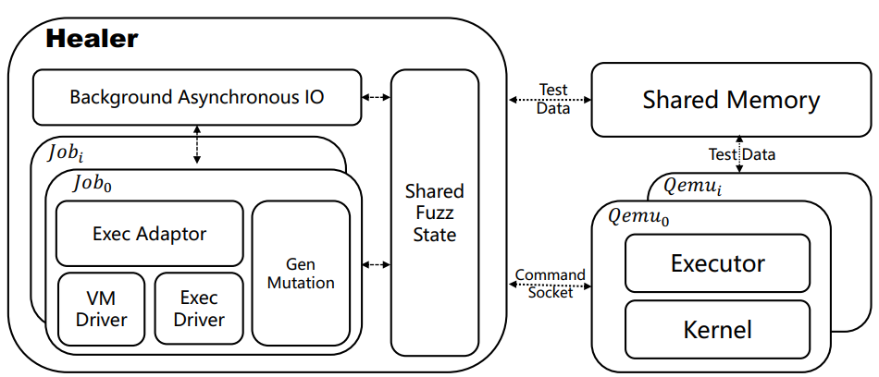
Implementation
Shared fuzzer states
Fuzzers run in host
Only executor runs in VM
Shmem communication
QEMU ivshm
Notes:
Healer将待测的kernel放入虚拟机当中执行，其余的部分都在host端，当生成了新的样例就通过shared memory传递给虚拟机

Slide 28
Evaluation
Setup
16 core CPU
32 GB memory
Linux-5.11, Linux-5.4, Linux-4.19
Each set of experiments is repeated 10 times
Each experiment is executed over 24h
Healer-: Healer without relation learning

Slide 29
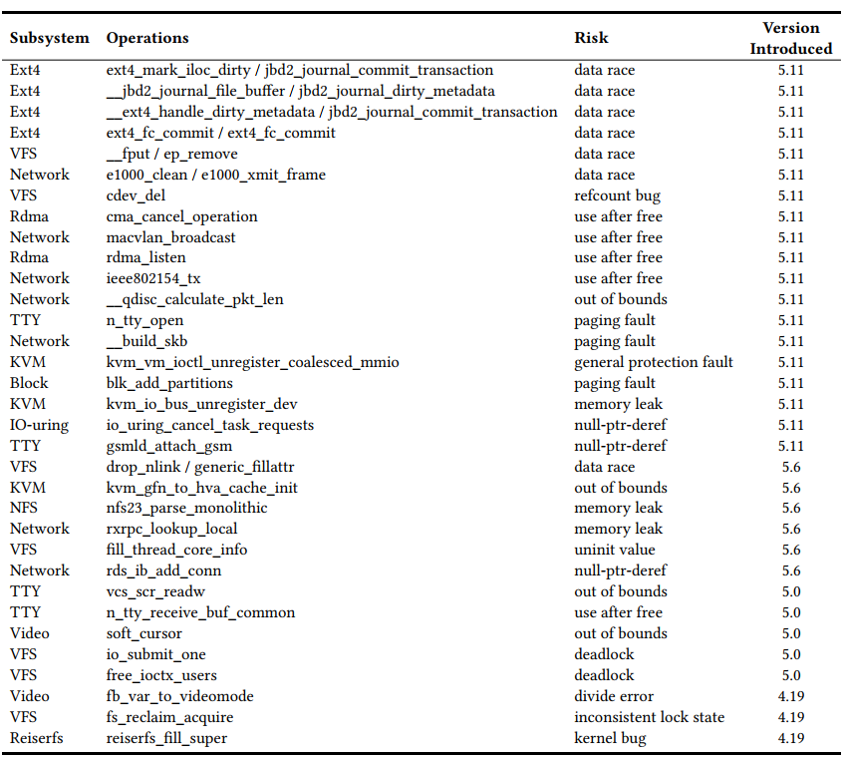
Evaluation
Q1: how many new bugs can healer find?
HEALER find 33 previously unknown vulnerabilities which are confirmed by corresponding maintainers.
Notes:
这个实验跑了两周

Slide 30
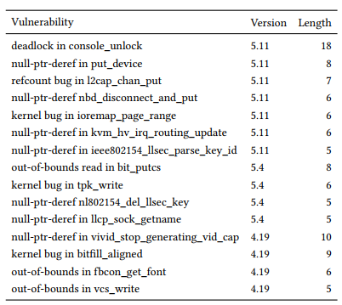
Evaluation
Q2: can healer find more bugs than Syzkaller, Moonshine, Healer-?
15 vulnerabilities found by HEALER while missed by Syzkaller, Moonshine and HEALER-
Fuzzing System | Vulnerability Found
Healer | 32
Syzkaller | 20
Moonshine | 17
Healer- | 10
Healer only misses 3 vulnerabilities

Slide 31
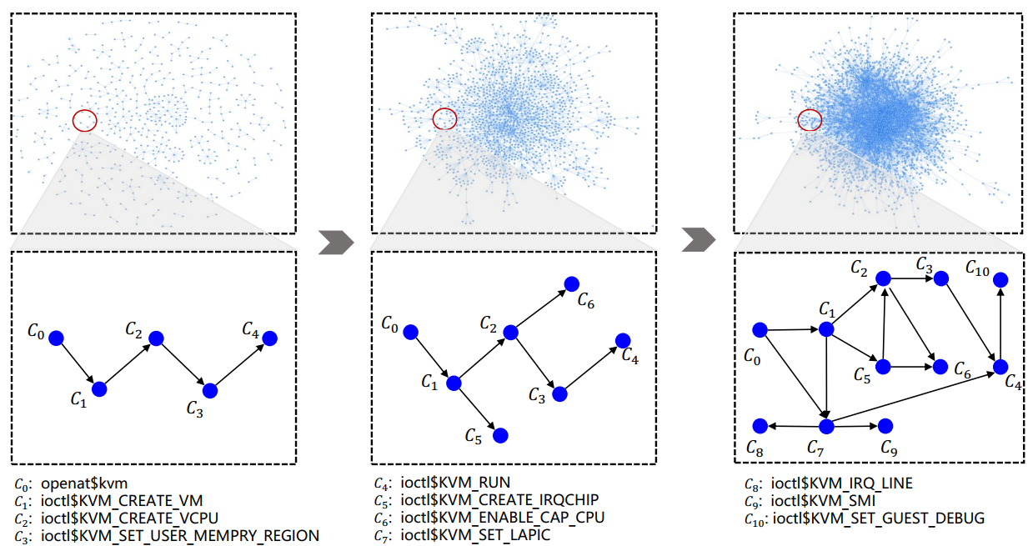
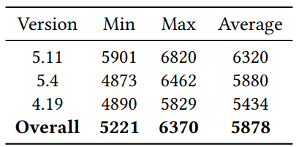
Evaluation
Q3: can relation learning work as expected?
The influence relations is overall sparse and locally dense
Notes:
用关系图直观展示了学到的relation table，两个call如果在relation table当中的项为1，就在图中链接一条边，可以看到随着时间的进行，图也是越来越密集，但也有个特点：就是总体还是稀疏的，但是局部是非常密集的，因为一个模块当中的syscall联系肯定是会多的
Click

Slide 32
Evaluation
Q3: can relation learning work as expected?
Notes:
与两个baseline比较了运行时code coverage的情况，这些图的纵坐标表示触发的分支数随系统运行时间的变化

Slide 33
THANKS!

