Slide 1
SplitFS: Reducing Software Overhead in File Systems for Persistent Memory
SOSP 2019
§Rohan Kadeko, §Se Kwon Lee, †Sanidhya Kashyap, †Taesoo Kim,
‡*Aasheesh Kolli, §*Vijay Chidambaram
§UT Austin, †Georgia Tech, ‡Penn State, *VMware Researsh
Presented by Meng Wang, USTC, ADSL
Nov 6th, 2019

Slide 2
Outline
Background
Implementation
Evalution
Conclusion

Slide 3
Outline
Background
Implementation
Evalution
Conclusion

Slide 4
What's persistent memory?
a non-volatile memory
offer durability and performance close to that of DRAM
attached on the memory bus and byte-addressable
accessed via processor loads and stores
Notes:
ＰＭ的一些性质

Slide 5
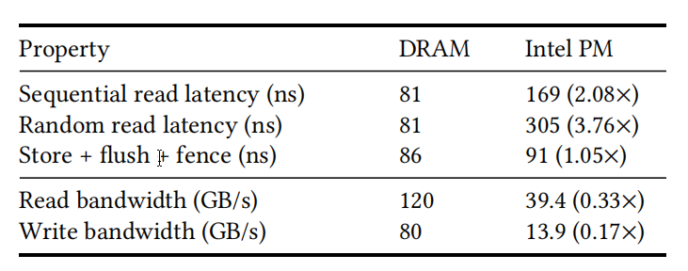
Why PM acts as new storage?
Low latency:
Large capacity:
up to 6 TB per single machine.
Notes:
ＰＭ为什么可以作为新的存储介质
硬件的低延迟导致文件系统的瓶颈变成了软件开销

Slide 6
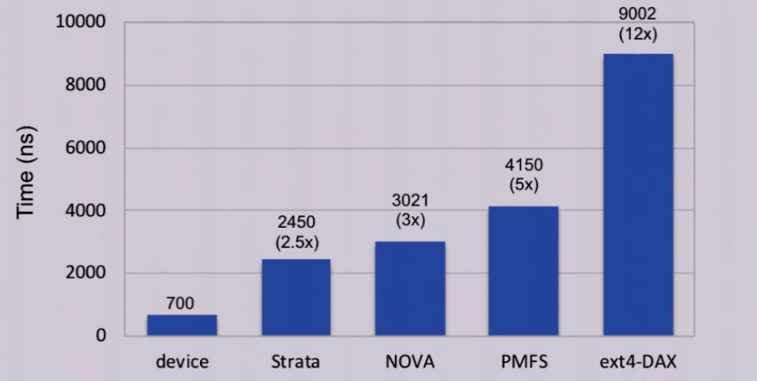
Software overhead in PM file system
Append 4KB data to file
Time taken to copy user data to PM: ~700ns
Notes:
形象展示软件开销大小
PM file system上软件开销超过硬件开销，成为瓶颈

Slide 7
Overview of PM file systems
Data opertions are serverd from user space
Metadata operations are serverd from ext4-DAX
Data in user
Metadata in user
Allocation in kernel
Data in kernel
Metadata in kernel
Data in user
Metadata in kernel
Data in user
Metadata in user
ext4DAX,
PMFS[EuroSys 14],
NOVA[FAST 16]
SplitFS
SplitFS
Aerie[EuroSys 14]
Strata[SOSP 17]
High performance
Low complexity
Low performance
High complexity
Low performance
High complexity
High complexity
Notes:
比较当前各个PM file system的不同设计以及优缺点。
介绍spiltfs中split的意义。user space library file system; ext4dax

Slide 8
SplitFS Introduction
two components: U-Split and K-Split
Application
create()
delete()
write()
read()
U-Split (user space library file system)
user
kernel
K-Split (ext4-DAX)
PM
file 1
file 2
file 3
operation log
Notes:
介绍体系结构，usplit ksplit。附图

Slide 9
Targets and Goals of SplitFS
Targets: posix app which use read/write to access data on PM
Goals:
Low software overhead
strong consistency guarantees
leverage the maturity and active development of ext4-DAX
Notes:
SplitFS的设计目标

Slide 10
Ext4-DAX
a new mode of ext4 file system to access PM
DAX means Direct Access
bypass page caches and rely on memory mapping
drawback: no naming, atomicity guarantee for opertions
Notes:
介绍ext4dax，缺点是没有原子操作、命名等，引出memory mapping

Slide 11
Memory mapping(mmap syscall)
map one or more consequent pages from va to extents of file
regular read/write:
user space
buffer
read
read
CPU copy
kernel space
page cache
DMA copy
storage
disk
Notes:
介绍非mmap方式下的读写过程，以及mmap方式下的读写。进行比较。

Slide 12
Memory mapping(mmap syscall)
map one or more consequent pages from va to extents of file
mmap:
user space
buffer
mmap
mmap
kernel space
page cache
DMA copy when read
storage
disk
Notes:
介绍非mmap方式下的读写过程，以及mmap方式下的读写。进行比较。

Slide 13
Memory mapping(mmap syscall)
for mmap in ext4-DAX on PM
direct access to PM via loads and stores
user space
virtual addr space
4K
8K-1
Access to virtual address to 4K can be translated to access to 10*4K on PM.
kernel space
file f
0
4K-1
storage
PM
10*4K
11*4K-1
Notes:
mmap in ext4-DAX on PM

Slide 14
Outline
Background
Implementation
Evalution
Conclusion

Slide 15
SplitFS modes and guarantees
three modes with diffreent guarantees:
POSIX, sync, strict; guarantees weak to strong.
synchronous: operations complete and persistent once call returns
exception: append is atomic across all modes.
Mode | Metadata Atomicity | Synchronous Operations | Data Atomicity | File System
POSIX | √ | x | x | ext4-DAX
sync | √ | √ | x | PMFS
strict | √ | √ | √ | NOVA, Strata
Notes:
介绍SplitFS的三种模式，互不影响。
同步操作是指返回时已经确定数据持久化到了PM上。

Slide 16
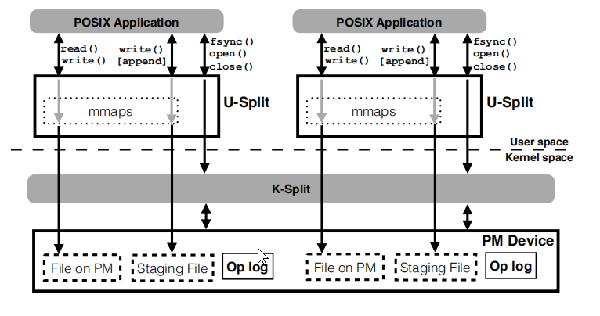
SplitFS overview
each app runs in different modes without interference.
each app has a mmap collection within U-Split.

Slide 17
Data operations
read: memcpy from PM to DRAM
overwrite:
non-temporal stores instructions, eg: movnt in x86.
“nt” means bypass cache and reach PM controller dircetly

Slide 18
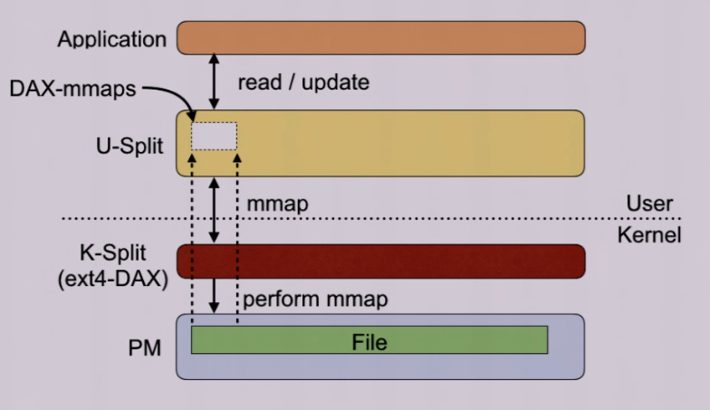
Data operations
Common read/overwrite don't go through kernel

Slide 19
Data operations
Adjust to fixed size of mmap as well as providing atomicity.
For append and atomic overwrite: staging file + relink
find an staging file
later reads will be routed to staging file.
relink atomically on fsync() or close()
log the phys block
Notes:
介绍staging files + relink技术，其应用场景。

Slide 20
Data operations
Adjust to fixed size of mmap as well as providing atomicity.
For append and atomic overwrite: staging file + relink
find an staging file
append and atomic overwrite do not go through the kernel.
later reads will be routed to staging file.
relink atomically on fsync() or close()
log the phys block
relink atomically on fsync() or close()
log the phys block
Notes:
介绍staging files + relink技术，其应用场景。

Slide 21
Optimized logging
pre-allocated and mapped by U-Split
Optimization:
write one cache line worth of data to PM and a single sfense
entries do not have file data instead a logical pointer to the staging file
4B checksum within 64B entry.
a tail in DRAM and concurrent threads use CAS to advance it.
most ops use one entry.
Notes:
介绍optimized logging 技术。
NOVA 每个inode里有一个log，要更新所有inode的log，同时还有一个Inode存着tail，也需要持久化更新。

Slide 22
Summary of techniques
Split architecture:
low-overhead data ops
correct metadata ops
Collection of mmaps:
low-overhead data ops in the presence of updates and appends
Staging file + Relink:
Optimized appends
atomic data ops
low write amplification
Optimized operation logging:
Atomic operations
low write amplification

Slide 23
Outline
Background
Implementation
Evalution
Conclusion

Slide 24
Evaluation
Hardware:
2-socket 96-core machine with 32MB LLC
768GB Intel Optane DC PM, 378GB DRAM.
Software:
OS: Ubuntu 16.04
kernel: Linux kernel, version 4.13
File systems compared:
ext4-DAX, PMFS, NOVA, Strata

Slide 25
Evaluation
Workload:
Application | Description | Configuration
TPC-C on SQLite | Online transaction processing | SQLite v3.23.1, WAL mode
YCSB on LevelDB | Data retreival & maintenance | Load A, Run A/B/C/D; Load E, Run E/F
Set in Redis | In-memory data structure store | set 1M kv pairs in Append Only Mode, fsync() per second
Git | Popular version control software | git add & git commit all files in the Linux kernel 10 times
Tar | Linux utility for data compression | compress the Linux kernel 4.18 along with backup dataset
Rsync | Linux utility for data copy | copy 7GB dataset with 1200 files

Slide 26
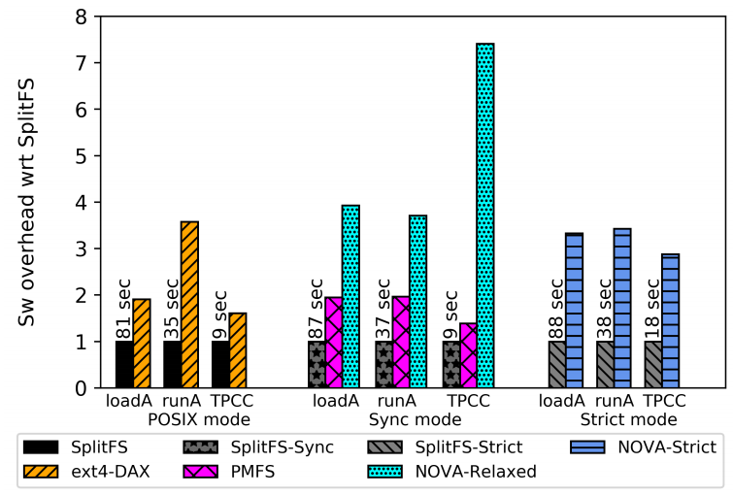
Software overhead
Lower is better.
SplitFS has the lowest sw overhead.
Load A: 100% writres
Run A: 50% writes, 50% reads

Slide 27
Software overhead
ext4-DAX suffers the highest relative sw overheads up to 3.6×
NOVA suffers the highest relative sw overheads up to 7.4×
Load A: 100% writres
Run A: 50% writes, 50% reads
Notes:
nova-relaxed 7.4是因为在in-place更新data之前，要对每个Inode中的log entry 进行更新。

Slide 28
Performance on data-intense workload
POSIX mode(Kops/s)

Slide 29
Performance on data-intense workload
sync mode(Kops/s)

Slide 30
Performance on data-intense workload
strict mode(Kops/s)

Slide 31
Performance on data-intense workload
Across all modes:
SpiltFS performs better as write operations ratio increases.
For read operations, there is a little improvment in SplitFS.

Slide 32
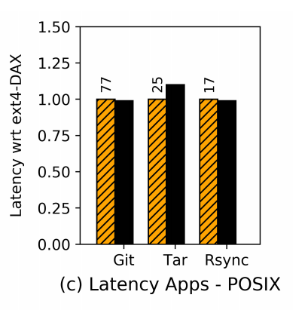
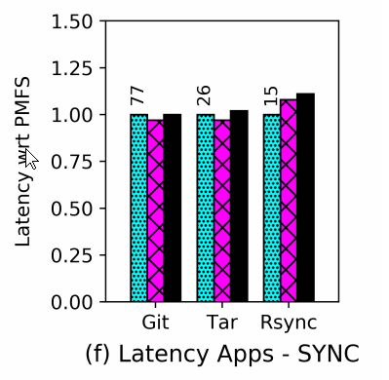
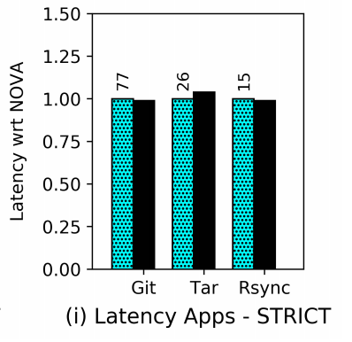
Metadata-heavy workloads
latency in seconds. Lower is better.
slightly slower than other fs.

Slide 33
Resources comsumption
Memory usage:
100MB:
its own metadata to help track different files
mappings info
40MB:
maintain data structure for atomicity guarantees
CPU utilization:
a background thread to do:
stage file allocation
file closures
the thread utilizes one physical thread of the machine
occasionally increasing CPU comsumption by 100%.

Slide 34
Outline
Background
Implementation
Evalution
Conclusion

Slide 35
Conclusion
Split architecture:
data operations in user space to get performance
routes metadata ops to ext4-DAX to benefit from the maturity and constant development of ext4-DAX.
provides different guarantees.
SplitFS outperforms state-of-the-art PM file system like NOVA on many workloads.

Slide 36
SplitFS: Reducing Software Overhead in File Systems for Persistent Memory
Thanks & QA!
Nov 6th, 2019

