Slide 1
D2FQ: Device-Direct Fair Queueing for NVMe SSDs
Speaker: Jin Li, Chuqing Gao
Authors: Jiwon Woo, Minwoo Ahn, Gyusun Lee and Jinkyu Jeong Sungkyunkwan University (SKKU) Computer Systems Laboratory

Slide 2
Outline
1
Background & Motivation
2
Design
3
Implementation & Evaluation
4
Conclusion

Slide 3
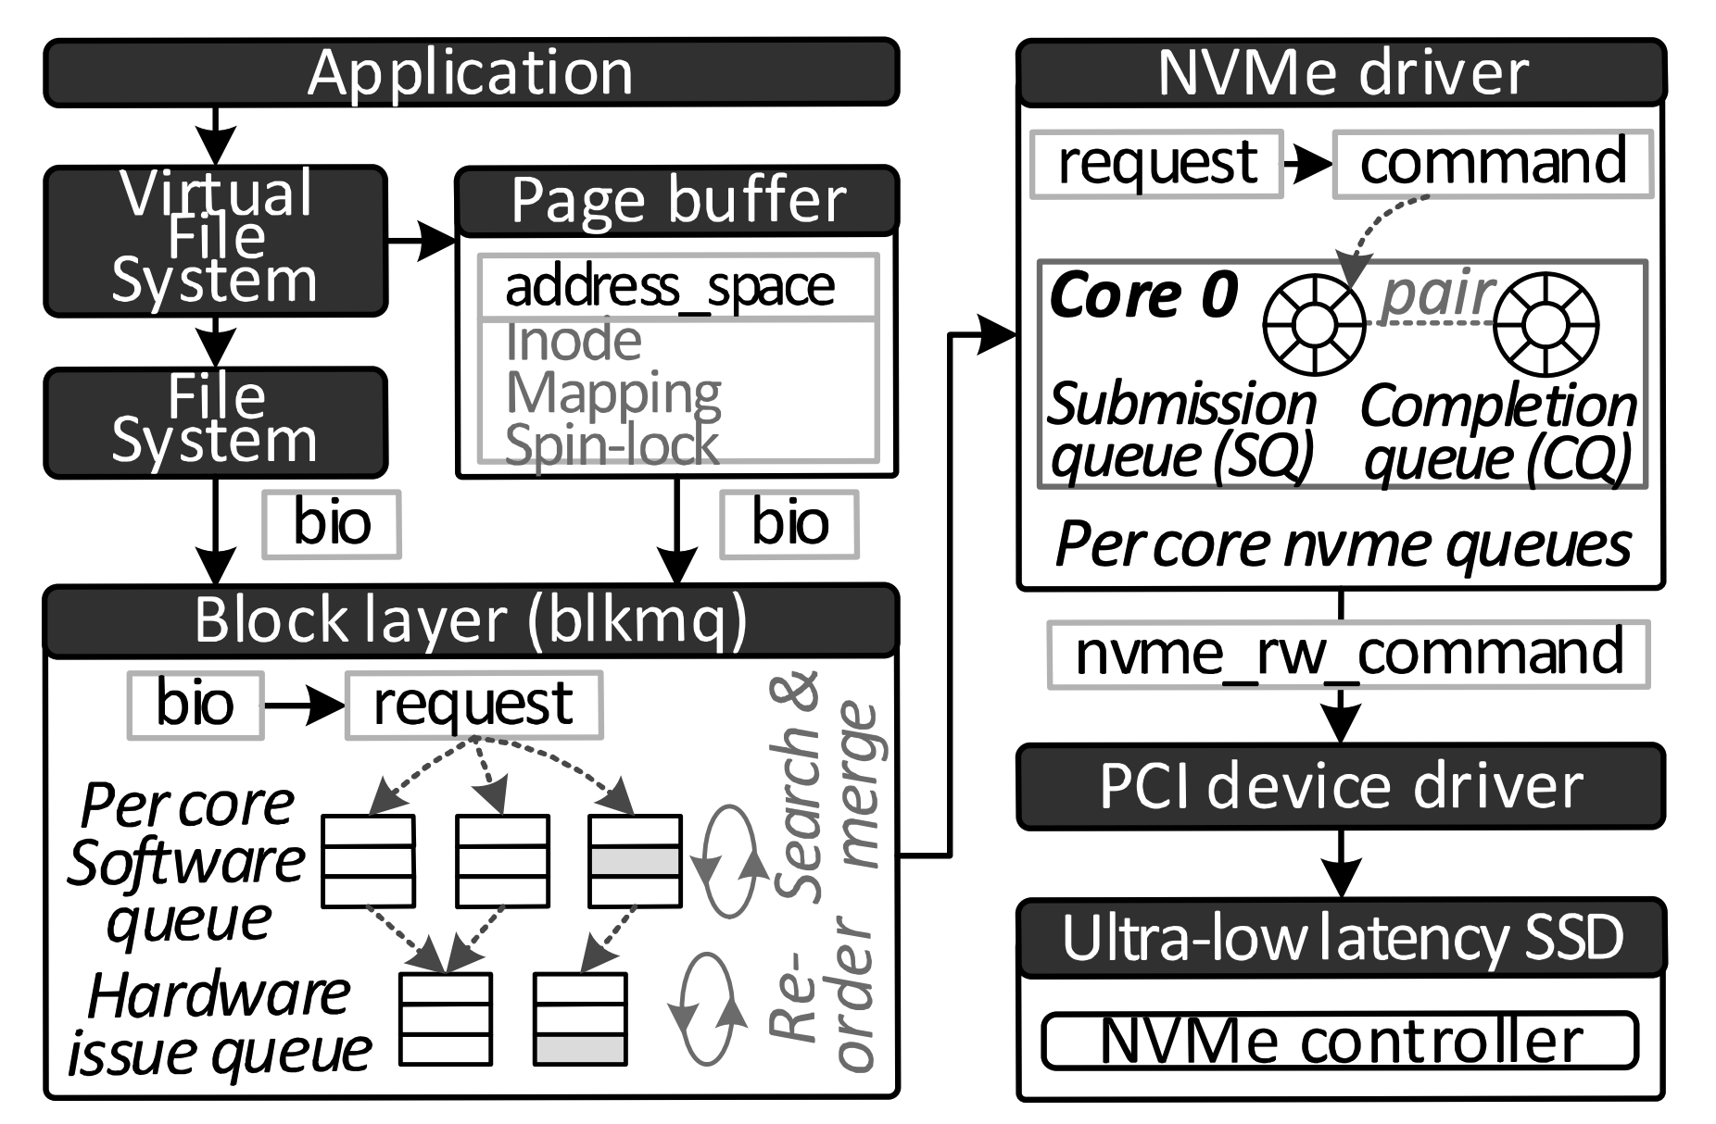
Storage Stack

Slide 4
I/O Scheduling
APP
APP
APP
multi queue
block layer
Software queues
🔥
Hardware issue queues
I/O Scheduling
NVMe SSD

Slide 5
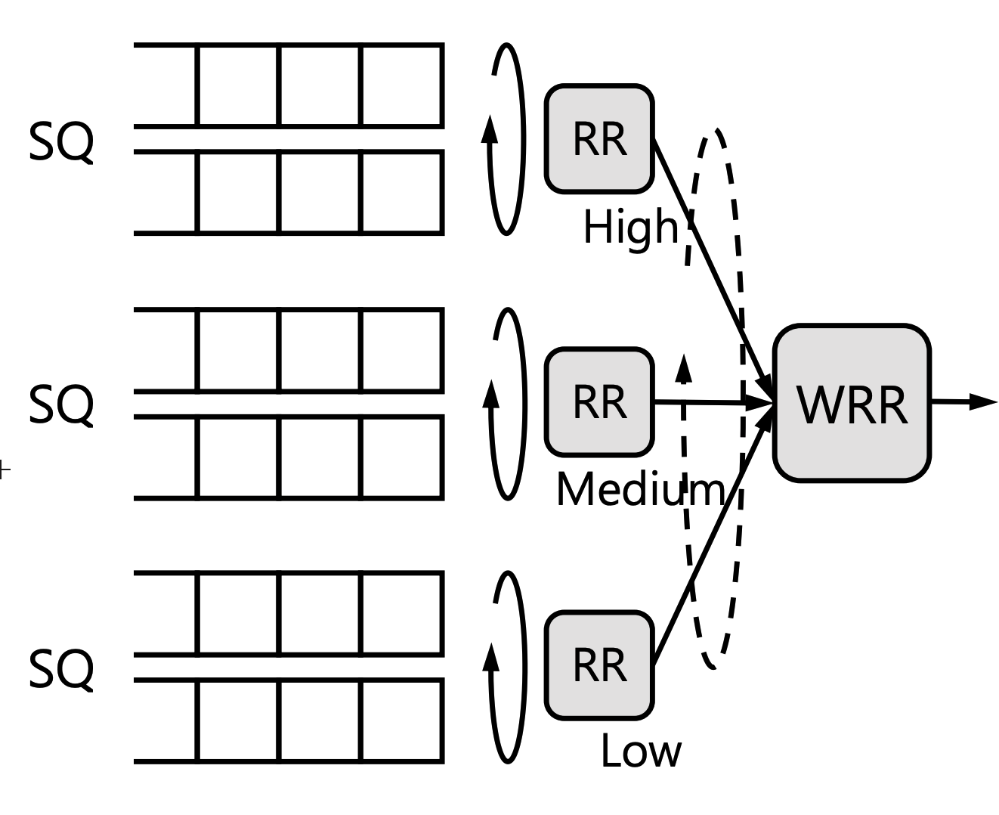
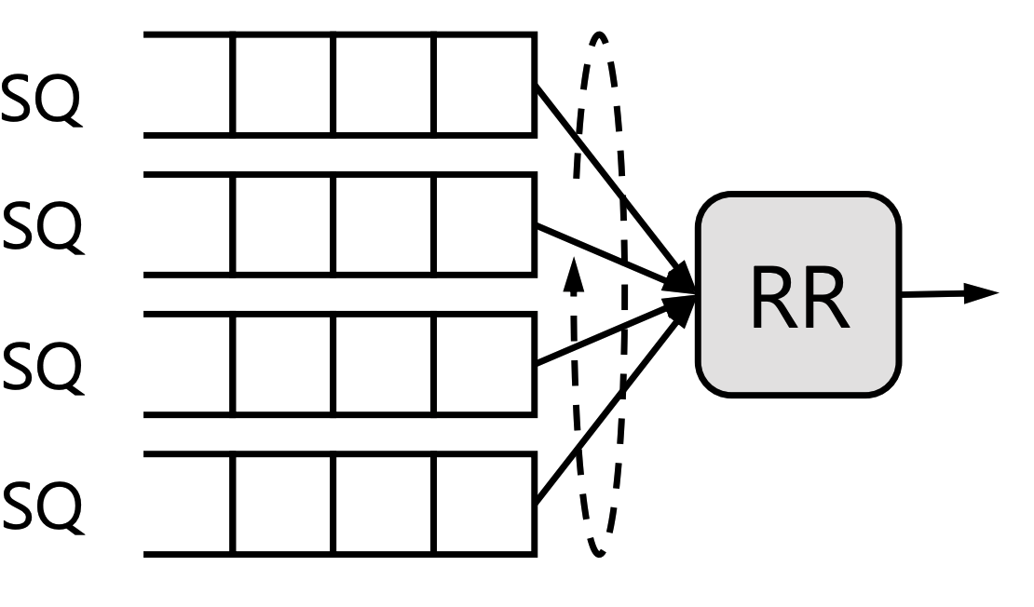
NVMe Weighted Round-Robin
Round-Robin
Weighted Round-Robin

Slide 6
Device-side I/O Scheduling
Not good enough:
Supporting only three priority classes
I/O handling frequency is the only adjustable parameter
No consideration on I/O size
weight: 1
weight 3
…
Op4
…
Op3
Op1
Op2
…
Op4
Op1 > Op2+3+4
Op3
NVMe SSD
Op2
Op1

Slide 7
Still need to use Block Layer…
State-of-art
Notes:
鉴于硬盘提供的fairing机制过于简单，我们仍然需要系统的IO调度层

Slide 8
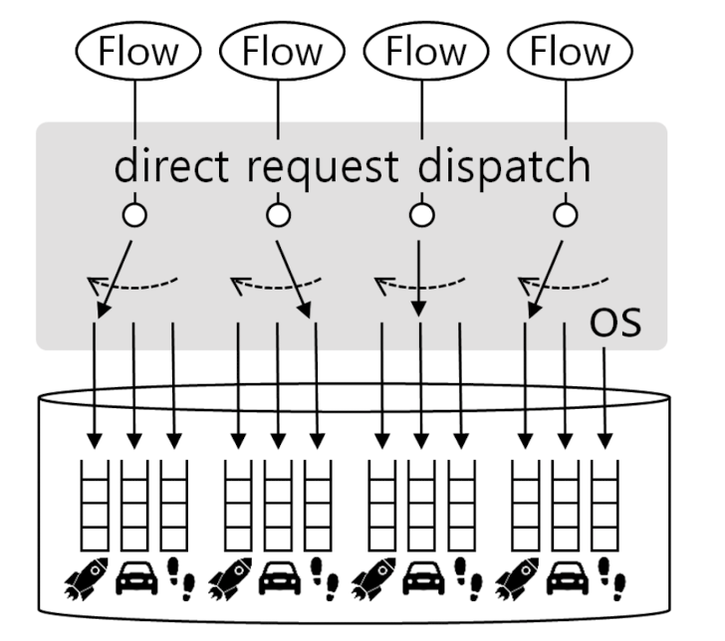
Still need to use Block Layer?
flow weight
A simple decider
queue weight
H/L Ratio
D2FQ
Submission = Dispatch

Slide 9
Virtual Time-based Fair Queueing
$Virtual Time=\frac{\sum{{I/O size}_{completed}}}{I/O weight}$
gvt: global virtual time
gvt
$$ω=1$$
flow 1
$$ω=3$$
flow 2
virtual time (I/O size)
Notes:
Global virtual time就是当前所有flow中最小的virtual time，它是一个用来参照的量，我们看下图。

Slide 10
Virtual Time-based Fair Queueing
$Virtual Time=\frac{\sum{{I/O size}_{completed}}}{I/O weight}$
gvt: global virtual time
gvt
$$ω=1$$
flow 1
$$ω=3$$
flow 2
virtual time (I/O size)
Notes:
假设这里flow1处理了1份，flow2处理了3份。因为flow2的权重是3，我们知道这是合理的，但是如果不考虑权重，图上显示flow2领先flow1很多，这样之后flow2就有被丢进慢车道的风险。

Slide 11
Virtual Time-based Fair Queueing
$Virtual Time=\frac{\sum{{I/O size}_{completed}}}{I/O weight}$
gvt: global virtual time
gvt
$$ω=1$$
flow 1
$$ω=3$$
flow 2
virtual time (I/O size)
Notes:
于是我们按照1/3flow2来计算，就刚好二者齐步并进。所以大家可以理解：我们的目的就是让各个flow间的virtual time差异尽量小

Slide 12
Virtual Time-based Fair Queueing
Two thresholds: $τ_{m},τ_{l}$
gvt
flow 1
$$τ_{m}$$
flow 2
$$τ_{l}$$
flow 3
virtual time (I/O size)
Notes:
弄清gvt后，我们再看

Slide 13
Virtual Time-based Fair Queueing
$Virtual Time=\frac{\sum{{I/O size}_{completed}}}{I/O weight}$
gvt
Initial: Both use high queue
$$ω=1$$
flow 1
$$ω=3$$
flow 2
virtual time (I/O size)

Slide 14
Virtual Time-based Fair Queueing
$Virtual Time=\frac{\sum{{I/O size}_{completed}}}{I/O weight}$
gvt
Initial: Both use high queue
Stage 1
$$ω=1$$
4KB
flow 1
$$ω=3$$
4KB/3
flow 2
virtual time (I/O size)

Slide 15
Virtual Time-based Fair Queueing
$Virtual Time=\frac{\sum{{I/O size}_{completed}}}{I/O weight}$
gvt
Initial: Both use high queue
Stage 1
Difference: 2KB > $τ_{l}$ (assume)
flow1 sent to low queue
flow2 sent to high queue
$$ω=1$$
4KB
flow 1
2KB
$$ω=2$$
4KB/2
flow 2
virtual time (I/O size)
Stable?
Ask H/L Ratio!
Notes:
H/L Ratio太小的话…但是太大的话…同时也不能是定值，是定值的话…这就需要我们动态调整它

Slide 16
Outline
Background & motivation
Design
Evaluation
Conclusion

Slide 17
Increasing H/L Ratio
Only used when not stable
$f_{max}$ uses low queue, but still fast than expect
$∆{vt}_{max}$
$f_{min}$ uses high queue, but…
$∆{vt}_{min}$
Current H/L Ratio not enough!
How to detect? ${vt}_{max} −gvt> τ_{w}$
How to increase?
$$H/L ratio=H/L{ratio}_{prev} × \frac{∆{vt}_{max}}{∆{vt}_{min}}+1$$

Slide 18
Decreasing H/L Ratio
Virtual Slowdown
How to detect? ${vt}_{max} −gvt< τ_{w}$
How to modify?

Slide 19
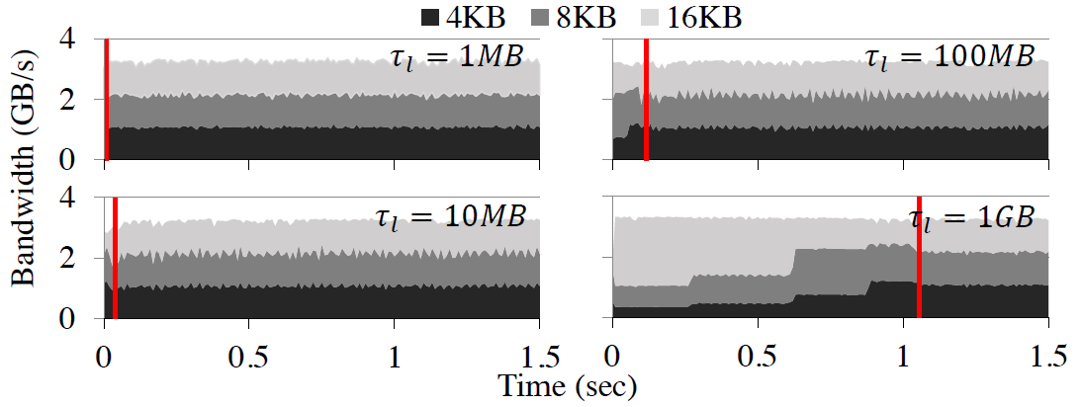
How to determine threshold？
Small threshold put off fairness！

Slide 20
How to determine threshold？
Big threshold leaded to high latency！

Slide 21
A question？
If we have one $f_{1}$ and 3$f_{3}$, static H/L ratio = 2
$f_{1}:25\%$
$f_{1}:33.3\%$
low
$f_{3}:25\%$
$f_{3}:22.2\%$
high
$f_{3}:25\%$
$f_{3}:22.2\%$
high
$f_{3}:25\%$
$f_{3}:22.2\%$

Slide 22
Tracking global virtual time
void update_gvt (vt my)
while (true) {
vt old = gvt
if ((old.id == NO_HOLDER)
|| (old.id == my.id && old.vt < my.vt)
|| (old.id != my.id && old.vt > my.vt)) {
if ( CAS(&gvt, old, my) == SUCCESS )
return
} else
return
}

Slide 23
Outline
Background & motivation
Design
Evaluation
Conclusion

Slide 24
Evaluation Methodology
① None
② D2FQ
· dynamic H/L ratio enable
· $τ_{l}=$ 1MB/s· weight , $τ_{w}={2τ}_{l}$, $τ_{m}=\frac{1}{2}τ_{l}$
③ MQFQ(state-of-art)
· D = 64， T = 45KB
④ BFQ
· max_budget = 256
Notes:
一个被添加到至少2f+1个节点的localsequencedset中的时间戳为ts的命令c,最终会被添加到那个包含ts的时间间隔所提交的值中。

Slide 25
Evaluation
Answer what questions ?
Fairness when storage device is saturated
performance when storage device is unsaturated
How about with realistic workload ?
Notes:
一个被添加到至少2f+1个节点的localsequencedset中的时间戳为ts的命令c,最终会被添加到那个包含ts的时间间隔所提交的值中。

Slide 26
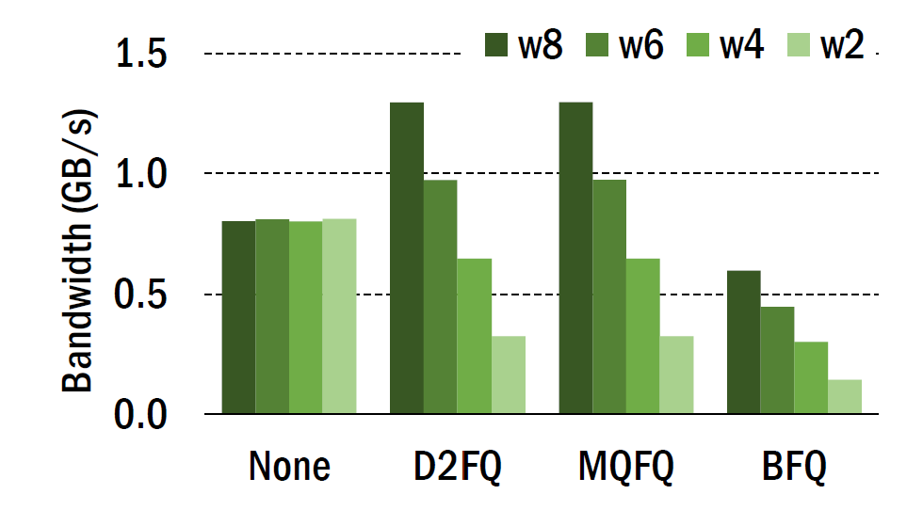
Fairness when saturated
I/O request size
Thread count
weight

Slide 27
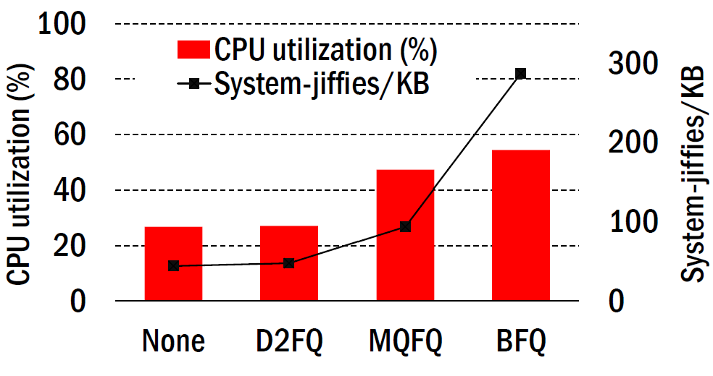
Performance when unsaturated
D2FQ minimizes scheduling cost by avoiding arbitration including request staging in the block layer
Notes:
Cost->cpu cycles
Latency 同样也降低

Slide 28
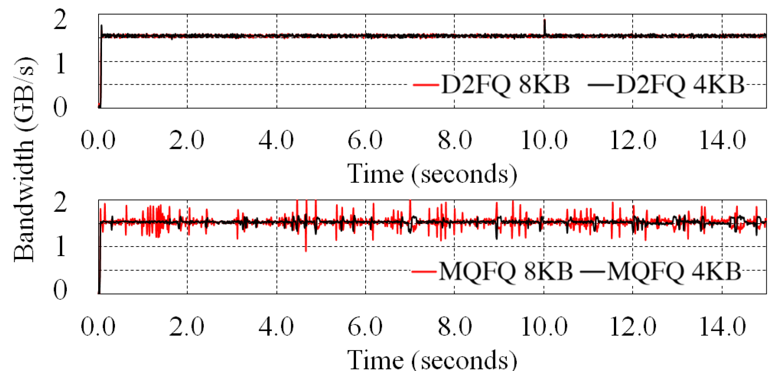
Short-term fairness
Meature every 10ms
D2FQ is stable when MQFQ fluctuates due to frequent exchange of dispatch slots across the sockets.
Notes:
Cost->cpu cycles
Latency 同样也降低

Slide 29
Dynamic H/L ratio adjustment
Notes:
Cost->cpu cycles
Latency 同样也降低

Slide 30
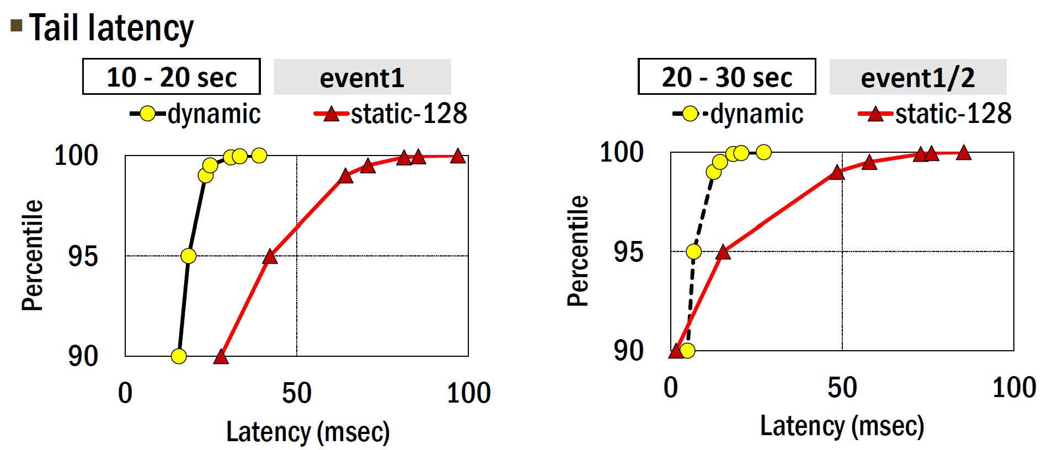
Dynamic H/L ratio adjustment
static-128 shows long tail latency because the H/L ratio is too high and flows using the low queues experience long I/O delays
Notes:
Cost->cpu cycles
Latency 同样也降低

Slide 31
Dynamic H/L ratio adjustment
the use of the medium queues gives additional fairness control over the low queues
Notes:
Cost->cpu cycles
Latency 同样也降低

Slide 32
Medium gives additional fairness!
static H/L ratio = 4
NVMe
$f_{1}:$weight=1
low
$f_{2}:$weight=3
dispatch
medium
$f_{3}:$weight=3
$f_{4}:$weight=3
high

Slide 33
Medium gives additional fairness!
static H/L ratio = 4
NVMe
h
$f_{1}:$weight=1
low
h
$f_{2}:$weight=3
dispatch
medium
h
$f_{3}:$weight=3
$f_{4}:$weight=3
$$r_{1,1}$$
$$r_{2,1}$$
$$r_{3,1}$$
$$r_{4,1}$$
h
high

Slide 34
Medium gives additional fairness!
static H/L ratio = 4
NVMe
l
$f_{1}:$weight=1
low
m
$f_{2}:$weight=3
dispatch
medium
h
$f_{3}:$weight=3
$f_{4}:$weight=3
$$r_{1,1}$$
$$r_{2,1}$$
$$r_{3,1}$$
$$r_{4,1}$$
h
high

Slide 35
Medium gives additional fairness!
static H/L ratio = 4
NVMe
l
$f_{1}:$weight=1
$$r_{1,2}$$
low
m
$f_{2}:$weight=3
dispatch
medium
h
$f_{3}:$weight=3
$f_{4}:$weight=3
$$r_{1,1}$$
$$r_{2,1}$$
$$r_{3,1}$$
$$r_{4,1}$$
h
high

Slide 36
Medium gives additional fairness!
static H/L ratio = 4
NVMe
l
$f_{1}:$weight=1
$$r_{1,2}$$
low
m
$f_{2}:$weight=3
dispatch
$$r_{2,2}$$
medium
h
$f_{3}:$weight=3
$f_{4}:$weight=3
$$r_{1,1}$$
$$r_{2,1}$$
$$r_{3,1}$$
$$r_{4,1}$$
h
high

Slide 37
Medium gives additional fairness!
static H/L ratio = 4
NVMe
l
$f_{1}:$weight=1
$$r_{1,2}$$
low
m
$f_{2}:$weight=3
dispatch
$$r_{2,2}$$
medium
h
$f_{3}:$weight=3
$f_{4}:$weight=3
$$r_{1,1}$$
$$r_{2,1}$$
$$r_{3,1}$$
$$r_{4,1}$$
$$r_{3,2}$$
$$r_{4,2}$$
h
high

Slide 38
Medium gives additional fairness!
static H/L ratio = 4
NVMe
l
$f_{1}:$weight=1
$$r_{1,2}$$
$$r_{1,3}$$
low
m
$f_{2}:$weight=3
dispatch
$$r_{2,2}$$
$$r_{2,3}$$
medium
h
$f_{3}:$weight=3
$f_{4}:$weight=3
$$r_{1,1}$$
$$r_{2,1}$$
$$r_{3,1}$$
$$r_{4,1}$$
$$r_{3,2}$$
$$r_{4,2}$$
$$r_{3,3}$$
$$r_{4,3}$$
h
high

Slide 39
Medium gives additional fairness!
static H/L ratio = 4
NVMe
l
$f_{1}:$weight=1
$$r_{1,2}$$
$$r_{1,3}$$
low
m
$f_{2}:$weight=3
dispatch
$$r_{2,2}$$
$$r_{2,3}$$
medium
h
$f_{3}:$weight=3
$f_{4}:$weight=3
$$r_{1,1}$$
$$r_{2,1}$$
$$r_{3,1}$$
$$r_{4,1}$$
$$r_{3,2}$$
$$r_{4,2}$$
$$r_{3,3}$$
$$r_{4,3}$$
h
high

Slide 40
Medium gives additional fairness!
static H/L ratio = 4
NVMe
l
$f_{1}:$weight=1
$$r_{1,2}$$
$$r_{1,3}$$
low
m
$f_{2}:$weight=3
dispatch
$$r_{2,2}$$
$$r_{2,3}$$
medium
h
$f_{3}:$weight=3
$f_{4}:$weight=3
$$r_{1,1}$$
$$r_{2,1}$$
$$r_{3,1}$$
$$r_{4,1}$$
$$r_{3,2}$$
$$r_{4,2}$$
$$r_{3,3}$$
$$r_{4,3}$$
h
high
We got 6:1 > 4:1

Slide 41
I/O performance
LL-D2FQ: low-latency block-layer bypassing scheme(ATC’19) with D2FQ
D2FQ is independent of multi-queue block layer

Slide 42
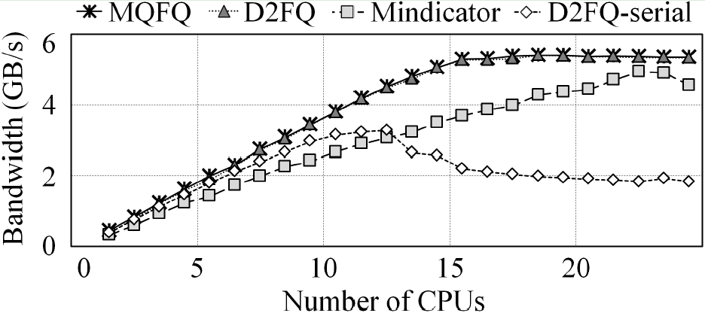
Scalability
None
D2FQ shows identical scaling to None

Slide 43
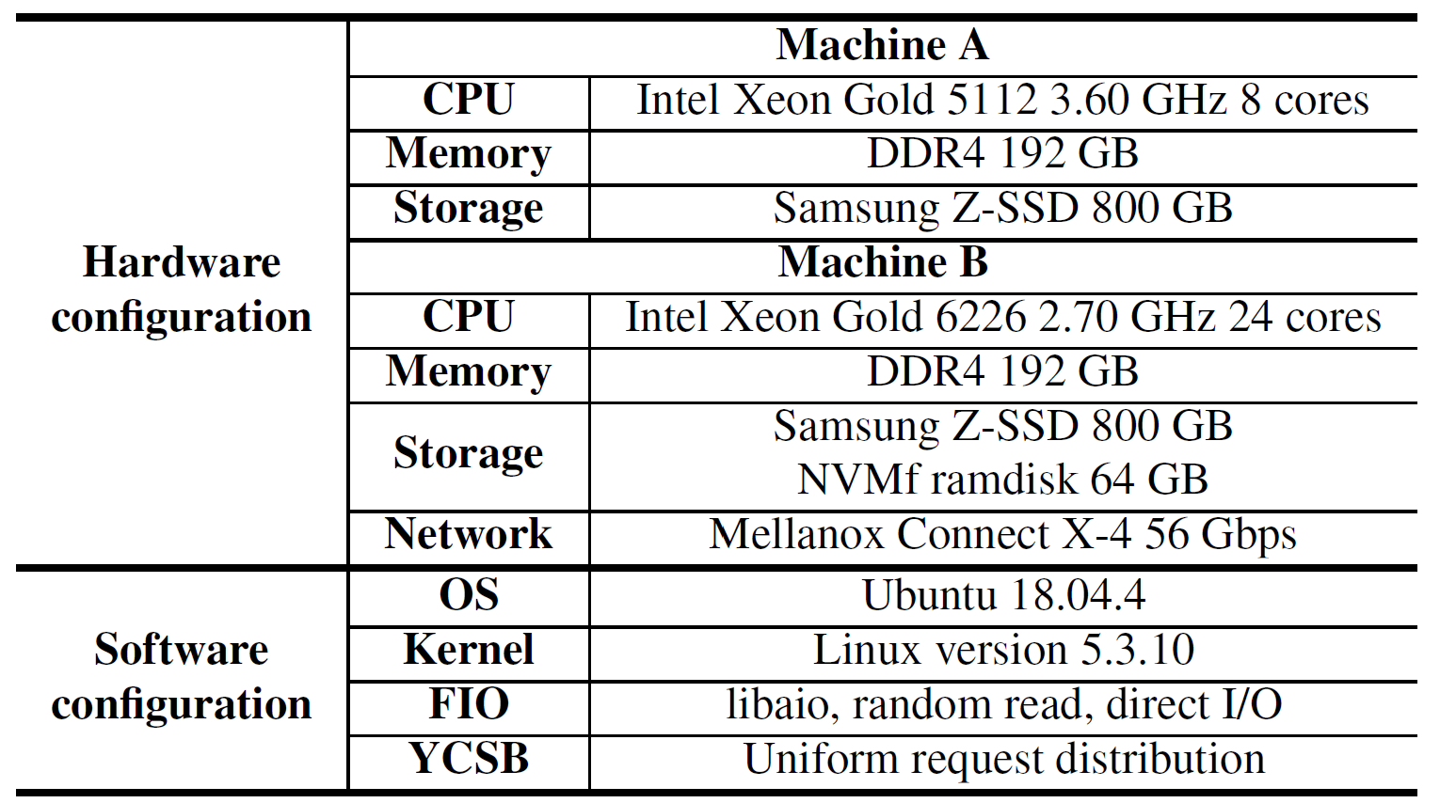
Realistic workload setup
Flow 1
Flow 2

Slide 44
Realistic workload
D2FQ shows a little higher (1.83%) total bandwidth and lower CPU utilization when fairness is similar

Slide 45
Outline
Background & motivation
Design
Evaluation
Conclusion

Slide 46
D2FQ challenges
From NVMe WRR to fair queueing, how to obtain sufficient I/O processing speed difference?
Which flow should be selected for I/O throttling?
How to manage gvt scalably ?

Slide 47
Conclusion
Fair queueing with high scheduling performance
Reducing CPU utilization by up to 45%
Low latency
Enhanced scalability
Built scheduler on top of NVMe WRR
Augmented low-latency block-layer-bypass schemes with fair I/O scheduling

Slide 48
Thanks for listening ! Q&A

