Slide 1
The Demikernel Datapath OS Architecture for
Microsecond-scale Datacenter Systems -- Reading Group Shared paper [SOSP 2021]
Irene Zhang❤, Amanda Raybuck♣, Pratyush Patel∗, Kirk Olynyk ❤, Jacob Nelson ❤, Omar S. Navarro Leija★, Ashlie Martinez∗, Jing Liu♠, Anna Kornfeld Simpson∗, Sujay Jayakar∞, Pedro Henrique Penna ❤, Max Demoulin★, Piali Choudhury
❤, Anirudh Badam ❤
❤ Microsoft Research,
♣University of Texas at Austin,
∗University of Washington,
♠University of Wisconsin Madison,
★University of Pennsylvania, ∞Zerowatt, Inc.
Ziwei Huang 2021.11.03

Slide 2
Author
Irene Zhang
Senior Researcher in Microsoft [1]
completed her PhD in 2017 at the University of Washington
received S.B. and M.Eng. degrees from MIT
Interest (Excerpted from personal profile)[2]
My research focuses on datacenter operating systems and distributed systems. I am especially interested in making it easier to build microsecond-scale datacenter systems by leveraging new datacenter hardware technologies, like kernel-bypass, RDMA and programmable devices. My most recent work has been on the Demikernel datapath OS and related projects. A bio and talk abstract for my most recent work is available
Participate in two other papers in SOSP 2021
PRISM: Rethinking the RDMA Interface for Distributed Systems [SOSP 2021]
Matthew Burke, Shannon Joyner, Adriana Szekeres, Jacob Nelson, Irene Zhang, Dan RK Ports
When Idling is Ideal: Optimizing Tail-Latency for Heavy-Tailed Datacenter Workloads with Perséphone [SOSP 2021]
Henri Maxime Demoulin, Joshua Fried, Isaac Pedisich, Marios Kogias, Boon Thau Loo, Linh Thi Xuan Phan, Irene Zhang
[1] https://www.microsoft.com/en-us/research/people/irzha/
[2] https://irenezhang.net/

Slide 3
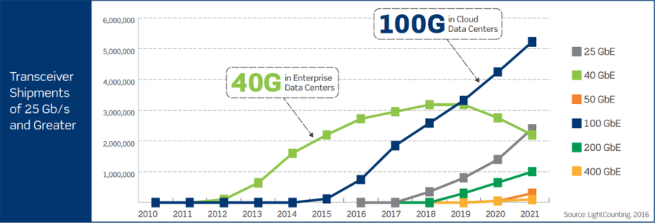
Introduction
I/O device are getting faster, but CPUs are not
Network Speeds
CPU Speeds
The CPU is increasingly a bottleneck in datacenters
https://www.datacenterdynamics.com/en/opinions/cloud-vs-enterprise-data-center-networks/

Slide 4
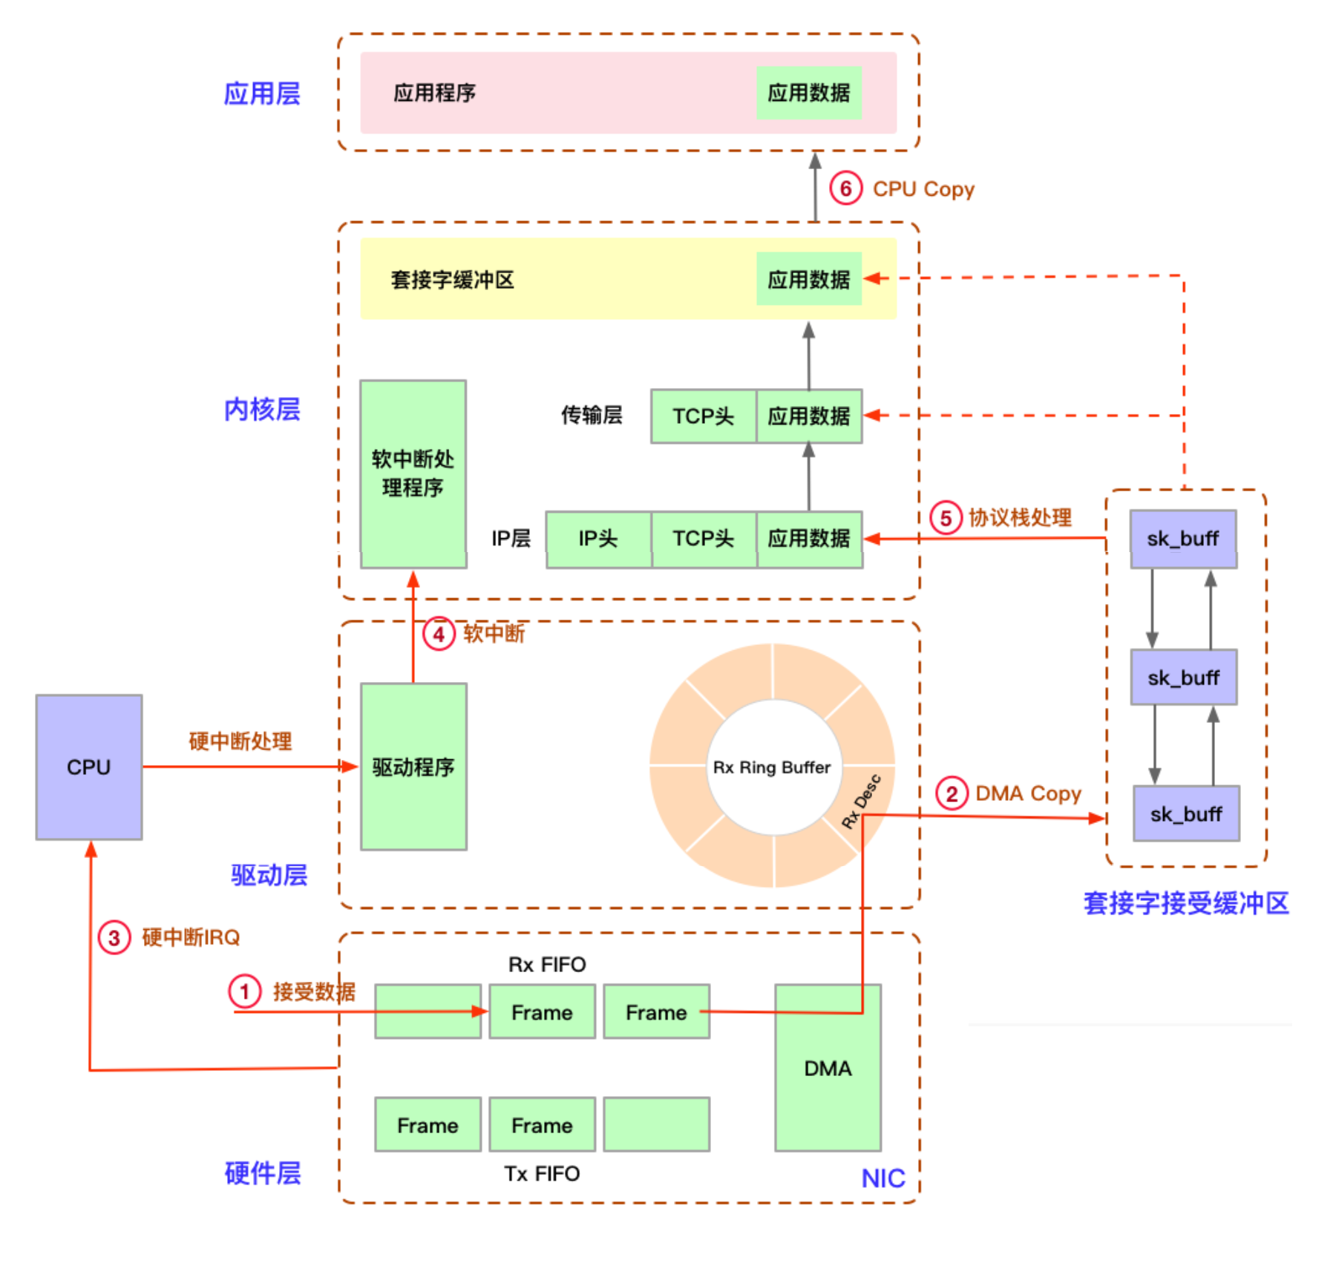
网络包接收的过程

Slide 5
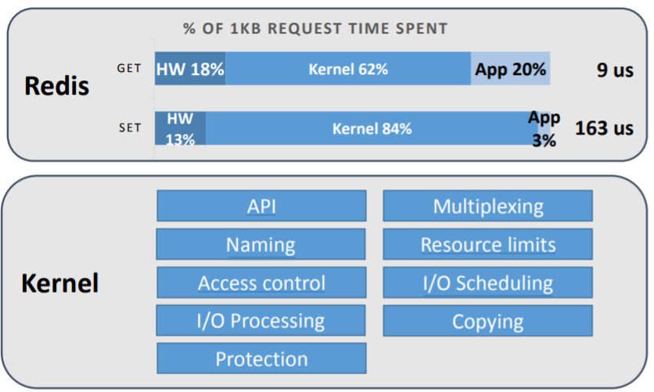
Introduction
OS kernels consume a big percentage of CPU cycles
OS kernel can no longer keep up with datacenter application or I/O
[1] Arrakis: The Operating System is the Control Plane

Slide 6
Introduction
Kernel-bypass eliminates the kernel on the datapath
Datapath
User space
Redis
Kernel-bypass offloads OS protection features to let application safely perform I/O on datapath.
Kernel space
OS Management
OS Management
OS Protection
CPU
I/O Device

Slide 7
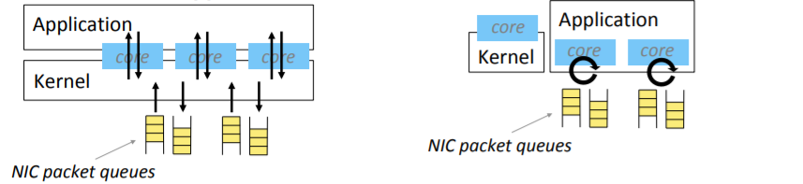
The Kernel Bypass
Introduction
Shenago [NSDI 2019]
Traditional Approach
Kernel Bypass
Dedicate busy-spinning cores
Applications directly poll NIC queues
Enables higher throughput and lower latency
[1] Shenango: Achieving High CPU Efficiency for Latency-sensitive Datacenter Workloads
[2] Caladan: Mitigating Interference at Microsecond Timescales

Slide 8
Shenago
[1] Shenango: Achieving High CPU Efficiency for Latency-sensitive Datacenter Workloads

Slide 9
OUTLINE
INTRODUCTION How does kernel-bypass work and why is it important?
BACKGROUND Why is kernel-bypass hard to use?
DEMIKERNEL OVERVIEW What is Demikernel and how does it help?
DEMIKERNEL API What is the Demikernel APl for kernel-bypass I/O?
EVALUATION What improvements does Demikernel provide?

Slide 10
Motivative - Kernel-bypass device are heterogenous
Different device implement different interfaces and os services based on hardware capabilities
Application
congestion control
retransmission
Protobufs
ordering
memory allocation
TCP?
address translation
address translation
address translation
user-level I/O access
user-level I/O access
user-level I/O access
RDMA
DPDK
Programmable
There is no common datapath architecture

Slide 11
Demikernel
A new kernel-bypass OS [architecture]

Slide 12
Overview - Demikernel Design Goals
Flexible architecture for heterogenous device
Simplify µs-scale kernel-bypass system development
Portable, high-level datapath API
Offer portability across heterogenous devices
Microsecond-scale OS features
Achieve nanosecond-scale latency overheads.

Slide 13
Overview -Kernel-bypass eliminates the kernel on the datapath
Datapath
User space
Redis
Gap - without replacing its other features
OS Management
I/O buffer allocation
flow control
congestion control
ordered, reliable delivery
IP resolution
……
Kernel space
OS Management
kernel-bypass OSes
-Arrakis (OSDI‘2014) kernel-bypass library
-Caladan(OSDI’2020)
libOS
OS Protection
address translation
isolation/protection
device multiplexing
CPU
I/O Device

Slide 14
Demikernel Overview
Demikernel supplies missing os services in a user-space libos
Control path
Datapath
Redis
Redis
OS kernel
OS Management
Demikernel
libOS
OS Protection
address translation
isolation/protection
device multiplexing
CPU
CPU
I/O Device

Slide 15
Demikernel uses a library os datapath architecture
Demikernel supplies a different LIBOS for each device
Application
Demikernel Portable Datapath API(PDPIX)
DPDK libOS
RDMA libOS
TCP-including
flow control
congestion control
ordered, reliable delivery
……
missing OS services
……
flow control
buffer allocation&manage
Feature libOS
congestion control
retransmission
Protobufs
ordering
memory allocation
TCP?
address translation
address translation
address translation
user-level I/O access
user-level I/O access
user-level I/O access
RDMA
DPDK
Programmable
To flexibly accommodate heterogeneous device

Slide 16
OUTLINE
INTRODUCTION What is kernel-bypass and why is it important?
BACKGROUND How does kernel-bypass work and why is it hard to use?
DEMIKERNEL OVERVIEW What is Demikernel and how does it help?
DEMIKERNEL API Demikernel features?
EVALUATION What improvements does Demikernel provide?

Slide 17
zero-copy
user thread
CPU
DMA
NIC
read() syscall
context switch
issue I/O
issue I/O
blocking wait
NIC
DMA copy
CPU copy
read() return
context switch
continue

Slide 18
zero-copy
three new external OS feature
a portable API with clear semantics for I/O memory buffer ownership
invoking I/O : applications pass ownership to the Demikernel datapath OS
I/O completes : application receive ownership
DMA-capable heap
replace the application’s memory allocator to back the heap with DMA-capable memory in a device-specific way
RDMA libOS’s memory allocator registers heap memory transparently for RDMA on the first I/O access
DPDK libOS’s allocator backs the application’s heap with memory from the DPDK memory allocator
UAF protection
in-use zero-copy I/O buffers free : both the application and datapath OS explicitly free.
zero-copy coordination : preventing applications from accidentally freeing memory buffers in use for I/O processing

Slide 19
PDPIX: A Portable Datapath API
I/O queue
PDPIX does not modify the POSIX listen/accept interface for accepting network connections
qtoken : accept returns a queue descriptor, instead of a file descriptor, used to accept incoming connections
Network and Storage I/O
push / pop : datapath operations for submitting and receiving I/O operations
push and pop are non-blocking and return a qtoken indicating their asynchronous result
wait_* : use the qtoken to fetch the completion
Request processing loop
All I/O must be from the DMA-capable heap
parse
response
pop
qtoken
wait
sgarray
push
qtoken
Demikernel libOS

Slide 20
Coroutines and µs-scale CPU scheduling.
encapsulate both OS and application computation.
coroutines lets applications workers wait on specific I/O requests and the datapath OSes explicitly assign I/O requests to workers.
Coroutines are lightweight, have low-cost context switches and are well-suited for the state-machine-based asynchronous event handling that I/O stacks commonly require.
compare to user-level threads(Caladan’s green threads) : coroutines encapsulate state for each task, removing the need for global state management. For example, Demikernel’s TCP stack uses one coroutine per TCP connection for retransmissions, which keeps the relevant TCP state.
Every libOS has a centralized coroutine scheduler, optimized for the kernel-bypass device

Slide 21
Evaluation
2 kernel-bypass applications
testpmd
perftest
testpmd and perftest are included with the DPDK and RDMA SDKs, respectively, and used as raw performance measurement tools
3 recent kernel-bypass libraries :
eRPC
Shenango
Caladan

Slide 22
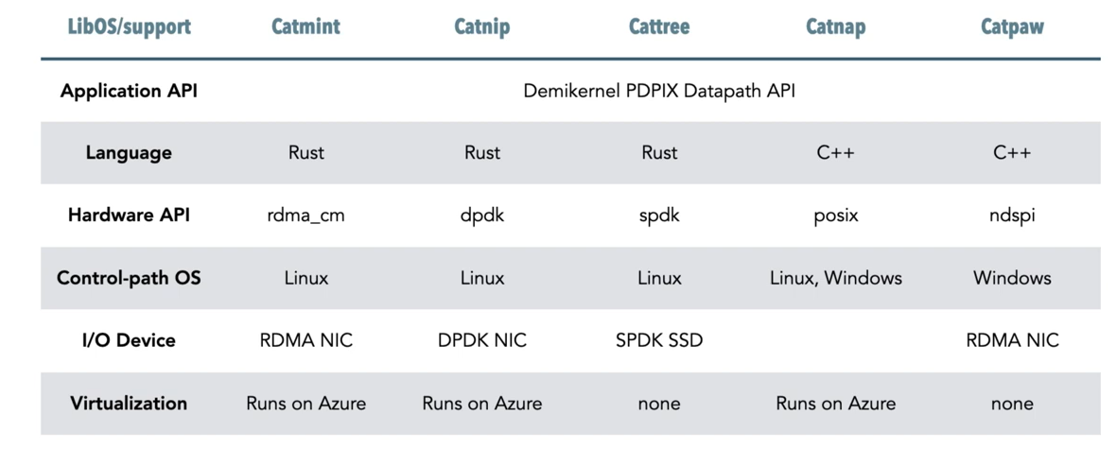
Demikernel prototypes

Slide 23
Evaluation
LoC for µs-scale kernel-bypass systems
Demikernel easier to use than POSIX-based OSes
exp1 : Echo latencies on Linux (64B).
Demikernel can achieve competitive µs latencies without sacrificing portability
Notes:
我们发现Demikernel比基于posix的操作系统更容易使用，因为它的API更适合μs-尺度的数据中心系统及其操作系统服务更好地满足了他们的需求，包括可移植的I/O堆栈、dma支持的堆和UAF保护
如上图所示，在测试中，基于Demikernel实现的Catmint，Catnip等libOS在进行IO事件处理时比传统的基于内核的IO减少了80%左右的时延。与原有的kernel-bypass技术（如Shenango和Caladan）相比，Demikernel拥有相近的IO操作时延，却提供了更好的可移植性与抽象等级。Demikernel提供的抽象只为DPDK和RDMA的处理增加了几微秒的额外时延。综上所述，Demikernel在提供了OS抽象与管理特性的同时将对数据通路的时延影响降到了次微秒级别，达成了其设计目标。

Slide 24
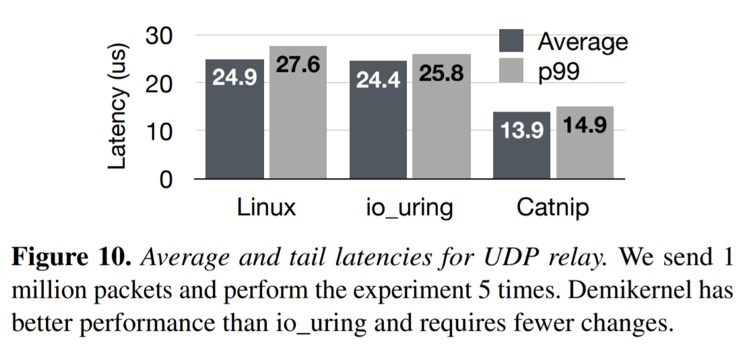
Evaluation
exp2 : Echo latencies on Linux (64B).
Notes:
UDP中继的平均延迟和尾延迟。我们发送100万个数据包，进行5次实验。与io_uring相比，Demikernel有更好的性能，需要的更改更少。

Slide 25
Summary
Demikernel is a microsecond scale datapath 0S.
Demikernel lets applications portably run across devices with no code changes.
There are many open research problems in datapath OS design.
source code : https://github.com/demikernel/demikernel

Slide 26
THANKS!
Q & A

Slide 27
IX Project
lib OS（数据面）： 硬件虚拟化分开控制面和数据面-->a.控制面负责资源分配,b.数据面负责高性能网络I/O
解决问题： 低时延，高吞吐量，高能效，保护
方法：
按批次绑定数据包，最小化连续传输，保持多核同步
不信任直接访问设备的应用 ----为什么--->担心稳定性核安全性不行
dune的安全核 ：Intel硬件虚拟化拓展让I/O路径和应用程序代码共存，将队列映射到内核，但是仍然设法在隔离的保护域中运行网络堆栈，在这个隔离的保护域中，应用程序不能使用数据。
mTCP - 高性能用户态协议
问题：内核和用户之间移动数据采取的数据拷贝和上下文切换不好 ---->新的网卡NIC和CPU功能（如multiqueue）
将设备驱动程序和网络堆栈直接移入应用程序，并将内核完全从IO路径中取出。
Arrakis - 不仅在应用数据上绕过了内核，它不仅对网络数据包进行内核屏蔽，对数据存储也进行了屏蔽。
Sandstorm
mTCP在层和API方面更深入一些，它保留了到客户端应用程序的POSIX套接字接口，尽管它们被重新编译链接到mTCP而不是网络的libc，它还实现了一个用户级堆栈，对网络代码进行特定应用调整，为Web和DNS服务器实现提供加速。

