Slide 1
InfiniCache: Exploiting Ephemeral
Serverless Functions to
Build a Cost-Effective Memory Cache
Shared by Zevin King and Dongbo Yu
March 20
Notes:
今天的这篇paper是讲的是InifiniCache,
这是基于Serverless function实现的memory cache.
提到serverless,首先想到的stateless,而cache明显是stateful的,这怎么可能呢?
这篇paper用了很多tricky的东西成功实现了cache.
在正式开始之前,我们用几分钟给小朋友们简单介绍一下Serverless

Slide 2
Outline
1
Intro
2
Dongbo’s Part: Background, Motivation and Design
3
Evaluation
3
4
Discussion
Notes:
我先来介绍一下serverless,然后由波波讲一下这篇paper的背景,动机和设计,然后我讲一下evaluation

Slide 3
Intro - 1. Serverless Functions
Flow:
Step 1:
Step 2:
Step 3:
Notes:
这是我们用serverless function的大致流程

Slide 4
Intro - 1. Serverless Functions
Flow:
Step 1: Clients submit the function to the providers
Step 2:
Step 3:
Code Package:
├─ app.js:
...
function handler():
...
├─ pakcage.json
├─ node_modules/
Notes:
第一步,用户提交函数到provider,
这里的函数指的是一个code package,可以是python/node.js/java/go,里面有一些配置文件

Slide 5
Intro - 1. Serverless Functions
Flow:
Step 1: Clients submit the function to the providers
Step 2: To invoke it, clients send a message to the providers.
with some parameters as input
Step 3:
Code Package:
├─ app.js:
...
function handler():
...
├─ pakcage.json
├─ node_modules/
Notes:
提交了provider就部署了
用户可以发送message给provider
来调用我们的函数/代码,

Slide 6
Intro - 1. Serverless Functions
Flow:
Step 1: Clients submit the function to the providers
Step 2: To invoke it, clients send a message to the providers.
with some parameters as input
Step 3: The providers
1) start a container if no warm one available
2) invoke the handler function
3) return the result to the caller
Code Package:
├─ app.js:
...
function handler():
...
├─ pakcage.json
├─ node_modules/
Notes:
然后provider就会在一个容器里面,调用我们的入口函数,
如果之前没有正在跑的容器,就新开一个
执行之后返回结果给用户
这就是flow

Slide 7
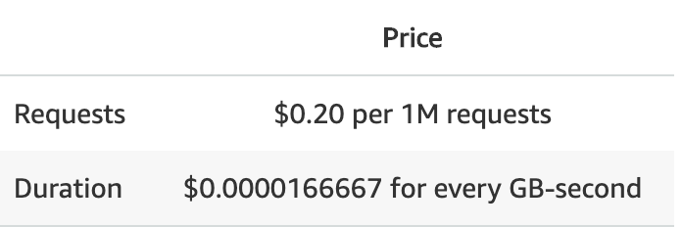
Intro - 1. Serverless Functions
Pros:
Auto-scaling
Pay-as-you-go: 100ms-grained duration
Notes:
以lambda为代表的serverless function服务
有这么几个好处:
它支持autoscaling,自动扩展,如果没有人invoke,就不执行,如果突然又了1百万个人invoke,就会马上开启1百万个instance
他的付费方式是很细粒度的.
分成两个维度,一是request个数
二是计算时长和内存使用
时长是以100ms为粒度的

Slide 8
Intro - 1. Serverless Functions
Pros:
Auto-scaling
Pay-as-you-go: 100ms-grained duration
Cons:
Short lifetime: 15 mins
Storage through network: e.g. S3
No in-bound network: NAT
Notes:
然后lambda中,每个任务一次最多执行15min
这里是计算和存储分离,所以想要持久化的存储,必须通过网络发送到S3等
之后因为NAT的网络模式,一个lambda实例不支持由外界发起的连接

Slide 9
Intro - 1. Serverless Functions
Lambda & InfiniCache:
In a common use case:
Clients deploy one Lambda package with one Lambda ID
Notes:
然后这篇工作里面有一个和common case不太一样的地方,很巧妙
官方给出了很多成功的common use case,他们是这样的
客户用一个代码包,部署一个lambda,
workload一般是并发的调用这个lambda,可能会开启几千个实例
然后按照官方给出的教程,client是不能知道指定invoke某一个固定实例的,

Slide 10
Intro - 1. Serverless Functions
Lambda & InfiniCache:
In a common use case:
Clients deploy one Lambda package with one Lambda ID
Clients concurrently invoke the Lambda ID with several or thousands of instances
Notes:
然后这篇工作里面有一个和common case不太一样的地方,很巧妙
官方给出了很多成功的common use case,他们是这样的
客户用一个代码包,部署一个lambda,
workload一般是并发的调用这个lambda,可能会开启几千个实例
然后按照官方给出的教程,client是不能知道指定invoke某一个固定实例的,

Slide 11
Intro - 1. Serverless Functions
Lambda & InfiniCache:
In a common use case:
Clients deploy one Lambda package with one Lambda ID
Clients concurrently invoke the Lambda ID with several or thousands of instances
Clients can’t specify an instance to invoke
Notes:
然后这篇工作里面有一个和common case不太一样的地方,很巧妙
官方给出了很多成功的common use case,他们是这样的
客户用一个代码包,部署一个lambda,
workload一般是并发的调用这个lambda,可能会开启几千个实例
client是不能知道指定invoke某一个固定实例的,

Slide 12
Intro - 1. Serverless Functions
Lambda & InfiniCache:
In a common use case:
Clients deploy one Lambda package with one Lambda ID
Clients concurrently invoke the Lambda ID with several or thousands of instances
Clients can’t specify an instance to invoke
But in InfiniCache:
Clients deploy the same Lambda package with hundreds of Lambda IDs
Notes:
但是在infiniCache里面,他们是怎么做的呢?
他们提交了相同的代码包,但是提交了几百次
每提交一次,就有一个ID
然后他们

Slide 13
Intro - 1. Serverless Functions
Lambda & InfiniCache:
In a common use case:
Clients deploy one Lambda package with one Lambda ID
Clients concurrently invoke the Lambda ID with several or thousands of instances
Clients can’t specify an instance to invoke
But in InfiniCache:
Clients deploy the same Lambda package with hundreds of Lambda IDs
Clients invoke function with the specific ID to run the reused instance
Notes:
但是在infiniCache里面,他们是怎么做的呢?
他们提交了相同的代码包,但是提交了几百次
提交时的ID都不同,
并发的只invoke个instance,
这样就可以在第一次invoke之后复用instance,如果没有被收回

Slide 14
Intro - 1. Serverless Functions
In InfiniCache:
Basic:
serverless functions’ <cpu, memory> resources are pay-per-use
Notes:
目前比较值得一谈的软件架构有这三种

Slide 15
Intro - 1. Serverless Functions
Insights in InfiniCache:
Basic:
serverless functions’ <cpu, memory> resources are pay-per-use
Advanced:
serverless providers offer “free” caching for lower latency
Notes:
目前比较值得一谈的软件架构有这三种

Slide 16
Intro - 1. Serverless Functions
Insights in InfiniCache:
Basic:
serverless functions’ <cpu, memory> resources are pay-per-use
Advanced:
serverless providers offer “free” caching for lower latency
Tricky:
users can pin lambda nodes
with deploying the same code package with hundreds of lambda IDs and launch 1 or 2 instances,
Notes:
目前比较值得一谈的软件架构有这三种

Slide 17
Intro - 1. Serverless Functions
Insights in InfiniCache:
Basic:
serverless functions’ <cpu, memory> resources are pay-per-use
Advanced:
serverless providers offer “free” caching for lower latency
Tricky:
users can pin lambda nodes
with deploying the same code package with hundreds of lambda IDs and launch 1 or 2 instances,
while the common cases are to deploy one ID and launch hundreds of instances
and it was believed that we couldn’t invoke a specific instance
Notes:
目前比较值得一谈的软件架构有这三种

Slide 18
Intro - 2. Erasure Coding
n = d + p:
d chunks of data and p chunks of parities
Notes:
然后简单介绍一下EC

Slide 19
Intro - 2. Erasure Coding
n = d + p:
d chunks of data and p chunks of parities
No data loss even if pieces(≤p) of chunks are erased
Notes:
然后简单讲一下EC

Slide 20
Intro - 2. Erasure Coding
n = d + p:
d chunks of data and p chunks of parities
No data loss even if pieces(≤p) of chunks are erased
Cases:
Reed–Solomon
Notes:
目前比较值得一谈的软件架构有这三种

Slide 21
Intro - 2. Erasure Coding
n = d + p:
d chunks of data and p chunks of parities
No data loss even if pieces(≤p) of chunks are erased
Cases:
Reed–Solomon
Insights in InfiniCache:
mitigate the straggler issue
fault tolerance against the potential loss of the cloud functions
Notes:
目前比较值得一谈的软件架构有这三种

Slide 22
Outline
1
Intro
2
Dongbo’s Part: Background, Motivation and Design
3
Evaluation
3
4
Discussion

Slide 23
Outline
1
Intro
2
Dongbo’s Part: Background, Motivation and Design
3
Evaluation
3
4
Discussion

Slide 24
Evaluation - Setup
5k+ LOC of Go
Notes:
目前比较值得一谈的软件架构有这三种

Slide 25
Evaluation - Setup
5k+ LOC of Go
Clients and Proxy on c5n.4xlarge EC2 VMs
c5n.4xlarge: 16 vCPUs, 42 GiB RAM, EBS, $0.864 per Hour
Notes:
目前比较值得一谈的软件架构有这三种

Slide 26
Evaluation - Setup
5k+ LOC of Go
Clients and Proxy on c5n.4xlarge EC2 VMs
c5n.4xlarge: 16 vCPUs, 42 GiB RAM, EBS, $0.864 per Hour
Lambda nodes with 10Gbps connection
50-160 MBps for each Lambda
Notes:
目前比较值得一谈的软件架构有这三种

Slide 27
Evaluation - Setup
5k+ LOC of Go
Clients and Proxy on c5n.4xlarge EC2 VMs
c5n.4xlarge: 16 vCPUs, 42 GiB RAM, EBS, $0.864 per Hour
Lambda nodes with 10Gbps connection
50-160 MBps for each Lambda
2 Workloads: Microbenchmark and Production workload
Notes:
目前比较值得一谈的软件架构有这三种

Slide 28
Evaluation - Setup
5k+ LOC of Go
Clients and Proxy on c5n.4xlarge EC2 VMs
c5n.4xlarge: 16 vCPUs, 42 GiB RAM, EBS, $0.864 per Hour
Lambda nodes with 10Gbps connection
50-160 MBps for each Lambda
2 Workloads: Microbenchmark and Production workload
VS: ElastiCache(with Redis engine) and S3
Notes:
目前比较值得一谈的软件架构有这三种

Slide 29
Evaluation - Microbenchmark
Factor-Y:
Latency
Factor-X:
EC Code(d+p)
Object sizes(10-100MB)
Mem in Lambda(128-3008MB)
Notes:
目前比较值得一谈的软件架构有这三种

Slide 30
Evaluation - Microbenchmark
Factor-X:
EC Code(d+p)
Object sizes(10-100MB)
Mem in Lambda(128-3008MB)
Factor-Y:
Latency
Throughput
Scalability
Notes:
目前比较值得一谈的软件架构有这三种

Slide 31
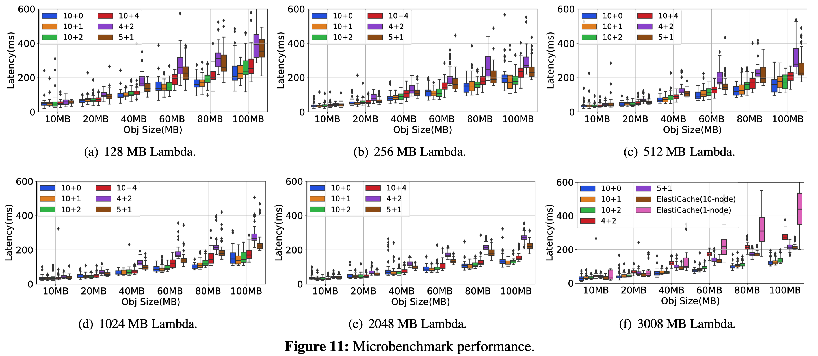
Evaluation - Microbenchmark
End-to-end latency
Notes:
目前比较值得一谈的软件架构有这三种

Slide 32
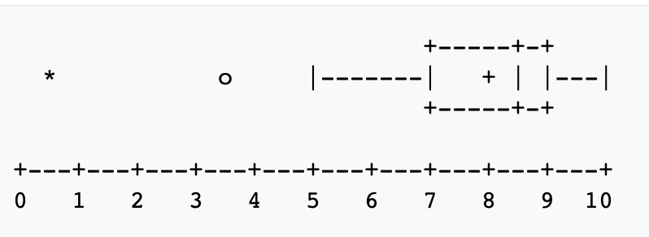
Evaluation - Box-and-Whisk Plots
Also called box plots(箱型图,盒须图,盒式图,盒状图)
https://zh.wikipedia.org/wiki/箱形圖
Notes:
目前比较值得一谈的软件架构有这三种

Slide 33
Evaluation - Box-and-Whisk Plots
Also called box plots(箱型图,盒须图,盒式图,盒状图)
Left to right:
extreme outlier 极端值: 0.5
mild outlier 离群值: 3.5
minimum 最小值: 5
Q1 下四分位: 7
Average 平均值: 8
Med(Q2) 中位数: 8.5
Q3 上四分位: 9
...
https://zh.wikipedia.org/wiki/箱形圖
Notes:
目前比较值得一谈的软件架构有这三种

Slide 34
Evaluation - Microbenchmark
End-to-end latency
Notes:
目前比较值得一谈的软件架构有这三种

Slide 35
Evaluation - Microbenchmark
End-to-end latency
EC Code(d+p)
Conclusion 1: (10+1) better than (10+x)
Explanation:
minimum IO
minimum coding
stragglers
Notes:
目前比较值得一谈的软件架构有这三种

Slide 36
Evaluation - Microbenchmark
End-to-end latency
EC Code(d+p)
Conclusion 1: (10+1) better than (10+x)
Explanation:
minimum IO
minimum coding
stragglers
Mem in Lambda(128-3008MB)
Conclusion 2: Larger mem, lower latency
Explanation: for (10+1)
110-290ms in (c)
100-160ms in (e)
Notes:
目前比较值得一谈的软件架构有这三种

Slide 37
Evaluation - Microbenchmark
End-to-end latency
EC Code(d+p)
Conclusion 1: (10+1) better than (10+x)
Explanation:
minimum IO
minimum coding
stragglers
Mem in Lambda(128-3008MB)
Conclusion 2: Larger mem, lower latency
Explanation: for (10+1)
110-290ms in (c)
100-160ms in (e)
vs ElastiCache(f)
Conclusion 3:
Better in all large objects than 1 Node
Exp: 1 thread in Redis
Better in larger objects than 10 Nodes
Exp: stragglers
Notes:
目前比较值得一谈的软件架构有这三种

Slide 38
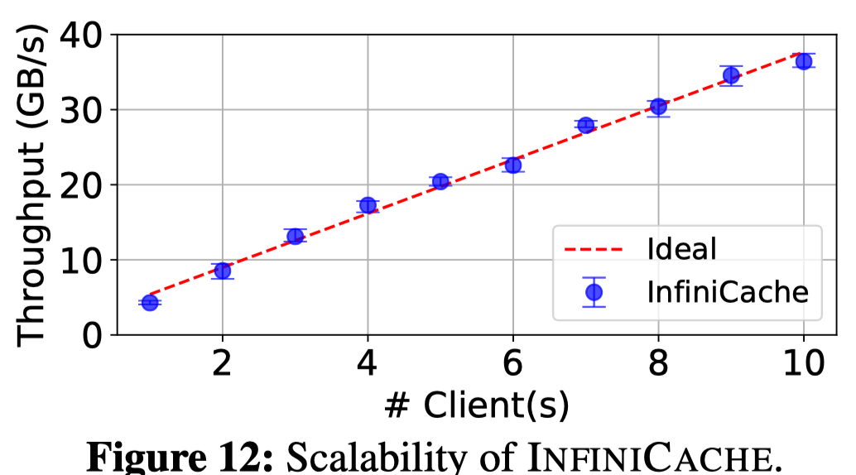
Evaluation - Microbenchmark
Scalability:
Setup:
Notes:
目前比较值得一谈的软件架构有这三种

Slide 39
Evaluation - Production Workload
Setup:
400 1.5GB Lambda functions
one proxy co-located with the client.
RS(10+2)
$T_{warm}$ = 1 min, $T_{bak}$ = 5 min
Notes:
目前比较值得一谈的软件架构有这三种

Slide 40
Evaluation - Production Workload
Setup:
400 1.5GB Lambda functions
one proxy co-located with the client.
RS(10+2)
$T_{warm}$ = 1 min, $T_{bak}$ = 5 min
Workload:
IBM Docker registry production workload(50 hours out of 75 days)
objects sizes:
a) all objects
b) large only(with/without backup)
request: mostly GET
Notes:
目前比较值得一谈的软件架构有这三种

Slide 41
Evaluation - Production Workload
Cost-savings:
Cost model:
$C$ = $C_{serving}$ + $C_{warm}$ + $C_{bak}$
Each $C_{_}$ = $C_{_req_count}$ + $C_{_duration}$
Notes:
目前比较值得一谈的软件架构有这三种

Slide 42
Evaluation - Production Workload
Cost-savings:
Cost model:
$C$ = $C_{serving}$ + $C_{warm}$ + $C_{bak}$
Each $C_{_}$ = $C_{_req_count}$ + $C_{_duration}$
Notes:
目前比较值得一谈的软件架构有这三种

Slide 43
Evaluation - Production Workload
Cost-savings:
Cost model:
$C$ = $C_{serving}$ + $C_{warm}$ + $C_{bak}$
Each $C_{_}$ = $C_{_req_count}$ + $C_{_duration}$
Cost of Proxy and Client library not involved
Notes:
目前比较值得一谈的软件架构有这三种

Slide 44
Evaluation - Production Workload
Fault tolerance:
Recovery: EC-based recovery
RESET: after a cache miss, retrieves from S3
Notes:
目前比较值得一谈的软件架构有这三种

Slide 45
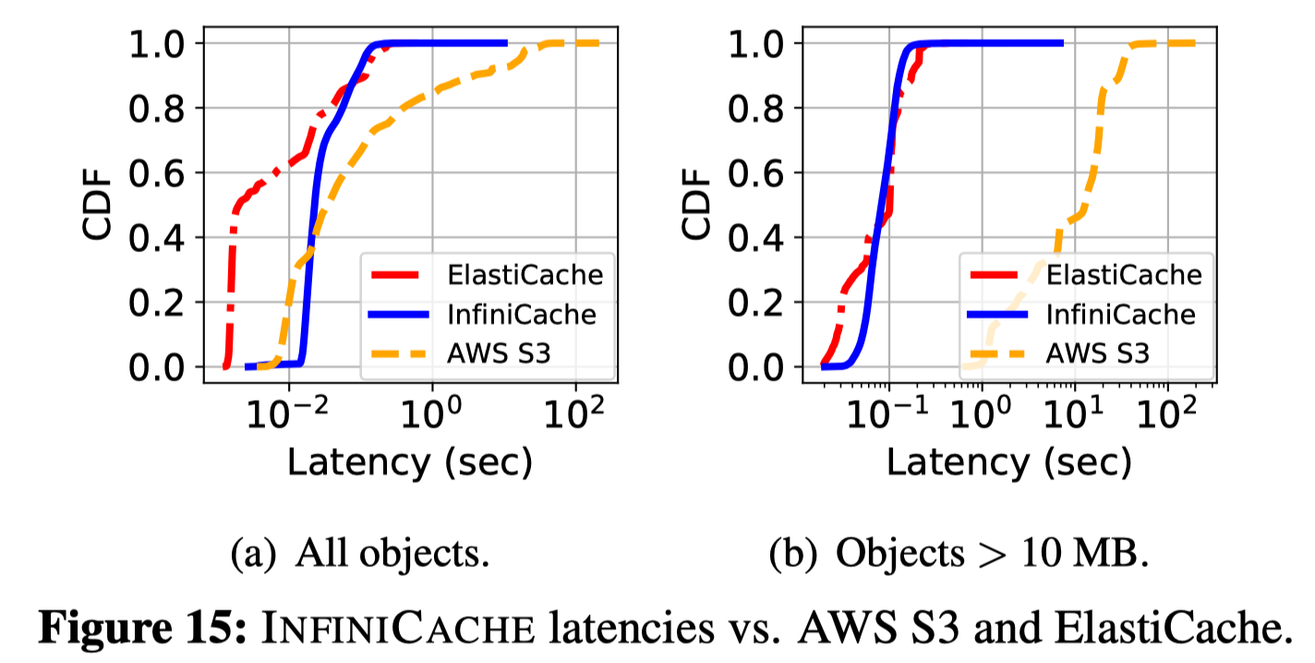
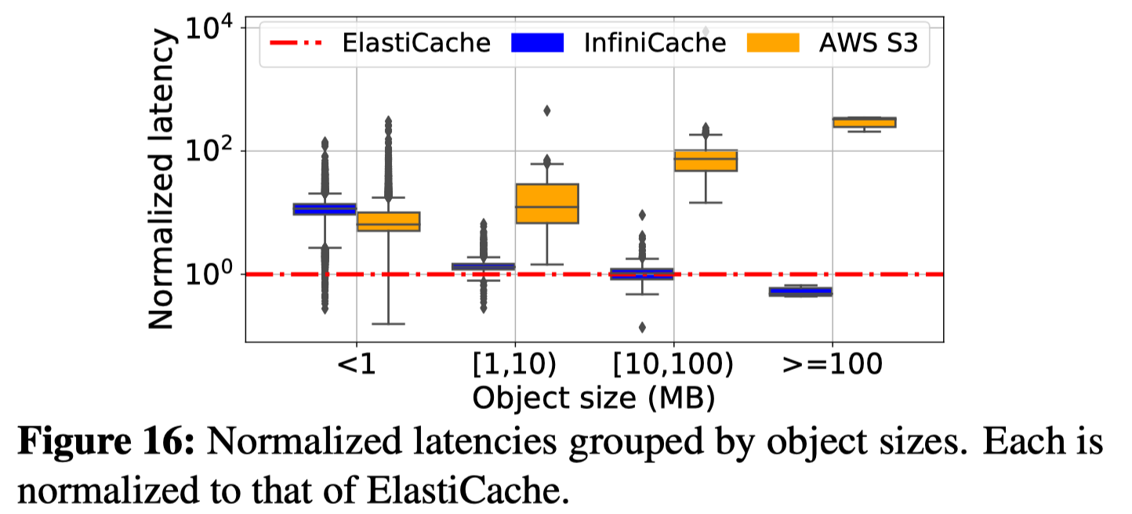
Evaluation - Production Workload
Performance:
vs ElastiCache and S3
<1 : warm invoking latency: ~13ms
≥100: parallel IO of IC
Notes:
目前比较值得一谈的软件架构有这三种

Slide 46
Outline
1
Intro
2
Dongbo’s Part: Background, Motivation and Design
3
Evaluation
3
4
Discussion
Notes:
这是今天的主线思路,
首先是背景,介绍一下这三个概念;
其次是迁移的理由,为什么要迁移;
然后是我们用来向serverless迁移的一个case study,用的是sharelatex;
最后是我们对未来工作的一些思考
下面来介绍一下这三个概念

Slide 47
Discussion
Insights in serverless functions:
Basic:
serverless functions’ <cpu, memory> resources are pay-per-use
Advanced:
serverless providers offer “free” caching for lower latency
Notes:
目前比较值得一谈的软件架构有这三种

Slide 48
Discussion
Insights in serverless functions:
Basic:
serverless functions’ <cpu, memory> resources are pay-per-use
Advanced:
serverless providers offer “free” caching for lower latency
Tricky:
users can pin lambda nodes
with deploying the same code package with hundreds of lambda IDs and launch 1 or 2 instances,
Notes:
目前比较值得一谈的软件架构有这三种

Slide 49
Discussion
Insights in serverless functions:
Basic:
serverless functions’ <cpu, memory> resources are pay-per-use
Advanced:
serverless providers offer “free” caching for lower latency
Tricky:
users can pin lambda nodes
with deploying the same code package with hundreds of lambda IDs and launch 1 or 2 instances,
while the common cases are to deploy one ID and launch hundreds of instances
and it was believed that we couldn’t invoke a specific instance
Notes:
目前比较值得一谈的软件架构有这三种

Slide 50
Discussion
Insights in EC:
mitigate the straggler issue
fault tolerance against the potential loss of the cloud functions
Notes:
目前比较值得一谈的软件架构有这三种

Slide 51
Discussion
Tricky:
TCP connection started from Lambda
backup Lambda instance invoked by the primary lambda instance
cost modeling: proxy & library not involved
Notes:
目前比较值得一谈的软件架构有这三种

Slide 52
InfiniCache: Exploiting Ephemeral
Serverless Functions to
Build a Cost-Effective Memory Cache
Thanks!
Shared by Zevin King and Dongbo Yu
March 20

