Slide 1
Distributed Systems
Lecture 2 – Communication & RPC
Cheng Li

Slide 2
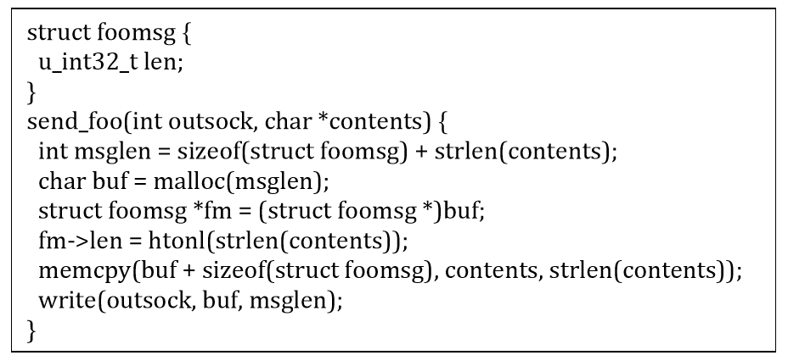
Using socket
Many issues:
lots of ugly boiler plate
bug prone
portability details are easy to miss
hard to understand and hard to maintain
hard to evolve protocol
vulnerability prone

Slide 3
Remote procedure call (RPC)
RPC’s goal is to make distributed programming look like as much as possible like normal programming.
Proposed by Birrell & Nelson in 1984
RPC transparency
Preserve original client code
Preserve original server code
RPC glues client/server together w/o changing behavior
Programmer doesn't have to think about network

Slide 4
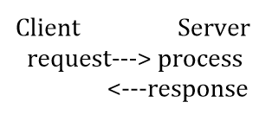
Remote procedure call (RPC)
A request from the client to execute a function on the server.
To the client, looks like a procedure call
To the server, looks like an implementation of a procedure call
Implement RPC through request-response protocol
Procedure call generates network request to server
Server return generates response

Slide 5
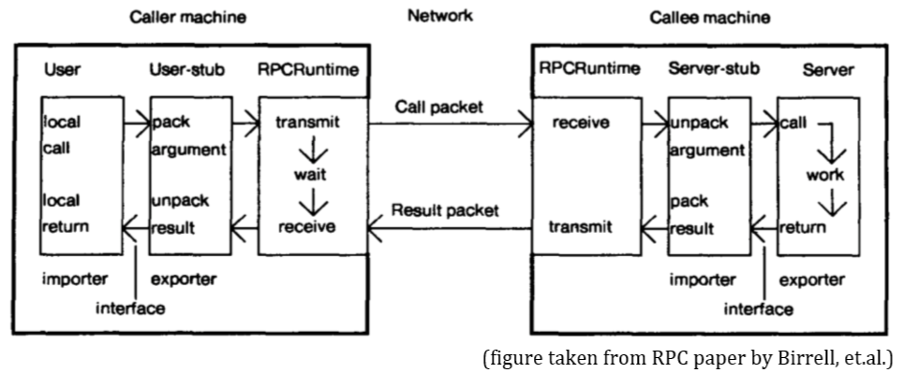
RPC software structure
source: http://www.birrell.org/andrew/papers/ImplementingRPC.pdf
http://www.cs.cornell.edu/courses/cs614/1999sp/notes97/implrpc.html

Slide 6
RPC’s problems
High latency
LPC is fast, RPC can be really expensive (esp. if it goes over WAN, but not only)
State-of-the-art solutions
Datacenter RPCs can be General and Fast (erpc, nsdi’19)
https://www.usenix.org/conference/nsdi19/presentation/kalia

Slide 7
RPC’s problems
Pointer transfers
Local address space isn’t shared with remote process.
The programmer/RPC library has to make a decision of whether to follow pointers and serialize in depth, or to execute that information.
Typically, an “interface definition language” (IDL) avoids this problem by requiring one to specify one’s messages/data structures to avoid pointer confusion.
E.g.,: protobuf by Google

Slide 8
RPC’s problems
Failures in the middle (split mind)
What happens if messages get dropped?
What if client crashes?
What if server crashes?
What if server crashes after performing op but before replying?
What if server appears to crash but is slow?
What if network partitions?
Transparency breaks here
Applications should be prepared to deal with RPC failure.

Slide 9
RPC semantics
At-least-once: the RPC call, once issued by the client, is executed eventually at least once, but possibly multiple times. This semantic is the easiest to implement but raises issues.
If no side effects
read-only operations (or idempotent ops)
However, problematic for other types of requests
E.g., ATM example, purchasing an item

Slide 10
RPC semantics
At-most-once: the RPC call, once issued by a client, gets executed zero or one time. This semantic is next easiest to implement, but has complications.
How to detect duplicates?

Slide 11
RPC semantics - At-most-once
Client includes unique ID (UID) with each request
use same UID for re-send
Server RPC code detects duplicate requests
return previous reply instead of re-running handler
if seen[uid] {
r = old[uid]
} else {
r = handler()
old[uid] = r
seen[uid] = true
}

Slide 12
RPC semantics - At-most-once
How do we ensure UID is unique across multiple clients?
Combine unique client ID (IP address?) with seq#?
What if client crashes and restarts? Can it reuse the same UID?

Slide 13
RPC semantics - At-most-once
If at-most-once list of recent RPC results are stored in memory, server will forget and accept duplicate requests when it reboots
Does server need to write the recent RPC results to disk?
Write-ahead-log (WAL, please talk to Hao Chen)
If replicated, does replica also need to store recent RPC results?
Please talk to Jingbo Su

Slide 14
RPC semantics
Exactly once: this is the ideal (it resembles the LPC model most closely and it’s easiest to understand), but it’s surprisingly hard to implement.
Server failure at an inopportune time can stymie -- client blocks forever
need to implement handler() as a transaction that includes s[xid], r[xid] commit on server
Most RPC systems will offer either at least once or at most once semantics.

Slide 15
Programming with RPC
Language support
Most programming languages (C, C++, Java, …) have no concept of remote procedure calls
Language compilers will not generate client and server stubs
Common solution:
Use a separate compiler to generate stubs (precompiler)

Slide 16
Interface Definition Language
Allow programmer to specify remote procedure interfaces (names, parameters, return values)
Pre-compiler can use this to generate client and server stubs:
Marshaling code
Unmarshaling code
Network transport routines
Conform to defined interface

Slide 17
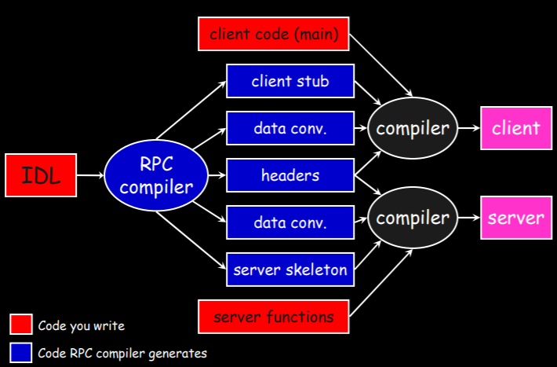
RPC compiler

Slide 18
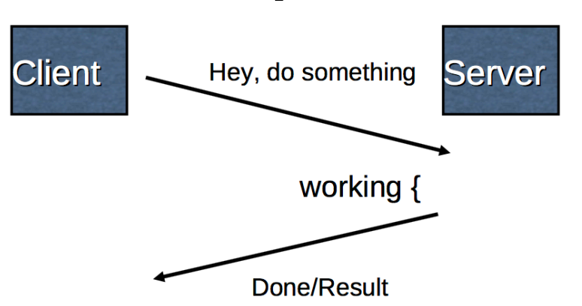
Other communication models
point-to-point, request/process/response to a server or service.
lots of communication in distributed systems look like that, but not all.
netty aio

Slide 19
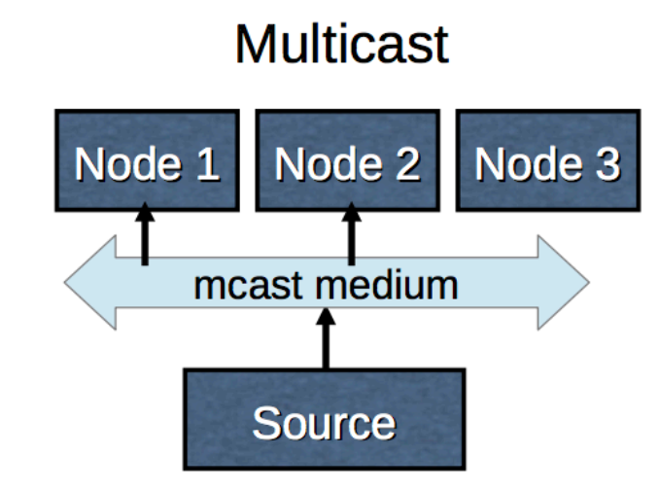
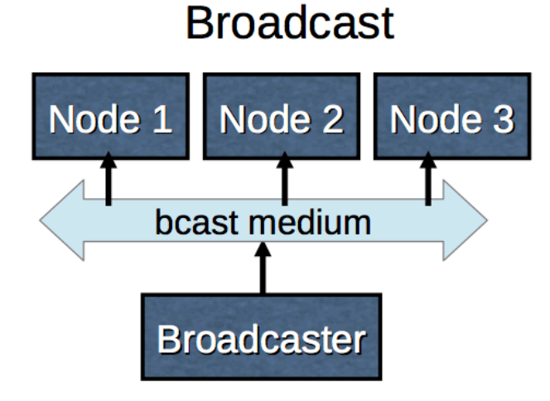
Other communication models

Slide 20
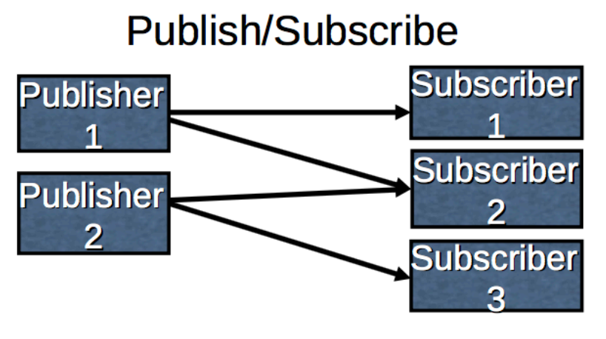
Other communication models

Slide 21
Homework
Please find a list of most popular and widely used communication library
Can be either specific or general.

Slide 22
Distributed Systems
Lecture 1 – Communication & RPC
Q & A!

