Slide 1
Scaling Metadata of Distributed File System
Shared by Yiduo Wang

Slide 2
What we talk about when we talk about File System?

Slide 3
File System
What we talk about when we talk about filesystem?
A system for storing files.
Why filesystem different？(KV, Database, Object…)

Slide 4
File System Standard
From 1980: POSIX^{[1]} filesystem standard
A sets of system calls with certain behaviors: open(), read(), write() …
File Type
Directory, File, Hard link, Symbol link
Permissions
ACL, e.g., 755(rwxr-xr-x) …
Attributes:
e.g., atime, mtime, ctime …
Atomicity and Consistency:
e.g., content written should be visible after flush()
[1] The Open Group Base Specifications Issue 7, 2018 edition. https://pubs.opengroup.org/onlinepubs/9699919799/

Slide 5
File System Standard
From 1980: POSIX^{[1]} filesystem standard
A sets of system calls with certain behaviors: open(), read(), write() …
File Type
Directory, File, Hard link, Symbol link
Permissions
ACL, e.g., 755(rwxr-xr-x) …
Attributes:
e.g., atime, mtime, ctime …
Atomicity and Consistency:
e.g., content written should be visible after flush()
Provide a global namespace
[1] The Open Group Base Specifications Issue 7, 2018 edition. https://pubs.opengroup.org/onlinepubs/9699919799/

Slide 6
File System Namespace
Namespace:
A directory tree from the root
or a DAG which has the unique root: "/"
/
Dir1
Dir2
Link
SymLink
✓
File1
File2
data
data

Slide 7
File System Namespace
Namespace:
A directory tree from the root
or a DAG which has the unique root: "/"
/
/
X
Dir1
Dir2
Dir1
Dir3
Link
SymLink
Dir2
✓
File2
File1
File2
File1
data
data
data
data

Slide 8
What is File System Metadata？

Slide 9
File System Metadata
What is metadata?
Meta-X: x of x
Meta-physics: physics of physics
Meta-model: model of model

Slide 10
File System Metadata
What is metadata?
Meta-X: x of x
Meta-physics: physics of physics
Meta-model: model of model
Meta-data: data of data
In FS: names, parent, accessed time, ACLs, blocks…
Metadata
/
Dir1
Dir2
Link
SymLink
File1
File2
data
data
Data

Slide 11
How File System access Metadata？

Slide 12
File System Hierarchy
Applications
User Space

Slide 13
File System Hierarchy
Applications
read()
write()
open()
chmod()
…
POSIX system call
User Space
VFS (Virtual file system)
Kernel Space

Slide 14
File System Hierarchy
Applications
read()
write()
open()
chmod()
…
POSIX system call
User Space
VFS (Virtual file system)
read()
write()
create()
setattr()
VFS Interface
…
Kernel Space

Slide 15
File System Hierarchy
Applications
read()
write()
open()
chmod()
…
POSIX system call
User Space
VFS (Virtual file system)
read()
write()
create()
setattr()
VFS Interface
…
Block Filesystem
Network Filesystem
FUSE
Ceph-fuse
EXT2
EXT3
EXT4
NFS
CephFS
Lustre-fuse
XFS
BtrFS
…
Lustre
…
…
Kernel Space

Slide 16
Why File Systems are always evolving?

Slide 17
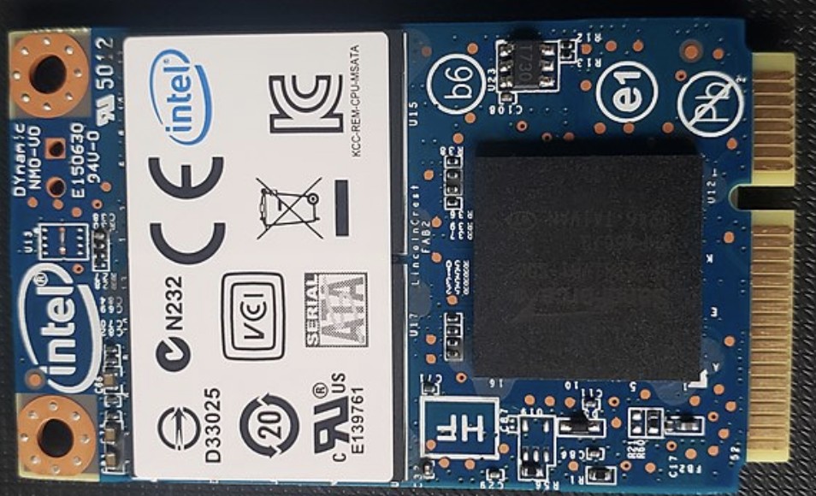
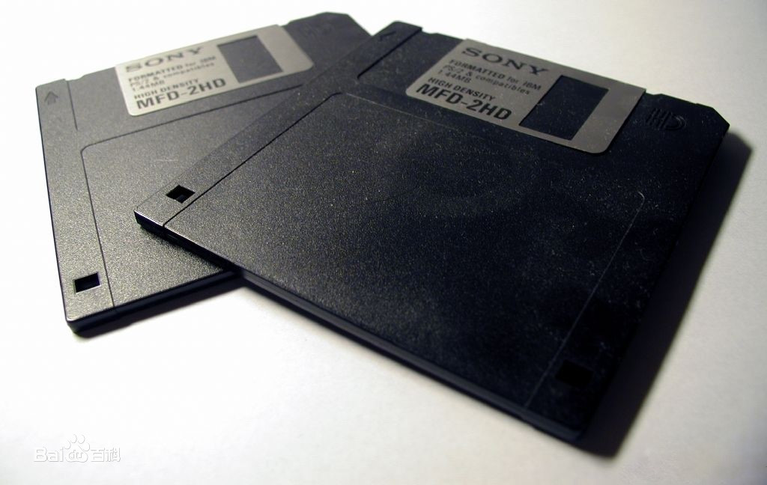
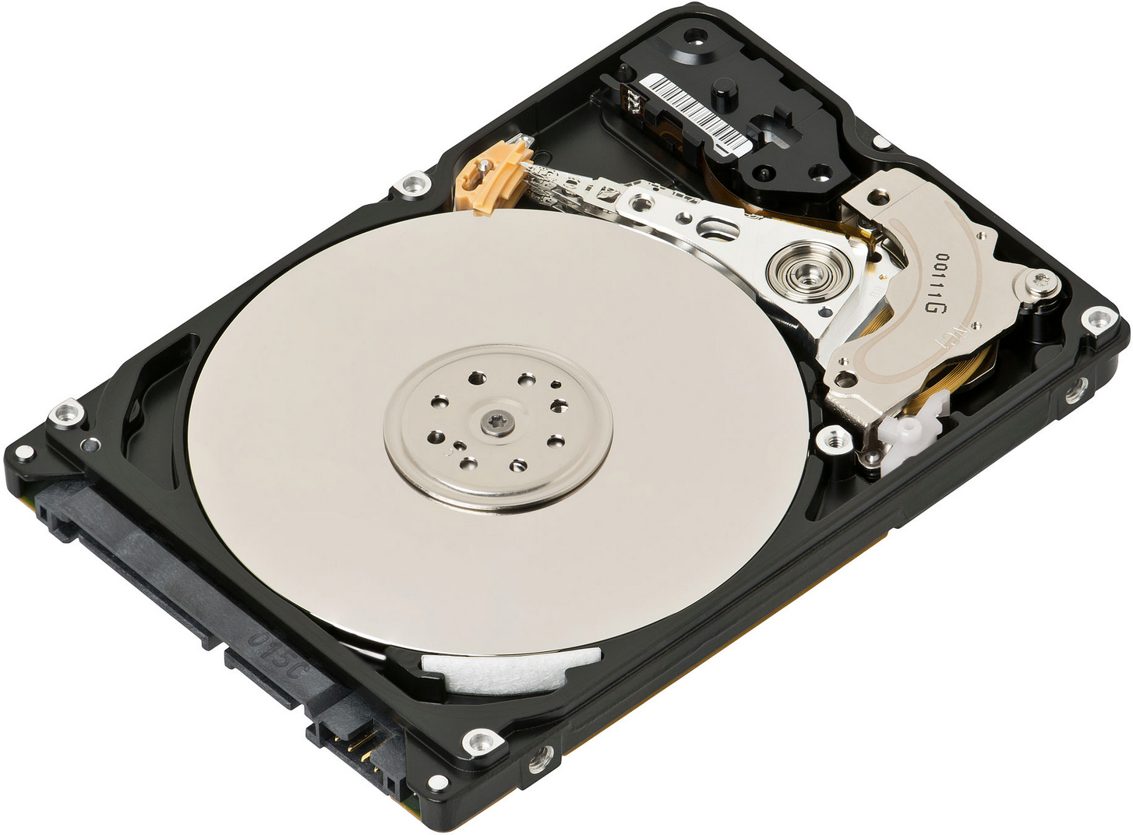
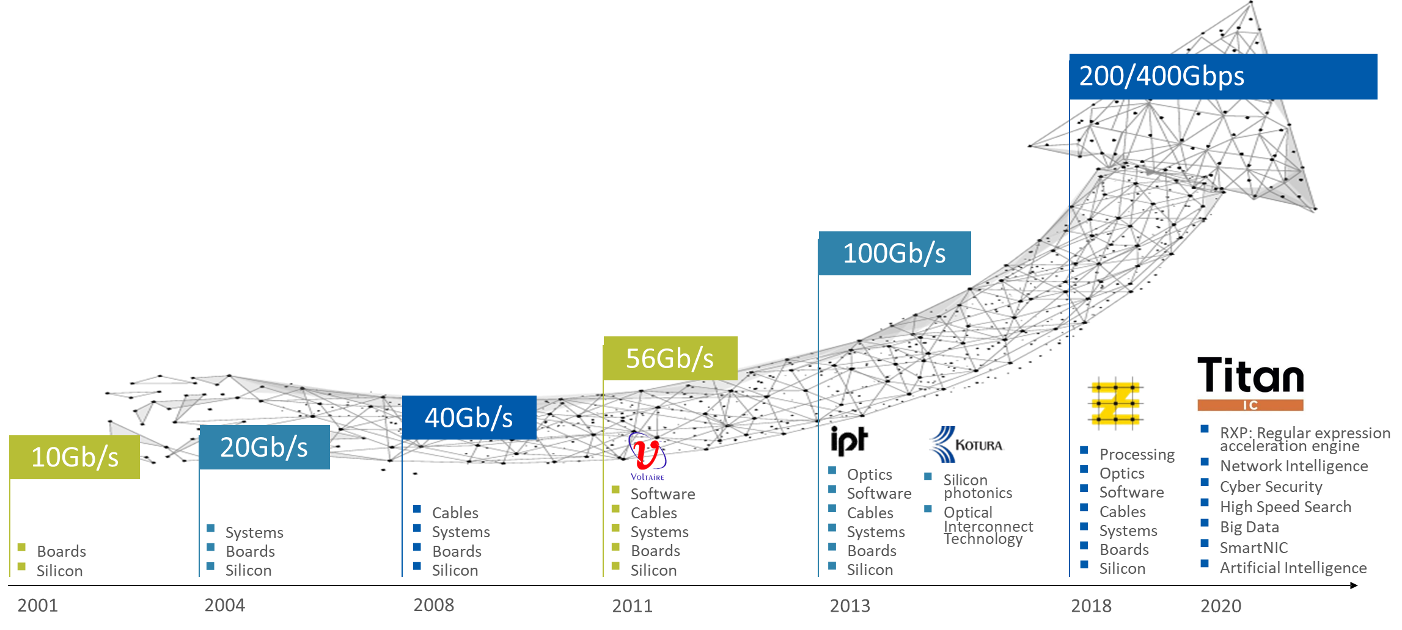
Evolution: Hardware
Storage
Network
Floppy disk, ~10KB/s
HDD, ~100MB/s
SSD, ~X00MB/s
NVMe-SSD, ~XGB/s

Slide 18
Evolution: Scenario
Scenario
Multi-user computer → Multi-tenant datacenter → Cloud
Workload inclination
Massive small file
95% files smaller than 96KB^{[1]}
High metadata operation ratio
2000: Meta-op > 50% ^{[1]}
2020: Meta-op > 85%
[1] A comparison of file system workloads. ATC 00

Slide 19
Evolution: Scalability
Capacity (single FS)
Facebook: Billions of files^{[1]}
Alibaba: Tens of billions of files ^{[2]}
LinkedIn: Billions of object^{[3]}
Scale (single Cluster)
LinkedIn: Tens of thousands of nodes ^{[3]}
Summit: Thousands of nodes ^{[4]}
[1] ﻿Facebook’s Tectonic filesystem: Efficiency from exascale. FAST 21
[2] ﻿InfiniFS: An efficient metadata service for large-scale distributed filesystems. FAST 22
[3] The exabyte club: LinkedIn’s journey of scaling the Hadoop Distributed File System. 2021
[4] ﻿Exascale deep learning for climate analytics. SC 18

Slide 20
Evolution: Scalability
Capacity (single FS)
Facebook: Billions of files^{[1]}
Alibaba: Tens of billions of files ^{[2]}
LinkedIn: Billions of object^{[3]}
Scale (single Cluster)
LinkedIn: Tens of thousands of nodes ^{[3]}
Summit: Thousands of nodes ^{[4]}
Have to scale DFS,
Especially the metadata!
[1] ﻿Facebook’s Tectonic filesystem: Efficiency from exascale. FAST 21
[2] ﻿InfiniFS: An efficient metadata service for large-scale distributed filesystems. FAST 22
[3] The exabyte club: LinkedIn’s journey of scaling the Hadoop Distributed File System. 2021
[4] ﻿Exascale deep learning for climate analytics. SC 18

Slide 21
How to scale metadata?

Slide 22
Scale Metadata
How to utilize cross-node resources on one client?

Slide 23
Scale Metadata: Coupled
Network filesystems, from 198X
NFS, CIFS, Sprite, Coda…
Client
/
NFS-server
mnt
data
Server-1
local disk
Dir1
Dir2
NFS-client
/
NFS-server
data
Server-2
local disk

Slide 24
Scale Metadata: Coupled
Network filesystems, from 198X
NFS, CIFS, Sprite, Coda…
Client
/
Scalability
Flexibility
Resource utilization
Concurrency
…
NFS-server
mnt
data
Server-1
local disk
X
Dir1
Dir2
NFS-client
/
NFS-server
data
Server-2
local disk

Slide 25
Scale FS: Decouple Metadata

Slide 26
Scale FS: Decouple Metadata
Motivation: A global & scalable filesystem service
Decouple metadata from filesystem
HDFS, Lustre, MooseFS, GFS…

Slide 27
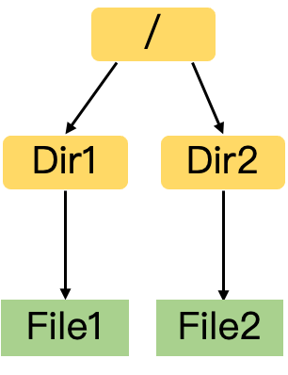
Scale FS: Decouple Metadata
Motivation: A global & scalable filesystem service
Decouple metadata from filesystem
HDFS, Lustre, MooseFS, GFS…
Cluster maintenance
Request resolve
Metadata processing
Metadata storage
…
/
Metadata
Dir1
Dir2
Metadata Server
File1
File2
file1-data
file2-data
…
Data Server1
Data Server2
…
data
data
Data
Data Server Cluster

Slide 28
Scale FS: Decouple Metadata
Motivation: A global & scalable filesystem service
Decouple metadata from filesystem
HDFS, Lustre, MooseFS, GFS…
①get metadata
read file1 data
Metadata Server
Client
②get data
file1-data
file2-data
…
Data Server1
Data Server2
…
Data Server Cluster

Slide 29
Scale FS: Decouple Metadata
Motivation: A global & scalable filesystem service
Decouple metadata from filesystem
HDFS, Lustre, MooseFS, GFS…
Independent metadata/data scaling
①get metadata
Fast in-memory \
Metadata processing
read file1 data
Metadata Server
Client
②get data
file1-data
file2-data
…
Data Server1
Data Server2
…
Data Server Cluster

Slide 30
New FS Semantic
HDFS propose a relaxed filesystem semantic for DFS.
HDFS, HopsFS…
HDFS Semantic
Ext4, XFS, BtrFS…
NFS, CIFS…
Lustre, MooseFS…
POSIX Semantic
Local filesystem
Network filesystem
Distributed filesystem

Slide 31
New FS Semantic
HDFS propose new semantic for distributed scenario.
HDFS, HopsFS…
HDFS Semantic
Ext4, XFS, BtrFS…
NFS, CIFS…
Lustre, MooseFS…
POSIX Semantic
Local filesystem
Network filesystem
Distributed filesystem
 | FS model | R/W model | Path resolution | Scenario | Average file size | MDS: DS
HDFS | Directory, File, Symlink | Read & append write | Full-path | Big file; Write once read many | 500MB 500PB:1Billion^{[1]} | 1:10000^{[1]}
POSIX | Directory, File, Symlink, Link | Read & random write | Recursively (parent, name) | Small file; Write many read many | 95%<96KB^{[2]} | 1:4^{[3]}/10^{[4]}/40^{[5]}
[1] The exabyte club: LinkedIn’s journey of scaling the Hadoop Distributed File System. 2021
[2] A comparison of file system workloads. ATC 00
[3] Large-scale Stability and Performanceof the Ceph File System. Linux Vault 2017
[4] The Feature Development and Architecture Evolvement of Lustre under New Challenges. 2019
[5] Lustre Scalability. LUG 2009

Slide 32
Decouple Metadata: Limitation
Single metadata server limitation
- Scalability
Throughput
Capacity
- Availability
To scale metadata service: Multi-MDS
From ~200X

Slide 33
Scale FS: Partition Metadata

Slide 34
Challenge: How to partition?
?
?
Metadata Server
?
?
Metadata Server
Metadata Server
Metadata Server
Metadata Server Cluster
file1-data
…
file1-data
…
Still Hash
Data Server1
…
Data Server1
…
Data Server Cluster
Data Server Cluster

Slide 35
No Partition, Only Backup
Metadata Server
Metadata Server
Metadata Server
Metadata Server
Example: HDFS, Farsite, ShardFS…
Metadata Server Cluster
Availability
Scalability, Consistency…

Slide 36
Partition: Hash
/
Metadata
/
File1
Dir2
MDS1
MDS2
Dir1
Dir2
Dir1
File2
MDS3
MDS4
File1
File2
Hash by full-path/file name/dir name/attributes

Slide 37
Partition: Hash
/
Metadata
/
File1
Dir2
MDS1
MDS2
Dir1
Dir2
Dir1
File2
MDS3
MDS4
File1
File2
Hash by full-path/file name/dir name/attributes
Meta-Management | Name | Partition | Conference | Opensource
Multi-MDS Hash-table | Lustre-DNE2 | Hash by full path |  | √
 | BeeGFS | Hash by entryID+fileID |  | √
 | HBA&G-HBA | Bloom Filter | TPDS07
 | SoMeta | Hash by file attribute | Cluster17
 | GlusterFS | Hash by file name
 | Tectonic | Hash by dir name | FAST21
 | InfiniFS | Hash by dir name | FAST22

Slide 38
Limitation: Hash
/
Metadata
/
File1
Dir2
MDS1
MDS2
Dir1
Dir2
Dir1
File2
MDS3
MDS4
File1
File2
Hash by full-path/file name/dir name/attributes
Advantage: Very good load balance
✓
Is this method get the best scalability?

Slide 39
Limitation: Hash
/
Metadata
/
File1
Dir2
MDS1
MDS2
Dir1
Dir2
Dir1
File2
MDS3
MDS4
File1
File2
Hash by full-path/file name/dir name/attributes
✓
Advantage: Very good load balance
Disadvantage: Destroy locality
⤫

Slide 40
Limitation: Hash
/
Metadata
/
File1
Dir2
MDS1
MDS2
Dir1
Dir2
Dir1
File2
MDS3
MDS4
File1
File2
Hash by full-path/file name/dir name/attributes
✓
Advantage: Very good load balance
Disadvantage: Destroy locality
⤫
E.g.: open(/Dir2/File2):
query MDS1
query MDS2
query MDS4
More RPC
Higher latency^{[1]}
Recursive operations^{[2]}
…
⤫
[1] ﻿InfiniFS: An Efficient Metadata Service for Large-Scale Distributed Filesystems. FAST 22
[2] ﻿Efficient Metadata Management in Large Distributed Storage Systems. MSST 03

Slide 41
Partition: Static Subtree
/
Metadata
/
Dir1
Dir2
Dir1
Dir2
File1
File2
MDS1
MDS3
File1
File2
Bind subtree to specific MDS
Meta-Management | Name | Partition | Conference | Opensource
Multi-MDS Static Subtree | Lustre-DNE1 | Static subtree |  | √
 | CephFS-pin | Static subtree | OSDI 06 | √

Slide 42
Partition: Dynamic Subtree
Requests

Slide 43
Partition: Dynamic Subtree
Requests

Slide 44
Partition: Dynamic Subtree
Requests

Slide 45
Partition: Dynamic Subtree
Requests

Slide 46
Partition: Dynamic Subtree
/
Metadata
/
Dir1
Dir2
Dir1
Dir2
File1
File2
MDS1
MDS2
File1
File2
Meta-Management | Name | Partition | Conference | Opensource
Multi-MDS Dynamic Subtree | CephFS | Dynamic subtree | OSDI 06 | √
 | IndexFS | Dynamic subtree | SC14 | √
 | ADLS | Range split by dir-inode | SIGMOD17
 | CubeFS | Range split by inode | SIGMOD19 | √
 | HopsFS | Dynamic database partition | FAST19 | √

Slide 47
Limitation: Subtree
/
Metadata
/
Dir1
Dir2
Dir1
Dir2
File1
File2
MDS1
MDS2
File1
File2
✓
Advantage: Better locality
Disadvantage: Load imbalance ^{[1, 2]}
Big directory ^{[3, 4]}
⤫
[1] ﻿﻿Mantle: A programmable metadata load balancer for the Ceph file system. SC 15
[2] ﻿﻿Lunule: An agile and judicious metadata load balancer for CephFS. SC 21
[3] ﻿﻿Scale and concurrency of GIGA+: File system directories with millions of files. FAST 11
[4] ﻿IndexFS: Scaling file system metadata performance with stateless caching and bulk insertion SC 14

Slide 48
Partition Metadata
Trade-off between locality and balance
Stateful metadata service is hard to scale
Consistency is complex

Slide 49
Partition Metadata
Trade-off between locality and balance
Stateful metadata service is hard to scale
Filesystem consistency is complex
If we can store metadata in a storage system with
Good Scalability
Strong Consistency
Dynamic Partition
High Availability
Fault Tolerance
…

Slide 50
Scale FS: Disaggregate Metadata

Slide 51
Store Metadata in …
CephFS: Store metadata and data in object store
entry
entry
…
meta-op
MEM
MDS
Meta-WAL
Client
data-op
meta
meta
data
data
data
data
…
…
DISK
DISK
RADOS

Slide 52
Store Metadata in …
CephFS: Store metadata and data in object store
entry
entry
…
meta-op
MEM
Simplify system design
High reliability
MDS
Meta-WAL
✓
Client
data-op
meta
meta
Stateful MDS
Complex consistency
data
data
⤫
data
data
…
…
DISK
DISK
RADOS
MDS still very heavy!

Slide 53
Store Metadata in DDBS
From 2015, some DFS store metadata in DDBS
Distributed
transactions
Table
Table
meta-op
MEM
DISK
DISK
MDS
Distributed Database
Client
data-op
data
data
data
data
data
data
…
…
DISK
DISK
Data Cluster

Slide 54
Store Metadata in DDBS
From 2015, some DFS store metadata in DDBS
Distributed
transactions
Table
Table
meta-op
DISK
DISK
Name | Partition | Meta-operation | Storage System | Conference | Opensource
CalvinFS | Hash inode | Distributed transaction (order-based) | CalvinDB | FAST 15
HopsFS | Dynamic subtree | Distributed transaction (lock-based) | MySQL-NDB | FAST 17 | √
ADLS | Dynamic subtree | Distributed transaction (optimistic lock-based) | RSL-HK | SIGMOD17
MEM
MDS
Distributed Database
Client
data-op
data
data
data
data
data
data
…
…
DISK
DISK
Data Cluster

Slide 55
Store Metadata in DDBS
From 2015, some DFS store metadata in DDBS
Distributed
transactions
Table
Table
meta-op
DISK
DISK
Name | Partition | Meta-operation | Storage System | Conference | Opensource
CalvinFS | Hash inode | Distributed transaction (order-based) | CalvinDB | FAST 15
HopsFS | Dynamic subtree | Distributed transaction (lock-based) | MySQL-NDB | FAST 17 | √
ADLS | Dynamic subtree | Distributed transaction (optimistic lock-based) | RSL-HK | SIGMOD17
MEM
MDS
Distributed Database
Client
data-op
data
data
data
data
data
data
…
…
DISK
DISK
Disaggregated design scales metadata service
But: Heavy distributed transaction makes meta-op slow
Data Cluster

Slide 56
Store Metadata in KV-store
From ~2020, some DFS store metadata in KV-store
Benefit: Higher scalability, lower latency
/
Step1: Create File1
File1
KV2
Dir1
File1
Create /Dir1/File1
Step2: Modify Dir1 attribute
Dir1
KV1
Attribute: atime, ctime, childs…
Name | Partition | Meta-operation | Storage System | Conference | Opensource
Tectonic | Hash dir-inode | Local transaction | ﻿ZippyDB | FAST 21

Slide 57
Store Metadata in KV-store
From ~2020, some DFS store metadata in KV-store
Benefit: Higher scalability, lower latency
Problem: No transaction
/
Step1: Create File1
File1
KV2
Dir1
File1
Create /Dir1/File1
Step2: Modify Dir1 attribute
Dir1
KV1
Attribute: atime, ctime, childs…

Slide 58
Store Metadata in KV-store
From ~2020, some DFS store metadata in KV-store
Benefit: Higher scalability, lower latency
Problem: No transaction
/
Step1: Create File1
File1
KV2
Dir1
Crash, Overwrite…
File1
Create /Dir1/File1
Step2: Modify Dir1 attribute
Dir1
KV1
Attribute: atime, ctime, childs…
May break Atomicity and Isolation

Slide 59
Store Metadata in KV-store
From ~2020, some DFS store metadata in KV-store
InfiniFS: Redesign metadata partition
Key idea: partition file and parent-attribute in same shard
/
Dir1-inode
KV1
Local Transaction
Dir1
Step1: Create File1
File1
Dir1-attr
File1
Step2: Modify Dir1 attribute
KV1
Create /Dir1/File1
Name | Partition | Meta-operation | Storage System | Conference | Opensource
Tectonic | Hash dir-inode | Local transaction | ﻿ZippyDB | FAST 21
InfiniFS | Disaggregate dir-attr Hash dir-inode | Local transaction + 2PC transaction | RocksDB | FAST 22

Slide 60
Next Reading Group
Rethink DFS architecture with new hardware
Paper sharing: InfiniFS, …

