Slide 1
Segcache: a memory-efficient and scalable in-memory key-value cache for small objects
Juncheng Yang, Carnegie Mellon University; Yao Yue, Twitter; Rashmi Vinayak, Carnegie Mellon University
Presenter: Ziyue Qiu, Chuqing Gao (USTC)
ADSL Reading Group
2022-04-13
Notes:
大家好，我是邱子悦。这次的主题是In-memory caching，文章来自NSDI21。本文作者基于twitter in-memory workloads 现状，提出了全新的 in-memory cache 设计，目标是 memory efficient & scalable。

Slide 2
Background Knowledge
In-memory key-value caches
How to organize an LRU cache
Time-to-live (TTL) and expiration (v.s. eviction)
Existing solutions for TTL expiration
Slab-based Memory Allocator
Where does scalability problem come from
Notes:
我会先介绍这四个需要了解的背景，论文中1，2，和4都涉及不多。

Slide 3
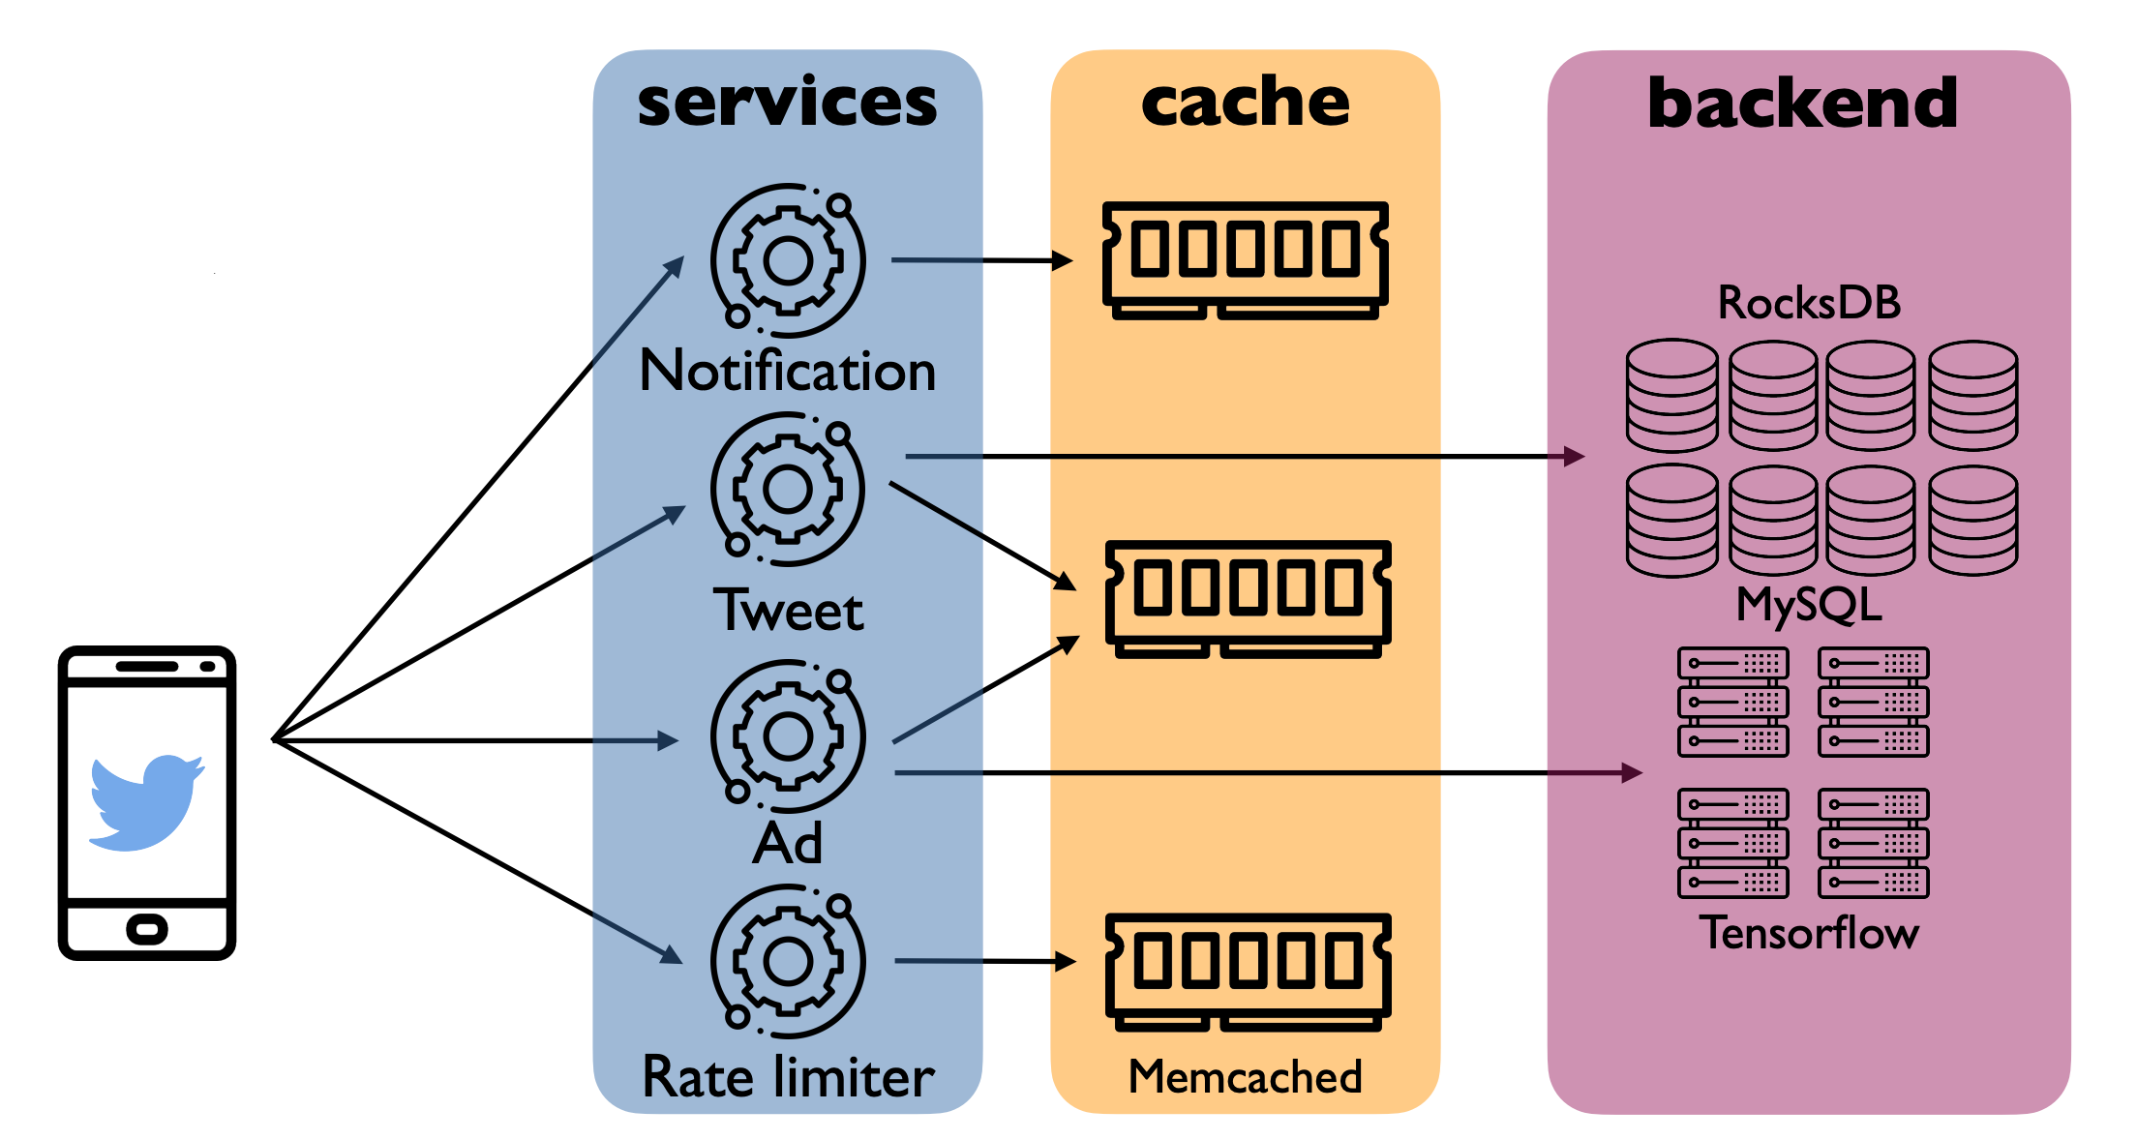
In-memory key-value caches
Reduce latency
Increase throughput
and scalability
Reduce backend load
Notes:
本文关注的Cache 处于service和backend storage devices 之间，帮助降低延迟、提高吞吐并且减少对存储设备的访问。这对应了存储设备的通常有的三个特征，相比memory，往往有10^3量级以上的差距、很容易打满的带宽和一定的寿命。但不是每篇paper都关注这样的场景，比如Twitter需要尽量高的命中率来控制较低的延迟，愿意为此给出更多memory作cache，workload命中率往往95%以上，而kangaroo(SOSP21)不太在意延迟，用大量的Flash SSD作为cache，着重解决使用Flash面临的，例如write amplification问题。

Slide 4
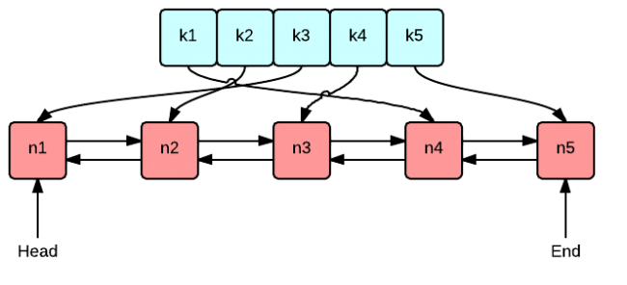
How to organize an LRU cache
Least Recently Used (LRU): Redis, Memcached, Twemcached, etc
Pair a doubly linked list with a hash map
O(1) Lookup, Update, and Remove
HashMap<TKey, TValue> for O(1) access
Huge per-object metadata
e.g. 8B per pointer
Doubly Linked List for O(1) removal and update of cache data
Notes:
LRU 应该是最耳熟能详、最常用的算法了。虽然新算法层出不穷，但大量工业级application仍在使用LRU算法，例如，本文涉及到的memcached, Redis, Twitter的Twememcached等都用的LRU，Research work算法是另外的。
LRU 的含义xxxxxx
Lock! -> scalability

Slide 5
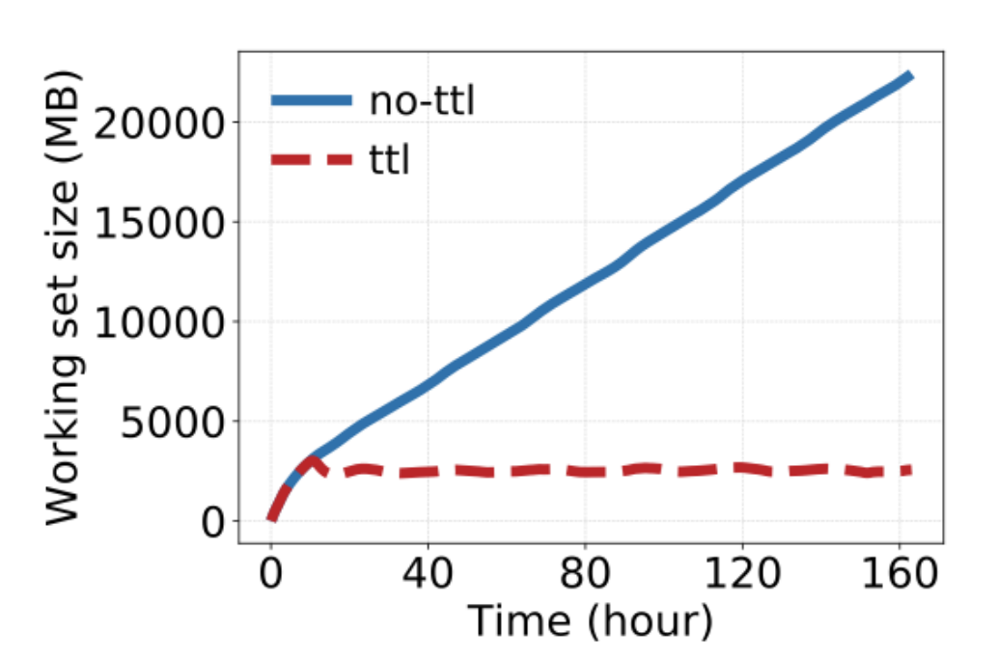
TTL and expiration
Time-to-live (TTL)
TTL is set during object write
Expired objects cannot be served
Short TTLs are widely used in production
TTL usages
Reduce stale data
Periodic refresh (e.g. ML predictions, negative caching)
Implicit deletions (e.g. limiters, GDPR)
Impact of TTL
Reduce effective working set size
Removing expired objects is critical
Expiration: cannot
Eviction: could potentially
Smaller working set if expired objects are not considered

Slide 6
Existing solutions for TTL expiration
Efficient: low overhead
Sufficient: can remove all or most expired objects
Sampling: periodically sample and remove expired ones to keep low
Transient object pool: store objects with “small” TTLs separately (how to choose TTL threshold)
Category | Technique | Efficient | Sufficient | Application
Lazy expiration | Delete upon re-access | √ | x | Most applications
 | Check LRU tail | √ (need lock) | x | Memcached
Proactive expiration | Scanning | x | √ | Memcached, CacheLib
 | Sampling | x | x | Redis
 | Transient object pool | √ | x | Facebook
Either not efficient or not sufficient
Notes:
越少访问的越能留在里面占位置，很可能需要等到走到末尾的eviction
尾部不一定有多少expiration的块，更何况比较大的cache的流动性不一定很好，no guarantee，还会需要动用LRU list的锁
浪费了大量资源在绝大多数没有expired的块，强行增加scalability压力
Random memory access 还会影响cpu cache，不够efficient也不够sufficient
如何处理这个pool，比如 TTL threshold 怎么设置,更不用说稍微大一些TTL的object早晚有expired的一天

Slide 7
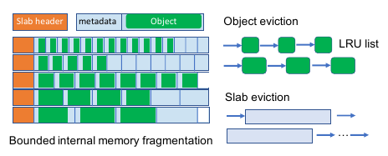
Slab-based Memory Allocator
Redis uses external memory allocator (e.g. malloc)
External memory fragmentation
Memcached uses a slab-based memory allocator
Fixed-size slabs, different size chunks
Internal memory fragmentation
Where does scalability problem come from? the extensive locking in the object LRU queues, free object queues, and the hash table

Slide 8
Today’s in-memory caching systems
Have significant room for improvement
Memory efficiency
TTL and expiration
Huge per-object metadata
Memory fragmentation
Throughput and scalability
Tradeoff between efficiency and throughput or scalability

Slide 9
In-memory Caching at Twitter (OSDI’20)
Container-based deployment, single tenant, single layer
No need to tease out individual workloads from the mixture
Without being filtered by other caches (Counter example: MSR Cambridge)
A large scale analysis of hundreds of in-memory cache clusters at Twitter, OSDI’20
Large scale deployment
100s TB DRAM
100, 000s CPU cores
100s cache clusters
Slab-based memory management
On-demand heap memory allocators: external fragmentation
Slab (1MB by default), items in slab (with growth factor default to 1.25): internal fragmentation
Notes:
从论文背景说起

Slide 10
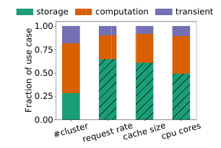
In-memory Caching at Twitter (OSDI’20)
Eviction in slab-based cache
item-level v.s. slab-level
Twemcache: random slab, slabLRU, slabLRC (FIFO)
Cache Use Cases (no strict boundary)
Caching for storage
Caching for computation
Increasingly popular, Machine learning, stream processing
Transient data with no backing store
Rate limiters, negative caches

Slide 11
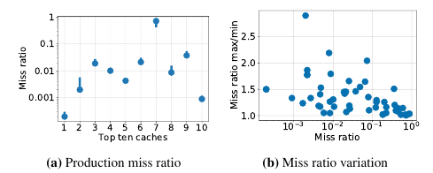
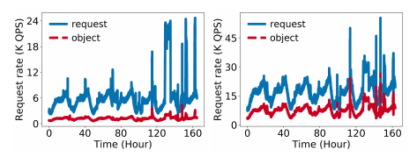
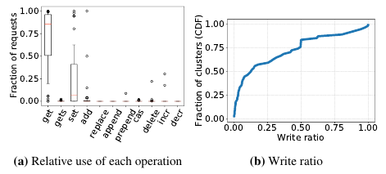
In-memory Caching at Twitter (OSDI’20)
Traces
Week-long unsampled traces from one instance of each Twemcache cluster
700 billion requests, 80 TB in size
Focus on 54 representative clusters
Small miss ratio & small variations (each day)
Diurnal request rates related to hot keys
Eleven operations (get and set most common)
Write-heavy workloads
35% of clusters are write-heavy (more than 30% write)
Cache for computation or transient data
e.g. opportunistic pre-computation

Slide 12
In-memory Caching at Twitter (OSDI’20)
TTL
Bounding inconsistency
Periodic refresh (cache for computation)
Implicit deletion (Rate limiter & GDPR compliant)
TTL jitter: Intentionally scatter TTLs over a time range to avoid objects expiring at the same time

Slide 13
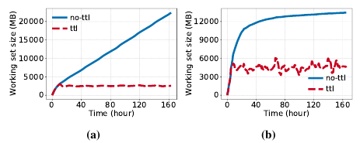
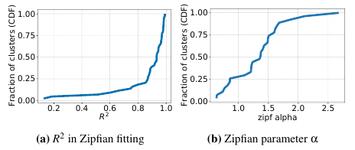
In-memory Caching at Twitter (OSDI’20)
Working set size
There is no need for a huge cache size if expired objects can be removed in time
Proactive expiration is more important than eviction!
Popularity distribution
Mostly Zipfian with large parameter alpha
Small deviations

Slide 14
In-memory Caching at Twitter (OSDI’20)
Object sizes are small but metadata size (56B Memcached, 38B Twemcache) is large
Future research: key compression
Name spaces are part of keys, e.g. Ns1:ns2:obj or obj/ns1/ns2
Dynamic size distribution

Slide 15
In-memory Caching at Twitter (OSDI’20)
Eviction algorithms
Memcached-LRU: disable Slab moving
Highly workload dependent
Notes:
b更好可能是因为LRU per object removal更精细（小miss ratio）
c更好是因为scanning（大miss rate）
d更好可能是因为周期性改变，热度直接从某种chunk size转到另一种，slab eviction 适应起来更快

Slide 16
Segcache Overview
Segcache: segment-structured cache
High memory efficiency
Efficient and sufficient TTL expiration
Tiny object metadata (5-byte)
Almost no memory fragmentation
Merge-based eviction for low miss ratio
High performance
High throughput
Close-to-linear scalability

Slide 17
Segcache Principles
Be proactive, don’t be lazy
Maximize metadata sharing for economy
Perform macro management
Notes:
Read path会更新8bit的frequency计数器位于hash table
写的时候知道TTL，写到对应bucket的segment。为了scalability做的优化后面介绍。
how to perform delete?

Slide 18
Segcache Design: metadata sharing
Group objects into segments to approximate and share metadata
Segment: a small fixed-size log storing objects of similar TTLs

Slide 19
Segcache Design: technical details
1024 TTL buckets divided into 4 groups (grows by a factor of 16)
Append updated objects to the end of a segment, mark the old ones as deleted
5B per object metadata: 1B key size, 3B value size, 1B flag (e.g. deleted flag), 56B Memcached->5B Segcache

Slide 20
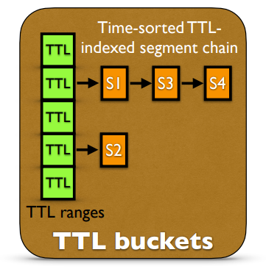
Segcache Design: TTL buckets
Objects in a segment share creation time and TTL => expire at the same time
Segments in a chain have same TTL with sorted creation time => examine the first segment only
Background thread scans TTL buckets (small array of metadata) => efficient and proactive expiration
Manage segments (groups of objects), not objects

Slide 21
Segcache Design: eviction
Merge-based eviction
One TTL bucket: merge N consecutive, un-expired, and un-merged segments
Segment homogeneity (retain 1/N per segment)
Across TTL bucket: round-robin
Approximate and smoothed frequency counter
Low overhead (reset frequency of retained objects during evictions ~ window-based frequency)
Burst-resistant (increment at most once per second)
Scan-resistant (frequency-based)
Need improvement
How to pick the start of N segments? How to merge?

Slide 22
Segcache Evaluation: Overview
Defend the performance of its design
Proactive expiration
Shared metadata
Less memory fragmentation
Merge-based segment eviction
How to set magic number: N in eviction
Memory efficiency -> miss ratio
Throughput

Slide 23
Segcache Evaluation: Setup
Implemented on Pelikan
Twitter’s open-source caching framework
Setup: Five systems (research + production)
Production cache of Twitter (PCache)
Memcached and Memcached + scanning
LHD + sampling
Hyperbolic + sampling
Segcache
Five production traces
Category | Technique | Efficient | Sufficient | Application
Lazy expiration | Delete upon re-access | √ | x | Most applications
 | Check LRU tail | √ | x | Memcached
Proactive expiration | Scanning | x | √ | Memcached, CacheLib
 | Sampling | x | x | Redis
 | Transient object pool | √ | x | Facebook
Notes:
S-Memcached 是 scanning enabled

Slide 24
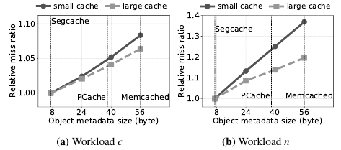
Segcache Evaluation
n (small object sizes): single TTL => no benefit from scanning (TTL=30days)
mix: mixture TTLs => checking LRU tail performs better than scanning
r-LHD is designed for scan+LRU, no scanning workload here => no benefit
r-Hyperbolic uses ranking to select eviction candidates
Notes:
S-Memcached 是 scanning enabled
n和mix都使得memcached vs s-memcached一样，其他情况下scanning肯定对hit rate更好，因为驱逐了更多无效块，有效空间更大了。
metadata这部分使得segcache比s-memcached在expiration不考虑scalability的情况下有优势，但是不一定和hyperbolic+scanning比有优势。
几组对照：
Proactive expiration： 通过memcached和s-Memcached （scan掉mix里的short TTL对miss rate改善微乎其微可能是因为给的workload里short TTL占比少（？但是其实7天以内有70%+））
Shared metadata：workload c那组
Merge-based eviction：虽然作者提了但并没有哪组能单独证明

Slide 25
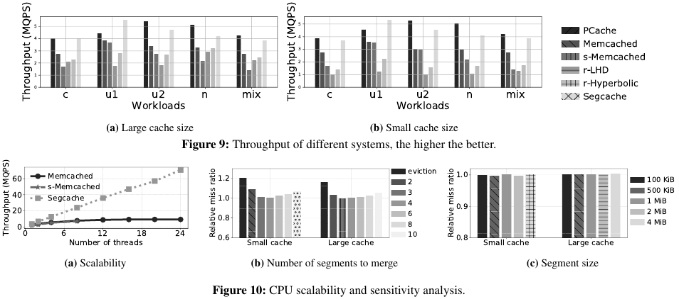
Segcache Evaluation: Throughput
PCache and Segcache:
Large management unit, higher throughput
No need to maintain object LRU chain
r-LHD and r-Hyperbolic: random memory accesses => poor CPU hit rates
s-Memcached: scanning hurts performance
Notes:
这个目前看来是个缺陷，但后面会看到hyperbolic-r已经在吞吐上不如了，换成scanning可用性会更差。scanning对hit rate提升的benefit被开销抵消了。
Figure9看到有时segcache略低于pcache，但这是single thread的情况，本文没有解释为什么segcache在前面hit ratio比pcache高的情况下还会有更低的吞吐，除非是merge-based eviction的优势在single thread体现不出来。据我所知他们确实最近在关注优化eviction policy。
scanning memcached 会死锁，而memcached原版受到locking严重影响。
Pcache和segcache分别以slab和segment为单位管理，batching=>reduce random mem access & eviction（？），另外sequential chain比LRU chain的维护开销低

Slide 26
Segcache Evaluation
Scalability: close-to-linear
N: Balance between eviction frequency & accuracy
Big N: too difficult to retain objects
Small N: wasted space & inaccurate decision
How to get Higher miss ratio
Notes:
Scalability：
Pcache不支持multi-threading，r-LHD和r-Hyperbolic（感觉是因为在pcache上写的懒得改通信架构而）认为不可能比memcached强而没有测，memcached和s-memcached性能接近，s-m大于8死锁
从N选择这段来看，作为slab和log的结合体，segcache并不能严格实现他说的no memory fragmentation（又或者因为某种原因忽略了每个segment内部剩余（？存疑））

Slide 27
Conclusion
Expiration and metadata play an important role
Impressive design of Segcache
Solid evaluation against state-of-the-art designs

Slide 28
Appendix

Slide 29
Segcache Design
Idea 1: Be proactive, don’t be lazy
Existing solutions for TTL expiration
Category | Technique | Efficient | Sufficient | Application
Lazy expiration | Delete upon re-access | √ | x
 | Check LRU tail | √ | x | Memcached
Proactive expiration | Scanning | x | √ | Memcached, CacheLib
 | Sampling | x | x | Redis
 | Transient object pool | √ | x
Notes:
越少访问的越能留在里面占位置
尾部不一定有多少expiration的块，更何况比较大的cache的流动性不一定很好
浪费了大量资源在绝大多数没有expired的块
Random memory access 还会影响cpu cache
如何处理这个pool，比如 TTL threshold 怎么设置

