Slide 1
Decoupling the Control Plane from Program Control Flow for Flexibility and Performance in Cloud Computing
Hang Qu
Stanford Omid Mashayekhi
Chinmayee Shah
Philip Levis

Slide 2
Problem the paper described
Control Plane
Notes:
dispatch fewer than 10,000 tasks per second ,, In practice, however, increasing parallelism past even a few hundred cores quickly hits the control plane’s scaling limit, making jobs run slower
This higher task rate allows them to run jobs on more cores, running jobs 5-8 times faster. This improvement, however, is only a constant factor and does not remove the fundamental limit
remove the control plane entirely. Sys- tems such as TensorFlow , his takes tens of seconds, stalling computations for hundreds of iterations and precluding interac- tive jobs

Slide 3
Problem the paper described
Synchronous
Poor scaling/Flexibility
Poor performance
Existing Control plane Framework
1.Not more than a few hundred cores
2.Cost to reinstall

Slide 4
Problem the paper described
Existing Control plane Framework
Notes:
A worker waits for the controller to send it new tasks, executes new tasks when requested, and falls idle while it waits. The effect of this synchronous operation is especially pronounced during an application barrier, when every worker waits for the controller to synchronously dispatch a new batch of tasks.
optimizes this centralized design by enabling a worker to spawn and execute some tasks locally. If a task accesses data on other workers, however, it must still perform synchronous opera- tions with a controller.
These systems impose no control plane overhead at runtime, but are locked to a static execution distribution decided at the start of a job. Redistributing job execution, if possible, requires stopping all the nodes, regenerating the execution plans, reinstalling them on the nodes, and restarting from a checkpoint. Any changes in the task schedule (for the purpose of straggler mitigation or load balancing) are either very expensive, or impossible.

Slide 5
Contribution
Asynchronous Control Plane Architecture
Task Recipe
Partition Map
Canary

Slide 6
Asynchronous Architecture
Centralized control
3
Atomic migration
2
Distributed scheduling
1
4
Maximized locality
Notes:
Distributed scheduling: workers must spawn and execute tasks locally, requiring no communication with a central controller.
Atomic migration: the output of a job must have each task execute exactly once, despite mid-job migrations.
Centralized control: a centralized controller must be able to dynamically change how a job is distributed across work- ers without introducing any synchronous operation.
Maximized locality: a controller must be able to very effi- ciently calculate data distributions, so that workers exchange minimal data as they execute.

Slide 7
TASK RECIPE
RECIPE
Function
Dataset
Precondition

Slide 8
TASK RECIPE --PRECONDITION
Last input writer
Output Readers
Read messages
Notes:
For each partition it reads or writes, the recipe specifies which recipe should have last written it. This enforces local write-read dependencies, so that a recipe always sees the correct version of its inputs.
For each partitionitwrites,therecipespec- ifies which recipes should have read it since the last write. This ensures that a partition is not overwritten until tasks have finished reading the old data
Read messages: The recipe specifies how many messages a recipe should read before it is ready to run. Unlike the other two preconditions, which specify local dependencies between tasks that run on the same worker, messages specify remote dependencies between tasks that can run on different workers.

Slide 9
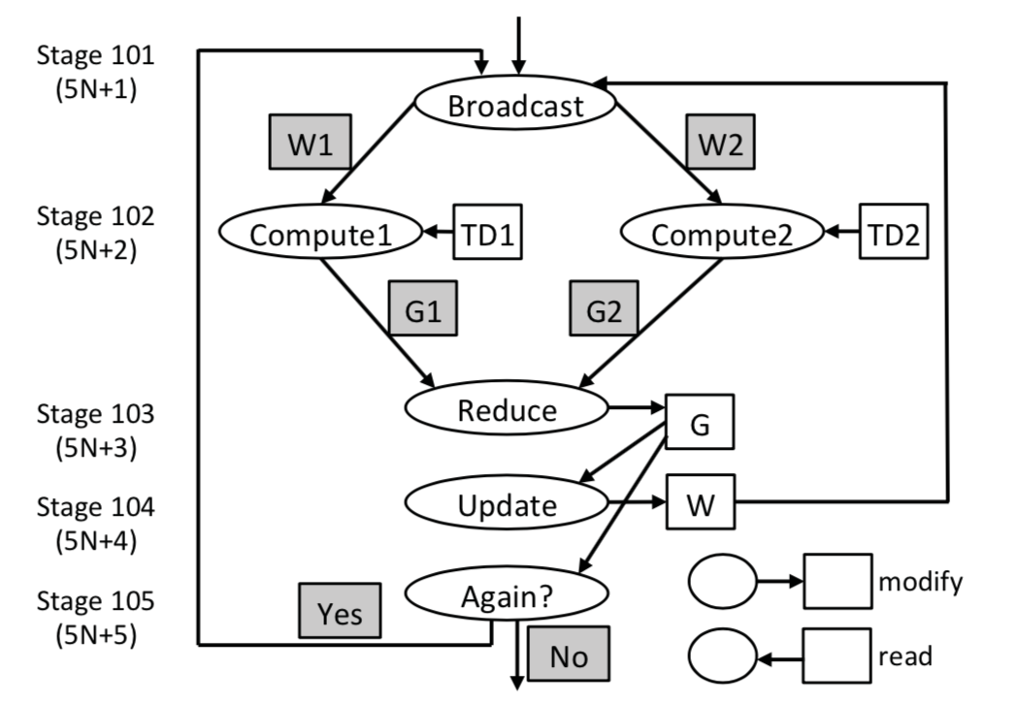
Task Recipe
Exactly-once Execution

Slide 10
TASK RECIPE

Slide 11
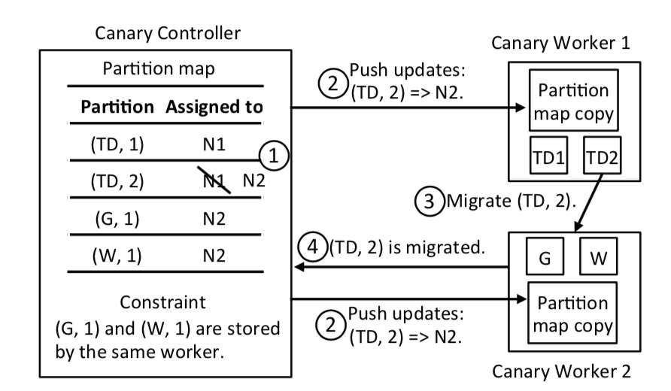
Partition Map
Definition
a table that specifies, for each partition, which worker stores that partition in memory.
(name, index)

Slide 12
Partition Map
Controller-worker Interface
1
Start a job
2
Exchange heartbeat message
3
Update Partition Map
Push Update
Checkpoints for failure
4
5

Slide 13
Partition Map
Dataset1
1
2
Dataset2
1
2
...
j
...
j
Maximize Data Locality
Same worker
Same worker
Same worker

Slide 14
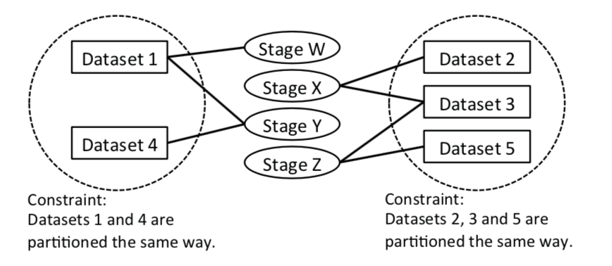
Partition Map
Maximize Data Locality

Slide 15
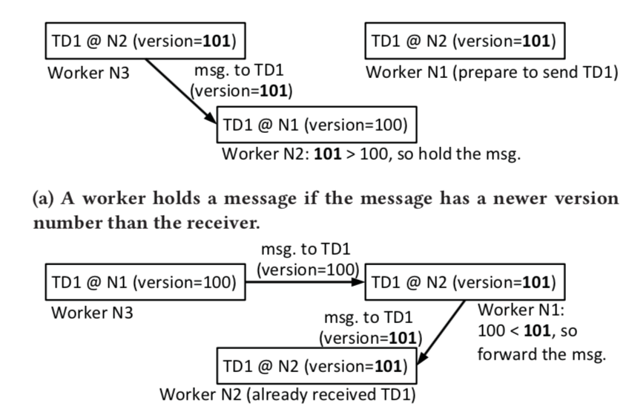
Partition Map
Message Delivery

Slide 16
Implementation
1
Data-dependent control flow
2
Distributed driver program execution
3
Weak data model
4
Message passing
5
Fault Tolerance
Notes:
The loop in Figure 7 is iteratively executed until the Again stage computes False. The Again stage should have one task and compute one boolean value, so that there is a unique boolean decision for each iteration.
Before a job starts, every worker receives a driver program copy from the controller, and independently runs the copy to construct the sequential program of stages and translate it to recipes
nables working on geometric data and reusing existing data structures, which is handy for scientific computing applications.

Slide 17
Evaluation
1
Scalability
2
Task Rate
3
Tiny Task Benefit
4
Reschedule Rate
Notes:
(1) Can an asynchronous control plane scale to parallelize com- putations as highly as dataflow systems that have no control plane?
(2) What limits the maximum task rate an asynchronous control plane can support?
(3) Can the ability to run large numbers of tiny tasks reduce job completion time?
(4) Can an asynchronous control plane reschedule tasks as quickly as a synchronous one?
Spark release 2.0 is an example of a centralized control plane, Nimbus is an example of a distributed control plane, and Open MPI release 1.10 as well as TensorFlow release 1.0 are examples of no control plane

Slide 18
Evaluation--Scaling

Slide 19
Evaluation--Task Rate

Slide 20
Evaluation—Tiny Task

Slide 21
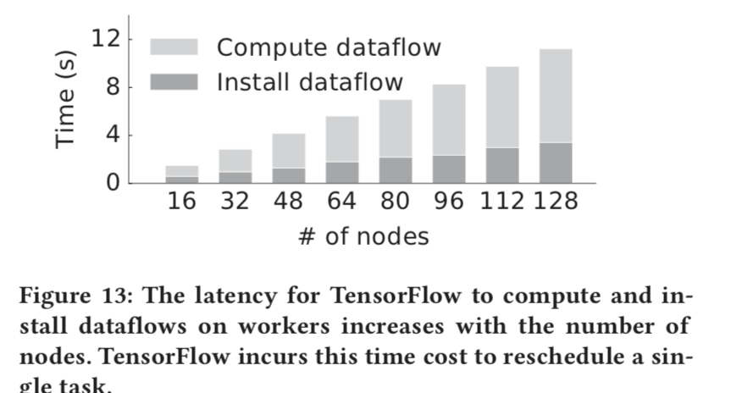
Evaluation--Reschedule

