Slide 1
Distributed File Systems with NVMM and RDMA
Shared by Xinyang Shao

Slide 2
Next Reading Group
Metadata decouple
Metadata partition
Metadata disaggregation
Paper sharing: InfiniFS
DFS architecture with new hardware

Slide 3
Contents
New hardwares
NVM: Non-Volatile Memory
RDMA (Remote Direct Memory Access)
State-of-the-art DFSs with NVM and RDMA

Slide 4
NVM concept family
NVMM
NVM
PCM
ReRAM/Memristor
STT-MRAM
PM / PMEM / SCM
NVDIMM

Slide 5
NVM techs
PCM=Phase-Change Memory（相变存储器）
ReRAM=Resistive RAM（可变电阻式存储器），也叫Memristor（忆阻器）
STT-MRAM=Spin Transfer Torque - Magnetic Random Access Memory（自旋扭矩转换随机存储器）
FeRAM=Ferroelectric RAM（铁电随机存储器）
MRAM=Magnetoresistive RAM（磁阻式随机存储器）
Flash（闪存）

Slide 6
Intel Optane DC memories

Slide 7
NVM concept family
NVMM=Non-Volatile Main Memory（统称）
NVM=Non-Volatile Memory=NVMM
PM/PMEM=Persistent Memory（持久化内存），一般等同于SCM=Storage Class Memory（存储级内存）
NVDIMM=Non-Volatile Dual In-line Memory Module（非易失性双列直插式内存模块）

Slide 8
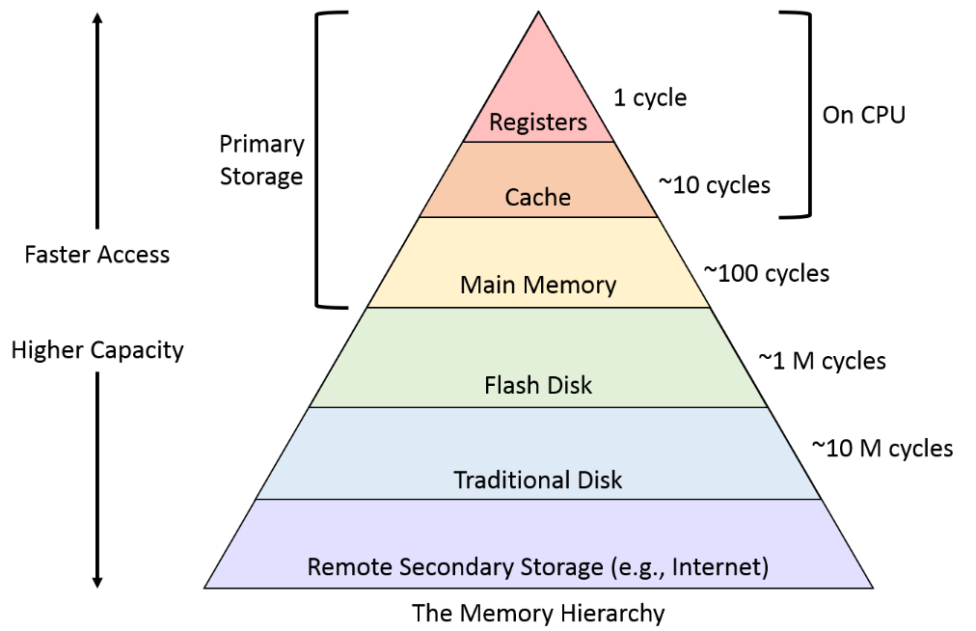
Hierarchy layer of NVM
DRAM: ~100ns
Optane: ~350ns

Slide 9
Incorporation of NVM
As memory
Replace DRAM
Co-exist with DRAM
Replace SWAP
As storage

Slide 10
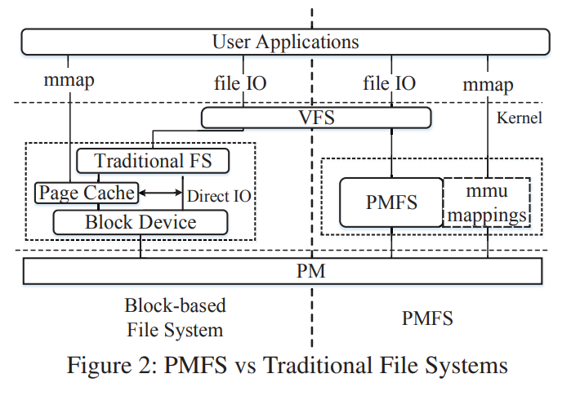
New software stacks for local FS
PMFS (EuroSys’14): Skip page cache for traditional FS

Slide 11
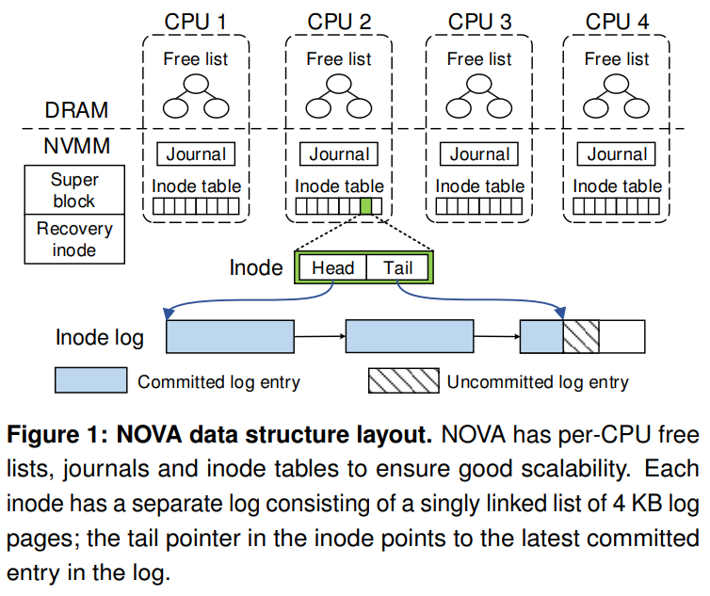
New software stacks for local FS
NOVA (FAST’16): Log-structured FS for DRAM+NVMM

Slide 12
Summary of NVMM
Low latency and high bandwidth
Expensive
Excellent crash consistency
Byte-addressable

Slide 13
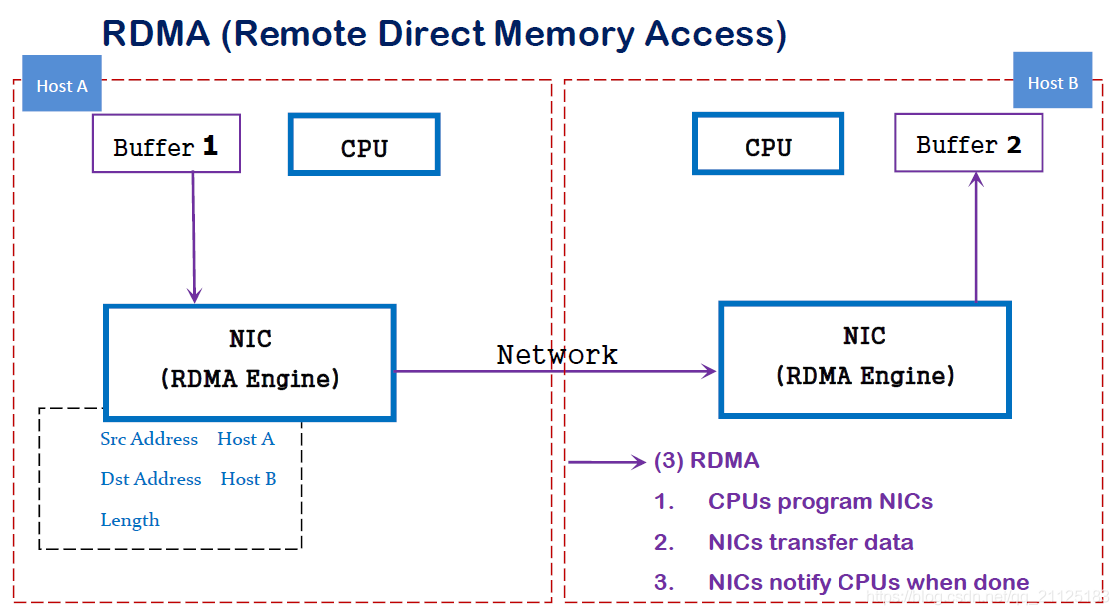
RDMA
CPU offload
Kernel bypass
Zero copy
图来源：https://img-blog.csdnimg.cn/20190117125615125.png?x-oss-process=image/watermark,type_ZmFuZ3poZW5naGVpdGk,shadow_10,text_aHR0cHM6Ly9ibG9nLmNzZG4ubmV0L3FxXzIxMTI1MTgz,size_16,color_FFFFFF,t_70

Slide 14
Contents
New hardwares
NVM: Non-Volatile Memory
RDMA (Remote Direct Memory Access)
State-of-the-art DFSs with RDMA and/or NVM
Traditional DFS with RDMA (CephFS, GlusterFS, etc)
New archs: NVFS, Octopus, Orion, Assise, …

Slide 15
Traditional DFS with RDMA
CephFS with Accelio
GlusterFS with its own RDMA library.
Lustre with RoCEv2

Slide 16
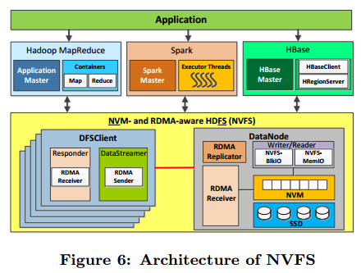
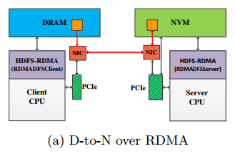
NVFS (ICS’16)
NVFS=NVM- and RDMA-aware HDFS

Slide 17
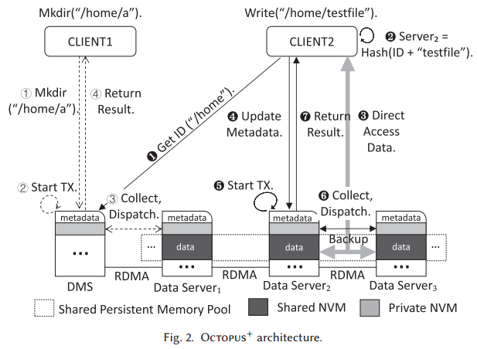
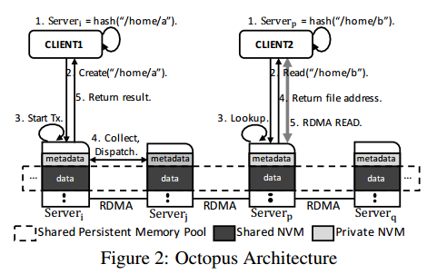
Octopus (ATC’17) Octopus⁺ (ToS’21)
Metadata and data of single file is coupled.
Consistent hashing partition.

Slide 18
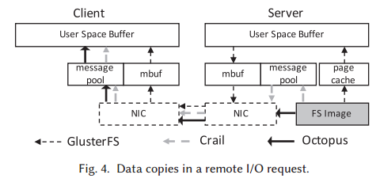
Octopus (ATC’17) Octopus⁺ (ToS’21)
Eliminating memory copies:

Slide 19
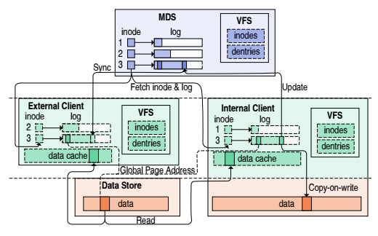
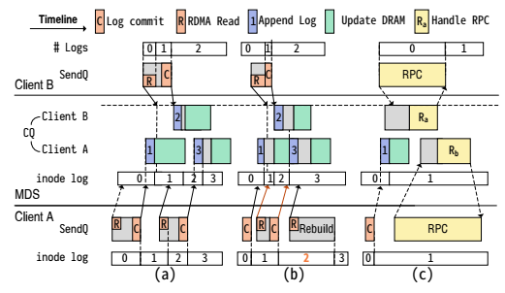
Orion (FAST’19)
Orion exposes as a log-structured file system across only one MDS and clients.

Slide 20
Assise (OSDI’20)
Full Client-side NVM implementation of DFS.

Slide 21
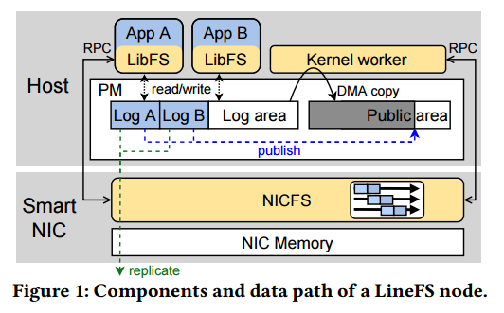
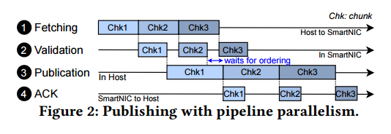
LineFS (SOSP’21)
Offload DFS operations to smart NICs.

Slide 22
Q & A

