Slide 1
PipeDream: Generalized Pipeline Parallelism for DNN Training
SOSP 2019
Deepak Narayanan, Aaron Harlap, Amar Phanishayee, Vivek Seshadri, Nikhil R. Devanur, GreGory R. Ganger, Phillip B. Gibbons, Matei Zaharia
Microsoft Research, Carnegie Mellon University, Stanford University
Presented by Youhui Bai and Quan Zhou, USTC, ADSL
April 17th, 2020

Slide 2
Outline
Background and Motivation
Design and implementation
Evaluation
Conclusion
Notes:
接下来讲一下我们的研究内容

Slide 3
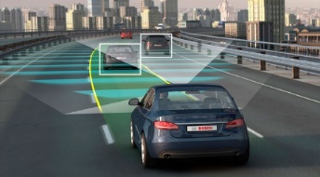
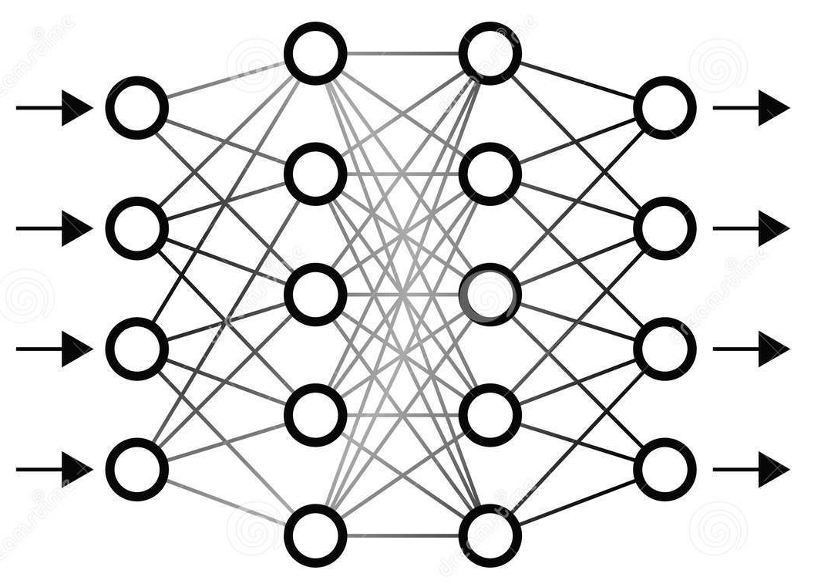
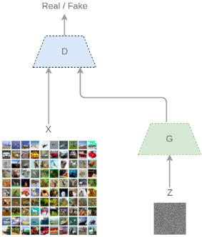
What can deep learning do?
Self-driving
Surveillance detection
Translation
Medical diagnostics
Game
Personal assistant
Art
Image recognition
Speech recognition
Natural language
Generative model
Reinforcement learning

Slide 4
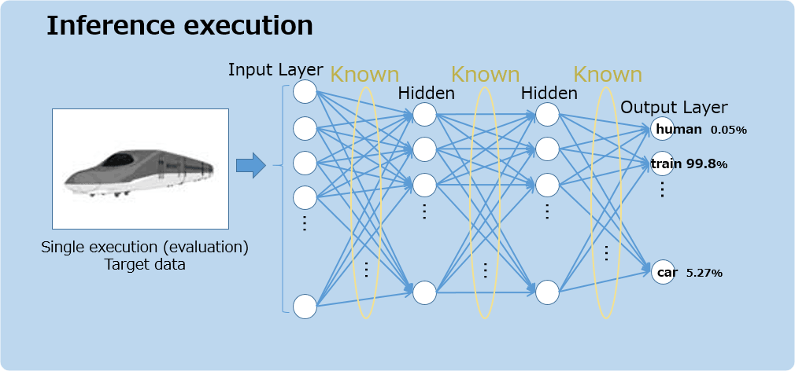
How deep learning works?
Deep Neural Networks (DNNs)

Slide 5
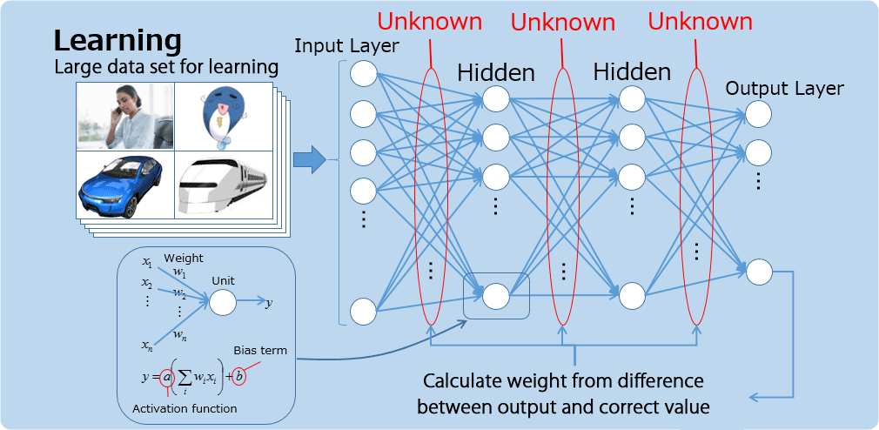
Train your models first!

Slide 6
Forward and Backward in depths
layer1
$$y_{1}=W_{1}X+b_{1}$$
$$ΔW_{1}=\frac{δ loss}{δW_{1}}=\frac{δf}{δy_{2}}⋅\frac{{δy}_{2}}{δy_{1}}⋅\frac{{δy}_{1}}{δW_{1}}=\frac{δf}{δy_{2}}⋅W_{2}⋅X$$
$$W_{1}^{′}=W_{1}+ΔW_{1}$$
layer2
$$y_{2}=W_{2}y_{1}+b_{2}$$
$$ΔW_{2}=\frac{δ loss}{δW_{2}}=\frac{δf}{δy_{2}}⋅\frac{{δy}_{2}}{δW_{2}}=\frac{δf}{δy_{2}}⋅y_{1}$$
$$W_{2}^{′}=W_{2}+ΔW_{2}$$
output
$$loss=f(y_{2})$$
$$y_{1}(4096,1)$$
$$y_{2}(1000,1)$$
$$W_{1}(4096,4096)$$
$$b_{1}(4096,1)$$
$$W_{2}(1000,4096)$$
$$b_{1}(1000,1)$$
$$X(4096,1)$$
$$loss$$
$$ΔW_{1}(4096,4096)$$
$$ΔW_{2}(1000,4096)$$
$$\frac{δf}{δy_{2}}⋅W_{2}(4096,1)$$
$$\frac{δf}{δy_{2}}(1000,1)$$

Slide 7
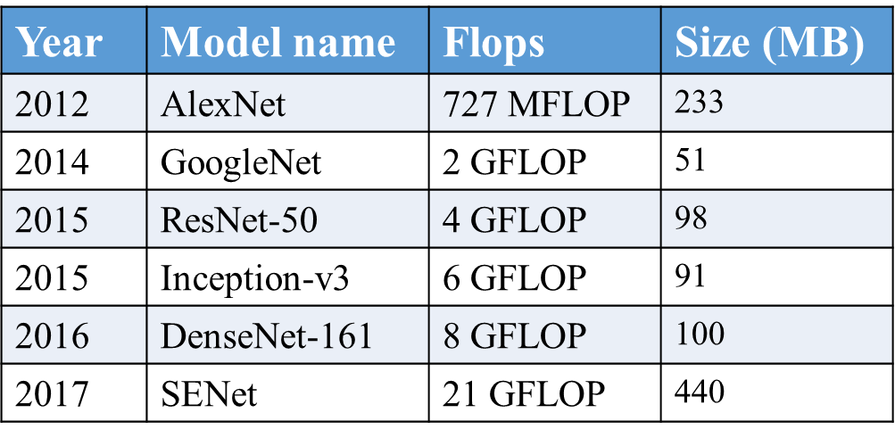
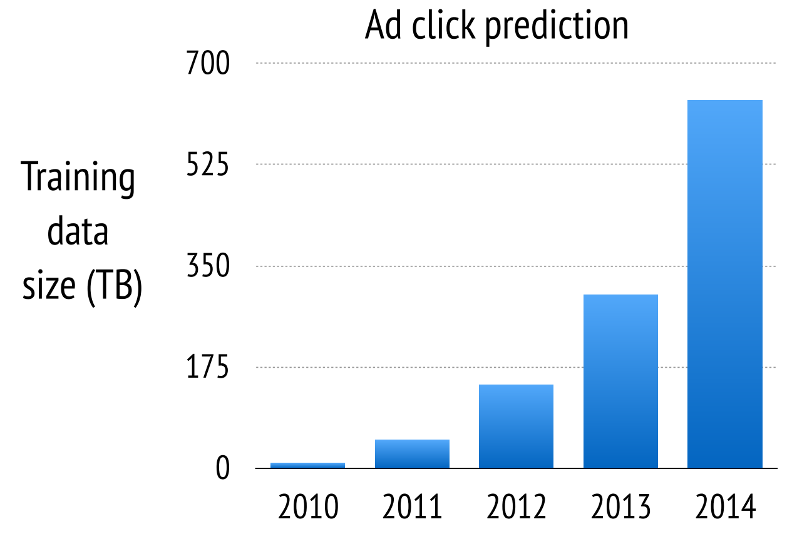
Why Distributed DNN Training?
More complicated DNN models
Explosive growth in the scale of training data
Note: The numbers above are given for single element batches.
Source: https://github.com/albanie/convnet-burden
Source: Mu Li, David G Andersen, etc. Scaling distributed machine
learning with the parameter server. OSDI 2014.

Slide 8
Intra-batch – data parallel
Iteration N
Iteration N + 1
Batch
Batch
GPU 0
Compute gradient
Aggregate gradients
(PS or allreduce)
Update
replica
Compute gradient
Computeaverage
GPU 1
Compute gradient
Update
replica
Compute gradient

Slide 9
Data parallel problems
Setup: a 25Gbps; b 10Gbps; c 25Gbps
Observations
The communication overhead for many of these models is high
Inter-server links are always the bottleneck (compare with PCIe 10-15GBps, NVLink 30GBps)
As the number of workers instance increases, communication overhead increases
As GPU compute speed increases, communication overhead increases
Notes:
补齐setup和四点发现

Slide 10
Intra-batch – model parallel
node 1
1
1
1
2
node 1
node 2
1
1
1
2
node 3
1
1
1
2
node 2
node 4
1
1
1
2
Time
node 3
Forward
Backward
Idle
Observations
The burden of partitioning a model is left to the programmer
Under-utilization of compute resources
node 4

Slide 11
Inter-batch – Gpipe[1]
Pipeline flush:
Add gradients
All inputs use weights from last flush
node 1
1
2
3
4
1
1
2
2
3
3
4
4
5
node 2
1
2
3
4
1
1
2
2
3
3
4
4
node 3
1
2
3
4
1
1
2
2
3
3
4
4
node 4
1
2
3
4
1
1
2
2
3
3
4
4
Time
Forward
Backward
Idle
Observations
The burden of partitioning a model is left to the programmer
Frequent pipeline flushes lead to increased idle time
[1] GPipe: Efficient Training of Giant Neural Networks using Pipeline Parallelism. NIPS 2019.

Slide 12
Preliminary summary
Intra-batch parallelism
Data parallelism: high communication overhead
Model parallelism
Low utilization of compute resources
High programming burden to partition the model
Inter-batch parallelism
Inefficient pipeline
High programming burden
DNN models and Hardware are diverse
Can we automatically partition DNN layers and fully utilize the compute resources?

Slide 13
Outline
Background and Motivation
Design and implementation
Evaluation
Conclusion
Notes:
接下来讲一下我们的研究内容

Slide 14
Concepts and definitions
W1
W2
W3
X
Y1
Y2
Y
Y3
W1
W2
W3
Loss
ΔW1
δL/δY3·W3·W2
ΔW2
δL/δY3·W3
ΔW3

Slide 15
Concepts and definitions
How to assign 3 layers to 2 workers?
W1
W2
W3
a1
X
Y1
Y2
Y
Y3
W1
W2
W3
Loss
layer1
ΔW1
δL/δY3·W3·W2
ΔW2
δL/δY3·W3
ΔW3
a1
T1=2
T2=2
T3=4

Slide 16
Solution
W1
W2
W3
a1
X
Y1
Y2
Y
Y3
W1
W2
W3
Loss
layer1
ΔW1
δL/δY3·W3·W2
ΔW2
δL/δY3·W3
ΔW3
stage1
stage2
t1=2
t2=2
t3=4

Slide 17
PipeDream Scheduling
stage1: layer1~2, worker1, f1 = 2, b1 = 2
stage2: layer3, worker2, f2 = 2, b2 = 2
Forward
stage1, worker1
1
2
1
3
2
4
3
5
4
6
5
7
6
8
Backward
stage2, worker2
1
1
2
2
3
3
4
4
5
5
6
6
7
7
Idle
Key: To process one minibatch, every worker costs same time!

Slide 18
How to assign 3 layers to 3 workers
W1
W2
W3
a1
X
Y1
Y2
Y
Y3
W1
W2
W3
Loss
layer1
ΔW1
δL/δY3·W3·W2
ΔW2
δL/δY3·W3
ΔW3
t1=1
t2=3
t3=2
for each minibatch, worker1 wastes 2 unit times, worker3 wastes 1 unit times

Slide 19
Solution
W1
W2
W3
a1
X
Y1
Y2
Y
Y3
W1
W2
W3
Loss
layer1
ΔW1
δL/δY3·W3·W2
ΔW2
δL/δY3·W3
ΔW3
t1=1
t2=3
t3=2
worker1, worker2
worker3

Slide 20
PipeDream Scheduling
stage1: layer1~2, worker1~2, f₁ = 2, b₁ = 2
stage2: layer3, worker3, f₂ = 1, b₂ = 1
stage1, worker1
1
1
3
3
1
1
5
5
3
3
7
7
5
5
9
stage1, worker2
2
2
4
4
2
2
6
6
4
4
8
8
6
stage2, worker3
1
1
2
2
3
3
4
4
5
5
6
6
7
To process 2 minibatches,
worker1 process 1 minibatch, time cost = 4
worker2 process 1 minibatch, time cost = 4
worker3 process 2 minibatch, time cost = 2 x 2 = 4
Key: To process one minibatch, every worker costs same time on average!

Slide 21
Program
给定条件：
n个layers，包括每个layer的t_{l}, a_{l}, w_{l}
m个workers
workers之间全连接，带宽为B
目标
layers → stages 的划分方案
stages→ workers 的分配方案
解决方案
动态规划

Slide 22
Concepts and definitions
How to assign 3 layers to 2 workers?
W1
W2
W3
a1
X
Y1
Y2
Y
Y3
W1
W2
W3
Loss
layer1
ΔW1
δL/δY3·W3·W2
ΔW2
δL/δY3·W3
ΔW3
a1
T1=2
T2=2
T3=4

Slide 23
Dynamic Programming
起点
终点

Slide 24
Dynamic Programming
f（0,0）
f（0,1）
f（0,2）
f（0,3）
f（1,0）
f（1,1）
f（1,2）
f（1,3）
f（2,0）
f（2,1）
f（2,2）
f（2,3）

Slide 25
Dynamic Programming
递推公式: f(x,y) = f(x-1,y) + f(x, y-1)
f（0,0）
f（0,1）
f（0,2）
f（0,3）
f（1,0）
f（1,1）
f（1,2）
f（1,3）
f（2,0）
f（2,1）
f（2,2）
f（2,3）

Slide 26
Dynamic Programming
递推公式: f(x,y) = f(x-1,y) + f(x, y-1)
边界条件: f(0,y) = f(x,0) = 1
f（0,0）
f（0,1）
f（0,2）
f（0,3）
f（1,0）
f（1,1）
f（1,2）
f（1,3）
f（2,0）
f（2,1）
f（2,2）
f（2,3）

Slide 27
Dynamic Programming
递推公式: f(x,y) = f(x-1,y) + f(x, y-1)
边界条件: f(0,y) = f(x,0) = 1
def f(x,y):
if x==0 or y==0:
return 1
return f(x-1,y) + f(x,y-1)
if __name__ == '__main__':
print(f(2,3))
# output: 10
f（0,0）
f（0,1）
f（0,2）
f（0,3）
f（1,0）
f（1,1）
f（1,2）
f（1,3）
f（2,0）
f（2,1）
f（2,2）
f（2,3）

Slide 28
Dynamic Programming
A(i→j, m): 将layeri, layeri+1, … layerj分配给m个workers后，平均处理一个minibatch的最优时间。

Slide 29
A(1→3, 3) = 2
W1
W2
W3
a1
X
Y1
Y2
Y
Y3
W1
W2
W3
Loss
layer1
ΔW1
δL/δY3·W3·W2
ΔW2
δL/δY3·W3
ΔW3
t1=1
t2=3
t3=2
worker1, worker2
worker3

Slide 30
Dynamic Programming
A(i→j, m): 将layeri, layeri+1, … layerj分配给m个workers后，平均处理一个minibatch的最优时间。
T(i→j, m): 将layeri, layeri+1, … layerj封装成一个stage，交给m个workers之后，平均处理一个minibatch的最优时间。

Slide 31
T(1→2, 2) = 2
不考虑通信开销，T(i→j,m) = T(i→j,1)/m
T(1→2, 1) = 4
W1
W2
W3
a1
X
Y1
Y2
Y
Y3
W1
W2
W3
Loss
layer1
ΔW1
δL/δY3·W3·W2
ΔW2
δL/δY3·W3
ΔW3
t1=1
t2=3
t3=2
worker1, worker2
worker3

Slide 32
Dynamic Programming
A(i→j, m): 将layeri, layeri+1, … layerj分配给m个workers后，平均处理一个minibatch的最优时间。
T(i→j, m): 将layeri, layeri+1, … layerj封装成一个stage，交给m个workers之后，平均处理一个minibatch的最优时间。
求解目标：A (1 → n, m) (n个layers，m个workers）
边界条件：A(i → j,1) = T(i→j, 1) = ti+ti+1+…+tj
递推公式：T(i → j,m) = max(计算时间，通信时间)/m
处理m个minibatches的计算时间=T(i→j,1)
处理m个minibatches的通信时间=2(m-1)(wi+wi+1+…+wj)/B

Slide 33
Dynamic Programming
A(i→j, m): 将layeri, layeri+1, … layerj分配给m个workers后，平均处理一个minibatch的最优时间。
T(i→j, m): 将layeri, layeri+1, … layerj封装成一个stage，交给m个workers之后，平均处理一个minibatch的最优时间。
A的递推公式？
i
j
worker1
worker2
worker3
worker4

Slide 34
Dynamic Programming
A(i→j, m): 将layeri, layeri+1, … layerj分配给m个workers后，平均处理一个minibatch的最优时间。
T(i→j, m): 将layeri, layeri+1, … layerj封装成一个stage，交给m个workers之后，平均处理一个minibatch的最优时间。
A的递推公式？
i
s
s+1
j
worker1
worker2
worker3
worker4

Slide 35
Dynamic Programming
A(i→j, m): 将layeri, layeri+1, … layerj分配给m个workers后，平均处理一个minibatch的最优时间。
T(i→j, m): 将layeri, layeri+1, … layerj封装成一个stage，交给m个workers之后，平均处理一个minibatch的最优时间。
A的递推公式？
i
s
s+1
j
worker1
worker2
worker3
worker4
最后一个stage分配给了m’个workers
T(s+1→j, m’)

Slide 36
Dynamic Programming
A(i→j, m): 将layeri, layeri+1, … layerj分配给m个workers后，平均处理一个minibatch的最优时间。
T(i→j, m): 将layeri, layeri+1, … layerj封装成一个stage，交给m个workers之后，平均处理一个minibatch的最优时间。
A的递推公式？
i
s
s+1
j
worker1
worker2
worker3
worker4
layer i → s 还剩m-m’个workers
A(i→s, m-m’)
最后一个stage分配给了m’个workers
T(s+1→j, m’)

Slide 37
Dynamic Programming
A(i→j, m): 将layeri, layeri+1, … layerj分配给m个workers后，平均处理一个minibatch的最优时间。
T(i→j, m): 将layeri, layeri+1, … layerj封装成一个stage，交给m个workers之后，平均处理一个minibatch的最优时间。
A的递推公式？
i
s
s+1
j
worker1
worker2
worker3
worker4
layer i → s 还剩m-m’个workers
A(i→s, m-m’)
最后一个stage分配给了m’个workers
T(s+1→j, m’)
通信时间：
2*as/B

Slide 38
Dynamic Programming
A(i→j, m): 将layeri, layeri+1, … layerj分配给m个workers后，平均处理一个minibatch的最优时间。
T(i→j, m): 将layeri, layeri+1, … layerj封装成一个stage，交给m个workers之后，平均处理一个minibatch的最优时间。
A的递推公式？
i
s
s+1
j
worker1
worker2
worker3
worker4
layer i → s 还剩m-m’个workers
A(i→s, m-m’)
最后一个stage分配给了m’个workers
T(s+1→j, m’)
通信时间：
2*as/B
max$\left\{\begin{aligned}A^{ }(i→s, m−m^{′}) \\ 2a_{s}/B_{k} \\ T^{ }(s+1→j,m^{′})\end{aligned}\right.$
$$A^{ }\left(i→j,m\right)=⁡$$

Slide 39
Dynamic Programming
A(i→j, m): 将layeri, layeri+1, … layerj分配给m个workers后，平均处理一个minibatch的最优时间。
T(i→j, m): 将layeri, layeri+1, … layerj封装成一个stage，交给m个workers之后，平均处理一个minibatch的最优时间。
A的递推公式？
i
s
s+1
j
worker1
worker2
worker3
worker4
layer i → s 还剩m-m’个workers
A(i→s, m-m’)
最后一个stage分配给了m’个workers
T(s+1→j, m’)
通信时间：
2*as/B
max$\left\{\begin{aligned}A^{ }(i→s, m−m^{′}) \\ 2a_{s}/B_{k} \\ T^{ }(s+1→j,m^{′})\end{aligned}\right.$
$$A^{ }\left(i→j,m\right)=⁡$$
$$\min_{i≤s<j}{\min_{1≤m^{′}<m}{ }}$$

Slide 40
Complicated Topology
m0=1

Slide 41
Complicated Topology
B1
m0=1
m1=4

Slide 42
Complicated Topology
B1
m0=1
m1=4
m2=3
B1
B1
B2

Slide 43
Dynamic Programming
A^{k}(i→j, m): 将layeri, layeri+1, … layerj分配给第k层的m个workers后，平均处理一个minibatch的最优时间。
T^{k} (i→j, m): 将layeri, layeri+1, … layerj封装成一个stage，交给m个第k层的workers之后，平均处理一个minibatch的最优时间。
求解目标：A^{k}(1→n, m)
A⁰(i → j,1) = ti+ti+1+…+tj
A^{k}(i → j,1) = A^{k-1}(i → j, m_{k-1})
T^{k} (i → j,m) = max(计算时间，通信时间)/m
计算时间=A^{k}(i → j,1)
通信时间=2(m-1)(wi+wi+1+…+wj)/B_{k}

Slide 44
Dynamic Programming
A^{k} (i → j, m): 将layeri, layeri+1, … layerj分配给第k层的m个workers后，平均处理一个minibatch的最优时间。
T^{k} (i → j, m): 将layeri, layeri+1, … layerj封装成一个stage，交给第k层的m个workers之后，平均处理一个minibatch的最优时间。
i
s
s+1
j
worker1
worker2
worker3
worker4
layer i → s 还剩m-m’个workers
A^{k}(i→s, m-m’)
最后一个stage分配给了m’个workers
T^{k} (s+1→j, m’)
通信时间：
2*as/B_{k}
max$\left\{\begin{aligned}A^{k}(i→s, m−m^{′}) \\ 2a_{s}/B_{k} \\ T^{k}(s+1→j,m^{′})\end{aligned}\right.$
$$A^{k}\left(i→j,m\right)=⁡$$
$$\min_{i≤s<j}{\min_{1≤m^{′}<m}{ }}$$

Slide 45
How to Schedule
stage1, worker1
1
3
5
1
7
3
9
5
11
7
13
9
15
11
stage1, worker2
2
4
6
2
8
4
10
6
12
8
14
stage2, worker3
1
1
1
2
2
2
7
7
7
8
8
8
13
13
stage2, worker4
3
3
3
4
4
4
9
9
9
10
10
10
15
stage2, worker5
5
5
5
6
6
6
11
11
11
12
12
12

Slide 46
How to Schedule
stage1, worker1
1
3
5
1
7
3
9
5
11
7
13
9
15
11
stage1, worker2
2
4
6
2
8
4
10
6
12
8
14
stage2, worker3
1
1
1
2
2
2
7
7
7
8
8
8
13
13
stage2, worker4
3
3
3
4
4
4
9
9
9
10
10
10
15
stage2, worker5
5
5
5
6
6
6
11
11
11
12
12
12
NOAM(number of active minibatches) = 3, why?
worker1中的minibatch 1/3/5/7/9… 以何种规则分配给worker3~5?
为什么先做前向8，而不是反向4？
NOAM = ceil( #workers / # replicas for stage1) = ceil( 5 / 2) = 3
round-robin策略
稳态状态下，前向计算与反向计算交替进行。

Slide 47
Weight Versions
stage1, worker1
1
2
1
3
2
4
3
5
4
6
5
7
6
8
stage2, worker2
1
1
2
2
3
3
4
4
5
5
6
6
7
7

Slide 48
Weight Versions
stage1, worker1
1
2
1
3
2
4
3
5
4
6
5
7
6
8
stage2, worker2
1
1
2
2
3
3
4
4
5
5
6
6
7
7

Slide 49
Weight Versions
stage1, worker1
1
2
1
3
2
4
3
5
4
6
5
7
6
8
stage2, worker2
1
1
2
2
3
3
4
4
5
5
6
6
7
7
反向2计算完成之后，反向1更新的梯度仍会保留，直至反向3计算完成之后才会释放。
weight stashing: 会暂存几个版本的weights，直到后面不再需要才释放。

Slide 50
Weight Versions
stage1, worker1
1
2
1
3
2
4
3
5
4
6
5
7
6
8
stage2, worker2
1
1
2
2
3
3
4
4
5
5
6
6
7
7
Default
stage1, worker1
1
2
1
3
2
4
3
5
4
6
5
7
6
8
stage2, worker2
1
1
2
2
3
3
4
4
5
5
6
6
7
7
Vertical Sync

Slide 51
Memory Overhead
stage1, worker1
1
2
1
3
2
4
3
5
4
6
5
7
6
8
W₁ x 2
stage2, worker2
1
1
2
2
3
3
4
4
5
5
6
6
7
7
W₂ x 1
Default
stage1, worker1
1
2
1
3
2
4
3
5
4
6
5
7
6
8
W₁ x 2
stage2, worker2
1
1
2
2
3
3
4
4
5
5
6
6
7
7
W₂ x 2
Vertical Sync
For data parallel, each worker holds all weights in a model, which is W₁+W_{2.}
The paper declares it’s memory usage is on par with model parallel.（与model parallel的内存占用大致相当）。But it depends on whether weights are split equally among stages.

Slide 52
目录
Design
Implementation
Notes:
接下来讲一下我们的研究内容

Slide 53
What’s More
Implemented as a standalone Python library for PyTorch.
~3000 LOC(Lines of Code)
Support checkpointing.

Slide 54
Outline
Background and Motivation
Design and implementation
Evaluation
Conclusion
Notes:
接下来讲一下我们的研究内容

Slide 55
Evaluation – experimental setup
Experiments run on three different server types
Notes:
Cluster A应该有8台机器，B应该有4台

Slide 56
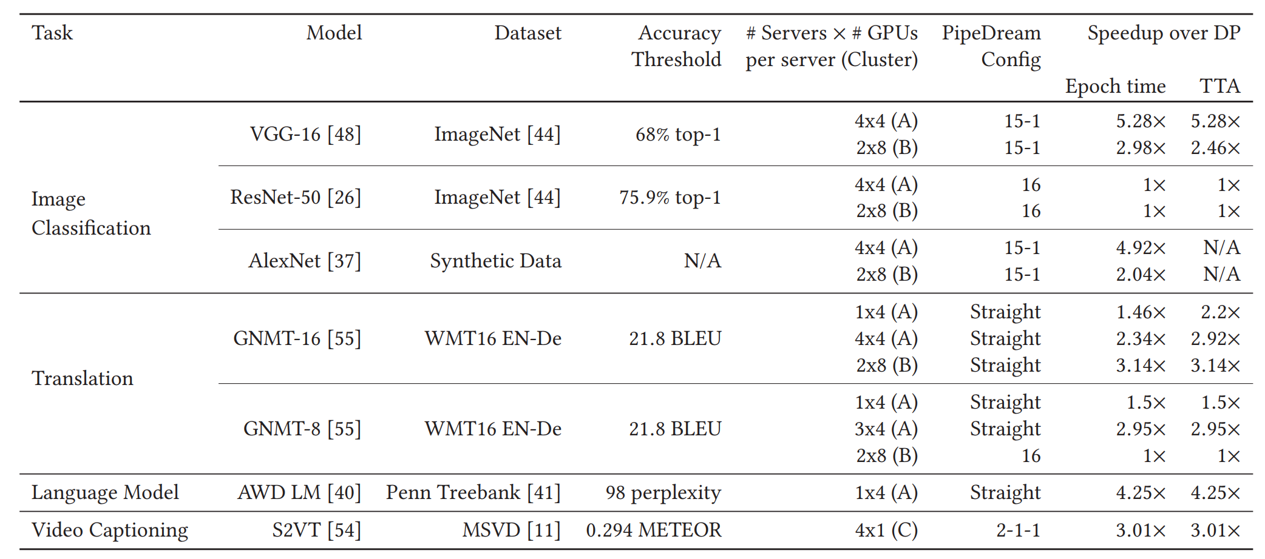
PipeDream vs. Data Parallelism on TTA
Notes:
4种不同的task

Slide 57
PipeDream vs. Data Parallelism on TTA
With the same number of GPUs,
PipeDream up to 5.3x faster than Data Parallelism
PipeDream’s speedups are due to better
system performance

Slide 58
PipeDream vs. Data Parallelism on TTA
Optimizer recommends a number of
different configurations like
hybrid, straight, and fully data-parallel

Slide 59
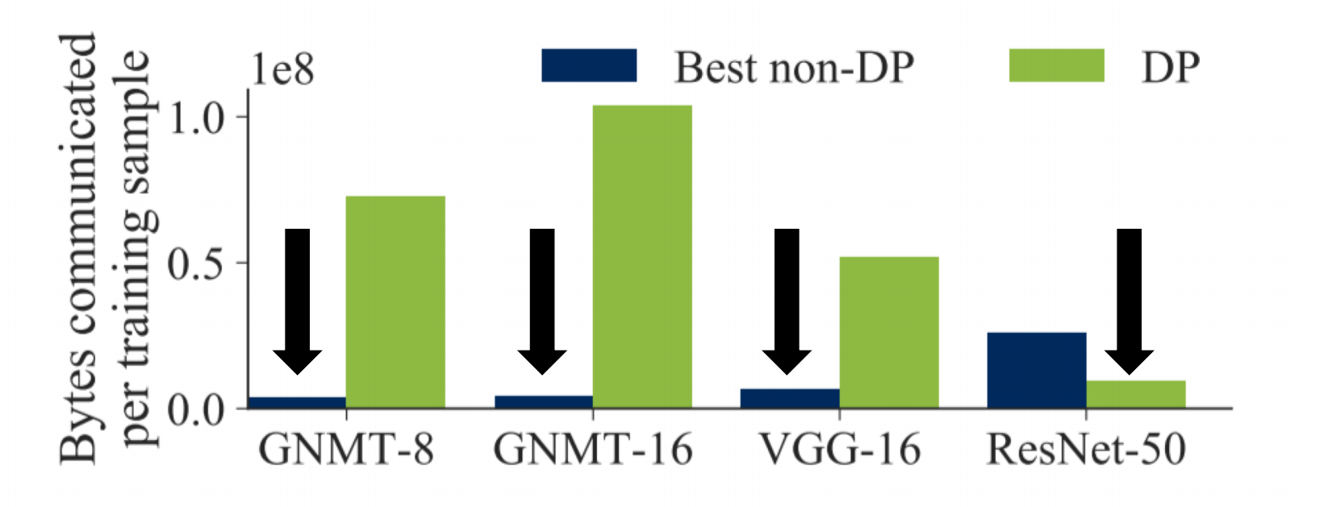
PipeDream reduces communication overhead
For many models, intermediate activations and gradients order of magnitude smaller than communication with Data Parallelism (DP)

Slide 60
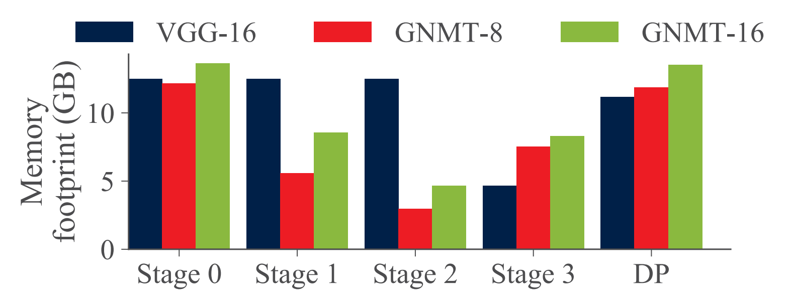
PipeDream memory footprint
PipeDream’s worst-case memory footprint is on par with that of data parallelism
Notes:
This is because each stage in PipeDream is responsible for only a fraction of the total number of weights and activations in the model

Slide 61
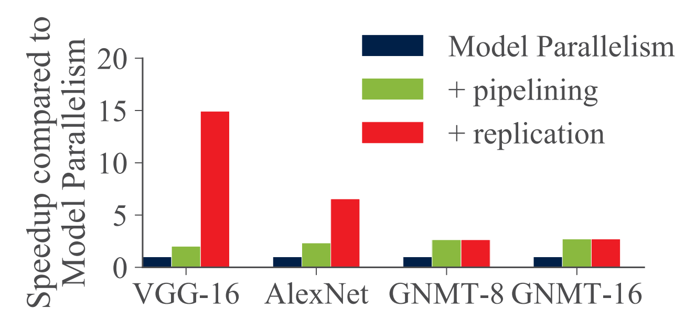
PipeDream vs. Model parallelism
For all four models, pipelining alone increases throughput by 2× or more

Slide 62
Outline
Background and Motivation
Design and implementation
Evaluation
Conclusion
Notes:
接下来讲一下我们的研究内容

Slide 63
Conclusion
Model and data parallelism often suffer from high communication overhead and low resource utilization for certain models and deployments
PipeDream shows pipelining can be used to accelerate DNN training
Pipelining, when combined with data and model parallelism in a principled way, achieves end-to-end speedups of up to 5.3x

Slide 64
PipeDream: Generalized Pipeline Parallelism for DNN Training
Thanks & QA!
April 17th, 2019

