Slide 1
AIFM: High-Performance Application-Integrated Far Memory
Authors: Zhenyuan Ruan (MIT CSAIL), Malte Schwarzkopf (Brown U), Marcos K. Aguilera (VMware Research), Adam Belay (MIT CSAIL)
Presenters: Kai Ma, Zhanghan Wang

Slide 2
Outline
1
Background
2
AIFM Design and Abstraction
3
AIFM Runtime
4
Implementation & Evaluation
5
Conclusion

Slide 3
In-memory Applications

Slide 4
Memory is limited and Inelastic
Apps are limited by server physical memory boundary
Solutions
Overprovision memory for peak usage
Trending: far memory

Slide 5
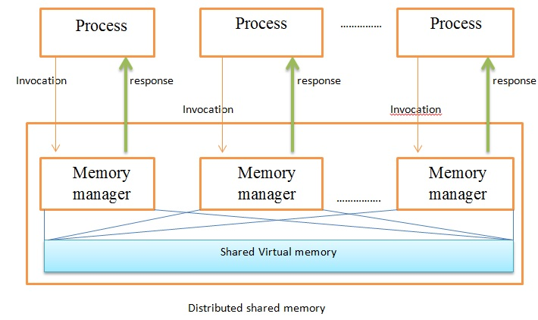
Distributed Shared Memory
Provides an abstraction of shared memory
Implemented over message passing
Data shared across hosts, need cache coherence protocol
Image from wikipedia

Slide 6
Far Memory
Remote Server Memory
Different with Distributed Shared Memory
Data in far memory is private to a host

Slide 7
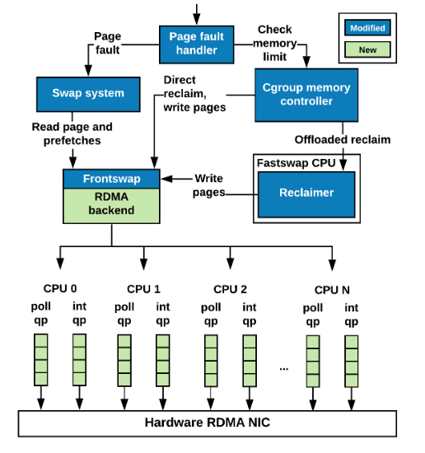
Far Memory——Fastswap
In-kernel paging system
Using RDMA
Transparent
System architecture of Fastswap

Slide 8
Far Memory
Existing far-memory system performs poorly:
Real-world Data Analytics from Kaggle
Provision 25% of working set in local mem.
1.0
Ideal(Local only)
Normalized performance
0.8
70% of
Performance
loss
0.6
0.4
0.2
0
FastSwap
AIFM

Slide 9
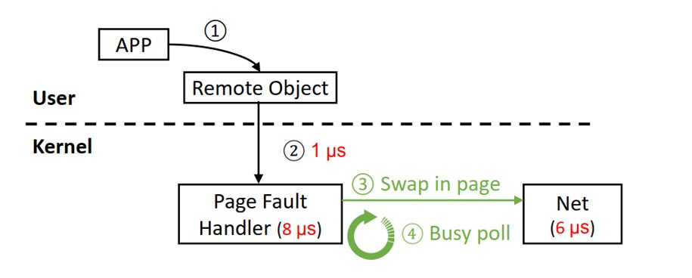
Challenges of Far Memory
Semantic Gap
No knowledge for prefetching
Page granularity causing R/W amplification

Slide 10
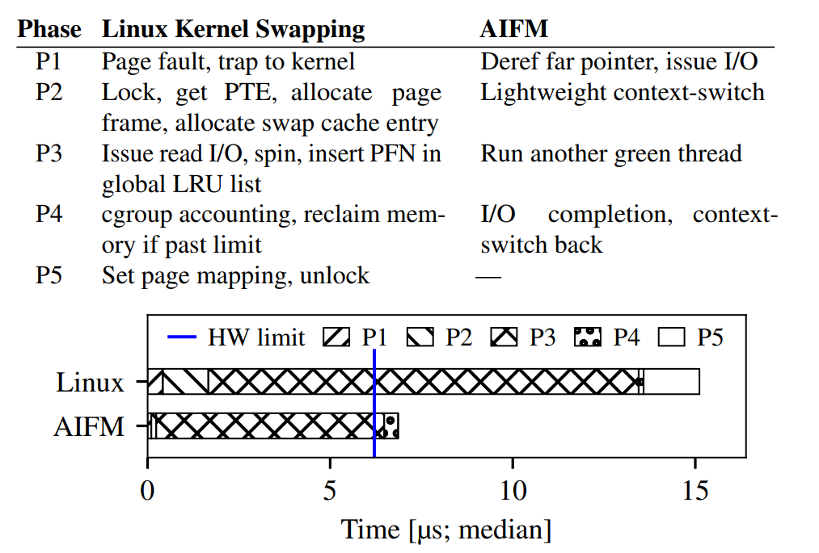
Challenges of Far Memory
2. High kernel overhead
Linux kernel-based swapping
SSD-backend AIFM

Slide 11
Challenges of Far Memory
3. Impact of Memory Reclamation
Might need pause when reclaiming
High tail latencies
4. Network BW < DRAM BW

Slide 12
AIFM’s Solutions
Challenge | AIFM’s solution
Semantic Gap | Remoteable Data Structure Library
Kernel Overhead | Userspace Runtime
Impact of Memory Reclamation | Pauseless Evacuator
Network BW < DRAM BW | Remote Agent

Slide 13
Design Space
Manually manage
objects with RDMA
Performance
AIFM
Existing OS
Paging System
Transparency

Slide 14
Outline
1
Background
2
AIFM Design and Abstraction
3
AIFM Runtime
4
Implementation & Evaluation
5
Conclusion

Slide 15
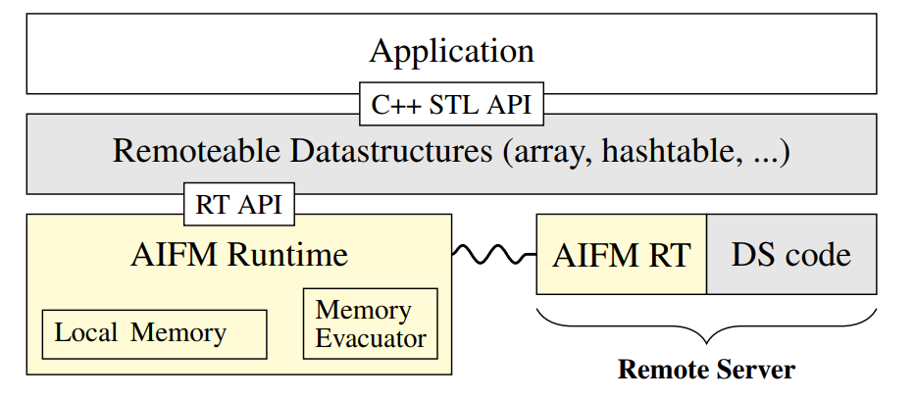
AIFM’s Design Overview

Slide 16
AIFM’s Design Overview
User-level
Thread 0
Local memory
Remote Memory

Slide 17
AIFM’s Design Overview
Remoteable
Data Structure
Lib API
User-level
Thread 0
Local memory
Remote Memory

Slide 18
AIFM’s Design Overview
1. Solve: semantic gap
Remoteable
Data Structure
Lib API
User-level
Thread 0
App Semantics
Prefetcher
Local memory
Remote Memory

Slide 19
AIFM’s Design Overview
Remoteable Pointers
Remoteable
Data Structure
Lib API
Ptr 0
Obj 0
User-level
Thread 0
App Semantics
Ptr 1
Prefetcher
Local memory
Remote Memory
Obj 1

Slide 20
AIFM’s Design Overview
2. Solve: kernel overhead
Remoteable
Data Structure
Lib API
Ptr 0
Obj 0
User-level
Thread 0
App Semantics
Ptr 1
yield
Prefetcher
User-level
Thread 1
Local memory
Remote Memory
Obj 1

Slide 21
AIFM’s Design Overview
2. Solve: kernel overhead
Remoteable
Data Structure
Lib API
Ptr 0
Obj 0
User-level
Thread 0
App Semantics
Ptr 1
Obj 1
yield
yield
Prefetcher
User-level
Thread 1
Local memory
Remote Memory

Slide 22
AIFM’s Design Overview
3. Solve: impact of memory reclamation
Remoteable
Data Structure
Lib API
Ptr 0
Obj 0
User-level
Thread 0
App Semantics
Ptr 1
Obj 1
yield
yield
…
Prefetcher
User-level
Thread 1
Ptr n
Obj n
Close to full
Local memory
Remote Memory

Slide 23
AIFM’s Design Overview
3. Solve: impact of memory reclamation
Remoteable
Data Structure
Lib API
Race with mutator
to evacuate
User-level
Thread 0
Ptr 0
Obj 0
App Semantics
Ptr 1
Obj 1
yield
yield
Pauseless
Evacuator
…
Prefetcher
User-level
Thread 1
Ptr n
Obj n
Close to full
Local memory
Remote Memory

Slide 24
AIFM’s Design Overview
3. Solve: impact of memory reclamation
Remoteable
Data Structure
Lib API
Ptr 0
Obj 0
User-level
Thread 0
App Semantics
Ptr 1
yield
yield
Pauseless
Evacuator
…
Prefetcher
User-level
Thread 1
Ptr n
Local memory
Remote Memory
…
Obj 1
Obj n

Slide 25
AIFM’s Design Overview
4. Solve: network BW < DRAM BW
Remoteable
Data Structure
Lib API
Ptr 0
Obj 0
User-level
Thread 0
App Semantics
Ptr 1
yield
yield
Pauseless
Evacuator
…
Prefetcher
User-level
Thread 1
Ptr n
Light Operations
e.g. Copy Obj 1
Local memory
Remote Memory
Remote
Agent
…
Obj 1
Obj n

Slide 26
AIFM’s Design Overview
4. Solve: network BW < DRAM BW
Remoteable
Data Structure
Lib API
Ptr 0
Obj 0
User-level
Thread 0
App Semantics
Ptr 1
yield
yield
Pauseless
Evacuator
…
Prefetcher
User-level
Thread 1
Ptr n
Local memory
Remote Memory
Copy Obj 1
…
Remote
Agent
Obj 1
Obj n
Notes:
Copy 得到一个新 ptr

Slide 27
AIFM’s Design Overview
4. Solve: network BW < DRAM BW
Remoteable
Data Structure
Lib API
Ptr 0
Obj 0
User-level
Thread 0
App Semantics
Ptr 1
yield
yield
Pauseless
Evacuator
…
Prefeter
User-level
Thread 1
Ptr n
Ptr 1'
Local memory
Remote Memory
Remote
Agent
…
Obj 1'
Obj 1
Obj n
Notes:
Copy 得到一个新 ptr

Slide 28
For Application Developers
std::unordered_map<key_t, int> hashtable;
std::array<data_t> arr;
void foo(std::vector<key_t>& keys_list) {
int sum = 0;
for (auto key: keys_list) {
sum += hashtable.at(key);
}
std::cout << arr.at(sum) << std::endl;
}
RemHashtable<key_t, int> hashtable;
RemArray<data_t> arr;
void foo(RemList<key_t>& keys_list) {
int sum = 0;
for (auto key: keys_list) {
DerefScope s1;
sum += hashtable.at(key, s1);
}
DerefScope s2;
std::cout << arr.at<true>(sum, s2) << std::endl;
}
Prefetch data in list
Make the object be evacuated
as soon as possible
Idiomatic C++ code
Using AIFM

Slide 29
For Data Structure Engineers
Rely on AIFM to fetch remote objects
Or deploy custom logic on the remote side

Slide 30
Abstraction Details
Remoteable Pointer
Dereference Scope
Evacuation Handler
Remote Device
Semantic Hints

Slide 31
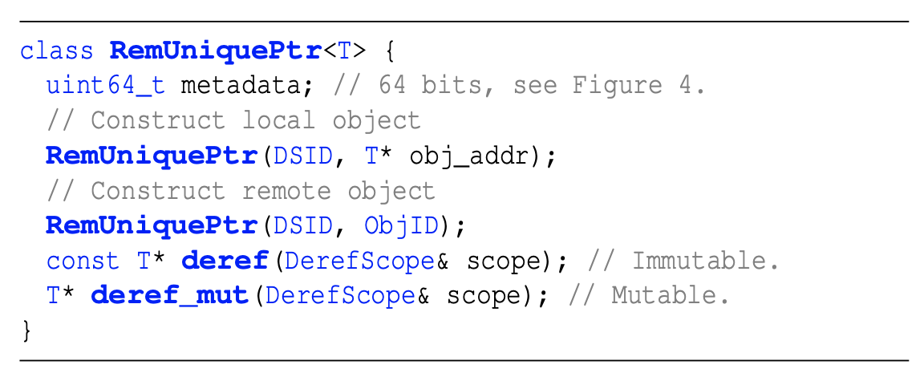
Remoteable Pointers
RemUniquePtr
A unique, lightweight reference to an object
Ptr
Obj

Slide 32
Remoteable Pointers
RemSharedPtr
Pointers can alias
128bit, 64bit to link to other pointers
Ptr
Ptr
Ptr
Obj

Slide 33
Remoteable Pointers
Point to Local Object
H: hot, P: present, S: shared, D: dirty, E: evacuating.
Point to Remote Object
DS ID: Data Structure Instance ID
Notes:
Hot 有 8bit 信息

Slide 34
Remoteable Pointers Dereference
Hot path for local access needs 4 uops
Ordinary pointer dereference needs 1 uop
1. mov to load ptr
2. andl to check present and evacuation bit
Hot path
for local access
Cold path
for remote access
3. shrq to extract address
4. mov to return it
AIFM runtime fetch data
Set hot bit and dirty bit
Notes:
muop

Slide 35
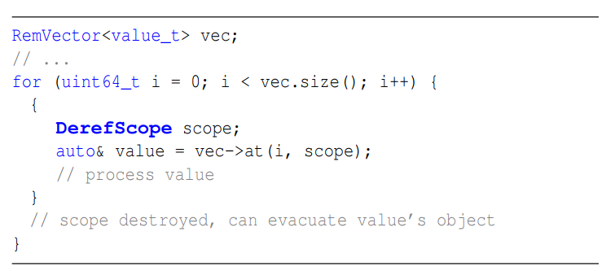
Dereference Scope
while the application holds a pointer returned from dereferencing a RemUniquePtr, the runtime must never swap out the object.
Thus we need dereference scope to block upcoming evacuations

Slide 36
Evacuation Handler
Custom behavior on evacuation
E.g. when evacuate an obj in a hash table, we might want to remove key and obj pointer to save local space
using EvacHandler = std::function< void(Object&, const Runtime::CopyToRemoteFn&)>;
void evacHandler(Object& obj, const Runtime::CopyToRemoteFn& ctrf) {
// do sth. (E.g. modify the state of obj’s embedded pointers)
// copy to remote
ctrf();
// do sth. (E.g. cleanup)
}

Slide 37
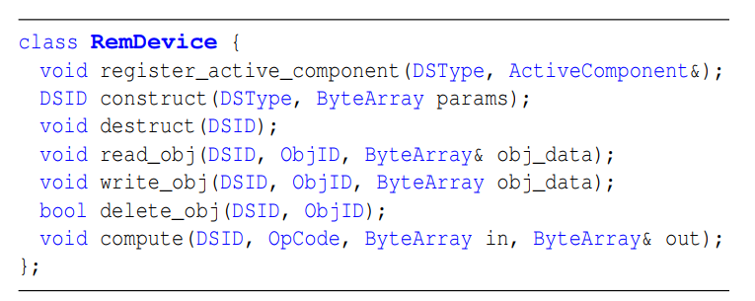
Remote Device
Basic R/W operations
Custom active component
Offload simple operations (compute)

Slide 38
Semantic Hints
Hotness Tracking
Prefetching
E.g. sequential access and strided access
Nontemporal Access
“ptr.deref_mut<true>(scope)” or “ptr.deref_mut<false>(scope)”

Slide 39
Outline
1
Background
2
AIFM Design and Abstraction
3
AIFM Runtime
4
Implementation & Evaluation
5
Conclusion

Slide 40
Runtime Overview
Ultimate goal: low latency & high throughput
Better utilization of CPU cycles
Green threads
Light-weight, user-level threading
Latency hiding
Kernel-bypass TCP/IP networking stack
Pauseless memory evacuator
Log-structured memory layout
Multi-queue algorithm thread scheduler

Slide 41
Green threads
Remoteable
Data Structure
Lib API
Ptr 0
Obj 0
User-level
Thread 0
App Semantics
Ptr 1
yield
Prefetcher
User-level
Thread 1
Local memory
Remote Memory
Obj 1
Notes:
前面有，可以不要这张

Slide 42
Memory Evacuator
Challenges
Good memory utilization: log-structured memory layout
High latency of evacuation: pauseless design
Goal
Evacuation doesn’t block computation
Computation doesn’t block evacuation

Slide 43
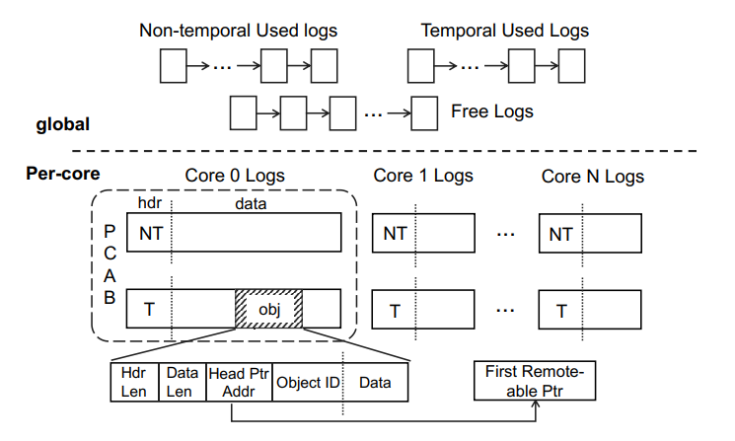
Log-structured Memory Layout
Log-structured memory as the object allocator^{[1]}
Enable efficient memory compaction for better memory utilization
Per-Core Allocation Buffer (PCAB) for multicore scalability
[1] Stephen M. Rumble, et al. “Log-structured Memory for DRAM-based Storage”. In: USENIX Conference on File and Storage Technologies (FAST). 2014

Slide 44
Pauseless Memory Evacuator
When memory pressure is detected, the evacuator is run
Log selection
Concurrent marking
Evacuator waiting
Concurrent evacuation
* Safety
Evacuator: Can’t evacuate an object that’s in use
Mutator: Can’t use an object that’s being evacuated

Slide 45
Pauseless Memory Evacuator
Phase 1: Log Selection
Pick in FIFO order
First global non-temporal used list; then global temporal used list if necessary
Or other more sophisticated schemas
Non-temporal
Used Logs
…
first
Pauseless
Evacuator
Temporal
Used Logs
…
then

Slide 46
Pauseless Memory Evacuator
Phase 2: Concurrent Marking
Spawn threads to iterate objects in logs
Set the evacuation bit of the pointers to the live objects
Worker 0
Worker 1
spawn
Pauseless
Evacuator
Selected Logs
Worker 2

Slide 47
Pauseless Memory Evacuator
Phase 3: Evacuator Waiting
Wait until all mutators have witnessed the E bit
What if the mutator now dereferences the pointer?
Mutator
dereference
Ptr 0
Obj 0
E
evacuation bit is set
Notes:
gaiyuixia

Slide 48
Pauseless Memory Evacuator
Phase 3: Evacuator Waiting
Naive: mutators are blocked until E is cleared
Inspiration from RCU (Read-copy update)
RCU is a sync mechanism, allows reads to happen while writing
mutator = RCU reader, evacuator = RCU writer
Mutator
dereference
Ptr 0
Obj 0
E
evacuation bit is set
Notes:
gaiyuixia

Slide 49
Pauseless Memory Evacuator
Phase 3: Evacuator Waiting
New log with Obj 0
Obj 0
Copy
Mutator
dereference
Ptr 0
Obj 0
E
evacuation bit is set

Slide 50
Pauseless Memory Evacuator
Phase 3: Evacuator Waiting
New log with Obj 0
Obj 0
Mutator
dereference
Ptr 0
Obj 0
P
E
addr
CAS
set
clear
set
simultaneously

Slide 51
Pauseless Memory Evacuator
Phase 3: Evacuator Waiting
If mutator succeed in racing:
Then it obtains a local reference
And need to update all pointers in the pointer chain
New log with Obj 0
Obj 0
Mutator
dereference
Ptr 0
P
E
newaddr

Slide 52
Pauseless Memory Evacuator
Phase 3: Evacuator Waiting
If mutator failed in racing:
Free the copy
Obtained a remote reference
Free it
New log with Obj 0
Obj 0
Mutator
dereference
Ptr 0
Local memory
Remote Memory
Obj 0

Slide 53
Pauseless Memory Evacuator
Phase 4: Concurrent Evacuation
Evacuator spawns more workers to evacuate
Cold objects:
Copy remote
CAS to clear P(present) and set remote pointer metadata
If succeed, update all pointers in pointer chain
Hot objects:
Compact and copy to new log
update related information
Notes:
此处可能需要图解，拿phase3的图改一改

Slide 54
Thread Scheduler
Dilemma
A large number of threads create memory pressure
DerefScope blocks evacuation
Multi-queue algorithm
Mutators in a dereference scope > evacuation threads > other mutators

Slide 55
Data Structure Library
Array
Native array of RemUniquePtr
Vector
std::vector<RemUniquePtr>
List
Like vector but use a local list
Stack and Queue
Wrappers of Remoteable List
Hashtable
Concurrent Hopscotch
Local hashtable is an inclusive or exclusive cache of remote part
Notes:
Buchong hashtable

Slide 56
Outline
1
Background
2
AIFM Design and Abstraction
3
AIFM Runtime
4
Implementation & Evaluation
5
Conclusion

Slide 57
Implementation
C++
Core Runtime: 6451 lines
on top of Shenango^{[1]}: 750 lines modified
Kernel-bypassing I/O stack
Green threads
Data Structure Library: 5535 lines
Two Far Memory Backends
NVMe SSD: SPDK-based (no remote component, amplification)
TCP: DPDK-based (no TCP offloading)
[1] Amy Ousterhout, et al. “Shenango: Achieving High CPU Efficiency for Latency-sensitive Datacenter Workloads”. In: Symposium on Networked Systems Design and Implementation (NSDI). 2019.

Slide 58
Evaluation
End-to-end: What performance does AIFM achieve for end-to-end applications, including ones that combine multiple remoteable data structures?
Comparison: How does AIFM compare to SOTA far memory system, Fastswap?
Microbenchmarks: How well do AIFM data structures perform?
Breakdown: What factors contribute to AIFM’s performance?

Slide 59
Setup
Two nodes on CloudLab^{[1]}, each:
10-core Intel Xeon E5-2640 v4 CPUs (2.40GB)
64GB RAM
25 Gbits/s Mellanox ConnectX-4 Lx MT27710 NIC
[1] Dmitry Duplyakin, et al. “The Design and Operation of CloudLab”. In: USENIX Annual Technical Conference (ATC). 2019.

Slide 60
End-to-end applications
Understand what end-to-end performance is delivered
Synthetic Web application
DataFrame application (NYC taxi data analytics)

Slide 61
(1) Synthetic Web application
Used Remotable Data Structures
Remoteable hash table (10GB)
Remoteable array (16GB, each element 8KB)
Local memory limit: 19% (5GB)
For each client request:
keys <- 32 keys following zipf(s) dist
values <- keys.map { HT[_] }
idx <- f(values) following zipf(s) dist
data <- Array[idx]
return Compress(Encrypt(data))

Slide 62
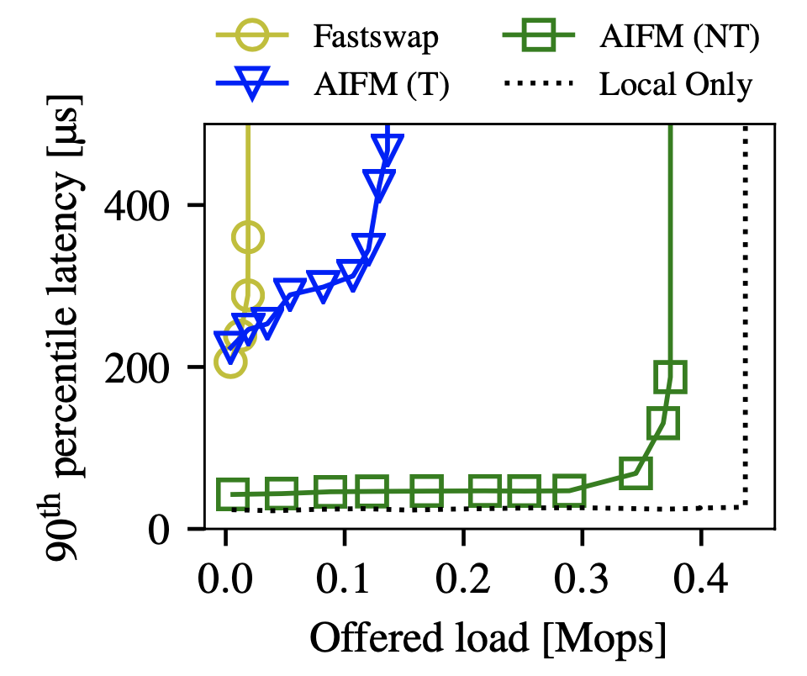
(1) Synthetic Web application
NT = non-temporal access to the array
T = temporal access to the array

Slide 63
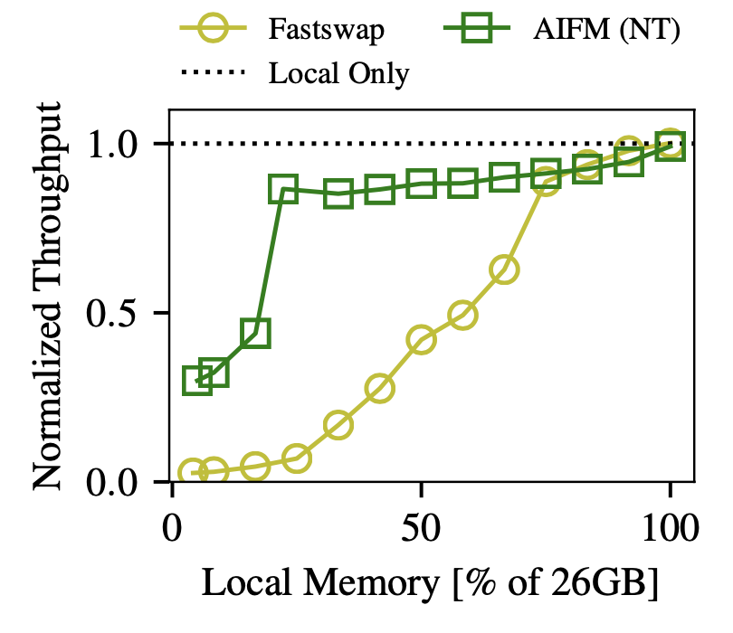
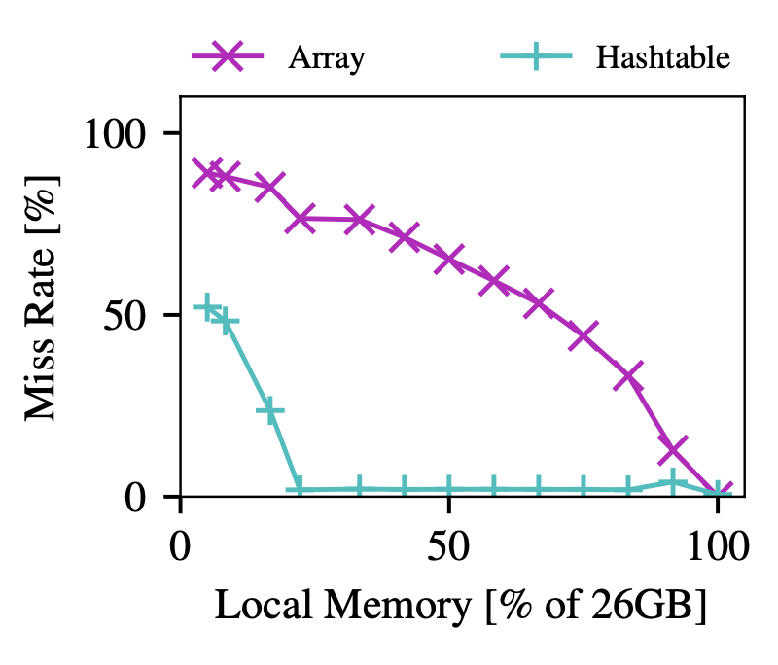
(1) Synthetic Web application

Slide 64
(2) DataFrame application
DataFrame abstraction popularized by Pandas^{[1]}
Ported C++ library DataFrame^{[2]} to AIFM
Main data structures
std::vector storing DataFrame columns and indexes
Replace std::vector by RemVector
NYC taxi trip analysis
[1] “pandas - Python Data Analysis Library”. In: https://pandas.pydata.org/
[2] “C++ DataFrame for statistical, Financial, and ML analysis”. In: https://github.com/hosseinmoein/DataFrame

Slide 65
(2) DataFrame application
Three offload operations
Copy & Shuffle pure memory ops
Aggregate +lightweight server-side computation

Slide 66
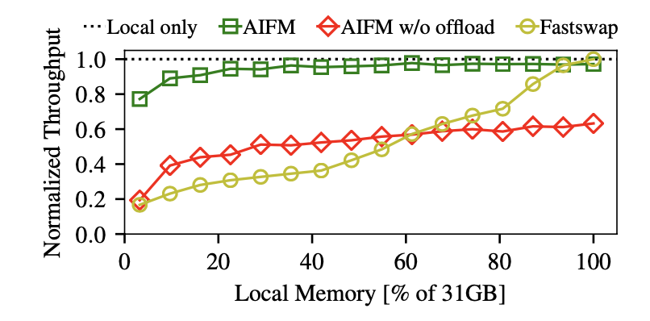
(2) DataFrame application

Slide 67
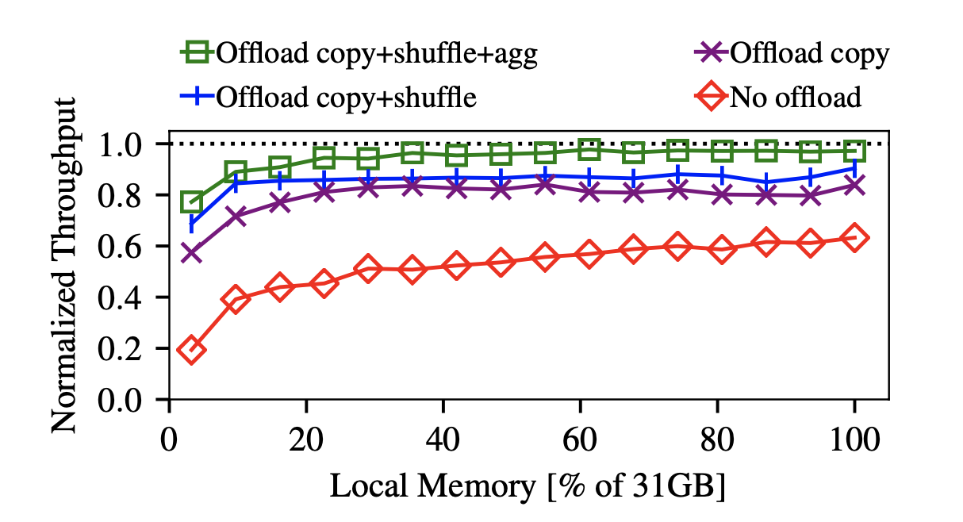
(2) DataFrame application
18-38%
2.9-13%
4.5-12%

Slide 68
Microbenchmarks
Understand Two Representative DSs
Hashtable
Array
Factors
Prefetching
Non-temporal local storage
R/W amplification reducing

Slide 69
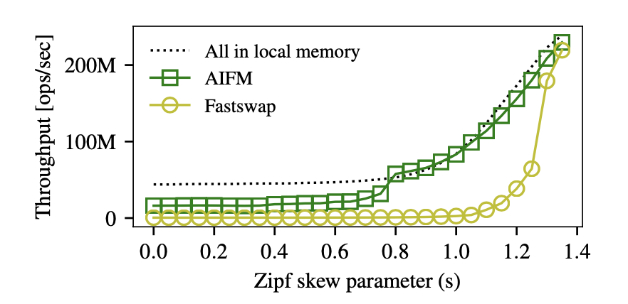
Hashtable
10 GB data, object size = ?
Fastswap: 5GB
AIFM: 3GB mem for index, 2GB mem for data

Slide 70
Hashtable
s > 0.8, competitive with local memory
miss rate 1%
outperforms Fastswap up to 61x (s = 0.8)
amplification due to coarser granularity
lack of per-KV pair hotness information (CLOCK replacement for AIFM)
kernel paging overheads

Slide 71
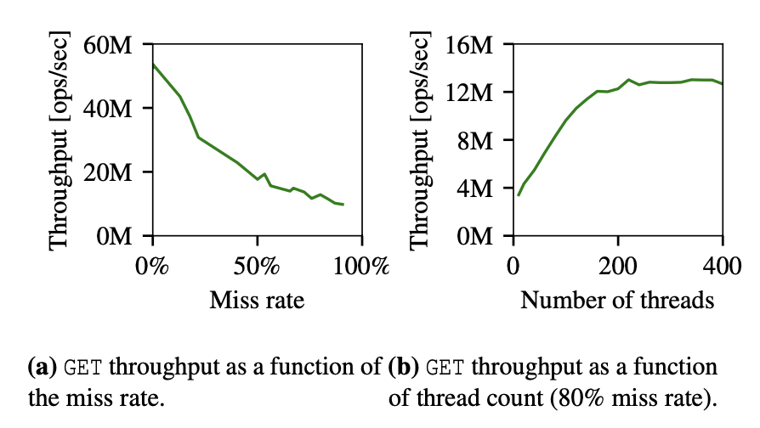
Hashtable
Extract more performance up to 160 threads

Slide 72
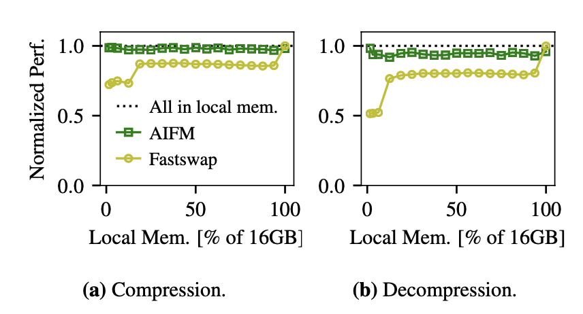
Array
In-memory compression (16 files of 1GB)
In-memory decompression (30 files of 0.5GB)
Access patterns: streaming, sequential

Slide 73
Design Drill-Down
Fast Path
Access L1 memory
Direct access: 1μop
AIFM fast path: 4μop
ILP helps: approx. 2x overheads for L1 hits

Slide 74
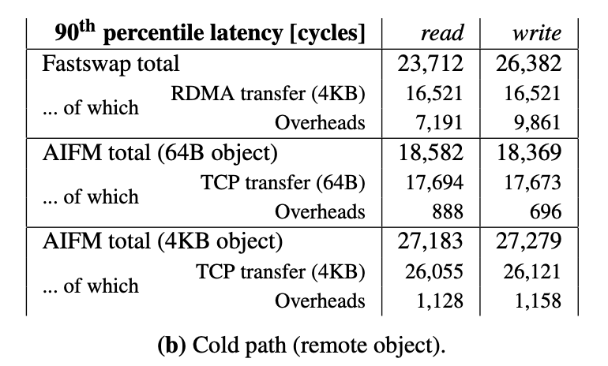
Design Drill-Down
Cold Path
Small objects: AIFM lower latency, as expected
Page-sized or bigger objects: Fastswap lower latency (due to RDMA)
AIFM higher throughput (1.8-6.8x increase) due to better CPU utilization and lower overheads

Slide 75
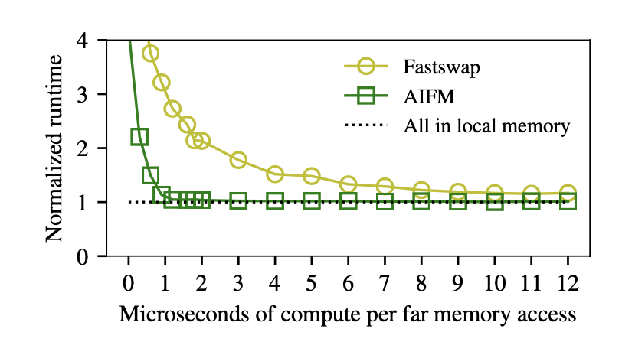
Design Drill-Down
Operating Point
How much compute time can amortize far memory overheads?
4KB objects
AIFM 1.2us
Fastswap 50us
Notes:
zaixiangxiang

Slide 76
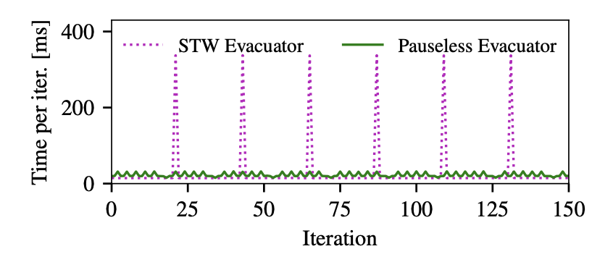
Design Drill-Down
Memory Evacuator
Pauseless memory evacuator
A stop-the-world evacuator incurs 10x higher latency

Slide 77
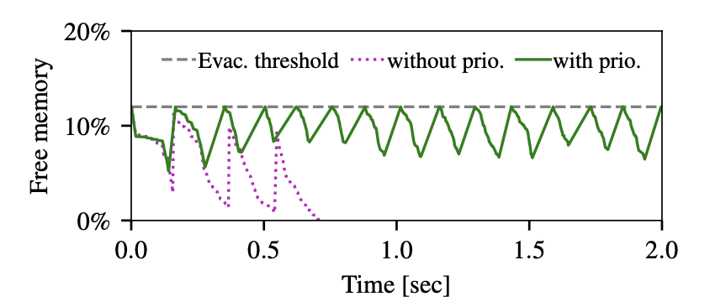
Design Drill-Down
Memory Evacuator
Thread Scheduler Co-design
Notes:
Buchoong workload

Slide 78
Outline
1
Background
2
AIFM Design and Abstraction
3
AIFM Runtime
4
Implementation & Evaluation
5
Conclusion

Slide 79
Conclusion
New direction: a bit less transparency for much more performance
New abstraction: Remoteable pointers
Realization: runtime + library
Result: high performance & convenient APIs for both app devs and DS devs

Slide 80
Why AIFM made it to OSDI?
Category | Our thoughts
Novelty | Though simple on the surface, it represents a new corner in the design space, and looks very promising
Writing | Despite a few clarity problems (maybe due to limited space?) Great introduction to background. Complete; easy to follow. Discussion on other similar technology.
Engineering | Top-notch. Every detail considered. The code^{[1]} is pretty clear. Acknowledge limitations.
Evaluation | Comprehensive (diversity of workloads and access patterns) In-depth understanding & convincing arguments
[1] “AIFM-sys/AIFM”. In: https://github.com/aifm-sys/aifm

Slide 81
AIFM: High-Performance Application-Integrated Far Memory
Thanks for your attention!

Slide 85
Limitations
TCP offloading: CPU↓
RDMA support: network latency↓
No nested DerefScopes
A local compute server can connect to only one memory server (remote memory is not shared)

