Slide 1
Evolution of Development
Priorities in Key-value Stores
Serving Large-scale Applications:
The RocksDB Experience
FAST’21
Authors: Siying Dong, Andrew Kryczka, Yanqin Jin and Michael Stumm
Presenter: Hao Chen, Chaoyi Ruan

Slide 2
Outline
1
Background
2
Evolution of Resource Optimization Targets
3
Lessons from Real-world Applications
4
Conclusion

Slide 3
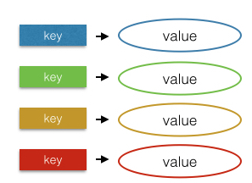
Key-value Stores Widely Used
Data represented in the form of array[‘key’] = value
Simple APIs like Put(k,v), Get(k)
High performance on semi-structured data
Widely used in many applications
Social networks
Cloud storage
New-SQL database
Examples of key-value stores

Slide 4
Popular KV Store: RocksDB
Goal
For modern hardware (SSDs, Multicore CPUs)
Versatile (server range of applications)
Single node (doesn’t handle replication, load balancing, etc)
Persistent Key-Value Store Library

Slide 5
Popular KV Store: RocksDB
Goal
For modern hardware (SSDs, Multicore CPUs)
Versatile (server range of applications)
Single node (doesn’t handle replication, load balancing, etc)
Development
2012: fork from LevelDB
2013: Open-source
2014: MongoRocks (MongoDB engine)
2016: MyRocks (MySQL engine)
2018: Rocksandra (Cassandra engine)
Persistent Key-Value Store Library

Slide 6
Popular KV Store: RocksDB
Goal
For modern hardware (SSDs, Multicore CPUs)
Versatile (server range of applications)
Single node (doesn’t handle replication, load balancing, etc)
Development
2012: fork from LevelDB
2013: Open-source
2014: MongoRocks (MongoDB engine)
2016: MyRocks (MySQL engine)
2018: Rocksandra (Cassandra engine)
Persistent Key-Value Store Library
Widely adopted
Used by over 30 different applications (storing many hundreds of PB data ) at Facebook
Widely used in: stream processing, logging/queuing services, index services and caching on SSD

Slide 7
Leading Data Structure in KV: LSM-tree
Memory
Immutable MemTable
Mutable MemTable
L0
Static Sorted Table (SST)
L1
L2
L3
…
On-disk data

Slide 8
Leading Data Structure in KV: LSM-tree
write
Memory
Write process
Write log to WAL
Write data to mutable MemTable
When mutable MT full, changed to immutable
Flush immutable MT to L0 in background
Merge ${Level}_{n}$ to ${Level}_{n+1}$ when it’s oversize
Immutable MemTable
Mutable MemTable
2
1
L0
compaction
Write-ahead log (WAL)
L1
L2
L3
…
On-disk data

Slide 9
Leading Data Structure in KV: LSM-tree
read
Memory
Write process
Write log to WAL
Write data to mutable MemTable
When mutable MT full, changed to immutable
Flush immutable MT to L0 in background
Merge ${Level}_{n}$ to ${Level}_{n+1}$ when it’s oversize
Immutable MemTable
Mutable MemTable
L0
compaction
Write-ahead log (WAL)
L1
Read process
Search in mutable MT, immutable MT
Search in ${Level}_{0},{Level}_{1},{Level}_{2}, …$
L2
L3
…
On-disk data

Slide 10
Compaction in LSM-tree
Leveled compaction
Newest SSTs are created by MemTable flush and placed in Level-0
Each level has configurable size
When ${Level}_{i}$ size is exceeded, trigger compaction
L0
L1
250 MB
L2
2.5 GB
L3
25 GB
110
130
140
180
…
120
150
Compaction process
Select SST in ${Level}_{i}$
Select overlapped SST in ${Level}_{i+1}$
$${Level}_{i}$$
oversize
$${Level}_{i+1}$$

Slide 11
Compaction in LSM-tree
Leveled compaction
Newest SSTs are created by MemTable flush and placed in Level-0
Each level has configurable size
When ${Level}_{i}$ size is exceeded, trigger compaction
L0
L1
250 MB
L2
2.5 GB
L3
25 GB
110
130
140
180
110
140
150
180
…
120
150
+
Compaction process
Select SST in ${Level}_{i}$
Select overlapped SSTs in ${Level}_{i+1}$
Merge old SSTs to produce new SSTs
Write new SSTs to ${Level}_{i+1}$
$${Level}_{i}$$
$${Level}_{i+1}$$

Slide 12
Compaction in LSM-tree
Leveled compaction
Newest SSTs are created by MemTable flush and placed in Level-0
Each level has configurable size
When ${Level}_{i}$ size is exceeded, trigger compaction
L0
L1
250 MB
L2
2.5 GB
L3
25 GB
110
130
140
180
110
140
150
180
…
120
150
+
Compaction process
Select SST in ${Level}_{i}$
Select overlapped SSTs in ${Level}_{i+1}$
Merge old SSTs to produce new SSTs
Write new SSTs to ${Level}_{i+1}$
$${Level}_{i}$$
$${Level}_{i+1}$$
key range:
(10, 20)
(25, 40)
(50, 80)
(81, 105)
(110, 140)
(150, 180)
Key range of SSTs not overlapped in the same level (except L0)
Up to 1 time lookup in each level for get(key)

Slide 13
Compaction in LSM-tree
Tiered compaction
Each level has the same number of files (n)
File size in ${Level}_{i+1}$ is n times bigger than that in ${Level}_{i}$
L0
L1
Compaction process
L2
…
merge
L0
L1
L2
…

Slide 14
Compaction in LSM-tree
Tiered compaction
Each level has the same number of files (n)
File size in ${Level}_{i+1}$ is n times bigger than that in ${Level}_{i}$
L0
L1
Compaction process
L2
…
L0
L1
key range
Key range overlapped in each level
(100, 500)
L2
(200, 600)
(100, 400)
Worse read performance
(400, 800)
…

Slide 15
Outline
1
Background
2
Evolution of Resource Optimization Targets
3
Lessons from Real-world Applications
4
Conclusion

Slide 16
Evolution of Resource Optimization Targets
Write amplification
Space amplification
CPU utilization
Adapting to newer technologies
Main Data Structure Revisited

Slide 17
Write Amplification (WA)
WA matters
Save SSD erase cycle
WA comes from
SSD themselves (4KB write unit, garbage collection), usually 1.1~3
Storage and database software (100B changes cause 4KB write), as high as 100
Values of WA
Leveled compaction: 10~30
Tiered compaction: 4~10 (with lower read performance)

Slide 18
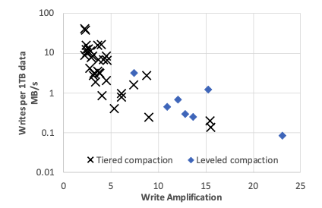
Write Amplification (WA)
Tradeoff between WA and data ingestion rates
42 randomly sampled ZippyDB and MyRocks Apps
High write rate: tiered compaction to reduce WA
Low write rate: leveled compaction to achieve space efficiency and read performance

Slide 19
Space Amplification
Space utilization was far more important than write amplification
Neither flash write cycles nor write overhead were constraining
IOPS in practice was low compared to what SSD could provide
Dynamic leveled compaction
Level’s size is dynamically adjusted based on actual size of last level
Achieves better and more stable space efficiency
 | Dynamic Leveled Compaction |  |  | LevelDB-style Compaction
# Keys (millions) | Fully compacted size (GB) | Steady DB size (GB) | Space overhead (%) | Fully compacted size (GB) | Steady DB size (GB) | Space overhead (%)
200 | 12.0 | 13.5 | 12.4 | 12.0 | 15.1 | 25.6
400 | 24.0 | 26.9 | 11.8 | 24.0 | 26.9 | 12.2
600 | 36.0 | 40.4 | 12.2 | 36.4 | 42.5 | 16.9
800 | 48.0 | 54.2 | 12.7 | 48.3 | 57.9 | 19.7
1000 | 60.1 | 67.5 | 12.4 | 60.3 | 73.8 | 22.4
Random write

Slide 20
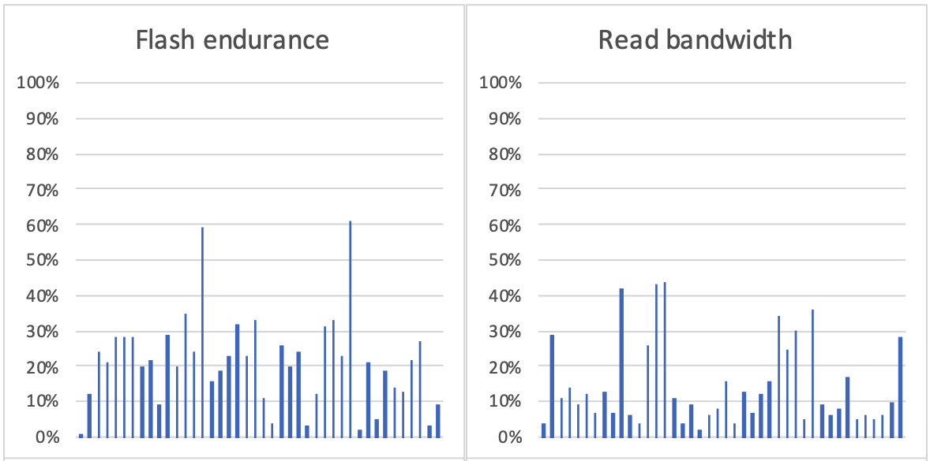
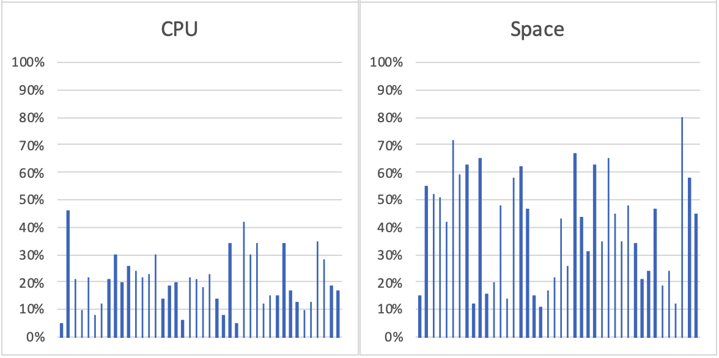
CPU Utilization
Bottleneck shifted from storage to CPU with SSD, but not expect to become an issue
Only a few applications limited by SSDs, most limited by space
A high-end CPU has enough power to saturate one high-end SSD
42 randomly sampled ZippyDB and MyRocks Apps

Slide 21
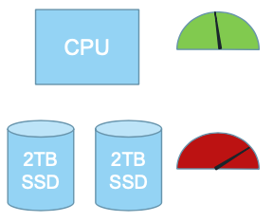
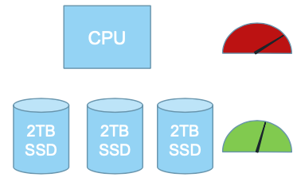
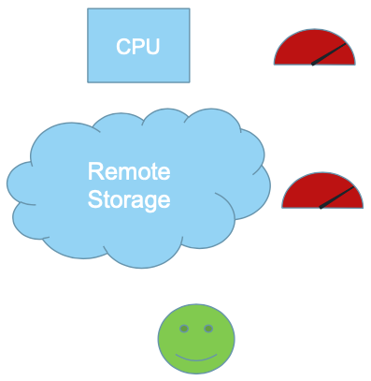
CPU Utilization
Reducing CPU overheads becoming more important
Make hardware configurations more cost-effective
CPU and memory prices increased substantially
CPU and space balance is important
Space bottleneck
CPU bottleneck
Hard to balance CPU and SSD
Make full use of both CPU and SSD

Slide 22
New Technology Adaption
New SSD architecture (Open-channel, multi-stream, ZNS SSD)
Promise low latency and save erase cycles, but most app are space constrained
Challenge unified experience when accommodating these technologies
Delegate to underlying file system

Slide 23
New Technology Adaption
New SSD architecture (Open-channel, multi-stream, ZNS SSD)
Promise low latency and save erase cycles, but most app are space constrained
Challenge unified experience when accommodating these technologies
Delegate to underlying file system
In-storage computing
Might offer significant gains
Challenging for RocksDB to adapt to in-storage computing

Slide 24
New Technology Adaption
New SSD architecture (Open-channel, multi-stream, ZNS SSD)
Promise low latency and save erase cycles, but most app are space constrained
Challenge unified experience when accommodating these technologies
Delegate to underlying file system
In-storage computing
Might offer significant gains
Challenging for RocksDB to adapt to in-storage computing
Disaggregated (remote) storage
More interesting and current priority
Easier to make full use of both CPU and SSD

Slide 25
New Technology Adaption
New SSD architecture (Open-channel, multi-stream, ZNS SSD)
Promise low latency and save erase cycles, but most app are space constrained
Challenge unified experience when accommodating these technologies
Delegate to underlying file system
In-storage computing
Might offer significant gains
Challenging for RocksDB to adapt to in-storage computing
Disaggregated (remote) storage
More interesting and current priority
Easier to make full use of both CPU and SSD
Storage Class Memory (SCM)
Use as extension of DRAM (how best to implement data structure)
Use as main storage (but RocksDB bottlenecked by space or CPU)
Use for WAL (could justify the cost of SCM, WAL size is small)

Slide 26
Main Data Structure Revisited
LSM-trees still appropriate
SSDs’ price has not drop enough (space and endurance matter)
Trading SSD usage with CPU or DRAM only suitable for few app
LSM-tree good for space efficiency (with some optimization)
Separating key and value to reduce WA for big object (WiscKey, ForrestDB)
RocksDB trying to separate key and value (BlobDB)

Slide 27
Outline
1
Background
2
Evolution of Resource Optimization Targets
3
Lessons from Real-world Applications
4
Conclusion

Slide 28
Lessons from Real-world Applications
Lessons on Serving Large-scale Systems
Lessons on Failure Handling
Lessons on the Key-value Interface

Slide 29
Lessons on Serving Large-scale Systems
Resource management
WAL treatment
Rate-limited file deletions
Data format compatibility
Manage configuration

Slide 30
Lessons on Serving Large-scale Systems
Hundreds of thousands of instance
…
…
…
…
…
Server 1
Server 2
Server 3
Server N
Shard / RocksDB

Slide 31
Lessons on Serving Large-scale Systems
Resource management
One Process Mode
Global & Local resource Limits
Memory, compaction I/O & BW & threads, disk usage …
Single instance limits
Using thread pools
Avoid context switch, debugging, IO spike
Multiple Process Mode
Conservative Policy
Global Information Sharing

Slide 32
Lessons on Serving Large-scale Systems
WAL treatment
No needed always
Traditional DB need it always
Distributed System
Replication mechanism
Copy from normal node when node crashes
Three mode
Synchronous WAL
Buffered WAL
No WAL

Slide 33
Lessons on Serving Large-scale Systems
Rate-limited ﬁle deletions
TRIM
Improve performance & ﬂash endurance
Writing to FTL journal -> trigger GC and data movement
Harm foreground IO
Rate limiter
Data format compatibility
For roll out/back

Slide 34
Lessons on Serving Large-scale Systems
Managing conﬁgurations
Challenges
Data-specific
Changes to default value for parameter
Too many options to tune
ZippyDB with rocksdb configuration
Solutions
String parameter when opening a database
Validation tool
Migration tool
Automatic adaptivity while supporting extensive explicit conﬁguration

Slide 35
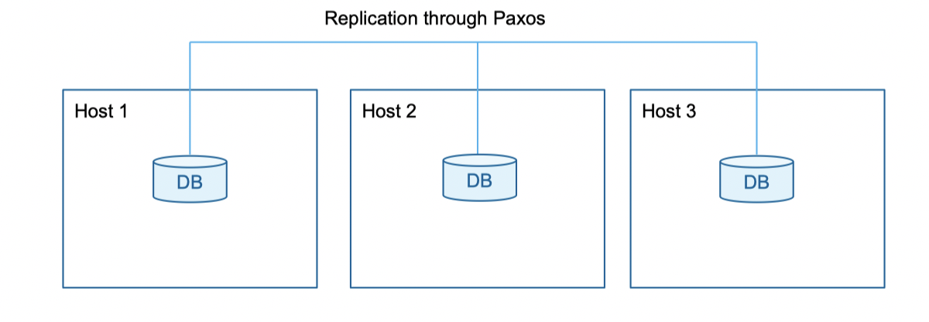
Lessons on Serving Large-scale Systems
Replication and backup support
RocksDB is a stand-alone library
Support
Logical Copy
Scan operation while no cache trashing in source side
Bulk load in destination side
Physical Copy
Identifying database in point in time
Using file system

Slide 36
Lessons on Serving Large-scale Systems
Replication and backup support
Challenges (future improvements)
Applying updates in a consistent order on different replicas
Issue write one at a time and falling behind among replicas

Slide 37
Lessons on Failure Handling
Data corruption errors earlier to minimize risk
Integrity protection covering entire system
Treat errors in different ways

Slide 38
Lessons on Failure Handling
Frequency of silent corruptions
CPU/memory corruption does happen rarely, and it is needed to be detected earlier
Once every three months for each 100PB of data
In 40% of those cases, the corruption had already propagated to other replicas
Roughly 17 checksum mismatches for every petabyte of physical data transferred

Slide 39
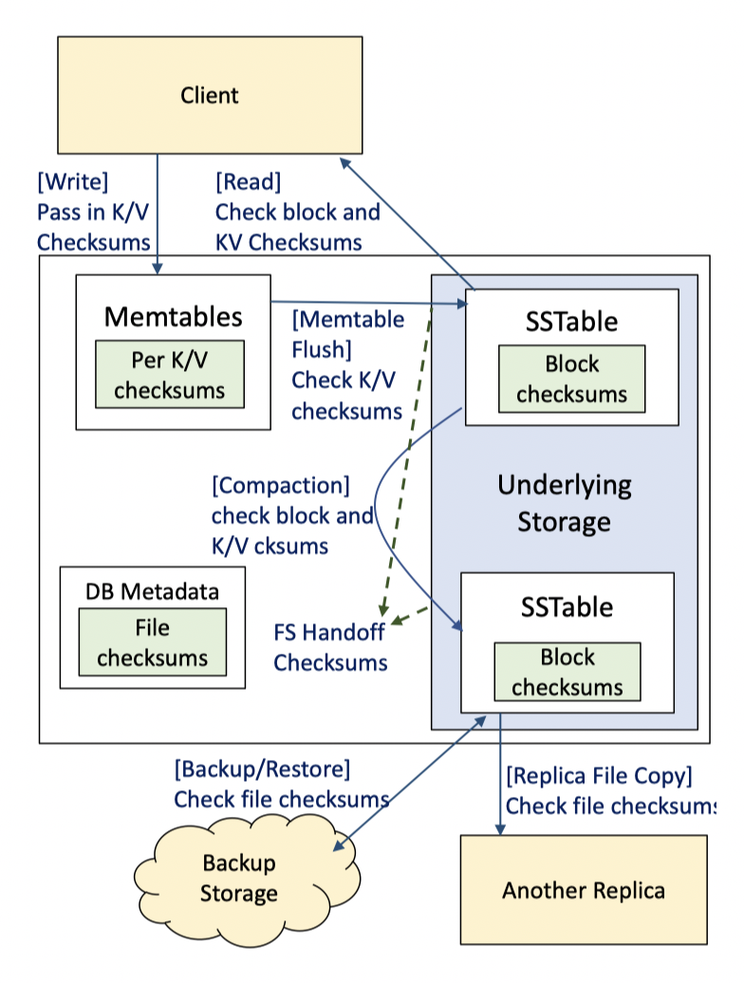
Lessons on Failure Handling
Multi-layer protection
Block integrity
Sstable, wal fragment
File integrity
Network transfer
Handoff integrity
Leave
Key-value integrity

Slide 40
Lessons on Failure Handling
Severity-based error handling
Return from underlying storage system
halting all write operations
Improvement
Interrupt and retry periodically
operational beneﬁts

Slide 41
Lessons on the Key-value Interface
The key-value interface enjoys great popularity for its simplicity
Variable-length byte arrays
Portability

Slide 42
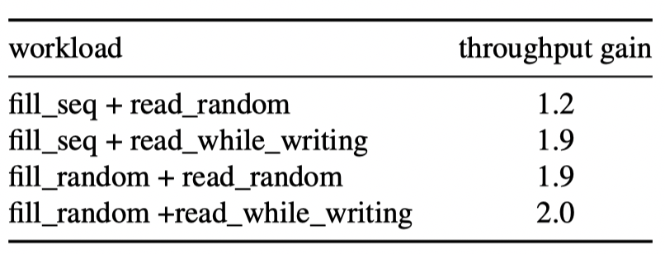
Lessons on the Key-value Interface
Versions and timestamps
No explicit API for timestamp
No cross-shard support
Improvement
Separate timestamp from key
DB_bench microbenchmark using the timestamp API

Slide 43
Outline
1
Background
2
Evolution of Resource Optimization Targets
3
Lessons from Real-world Applications
4
Conclusion

Slide 44
Conclusion
Views
Write and space amplification remain the primary concern
Additional focus shifted to CPU and DRAM efficiency, and remote storage
Lessons
Resource allocation across different RocksDB instances
Backward and forward compatible
Automated configuration
Detect errors earlier at every layer
Simple revisions to interface yield better balance

Slide 45
Evolution of Development
Priorities in Key-value Stores
Serving Large-scale Applications:
The RocksDB Experience
Thanks for your attention!

