Slide 1
SwapAdvisor: Push Deep Learning Beyond the GPU Memory Limit via Smart Swapping
王海权 周泉
2021-5-12
ASPLOS’20

Slide 2
Outline
1
Background
2
Observation and Motivation
3
Design
4
Evaluation
3
5
Conclusion

Slide 3
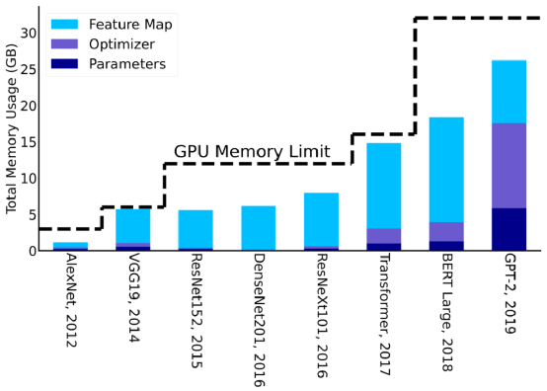
GPU memory wall

Slide 4
GPU memory wall

Slide 5
Computation Flow in DNN
…
…
Wi
: parameter
: Operator
Conv3
bConv3
A4
gA4
: Intermediate data
Ai
W3
g3
Conv2
A3
bConv2
gA3
Forward Propagation
Backward Propagation
W2
g2
Conv1
A2
bConv1
gA2
g1
A1
W1
gA1
…
…

Slide 6
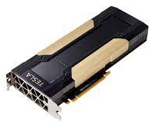
How to fit a larger model in a GPU?
…
…
Conv3
bConv3
A4
gA4
W3
g3
Conv2
A3
bConv2
gA3
W2
g2
Conv1
A2
bConv1
gA2
g1
A1
W1
gA1
…
…

Slide 7
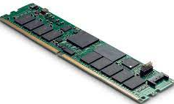
How to fit a larger model in a GPU?
…
…
Conv3
bConv3
A4
gA4
W3
g3
Conv2
A3
bConv2
gA3
W2
g2
Conv1
A2
bConv1
gA2
Swap in
Swap out
g1
A1
W1
gA1
…
…

Slide 8
SwapAdvisor’s goals
Enable the ability to train various deeper and wider DNN models on a GPU
Minimize the swapping overhead
A good swapping strategy should overlap the computation with communication
Which tensor to swap and when to swap
Different operator schedules and memory allocation result in different swap overlapping
Result:
Can train models up to 12 times the GPU memory limit
achieving 53~99% of the throughput of hypothetical baseline

Slide 9
Outline
1
Background
2
Observation and Motivation
3
Design
4
Evaluation
3
5
Conclusion

Slide 10
Swapping examples
Wi
: parameter
Memory size is 10MB;
A2 and A5 are 2MB. Others are 1MB.
It takes one unit of time to execute an operator or to transmit 1MB data between GPU and CPU.
: Operator
Concat
A5
: Intermediate data
Ai
2MB
2MB
Conv4
A4
2MB
1MB
1MB
W4
Conv1
A1
Conv3
2MB
A3
1MB
1MB
2MB
1MB
W1
W3
Conv2
A2
1MB
2MB
1MB
Left first
Right first
Data
A0
1MB
W2
Memory allocation1
Memory allocation2

Slide 11
Swapping example: the left branch first
Memory size is 10MB;
A2 and A5 are 2MB. Others are 1MB.
It takes one unit of time to execute an operator or to transmit 1MB data between GPU and CPU.
Concat
A5
Conv4
A4
A0
W1
Time Step: 1
W4
Conv1
A1
Conv3
A3
: Current Operator
W1
W3
Conv2
A2
Ai
: Tensors which are being created
Data
: Swap-out
A0
W2
: Swap-in
GPU memory
CPU memory

Slide 12
Swapping example: the left branch first
Memory size is 10MB;
A2 and A5 are 2MB. Others are 1MB.
It takes one unit of time to execute an operator or to transmit 1MB data between GPU and CPU.
Concat
A5
Conv4
A4
A0
W1
Time Step: 2
W4
Conv1
A1
Conv3
A3
A1
: Current Operator
W1
W3
Conv2
A2
W2
Ai
: Tensors which are being created
Data
: Swap-out
A0
W2
: Swap-in
GPU memory
CPU memory
Notes:
因为A0待会还要用到，所,以不会移动它

Slide 13
Swapping example: the left branch first
Memory size is 10MB;
A2 and A5 are 2MB. Others are 1MB.
It takes one unit of time to execute an operator or to transmit 1MB data between GPU and CPU.
Concat
A5
Conv4
A4
A0
A2
Time Step: 3
W4
Conv1
A1
Conv3
A3
A1
: Current Operator
W1
W3
Conv2
A2
W2
Ai
: Tensors which are being created
Data
: Swap-out
A0
W3
W2
: Swap-in
GPU memory
CPU memory

Slide 14
Swapping example: the left branch first
Memory size is 10MB;
A2 and A5 are 2MB. Others are 1MB.
It takes one unit of time to execute an operator or to transmit 1MB data between GPU and CPU.
Concat
A5
Conv4
A4
A0
A2
Time Step: 4
W4
Conv1
A1
Conv3
A3
A3
: Current Operator
W1
W3
Conv2
A2
W4
Ai
: Tensors which are being created
Data
: Swap-out
A0
W3
W2
: Swap-in
GPU memory
CPU memory

Slide 15
Swapping example: the left branch first
Memory size is 10MB;
A2 and A5 are 2MB. Others are 1MB.
It takes one unit of time to execute an operator or to transmit 1MB data between GPU and CPU.
Concat
A5
Conv4
A4
A1
A2
Time Step: 5
W4
Conv1
A1
Conv3
A3
A3
: Current Operator
W1
W3
Conv2
A2
W4
Ai
: Tensors which are being created
Data
: Swap-out
A0
A4
W2
: Swap-in
GPU memory
CPU memory

Slide 16
Swapping example: the left branch first
Memory size is 10MB;
A2 and A5 are 2MB. Others are 1MB.
It takes one unit of time to execute an operator or to transmit 1MB data between GPU and CPU.
Concat
A5
Conv4
A4
A1
A2
Time Step: 6
W4
Conv1
A1
Conv3
A3
: Current Operator
W1
W3
Conv2
A2
A5
Ai
: Tensors which are being created
Data
: Swap-out
A0
A4
W2
: Swap-in
GPU memory
CPU memory

Slide 17
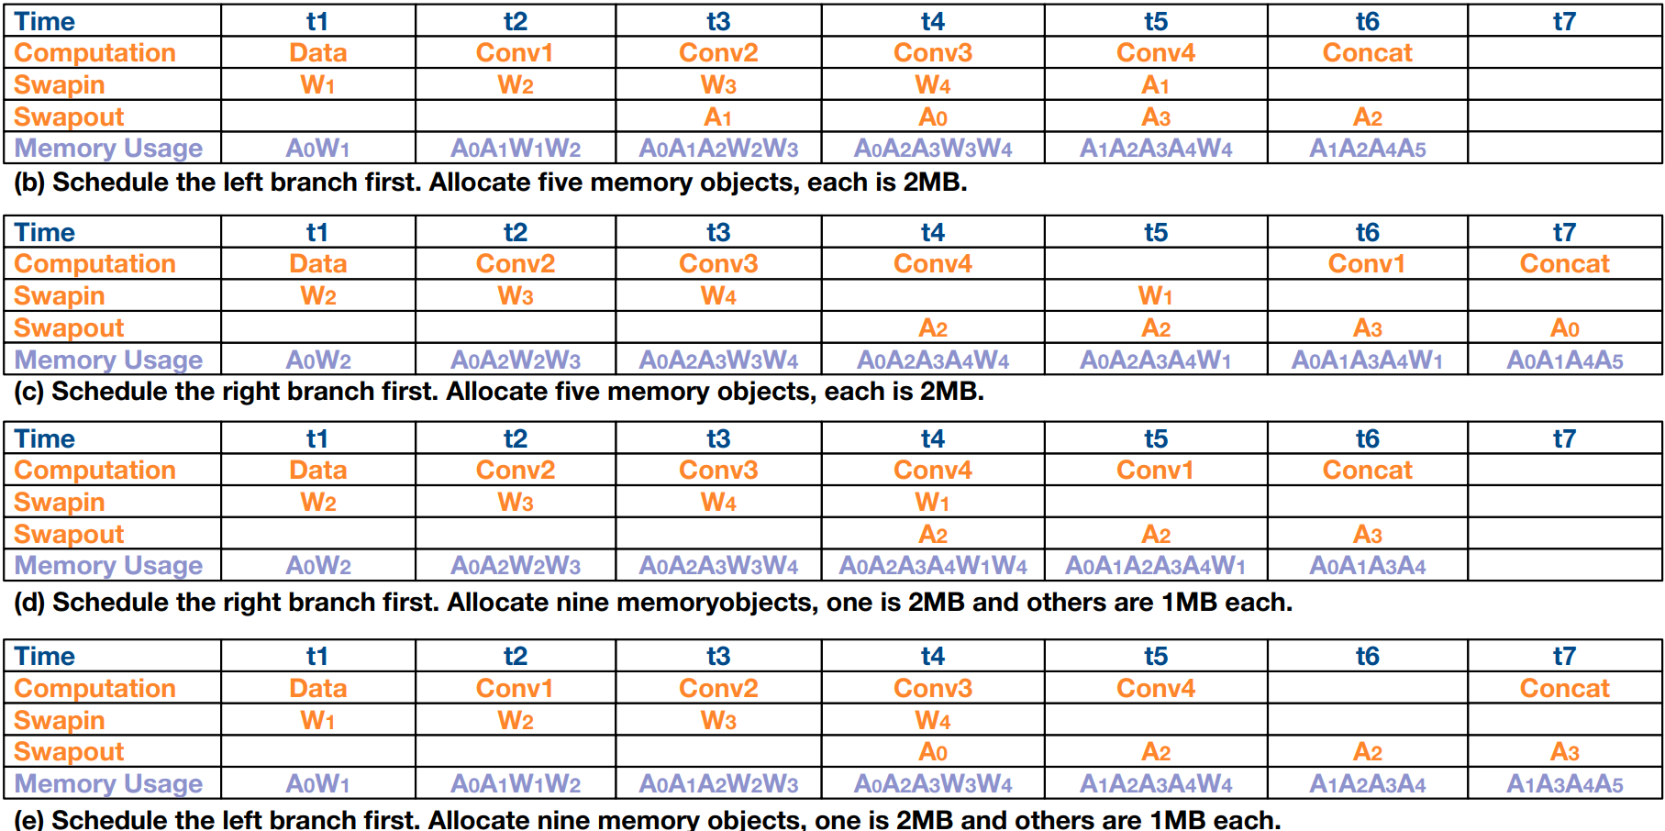
Swapping examples
(a)
(b)
(c)
(b)

Slide 18
Swapping examples
(a)
(b)
(c)
(b)

Slide 19
Swapping examples
(a)
(b)
(c)
(b)

Slide 20
Outline
1
Background
2
Observation and Motivation
3
Design
4
Evaluation
3
5
Conclusion

Slide 21
Design Overview
MXNet
(schedule1, memory allocation1)
(schedule2, memory allocation2)
(schedule3, memory allocation3)
(schedule4, memory allocation4)
(schedule5, memory allocation5)
(schedule6, memory allocation6)
Wi
: parameter
Concat
: Operator
A5
Ai
: Intermediate data
Input
Conv4
A4
Swap Planner
Conv1
W4
A1
Conv3
A3
W1
Conv2
W3
A2
Data
A0
W2
Dataflow
SwapAdvisor
GA selection
Simulator
Notes:
GA算法生成多种调度和内存分配方案
Swap planner：决定swap的方案
Simulator模拟运行得出每个方案的运行时间
最后找到最优解给到GPU去执行

Slide 22
Swap Planner: what and when
Pick the tensor that will not be used for the longest time in the future
Pick from the tensors that are most recently used at least θ time ago
Op5
Op6
Op7
Op8
…
OpX
OpY
…
OpZ
θ
…
…
A5
A6
A7
A8
A6
A5
A7
Notes:
Upon encountering memory pressure when adding a tensor of size s
A8需要去向memory pool去请求空间
原文中没有讲过这个θ是否是人为设定的，不过按我的理解，其实不应该是个固定值，它的具体值应该取决于要做swap的tensor大小

Slide 23
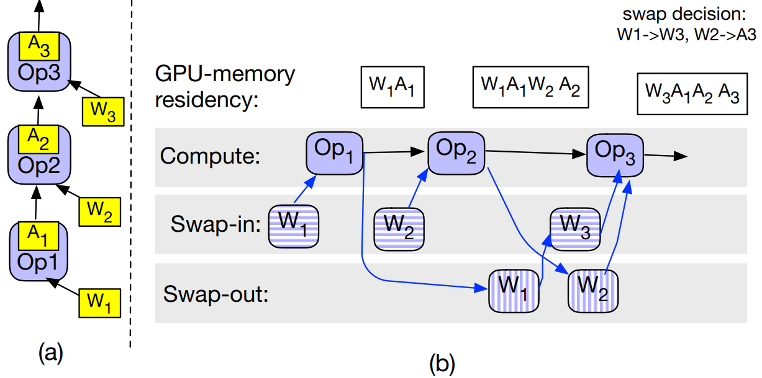
Swap Planner: what and when
Each tensor is 1MB
GPU memory: 4MB
Notes:
通过将swap in 和 out作为算子插入到流图里面，并通过加入控制流来描述执行次序
Swapadvisor在gpu中启用了三条流，流中的任务可以并行的执行，只要算子满足依赖条件，就会被放到相应的流中去执行

Slide 24
Design Overview
(schedule1, memory allocation1)
(schedule2, memory allocation2)
(schedule3, memory allocation3)
(schedule4, memory allocation4)
(schedule5, memory allocation5)
(schedule6, memory allocation6)
Wi
: parameter
Concat
: Operator
A5
Ai
: Intermediate data
Input
Conv4
A4
Swap Planner
Conv1
W4
A1
Conv3
A3
W1
Conv2
W3
A2
Data
A0
W2
Dataflow
SwapAdvisor
GA selection
Simulator
Notes:
GA算法生成多种调度和内存分配方案
Swap planner：决定swap的方案
Simulator模拟运行得出每个方案的运行时间
最后找到最优解给到GPU去执行

Slide 25
Genetic Algorithm
Chromosome(染色体)
Gene1(基因1)：scheduling
Gene2：memory allocation
Propagate(繁殖): Np chromosomes → 5*Np chromosomes
Crossover(交叉)
Mutation(变异)
Survival of the fittest: 5*Np chromosomes → Np chromosomes
Use simulator to score a chromosome
Chromosomes with higher scores are more likely to survive
Notes:
前面都好理解，怎么对染色体做交叉变异呢？

Slide 26
What is CROSSOVER
0
0
0
0
0
1
1
1
0
0
1
1
1
1
1
0
0
0
1
1
Notes:
这东西与Scheduling或者memory allocation完全不沾边；
对于Scheduling和memory allocation怎么做交叉？

Slide 27
Scheduling - Encoding
Legal Encodings:
012345
021345
023145
023415
Illegal Encodings:
012435
023451
…
Wi
: parameter
: Operator
5
A5
: Intermediate data
Ai
4
A4
W4
1
A1
3
A3
W1
W3
2
A2
0
A0
W2

Slide 28
Scheduling - Crossover
1
2
5
4
3
2
3
4
5
1
2
3
4
5
1

Slide 29
Scheduling - Crossover
1
2
5
4
3
2
3
4
5
1
2
3
4
5
1

Slide 30
Scheduling - Crossover
1
2
5
4
3
2
3
4
5
1
2
3
4
5
1
1
2
5
3
4

Slide 31
Scheduling - Mutation
Original Scheduling
9
0
1
2
3
4
5
6
7
8
9
7
8
3
4
5
6
1
2
0

Slide 32
Scheduling - Mutation
Original Scheduling
9
0
1
2
3
4
5
6
7
8
9
7
8
Mutated Scheduling
3
4
5
6
1
2
Ready
0
Picked

Slide 33
Scheduling - Mutation
Original Scheduling
9
0
1
2
3
4
5
6
7
8
9
7
8
Mutated Scheduling
0
3
4
5
6
1
2
20%的概率从[1,2]中随机选一个;
80%的概率选1
Ready
0
Picked

Slide 34
Scheduling - Mutation
Original Scheduling
9
0
1
2
3
4
5
6
7
8
9
7
8
Mutated Scheduling
0
1
3
4
5
6
1
2
20%的概率从[2,3,4]中随机选一个;
80%的概率选2
Ready
0
Picked

Slide 35
Scheduling - Mutation
Original Scheduling
9
0
1
2
3
4
5
6
7
8
9
7
8
Mutated Scheduling
0
1
4
3
4
5
6
1
2
20%的概率从[2,3]中随机选一个;
80%的概率选2
Ready
0
Picked

Slide 36
Scheduling - Mutation
Original Scheduling
9
0
1
2
3
4
5
6
7
8
9
7
8
Mutated Scheduling
0
1
4
2
3
4
5
6
1
2
20%的概率从[3,5,6]中随机选一个;
80%的概率选3
Ready
0
Picked

Slide 37
Scheduling - Mutation
Original Scheduling
9
0
1
2
3
4
5
6
7
8
9
7
8
Mutated Scheduling
0
1
4
2
3
6
5
7
8
9
3
4
5
6
1
2
Ready
0
Picked

Slide 38
Memory Allocation - Definition
Tensors in Training
Total = 1*4+2*3+3*2+4*1=20MB
GPU Memory = 12MB
Pre-allocated Tensors (B)
Pre-allocated Tensors (A)
1MB
1MB
1MB
1MB
1MB
1MB
4MB
2MB
2MB
2MB
2MB
4MB
4MB
3MB
3MB
4MB
4MB
4MB

Slide 39
Memory Allocation - Encoding
TS = [1MB, 2MB, 3MB, 4MB]
PT = [1MB, 2MB, 4MB]
CLS = [1,2,3,3]
CNT = [2,1,2]
1MB
1MB
1MB
1MB
1MB
1MB
2MB
2MB
2MB
2MB
3MB
3MB
4MB
4MB
4MB

Slide 40
Memory Allocation - Encoding
TS = [1MB, 2MB, 3MB, 4MB]
PT = [1MB, 2MB, 4MB]
CLS = [1,2,3,3]
CNT = [2,1,2]
1MB
1MB
1MB
1MB
1MB
1MB
2MB
2MB
2MB
2MB
3MB
3MB
4MB
4MB
4MB
Notes:
用CLS和CNT即可表示Memory Allocation

Slide 41
Memory Allocation - Encoding
TS = [1MB, 2MB, 3MB, 4MB]
PT = [4MB]
CLS = [1,1,1,1]
CNT = [3]
1MB
1MB
1MB
1MB
4MB
2MB
2MB
2MB
4MB
3MB
3MB
4MB
4MB

Slide 42
Memory Allocation - Crossover
(CLS₁, CNT₁)
(CLS₂, CNT₂)
(CLS_{C1}, CNT_{C1})
(CLS_{C2}, CNT_{C2})
([1,1,1,1], [4] )
([1,2,2,2], [8,1])
(???, ???)
(???, ???)

Slide 43
CLS - Crossover
1
1
1
1
1
2
1
1
1
2
2
2
repair
1
2
2
2
1
1
2
2
1
1
2
2

Slide 44
CNT - Crossover
8*1+3*4=20 ( > 12)
4
4
4
4
4
8
1
4
4
8
3
4
2
extend
average
repair
8
1
8
1
1
1
4
4
1
1
4
1
4
1
Extend： 结合原来的CLS
Average：结合交叉后的CLS
Notes:
这个我觉得是硬凑的一个方法，

Slide 45
CLS - Mutation
1
3
2
Mutate with Probability = 20%
mutate
repair
1
2
2
3
1
1
3
2
1
1
2
2
Maintain with Probability = 80%
2
2
3

Slide 46
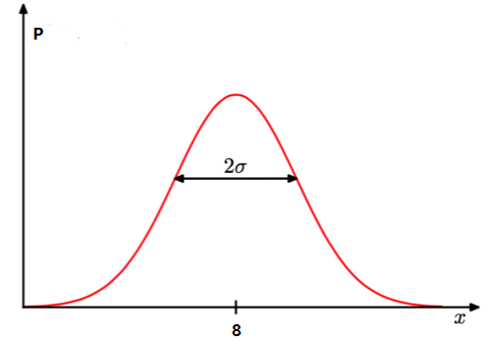
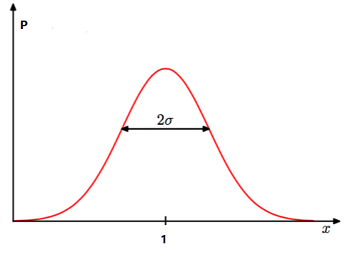
CNT - Mutation
mutate
repair
8
1
9
1
8
1

Slide 47
Outline
1
Background
2
Observation and Motivation
3
Design
4
Evaluation
3
5
Conclusion

Slide 48
Evaluation
Training throughput
Ideal
SwapAdvisor
ODSwap
TFLMS
Inference
Lower down memory consumption
Inference more models in one GPU
Scheduling or Mem alloc?
Genetic Algorithm
Simulator Accuracy

Slide 49
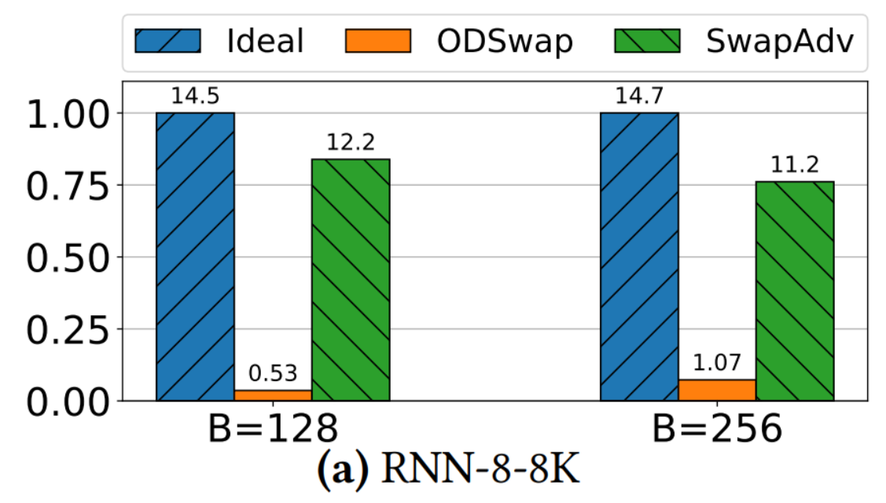
Training Throughput
Ideal: Replace without swap
ODSwap: LRU strategy
SwapAdv

Slide 50
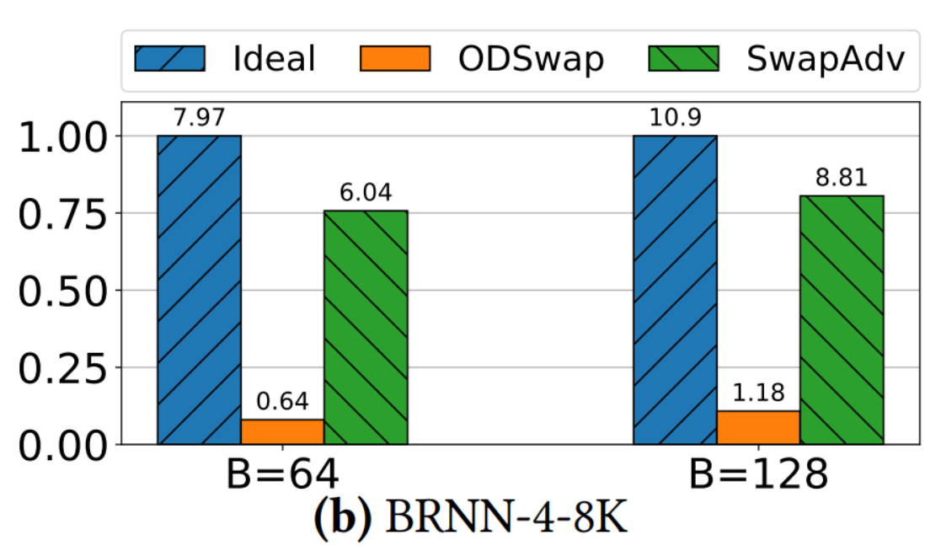
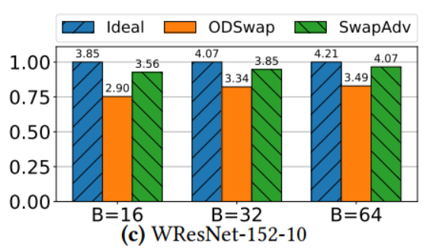
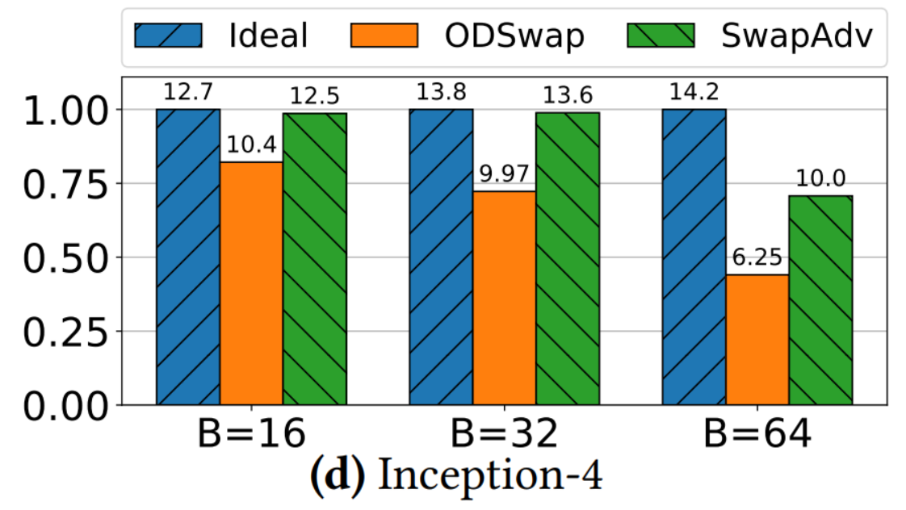
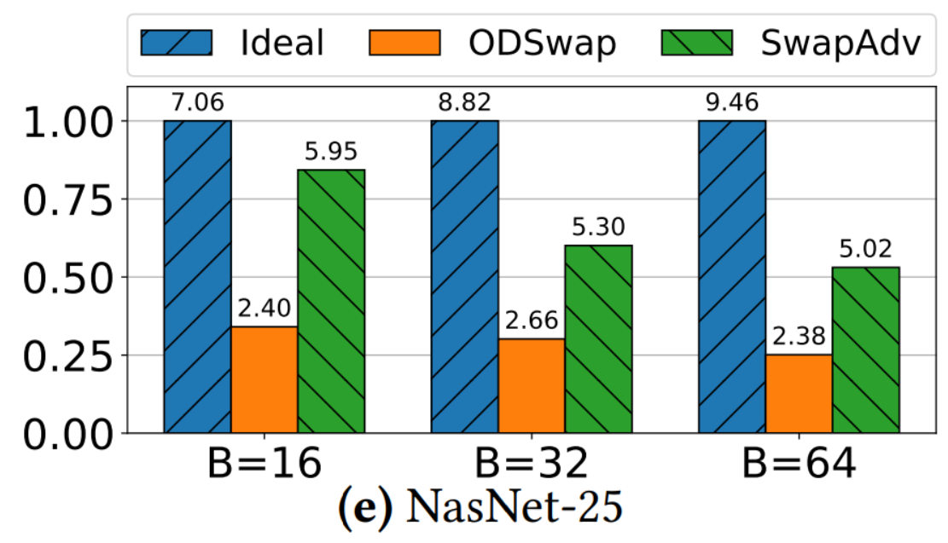
Training Throughput
Ideal: Replace without swap
ODSwap: LRU strategy
SwapAdv

Slide 51
Training Throughput
Ideal: Replace without swap
ODSwap: LRU strategy
SwapAdv
RNN模型中ODSwap性能很差，SwapAdvisor能达到理想的70%~80%性能
WResNet因为网络简单，所以ODSwap也能有很好的性能
Inception-4与NasNet在Batchsize增加时，SwapAdvisor性能下降明显（有限的空间存更多的数据）

Slide 52
Training Throughput
Ideal: Replace without swap
ODSwap: LRU strategy
SwapAdv
RNN模型中ODSwap性能很差，SwapAdvisor能达到理想的70%~80%性能
WResNet因为网络简单，所以ODSwap也能有很好的性能
Inception-4与NasNet在Batchsize增加时，SwapAdvisor性能下降明显（有限的空间存更多的数据）

Slide 53
Training Throughput
Ideal: Replace without swap
ODSwap: LRU strategy
SwapAdv
RNN模型中ODSwap性能很差，SwapAdvisor能达到理想的70%~80%性能
WResNet因为网络简单，所以ODSwap也能有很好的性能
Inception-4与NasNet在Batchsize增加时，SwapAdvisor性能下降明显（有限的空间存更多的数据）

Slide 54
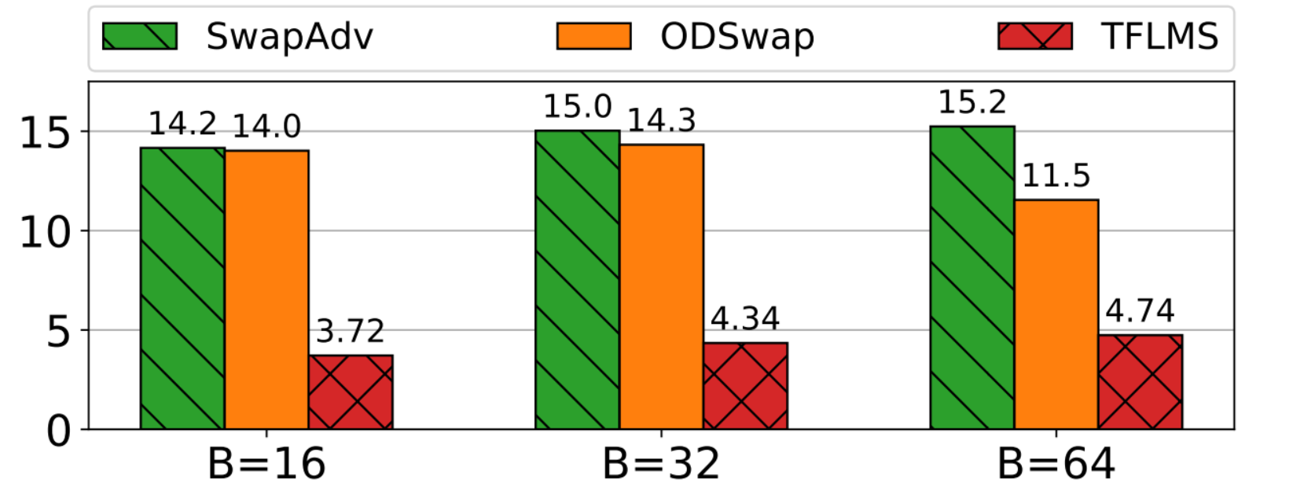
Training Throughput
SwapAdv
ODSwap: LRU strategy
TFLMS: Swap activations only
Model: WResNet-152-4
TFLMS表现很差：WResNet中Parameters很多，但是TFLMS仅支持交换Activations

Slide 55
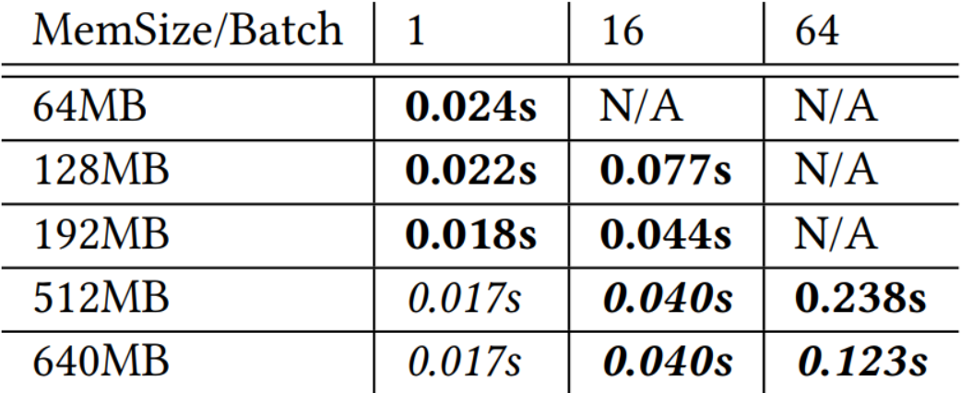
Inference – Lower Memsize
Bold: Enable SwapAdvisor
Italic: < 1% performance diff
Model: ResNet-152
Dramatically reduce memsize when batchsize = 1.
Increase batchsize with limited memsize (with negligible performance loss)

Slide 56
Inference – Lower Memsize
Bold: Enable SwapAdvisor
Italic: < 1% performance diff
Model: ResNet-152
Dramatically reduce memsize when batchsize = 1.
Increase batchsize with limited memsize (with negligible performance loss)

Slide 57
Inference – Lower Memsize
Bold: Enable SwapAdvisor
Italic: < 1% performance diff
Model: ResNet-152
Dramatically reduce memsize when batchsize = 1.
Increase batchsize with limited memsize (with negligible performance loss)

Slide 58
Inference – Lower Memsize
Bold: Enable SwapAdvisor
Italic: < 1% performance diff
Model: ResNet-152
Dramatically reduce memsize when batchsize = 1.
Increase batchsize with limited memsize (with negligible performance loss)

Slide 59
Inference – More Models in 1 GPU
Skipped due to bad experiment design

Slide 60
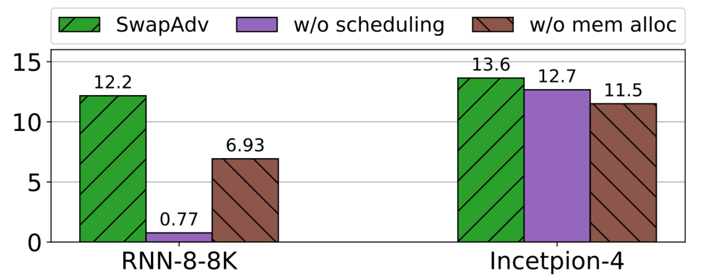
Scheduling or mem alloc?

Slide 61
Scheduling or mem alloc?
Combining scheduling and mem alloc achieves best performance
The effectiveness of scheduling and mem alloc varies from model to model

Slide 62
Scheduling or mem alloc?
Combining scheduling and mem alloc achieves best performance
The effectiveness of scheduling and mem alloc varies from model to model

Slide 63
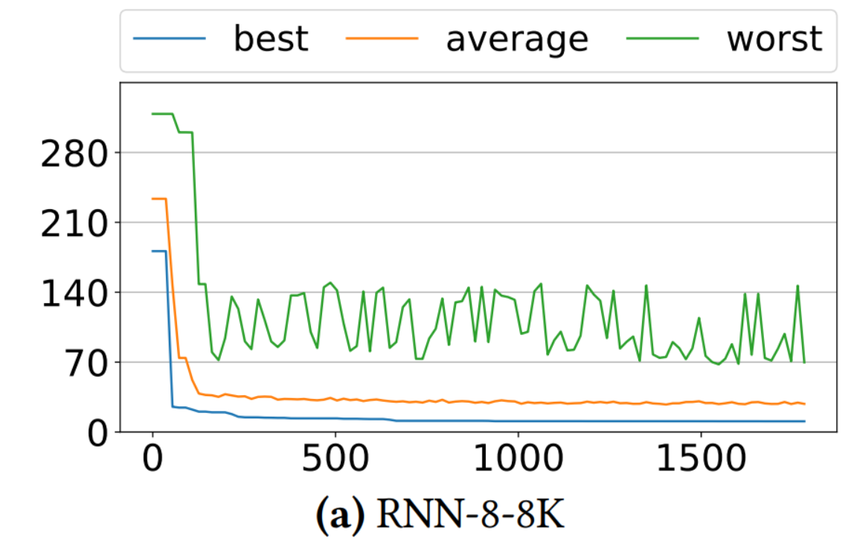
Genetic Algorithm
X: Searching time
Y: Training time per iteration(lower is better)

Slide 64
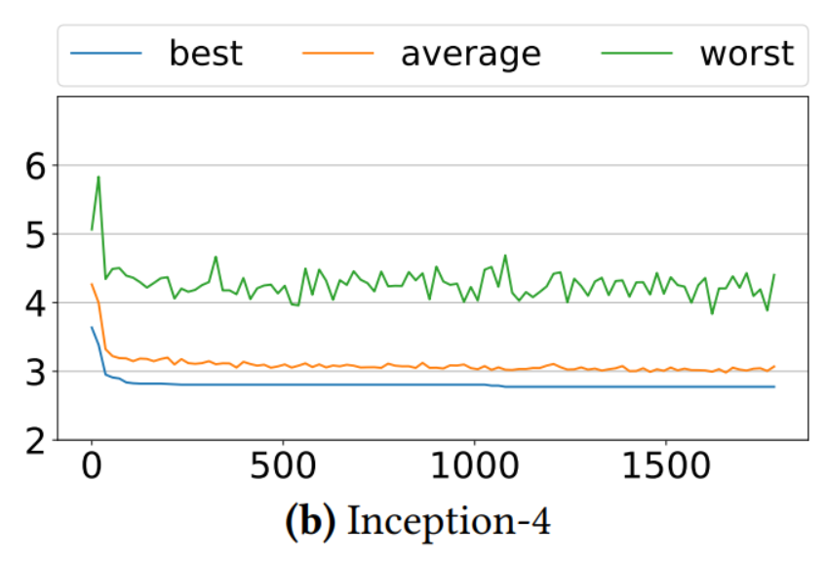
Genetic Algorithm
X: Searching time
Y: Training time per iteration(lower is better)
Converge in 100 seconds
Diversity remains

Slide 65
Genetic Algorithm
X: Searching time
Y: Training time per iteration(lower is better)
Converge in 100 seconds
Diversity remains

Slide 66
Genetic Algorithm
X: Searching time
Y: Training time per iteration(lower is better)
Converge in 100 seconds
Diversity remains

Slide 67
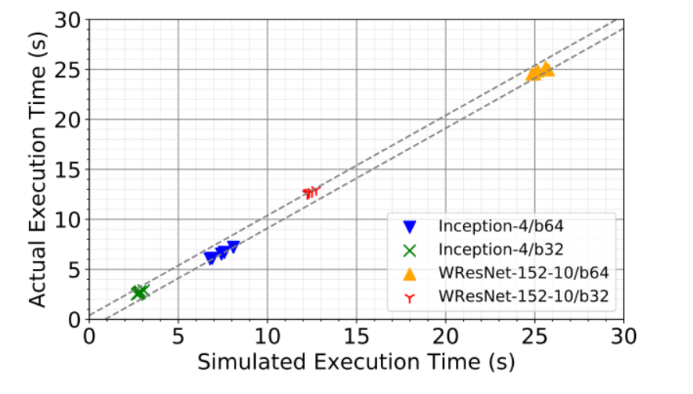
Simulator Accuracy
High accuracy ( -4% ~ 12% error)
Not open-sourced

Slide 68
Outline
1
Background
2
Observation and Motivation
3
Design
4
Evaluation
3
5
Conclusion

Slide 69
Conclusions
Contributions
Optimize from 3 dimensions: Scheduling, Memory Allocation and Swap Decisions
Larger model / Lower memsize
High performance(53%~99% of ideal throughput)
Limitations
Dynamic graph not supported
Model Parallel not supported
Dynamic allocator not supported
Simulator not open sourced

Slide 70
THANK YOU

