Slide 1
Distributed Systems
Lecture 4 – Replication
Cheng Li

Slide 2
Outline
Two casestudy applications
GFS
MapReduce
Replicated state machine
Primary-backup replication
Chain replication

Slide 3
Google File System (GFS, SOSP’03)
Google needs to store
search indexes
all the HTML files on the web
all the images on the web
Map/reduce uses GFS for input/output
...

Slide 4
Google File System (GFS, SOSP’03)
GFS Goal:
Create a shared file system
Files are huge – multi-GB
Most files are modified by appending at the end
Random writes (and overwrites) are practically non-existent
Place more priority on processing data in bulk
High aggregate performance (huge storage, huge throughput) is more important than low latency

Slide 5
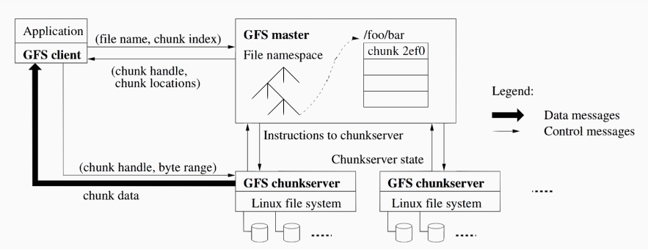
GFS overall architecture
Notes:
How GFS works at a high level? [draw picture] client read: send file name and offset to master master replies with chunk_handle + location (i.e. set of servers storing that chunk) clients cache that information for a little while read from nearest chunk server client write: ask master where to store, master returns chunk_handle + location. send writes to the 3 chunk servers. need to ask master again whenever crossing 64 MB

Slide 6
How does this achieve GFS' goal?
high performance: single master design is sufficient because of GFS' workloads:
Files are huge:
Multi-terabyte data sets
Many of the files are large: 100MB~several GB
Mostly large sequential reads/writes
Workload GFS is not good for?
tons of small file operations
(git, compile large source tree)

Slide 7
Influences
GFS -> HDFS -> CephFS
Widely deployed

Slide 8
Fault tolerance problems
Failures are common (built from inexpensive commodity components)
Master manages metadata
It would lead to the whole GFS crash and data inconsistencies, if it went down.
Chunk servers manage data
It would lead to data loss when failures occur.
How to solve?

Slide 9
Outline
Two casestudy applications
GFS
MapReduce
Replicated state machine
Primary-backup replication
Chain replication

Slide 10
Example scenario
Genome data from over 10 million users
~100 MB of data per user
Goal: Analyze data to identify genes that show susceptibility to Parkinson’s disease

Slide 11
Other Example Scenarios
Ranking web pages
~100 trillion web pages
Selecting ads to show
Clickstreams of over two billion users

Slide 12
Lots of Data!
Petabytes or even exabytes of data
Impossible to store data on one server
Will take forever to process on one server
Need distributed storage and processing

Slide 13
Desirable Properties
Scalable
Performance grows with # of machines
Fault-tolerant
Can make progress despite machine failures
Simple
Minimize expertise required of programmer
Widely applicable
Should not restrict kinds of processing feasible

Slide 14
MapReduce
Distributed data processing paradigm
introduced by Google (OSDI, 2004)
Popularized by open-source Hadoop framework
MapReduce represents
A programming interface for data processing jobs
Map and Reduce functions
A distributed execution framework
Scalable and fault-tolerant

Slide 15
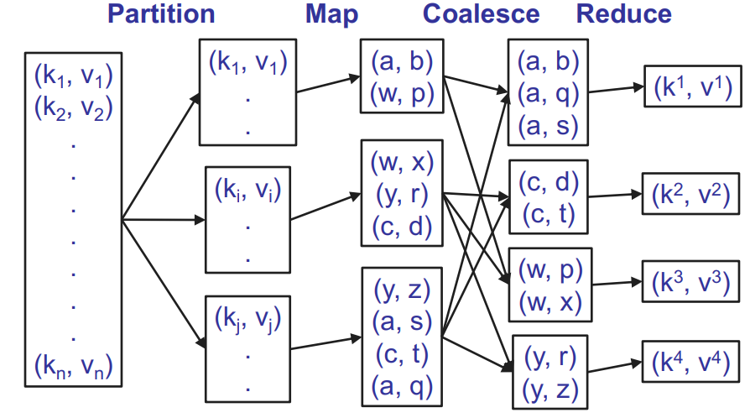
MapReduce Execution

Slide 16
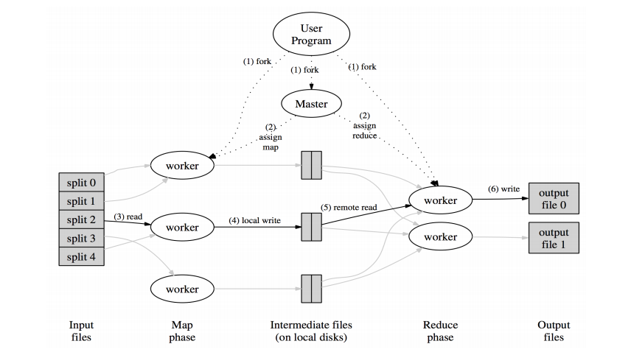
MapReduce overall architecture

Slide 17
Handling Failures
Hearbeats between master and workers (either mapper or reducer) to detect failures
Re-assign and resume the failed jobs
But, if Master fails, can we start up a new Master and resume execution of job?
No!
Lost all state about execution status of tasks
Must replicate Master state to tolerate failures

Slide 18
Outline
Two casestudy applications
GFS
MapReduce
Replicated state machine
Primary-backup replication
Chain replication

Slide 19
Fault tolerance
We'd like a service that continues despite failures
Some ideal properties:
available: still useable despite [some class of] failures
strongly consistent: looks just like a single server to clients
transparent to clients
transparent to server software
efficient

Slide 20
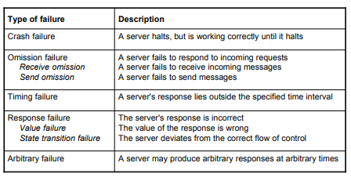
Failure models
Different type of failures

Slide 21
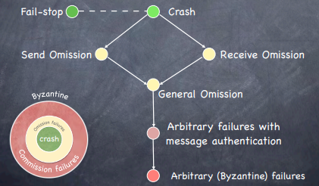
A hierarchy of failure models

Slide 22
What failures will we try to cope with?
Fail-stop failures (crash failures)
Independent failures
Network drops some/all packets
Network partition

Slide 23
But not for
Incorrect execution
Correlated failures
Configuration errors
Malice

Slide 24
Replication in space
Run parallel copies of a unit
Vote on replica output
Failures are masked
High availability, but at high cost

Slide 25
Replicated state machine
All replicas execute all operations
If same start state, same operations, same order, deterministic, then same end state

Slide 26
Non-determinism
An event is non-deterministic if the state that it produces is not uniquely determined by the state in which it is executed
Handling non-deterministic events at different replicas is challenging
It requires to reproduce during recovery the original outcome of all non-deterministic events.
It requires each replica to handle non-deterministic events identically.

Slide 27
The Solution – Replicated State Machine
Source: F.B. Schneider The State Machine Approach SIGOPS Hall of Fame
http://www.cs.utexas.edu/~lorenzo/corsi/cs380d/papers/statemachines.pdf

Slide 28
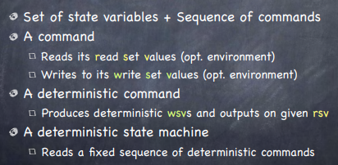
State Machines

Slide 29
Replica Coordination (RC)

Slide 30
Outline
Two casestudy applications
GFS
MapReduce
Replicated state machine
Primary-backup replication
Chain replication

Slide 31
Primary-backup replication
Clients communicate with a single replica (primary)
Primary:
sequences clients’ requests
updates as needed other replicas (backups) with sequence of client requests or state updates
waits for acks from all non-faulty clients
Backups use timeouts to detect failure of primary
On primary failure, a backup is elected as new primary

Slide 32
Challenges
Non-deterministic operations
Dropped messages
State transfer between primary and backup
Write log? Write state?
There can be only one primary at a time
Clients, primary and backup need to agree

Slide 33
Avoiding non-determinism
Non-deterministic commands executed only at the primary
Backups receive either
state updates (non-determinism?)
command sequence (non-determinism?)

Slide 34
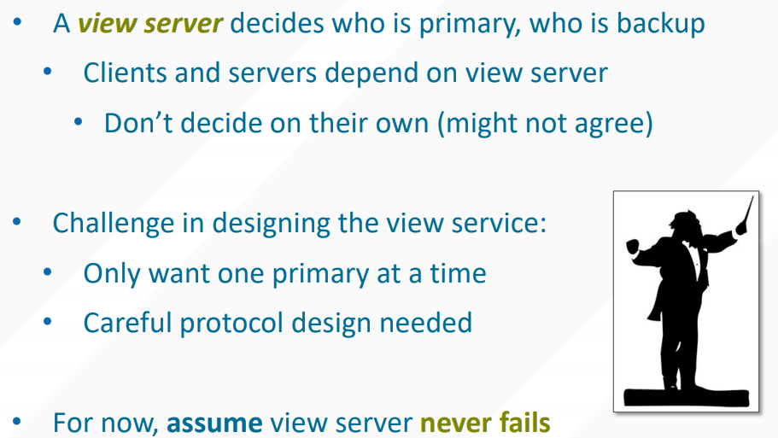
View server

Slide 35
Views
A view is a statement about the current roles in the system
View = (view #, primary server, backup server)
Views form a sequence in time

Slide 36
Monitoring server liveness
Liveness: good thing will eventually happen
Each replica periodically pings the view server
View server declares replica dead if it missed N pings in a row
Considers the replica alive after a single ping
Can a replica be alive but declared “dead” by view server?
Yes, in the case of network failure or partition

Slide 37
Managing servers
Any number of servers can send Pings
If more than two servers are live, extras are “idle”
Idle servers can be promoted to backup
If primary dies
New view with old backup as primary, idle as backup
If backup dies
New view with idle server as backup
OK to have a view with a primary and no backup
But can lead to getting stuck later

Slide 38
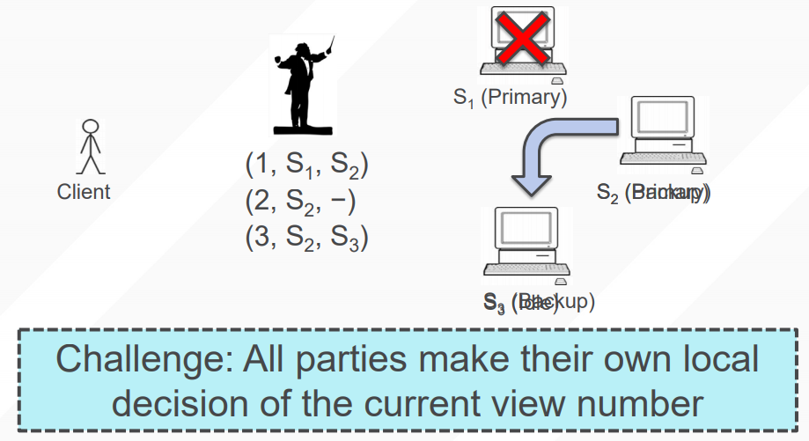
View server decides the current view

Slide 39
View related rules
Primary in view i+1 must have been backup or primary in view i
Primary must wait for backup to accept/execute each op before doing op and replying to client
Backup must accept forwarded requests only if view is correct
Non-primary must reject client requests
Every operation must be before or after state transfer
New backup learns from others about the previous states.

Slide 40
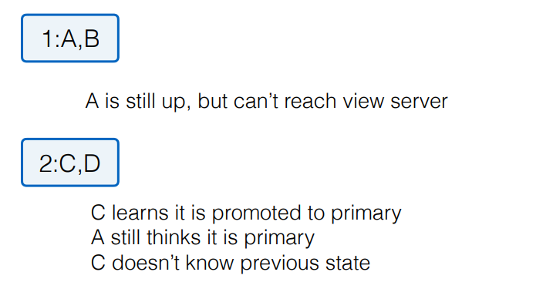
Incomplete state
Impossible by Rule 1 that Primary in view i+1 must have been backup or primary in view i

Slide 41
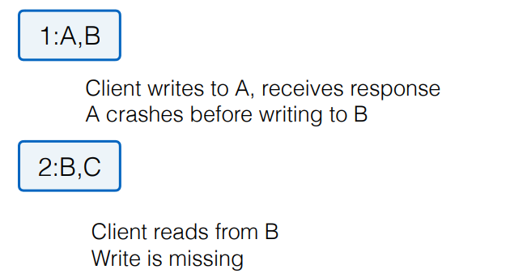
Missing writes
Impossible by Rule 2 that Primary must wait for backup to accept/execute each op before doing op and replying to client

Slide 42
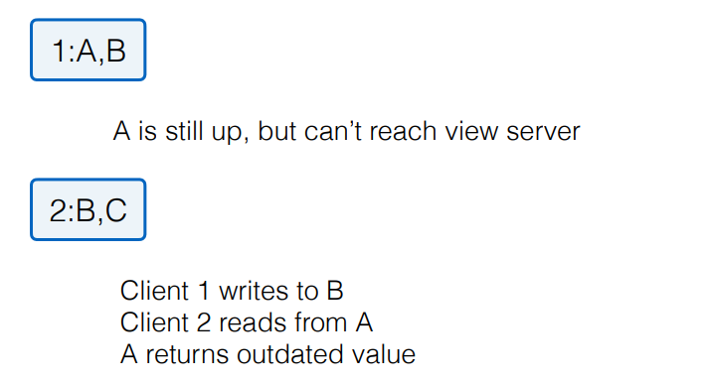
Stale reads
Possible due to optimization

Slide 43
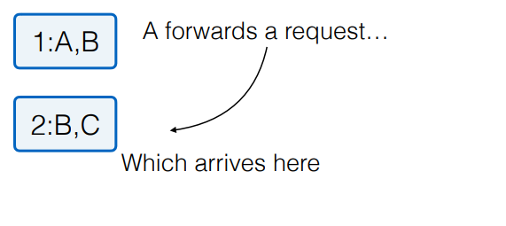
Partially split brain
Impossible by Rule 3 that Backup must accept forwarded requests only if view is correct

Slide 44
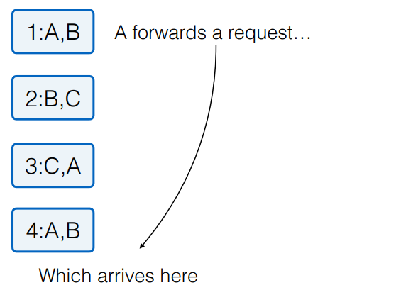
Old messages
Impossible by Rule 3 that Backup must accept forwarded requests only if view is correct

Slide 45
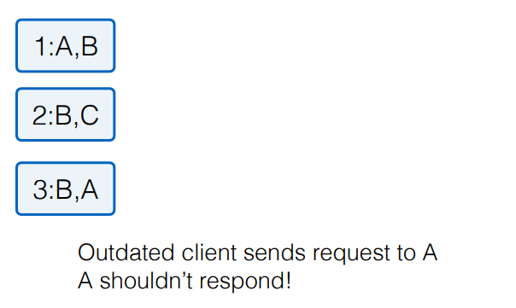
Inconsistencies
Impossible by Rule 4 that Non-primary must reject client requests

Slide 46
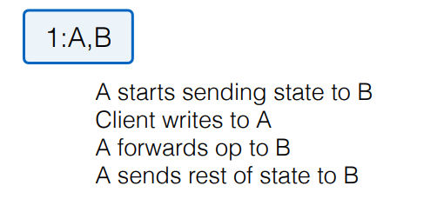
Inconsistencies
Impossible by Rule 5 that Every operation must be before or after state transfer

Slide 47
State transfer via operation log
How does a new backup get the current state?
If B is backup in view i but was not in view i−1
B asks primary to transfer the state
One alternative: transfer the entire operation log
Simple but inefficient since the log can be long

Slide 48
State transfer via snapshot
Every op must be either before or after state transfer
If op before transfer, transfer must reflect op
If op after transfer, primary forwards the op to the backup after the state transfer finishes

Slide 49
Progress
Are there cases when the system can’t make further progress (i.e. process new client requests)?
View server fails
Network fails entirely (hard to get around this one)
Client can’t reach primary but it can ping VS
- Primary fails before completing state transfer

Slide 50
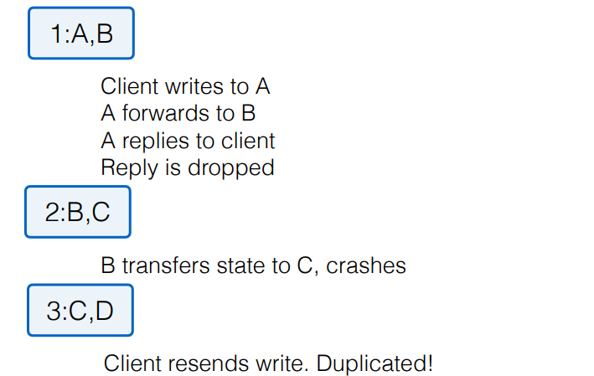
Duplicate writes

Slide 51
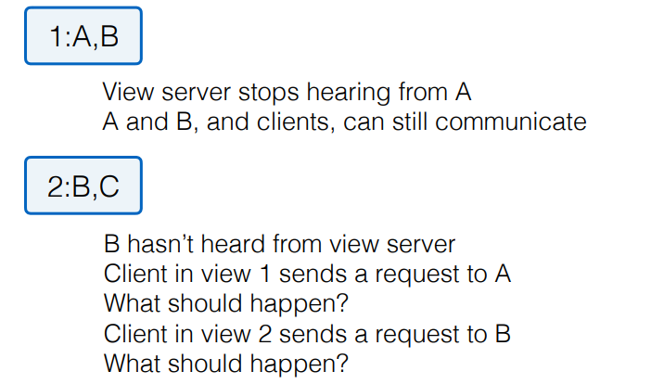
One more corner case

Slide 52
Outline
Two casestudy applications
GFS
MapReduce
Replicated state machine
Primary-backup replication
Case study: VMWare’s fault-tolerant virtual machine
Scales et al., SIGOPS Operating Systems Review 44(4), Dec. 2010
another prior work:
http://www.cs.utexas.edu/~lorenzo/corsi/cs380d/papers/p80-bressoud.pdf

Slide 53
At what level to define a replicated state machine?
K/V put and get?
"application-level" RSM
usually requires server and client modifications
can be efficient; primary only sends high-level operations to backup
x86 instructions?
might allow us to replicate any existing server w/o modification!
but requires much more detailed primary/backup synchronization
and we have to deal with interrupts, DMA, weird x86 instructions

Slide 54
VMware vSphere Fault Tolerance (VM-FT)
Very ambitious system:
Goal: fault-tolerance for existing server software
Goal: clients should not notice a failure
Goal: no changes required to client or server software

Slide 55
Overview
hypervisor == monitor == VMM (virtual machine monitor)
app and O/S are "guest" running inside a virtual machine

Slide 56
Sources of divergence
Many instructions are guaranteed to execute exactly the same on primary and backup.
As long as memory+registers are identical, which we're assuming by induction.
When might execution on primary differ from backup?
Inputs from external world (the network).
Data read from storage server.
Timing of interrupts.
Instructions that aren't pure functions of state, such as cycle counter.
Races.

Slide 57
Deterministic Replay
Key idea: state of VM depends only on its input
Content of all input/output
Precise instruction of every interrupt
Only a few exceptions (e.g., timestamp instruction)
Record all hardware events into a log
Modern processors have instruction counters and can interrupt after (precisely) x instructions
Trap and emulate any non-deterministic instructions

Slide 58
Outline
Two casestudy applications
GFS
MapReduce
Replicated state machine
Primary-backup replication
Chain replication

Slide 59
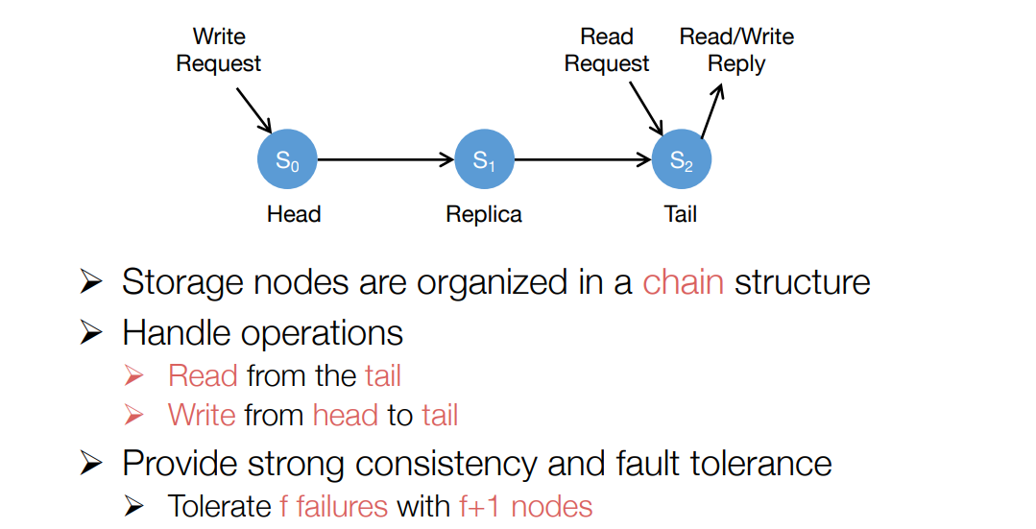
Chain replication (Renesse, OSDI’04)
Chain replication is also
a primary-backup solution.

Slide 60
Chain Replication
Node State:
Hist[i] = list of updates processed by node ‘i’
Sent[i] = updates seen by ‘i’ but not ACKed
System state:
Pending = requests seen by any node but not yet processed by TAIL
Hist = Hist[TAIL]

Slide 61
Chain Replication
Invariants:
Hist[i] >= Hist[i+1]
(Update Invariant)
Hist[i] = Hist[i+1] + Sent[i]
(In-process Requests Invariant)

Slide 62
Chain Replication
Dealing with Failure
“Single” master (similar to view server)
AKA Zookeeper
Detects failed nodes
Reconfigures the chain (View changes)
Points clients to HEAD and TAIL

Slide 63
Chain Replication
Transitions:
T1: Client request ‘r’ arrives
Pending[objId] += r
T2: Client request ‘r’ ignored
Pending[objId] -= r
T3: Client request processed
Pending[objId] -= r
if (update) Hist[objId] += r

Slide 64
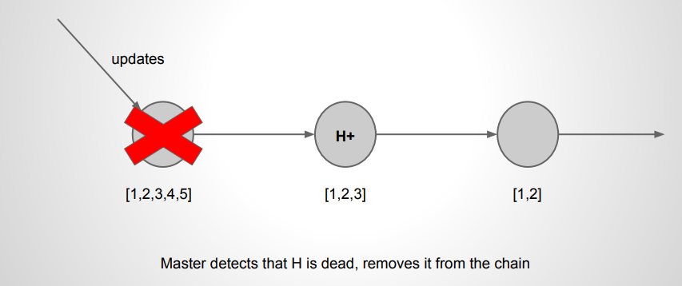
Chain Replication - Failure of HEAD

Slide 65
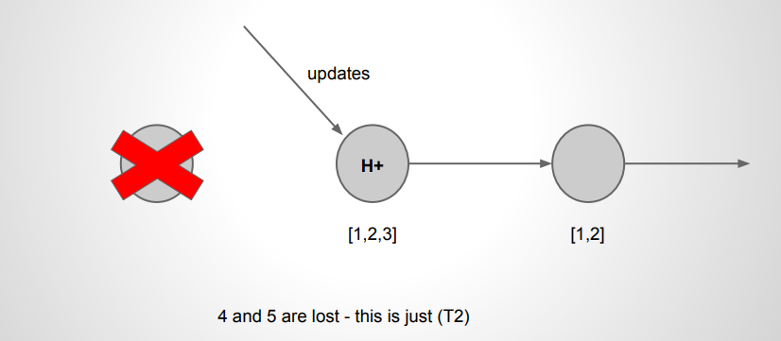
Chain Replication - Failure of HEAD

Slide 66
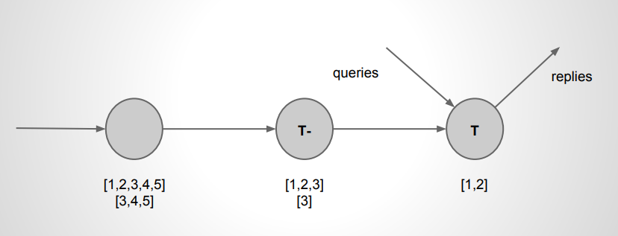
Chain Replication - Failure of TAIL

Slide 67
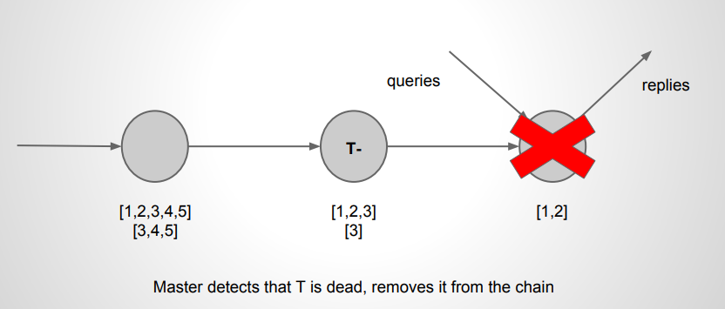
Chain Replication - Failure of TAIL

Slide 68
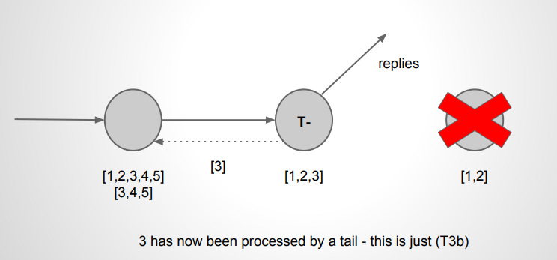
Chain Replication - Failure of TAIL

Slide 69
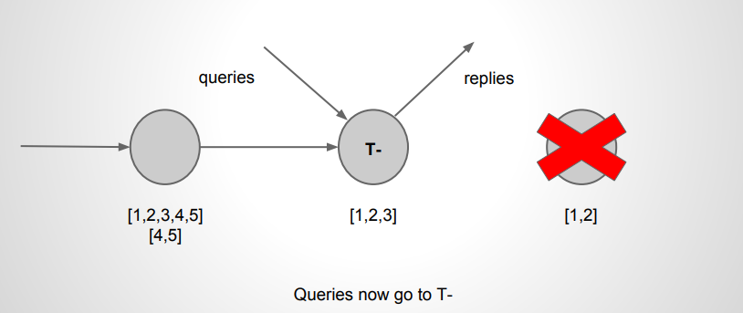
Chain Replication - Failure of TAIL

Slide 70
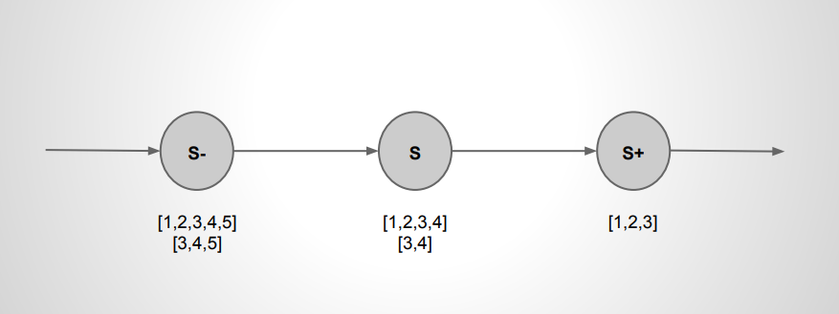
Chain Replication - Failure of Interior

Slide 71
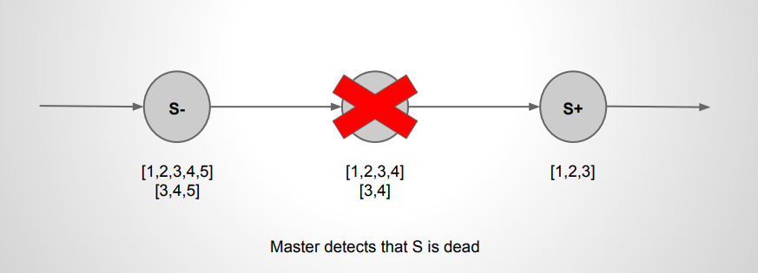
Chain Replication - Failure of Interior

Slide 72
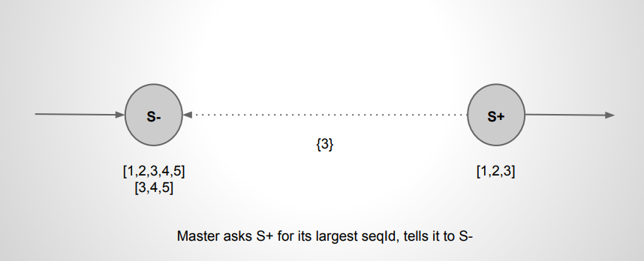
Chain Replication - Failure of Interior

Slide 73
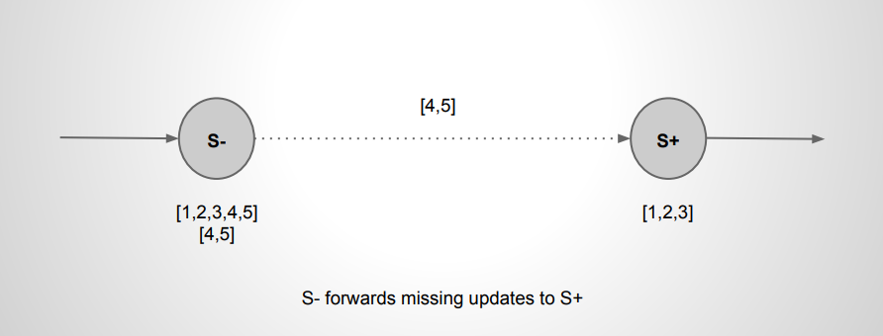
Chain Replication - Failure of Interior

Slide 74
Chain Replication - Failure of Interior

Slide 75
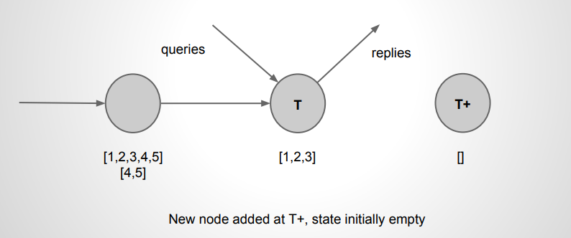
Chain Replication - Extending

Slide 76
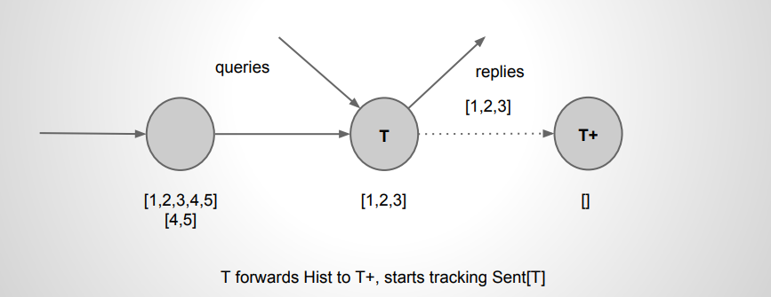
Chain Replication - Extending

Slide 77
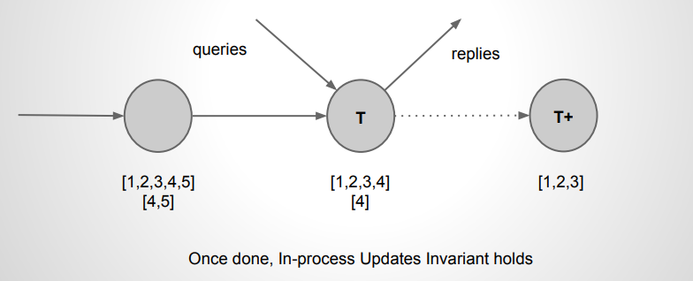
Chain Replication - Extending

Slide 78
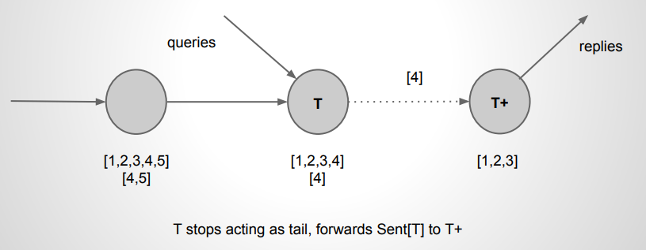
Chain Replication - Extending

Slide 79
Follow-up works
Object storage on CRAQ: High-throughput chain replication for read-mostly workloads (ATC 2009)
ChainReaction: a Causal+ Consistent Datastore based on Chain Replication (EuroSys 2013)
NetChain: Scale-Free Sub-RTT Coordination (NSDI 2018)
HyperLoop: Group-Based NIC-Offloading to Accelerate Replicated Transactions in Multi-Tenant Storage Systems (SIGCOMM 2018)

Slide 80
Homework
Please fine the real world case study applications that use either P/B or Chain replication protocols.
Please find the differences between P/B and Chain Replication!

Slide 81
Distributed Systems
Lecture 4 – Replication
Q & A!

