Slide 1
Effectively Prefetching Remote Memory with Leap
Kai Ma and Hao Wu
Nov. 4th, 2020

Slide 2
Contents
Background
Motivation
Goals
Design
Evaluation
Conclusion
Kai Ma
Hao Wu

Slide 3
Background
Memory-Intensive Applications

Slide 4
Background
Memory-Intensive Applications
Wow!
So many!!!
Notes:
但是，这些程序在低内存的情况下工作得很差

Slide 5
Background
Memory-Intensive Applications
Wow!
So many!!!
But...

Slide 6
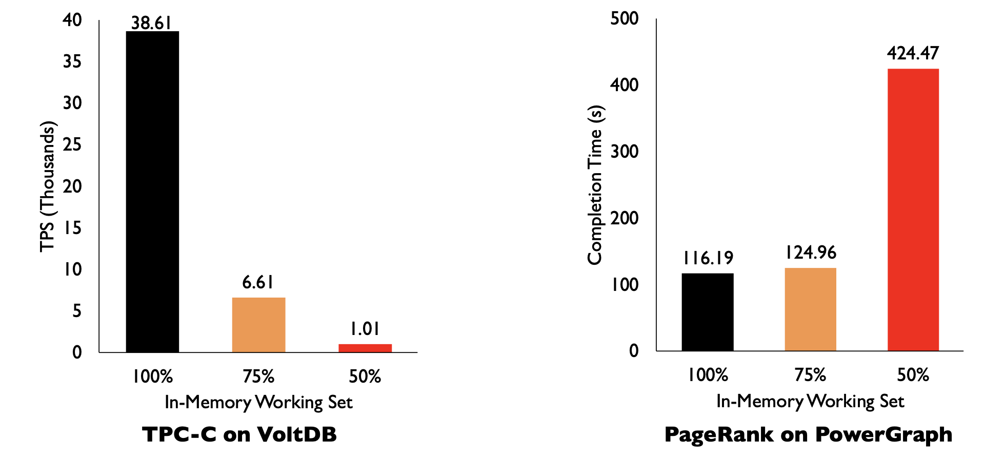
Background
Applications run terribly when memory is low
Performance degradation is disproportional
Figure Credit: Hasan Al Maruf

Slide 7
Background
Memory balance is often ununiform
An observation
Network getting faster
Disk getting (relatively) slower

Slide 8
Background
Memory Disaggregation
Machine 1
Network
Machine 2
Machine 3

Slide 9
Background
Memory Disaggregation
Machine 1
Network
Machine 2
Machine 3

Slide 10
Background
Memory Disaggregation
Machine 1
Network
Machine 2
Machine 3

Slide 11
Background
Memory Disaggregation
Use RDMA primitives directly
Based on abstractions like Virtual Memory^{[1]}, Files I/O^{[2]}, etc.
[1] E.g., Infiniswap (Juncheng Gu, et al. USENIX NSDI’17)
[2] E.g., Remote regions (Marcos K. Aguilera, et al. USENIX ATC’18)

Slide 12
Motivation
Conventional Wisdom
What does Linux say?
Linux Paging
... and it’s fetcher
... and its defects
Strict prefetch algorithms
and why they are bad

Slide 13
Conventional Wisdom
Prefetch to Hide High Latencies
CPU
Local Page Access: 100 ns
RAM
Network
Disk

Slide 14
Conventional Wisdom
Prefetch to Hide High Latencies
CPU
Local Page Access: 100 ns
Remote Page Access: 4 us! (40x)
Preferably, memory access latency < 3 us^{[1]}
RAM
Network
Disk
[1] P. X. Gao et al. “Network requirements for resource disaggregation” OSDI’16.

Slide 15
Conventional Wisdom
Prefetch to Hide High Latencies
CPU
Local Page Access: 100 ns
Remote Page Access: 4 us! (40x)
Preferably, memory access latency < 3 us^{[1]}
Can we really achieve 4us latency?
RAM
Network
Disk
[1] P. X. Gao et al. “Network requirements for resource disaggregation” OSDI’16.

Slide 16
Paging in Linux
Process 1
Process 2
Process 3
User Space
Page fault
Done!
0.27us
MMU
Cache hit
Page Cache
Kernel Space
2.1us
Cache miss
10.04 us
Device Mapping Layer
Generic Block Layer
Queueing, batching, dispatching...
21.88us
Block Device Driver
4.3us
Remote Memory

Slide 17
Paging in Linux
Severely Disk-oriented
Page Prefetching
Optimized for sequential disk I/O
Only consider the last two page faults (to increase sequential I/O opportunity)
Process-unaware
Severe defects!

Slide 18
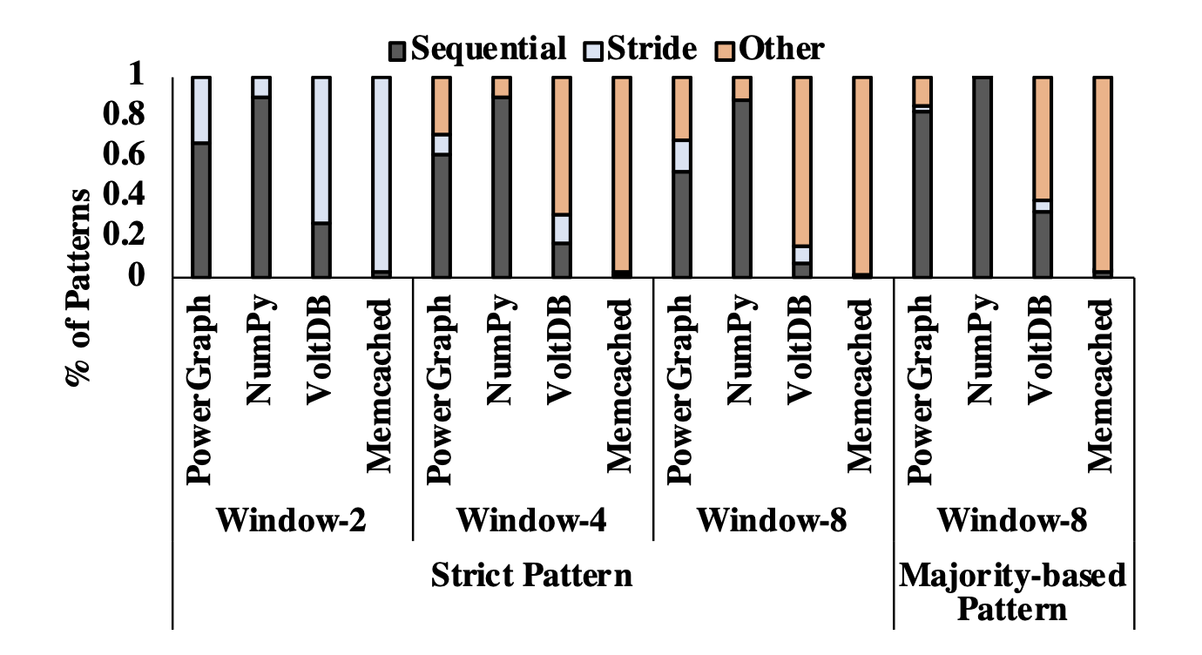
Consider more pages?
Credit: Hasan Al Maruf, et al.

Slide 19
Strict Prefetching
Aggressive
high cache pollution
more bandwidth
overhead of prefetching
Conservative
low cache hit rate

Slide 20
Think “Approximate”
Credit: Hasan Al Maruf, et al.

Slide 21
Summing up
Memory-intensive apps
Memory low
has
High Latency
Paging
Remote memory
to
negatively affects
does too much unnecessary work for
Disk
Data Path
optimized for
has
optimized for
High Latency
Prefetch
solution

Slide 22
What if...
Process 1
Process 2
Process 3
User Space
Page fault
Done!
0.27us
MMU
Cache hit
Page Cache
Kernel Space
2.1us
Cache miss
10.04 us
Device Mapping Layer
Generic Block Layer
Queueing, batching, dispatching...
21.88us
Block Device Driver
4.3us
Remote Memory

Slide 23
Summing up
Memory-intensive apps
Memory low
to
has
High Latency
Paging
Remote memory
to
optimized for
solution
Disk
Data Path
Something new?
has
optimized for
High Latency
Prefetch
solution

Slide 24
Design Goals
Ultimate Goal: Lower Latency
Data path overheads must be eliminated
A new data path
Higher cache hit rate
A new prefetch algorithm that is not strict
Lower cache eviction overhead
A new cache management policy

Slide 25
Design
System Design
Page Access Tracker
Prefetcher
Eager Cache Eviction
Prefetch Algorithm
Trend Detection
Prefetch Candidate Generation
Page Access Tracker
(Process-aware)
Prefetcher
Trend
Candidate
Eager Cache Eviction

Slide 26
System Design
VFS
VFS cache
MMU
Page cache
Page Access Tracker
(Process-aware)
Prefetcher
Trend
Candidate
Eager Cache Eviction
Leap
Remote Memory

Slide 27
Eager Cache Eviction
How LRU cache works
Cache full
Find the victim by scanning the cache
Evict it
What if our cache adding is timely?
Used cache pages can be evicted sooner

Slide 28
Eager Cache Eviction
Prefetched Page
cache hit
appended
Evicted
To be evicted
Eviction
Candidate
Eviction
Candidate
Prefetched Page
evicts
A Background Cache “Killer”

Slide 29
Design
System Design
Page Access Tracker
Prefetcher
Eager Cache Eviction
Prefetch Algorithm
Trend Detection
Prefetch Candidate Generation
Page Access Tracker
(Process-aware)
Prefetcher
Trend
Candidate
Eager Cache Eviction

Slide 30
DIY: Trend detection
How to detect the stride?
Only for a fixed window (here, w = 4)
t₁
100
t₂
110
t₃
120
t₄
130
t₁
t₂
+10
t₃
+10
t₄
+10

Slide 31
DIY: Trend detection
Irregularities occur in t₃ and t₄
How to ignore them?
Find the majority!
Only for a fixed window (here, w = 8)
t₁
128
t₂
130
t₃
131
t₄
132
t₅
134
t₆
136
t₇
138
t₈
140
t₁
(n.a.)
t₂
+2
t₃
+1
t₄
+1
t₅
+2
t₆
+2
t₇
+2
t₈
+2

Slide 32
DIY: Trend detection
No trend found for t1~t4
Insight: Extend the window to find more possible trends
Adaptive window selection
Start small
If no trend is found, double it and repeat, until a window limit is reached
t₁
+?
t₂
+2
t₃
+1
t₄
+1
t₅
+2
t₆
+2
t₇
+2
t₈
+2

Slide 33
Boyer-Mooer Majority Vote Alg.
Find the majority element in linear time and constant space
“MJRTY – A Fast Majority Vote Algorithm”

Slide 34
Design
System Design
Page Access Tracker
Prefetcher
Eager Cache Eviction
Prefetch Algorithm
Trend Detection
Prefetch Candidate Generation
Page Access Tracker
(Process-aware)
Prefetcher
Trend
Candidate
Eager Cache Eviction

Slide 35
Prefetch Candidate Gen.
Request a Page
Determine how many pages to prefetch
>0
=0
New trend found?
N
Y
Fetch only the request page
Fetch pages with previous trend
Fetch pages with new trend

Slide 36
Get Window Size
No hits since last prefetch?
Restart the prefetch
Requested page follows the current trend: #prefetch=1
Requested page doesn’t: #prefetch=0
N hits since last prefetch?
Round N+1 to the closest power of 2
Less hits, less prefetch
(Shrink gradually: if round(N+1) < last/2, cur = last/2)
Adaptive!

Slide 37
Evaluation
Data path
Improved lantency
Median: 104x VMM, 24.96x VFS
Prefetchers
Counterparts: Next-K, Stride, and Read-Ahead
1.62x cache pollution, 10.47x cache miss, 37.51% coverage
Overall impact on real-world applications
9.84x completion time, 10.16x throughput

Slide 38
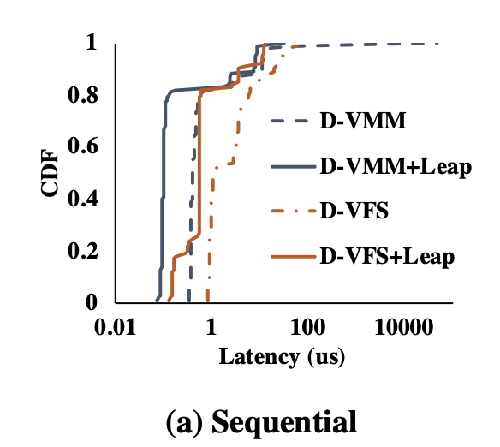
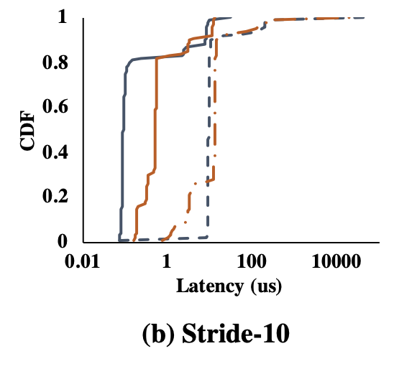
Data Path
VMM
Sequencial: median – 4.07x,
tail(99%) – 5.48x
Stride-10: median – 104.04x
tail – 22.06x
VFS
Sequencial: median – 1.99x,
tail – 3.42x
Stride-10: median – 24.96x
tail – 17.32x

Slide 39
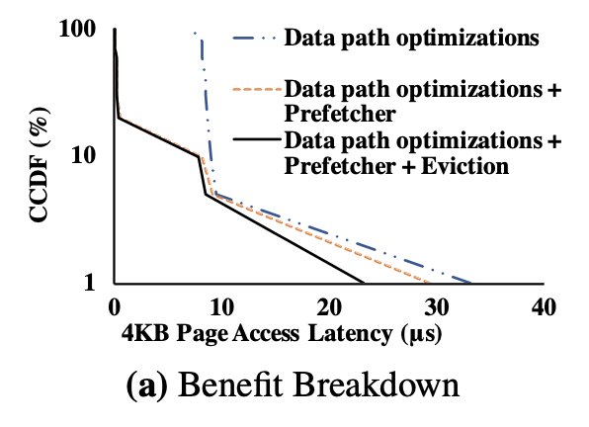
Data Path
Performance Benefit Breakdown
Prefetcher
VMM: tail – 25.4%
VFS: tail – 23.1%
Eager Cache Eviction
VMM: tail – 9.7%
VFS: tail – 8.5%

Slide 40
Prefetchers
Real-world Applications
Tunk Rank on PowerGraph
Matrix multiplication on NumPy
TPC-C benchmark on VoltDB
Facebook’s ETC workload on Memcached
Counterparts
Next-K
Stride
Linux Read-Ahead

Slide 41
Prefetchers
PowerGraph and Numpy

Slide 42
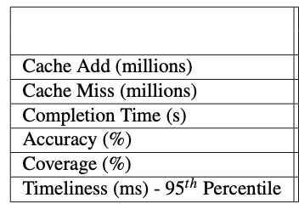
Prefetchers
VoltDB and Memcached

Slide 43
Prefetchers
Performance Benefit Breakdown
PowerGraph at 50% memory limit
95%: Single μs
85%: Sub μs
prefetcher: tail – 11.4%
Eager eviction: tail – 22.2%

Slide 44
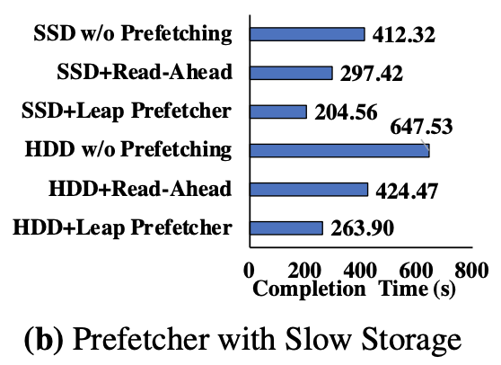
Prefetchers
Performance for HDD and SSD

Slide 45
Overall impact
PowerGraph and Numpy
Infiniswap: high miss rate
Leap: +19.03% hit rate in PowerGraph
+10.4% in Numpy
The higher hit rate, the faster cache eviction, and the faster page allocation for new prefetches
Reduces wastage in cachespace and RDMA bandwidth

Slide 46
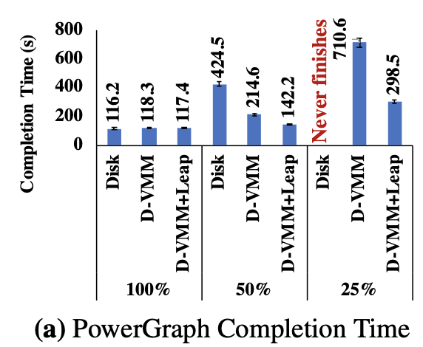
Overall Impact

Slide 47
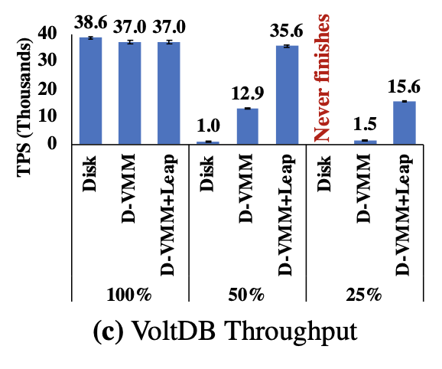
Overall Impact
VoltDB
Latency Sensitive
Infiniswap: slow data path
65.12% lower in 50% memory
95.72% lower in 25% memory

Slide 48
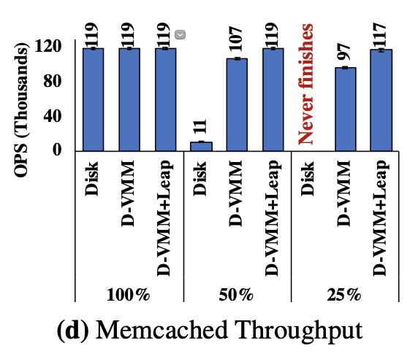
Overall Impact
Memcached
Random remote page access pattern

Slide 49
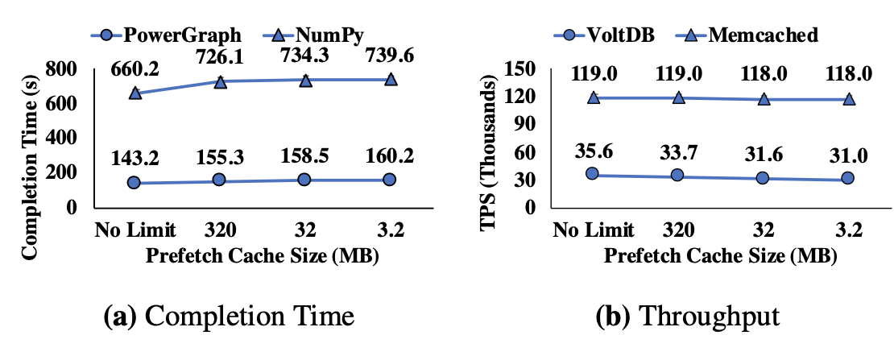
Overall Impact
Constrained Cache Size (Leap)

Slide 50
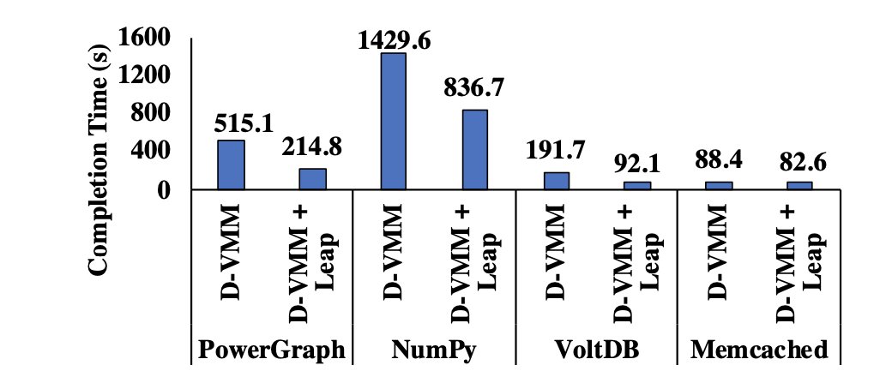
Overall Impact
All four applications running together

Slide 51
Conclusion
Traditional paging techniques do not scale well to RDMA scenarios
Leap, a majority-based prefetcher with leaner data path, can significantly reduce the latency of remote memory accesses
It minimizes remote memory accesses in the critical path

Slide 52
Why Best Paper?
Category | Verdict
Problem | Real & Practical
Idea | Neat & Novel
Implementation | Working; Code is available
Performance | Surprisingly good
Evaluation | Solid
Writing | Clear
Continuity | Based on prior research but with significant contributions
Impact | Probably huge

Slide 53
Q&A

