Slide 1
THE COMPOSITE-FILE fs
Youxu chen
2017-11-03

Slide 2
observations
Frequent access to small files
>80% of accesses are to files smaller than 32 Bytes
~40% of the access time to access small files can be attributable to metadata access
Redundant metadata information
Many files share similar file attributes
75% metadata compression ratio
File accessed in groups
Web access
Limitations of prefetching
Accessing 32 small files can incur 50% higher latency than accessing a single file with a size equal to the sum of the 32 files

Slide 3
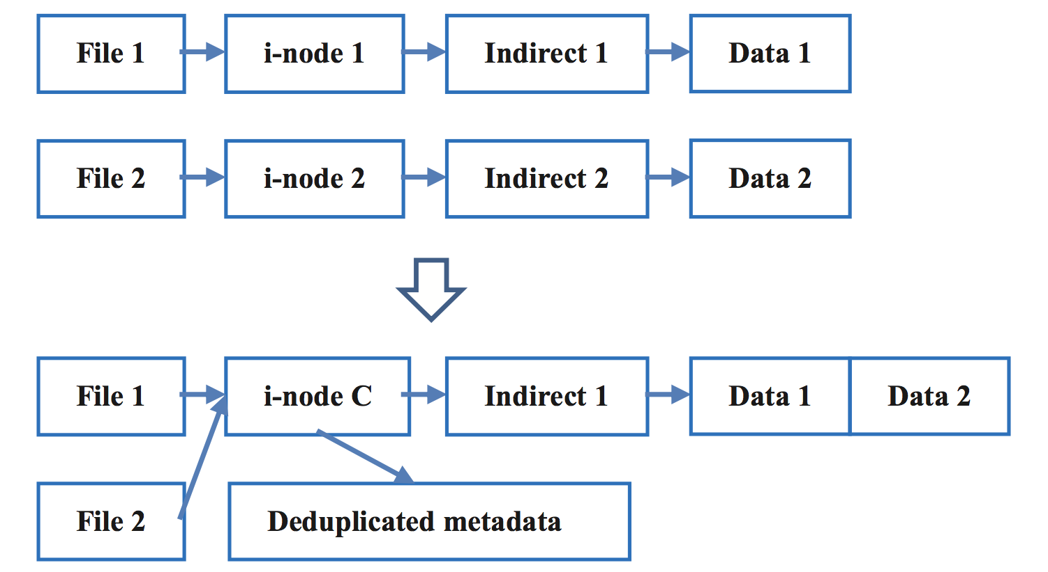
design
Decoupling one-to-one mapping
Metadata deduplication
The composite file
Entry point
Html
Subfiles
Css, html

Slide 4
Metadata operations
File creation
Extended attributes stores the metadata of subfiles
Content consolidation
Offset and length to partition contents
Indexing — N+M inode id bits
N: composite file id
M:subfile id
Permissions
Composite file has the broadest permissions across all subfiles
R + W == RW

Slide 5
Content operations
Enlarge content
append to composite file
In-place updates
No free space ?
Move the updated subfiles to the ned of composite file
Potential temporal locality – will grow again in the future
Delete content
mark space free
Reallocate when free space beyond half of allotted size
Mark free

Slide 6
Identifying composite file membership
Directory-based consolidation
Exclude sub-dirs
Lack of relationships across directories
Embedded-reference-based consolidation
Web access
Compilation
Extract dependency rules from Makefile
Requires knowledge of specific file formats
Frequency-mining-based consolidation
If a set is accessed frequently, its subsets must be as well
Composite file-1
Composite file-2

Slide 7
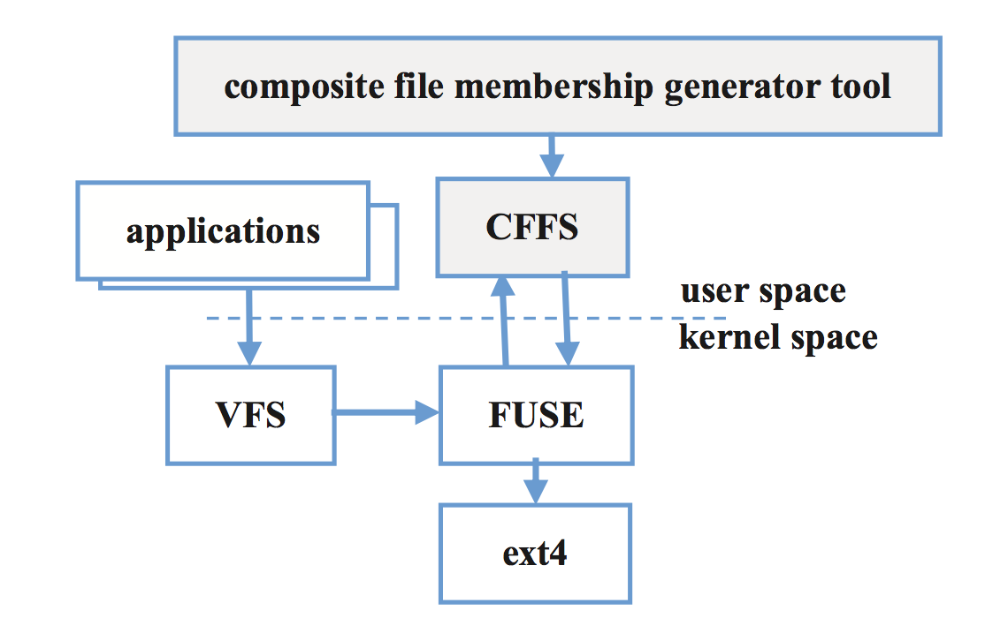
Implementation

Slide 8
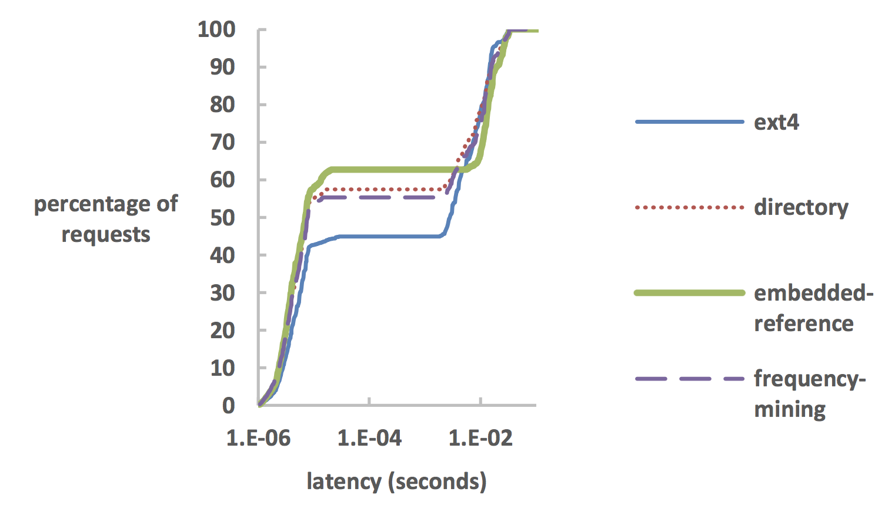
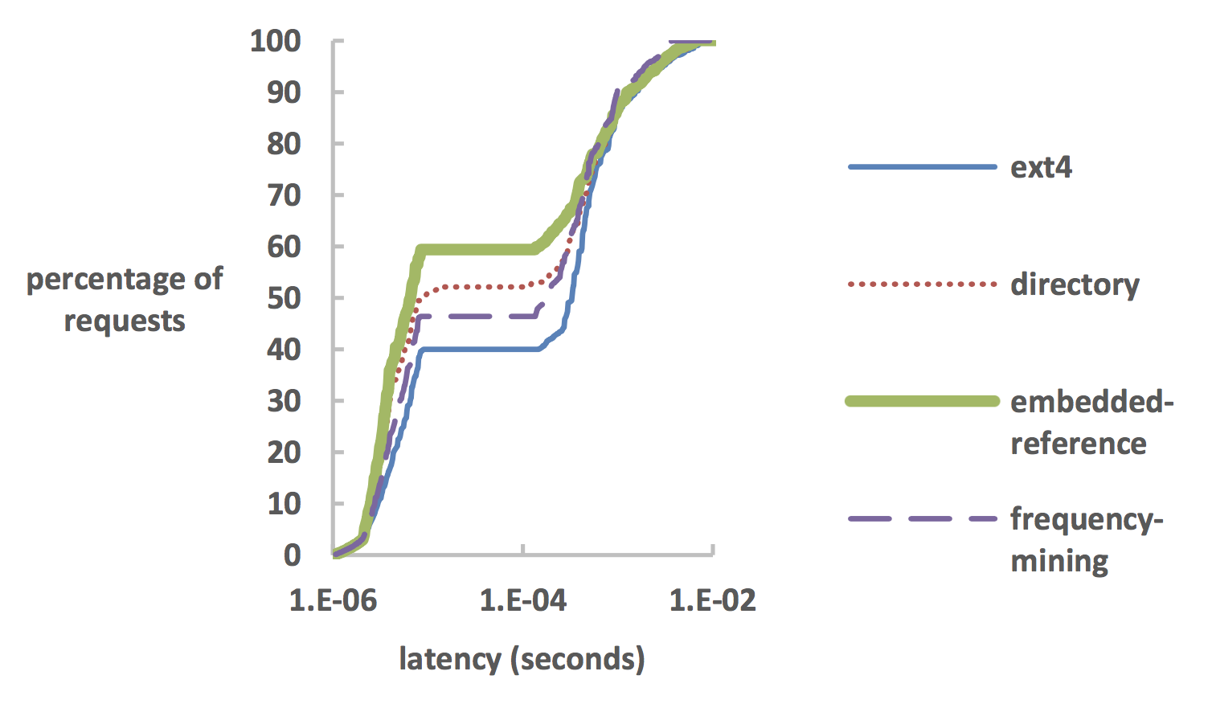
20% latency and cache hit ratio improvement
Web trace reply
HDD
SSD

Slide 9
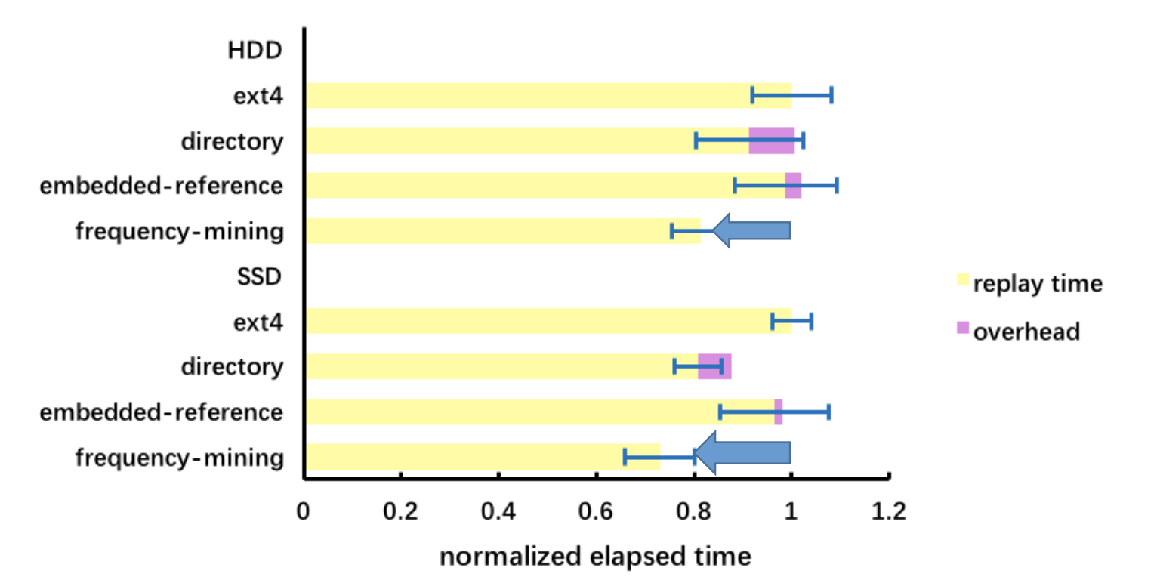
27% performance improvements
Software development file-system trace reply

