Slide 1
Byzantine Ordered Consensus
without Byzantine Oligarchy
Zhanghan Wang, Chuqing Gao
2020/12/16

Slide 2
Today’s agenda
Background
Byzantine ordered consensus
Pompe
Pompe’s features
Implementation and Experiments
Discussion and Conclusion

Slide 3
Today’s agenda
Background
Blockchain
SMR & BFT
Order Matters
Byzantine ordered consensus
Pompe
Pompe’s features
Implementation and Experiments
Discussion and Conclusion

Slide 4
Blockchain
Distributed ledgers
ledger2
ledger1
ledger3
ledger5
ledger4

Slide 5
Today’s agenda
Background
Blockchain
BFT SMR
Order Matters
Byzantine ordered consensus
Pompe
Pompe’s features
Implementation and Experiments
Discussion and Conclusion

Slide 6
BFT SMR
SMR: State Machine Replications
Safety: something bad will never happen
Liveness: something good will eventually occur
input
Node 1
output
Many hours
later
cmd1
cmd2
cmd1
cmd2
cmd3
cmd4
cmd5
input
Node 2
output
Many hours
later
cmd3
cmd5
cmd1
cmd2
cmd3
cmd4
cmd5
…
input
Node n
output
Many hours
later
cmd4
cmd1
cmd2
cmd3
cmd4
cmd5

Slide 7
BFT SMR
BFT: Byzantine Fault Tolerance
Leader-based BFT protocols
Rotating leaders protocols
Leaderless BFT protocols
Node 1
Node 2
Node 1
Node 2
Node 1
Node 2
Node 4
Node 3
Node 4
Node 3
Node 4
Node 3
Leader-based
Leaderless
Rotating-based

Slide 8
Order Matters
In Blockchain…
Respect each node

Slide 9
Today’s agenda
Background
Byzantine ordered consensus
Byzantine Oligarchy and Democracy
Ordering Properties
Pompe
Pompe’s features
Implementation and Experiments
Discussion and Conclusion

Slide 10
Byzantine Oligarchy
Good news: We can eliminate some of these!
I think
cmd1 < cmd2 < cmd3
Node 1
I don’t care!! Just let
cmd3 < cmd2 < cmd1
I think
cmd2 < cmd1 < cmd3
Node 4
Node 2
I think
cmd1 < cmd3 < cmd2
for all
Node 3

Slide 11
Some Concepts
Ordering Indicator:
<timestamp, command>
I think
cmd1 < cmd2 < cmd3
<1, cmd1>, <4, cmd2>, <5, cmd3>
$$𝒫^{1}$$
Node 1
profile
I think
cmd2 < cmd1 < cmd3
<2, cmd3>, <3, cmd1>, <5, cmd2>
$$𝒫^{2}$$
Node 2
I think
cmd1 < cmd3 < cmd2
<2, cmd1>, <3 cmd3>, <4, cmd2>
$$𝒫^{3}$$
Node 3
$𝒫^{C}是一个所有correct Nodes$的 profile 的集合
如 Node1 和 Node2 是 Correct Nodes,
则 $𝒫^{C}=\{$<1,cmd1>,<4,cmd2>,<5,cmd3>,<2,cmd3>,<3,cmd1>,<5,cmd2>}

Slide 12
Free Will
Exists $𝒫_{A}^{1}$ and $𝒫_{B}^{1}$ , s.t. for any pair cmd1 and cmd2, cmd1 < cmd2 in $𝒫_{A}^{1}$, but cmd1>cmd2 in $𝒫_{B}^{1}$
Node 1
Node 2
Node 3
Circumstance A
$$𝒫_{A}^{1}$$
$𝒫_{A}^{2}$ ={<4, cmd1>}
$𝒫_{A}^{1}$={<2, cmd4>}
cmd1 > cmd4
Circumstance B
$$𝒫_{B}^{1}$$
$𝒫_{B}^{2}$ ={<1, cmd1>}
$𝒫_{B}^{1}$={<4, cmd4>}
cmd1 < cmd4

Slide 13
Byzantine Democracy
Well, most of us think
cmd1 < cmd2, then do it!
But I can still manipulate cmd3
<1,cmd1>, <4, cmd2>, <5, cmd3>
Node 4
Node 1
<1, cmd1>
<2, cmd3>
<2, cmd1>
<3, cmd1>
<3, cmd3>
<4, cmd2>
<4, cmd2>
<5, cmd3>
<5, cmd2>
<2,cmd3>, <3, cmd1>, <5, cmd2>
cmd1
<
cmd2
Node 2
<2,cmd1>, <3, cmd3>, <4, cmd2>
Node 3
Ordering Indicator: <timestamp, command>

Slide 14
Byzantine Democracy
Great! I can manipulate all commands.
<1,cmd1>, <3, cmd2>, <5, cmd3>
Node 4
<1, cmd1>
<1, cmd3>
<1, cmd2>
<2, cmd2>
<2, cmd1>
<2, cmd3>
<3, cmd3>
<3, cmd2>
<3, cmd1>
Node 1
<1,cmd3>, <3, cmd1>, <5, cmd2>
Node 2
<1,cmd1>, <3, cmd3>, <5, cmd2>
Node 3
Ordering Indicator: <timestamp, command>

Slide 15
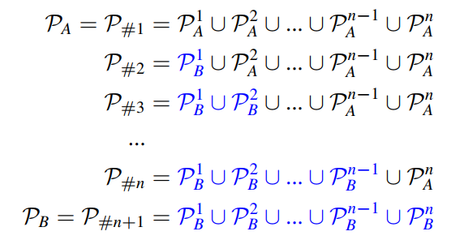
Byzantine Democracy
But Free Will means Byzantine Democracy
Node 1
Node 2
Node n-1
Node n

Slide 16
Byzantine ordered consensus
We want Free Will
We can refuse Byzantine Oligarchy
But we can’t refuse Byzantine Democracy

Slide 17
Today’s agenda
Background
Byzantine ordered consensus
Byzantine Oligarchy and Democracy
Ordering Properties
Pompe
Pompe’s features
Implementation and Experiments
Discussion and Conclusion

Slide 18
Ordering Properties
Ordering Unanimity ？
<1,cmd1>,
<3, cmd2>, <5, cmd3>
Node 1
<2,cmd3>, <4, cmd1>, <5, cmd2>
Node 2
Correct nodes
<2,cmd1>,
<3, cmd3>, <4, cmd2>
Node 3

Slide 19
Ordering Properties
Free will and Ordering Unanimity——but we can’t!
Node 1
cmd1 < cmd2 < cmd3 < cmd4
cmd1 < cmd2
Node 2
cmd2 < cmd3 < cmd4 < cmd1
<
<
Node 3
cmd4 > cmd3
cmd3 < cmd4 < cmd1 < cmd2
Node 4
cmd4 < cmd1 < cmd2 < cmd3

Slide 20
Ordering Properties
Ordering Linearizability
<1,cmd1>, <4, cmd2>, <5, cmd3>
<1, cmd1>
<2,cmd3>
<2,cmd1>
<3, cmd1>
<3, cmd3>
<4, cmd2>
<4, cmd2>
<5, cmd2>
Node 1
cmd1
<2,cmd3>, <3, cmd1>, <5, cmd2>
<
Node 2
cmd2
<2,cmd1>, <3, cmd3>, <4, cmd2>
Fortunately,
it’s achievable!
Node 3

Slide 21
Today’s agenda
Background
Byzantine ordered consensus
Pompe
Overview
Protocol
Pompe’s features
Implementation and Experiments
Discussion and Conclusion

Slide 22
Overview
A standard BFT SMR
Safety
Liveness
2 Phases
Ordering phase
Consensus phase
System Model
3f+1 nodes, where f nodes can be Byzantine nodes

Slide 23
Today’s agenda
Background
Byzantine ordered consensus
Pompe
Overview
Protocol
Pompe’s features
Implementation and Experiments
Discussion and Conclusion

Slide 24
Protocol——Ordering Phase
Step 1
I have a cmd c.
Please give it a timestamp
Collects 2f+1 responses
Get Midian TS
Node i
…
<RequestTS, c>
<RequestTS, c>
<RequestTS, c>
Node j
<${ResponseTS}_{j}$, c, ts>
…
Node k
<${ResponseTS}_{k}$, c, ts>
Node l

Slide 25
Protocol——Ordering Phase
Step 1
Byzantine nodes
Correct nodes
Suppose f = 2
Correct Nodes’ Bound
Correct Nodes’ Bound
Command 1
Command 2

Slide 26
Protocol——Ordering Phase
Step 2
Waits for 2f+1 responses
step1
Node i
…
…
<Sequence, c, T>
<Sequence, c, T>
<Sequence, c, T>
Node j
<SeqResponse, ack, h >
…
Sequence:
if c.TS>localAcceptThresholdTS
Add <c.TS, c> to
localSequencedSet ;
send ack;
else
send nack;
Node k
Node l
<SeqResponse, nack, h >

Slide 27
Protocol——Consensus Phase
Step 1
$$∆_{1}$$
Upper bound of Sync message travelling from one node to another
Collects 2f+1 responses
$$∆_{2}$$
Upper bound of ordering phase’s execution time
Node i
…
<Collect, k>
<Collect, k>
<Collect, k>
Node j
<CollectResponse, k, S>
①
$$∆_{1}$$
$$∆_{2}$$
②
…
①Wait for sync with $𝒯>ts′$
②update localAcceptThresholdTS
Node k
<CollectResponse, k, S>
①
$$∆_{1}$$
$$∆_{2}$$
②
Node l
①
$$∆_{1}$$
$$∆_{2}$$
②

Slide 28
Protocol——Consensus Phase
Step 2
$${ts}_{0}$$
$${ts}_{1}$$
$${ts}_{2}$$
$${ts}_{k−1}$$
$${ts}_{k}$$
$${ts}_{k+1}$$
Slot 1
Slot 2
…
Slot k
Slot k+1
Node j
Node j
√
…
√
…
2f+1 responses
$𝒰$: all commands
in slot k
…
Node i
Node k
BFT SMR
Node k
√
…
√
Node l
Node l
√
…
√

Slide 29
Outline
Background
Byzantine ordered consensus
Pompe
Pompe’s features
Implementation and Experiments
Discussion and Conclusion

Slide 30
Consistency
Node i
Node j
Node 1
Leader in consensus phase
Pompe
BFT SMR
Value U
……
Node n
Notes:
这里Li表示nodei的账本，len()是账本中记录数量
这里的一致性指的是在任意两个节点的账本中，其共有的部分的每条记录一定是一样的
BFT SMR协议保证了value U能准确无误的传播至每个节点中，而Pompe所提出的协议保证了共识阶段leader收集并构建的value U中包含每条命令所对应的时间戳，因此每个节点根据时间戳构建的序列是唯一的，因此每个节点的账本中的记录及其顺序是一致的

Slide 31
Validity
Node 1：<CollectResponse,k,S>
I propose <c,TSi>
value U
S: median of 2f+1 TS
c
……
Node i
Node 2f+1：<CollectResponse,k,S>
Notes:
如果一个正确节点最终将命令c添加到自己的账本上，则在排序阶段至少有一个节点曾经提出过这个命令
这是因为正确节点中的每个命令都来自于一个被共识阶段的leader所确认的，由2f+1个collresp构成的value，假设这个value是在slotk时被确认的，则每一个collectresponse上面都带有一个在slotk范围内的ts，只有在ordering阶段被提出时才能产生这个时间戳，因此…

Slide 32
Ordering linearizability
Byzantine nodes
Correct nodes
f个
$${Node}_{i}$$
$${Node}_{j}$$
小于f个
f个
$${TS}_{i}< {TS}_{medium}< {TS}_{j}$$
Median is bounded by TS from correct nodes
Median comes from correct node
Median comes from correct node
assigned TS for c1
assigned TS for c2
c1’ TS scope provided by correct nodes
c2’ TS scope provided by correct nodes
Notes:
Median被限制在cn的ts中间
case1 2 的情况下median恰好为cn的ts，而case3 中间是bn的话 每侧至少还有一个cn，
2. 根据上面得到的结论，当满足线性排序的前提，即…时，在最终排好序的账本中c1的时间戳一定低于c2

Slide 33
Strong liveness
Receive 2f+1 ResponseTS Broadcast$<c,\{ts\}>$
propose ${<c,ts}_{i}>$
Node i
Communication time
$$∆$$
Other nodes
$$∆_{1}$$
$$∆_{2}$$
Send ResponseTS
Add c to > 2f+1nodes’ localSequenceSet
Notes:
1. 在足够长的同步时间内，正确节点可以将自己的命令和分配的时间戳添加到至少2f+1个节点的localsequenceset中（也就是节点已经接受的命令集合
Delta2足够他把小于ts’的排完序之后就能腾出手处理别人的（？）

Slide 34
Strong liveness
Byzantine nodes
Correct nodes
$${localSequenceSet}_{1}$$
$${collectResponse}_{1}$$
Choose 2f+1 to construct value $U$
……
i ≥ 2f+1- f = f+1
……
At least one containing c
$$collectResponse$$
$$containing c$$
$${collectResponse}_{i}$$
$${localSequenceSet}_{i}$$
$${localSequenceSet}_{i+1}$$
$$other$$
$$collectResponse$$
…
$$other$$
$$collectResponse$$
$${localSequenceSet}_{2f+1}$$
2f
Notes:
2. 一个被添加到至少2f+1个节点的localSequenceSet中的时间戳为ts的命令c,最终会被添加到那个包含ts的时间间隔所提交的值中。
对于一个总结点数为3f+1,bn个数最多为f的的系统，这2f+1个含c的lss中最少有f+1个节点是cn，他们对应consensus阶段最后的f+1个包括c的collectResponse，因此在最终收集的的2f+1个cR中，至少包括一个来自于这f+1个节点，它含有c

Slide 35
Byzantine’s influence on Pompe
Byzantine nodes
Correct nodes
Request C1 & C2
When$N_{1}$ broadcast its request for c1 and c2…
$$N_{1}$$
$$N_{2}$$
$$N_{3}$$
$$N_{4}$$
C1 0 3 3 2
Byzantine node wins !
C2 1 4 2 3
Notes:
①不满足线性排序条件的时候
比如当f为1的时候，我们假设节点提出的时间戳如图，

Slide 36
Byzantine’s influence on Pompe
Byzantine nodes
Correct nodes
Node 1
OK, when I collect all these commands, I will show you first.
I want to check my command，could you help me?
Node 2
Node 3
Node 7
Thanks! I’d better drop my command
Node 4
Node 5
Node 6

Slide 37
Byzantine’s influence on Pompe
Solution
Hide commands by a threshold encryption until totally ordered.
Append-only linear hash chain to record timestamps.
Node 1
Other nodes
19:00 propose c1
<c1, 19:00>
C1
19:00
propose c2
c2
I want to make trouble
You lie! You haven’t seen c2 before 19:00!
ts = 18:00
Notes:
一个被添加到至少2f+1个节点的localsequencedset中的时间戳为ts的命令c,最终会被添加到那个包含ts的时间间隔所提交的值中。

Slide 38
Outline
Background
Byzantine ordered consensus
Pompe
Pompe’s features
Implementation and Experiments
Discussion and Conclusion

Slide 39
Implementation
Optimization:
CollectResponse hash of the set commands
Receive 2f matching hash?
Request a new set again, but with actual set of commands
Bcast <collect>
No
Node 1
Yes
Reach consensus
Notes:
一个被添加到至少2f+1个节点的localsequencedset中的时间戳为ts的命令c,最终会被添加到那个包含ts的时间间隔所提交的值中。

Slide 40
Experimental Evaluation
Batching in Pompe
Pompe implicitly batches commands whose timstamps fall within a time windows during consensus.
Additional batching: each node assign a single timestamp to an ordered sequence of its own commands.
For configuration with n nodes,
Baseline’s batchsize: $β_{c}=S(>1)$
Pompe’s batchsize: $β_{o}=S/n$
during ordering phase
To fairly compare Pompe to baselines

Slide 41
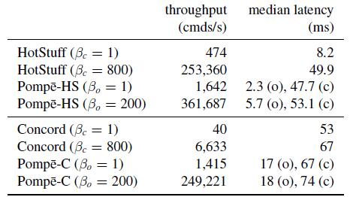
Experimental Evaluation
In the same datacenter: 4 nodes
Notes:
这俩怎么差这么多呢

Slide 42
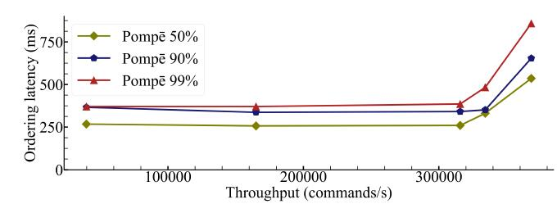
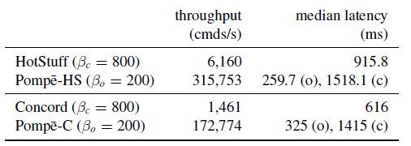
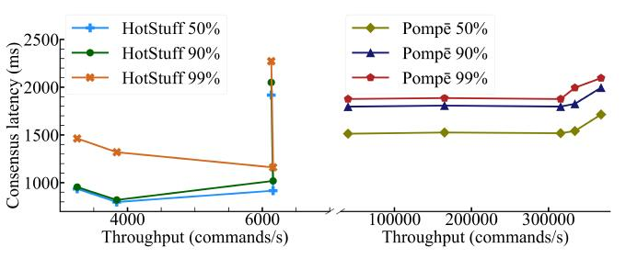
Experimental Evaluation
Geo-distributed
Pompe achieves higher throughput at competitive latencies

Slide 43
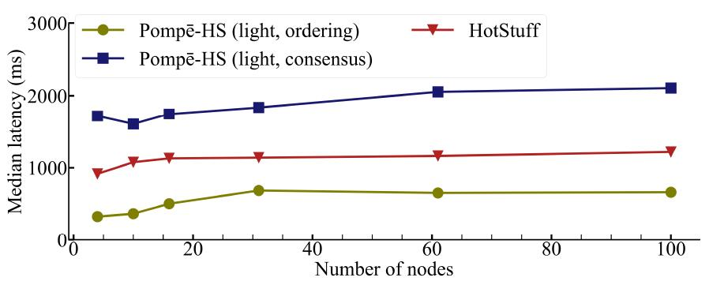
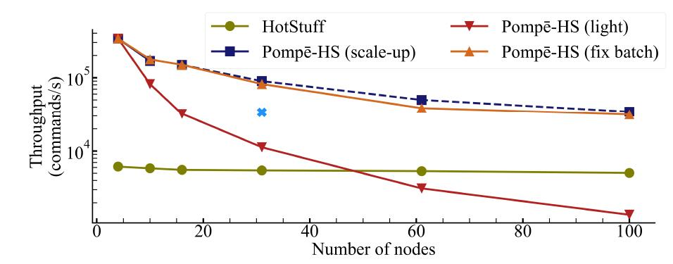
Experimental Evaluation
scalability
Light: $β_{o}=800/n$ , each node have one VM
Scale-up: $β_{o}=800/n$ , each node associate with $\left\lfloor n/4\right\rfloor$VMs.
Fixed batch: $β_{o}=200$ , one VM, regardless of n
Notes:
Pompe’s throughput degrades when n increases, but Pompe can scale up each node for higher throughput
Pompe incurs modest network overheads over its baselines（18％）

Slide 44
Outline
Background
Byzantine ordered consensus
Pompe
Pompe’s features
Implementation and Experiments
Discussion and Conclusion

Slide 45
Conclusion
Narrow the fundamental gap between SMR correctness spec and threat from order manipulation in blockchain.
Introduce a new primitive, ordered consensus, to allow rigorous expression and efficient enforcement of ordering requirements.
Design a modular architecture for ordered consensus and built Pompe which enforces ordering linearizability with performance comparable to state-of-the-art systems.

