Slide 1
PACTree: A High Performance Persistent Range Index Using PAC Guidelines SOSP’21
Wook-Hee Kim, R. Madhava Krishnan, Xinwei Fu, Sanidhya Kashyap Changwoo Min
Presenter: Jingbo Su, Luofan Chen
2021-11-17

Slide 2
Outline
PM and Index Primer
PAC(Packed, Asynchronous Concurrency) Guidelines
Design Choices of PACTree
Design Details of PACTree
Evaluation

Slide 3
PM and Index Primer

Slide 4
Primer: Optane Internals
NUMA 1
NUMA 0
Core
Core
L1 & L2
L1 & L2
LLC Cache
NVM
UPI
Mesh Interconnect
NVM
iMC
iMC
WPQ
NVM
DRAM
DRAM
Notes:
ADR Mode (Cache volatile)
Explicitly flush cache-line, enforce ordering (sfence, cflush)
iMC <-> Optane NVM: 64 bytes
NVM Access Data: 256 bytes
Single Cache-line Write: Read-Modify Write
Write Combining Buffer + Prefetcher

Slide 5
Primer: Optane Internals
NUMA 1
NUMA 0
Core
Core
Ack
L1 & L2
L1 & L2
LLC Cache
NVM
UPI
Mesh Interconnect
Data
NVM
iMC
iMC
WPQ
NVM
DRAM
DRAM
Notes:
ADR Mode (Cache volatile)
Explicitly flush cache-line, enforce ordering (sfence, cflush)
iMC <-> Optane NVM: 64 bytes
NVM Access Data: 256 bytes
Single Cache-line Write: Read-Modify Write
Write Combining Buffer + Prefetcher

Slide 6
Primer: Optane Internals
ADR (Asynchronous DRAM Refresh) Domain
Save data to NVM upon power loss
Explicitly flush cache using clwb
Enforce ordering using sfence
NUMA 0
Core
Core
eADR Domain
L1 & L2
L1 & L2
ADR Domain
LLC Cache
NVM
UPI
eADR (Enhanced ADR) Domain
CPU Cache included in domain
No need to flush domain
Currently not supported
Mesh Interconnect
NVM
iMC
iMC
WPQ
NVM
DRAM
DRAM
Notes:
ADR Mode (Cache volatile)
Explicitly flush cache-line, enforce ordering (sfence, cflush)
iMC <-> Optane NVM: 64 bytes
NVM Access Data: 256 bytes
Single Cache-line Write: Read-Modify Write
Write Combining Buffer + Prefetcher

Slide 7
Primer: Optane Internals
From CPU
NUMA 0
eADR Domain
iMC
Core
Core
WPQ
L1 & L2
L1 & L2
DDR-T
Cacheline 64B
ADR Domain
LLC Cache
XPController
Optane NVM
NVM
UPI
Mesh Interconnect
XPBuffer
XPPrefetcher
NVM
XPLine 256B
iMC
iMC
3D-Xpoint
Media
Directory Information
AIT
Data
WPQ
NVM
DRAM
DRAM
Notes:
ADR Mode (Cache volatile)
Explicitly flush cache-line, enforce ordering (sfence, cflush)
iMC <-> Optane NVM: 64 bytes
NVM Access Data: 256 bytes
Single Cache-line Write: Read-Modify Write
Write Combining Buffer + Prefetcher

Slide 8
Primer: Optane Internals
From CPU
NUMA 0
eADR Domain
iMC
Core
Core
WPQ
L1 & L2
L1 & L2
DDR-T
Cacheline 64B
ADR Domain
LLC Cache
XPController
Optane NVM
NVM
UPI
Mesh Interconnect
XPBuffer
XPPrefetcher
NVM
XPLine 256B
iMC
iMC
3D-Xpoint
Media
Directory Information
AIT
Data
WPQ
NVM
DRAM
DRAM
Notes:
ADR Mode (Cache volatile)
Explicitly flush cache-line, enforce ordering (sfence, cflush)
iMC <-> Optane NVM: 64 bytes
NVM Access Data: 256 bytes
Single Cache-line Write: Read-Modify Write
Write Combining Buffer + Prefetcher

Slide 9
Primer: Performance
Lower read/write bandwidth
2-5x higher read/write latency
Asymmetric read/write performance
Sequential 3-5x faster than random access
Latency | Optane Mem | DRAM
seq. read | ~170ns | ~75ns
rand. read | ~320ns | ~80ns
* Intel. Chapter 12. Intel Optane DC Persistent Memory, Intel 64 and IA-32 Architectures Optimization Reference Manual
Notes:
- R/W Latency: 2-5x
- 5x slower write bandwidth
- Asymmetric R/W Performance: write is 3–5× slower than read in latency and bandwidth
- Seq Access 3-5x faster than random
- Seq: 256-bytes
- Rand: read-modified-write: Ineffective Combining buffer ineffective

Slide 10
Primer: Software Stack
DAX (Direct Access) : Directly expose an NVM space to the program using mmap
NVM Program
NVM Allocator: Manages the mmap-ed NVM space
Should guarantee crash consistency
One NVM heap Resources on one NUMA node
File system API
load/store
NVM Allocator
NVM File system
mmap mapping
NVM Hardware
Notes:
- __DAX__ enabled file system: directly expose an NVM space associated with a file to the program’s virtual address space using mmap.
- **Direct access (DAX)** treats persistent memory devices as byte-addressable memory to get the lowest latency, providing direct access to byte-addressable memory rather than following normal file system block I/O conventions.
- __NVM allocators__ manage the mmap-ed NVM space
- Should guarantee crash consistency
- One NVM Heap on one NVM raw device utilizes only NVM DIMMs and iMCs of that device
- Thereby underutilizing both NVM bandwidth and capacity of a system

Slide 11
Primer: Persistent Range Indexes
B+-tree-based
AAD
Internal Nodes
AAC
BCA
AAA
AAC
AAD
FastFair (2018 FAST)
BzTree (2018 VLDB)
LB+-Tree (2020 VLDB)
Notes:
- Range Indexes (?????) --> Maybe it means tree-based index?
### B+-Tree-Based persistent index
Use B+-Tree
__FastFair__
__BzTree__
__FP-Tree__
__LB+-Tree__
### Trie-based persistent index
ref: [rohansuri/adaptive-radix-tree: A fast and space efficient Radix tree in Java (github.com)](https://github.com/rohansuri/adaptive-radix-tree)
Prefix tree. (前缀树)
Radix Tree （基数树）: A prefix tree in which each node that is the only child is merged with its parents
Adaptive Radix Tree ()
Adaptive Radix Tree
A third class of data structures, known as trie, radix tree, prefix tree, and digital search tree, is illustrated in Figure 1.
These data structures directly use the digital representation of keys instead of hashing or comparing keys. The underlying idea is similar to a thumb-index found in many alphabetically ordered dictionary books: The first character of a word can directly be used to jump to all words starting with that character. In a computer, this process can be repeated with the next characters until a match is found. As a consequence of this process, all operations have O(k) complexity where k is the length of the key. In the era of extremely large data sets, when n is growing faster than k, having a time complexity independent of n is very attractive. In this work, we present the adaptive radix tree (ART) which is a fast and space-efficient in-memory indexing structure specifically tuned for modern hardware. While most radix trees require to trade off tree height versus space efficiency by setting a globally valid fanout parameter, ART adapts the representation of every individual node, as exemplified in Figure 1. By adapting each inner node locally, it optimizes global space utilization and access efficiency at the same time. Nodes are represented using a small number of efficient and compact data structures, chosen dynamically depending on the number of child nodes. Two additional techniques, path compression and lazy expansion, allow ART to efficiently index long keys by collapsing nodes and thereby decreasing the tree height.
__WOART__
__P-ART__
__ROART__

Slide 12
Primer: Persistent Range Indexes
B+-tree-based
Trie-based (ART)
AAD
AA
B
AAC
BCA
A
C
D
C
AAA
AAC
AAD
A
FP-Tree (2015 SIGMOD)
FastFair (2018 FAST)
BzTree (2018 VLDB)
LB+-Tree (2020 VLDB)
WOART (FAST 2017)
P-ART (SOSP 2019)
ROART (FAST 2021)
Notes:
- Range Indexes (?????) --> Maybe it means tree-based index?
### B+-Tree-Based persistent index
Use B+-Tree
__FastFair__
__BzTree__
__FP-Tree__
__LB+-Tree__
### Trie-based persistent index
ref: [rohansuri/adaptive-radix-tree: A fast and space efficient Radix tree in Java (github.com)](https://github.com/rohansuri/adaptive-radix-tree)
Prefix tree. (前缀树)
Radix Tree （基数树）: A prefix tree in which each node that is the only child is merged with its parents
Adaptive Radix Tree ()
Adaptive Radix Tree
A third class of data structures, known as trie, radix tree, prefix tree, and digital search tree, is illustrated in Figure 1.
These data structures directly use the digital representation of keys instead of hashing or comparing keys. The underlying idea is similar to a thumb-index found in many alphabetically ordered dictionary books: The first character of a word can directly be used to jump to all words starting with that character. In a computer, this process can be repeated with the next characters until a match is found. As a consequence of this process, all operations have O(k) complexity where k is the length of the key. In the era of extremely large data sets, when n is growing faster than k, having a time complexity independent of n is very attractive. In this work, we present the adaptive radix tree (ART) which is a fast and space-efficient in-memory indexing structure specifically tuned for modern hardware. While most radix trees require to trade off tree height versus space efficiency by setting a globally valid fanout parameter, ART adapts the representation of every individual node, as exemplified in Figure 1. By adapting each inner node locally, it optimizes global space utilization and access efficiency at the same time. Nodes are represented using a small number of efficient and compact data structures, chosen dynamically depending on the number of child nodes. Two additional techniques, path compression and lazy expansion, allow ART to efficiently index long keys by collapsing nodes and thereby decreasing the tree height.
__WOART__
__P-ART__
__ROART__

Slide 13
PAC Guidelines

Slide 14
Guideline: Lessons learned
FH₁: NVM Bandwidth is limited
FH₂: NVM exhibites asymmetric latency and bandwidth
FH₃: Sequential NVM access is preferred

Slide 15
Guideline: Lessons learned
FH₁: NVM Bandwidth is limited
FH₂: NVM exhibites asymmetric latency and bandwidth
FH₃: Sequential NVM access is preferred
FH₄: NVM’s data persistence cost is more expensive than expected
clwb, sfence
Reveal raw NVM media latency
clwb invalidates cache lines

Slide 16
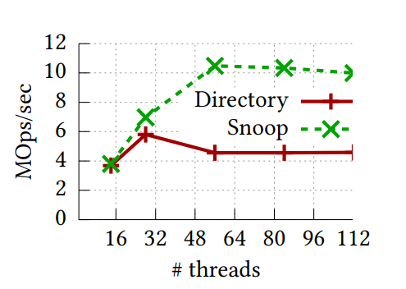
Guideline: Lessons learned
FH₁: NVM Bandwidth is limited
FH₂: NVM exhibites asymmetric latency and bandwidth
FH₃: Sequential NVM access is preferred
FH₄: NVM’s data persistence cost is more expensive than expected
FH₅: Cache coherence protocol impedes NUMA scalability
Directory coherence protocol NUMA bandwidth meltdown
Remote read causes directory “write” to 3D-Xpoint media
Snoop improves throughput by 2.5x
FastFair on YCSB workload-A, 60M integer keys
Notes:
c. We verify this by running a 100% remote random reads experiment in a 64-byte granularity for an 870 MB NVM file. It generated 870 MB and 481 MB of reads and writes, respectively, when we measured using PMWatch [29] for the directory protocol.

Slide 17
Guideline: Lessons learned
FH₁: NVM Bandwidth is limited
FH₂: NVM exhibites asymmetric latency and bandwidth
FH₃: Sequential NVM access is preferred
FH₄: NVM’s data persistence cost is more expensive than expected
FH₅: Cache coherence protocol impedes NUMA scalability

Slide 18
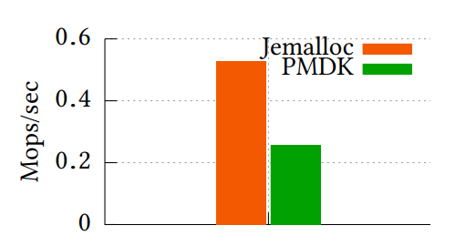
Guideline: Software Stack
FH₁: Limited Bandwidth
FH₂: Asymmetric r/w
FH₃: Prefer sequential
FH_{4:} Expensive persistence
FH₅: Cache coherence proto.
GS₁: Persistent memory allocation is very expensive
NVM allocators rely on expensive crash consistency mechanisms
E.g: PMDK: UNDO/REDO logging, 6 flushes for one alloc/free pair
2x performance drop v.s. modified jemalloc*
Insert only workload (64M Integer keys)
* Modified jemalloc, does not guarantee crash consistency
Notes:
These frequent crash consistency operations incur high overhead and generate additional NVM writes that impact the overall performance of an index

Slide 19
Guideline: Software Stack
FH₁: Limited Bandwidth
FH₂: Asymmetric r/w
FH₃: Prefer sequential
FH_{4:} Expensive persistence
FH₅: Cache coherence proto.
GS₁: Persistent memory alloc. is very expensive
GS₂: Persistent memory alloc. should be NUMA-aware
One NVM heap uses NVM resources only in one NUMA domain
Persistent index exploit all NUMA domains
Memory allocation NUMA-local
FastFair ~2x faster on using two NUMA domains (snoop protocol)

Slide 20
Guideline: Persistent index algorithm
FH₁: Limited Bandwidth
FH₂: Asymmetric r/w
FH₃: Prefer sequential
FH4: Expensive persistence
FH5: Cache coherence proto.
GA₁: Lookup should consume minimal bandwidth
Total reads of total key comparisons until reaching the target key
F: node fan out K: number of K-V pairs S: search key length
$BW_{Btree}=\left\lceil \log_{F}{K}\right\rceil ⋅\log_{2}{F}⋅S$
Full key comparison
Tree level
Binary search each level
Read-Only workload (YCSB C, 64M lookups)
Notes:
A B+tree performs a binary search in a node (log2 F ) with a full key comparison (S) for each level of a tree ( logF K ). A trie performs a binary search of a partial key in a node (log2 F ) at each level. Since internal nodes of a trie encode a key, its height cannot exceed the search key length (S), and one full key comparison (S) is needed at the end. The above equations show that a B+-tree consumes more NVM bandwidth than a trie. For instance, a trie (F = 256) consumes 3.8× less NVM IO for a lookup operation than a B+tree (F = 32) for 100M key-value pairs of the 8-byte key.

Slide 21
Guideline: Persistent index algorithm
FH₁: Limited Bandwidth
FH₂: Asymmetric r/w
FH₃: Prefer sequential
FH4: Expensive persistence
FH5: Cache coherence proto.
GA₁: Lookup should consume minimal bandwidth
Total reads of total key comparisons until reaching the target key
F: node fan out K: number of K-V pairs S: search key length
$BW_{Btree}=\left\lceil \log_{F}{K}\right\rceil ⋅\log_{2}{F}⋅S$
$BW_{Trie}=\log_{2}{F}⋅S+S$
B+-Tree does 7.7x reads as the key ls longer
Read-Only workload (YCSB C, 64M lookups)
Notes:
A B+tree performs a binary search in a node (log2 F ) with a full key comparison (S) for each level of a tree ( logF K ). A trie performs a binary search of a partial key in a node (log2 F ) at each level. Since internal nodes of a trie encode a key, its height cannot exceed the search key length (S), and one full key comparison (S) is needed at the end. The above equations show that a B+-tree consumes more NVM bandwidth than a trie. For instance, a trie (F = 256) consumes 3.8× less NVM IO for a lookup operation than a B+tree (F = 32) for 100M key-value pairs of the 8-byte key.

Slide 22
Guideline: Persistent index algorithm
FH₁: Limited Bandwidth
FH₂: Asymmetric r/w
FH₃: Prefer sequential
FH4: Expensive persistence
FH5: Cache coherence proto
GS₁: Expensive allocation.
GA₁: Lookup should consume minimal bandwidth
GA₂: Read operation should minimize NVM writes
Additional NVM writes caused by read
Modifications to lock status …
Read-Only workload (YCSB C, 64M lookups): 1.4GB writes in FastFair
Notes:
A B+tree performs a binary search in a node (log2 F ) with a full key comparison (S) for each level of a tree ( logF K ). A trie performs a binary search of a partial key in a node (log2 F ) at each level. Since internal nodes of a trie encode a key, its height cannot exceed the search key length (S), and one full key comparison (S) is needed at the end. The above equations show that a B+-tree consumes more NVM bandwidth than a trie. For instance, a trie (F = 256) consumes 3.8× less NVM IO for a lookup operation than a B+tree (F = 32) for 100M key-value pairs of the 8-byte key.

Slide 23
Guideline: Persistent index algorithm
FH₁: Limited Bandwidth
FH₂: Asymmetric r/w
FH₃: Prefer sequential
FH4: Expensive persistence
FH5: Cache coherence proto
GS₁: Expensive allocation.
GA₁: Lookup should consume minimal bandwidth
GA₂: Read operation should minimize NVM writes
GA₃: Write should minimize memory allocation
Frequent NVM alloc/free can cause scalability and performance issues
Insert-Only workload (YCSB Load A, 64M insert)
 | FastFair | PDL-ART | BzTree
Method | Embed key/value | - | Modifies internal node using CoW
Alloc time percentage | 2% | 20% | 40%
Relative performance | 1x | 1.2x | 3x
Notes:
FastFair embeds 30 8B-key and 8B-value pairs in a node. It needs NVM allocation/free only when a node split/merge occurs. Thus, it incurs the lowest NVM allocation overhead. Unlike FastFair, PDL-ART does not embed a key-value pair in a leaf node. Hence, it needs one NVM allocation for a keyvalue pair on every insert. BzTree modifies an internal node using the CoW technique, which incurs an NVM allocation
There are questions.

Slide 24
Guideline: Persistent index algorithm
FH₁: Limited Bandwidth
FH₂: Asymmetric r/w
FH₃: Prefer sequential
FH4: Expensive persistence
FH5: Cache coherence proto
GS₁: Expensive allocation.
GA₁: Lookup should consume minimal bandwidth
GA₂: Read operation should minimize NVM writes
GA₃: Write should minimize memory allocation
GA₄: Write should minimize persistence operation
Data not enforcing correct recovery Unnecessary to persist
Notes:
A B+tree performs a binary search in a node (log2 F ) with a full key comparison (S) for each level of a tree ( logF K ). A trie performs a binary search of a partial key in a node (log2 F ) at each level. Since internal nodes of a trie encode a key, its height cannot exceed the search key length (S), and one full key comparison (S) is needed at the end. The above equations show that a B+-tree consumes more NVM bandwidth than a trie. For instance, a trie (F = 256) consumes 3.8× less NVM IO for a lookup operation than a B+tree (F = 32) for 100M key-value pairs of the 8-byte key.

Slide 25
Guideline: Persistent index algorithm
FH₁: Limited Bandwidth
FH₂: Asymmetric r/w
FH₃: Prefer sequential
FH4: Expensive persistence
FH5: Cache coherence proto
GS₁: Expensive allocation.
GA₁: Lookup should consume minimal bandwidth
GA₂: Read operation should minimize NVM writes
GA₃: Write should minimize memory allocation
GA₄: Write should minimize persistence operation
GA₅: Scan should maximize sequential read to NVM
Index node structure should be prefetcher friendly and cache line efficient
64M Scan: FastFair 1.5x performance with 1.6x less reads
Notes:
A B+tree performs a binary search in a node (log2 F ) with a full key comparison (S) for each level of a tree ( logF K ). A trie performs a binary search of a partial key in a node (log2 F ) at each level. Since internal nodes of a trie encode a key, its height cannot exceed the search key length (S), and one full key comparison (S) is needed at the end. The above equations show that a B+-tree consumes more NVM bandwidth than a trie. For instance, a trie (F = 256) consumes 3.8× less NVM IO for a lookup operation than a B+tree (F = 32) for 100M key-value pairs of the 8-byte key.

Slide 26
Guideline: Concurrency control
GC₁: Maximize concurrent access for scalability and bandwidth utilization

Slide 27
Guideline: Concurrency control
GC₁: Maximize concurrent access for scalability and bandwidth utilization
GC₂: Minimize the blocking time of structural modification operations
Key insertion/deletion (Cascading) Index structural modification operations (SMO)
SMO resides in critical path Blocking concurrent thread
Notes:
. The NVM write and persistence operations (triggered by SMOs) are high latency operations that lengthen the critical section, stalling other concurrent threads.

Slide 28
Guideline: Concurrency control
GC₁: Maximize concurrent access for scalability and bandwidth utilization
GC₂: Minimize the blocking time of structural modification operations
GC₃: An index’s data size should not affect the operation progress.
Intel HTM only support L1 cache size data HTM Abort
FP-Tree on 10M / 60M uniform random integer keys

Slide 29
Guideline: Conclusion
A Persistent Range Index should provide
Packed Access to NVM Saving bandwidth
Asynchronous Concurrency Decouple long NVM latency

Slide 30
Design Choices of PACTree
Notes:
为了更好地理解Index设计选择的原因，在详细介绍PACTree的设计细节之前，我们先讨论一下Index和PM结合时的设计选择

Slide 31
Key Design Choices of Index
deciding the roles of PM and DRAM
achieving safe persistence while reducing consistency cost
handling concurrency
Notes:
纵观诸多基于PM的Index设计选择，可以总结3点最重要的选择。首先，要决定PM和DRAM所扮演的角色，Index是全部存储在PM中还是部分index存在于DRAM中。
其次，为了保证安全的持久化，如何减少崩溃一致性开销。最后，如何控制并发访问

Slide 32
Index Architecture
Notes:
当然也有其他选择，为了便于讨论，我们这里着重以以上3点来讨论PACTree的设计。
我们先说下PACTree的设计选择，然后解释其选择的原因
首先，PACTree的索引全部存在于PM中，其次，为了支持异步客观并发控制，PACTree将索引划分为两层，索引层和数据层。
数据层的每个数据节点包含了多个key, 而索引层其实检索的是每个数据节点
最后，PACtree并未使用Copy on write或者logging的方式保证崩溃一致性，仅仅是使用进行编排的原子性指令顺序来保证
下面，我们详细来说明一下，这些选择的原因

Slide 33
Search layer
GA₁. Lookup operation should consume minimal NVM bandwidth.
an internal node of trie keeps only the partial key
Notes:
先看一下索引层和数据层的设计选择，这取决于之前对于PM性质的探索，
对于索引层来说，为了减少对PM的查找操作，PACTree仅在中间缩影节点存储部分的键值

Slide 34
Data layer
GA₃. Write operation should minimize NVM memory allocation.
GA₅. Scan operation should maximize sequential read to NVM.
a doubly linked list of B+-tree-like leaf nodes, called data nodes, each containing multiple key-value pairs
Notes:
而对于索引层来说，为了避免昂贵的PM空间申请，每个数据节点会包含做个键值对，并且由于PM对于顺序读友好，有利于索引中scan操作的设计

Slide 35
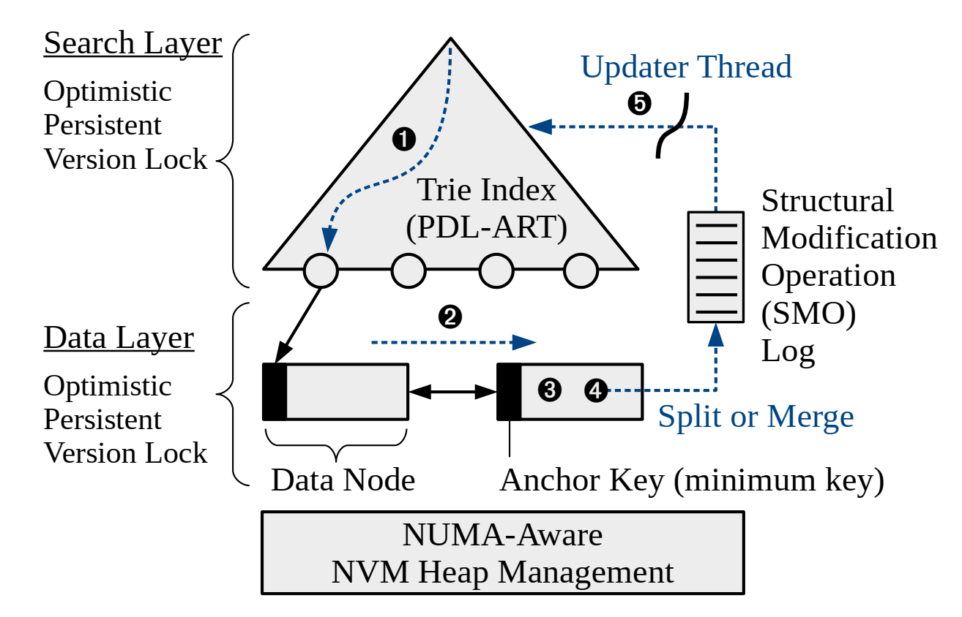
Read-optimized Concurrency Control
GC₁. Maximize concurrent access for both scalability and full NVM bandwidth utilization.
GC₃. An index’s data size should not affect the operation progress.
GA₂. Read operation should minimize NVM writes.
For scalability, PACTree maximizes the concurrent execution(GC₁)
readers do not change the lock status on NVM; hence, no writes (GA₂)
the progress is not affected by data size/footprint (GC₃)
Notes:
由于单线程并不能充分利用PM的带宽，而且为了索引的scalability，PACTree选择了支持多线程。
而对于PM而言，读操作时应该产生更少的写，并未索引大小不应该影响操作性能，所以PACtree选择了读优化并发控制

Slide 36
Asynchronous structural modification
GC₂. Minimize the blocking time of structural modification operations.
GA₃. Write operation should minimize NVM memory allocation.
GA₄. Write operation should minimize NVM persistence operation.
Insert and delete operations can trigger a structural modification
decouples the expensive search layer update from the critical path
Notes:
为了保证写操作时不会产生很多PM申请和持久化开销，同时为了尽可能避免SMO操作，PACtree将索引层拆离出IO关键路径

Slide 37
Mostly log-free crash consistency
GA₄. Write operation should minimize NVM persistence operation.
leverages the slotted list and the valid bitmap in a data node
Notes:
由于对于写操作应该减少对PM的持久化操作，所以PACtree并未选择copy on write或日志的方式，而是利用原子指令修改bitmap

Slide 38
Selective persistence in a data node
FH₄. NVM’s data persistence cost is more expensive than we think.
does not guarantee the consistency of the permutation array to avoid persistence overhead and cache-line invalidation
Notes:
最后，由于PM上的持久化操作是比较昂贵的，因此，PACtree仅对最重要的数据进行持久化，因此一些可以被重建的数据是可以被舍弃崩溃一致性保证

Slide 39
Design Details of PACTree
Notes:
至此，我们已经讨论完了PACtree的设计选择，现在我们详细讨论PACtree的设计细节

Slide 40
Index Architecture
A
B
AA
CA
AB
BB
AAA
AAB
ABA
ACA
ACC
BAB
BAC
BBB
BBC
BBC
Notes:
这里以一个PACtree的例子来详细解释其工作过程

Slide 41
Search Layer: PDL-ART
A
B
AA
CA
AB
BB
Durable linearizability and recovery
ART violates the durable linearizability guarantee
ROWEX for concurrency control requires resetting the per-nodelock status by visiting every ART node across crashes, which is expensive
employ an optimistic version lock with a global generation ID
Notes:
PACtree的索引层基于ART，但是它并不能保证线性持久化保证，另外，与ART结合的读偏向并发锁会频繁修改节点状态。
因此，PACtree使用了一个乐观版本锁来解决这些兼容性问题

Slide 42
Search Layer: PDL-ART
A
B
AA
CA
AB
BB
Log-free crash consistency
The use of version lock in the PDL-ART gives exclusive write access, therefore ,persisting the store instructions in the exact same order as the program execution order
Notes:
正是因为并发控制协议的选择，所以每个写操作可以使用log-free的方式保证崩溃一致性
此时，指令的顺序就是程序的执行顺序

Slide 43
Search Layer: PDL-ART
A
B
AA
CA
AB
BB
Persistent memory leak prevention
If a crash happens before persistent linking, the new node will be unreachable, resulting in a persistent memory leak
rely on the malloc to semantics of the NVM allocator and checks all addresses in the allocation logs
Notes:
另外，泄露的PM内存并不会随着重启被释放，为了避免内存泄漏，PACtree依赖于malloc语义以及allocation logs 来检查地址

Slide 44
Index Architecture
A
B
AA
CA
AB
BB
AAA
AAB
ABA
ACA
ACC
BAB
BAC
BBB
BBC
BBC
Notes:
下面，我们详细讨论数据节点的存储结构

Slide 45
Data Layer
AAA
AAB
ABA
ACA
ACC
BAB
BAC
BBB
BBC
BBC
Notes:
每个数据节点都包含了多个键值对，使用bitmap指示kv slot是否被占用。
为了提供有序索引，额外提供了置换数组，不过由于这部分可以在运行时重建，并不会被保证崩溃一致性
另外。为了保证并发控制，每个数据节点都会有个区域保存版本锁
最后，为了提供B+树类型的叶节点，还要有双向链表的指针

Slide 46
Index Architecture
A
B
AA
CA
AB
BB
AAA
AAB
ABA
ACA
ACC
BAB
BAC
BBB
BBC
BBC
Notes:
以上就是PACtree的主要索引结构，下面我们使用两个例子来详细解释其工作过程

Slide 47
Lookup Operation
Lookup key 'ABA'
A
A < ABA < B
B
AAA < ABA < ACA
AA
CA
AB
BB
AAA
AAB
ABA
ACA
ACC
BAB
BAC
BBB
BBC
BBC
Traversing the search layer ​
1. First traverses the search layer by comparing the target key with the partial anchor keys of data nodes.
Notes:
当查询key "ABA"时，首先工作在索引层，通过比较中间节点的部分key值，此时ABA会找到最左边的数据节点

Slide 48
Lookup Operation
Lookup key 'ABA'
A
A < ABA < B
B
AAA < ABA < ACA
AA
CA
AB
BB
AAA
AAB
ABA
ACA
ACC
BAB
BAC
BBB
BBC
BBC
Target Node
Traversing the search layer ​
2. Jump node. If the search layer is not synchronized with the data layer, the traversal will reach the adjacent node.
Notes:
另外，由于索引层和数据层可能由于异步更新导致不一致，但是即使是这样，由于数据节点是有序的，所以可以根据比较此时的Jump node来寻找到正确的数据节点

Slide 49
Lookup Operation
Lookup key 'ABA'
A
A < ABA < B
B
AAA < ABA < ACA
AA
CA
AB
BB
AAA
AAB
ABA
ACA
ACC
BAB
BAC
BBB
BBC
BBC
Target Node
Traversing the search layer ​
2. Target node. Otherwise, it will directly reach.
Notes:
当然，在我们的例子中暂时不考虑这么复杂的情况，此时假设索引和数据层是一致的，那么左边第一个数据节点就是目标节点

Slide 50
Lookup Operation
Lookup key 'ABA'
A
A < ABA < B
B
AAA < ABA < ACA
AA
CA
AB
BB
AAA
AAB
ABA
ACA
ACC
BAB
BAC
BBB
BBC
BBC
Target Node
Traversing the data layer
1. On reaching the target node, first matches the fingerprint and then compares the full key only for those keys whose fingerprint matched.
Notes:
由于数据节点包含了多个键值对，所以我们可以使用fingerprint 来快速寻找ABA

Slide 51
Lookup Operation
Lookup key 'ABA'
A
A < ABA < B
B
AAA < ABA < ACA
AA
CA
AB
BB
AAA
AAB
ABA
ACA
ACC
BAB
BAC
BBB
BBC
BBC
Target Node
Traversing the data layer
2. After finding the key, it checks the version number of the node after reaching the node.
Notes:
在找到ABA时，还需要检查该数据节点的版本信息来检查正确性

Slide 52
Scan Operation
First finds the target data node of the minimum key of a scan range.
After finding the target node, the scan operation first checks whether it needs to reconstruct the permutation array.
If the node version and the permutation array version are different, it first reconstructs the permutation array.
Then it traverses the key-value array in the order of permutation array.
Notes:
scan操作类似于lookup操作，在找到目标节点后，先检查是否需要重建置换数组，如果不需要，则可以快速的访问相应范围的键值

Slide 53
Insert Operations
Insert key 'ACD'
A
A < ACD < B
B
ACA < ACD
AA
CA
AB
BB
AAA
AAB
ABA
ACA
ACC
BAB
BAC
BBB
BBC
BBC
Target Node
1. First adds the key and updated value to an empty slot and updates the fingerprint array accordingly.
Notes:
下面，我们来看一下插入操作，例如插入ACD，首先仍然是先找到对应的数据结点，如果此时还存在空余的操作，则先计算键值的fingerprint

Slide 54
Insert Operations
Insert key 'ACD'
A
A < ACD < B
B
ACA < ACD
AA
CA
AB
BB
AAA
AAB
ABA
ACA
ACC
BAB
BAC
BBB
BBC
BBC
Target Node
2. Then it persists the added key-value pair and fingerprint.
Notes:
然后持久化键值对和fingerprint

Slide 55
Insert Operations
Insert key 'ACD'
A
A < ACD < B
B
ACA < ACD
AA
CA
AB
BB
AAA
AAB
ABA
ACA
ACC
ACD
BAB
BAC
BBB
BBC
BBC
Target Node
3. Finally, it atomically updates the bitmap by resetting the old key-value pair but setting the new key-value pair to one.
Notes:
最后，原子更新相应的元数据信息

Slide 56
Insert Operations
Insert key 'ABB'
A
A < ABB < B
B
AAA < ABB < ACA
AA
CA
AB
BB
AAA
AAB
ABA
ACA
ACC
BAB
BAC
BBB
BBC
BBC
Target Node
Notes:
但是，如果插入一个没有空余slot的数据节点会导致split操作，例如，插入键值ABB

Slide 57
Insert Operations (Split)
1. Once the node lock is acquired, a writer logs the split information in a per-thread SMO log.
AAA
AAB
ABA
ACA
ACC
BAB
BAC
BBB
BBC
BBC
Target Node
SMO Log
Notes:
首先我们需要申请节点粒度的锁，同时记录“插入ABB”到SMO Log中

Slide 58
Insert Operations (Split)
2. Writer allocates a new data node, copies the larger half of key-value pairs to the new data node with associated metadata.
AAA
AAB
ABA
ACA
ACC
BAB
BAC
BBB
BBC
BBC
Target Node
ABA
ABB
SMO Log
ABA < ABB < ACA
Notes:
然后申请一个新的数据节点，然后拷贝分裂节点的右半部分到新节点

Slide 59
Insert Operations (Split)
3. The copied key-value pairs are deleted from the splitting node by atomically updating the bitmap, and then persists the splitting node.
AAA
AAB
ACA
ACC
BAB
BAC
BBB
BBC
BBC
Target Node
ABA
ABB
SMO Log
ABA < ABB < ACA
Notes:
接着，删除分裂节点已被拷贝的数据，然后持久化分裂节点元数据等信息

Slide 60
Insert Operations (Split)
4. Finally, the new node is linked to the left of the splitting node’s right node and, persists the updated pointer
AAA
AAB
ACA
ACC
BAB
BAC
BBB
BBC
BBC
Target Node
ABA
ABB
SMO Log
ABA < ABB < ACA
Notes:
最后，更新双向链表上的指针，然后进行持久化操作

Slide 61
Insert Operations (Split)
Insert key 'ABB'
A
A < ABB < B
B
AAA < ABB < ACA
AA
CA
AB
BB
AAA
AAB
ACA
ACC
BAB
BAC
BBB
BBC
BBC
Target Node
ABA
ABB
SMO Log
ABA < ABB < ACA
Notes:
需要注意的是，数据节点的分裂并不会传递到索引层，因此分裂并不会传递到根节点

Slide 62
Optimistic Persistent Version Lock
optimistic persistent version lock for node level locking in search and data layer
typical version lock protocol:
A writer atomically increments the version upon lock and unlock.
When a version is an odd number, a thread should wait until the version becomes an even number.
A reader first checks if there is no writer.
If so, it optimistically performs an operation and then checks the version again. If two versions vary, the operation is retried.
Notes:
在上面的一个例子中提到的乐观版本锁的粒度是节点层次，实际实现就是一个典型的版本锁协议
仅有写操作在申请/释放锁时原子更新版本，当一个读或写线程看到数据节点的版本是偶数时，应该等待。
而读操作负责检查是否存在写操作。如果没有则会在读完后再次检查版本号

Slide 63
Evaluation
Notes:
以上，我们通过几个例子讨论了PACtree的查询与插入过程，至于删除，更新过程是比较类似的，另外，recovery其实就是重新执行SMO log，详细的可以参见论文的描述
下面我们讨论下PACTree的实验，

Slide 64
Evaluation Environment
Use a two-socket DCPMM machine with Intel Xeon Platinum 8280 processors (28 physical/56 logical cores) per socket, 3.0 TB of DCPMM (1.5TB per socket), and 768 GB of DRAM
Set the snoop coherence protocol and pmempoolset to exploit NVMs on all NUMA domains
Baseline : FPTree, BzTree, FastFair and PDL-ART
Notes:
在实验环境上，论文中使用的是两个插满PM的socket，并且NUMA间的协议是snoop。
基准测试分别是FPTree, BzTree, FastFair and PDL-ART

Slide 65
Workload Configuration
Use the index-microbench that generates YCSB workload
Use both the integer (8-byte) and string keys (23-byte on average) with uniform and Zipfian distribution
The value size is 8-byte, which is the default setting of the index-microbench and is used in previous studies
64M operations after populating the indexes using 64M keys except for the LOAD A evaluation
include the evaluation results for only the Zipfian distribution due to the space limitation
Notes:
测试的工作负载是YCSB，key的类型包括整型和字符串，分布是Zipfian

Slide 66
Performance and Scalability
PACTree vs B+Tree indexes
O₁.For the write-intensive workloads (W-A, L-A), PACTree performs up to 4× better than all the other B+tree indexes
R₁.The asynchronous search layer update in PACTree while the other B+Tree indexes experience high latency in the critical path due to the SMOs
Notes:
我们先谈论一下PACTree和B+树的性能，对于写密集型工作负载，PACTree的吞吐量是B+树的4倍
收益来自于异步更新索引层

Slide 67
Performance and Scalability
PACTree vs B+Tree indexes
O₂. For the read-intensive workloads (W-B, W-C, WE), PACTree outperforms all the other B+tree indexes by up to 3.2×
R₂. The trie-based search layer in the PACTree which incurs only a partial key comparison to get to the target node
Notes:
另外，对于读密集型工作负载，PACTree的吞吐量是B+树的3.2倍
收益主要是因为PACTree仅需要比较部分key

Slide 68
Performance and Scalability
PACTree vs BZTree
For write-intensive workloads, the main performance bottleneck in BZTree comes from a large number of NVM memory allocations and a high number of clwb/sfence incurred per insert operation due to the use of PMWCAS
Notes:
其次，我们讨论下PACTree和BzTree，对于写密集型应用，由于内存申请和大量的clwb会导致BzTree性能下降

Slide 69
Performance and Scalability
PACTree vs BZTree
Alternatively, with the slotted leaf node, memory allocation overhead in PACTree can be amortized, and with the asynchronous search layer update, the number of clwb/sfence in the critical path is significantly reduced
Notes:
另外，PACtree的slotted叶节点减少了内存申请，并且由于异步更新索引曾，clwb的指令数量对关键路径的影响被大大较少了

Slide 70
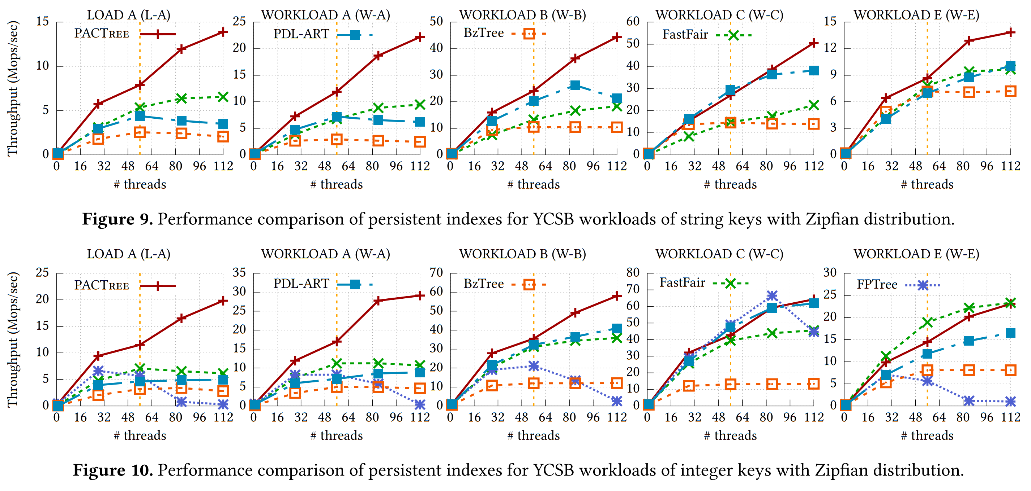
Performance and Scalability
PACTree vs FastFair
Fastfair performance drops up to 3× for string keys than that of the integer keys
Notes:
接着，我们讨论PACTree和FastFair的性能比较，Fastfail在字符串类型的key会比整型差3倍

Slide 71
Performance and Scalability
PACTree vs FastFair
The key value pairs are embedded in the leaf node for the integer keys, which makes FastFair cacheline efficient
Notes:
这是因为整型的key可以更容易保证cacheline

Slide 72
Performance and Scalability
PACTree vs FastFair
For string keys, the leaf node contains only pointers to the keys, which incurs additional pointer chasing and consequently a poor performance
Notes:
而且，字符串型的key会导致更多次索引

Slide 73
Performance and Scalability
PACTree vs PDL-ART
O₁.PACTree performs up to 3× better than PDL-ART across all the workloads
R₁.PDL-ART is NVM allocation heavy, and hence it is ∼3× slower than PACTree for write-intensive workloads
Notes:
最后，我们讨论下PACtree和PDL-ART的性能差别，PACTree可以获得3倍的性能提升，这是因为PDL-ART为每一个key申请内存，所以其内存申请开销很大

Slide 74
Performance and Scalability
PACTree vs PDL-ART
O₂.PDL-ART’s range scan performance is up to 2× slower than the PACTree
R₂.In PDL-ART, the key-value pairs are not embedded in its leaf nodes; instead, it stores a pointer to the key-value pairs. This incurs additional pointer dereference
Notes:
另外，PDL-ART的范围扫描比PACTree差2倍，由于PDL-ART并没有叶节点，所以会造成更多的索引操作

Slide 75
Factor Analysis
+ Per-NUMA pool
O₁. For write-intensive workloads, adding per-NUMA NVM pool improves the performance by up to 2×.
R₁. With per-NUMA pool, writers allocate memory locally, and they can fully utilize the NVM bandwidth of the system.
Notes:
在上面的PACTree和基准测试的比较讨论后，PACtree提供了每个组件的影响分析，首先对于NUMA的影响，对于写密集型应用，两个NUMA node会比一个性能高2倍
这是因为内存申请是本地的，所以可以比较好的利用PM带宽

Slide 76
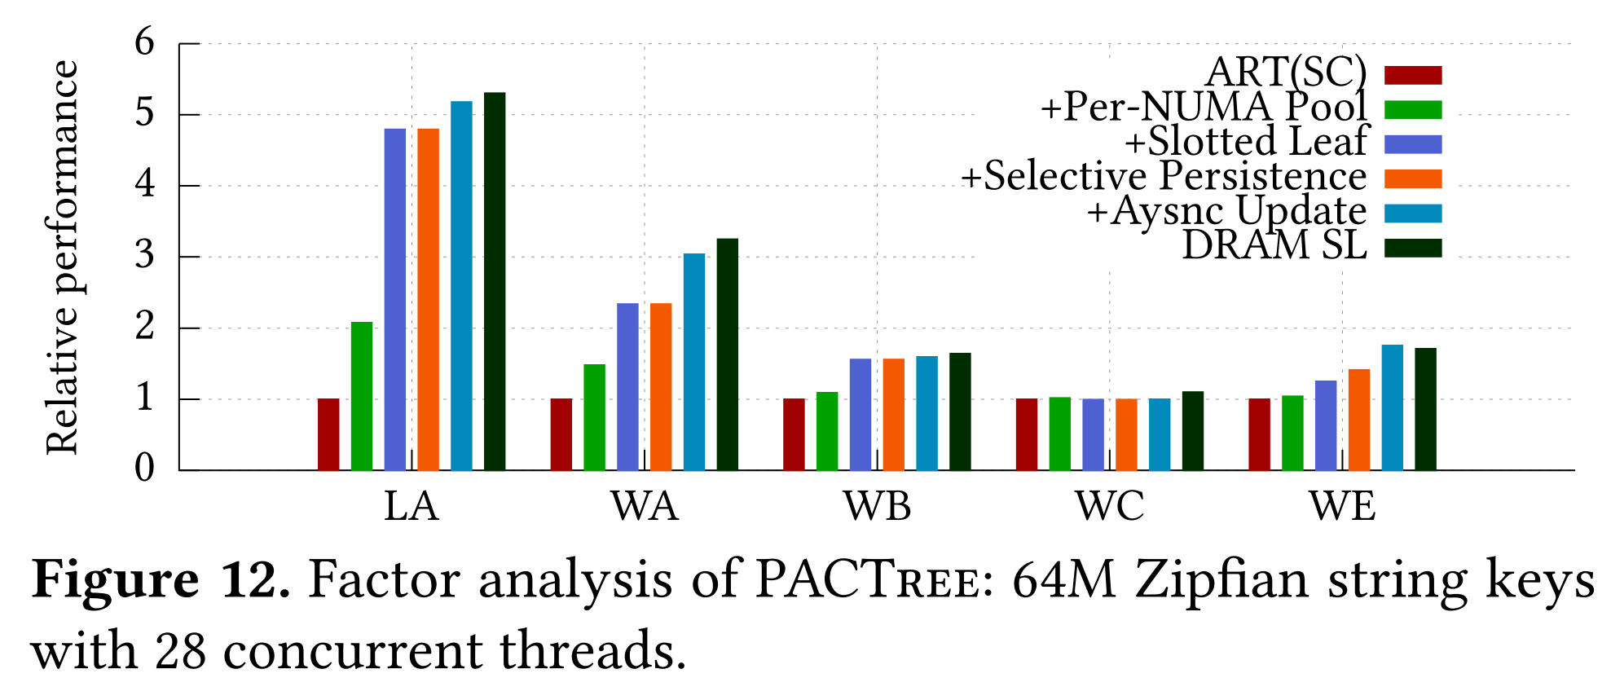
Factor Analysis
+ Slotted leaf nodes
O₁. Incorporating slotted leaf nodes to PDL-ART improves the performance by up to 2.5× across all workloads except for read-only Workload C.
R₁. Unlike the leaf nodes in PDL-ART, slotted leaf nodes do not incur NVM memory allocation for every insert operation, thereby amortizing the allocation overhead.
Notes:
接下来，B+树类型的叶节点可以提高2.5倍的性能，这是因为叶节点避免了大量的PM内存申请

Slide 77
Factor Analysis
+ Slotted leaf nodes
O₁. Incorporating slotted leaf nodes to PDL-ART improves the performance by up to 2.5× across all workloads except for read-only Workload C.
R₂. For Workload C, adding slotted leaf nodes shows a slight dip (<10%) in performance as it requires one fingerprint match operation, indirection to key-value pair, and full key comparisons.
Notes:
一个例外是WC工作负载，这是因为fingerprint 在该负载下部分失效了

Slide 78
Factor Analysis
+ Asynchronous search layer update
O₁. Adding asynchronous update improves the performance by up to 30% for write-intensive workloads.
R₁. Updating the search layer in the background significantly reduces the critical path latency of write operations.
Notes:
然后，对于写密集型工作负载，异步更新索引索引层可以提高30%的性能，这是因为写操作部分操作拆离开了关键路径

Slide 79
Factor Analysis
- Search layer on DRAM
O₁. DRAM-based search layer is not that beneficial for PACTree (less than 10% increase).
R₁. As the search layer is updated asynchronously in the background, there is no performance benefit in placing it on the DRAM.
Notes:
最后，如果将索引曾放到DRAM上，此时并不会有利于PACTree，这是因为异步更新的设计选择在DRAM是无效的，DRAM并没有那些性能

Slide 80
Conclusion
PAC guideline: design guidelines for persistent index
Access in a packed fashion to save the limited NVM bandwidth
Exploit asynchronous concurrency control to decouple the long NVM latency from the critical path.
PACTree: high-performance persistent index designed under the PAC guideline
Packed Access to NVM using Trie-based Search Layer
Asynchronous update for Search Layer and Data Layer
PAC guidelines can be applied to other NVM software design
Performance critical system software (e.g., File systems, Database systems)
In-memory storage systems that use NVM as large volatile memory
Notes:
最后，总结一些PACTree这篇论文的主要内容
首先提出了一些PAC指导意见，然后详细阐述了依据PACs设计了PACTree，最后论文提出PAC的指导意见可以适配到其他PM系统

Slide 81
Backup Slides

Slide 82
Recovery
first checks whether the SMO log entry of the new node address is NULL.
If NULL, the split is interrupted before a new node allocation. Hence, re-executes the split operation based on the information in the log entry.

Slide 83
Recovery
first checks whether the SMO log entry of the new node address is NULL.
Otherwise, checks whether the new node is fully initialized by checking if the splitting node points to the new node according to the persistence ordering.
If the new node is not fully initialized, re-initializes the new node.
Checks if the new node is fully inserted into the list in the data layer
Checks whether the parent entry of the new node exists in the search layer

Slide 84
Background
Optane NVM
iMC <-> Optane NVM: 64 bytes
NVM Access Data: 256 bytes
Single Cache-line Write: Read-Modify Write
Write Combining Buffer + Prefetcher
Notes:
ADR Mode (Cache volatile)
Explicitly flush cache-line, enforce ordering (sfence, cflush)
iMC <-> Optane NVM: 64 bytes
NVM Access Data: 256 bytes
Single Cache-line Write: Read-Modify Write
Write Combining Buffer + Prefetcher

Slide 85
Primer: Cache coherence
Snooping: Based on broadcast
1. Write cache line
Processor 0
Processor 1
Cache
Cache
Memory
Memory
3. Invalidate / Update cache
……….
2. Broadcast write
Interconnect (shared bus)
* Intel. Chapter 12. Intel Optane DC Persistent Memory, Intel 64 and IA-32 Architectures Optimization Reference Manual
Memory
Memory
Processor 0
Processor 0
Cache
Cache
Notes:
### General
On systems with multiple processors, a directory is used for cache coherence. This directory is implemented as a distributed in-memory directory, with the coherence state of each cache line stored in metadata within the line itself in memory. This implementation improves over the pure snoop-based mechanisms where for each memory access, the processor always checks the other processors’ caches in order to know the coherence state of the line, i.e., if the line is present elsewhere, therefore increasing the latency of each access. In directory based protocols, the directory tracks if the coherence state is changed. For example, a memory read from another processor is recorded in the metadata in memory. These directory updates result in write to memory (metadata) to record the change in coherence state.
### With DC PM
In cases where there are cores in different processors repeatedly reading the same set of lines in the Intel Optane DC Persistent Memory Module, there will be several writes to the Intel Optane DC Persistent Memory Module recording the change in the coherence state each time. These writes are called “directory writes” and tend to be random in nature. As a result, several of these writes can lower the effective Intel Optane DC Persistent Memory Module bandwidth that is available to the application. From a software standpoint, it is worth while to consider how the Intel Optane DC Persistent Memory Module may be accessed by different threads, and if these kind of patterns are observed, one option to consider is to change the coherence protocol for Intel Optane DC Persistent Memory Module regions from directory-based to snoop-based by disabling the directory system-wide.
__Lead to `bandwidth meltdown` in cross-NUMA NVM Access__

Slide 86
Primer: Cache coherence
Snooping: Based on broadcast
Directory: Maintain cache info
Processor 0
Processor 1
Cache
Cache
Memory
Memory
Directory
Directory
Interconnect (shared bus)
* Intel. Chapter 12. Intel Optane DC Persistent Memory, Intel 64 and IA-32 Architectures Optimization Reference Manual
Memory
Memory
Processor 0
Processor 0
Cache
Cache
Notes:
### General
On systems with multiple processors, a directory is used for cache coherence. This directory is implemented as a distributed in-memory directory, with the coherence state of each cache line stored in metadata within the line itself in memory. This implementation improves over the pure snoop-based mechanisms where for each memory access, the processor always checks the other processors’ caches in order to know the coherence state of the line, i.e., if the line is present elsewhere, therefore increasing the latency of each access. In directory based protocols, the directory tracks if the coherence state is changed. For example, a memory read from another processor is recorded in the metadata in memory. These directory updates result in write to memory (metadata) to record the change in coherence state.
### With DC PM
In cases where there are cores in different processors repeatedly reading the same set of lines in the Intel Optane DC Persistent Memory Module, there will be several writes to the Intel Optane DC Persistent Memory Module recording the change in the coherence state each time. These writes are called “directory writes” and tend to be random in nature. As a result, several of these writes can lower the effective Intel Optane DC Persistent Memory Module bandwidth that is available to the application. From a software standpoint, it is worth while to consider how the Intel Optane DC Persistent Memory Module may be accessed by different threads, and if these kind of patterns are observed, one option to consider is to change the coherence protocol for Intel Optane DC Persistent Memory Module regions from directory-based to snoop-based by disabling the directory system-wide.
__Lead to `bandwidth meltdown` in cross-NUMA NVM Access__

Slide 87
Tail Latency

