Slide 1
Fast RDMA-based Ordered Key-Value using Remote Learned Cache
OSDI ’20
Xingda Wei, Rong Chen, and Haibo Chen
Shanghai Jiao Tong University
Presented by Shige Liu and Edwardzcn (Chuannan Zhang)
Notes:
asjdhakd

Slide 2
Outline
Background
Analysis and Motivation
Design and Implementation
Evaluation
Conclusion

Slide 3
Outline
Background
Analysis and Motivation
Design and Implementation
Evaluation
Conclusion

Slide 4
KVS: key pillar for distributed systems
Server-centric design(S-RKV)
Client-direct design(C-RKV)
Index Caching

Slide 5
RPC
Memory
Memory
RNIC
Network
RNIC
CPU
CPU

Slide 6
RDMA
From one computer to another one
Bypass both CPUs
Permits high-throughput, low-latency networking
Memory
Memory
RNIC
Network
RNIC

Slide 7
KVS: key pillar for distributed systems
Server-centric design(S-RKV)
RPC
Client-direct design(C-RKV)
RDMA
Index Caching
Cache

Slide 8
Server-centric design(S-RKV)
Client
Server
RPC
CPU
RNIC
Network
RNIC
CPU
Get(K) = V
B+Tree
(K, V)

Slide 9
Client-direct design(C-RKV)
Client
Server
RDMA
CPU
RNIC
Network
RNIC
Get(K) = V
N RTT
B+Tree
(K, V)

Slide 10
Index Caching
Client
Server
RDMA
CPU
RNIC
Network
RNIC
Get(K) = V
Tree-based
Index Cache
B+Tree
position
(K, V)

Slide 11
Outline
Background
Analysis and Motivation
Design and Implementation
Evaluation
Conclusion

Slide 12
Trade-off in existing KVS

Slide 13
Trade-off in existing KVS

Slide 14
Opportunity: ML Models
The whole index caching
Low latency
Great memory efficiency
Notes:
图示意，Learned index to learned cache

Slide 15
Contribution
The idea of learned cache as index cache for RDMA-based, tree backed KV stores
A hybrid architecture that combines learned cache and tree based index
A layer of indirection that decouples ML retraining and allows a stale learned cache
Xstore: A prototype implementation and an evaluation

Slide 16
Outline
Background
Motivation
Design and Implementation
Evaluation
Conclusion

Slide 17
Overview of XSTORE
Hybrid architecture^{[1]}
Static workloads GET, SCAN -> Client-direct
Dynamic workloads INSERT, UPDATE -> Server-centric
Client
Server
Insert, Update
CPU
RNIC
Network
RNIC
CPU
Learned Cache
Request
B+Tree
[1] Similar to existing RDMA-based KVS, e.g., FaRM@SOSP’15, Cell@ATC’

Slide 18
Learned Cache
The key idea behind XSTORE
Leverage ML models as cache structure for tree-based index instead of a homogeneous structure
Motivated by the learned index^{[1]}
Key
Position
Training(retraining) models at the server
Demands the positions (virtual address) are always sorted by the keys
[1] The case for the learned index @ SIGMOD’19

Slide 19
Learned Cache
Unique Features
Cache whole (compared to partial) index
Cost: accuracy
Get: fewer network round trips and memory efficiency
Predict approximately but simply (a single multiplication and addition)
Reduce end-to-end latency even compared to a whole-index cache
Reduce and delay cache invalidations
Save invalidation cost in terms of network round trips and bandwidth usage.
Notes:
(注意加图说明)
引入Learned Cache主要有三个特点
相较于与index tree同构的partial index，我们可以cache全体而非部分。不过这里有一个balance，即付出了精度的代价，换取更少的网络往返（RDMA READ）以及更高效的内存使用
预测简单快速，仅需要简单的加乘运算
减少或延迟由于cache失效造成的额外开销

Slide 20
Design: Data Structures
XTree
At the server
B+tree index
Key-value pairs at the leaf level physically
Follow design of a concurrent B+tree^{[1]}
Server
B+Tree
LN
LN
Leaf Node
···
LN
INCA
CNT
NXT
K₀..K_{N-1}
V₀..V_{N-1}
[1] e.g. Masstree @ EuroSys’12 DBX @ EuroSys’14

Slide 21
Design: Data Structures
XCache (with TT)
Train(retrain) at the server
Host at the client
2-level recursive ML model (XModel)
A translation table (TT)
Client
XModel
train
XCache
TT
XTree
[1] e.g. Masstree @ EuroSys’12 DBX @ EuroSys’14

Slide 22
Design: Data Structures
XModel
Level 0: a multi-variate regression model
Level 1: simple linear regression models
Demands sorted positions
TT
Train(retrain) at the server
Host at the client
2-level recursive ML model (XModel)
A translation table (TT)
Client
XModel
NN
LR
LR
…
LR
Logical Position […]
TT
ALN
INCA
CNT
Actual Position […]
[1] e.g. Masstree @ EuroSys’12 DBX @ EuroSys’14

Slide 23
Outline
Background
Motivation
Design and Implementation
Evaluation
Conclusion

Slide 24
Evaluation of XStore
Experimental Setup
Testbed
1 server machine and (up to) 15 client machines
CPU: 2 12-core Intel Xeon CPUs in each machine
RAM: 128GB
RNIC: 2 ConnectX-4 100Gbps IB RNICs
Workloads
YCSB
Production workloads from Nutanix
Notes:
实验环境
使用16台机器，初始分配 1:15 ，CPU 2*12核，128G内存，每台机器2张RNIC
工作负载：YCSB以及生产环境负载。

Slide 25
Evaluation of XStore
Answer the following questions:
Comparing to server-centric designs?
Comparing to client-direct designs?
Does Xstore provide better trade-off?
Compare targets
DrTM-Tree @ Eurosys ’16
eRPC+Masstree(EMT) @ NSDI ’19
Cell @ ATC ‘16
RDMA-Memached(RMC)
Notes:
对于

Slide 26
YCSB Performance

Slide 27
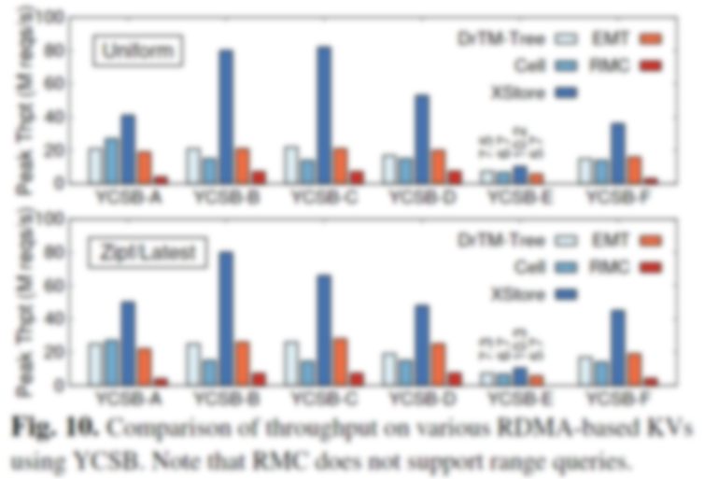
YCSB Performance
Read-only workload (C)
Bottlenecked by CPU synchronizations
Notes:
RMC Performs poorly in all experiments
无论是什么负载情况

Slide 28
YCSB Performance
Read-only workload (C)
Bottlenecked by server CPU
(server-centric design)
Notes:
RMC Performs poorly in all experiments

Slide 29
YCSB Performance
Read-only workload (C)
Traversing B+Tree with one-sided RDMA is costly! (client-direct design)
Cell has a 4-level cache in the client.
Notes:
RMC Performs poorly in all experiments

Slide 30
YCSB Performance
Read-only workload (C)
XStore (82M req/s)even higher than optimal (80M req/s)
Cell has a 4-level cache in the client.
Notes:
Optimal --- a whole-index cache
这是因为RDMA仅用一次payload很小的RDMA来找寻叶子节点的物理存储位置，相较于cache全部树节点结构逐层寻访，仍可以降低端到端的延迟，以及增大吞吐量。

Slide 31
YCSB Performance
Static workloads (A, B, C, F)
Update-heavy workloads
still bottleneck XStore.
Cell has a 4-level cache in the client.
Notes:
在整体静态负载，即有更新操作，但不涉及会影响server端树结构插入删除操作时。
实验结果，表明类似workload A这样的Update-heavy workload 仍然会显现出 Xstore的瓶颈，这符合我们的预期，因为当更新操作占比增大，XStore的工作压力会向server端迁移，类似退化成传统的server-centric设计，不能发挥client端learned cache的作用。

Slide 32
YCSB Performance
Static workloads (A, B, C, F)
Cell has a 4-level cache in the client.
Notes:
在读占多数，更新占小部分，这类比重的工作负载情景，比如workload B，实验表明，XStore吞吐量也显出巨大优势。
原因
读请求被更新请求分隔开，降低
Server端在全读负载时仍有，hybrid架构可以同时利用这部分server CPU剩余性能，异步并行
问题
为什么B的Zipf分布性能没有怎么下降，但是C降的比较明显

Slide 33
YCSB Performance
Dynamic workloads (D, E)
Dominated by scanning a large range of KV pairs
Notes:
对于动态负载，YCSB D E，峰值吞吐量这一指标XStore也体现出了明显优势。
For YCSB E,相对而言差别变小，这主要是因为性能取决于大范围的KV pair扫描。

Slide 34
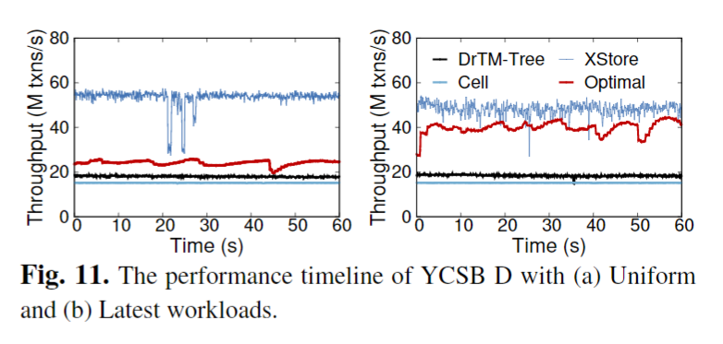
YCSB Performance
Dynamic workloads (D, E)
Suffer from performance fluctuations due to frequent cache invalidations.
4-level cache is more stable but performs worse.
Notes:
此外，对于动态负载，仅从峰值吞吐量并不能直观反映插入KV pair这类操作对系统的影响以及XStore的设计与传统方案的区别。
图11展示的是四种架构，吞吐量随时间的动态变化。
读取和插入的竞争会影响动态负载能力。
对于DrTM和EMT，吞吐量下降主要是因为基于树的索引
而对于Cell和XStore，下降则是由于缓存失效。
基于树索引的高速缓存的最佳吞吐量只达到25M reqs/s，1/3静态只读最优吞吐量（78M req/s），从时间线上可以看出由于频繁的cache失效造成的性能波动。
但是Cell仅缓存最顶部的4个level，相对Optimal的全缓存而言，缓存节点很少发生节点分裂。性能整体稳定但是能力要差一些。

Slide 35
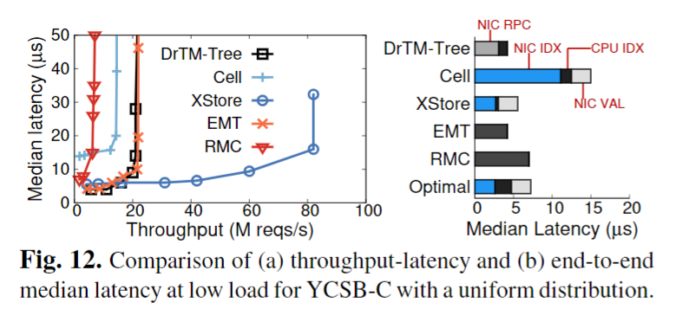
YCSB Performance
CPU utilizations
Need retraining
End-to-end latency
Use 2 auxiliary threads to retrain models. Save CPUs compared to S-RKV.
Notes:
CPU使用情况，根据文章所提，在动态负载情况使用了两个额外线程进行模型的retraining，单尽管如此，仍然比DrTM-Tree和其他S-RKV的性能要好。不过有趣的是，这里作者避开了和C-RKV比如Cell的CPU使用情况的比较，也没有给出图表，我猜测可能原因是C-RKV由于完全By pass server CPU，相较于Xstore Hybrid retraining的设计，显然在server端CPU使用率耕地，如果考虑client端和server端整体的CPU使用情况，直接相加又不是个指标（因为Hybrid同时使用了两边的CPU算力）。
端端延时，图12a展示了随负载增大，吞吐量提升时latency的变化，可以看出Xstore有显著优势。
使用较少客户端（low-load），以服务器为中心的KV系统有较低延迟（愿意 一次RPC过程要快于两次 one-side RDMA）
不过由于以服务器为中心的设计严重依赖服务端CPU，所以很快随负载提升，CPU饱和，延迟就会拔高，而Xstore缺能控制在较低水平。

Slide 36
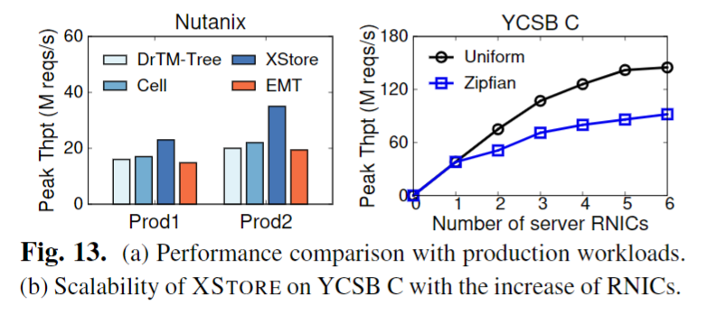
Production Workload Performance
Nutanix workload
Notes:
文章还测试了在生产环境的工作负载，使用了Nutanix提供的数据集，写密集型(57%)，类似YCSB A。从图表可以看出，峰值吞吐量在其他设计中均受到server端CPU的限制，Xstore有较为明显的提升。 不过文章没有进一步说明相较于YCSB性能提升不足的原因。

Slide 37
Scale-out Performance
One server -> More servers
Scale to 6 server RNICs (3 server machines)
Notes:
单server1:15 拓展为3server， 3:13，峰值吞吐量可以提升至 145M reqs/s。
根据测试，Xstore设计大约需要8个客户机的RNIC来饱和一个服务器的RNIC，通过拓展到2、3个服务器，使性能分别有1.97倍，2.81倍提升。

Slide 38
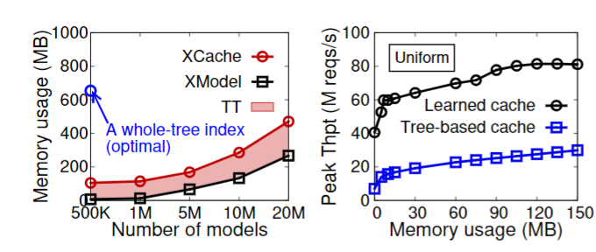
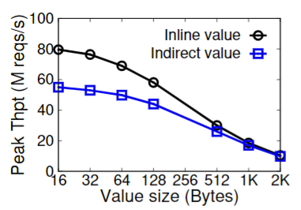
Others
Models expansion
Durability
Logging to SSD
Update-heavy: up to 24% drop
Read-heavy: nearly no drop
Variable-length Value
Replaced by a 64-bit fat pointer
An additional RDMA READ
Notes:
单server1:15 拓展为3server， 3:13，峰值吞吐量可以提升至 145M reqs/s。
根据测试，Xstore设计大约需要8个客户机的RNIC来饱和一个服务器的RNIC，通过拓展到2、3个服务器，使性能分别有1.97倍，2.81倍提升。

Slide 39
Outline
Background
Analysis and Motivation
Design and Implementation
Evaluation
Conclusion

Slide 40
Conclusion
Contribution
Provide a new design for RDMA-enabled KVS
A new hybrid architecture
Leverage ML model
Provide better trade-offs
Server-side CPU vs. Client-side memory vs.. Performance
Limitations and future work
fixed-length keys → variable-length keys
Currently focus on simple models
Notes:
总结本篇文章，主要贡献是提出了一种基于RDMA的KVS设计，针对C-RKV和S-RKV架构的不足提出了混合架构，并且引入了ML模型更好地优化client端地cache. 更好地平衡了服务器端CPU负载，客户端内存占用以及系统整体性能。
目前文章的工作仅支持固定长度的keys，以及简单的ML模型，比如线性回归。之后的研究会针对这两点进行拓展。

Slide 41
Fast RDMA-based Ordered Key-Value using Remote Learned Cache
OSDI ’20
Thanks
Presented by Shige Liu and Edwardzcn (Chuannan Zhang)

