Slide 1
CRaft: An Erasure-coding-supported Version of Raft for Reducing Storage Cost and Network Cost
FAST’20
Zizhong Wang,Tongliang Li,Haixia Wang,Airan Shao,Yunren Bai, Shangming Cai,
Zihan Xu, Dongsheng Wang
Department of Computer Science and Technology, Tsinghua University
Beijing National Research Center for Information Science and Technology, Tsinghua University
Presented by Chao Bi and JiaAn Zhu, USTC, ADSL
May 15th, 2020

Slide 2
Outline
Motivation
Background
Design and implementation
Safety Argument
Experiments and Evaluation
Conclusion
Notes:
接下来讲一下我们的研究内容

Slide 3
Motivation
Reduce Storage Cost and Network Cost！！

Slide 4
Outline
Motivation
Background
Design and implementation
Safety Argument
Experiments and Evaluation
Conclusion
Notes:
接下来讲一下我们的研究内容

Slide 5
Erasure Code
Reed-Solomon(RS) code
Original data fragments :k
Parity fragments: m

Slide 6
Erasure Code
Original data
split
k
…..
Math magic
k
…..
…..
m

Slide 7
Erasure Code
k
…..
…..
m
random select
k
…..
Math magic
Original data

Slide 8
Raft
Three states

Slide 9
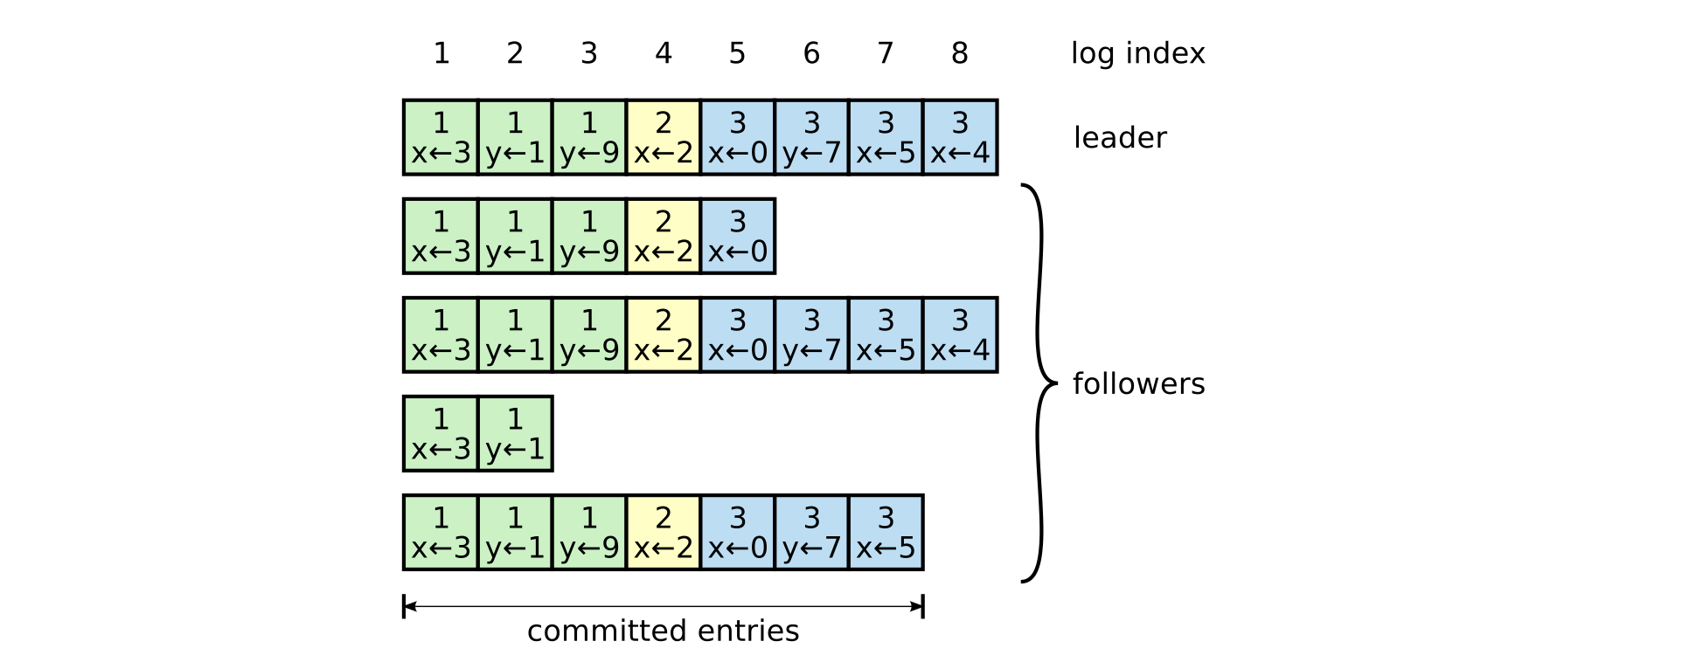
Raft
Term
Index

Slide 10
Raft
Property
Safety
Liveness(N=2F+1)

Slide 11
Prior work: RS-Paxos
Use (k,m)-RS code
$Q_{W}+Q_{R}−N≥k$
$$Q_{W}$$
N=7,k=3,m=4
$Q_{W}$=4, $Q_{R}=3$
$$Q_{R}$$

Slide 12
RS-Paxos
$$Q_{W}$$
N=7,k=3,m=4
$Q_{W}$=4, $Q_{R}=3$
$$Q_{R}$$
$$L≤N−max\left\{Q_{R},Q_{w}\right\}≤N−{(Q}_{R}+Q_{w})/2$$
$≤N−(N+k)/2$
$=F−(k−1)/2$

Slide 13
Outline
Motivation
Background
Design and implementation
Safety Argument
Experiments and Evaluation
Conclusion
Notes:
接下来讲一下我们的研究内容

Slide 14
CRaft
Liveness level: F
Need complete entry!
Notes:
Theorem . When there are only (F +1) healthy servers in an F liveness level protocol, an entry e can be committed only after the complete entry has been stored in all (F +1) healthy servers’ logs

Slide 15
CRaft
F+1
F
F+1
F

Slide 16
Coded-fragment Replication
The encoding procedure
Index Term
Content fragment
Index Term
content
…..
Index Term
Content fragment
Index Term
Content fragment
Notes:
Theorem . When there are only (F +1) healthy servers in an F liveness level protocol, an entry e can be committed only after the complete entry has been stored in all (F +1) healthy servers’ logs

Slide 17
Coded-fragment Replication
Data is committed when (F+k) fragments are stored,
F+k
N=7,F=3
k=3,m=4
F+1

Slide 18
Complete-entry Replication
If less then (F+k) healthy sevrer?
Use complete-entry replication
Parameter: p
The leader send complete copies of an entry to (F + p) followers
then send coded-fragments to remaining (F − p) followers

Slide 19
Complete-entry Replication

Slide 20
Prediction
use the most recent heartbeat answers to estimate the number of healthy servers.
Leader starts to replicate an entry
No
Complete-entry replication
And
Coded-fragment replication
heartbeat answers less than (F+k)?
Success？
Yes
No
No
Yes
Coded-fragment replication
Success？
Yes
Leader commits the entry

Slide 21
Newly-elected Leader
If only have coded fragments?
Add new operation : LeaderPre
delete
LeadPre start
No
Is more than (F+1)answers or have one complete copy
Is committed？
Require followers
No
Yes
Yes
require at least F+1 followers
Success recovery

Slide 22
More about CRaft
Snapshot？

Slide 23
Outline
Motivation
Background
Design and implementation
Safety Argument
Experiments and Evaluation
Conclusion
Notes:
接下来讲一下我们的研究内容

Slide 24
Theorem
Log Matching Property:
If two logs contain an entry with the same index and term, then the logs are the same in all entries up through the given index.
index | 1 | …… | 9 | 10 | 11
Leader | 1 | …… | 2 | 3 | 3
Follower1 | 1 | …… | 2 | 3
Follower2 | 1 | …… | 2
10 | 11
3 | 3
Content of RPC

Slide 25
Theorem
Log Matching Property:
If two logs contain an entry with the same index and term, then the logs are the same in all entries up through the given index.
Leader Completeness Property:
If a log entry e is committed in a given term (Term T), then e will be present in the logs of the leaders for all higher-numbered terms, and e will not be deleted in any higher-numbered term’s LeaderPre

Slide 26
Proof of LCP
LeaderU does not have e at the time of its election;
e is deleted in LeaderPre by LeaderU;

Slide 27
Proof of LCP
LeaderU does not have e at the time of its election;
F+1(LeaderT replicate)
According to assumption, leaders between Term T and Term U had e at the time of their own elections, and e was never deleted in LeaderPre.
e'
e'
e'
e'
e’ can be complete copy
or coded-fragments of e
x
F+1(vote for LeaderU)
x
1
……
e’
LeaderU
1
……
e’
……
LeaderP
1
……
e’
……

Slide 28
Proof of LCP
LeaderU does not have e at the time of its election;
e is deleted in LeaderPre by LeaderU;
Not the same e’ in last page!
e’’ represents entry e or
an entry before e
LeaderU
1
……
e’’
……

Slide 29
Proof of LCP
e is deleted in LeaderPre by LeaderU;
F+1(LeaderT replicate)
e'
e'
e'
e'
F+1
e’ is complete copy of e

Slide 30
Proof of LCP
e is deleted in LeaderPre by LeaderU;
F+k (LeaderT replicate)
e'
e'
e'
e'
e'
e'
F+1
e’ is coded-fragments of e

Slide 31
Theorem
State Machine Safety Property:
If a server has applied a log entry at a given index to its state machine, no other server will ever apply a different log entry for the same index.

Slide 32
Outline
Motivation
Background
Design and implementation
Safety Argument
Experiments and Evaluation
Conclusion
Notes:
接下来讲一下我们的研究内容

Slide 33
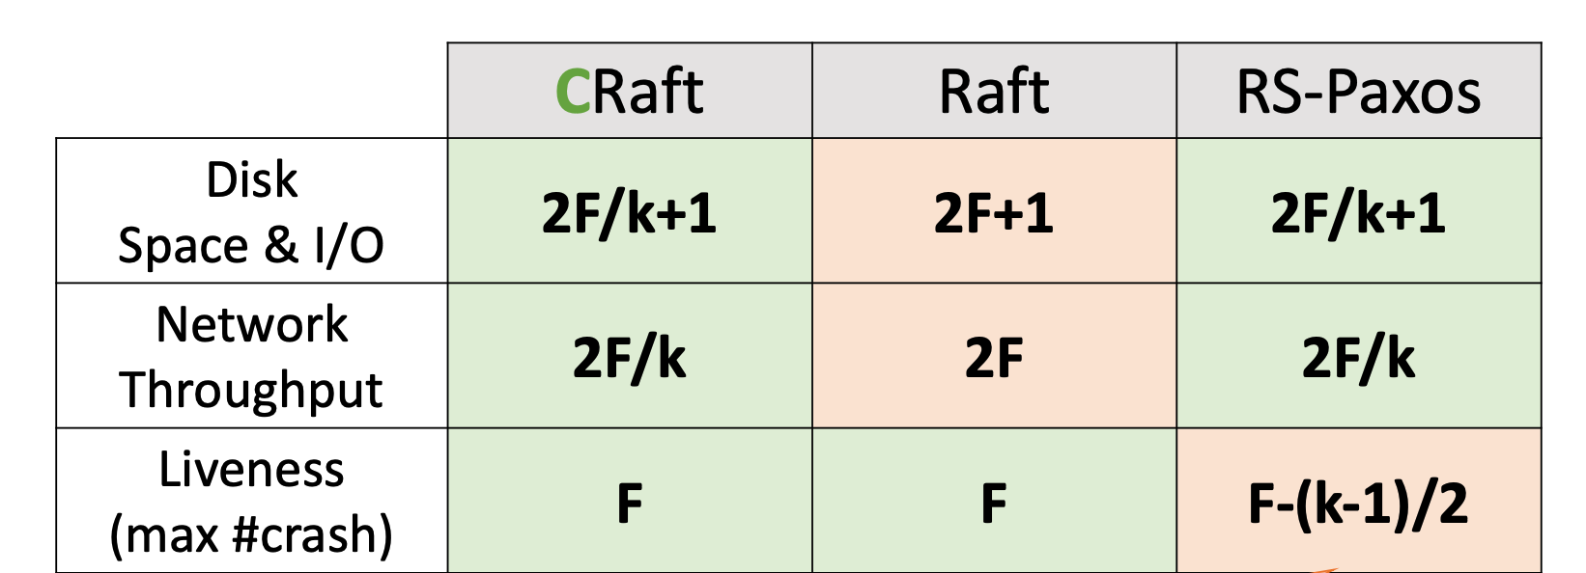
Performance
Notes:
Theorem . When there are only (F +1) healthy servers in an F liveness level protocol, an entry e can be committed only after the complete entry has been stored in all (F +1) healthy servers’ logs

Slide 34
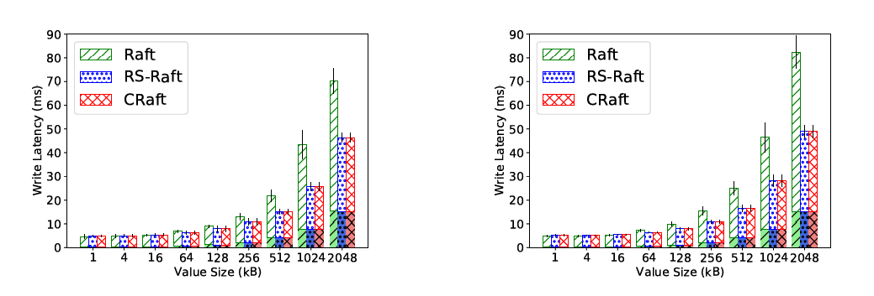
Latency
N = 5
N = 7

Slide 35
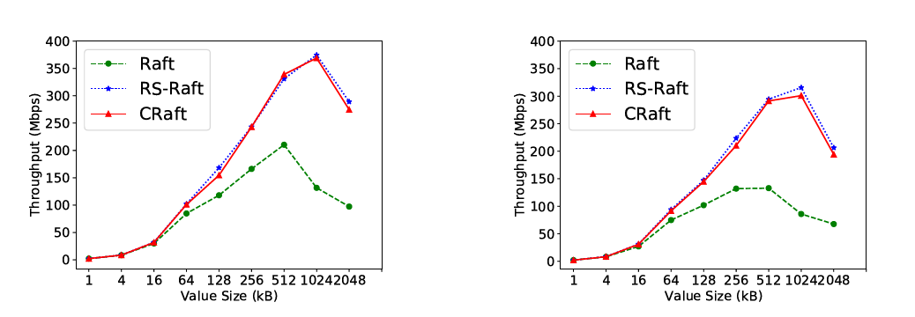
Throughput
N = 5
N = 7

Slide 36
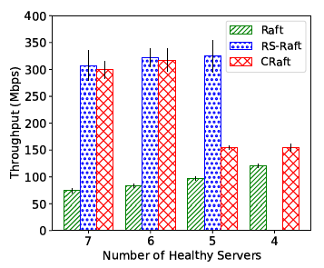
Liveness
F=3, k=3, N=7
Coded-fragment Replication when n ≥ F+k=6
Complete-entry replication when n < 6

Slide 37
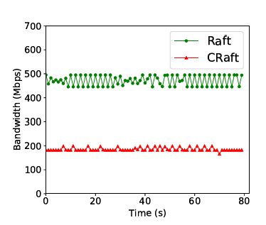
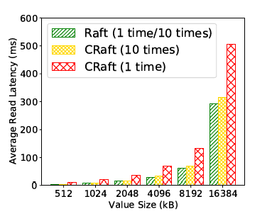
Network Cost
& Recovery Read
NOT THE SAME AS
WE EXPECT

Slide 38
Outline
Motivation
Background
Design and implementation
Safety Argument
Experiments and Evaluation
Conclusion
Notes:
接下来讲一下我们的研究内容

Slide 39
Conclusion
Not indeed an innovative idea
But practical
A wide range of applications

