Slide 1
Understanding, Detecting and Localizing
Partial Failures in Large System Software
Shared by Ziyue Qiu and King Zevin
November 18
Notes:
调研、设计和实验都做得很有借鉴意义，我们还找到了作者的前期paper，也会简单地为大家分析比较这两个工作。

Slide 2
Outline
1
Background
2
Findings
3
Design - Watchdog
3
4
Design - OmegaGen
5
Evaluation
3
6
Discussion
Notes:
首先为大家介绍背景

Slide 3
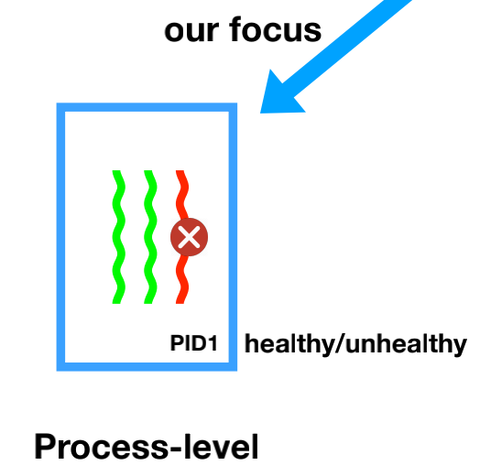
Background
Partial Failure
process-level failure
a fault does not crash process but causes
safety or liveness violation or severe
slowness for some functionalities
Notes:
不那么明显的后果

Slide 4
Background
Modern software are increasingly complex and often fail partially.
Partial failures are beyond the scope of existing detectors, which primarily focus on detecting fail-stop failures in distributed systems.
Notes:
现状
These partial failures cannot be detected by process-level failure detectors.

Slide 5
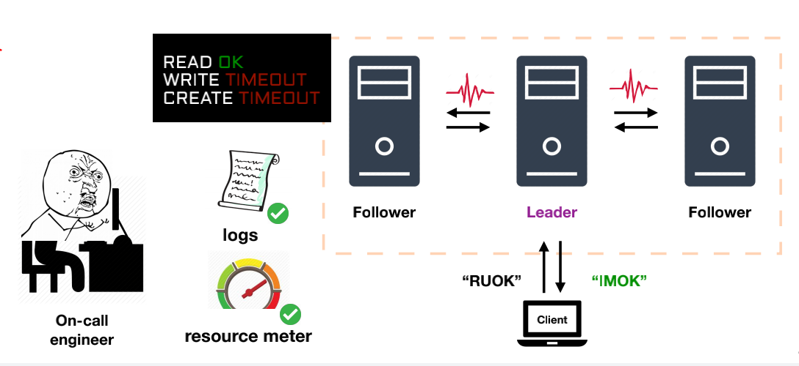
Background
Total Failure
e.g. crash, abort, or network disconnection
can be quickly identified, restarted or repaired
Notes:
Gray Failure
service-level failure

Slide 6
Outline
Background
Background
1
Background
Findings
2
Findings
3
Design - Watchdog
3
4
Design - OmegaGen
5
Evaluation
3
6
Discussion
Notes:
首先为大家介绍背景

Slide 7
Findings
Methodology : study 100 partial failure cases from five large, widely used software systems
Notes:
真正出问题的可能只是一个小的组成部分，甚至就是一条指令。
严谨性：
五个系统包括不同语言，不同服务
样例人工标记，随机选取

Slide 8
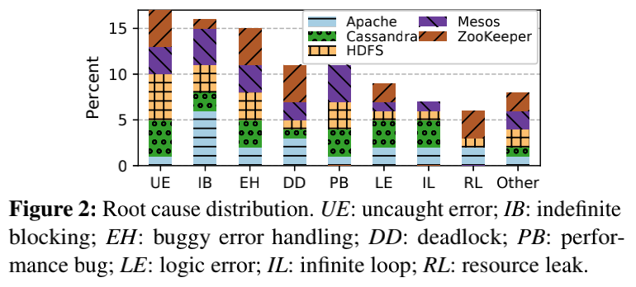
Finding 1 - Diverse root causes
There is no single uniformed or dominating root cause.

Slide 9
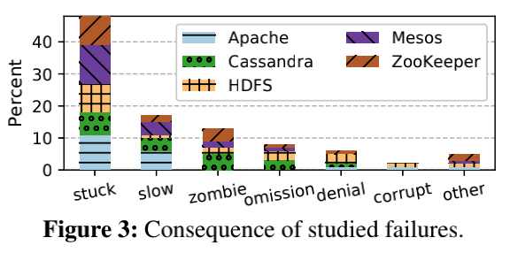
Finding 2 - stuck and silent
Nearly half (48%) - stuck
17% - slow
15% - silent (including data loss, corruption, inconsistency, and wrong results).

Slide 10
Finding 3 - Specific condition
71% of the failures are triggered by some specific environment condition, input, or faults in other processes.
Notes:
detect和localize有挑战

Slide 11
Finding 4 - Debug cost long time
Inefficiency ：
The median diagnosis time is 6 days and 5 hour.
Two reasons ：
confusing symptoms of the failures mislead the diagnosis direction
insuffcient exposure of runtime information in the faulty process
Notes:
enable debug logs, analyze heap, and/or instrument the code
【配图

Slide 12
Findings - Summary
85% violate liveness or trigger explicit errors -> without deep semantic understanding
specific workload or environment -> runtime mechanisms
debug cost long time -> localize
Notes:
工作量大 不系统

Slide 13
Outline
Background
1
Background
Findings
2
Findings
3
Design - Watchdog
3
4
Design - OmegaGen
5
Evaluation
3
6
Discussion
Notes:
首先为大家介绍背景

Slide 14
Design - Watchdog
intrinsic watchdog
(a) executing mimic-style checkers
(b) using stateful payloads
(c) sharing execution environment of the monitored process
Notes:
核心是把watchdog和主进程放在相似的环境里，分开讲解，最后回到图进行整体总结

Slide 15
Design - Watchdog
intrinsic watchdog
(a) executing mimic-style checkers
(b) using stateful payloads
(c) sharing execution environment of the monitored process
Select some representative operations from the main program, imitates them, and detects errors
accuracy (> signal checkers)
high coverage (> probe checkers)
Notes:
3-10%

Slide 16
Design - Watchdog
intrinsic watchdog
(a) executing mimic-style checkers
(b) using stateful payloads
(c) sharing execution environment of the monitored process
Contexts are synchronized with the program state through hooks in the main program

Slide 17
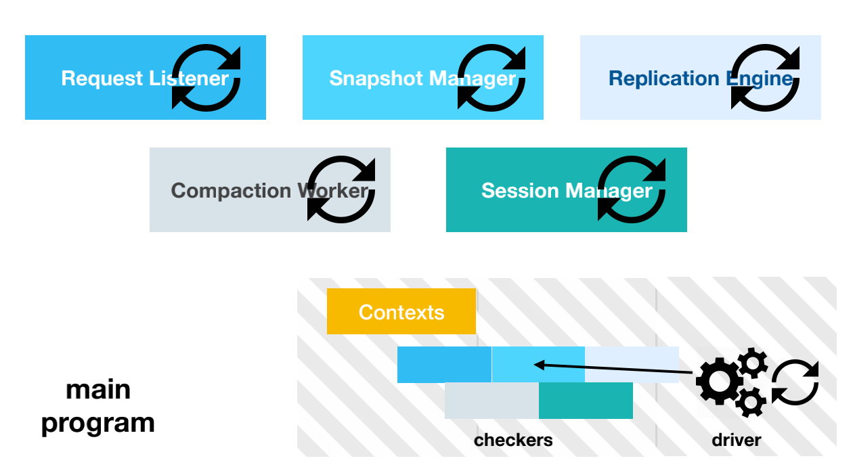
Design - Watchdog
intrinsic watchdog
(a) executing mimic-style checkers
(b) using stateful payloads
(c) sharing execution environment of the monitored process
Concurrent
Notes:
execute comprehensive checkers without delaying the main program during normal executions

Slide 18
Outline
1
Background
2
Findings
3
Design - Watchdog
3
4
Design - OmegaGen
5
Evaluation
3
6
Discussion
Notes:
首先为大家介绍背景

Slide 19
Design - OmegaGen
a prototype that systematically generate watchdogs described above for system softwares
Notes:
这是作者提供的运行截图，使用者只需将软件作为输入，OmegaGen会生成含有watchdogs的版本。注意到要求Java，但high-level的idea值得认可。

Slide 20
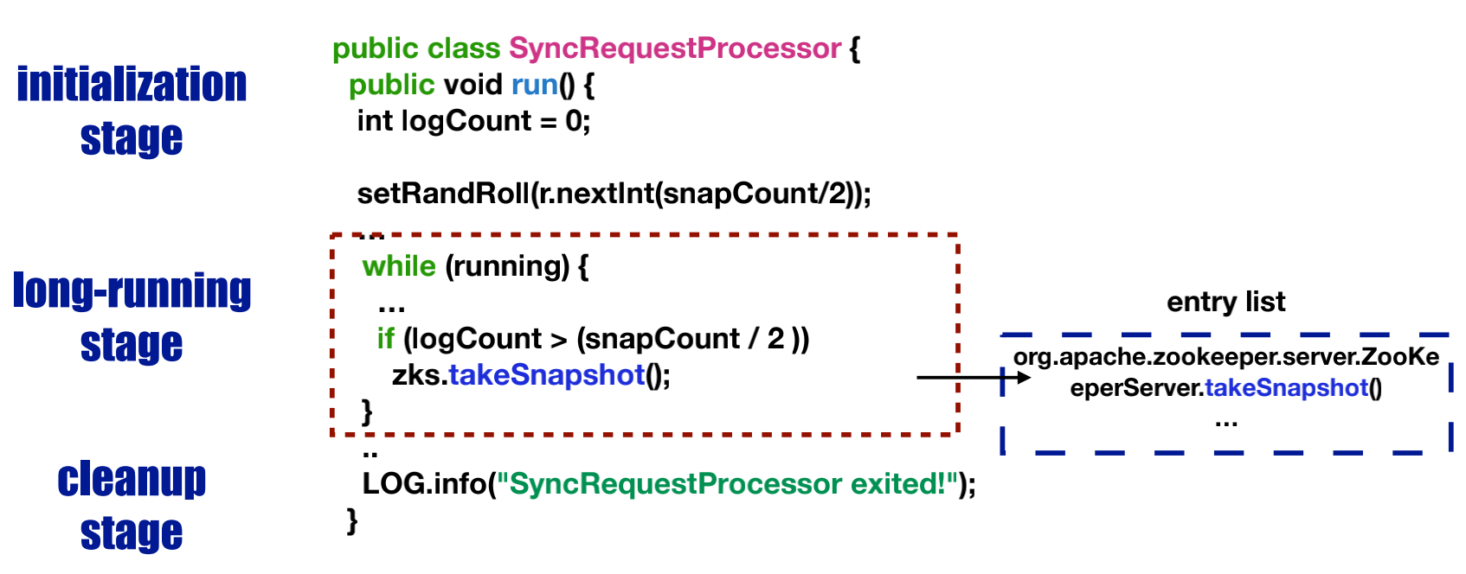
Design - OmegaGen
step1 : Identify Long-running Methods
while(True)/while(flag) -> yes!
others -> skipped!
Notes:
概率 tradeoff

Slide 21
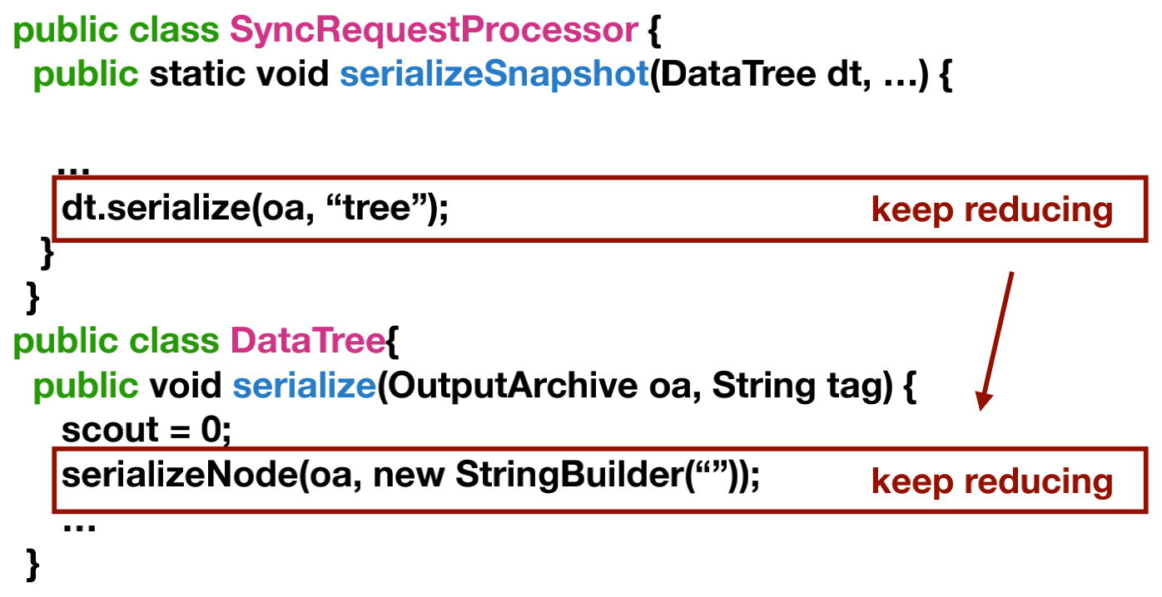
Design - OmegaGen
step2 : Reduce Main Program
preserve the original structure (in order)
recursively try to reduce the target function
Notes:
小函数先削命令，削空了就删掉这个函数，调用了这条函数的也可以删掉对应调用行。

Slide 22
Design - OmegaGen
step3 : Locate Vulnerable Operations
operations logically deterministic should be checked before production
heuristic : I/O, synchronization, resource, communication related... -> highly vulnerable!
Notes:
空！

Slide 23
Design - OmegaGen
step4 : Encapsulate Reduced Program
encapsulate the code snippets retained
add missing definitions or payloads

Slide 24
Design - OmegaGen
step5 : Add Checks to Catch Faults
insert watchdog hooks
Notes:
insert a timer before running a checker (good timeout?

Slide 25
Design - OmegaGen
step6 : Validate Impact of Caught Faults
reduce false alarms : focus on transient errors
simply re-execute the checker and compare
Notes:
涉及到timeout，有些不一定真的有问题 比如网络断了1s 之后恢复就再测不到了
not for handling errors but rather confirming impact
add user-defined kinds of validation

Slide 26
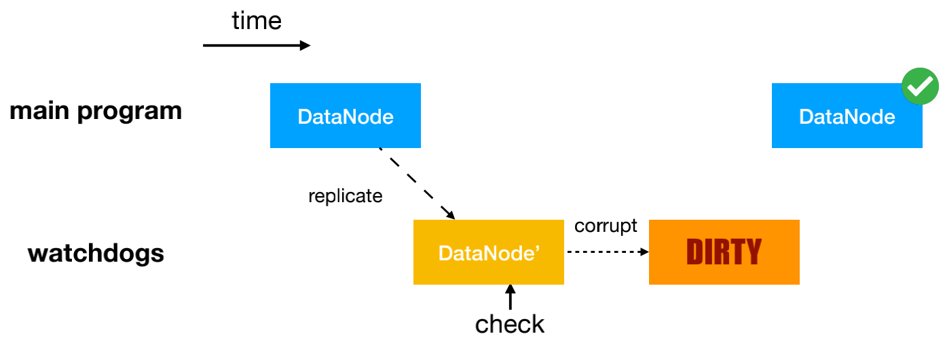
Design - OmegaGen
step7 : Prevent Side Effects
Memory side effects -> Context Replication
keep modifications in watchdog's state
blindly replicate? overhead!
hold reference -> lazy copy
Notes:
version, weak_ref (weak reference to the source object), and hash (hash code for the value of the source ob_x0002_ject)
其实还有immutability analysis

Slide 27
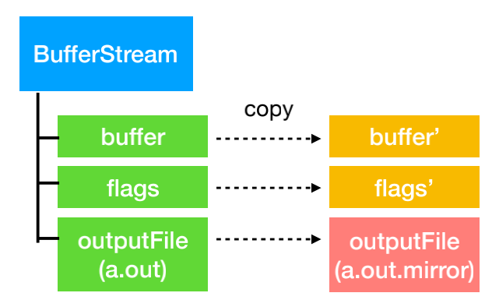
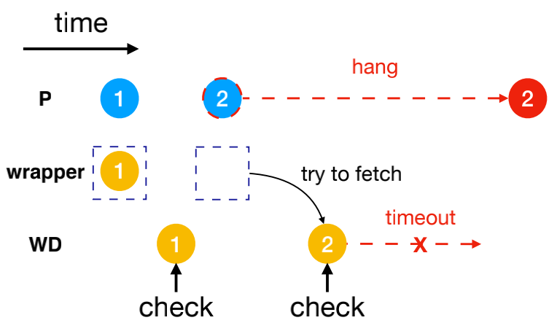
Design - OmegaGen
step7 : Prevent Side Effects
I/O side effects -> Redirection and Wrappers
write: file-related resource replicated with target path changed to test file
read: read caches or timeout
Notes:
the test file may get distributed to a different environment and thus miss issues that only affect the original file. This limitation can be addressed as our write redirection is implemented in a cloning library,
缓存和timeout

Slide 28
Outline
1
Background
2
Findings
3
Design - Watchdog
3
4
Design - OmegaGen
5
Evaluation
3
6
Discussion
Notes:
首先为大家介绍背景

Slide 29
Evaluation - Setup
Implementation:
8100 LOC in Java
on top of Soot program analysis framework
supports Java bytecode
10 cloud VMs:
4 vCPUs @ 2.3GHz
16 GB memory
256 GB disk.
Notes:
大家好.我来讲一下evaluation部分. 这篇paper的evaluation部分,工作量很大,有很多明显的优点和缺点. 我觉得可以学习借鉴一下.
首先是实现.基于前面的design, 作者写了8000行的java 代码.这是基于Soot这一分析框架的. 支持Java字节码的分析,避免了JDK的复杂特性.
然后他们后续的实验都是基于10台cloud vm做的.性能配置是这样.
但是有意思的是,后面的实验完全没有提这10台vm是怎么分配的.几台给所跑的系统,几台给benchmark

Slide 30
Evaluation - Workload: 6 Systems
 | Zookeeper | Cassandra | HDFS | HBase | MapReduce | Yarn
LOC | 28K | 102K | 219K | 728K | 191K | 229K
Methods | 3,562 | 12,919 | 79,584 | 179,821 | 16,633 | 10,432
Notes:
为了评测detector的效果,包括能不能探测到,探测花的时间,探测到的error离bug多远.
作者选取了6个现实中广泛使用的大型系统. 代码量和methods数目如图所示. 我们需要解释一下每个系统是干嘛的吗?
这些系统都是分布式的.
代码量很大
zk: 为大型分布式计算提供开源的分布式配置服务、同步服务和命名注册。
cassandra: Cassandra 分布式数据库
hdfs: hadoop fs
HBase: 非关系型分布式数据库
mapreduce: 大规模数据并行计算框架
yarn: 是hadoop的资源管理,任务调度的框架

Slide 31
Evaluation - Watchdog Generation
 | Zookeeper | Cassandra | HDFS | HBase | MapReduce | Yarn
LOC | 28K | 102K | 219K | 728K | 191K | 229K
Methods | 3,562 | 12,919 | 79,584 | 179,821 | 16,633 | 10,432
Watchdogs | 96 | 190 | 174 | 358 | 161 | 88
Reduced Methods | 118 | 464 | 482 | 795 | 371 | 222
Vulnerable Operations | 488 | 2,112 | 3,416 | 9,557 | 6,116 | 752
Number of watchdogs and checkers generated
30 lines of default rules for the vulnerable operation heuristics
+ an average of 10 system-speciﬁc rules
Notes:
基于这6个系统,omegagen生成了相应的watchdog.
我们从下往上看.
首先是vulnerable operation的选取. 对此,omegagen有30条default rule. 另外还有平均10条system-specific的rule. 这些rule是heuristic的,主要靠前期的经验知识.
比如前面design那里提到了,大都数是通过standard library call判断的,主要是I/O, synchronization, resource等等相关的operation.
就这样,以ZK为例,选取了488个vulnerable operation.
这488个operation归属于118个reduced method.
然后watchdog的定义是root of reduced methods.每个线程的入口
这个表里面,每个watchdog指的是root of reduced methods. 这些是产生的static watchdog,但是并不是所有都会在运行中被调用.调用的触发条件是4.1的predicate和context hook
因为没有开源,所以这些具体的rule是哪些,又有多specific,我们并没有找到.
watchdog他的说法是root of reduced methods.我的理解里,应该是 每个vulnerable operation所在的method往上递归. 多少个method放在同一个checker里面? todo

Slide 32
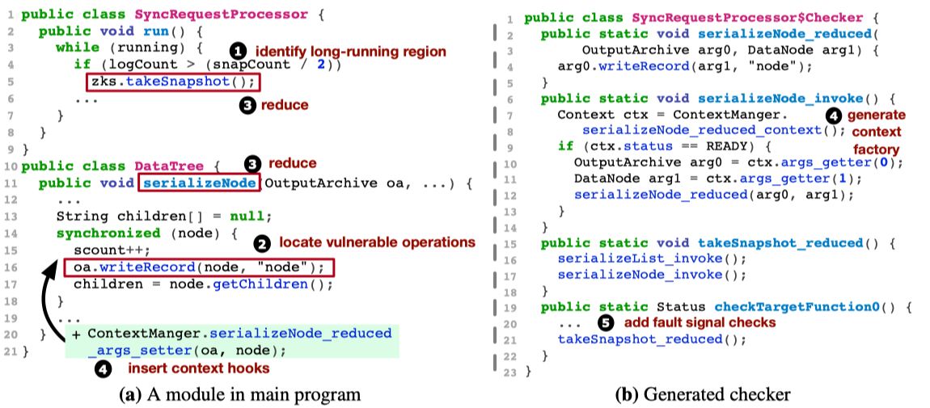
Evaluation - Watchdog Generation
 | Zookeeper | Cassandra | HDFS | HBase | MapReduce | Yarn
LOC | 28K | 102K | 219K | 728K | 191K | 229K
Methods | 3,562 | 12,919 | 79,584 | 179,821 | 16,633 | 10,432
Watchdogs | 96 | 190 | 174 | 358 | 161 | 88
Reduced Methods | 118 | 464 | 482 | 795 | 371 | 222
Vulnerable Operations | 488 | 2,112 | 3,416 | 9,557 | 6,116 | 752
Number of watchdogs and checkers generated
30 lines of default rules for the vulnerable operation heuristics
+ an average of 10 system-speciﬁc rules
Notes:
基于这6个系统,omegagen生成了相应的watchdog.
我们从下往上看.
首先是vulnerable operation的选取. 对此,omegagen有30条default rule. 另外还有平均10条system-specific的rule. 这些rule是heuristic的,主要靠前期的经验知识.
比如前面design那里提到了,大都数是通过standard library call判断的,主要是I/O, synchronization, resource等等相关的operation.
就这样,以ZK为例,选取了488个vulnerable operation.
这488个operation归属于118个reduced method.
然后watchdog的定义是root of reduced methods.每个线程的入口对应一个checker.
其实这里operation rule的选取我觉得是非常重要的一步.这些具体的rule是怎么样的,有多system-specific,有待确定,我们发邮件找作者要了代码,他们说即将开源,不过要过一段时间

Slide 33
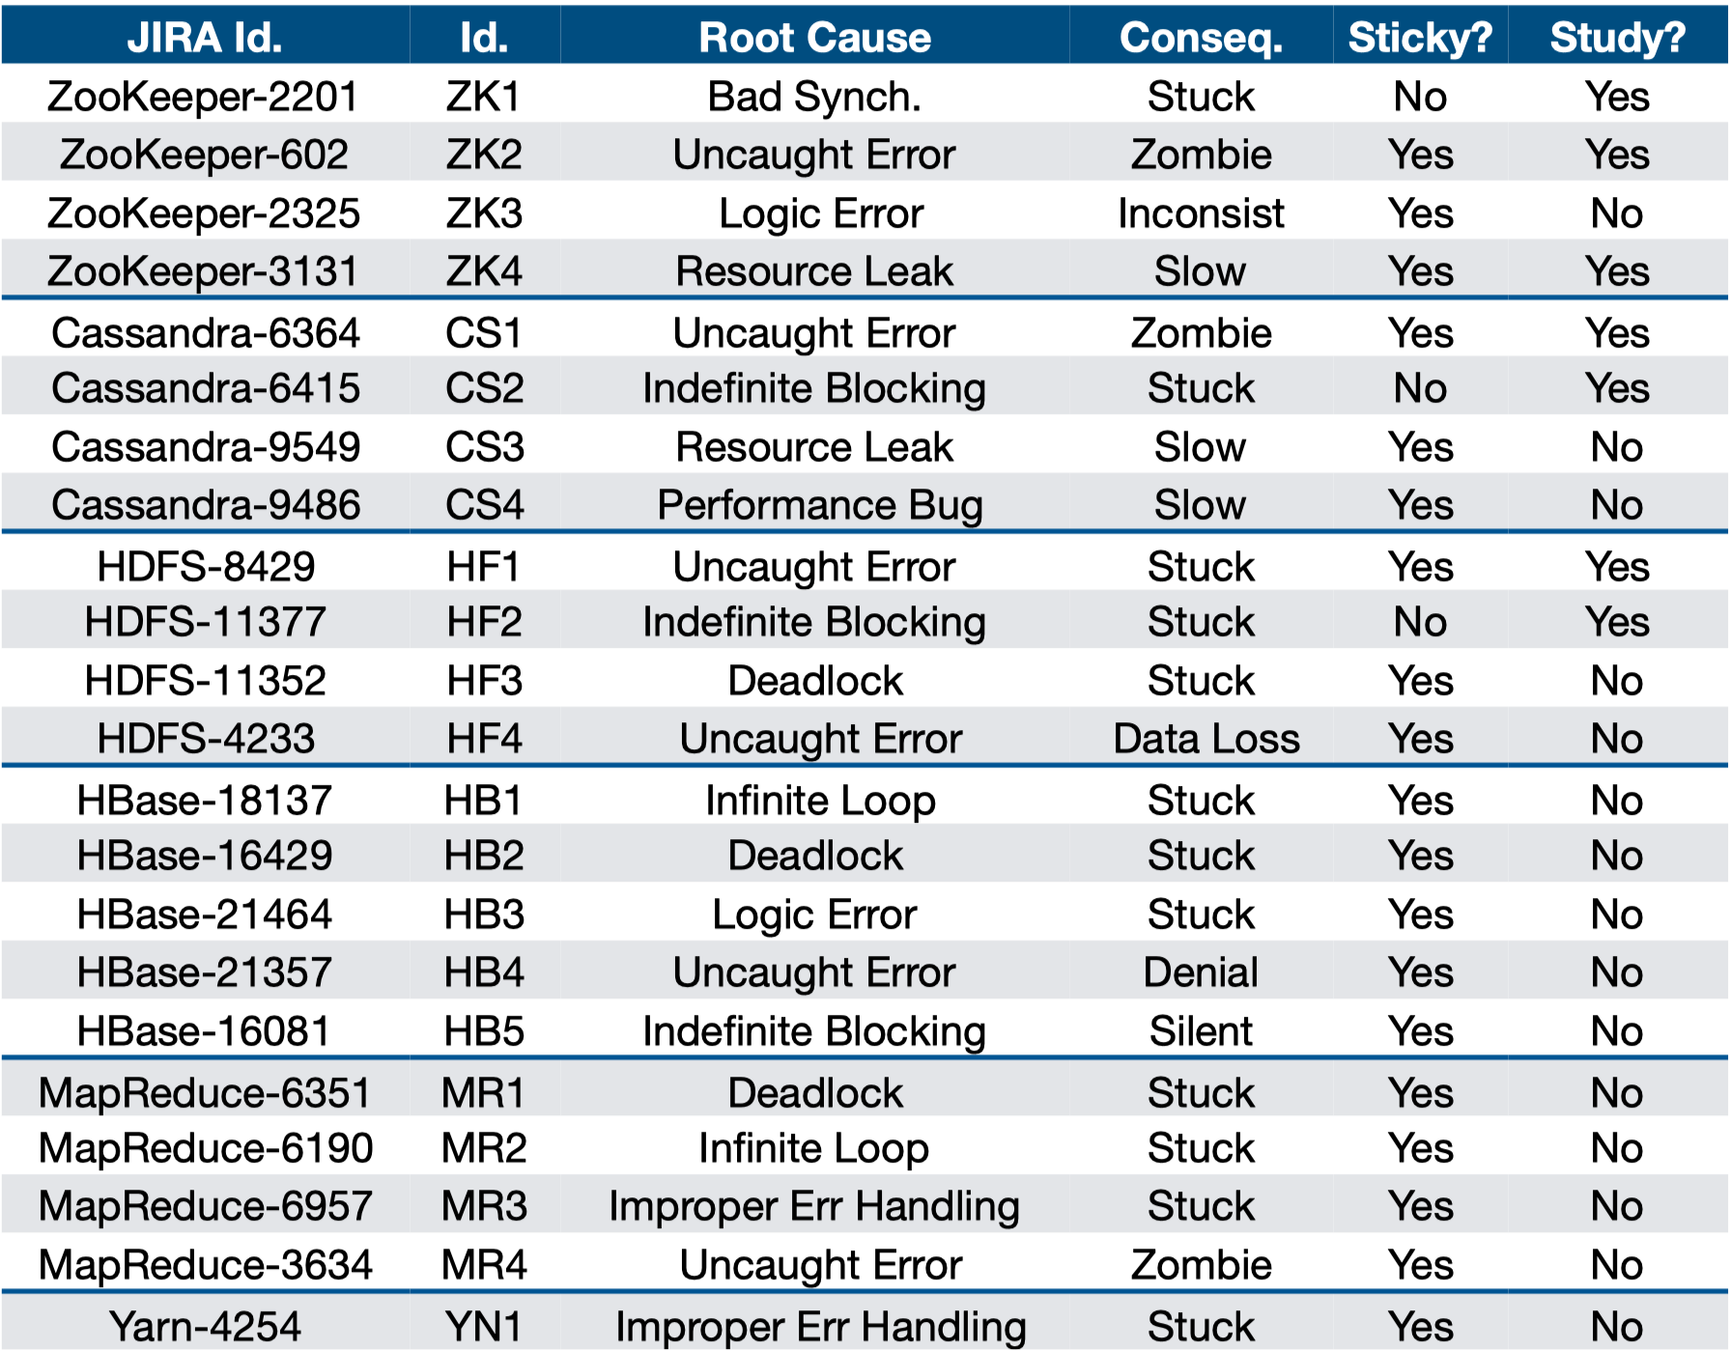
Evaluation - 22 Reproduced Failures
Notes:
从这6个system中,选取了22个failure进行复现,每个failure的复现花了平均1周的时间,root cause很多样.
Consequences都得说清
stuck 表示阻塞,但是不一定该进程的所有线程都阻塞,比如说heartbeat消息还是正常接收发送的
slow 慢,比如说latency从6ms变成了100ms(cassandra例子)
zombie exit,不服务了,但是进程还活着.
sticky? the failure persists forever.
study: 前面100个failure里面是否学过?

Slide 34
Evaluation - Baseline Checkers
Detector | Description
Client (Panorama [OSDI’18]) | instrument and monitor client responses
Probe (Falcon [SOSP’11]) | daemon thread in the process that periodically invokes internal functions with synthetic requests
Signal | script that scans logs and checks JMX metrics
Resource | daemon thread that monitors memory usage, disk and I/O health, and active thread count
Notes:
Client: Client基于的是OSDI18的Panorama.各个component以client的角度,收集并分析他所对应的server的运行情况,遇到错误就报错.
Probe: Probe是基于SOSP11的Falcon,周期性地调用内部API. 但是大应用有很多API.所以很难遍历全部,并构造测试样例.
盲目的测试API,开销很大.并且一些partial failure是API 层面测不到的
Signal和Resource: 除了这两篇工作之外,工业界还有一些效果比较好的,更有针对性的detect方法.
Signal: 扫描logs,检查JMX(Java Management Extensions)的metrics指标.该系统特殊的经常出问题的metrics.以zk为例, Outstanding Requests > 10, request average latency > 10 ticks
Resource: Swap usage > 128MB, Disk > 85% usage
四个比较统一的句式.
内容没体现在slides!!!!!!!!!!!!!!!!!!!!!

Slide 35
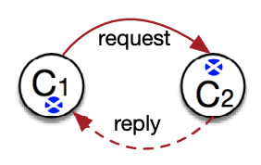
Evaluation - Baseline Checkers
Detector | Description
Client (Panorama [OSDI’18]) | instrument and monitor client responses
Probe (Falcon [SOSP’11]) | daemon thread in the process that periodically invokes internal functions with synthetic requests
Signal | script that scans logs and checks JMX metrics
Resource | daemon thread that monitors memory usage, disk and I/O health, and active thread count
Notes:
Client: Client基于的是OSDI18的Panorama.各个component以client的角度,收集并分析他所对应的server的运行情况,遇到错误就报错.
Probe: Probe是基于SOSP11的Falcon,周期性地调用内部API. 但是大应用有很多API.所以很难遍历全部,并构造测试样例.
盲目的测试API,开销很大.并且一些partial failure是API 层面测不到的
Signal和Resource: 除了这两篇工作之外,工业界还有一些效果比较好的,更有针对性的detect方法.
Signal: 扫描logs,检查JMX(Java Management Extensions)的metrics指标.该系统特殊的经常出问题的metrics.以zk为例, Outstanding Requests > 10, request average latency > 10 ticks
Resource: Swap usage > 128MB, Disk > 85% usage
四个比较统一的句式.
内容没体现在slides!!!!!!!!!!!!!!!!!!!!!

Slide 36
Evaluation - Baseline Checkers
Detector | Description
Client (Panorama [OSDI’18]) | instrument and monitor client responses
Probe (Falcon [SOSP’11]) | daemon thread in the process that periodically invokes internal functions with synthetic requests
Signal | script that scans logs and checks JMX metrics
Resource | daemon thread that monitors memory usage, disk and I/O health, and active thread count
outstanding requests > 10,
latency_avg > 10 ticks
Notes:
Client: Client基于的是OSDI18的Panorama.各个component以client的角度,收集并分析他所对应的server的运行情况,遇到错误就报错.
Probe: Probe是基于SOSP11的Falcon,周期性地调用内部API. 但是大应用有很多API.所以很难遍历全部,并构造测试样例.
盲目的测试API,开销很大.并且一些partial failure是API 层面测不到的
Signal和Resource: 除了这两篇工作之外,工业界还有一些效果比较好的,更有针对性的detect方法.
Signal: 扫描logs,检查JMX(Java Management Extensions)的metrics指标.该系统特殊的经常出问题的metrics.以zk为例, Outstanding Requests > 10, request average latency > 10 ticks
Resource: Swap usage > 128MB, Disk > 85% usage
四个比较统一的句式.
内容没体现在slides!!!!!!!!!!!!!!!!!!!!!

Slide 37
Evaluation - Baseline Checkers
Detector | Description
Client (Panorama [OSDI’18]) | instrument and monitor client responses
Probe (Falcon [SOSP’11]) | daemon thread in the process that periodically invokes internal functions with synthetic requests
Signal | script that scans logs and checks JMX metrics
Resource | daemon thread that monitors memory usage, disk and I/O health, and active thread count
outstanding requests > 10,
latency_avg > 10 ticks
disk usage > 85%
Notes:
Client: Client基于的是OSDI18的Panorama.各个component以client的角度,收集并分析他所对应的server的运行情况,遇到错误就报错.
Probe: Probe是基于SOSP11的Falcon,周期性地调用内部API. 但是大应用有很多API.所以很难遍历全部,并构造测试样例.
盲目的测试API,开销很大.并且一些partial failure是API 层面测不到的
Signal和Resource: 除了这两篇工作之外,工业界还有一些效果比较好的,更有针对性的detect方法.
Signal: 扫描logs,检查JMX(Java Management Extensions)的metrics指标.该系统特殊的经常出问题的metrics.以zk为例, Outstanding Requests > 10, request average latency > 10 ticks
Resource: Swap usage > 128MB, Disk > 85% usage
四个比较统一的句式.
内容没体现在slides!!!!!!!!!!!!!!!!!!!!!

Slide 38
Evaluation - Detection Time
T_detection =
Time_detector_reports_failure - Time_software_reaches_failure_point
Notes:
首先是detection time
是这么计算的,有两个时间点,第一个是我们的detector报告failure的时间点, 第二个是软件到达failure point的时间点.这两个时间点的差值,就是我们要考察的detection time

Slide 39
Evaluation - Detection Time
T_detection =
Time_detector_reports_failure - Time_software_reaches_failure_point
7
Detection times (in secs) for the real-world cases
Notes:
5个checker对22个例子的探测时间是这样的
client测到了7个,时间几秒为主,除了CS1的441秒

Slide 40
Evaluation - Detection Time
T_detection =
Time_detector_reports_failure - Time_software_reaches_failure_point
7
3
Detection times (in secs) for the real-world cases
Notes:
Probe是3个

Slide 41
Evaluation - Detection Time
T_detection =
Time_detector_reports_failure - Time_software_reaches_failure_point
7
3
11
Detection times (in secs) for the real-world cases
Notes:
Signal测的很多,11个

Slide 42
Evaluation - Detection Time
T_detection =
Time_detector_reports_failure - Time_software_reaches_failure_point
7
3
11
9
Detection times (in secs) for the real-world cases
Notes:
Resource也挺好,9个.
Signal和Resource效果好,是因为对他们的实现,作者采用了很多社区里面给出的经验指标. 不过还有个问题,这些经验指标获得的信息比较少,导致false positive的几率会变大

Slide 43
Evaluation - Detection Time
T_detection =
Time_detector_reports_failure - Time_software_reaches_failure_point
7
3
11
9
20
Detection times (in secs) for the real-world cases
Notes:
而wd是测到了20个,detection time的中位数是 4.2s
选择了12个默认operation rule, 和8个specific rule

Slide 44
Evaluation - Detection Time
T_detection =
Time_detector_reports_failure - Time_software_reaches_failure_point
Detection times (in secs) for the real-world cases
Notes:
细心的同学可能发现了,这里有4个负数的detection time.
负数是因为failure的开始,和对应的fault point被触发, 是两个概念.
我们通过下一页的例子来看一下具体是怎么回事

Slide 45
Evaluation - Detection Time
T_detection =
Time_detector_reports_failure - Time_software_reaches_failure_point
Time_detector_reports_failure ≠ Time_software_reaches_fault_point
Detection times (in secs) for the real-world cases
Notes:
细心的同学可能发现了,这里有4个负数的detection time.
负数是因为failure的开始,和对应的fault point被触发, 是两个概念.
我们通过下一页的例子来看一下具体是怎么回事

Slide 46
Evaluation - Detection Time
Case Study:
CS1: disk error → uncommitted write piled up → long gc
YN1:
try to create a new instance
error not handled properly
retry creating a new instance → stuck
org.apache.hadoop.security.SecurityUtil.buildTokenService() not regarded as vulnerable
Notes:
CS1: CS1的failure是这样的,首先,要写入的disk坏了.导致相应的写操作被堆积起来.过了一段时间之后内存占用太大,引发了很长的GC.
这里,failure的reach point,就是进入gc的时间.
而我们的wd,将这样的写operation标记成了vulnerable,在gc前就探测到disk error.导致我们的detection time成了负数,表示症状出现之前就发现了error
YN1: 再看一下YN1.YN1的failurewd没有测出来,YN1是在创建一个新的instance的时候有一个error没有被正确处理,导致反复重试创建新instance.
为什么没有追踪到这个failure呢?是因为在这样一个过程中,没有operation被当做vulnerable的.
出问题的operation是buildTokenService,它主要是创建新数据.没被作者当成vulnerable.所以没有生成对应的checker. 从这一点可以看到他们的一个局限性,vulnerable operation的选择很依赖经验
结果就是很少出错的这种operation,比如这里的buildTokenService,很难顾及到.

Slide 47
Evaluation - Detection Localization
Notes:
看完detection time之后,我们看一下error的定位情况. 定位的scope分成了7个等级.从精准到不精准,有从左到右的 instruction 级别,function级别, function chain级别,最右边是没有定位到和定位错误.
7

Slide 48
Evaluation - Detection Localization
Failure localization for the real-world cases.
Notes:
对这22个failure的定位情况是这样的.
定位到faulty entry,也就是thread入口开始的function chain的话,可以帮助开发人员更快的定位bug,
如果统计这样的level,也就是左边四个定位的level, 得到的数据是这样的

Slide 49
Evaluation - Detection Localization
0
3
8
0
18
Failure localization for the real-world cases.
Notes:
wd的定位效果很好,因为他会模仿 main program的operations

Slide 50
Evaluation - Find a New Bug
The bug similar to ZK1 but not reported before
Notes:
他们在进一步测试的时候,发现了一个新的bug.这个bug类似于ZK1,但是之前没有被report.
这里对应的vulnerable operation,和之前并不完全一样,刚好监测到了相似的bug
这证明他们并不是完全依赖之前已经report过的bug,有一定的积极意义

Slide 51
Evaluation - False Alarms
False alarm ratios under various setups: stable / loaded / tolerable
Notes:
除了detection之外,还有误报,也就是false positive.
这里是跑了三种不同的负载,监测误报的情况,
stable是稳定的,比较轻的负载,
loaded是较高的负载,
tolerable是引入了一些transient error,这样的error我们一般不当成是真的failure,因为可以自己恢复.
这样的setup,可能引起一些metrics的变化,导致误判,以signal为例,虽然前面监测的比较多,但是这里的误报也变多了.
watch_v指的是启用validation的watchdog. validation可以减少误判,减少transient error.
这里的ratio是怎么计算的呢? 误报的次数 除以 checker执行的次数, 这里是每秒钟执行一次checker.
这里没有client的测试数据了.怀疑是他们赶ddl时间不够了 后面也有一些确实的baseline evaluation少了些数据

Slide 52
Evaluation - Performance & Overhead
 | Zookeeper | Cassandra | HDFS | HBase | MapReduce | Yarn
Analysis | 21 | 166 | 75 | 92 | 55 | 50
Generation | 43 | 103 | 130 | 953 | 131 | 89
Performance of watchdog generation(seconds)
Notes:
然后我们来看一下watchdog相关的performance和overhead

Slide 53
Evaluation - Performance & Overhead
 | Zookeeper | Cassandra | HDFS | HBase | MapReduce | Yarn
Analysis | 21 | 166 | 75 | 92 | 55 | 50
Generation | 43 | 103 | 130 | 953 | 131 | 89
Performance of watchdog generation(seconds)
5 systems < 5 min
HBase ~ 17 min
Notes:
看wd生成的时间,6个系统里面, 有5个是5min以内,代码量最大的Hbase是17min.时间挺短的

Slide 54
Evaluation - Performance & Overhead
Workloads: Popular benchmarks for each system
CS: ycsb with 40 clients sending 100,000 requests(50% read)
...
Notes:
然后是跑benchmark来看具体的性能和overhead.采用的都是popular的benchmark
其实,
也没说每个系统的具体配置,以及workload的VM分配.可能是篇幅不够了? 或者赶

Slide 55
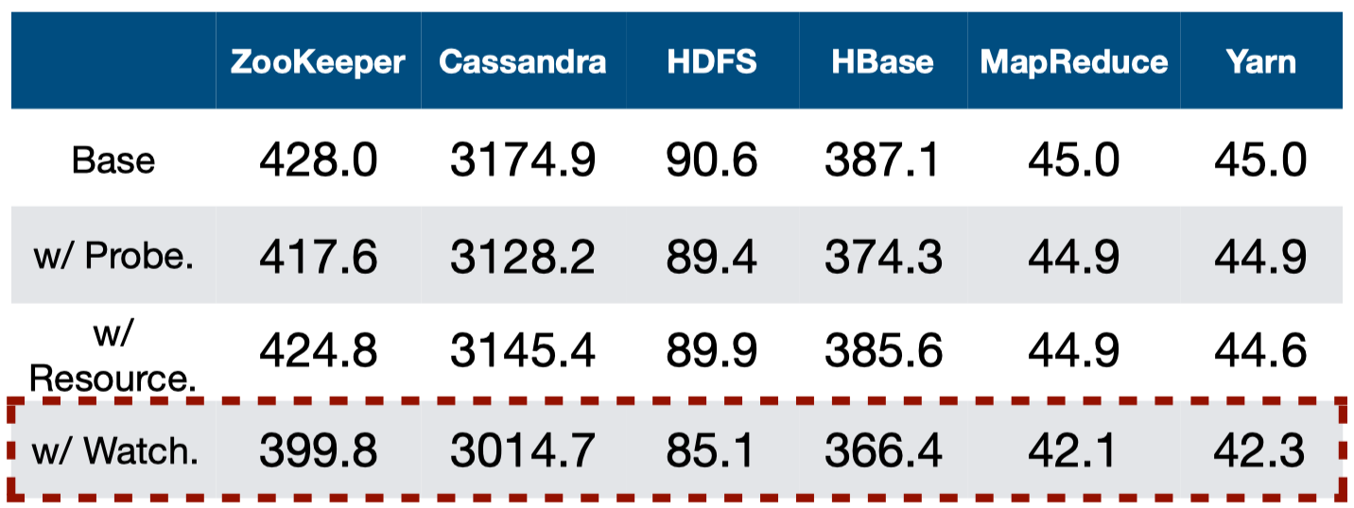
Evaluation - Overhead: Throughput
Throughput (op/s) w/ diﬀerent checkers
5.0%-6.6% throughput overhead w/ watchdog
Notes:
这里只有2个baseline checker了.

Slide 56
Evaluation - Overhead: Latency
Less numbers:
The watchdogs incur:
9.3%-12.2% overhead on average latency
8.3%-14.0% overhead on tail(99th) latency
Notes:
latency overhead只有这里两组数据了. 10%也不算小了其实. 我估计因为是劣势所以没有画表了.

Slide 57
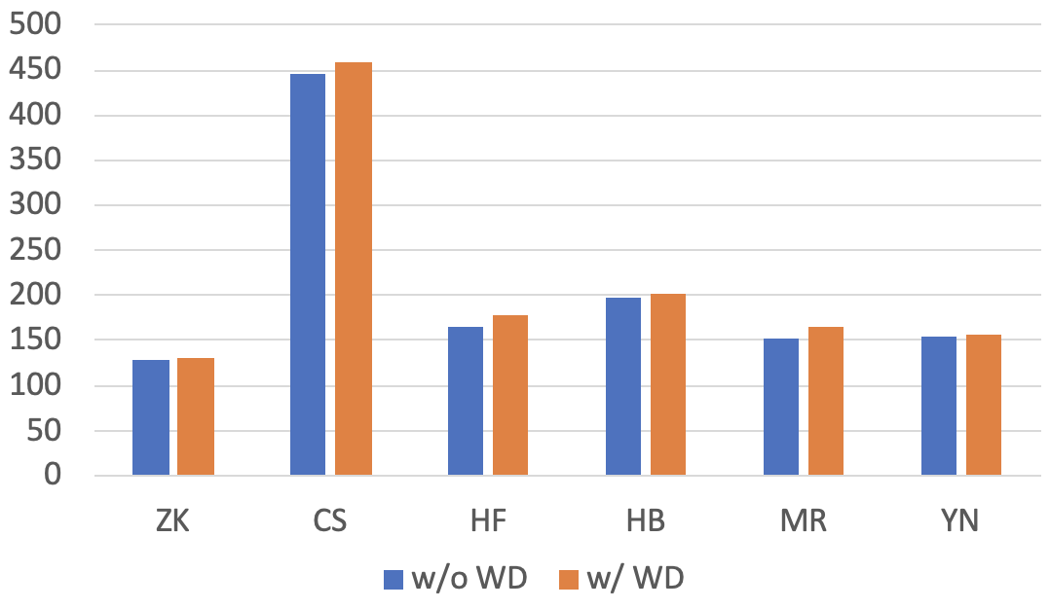
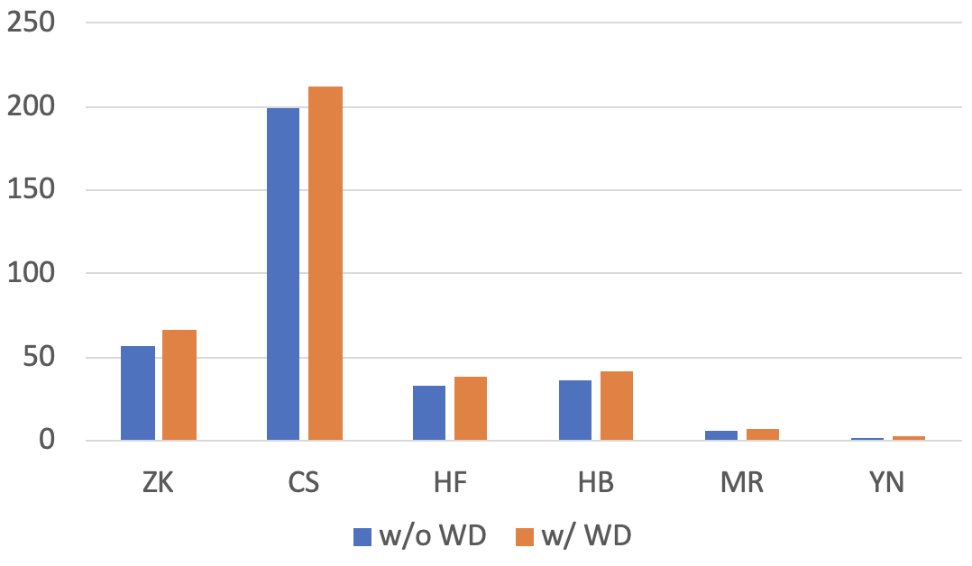
Evaluation - Overhead: Resources
median heap memory usage(MiB) w/ and w/o watchdogs
cpu usage(%) w/ and w/o watchdogs
Notes:
median 没说是哪个一组里面的median, cpu就没说
ddl!

Slide 58
Outline
1
Background
2
Findings
3
Design - Watchdog
3
4
Design - OmegaGen
5
Evaluation
3
6
Discussion
Notes:
首先为大家介绍背景

Slide 59
Limitations
Limit 1: heuristics-based vulnerable operation analysis
org.apache.hadoop.security.SecurityUtil.buildTokenService() in YN1 case
Limit 2: ineffective to catch silent semantic failures
semantics-specific errors
Limit 3: Java-specific
Soot framework for bytecode

Slide 60
If I were the reviewer
Incomplete descriptions & evaluations
Vulnerable operation rules not clear(10 system-specific rules)
Notes:
client的false alarm没有. signal和client的throughput没有
KK

Slide 61
If I were the reviewer
Incomplete descriptions & evaluations
Vulnerable operation rules not clear(10 system-specific rules)
Client & Probe implementation not clear(any system-specific optimization?)
Notes:
client的false alarm没有. signal和client的throughput没有
KK

Slide 62
If I were the reviewer
Incomplete descriptions & evaluations
Vulnerable operation rules not clear(10 system-specific rules)
Client & Probe implementation not clear(any system-specific optimization?)
Some baseline checkers not involved in several tables
Notes:
client的false alarm没有. signal和client的throughput没有
KK

Slide 63
If I were the reviewer
Incomplete descriptions & evaluations
Vulnerable operation rules not clear(10 system-specific rules)
Client & Probe implementation not clear(any system-specific optimization?)
Some baseline checkers not involved in several tables
Latency overhead not fully compared
Notes:
client的false alarm没有. signal和client的throughput没有
KK

Slide 64
If I were the reviewer
Incomplete descriptions & evaluations
Vulnerable operation rules not clear(10 system-specific rules)
Client & Probe implementation not clear(any system-specific optimization?)
Some baseline checkers not involved in several tables
Latency overhead not fully compared
How VMs are used?
Notes:
client的false alarm没有. signal和client的throughput没有
KK

Slide 65
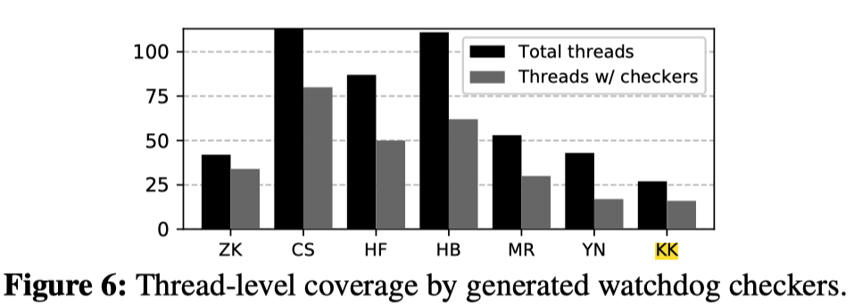
If I were the reviewer
Incomplete descriptions & evaluations
Vulnerable operation rules not clear(10 system-specific rules)
Client & Probe implementation not clear(any system-specific optimization?)
Some baseline checkers not involved in several tables
Latency overhead not fully compared
How VMs are used?
A weird system in Figure 6
Notes:
client的false alarm没有. signal和client的throughput没有
KK

Slide 66
Evolution
Workshop on HotOS’19
Mar, 2019, @2nd year PhD
Less knowledge about vulnerable operation selection
More overhead(more replication)
Less evaluations for study and implementation
2 of 4 baseline checkers, 3 of 6 systems, 1 of 22 failures
SOSP’19 Submission Rejected
July, 2019 @2nd year PhD
NSDI’20 Best Paper Awarded
Dec, 2019 @ 3rd year PhD
Notes:
study阶段的bug比较少
evaluation的bug也少,后面6个系统里面搞了3个. bug的reproduce只做了1个,而不是22个
baseline 只有2个,probe和signal

Slide 67
Understanding, Detecting and
Localizing Partial Failures in Large
System Software
Thanks!
Shared by Ziyue Qiu and King Zevin
Nov 18
Notes:
今天的这篇paper是讲的是InifiniCache,
这是基于Serverless function实现的memory cache.
提到serverless,首先想到的stateless,而cache明显是stateful的,这怎么可能呢?
这篇paper用了很多tricky的东西成功实现了cache.
在正式开始之前,我们用几分钟给小朋友们简单介绍一下Serverless

