Slide 1
Distributed Systems
Lecture 1 – Introduction
Cheng Li

Slide 2
This class will teach you …
Core concepts of distributed systems
Abstractions, algorithms, implementation techniques
Popular distributed systems and tools used by big companies today
E.g.: Google's protobuf/Bigtable/Spanner/MapReduce, Ceph, Hadoop, Amazon's Dynamo, MXNet, etc.

Slide 3
References
MIT‘s 6.824 (Robert Morris and Frans Kaashoek)
http://nil.csail.mit.edu/6.824/2018/schedule.html
NYU's G22.3033 (Jinyang Li)
http://www.news.cs.nyu.edu/~jinyang/fa16-ds/
UW’s CSE452 (Tom Anderson)
https://courses.cs.washington.edu/courses/cse452/18sp/
Acknowledgements: Lecture notes build on these courses!

Slide 4
References
Umich’s 491 (Harsha V. Madhyastha)
https://lamport.eecs.umich.edu/#schedule
Cornell’s 5414 (Lorenzo Alvisi)
http://www.cs.cornell.edu/courses/cs5414/2019fa/
Columbia’s 4113 (Roxana Geambasu)
https://columbia.github.io/ds1-class/
Stanford’s 244b (David Mazières)
http://www.scs.stanford.edu/17au-cs244b/
Acknowledgements: Lecture notes build on these courses!

Slide 5
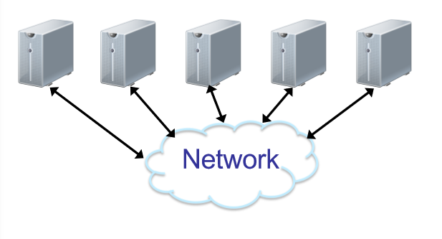
What is a Distributed System?
A distributed system is a collection of independent computers that
communicate via network
cooperate to provide some service
appear to the users of the system as a single system.

Slide 6
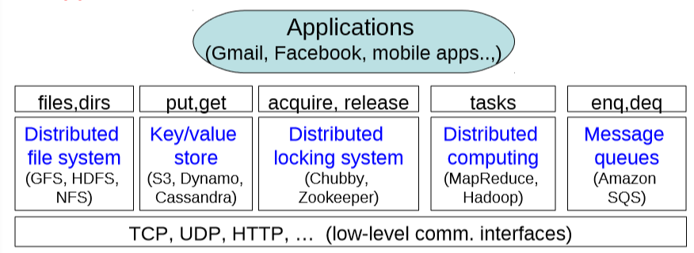
Distributed systems vs. networks
Distributed systems raise the level of abstraction
Hide many complexities and make it easier to build applications

Slide 7
Why Distributed Systems?
For location transparency
Examples:
Your browser doesn’t need to know which Google servers are serving Gmail right now
Your Amazon EC2-based mobile app doesn’t need to know which servers in S3 are storing its data

Slide 8
Why Distributed Systems?
For scalable capacity
Aggregate resources of many computers
CPU: MapReduce, Dryad, Hadoop
Disk: NFS, the Google file system, Hadoop HDFS
Memory: memcached, dist-cache
Bandwidth: Akamai CDN
What scales are we talking about?
Typical datacenters have 100-200K machines!
Each service runs on more like 20K machines, though

Slide 9
Why Distributed Systems?
For availability
Build a reliable system out of unreliable parts
Hardware can fail: power outage, disk failures, memory corruption, network switch failures…
Software can fail: bugs, mis-configuration, upgrade …
To achieve 0.9999 availability, replicate data/computation on many hosts with automatic failover

Slide 10
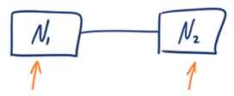
Availability
Simply, each request eventually receives a response.
Measured as uptime/(uptime + downtime)
Google Spanner achieves 99.999%
Availability | Downtime per year | Downtime per month | Downtime per day
90% ("one nine") | 36.5 days | 72 hours | 2.4 hours
99% ("two nines") | 3.65 days | 7.20 hours | 14.4 minutes
99.9% ("three nines") | 8.76 hours | 43.8 minutes | 1.44 minutes
99.99% ("four nines") | 52.56 minutes | 4.38 minutes | 8.64 seconds
99.999% ("five nines") | 5.26 minutes | 25.9 seconds | 864.3 milliseconds

Slide 11
Why Distributed Systems?
For modular functionality
Your application is split into many simpler parts, which may already exist or are easier to implement
Authentication service
Indexing service
Locking service
This is called the service-oriented architecture (SOA) and much of the Web is built this way
E.g.: one request on Amazon’s website touches tens of services, each with thousands of machines (e.g., pricing service, product rating service, inventory service, shopping cart service, user preferences service, etc…)

Slide 12
Challenges
Achieving location transparency, scalability, availability, and modularity in distributed systems is really hard!
System design challenges
What is the right interface or abstraction?
Achieving scalability is challenging
How to partition functions for scalability?
Consistency challenges
How do machines coordinate to achieve the task?

Slide 13
Challenges (Continued)
Security challenges
How to authenticate clients or servers?
How to defend against misbehaving servers?
Fault tolerance challenges
How to keep system available despite machine or network failures?
Implementation challenges
How to maximize concurrency?
What’s the bottleneck?
How to reduce load on the bottleneck resource?

Slide 14
A word of warning
“A distributed system is one in which the failure of a computer you didn’t even know existed can render your own computer unusable.”
--Leslie Lamport

Slide 15
Distributed Systems
Lecture 1 – Introduction
Q&A!

