Slide 1
Crossbow: Scaling Deep Learning with Small Batch Sizes on Multi-GPU Servers
Ping Gong, Yuxin Ma
2020/04/10

Slide 2
Outline
1
Background
2
Problem statement
3
System design and implementation
4
Evaluation and results
5
Conclusion
Notes:
Partial-Order Restrictions (or short, PoR) Consistency

Slide 3
Outline
1
Background
2
Problem statement
3
System design and implementation
4
Evaluation and results
5
Conclusion
Notes:
Partial-Order Restrictions (or short, PoR) Consistency

Slide 4
Background – GD & SGD
$$arg\min_{w}{L(w)}= \frac{1}{n}{||y −Xw||}_{2}^{2}$$
$X$is the input feature matrix and $y$ is the corresponding response label vector.
The solution for this question is $w={\left(X^{T}X\right)}^{−1}X^{T}y$
Two problem:
1. Inverse operation is very slow.
2.Not all function $L$ can get its solution directly.

Slide 5
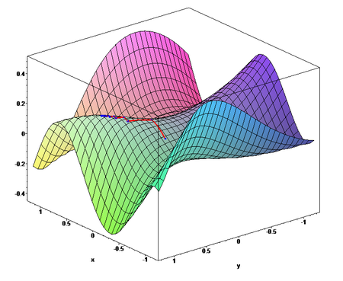
Background – GD & SGD
$$arg\min_{w}{L(w)}= \frac{1}{n}{||y −Xw||}_{2}^{2}$$
Import Gradient Descent algorithm:
While the termination condition does not hold do
$k≔k+1$
$w_{k+1} ≔ w_{k}− α∇L\left(w_{k}\right)$
End While

Slide 6
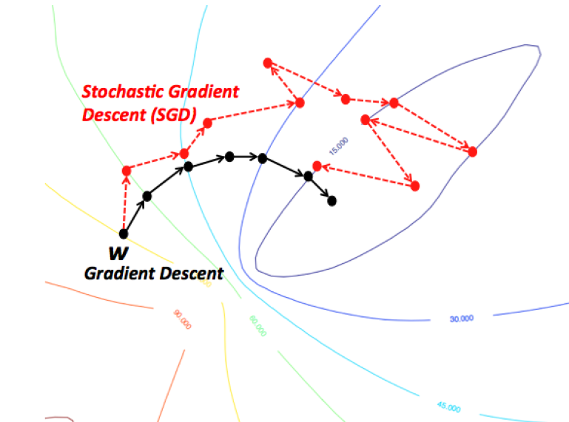
Background – GD & SGD
Import Stochastic Gradient Descent algorithm:
$$arg\min_{w}{L(w)}= \frac{1}{n}{||y −Xw||}_{2}^{2}$$
$$L_{X_{k}}\left(w\right)=\frac{1}{|X_{k}|}{||y_{k} −X_{k}w||}_{2}^{2}$$
While the termination condition does not hold do
$k≔k+1$
$w_{k+1} ≔ w_{k}− α∇L_{X_{k}}\left(w_{k}\right)$
End While

Slide 7
Background – GD & SGD
Import momentum:
$$arg\min_{w}{L(w)}= \frac{1}{n}{||y −Xw||}_{2}^{2}$$
$$L_{X_{k}}\left(w\right)=\frac{1}{|X_{k}|}{||y_{k} −X_{k}w||}_{2}^{2}$$
While the termination condition does not hold do
$k≔k+1$
$w_{k+1} ≔ w_{k}− α∇L_{X_{k}}\left(w_{k}\right)+ μ\left(w_{k} − w_{k−1}\right)$
End While

Slide 8
Background – GD & SGD
Import weight decay:
$$L_{X_{k}}\left(w\right)=\frac{1}{|X_{k}|}{||y_{k} −X_{k}w||}_{2}^{2}+h ∗\sum{{||w||}^{2}}$$
Algorithm 3:
While the termination condition does not hold do
$k≔k+1$
$w_{k+1} ≔ \left(1−d\right)∗w_{k}− α∇L_{X_{k}}\left(w_{k}\right)+ μ\left(w_{k} − w_{k−1}\right)$
End While

Slide 9
Background – GD & SGD
Algorithm 3:
While the termination condition does not hold do
$k≔k+1$
$w_{k+1} ≔ \left(1−d\right) ∗ w_{k}− α∇L_{X_{k}}\left(w_{k}\right)+ μ\left(w_{k} − w_{k−1}\right)$
End While
$X_{k} is a batch, batch size=|X_{k}|$
Iterating a batch is called a iteration and iterating the entire dataset is called an epoch.
$batch size →\left|X\right|, Algorithm3 → GD$
$batch size →1, Algorithm3 →SGD$
$Others, Algorithm3 →mini−batch SGD$
Update$w$ each iteration.

Slide 10
Background – Parallel synchronous SGD
Iteration N
Iteration N + 1
……
Batch
Batch
GPU 0
Compute gradient
Update
replica
Compute gradient
Aggregate gradients
Computeaverage
GPU 1
Compute gradient
Update
replica
Compute gradient

Slide 11
Outline
1
Background
2
Problem statement
3
System design and implementation
4
Evaluation and results
5
Conclusion
Notes:
Partial-Order Restrictions (or short, PoR) Consistency

Slide 12
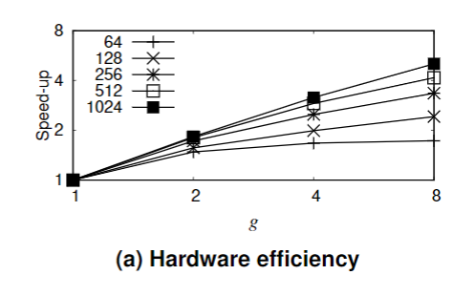
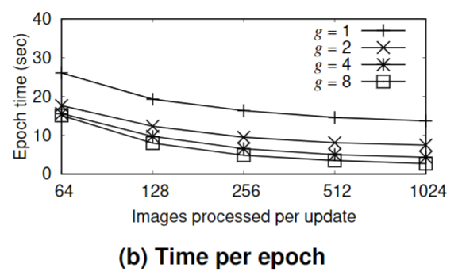
Problem statement
1.Hardware efficiency in the case of ResNet-32
Notes:
单卡上，小batch size 有一个扩展性的问题

Slide 13
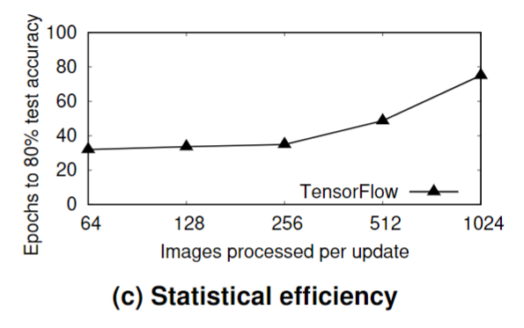
Problem statement
2. Statistical efficiency in the case of ResNet-32
Update weights frequency influenced by batch size
Notes:
更新频率
小的batch size 可以更容易找到一个更优解，使得收敛更快。

Slide 14
Problem statement
Trade-off between hardware efficiency and statistical efficiency.
Scaling problem in a small batch size.
Notes:
Adjust Learning rate and adjust batch size runtime
解决扩展性问题

Slide 15
Outline
1
Background
2
Problem statement
3
System design and implementation
4
Evaluation and results
5
Conclusion
Notes:
Partial-Order Restrictions (or short, PoR) Consistency

Slide 16
Training multiple learners per GPU
Multiple learners on each GPU, each has a replica of model
SMA (Synchronous Model Averaging)
Auto-tuner
Notes:
Single model cannot fill a GPU
Use multiple models
Sma(SYNCHRONOUS MODEL AVERAGING) and auto-tuner

Slide 17
SMA algorithm
SMA(Synchronous Model Averaging) uses the average model to compute corrections for each learner, thus ensuring that they follow the trajectory of the central average model.
Notes:
SYNCHRONOUS MODEL AVERAGING
Difference with sgd

Slide 18
SMA algorithm
z ← w₀ ;
z_{prev} ← ∅ ;
while target accuracy not reached ∧ |𝔹| ≥ k do
c₁, . . . , c_{k} ← ∅, . . . , ∅ ;
for j ∈ {1, . . . , k} do
B_{j} ← select(𝔹) ;
𝔹←𝔹\ {B_{j}} ;
g_{j} ← γ∇ ℓB_{j}(w_{j} ) ;
c_{j} ← α(w_{j} - z) ;
w_{j} ← w_{j} - g_{j} - c_{j} ;
z’ ← z ;
z ← z +$\sum_{j=1}^{k}{c_{j}}$+ µ(z-z_{prev} ) ;
z_{prev} ← z’;
Notes:
Meaning of 2 loop

Slide 19
SMA algorithm
Each time the learning rate changes, we restart SMA.
Notes:
Why
How

Slide 20
Tuning number of learners
When increase the number of learners promotes the throughput, increase it, until throughput reaches a peak
Notes:
Tune each GPU independently

Slide 21
System overview
Notes:
(1) The data pre-processors generate batches.
(2) The task manager controls the pools of model replicas, input batches and learner streams. Handles task completion events.
(3) The task scheduler assigns tasks to GPUs and triggers synchronization.
(4) The auto-tuner monitors the training throughput and controls number of learner.

Slide 22
SMA algorithm
Global synchronization
Local synchronization
Notes:
2 types of learner
2 types of communication mode

Slide 23
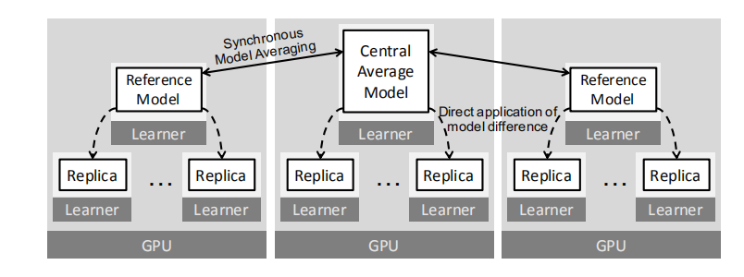
Task execution
Iteration N
Iteration N+1
GPU 1
z ← w₀ ;
z_{prev} ← ∅ ;
while target accuracy not reached ∧ |𝔹| ≥ k do
c₁, . . . , c_{k} ← ∅, . . . , ∅ ;
for j ∈ {1, . . . , k} do
B_{j} ← select(𝔹) ;
𝔹←𝔹\ {B_{j}} ;
g_{j} ← γ∇ ℓB_{j}(w_{j} ) ;
c_{j} ← α(w_{j} - z) ; //local synchronization
w_{j} ← w_{j} - g_{j} - c_{j} ;
z’ ← z ;
z ← z +$\sum_{j=1}^{k}{c_{j}}$+ µ(z-z_{prev} ) ;
z_{prev} ← z’;
Sync. stream
∑
z
Learn. stream
⇌
δ
w
⇌
δ
Learn. stream
⇌
δ
w
⇌
δ
timeline
GPU 2
Sync. stream
∑
z
Learn. stream
⇌
δ
w
⇌
δ
Learn. stream
⇌
δ
w
⇌
δ
Notes:
Loops
Local/global sync
Overlap

Slide 24
Task scheduling
The task scheduler works with a first-come, first-served basis. Compared to round-robin scheduling, this improves hardware efficiency
assign batch
assign batch
Learner 1
Learner 2
Learner 5
Learner 3
Learner 1
Learner 2
Learner 5
queue
Free learners get into queue
Learner 3
Learner 3
First come first serve
Round-robin
Notes:
Images
Tensorflow uses rr

Slide 25
Task scheduling
If there is a data dependency between GPU task1 and GPU task2
Stream 1
GPU task 1
Event generator
Other tasks
Stream 2
Other tasks
Event Handler
GPU task2
Wait for event
Notes:
0:for example
1:learner task
2:global sync task

Slide 26
Task scheduling
Tasks’ computational load varies both within and across operators, Crossbow submits tasks with multiple threads, letting GPU scheduler to consider multiple tasks together.
CPU
GPU
task
task
task
task
task
Notes:
Tasks submitted with multi threads

Slide 27
Tuning learners
According to throughput
Places a global barrier between iterations
Batch-size of a GPU remains the same
Costs several milliseconds
Iteration N
Iteration N+1
Global barrier
GPU 1
Sync. stream
∑
z
z
Learn. stream
⇌
δ
w
⇌
δ
Learn. stream
⇌
δ
w
⇌
δ
Learn. stream
⇌
δ
Notes:
Images use page 23
Barrier
According to throughput
Timecost (ms)

Slide 28
GPU memory management
Offline memory plan (tensorflow pytorch)
buffer
Reference count

Slide 29
Memory management
Online memory plan (crossbow)
buffer
buffer
Reference count
Reference count
……
Buffer pool

Slide 30
Outline
1
Background
2
Problem statement
3
System design and implementation
4
Evaluation
5
Conclusion
Notes:
Partial-Order Restrictions (or short, PoR) Consistency

Slide 31
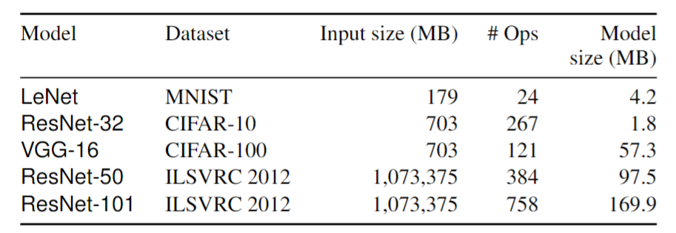
Evaluation -- setup
 | Low-end | High-end
CPU | 2 * Xeon E5-2650 v3 (total 20 cores)
GPU | 8 * GTX Titan X | 8 * V100
RAM | 256 GB
GPU switch | PCIe3.0 * 16 (NCCL) | NVLink, PCIe3.0
TensorFlow | 1.4 | 1.13
CUDA | 8.0
cuDNN | 6.0
Pre-processing : image decode -> image crop
Notes:
Dataset and model size problem?

Slide 32
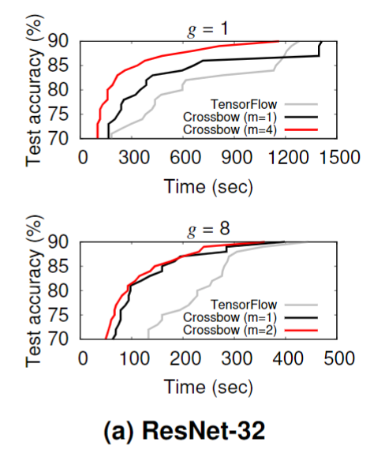
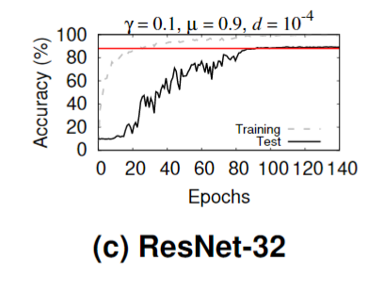
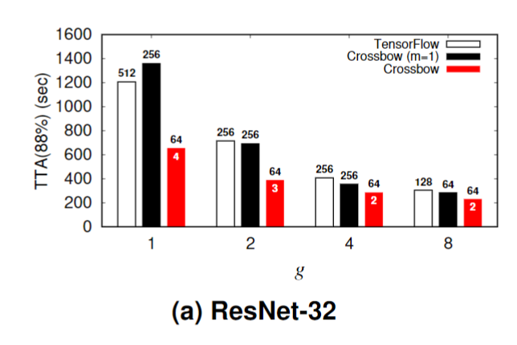
Evaluation

Slide 33
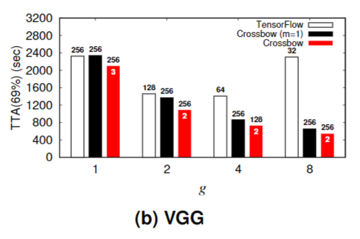
Evaluation

Slide 34
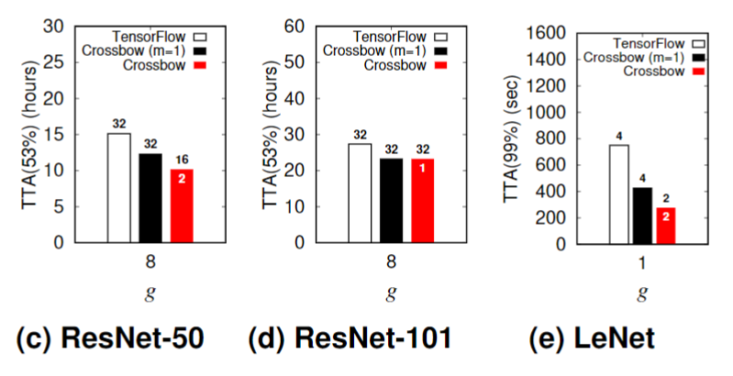
Evaluation
Notes:
Communication and scheduling
LeNet 的任务调度

Slide 35
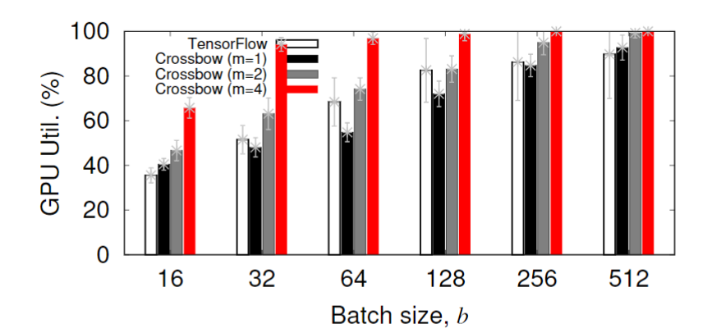
Evaluation – GPU utilization
ResNet-32
Notes:
Each replica batch size

Slide 36
Evaluation – trade-off
ResNet-32 1 GPU and batch size = 64
ResNet-32 8 GPU and batch size = 64
Notes:
a.Communication overhead
b.解空间探索
c. 选择正确的m

Slide 37
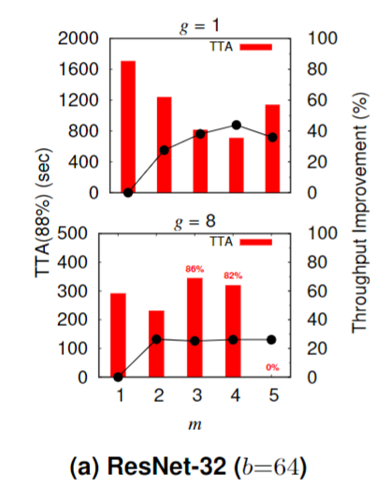
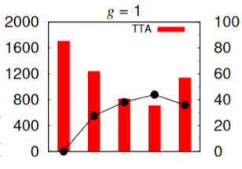
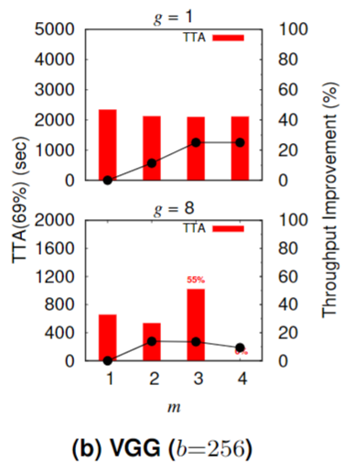
Evaluation – number of learners
Notes:
从实验角度，这个auto-tuning 算法是能够起到一定作用的。

Slide 38
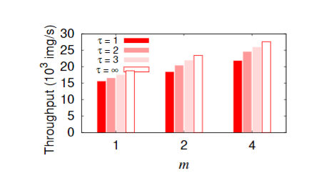
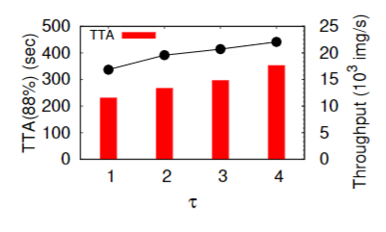
Evaluation – Synchronization efficiency
ResNet-32 g = 8
ResNet-32 g = 8 and m = 2
Notes:
1.百分之二十到百分之二十七的同步开销。作者任务这个同步开销是高度优化，可以接受的
2.

Slide 39
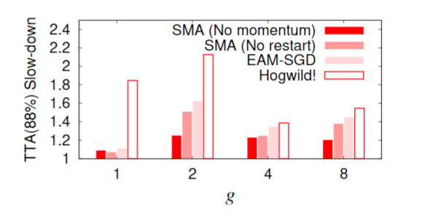
Evaluation – Synchronization model
ResNet-32

Slide 40
Outline
1
Background
2
Problem statement
3
System design and implementation
4
Evaluation and results
5
Conclusion
Notes:
Partial-Order Restrictions (or short, PoR) Consistency

Slide 41
Conclusion
CROSSBOW improves hardware efficiency when training with the preferred batch size, however small, with a low loss of statistical efficiency.
Solving the scaling problem in small batch size?

Slide 42
Deep thinking
The core of CROSSBOW is SMA.
Potential challenges:
The sampling or shuffling of dataset in a small batch size?
Auto-tuning algorithm of number of learners?
Resnet-32 with 8 GPUs

Slide 43
Thanks

