Slide 1
AI system: current situation and outlook
Presented by Mingliang Zeng, USTC, ADSL
July 17th, 2019

Slide 2
Outline
AI Introduction
AI system: current situation
AI system: outlook
AI system: an example

Slide 3
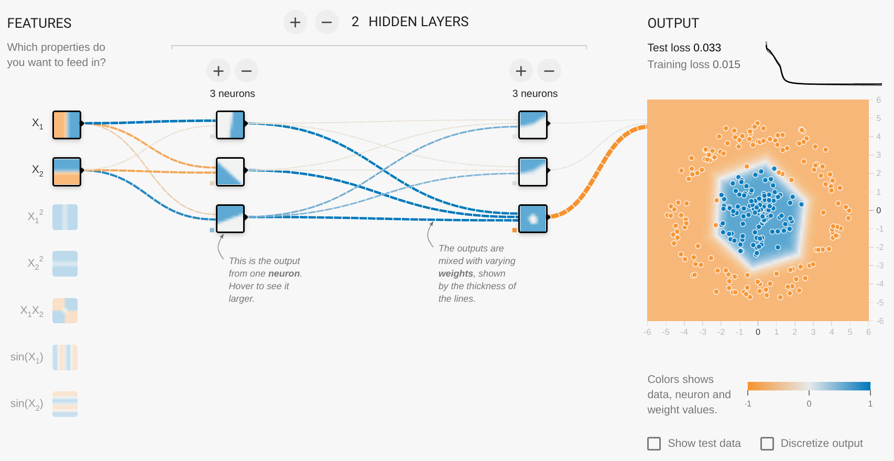
How deep learning works ?
I₁(x₁,x₂)=x₁
h₁(x₁,x₂)
h₄
I₂(x₁,x₂)=x₂
h₂(x₁,x₂)
h₅
h₃(x₁,x₂)
h₆
weight
activation function
(ReLU)
bias
h₃(x₁,x₂)=ReLU(w₁ I₁(x₁,x₂) + w₂ I₂(x₁,x₂) + b)
f_{b1,b2,…,w1,w2,…} (x₁,x₂)
parameters
Notes:
网络架构：输入——两个隐层——输出。
深度学习本质上就是函数拟合，神经元网络代表了一个函数 f，目标是调整参数使得 f 尽量符合测试数据。
每个神经元的输出代表了一个函数，由前面的神经元代表的函数线性组合（参数：weight 和 bias），再经过激活函数（打破线性关系又不损失信息）组成。
方框内画出了神经元函数图像，可以见到越往后图像就会越复杂，最终成功拟合了训练数据。
网络的架构给出了函数的假设空间，好的假设空间需要包含解，并且尽量简单（防止过拟合）。
泛逼近定理：单隐层无限神经元的神经网络，可以逼近任意函数。但实际中多一点隐层比较好。
训练就是在假设空间中寻找最好的函数，以前是人工设定，现在是自动求出。

Slide 4
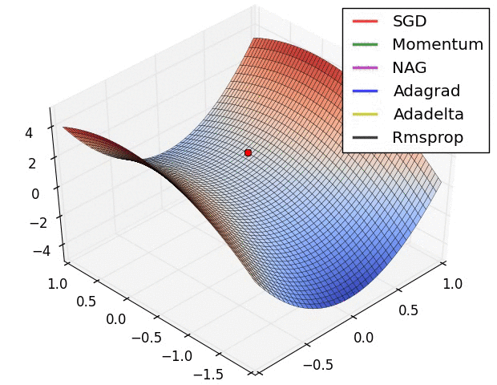
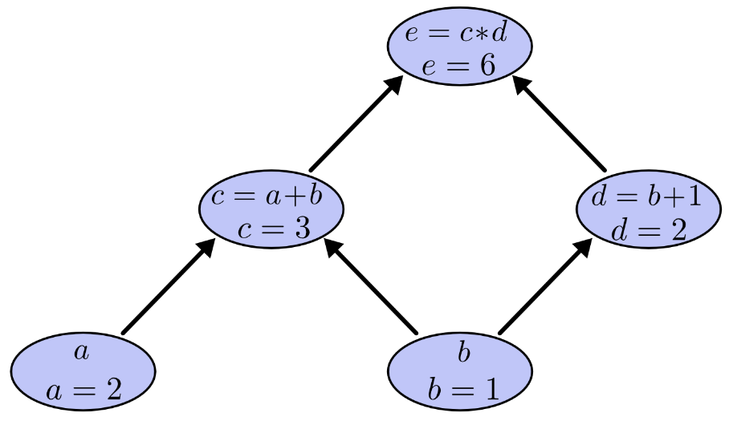
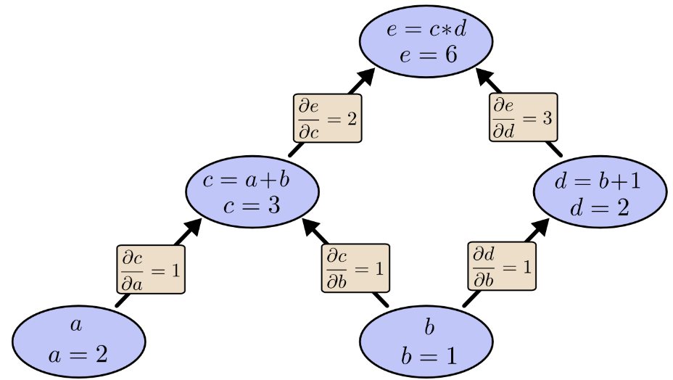
How to find optimal parameters ?
Evaluate f_{b1,b2,…,w1,w2,…} on training dataset
That yields a loss function L(b₁,b₂,…,w₁,w₂,…)
MSE, cross entropy
Use convex optimization techniques to minimize L
BGD, SGD, MBGD, …
Momentum, AdaGrad, RMSProp, Adam, …
Forward & Backward
1
1∙2 = 2
1∙3 = 3
2∙1 = 2
2∙1+3∙1 = 5
Notes:
Adam 等方法一定程度上解决了卡在鞍点和局部极小值的问题，但需要记录历史梯度信息，带来一些开销。
前馈和反馈走的是相同的路线，这样不仅减少了计算量，还为系统设计带来了方便。

Slide 5
Outline
AI Introduction
AI system: current situation
AI system: outlook
AI system: an example

Slide 6
How ML framework works ?
TensorFlow as an example
Front end
Back end

Slide 7
How ML framework works ?
TensorFlow as an example
Defines the computation as a dataflow graph.
Initiates graph execution using a session.

Slide 8
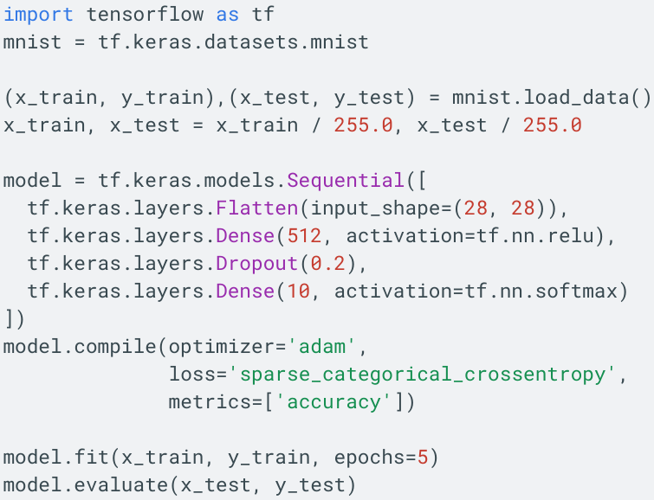
How ML framework works ?
TensorFlow as an example
# Define neural network
# Compile to computational graph
# Train via C API
# Inference via C API

Slide 9
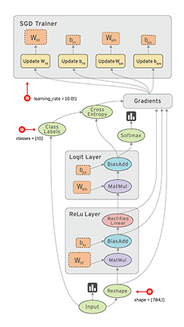
How ML framework works ?
TensorFlow as an example
Example of a computational graph:

Slide 10
How ML framework works ?
TensorFlow as an example
Distributed Master
Prunes a specific subgraph from the graph
Partitions the subgraph
Distributes the graph pieces to workers
Initiates graph piece execution by workers
Worker Services (one for each task)
Schedule the execution of graph operations using kernel implementations
Send and receive operation results to and from other worker services

Slide 11
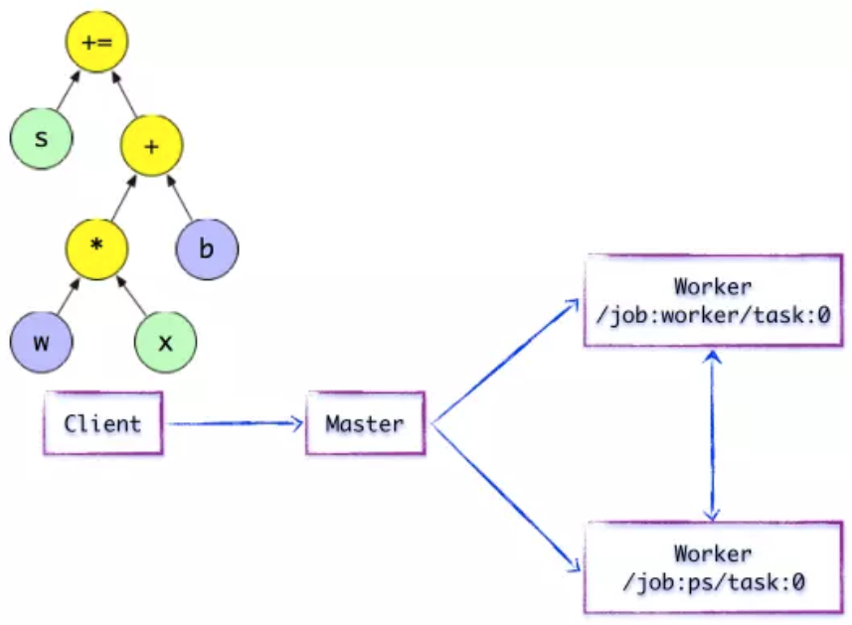
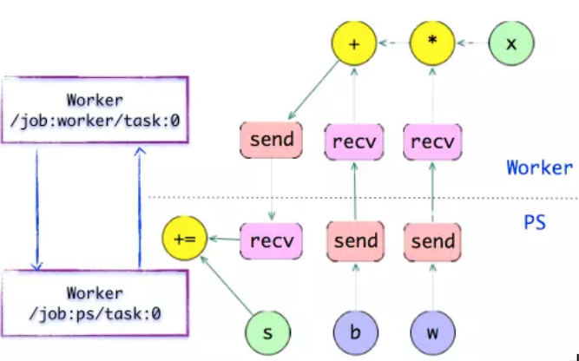
How ML framework works ?
TensorFlow as an example
Notes:
计算图的分割方式可以由用户指定，也可以由后端自动完成。

Slide 12
How ML framework works ?
TensorFlow as an example
The runtime contains over 200 standard operations including mathematical, array manipulation, control flow, and state management operations. Each of these operations can have kernel implementations optimized for a variety of devices.
cuBLAS
CUDA Driver
MatMul
GPU
Notes:
Kernel 是 OP 在某种硬件设备的特定实现，它负责执行 OP 的运算。
TensorFlow 的运行时包含 200 多个标准的 OP，包括数值计算，多维数组操作，控制流，状态管理等。每一个 OP 根据设备类型都会存在一个优化了的 Kernel 实现。在运行时，运行时根据本地设备的类型，为 OP 选择特定的 Kernel 实现，完成该 OP 的计算。
其中，大多数 Kernel 基于 Eigen::Tensor 实现。Eigen::Tensor 是一个使用 C++ 模板技术，为多核 CPU/GPU 生成高效的并发代码。但是，TensorFlow 也可以灵活地直接使用 cuDNN 实现的更高效的Kernel。TensorFlow 支持更高效的 Kernel 实现的注册，其扩展性表现相当优越。

Slide 13
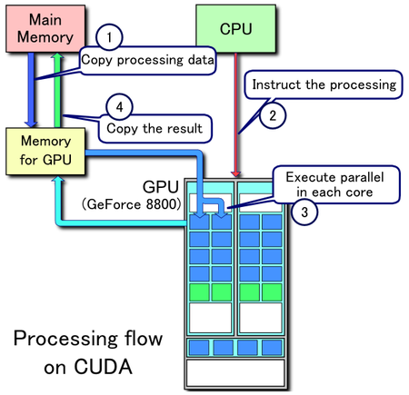
How ML framework works ?
TensorFlow as an example
PCIe

Slide 14
Outline
AI Introduction
AI system: current situation
AI system: outlook
AI system: an example

Slide 15
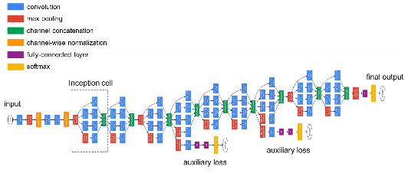
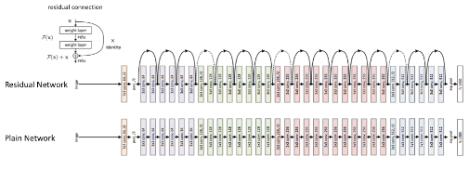
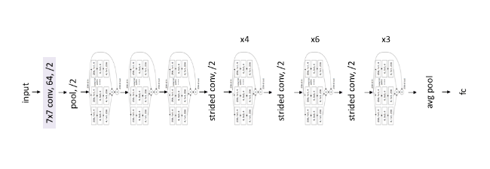
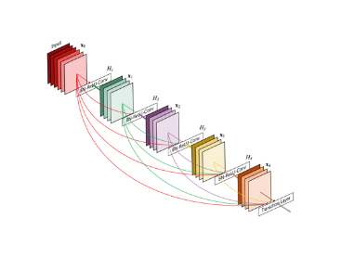
ML systems are stuck in a rut ?
1998: LeNet
2012: AlexNet
2014: GoogLeNet
2015: ResNet
2016: ResNeXt
2016: DenseNet
Classical convolutional networks
cuDNN 1.0 released
Modern convolutional networks
Notes:
卷积神经网络（CNN）的优势在于卷积层相比全连接层只保留了距离相近的像素点的连接，并且相对位置同样的连接共享参数。
由于是全连接层的子集，卷积层可以用矩阵乘法（cuBLAS）实现，但这样做效率很低。
cuDNN 非常有效地提高了卷积的运算速度，其诞生极大地促进了 CNN 的发展。

Slide 16
ML systems are stuck in a rut ?
Is convolution the chosen one?
Although convolutional Capsule model requires around 4 times fewer FLOPS with 16 times fewer training parameters than CNN, implementations in both TensorFlow and PyTorch were much slower and ran out of memory with much smaller models. Why ???
Capsule network
Notes:
Capsule network 在 MNIST 数据集上表现非常优越，但目前的系统无法支持在大数据集上进行大量实验和调优，导致其发展缓慢。

Slide 17
Compiling kernels
New ideas often require new primitives.
The resulting code of Conv2D is little more than 7 nested loops around a multiply-accumulate operation, but array layout, vectorization, parallelization and caching are extremely important for performance.
It is hard for researchers to write a highly optimized custom library.
Formula of Conv2D :
cuDNN
Scalar multiplication
???
+ Capsule
Formula of Capsule :
Matrix multiplication
Notes:
性能调优是极其复杂的（参考矩阵乘法）。
计算速度慢的最大原因就是我们没有专用的 kernel。
对计算的结构做了轻微的修改，原先的 kernel 就不能用了。这对算法研究造成了很大的阻碍。

Slide 18
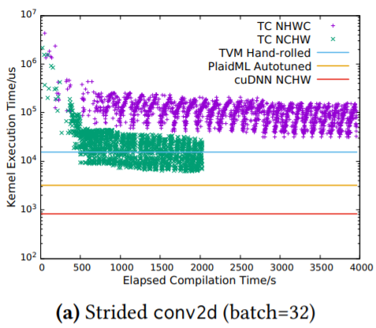
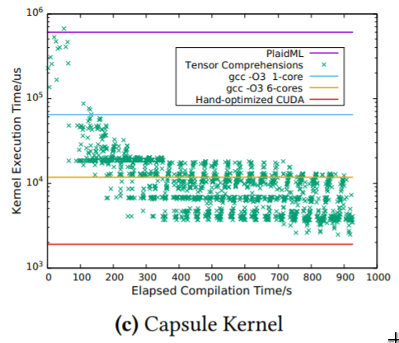
Compiling kernels
Solution: a DSL that can describe such tensor operations and a compiler that can compile tensor operations to highly optimized code.
Some attempts:
TC
TVM
PlaidML
uses tools from Halide whenever possible
Capsule
GPU: GTX1080
Notes:
调优需要的时间太长了。
仍然无法接近峰值速度。
NHWC：[batch, in_height, in_width, in_channels] 一般在CPU模式下使用该数据格式
NCHW：[batch, in_channels, in_height, in_width] 一般在GPU模式下使用该数据格式

Slide 19
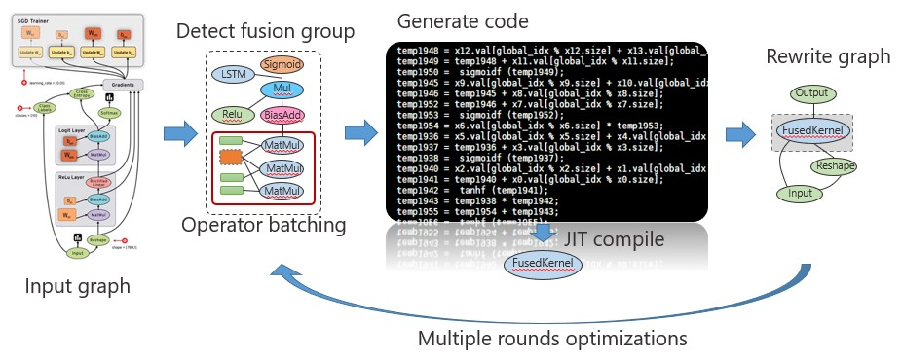
Compiling programs
Existing problems: In Capsule network case, no framework is able to fuse the final reduction into the batch matrix multiplication (a preoptimized kernel). The APIs force us to copy, rearrange and materialize to memory two orders of magnitude more data than strictly necessary.
Solution: extend optimization scope to computational graph.
JIT or AOT
+ Fused
kernel
Notes:
内核融合，小粒度变成大粒度，减少中间变量，减少访存开销。

Slide 20
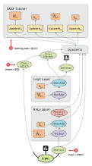
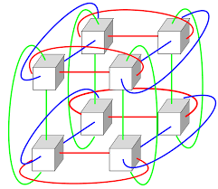
Compiling programs
Some attempts: TensorFlow XLA, TVM.
Compiling procedure:
Computational graph optimization: constant folding, CSE.
Kernel fusion: find subgraph of computational graph that can be fused.
Code generation: compile new kernel to machine code or IR.
Graph rewrite: substitute subgraph with by operator.
Challenges (optimizations no attempted by XLA and TVM):a
Layout choosing: choose to use a “compromise” layout.
Distributed execution: distribute computations over multiple accelerators.
JIT or AOT
+ Fused
kernel
a batch of computational graphs
processing nodes
Notes:
Standard CSE favors materializing the activations to memory, but the limited amount of accelerator memory and its slowness relative to ALUs means that it may frequently be preferable to recompute activations instead.

Slide 21
Conclusions of backend
Manually tuning is unrealistic, therefore auto tuning is important.
It is already hard to compile a single kernel in isolation. Optimizing an entire computation picking layouts and materialization points, and potentially distribution strategies, makes the search space much larger.
Current approaches are preliminary and typically focus on optimizing only one aspect of a program at a time.
Notes:
It is already hard to compile a single kernel in isolation, on a single device, with layout fixed in advance and relatively few choices for materialization.
Since the code to compute the gradient is not written by the programmer, there is limited opportunity for programmers to guide its optimization: for example, there are no identifiers in scope for intermediate values computed as part of the gradient, to which programmers could manually assign layouts. Even in the absence of auto-generated gradients it is hard to write modular code with the manual optimization annotations used by, e.g., Halide and TVM.

Slide 22
Improving frontend ?
Disadvantages of current ML systems:
Opaque operators hurt extensibility
Opaque operators hurt modularity
Ordered dimensions considered harmful
$$\sum_{x}{\sum_{y}{\sum_{z}{A_{x,y,z}}}}$$
$$\sum_{\{x,y,z\}}{A_{x,y,z}}$$
Julia client & libraries
Attempts:
Julia: Sophisticated type system targeting numerical computation.
APL: Polymorphic over the rank (number of dimensions) of their arguments.
+
Julia runtime

Slide 23
Outline
AI Introduction
AI system: current situation
AI system: outlook
AI system: an example

Slide 24
Tofu: an AI system example
Program compiling
Operator level parallelism
Supports very large models
Distributes computations over multiple accelerators
Uses a domain specific language TDL inspired by Halide
Partitioning is totally transparent to users
Targets reducing communication cost

Slide 25
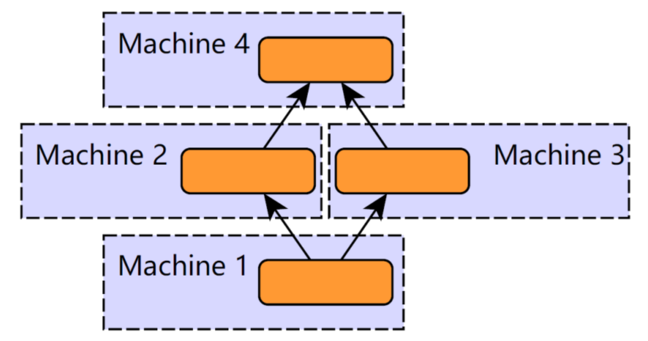
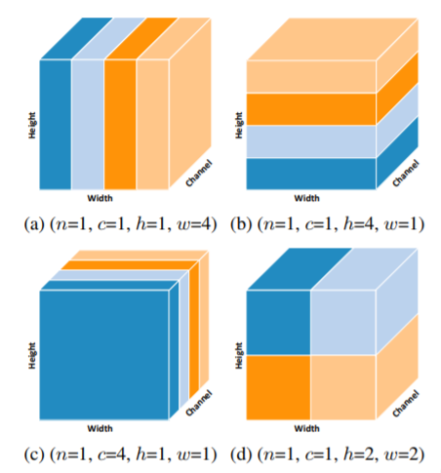
Different aspects of partitioning
Coarse
Data Parallelism
Computational Graph Parallelism
Operator Parallelism
Model Parallelism
Fine
operator
Machine 1
Machine 2
Machine 3
Machine 4
Notes:
Uniformity

Slide 26
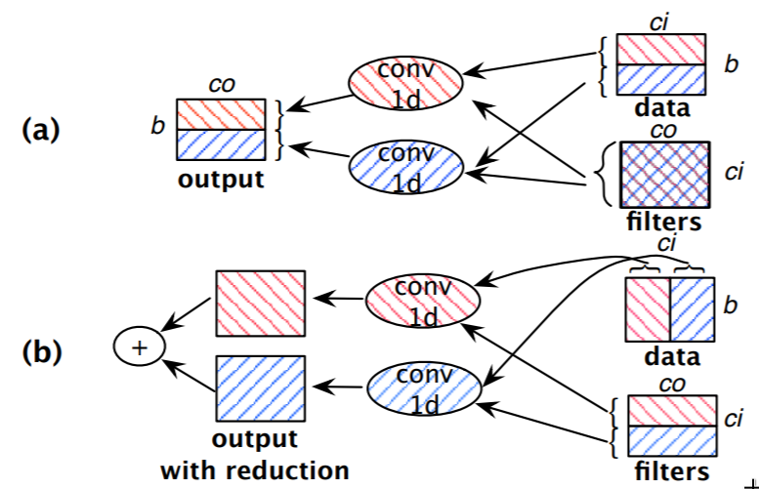
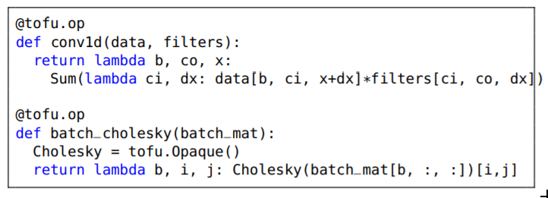
Partition-n-reduce
Partitioning conv1d
without reduction step
Python:
TDL:
with reduction step
What about (a)+(b) ?

Slide 27
Partitioning dataflow graph
Ideal optimization goal:
End-to-end execution time
Execution time
(have similar execution time)
Communication cost
(important optimization goal)
Per-worker memory consumption
For storing a worker’s share of tensor data
(same for every partition plan)
For buffering data for communication between GPUs
(proportional to the amount of communication)
Chosen by Tofu
Notes:
Lots of assumptions:
the GPU kernels for very large DNN models process large tensors and thus have similar execution time no matter which dimension its input/output tensors are partitioned on
The memory consumed for storing is the same for every partition plan: for k GPUs, it is always 1/k times the memory required to run the dataflow graph on one GPU.
The memory consumed for buffering data is proportional to the amount of communication

Slide 28
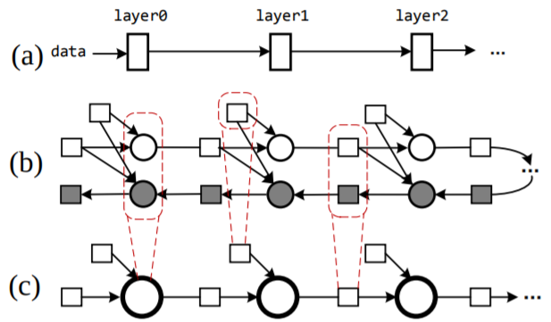
Partitioning dataflow graph
Algorithm: Dynamic programming
Making it practical:
Graph coarsening
Coalescing operators
Recursive partitioning
Optimizing:
Leveraging the existing memory planner
Fusing operators for remote data fetch

Slide 29
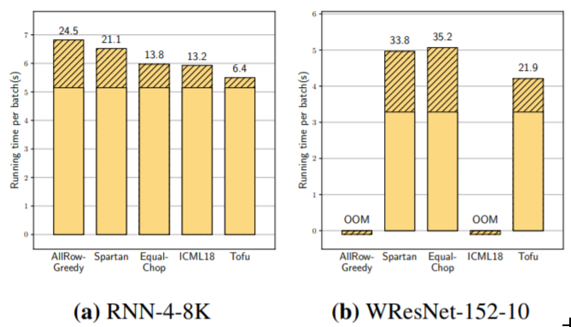
Evaluations

Slide 30
More improvements ?
Limitations of partition-n-reduce
restricts each worker to perform a coarse-grained task identical to the original computation
strategies do not necessarily minimize communication
do not take advantage of the underlying interconnect topology
Limitations of TDL
does not support sparse tensor operations well
does not support recursive operation
Limitations of partitioning strategy
does not support leaving some operators un-partitioned
Notes:
Cholesky
Cannon

Slide 31
Final conclusion
Researches on AI system are hard & promising

Slide 32
AI system: current situation and outlook
Thanks & QA!
July 17th, 2019

